Slide 1
Robotics & Control 2
Cristian Lorenzi
Filippo Gottardo
Giulia Pegoraro
Edoardo Di Pietrantonio

Slide 2
THE PROBLEM
3 mobile robotic agents should agree on a rendez-vous point and when in proximity of such point, they start a tracking task over a circular trajectory centered in the rendez-vous point.
SCENARIO SPECIFICS
All agents are unicycles;
All agents are independent from each other;
ADDITIONAL CONSTRAINTS
Agents live in a 2D grid 12x12;
Initial conditions of the agents can be randomly chosen (both position and orientation);
The final target trajectory is a circle of radius 1;
The proximity circle radius is 4;

Slide 3
SOLUTION APPROACH
THREE STEPS PROCEDURE:
Consensus - before moving
Regulation – until proximity to rendez-vouz point
Tracking – until the end of the simulation
This algorithm is applied to each agent INDEPENDENTLY.
REGULATION CONTROL will be validated before applying it to the final solution system.
TRACKING CONTROL will be implemented using different control strategies:
- Linearization of state error dynamics
- Non-linear controller of state error dynamics
- Feedback linearization based on a reference point on the sagittal axis
- Feedback linearization based on second order derivatives
Each one will be validated using the same methodologies and compared in order to draw final conclusions.

Slide 4
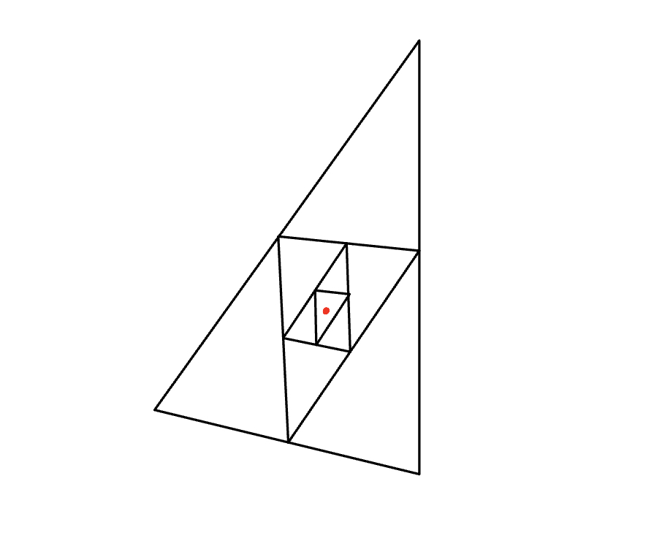
CONSENSUS
The adopted strategy is AVERAGE CONSENSUS.
Consensus is computed before starting the control action and does not change over time

Slide 5
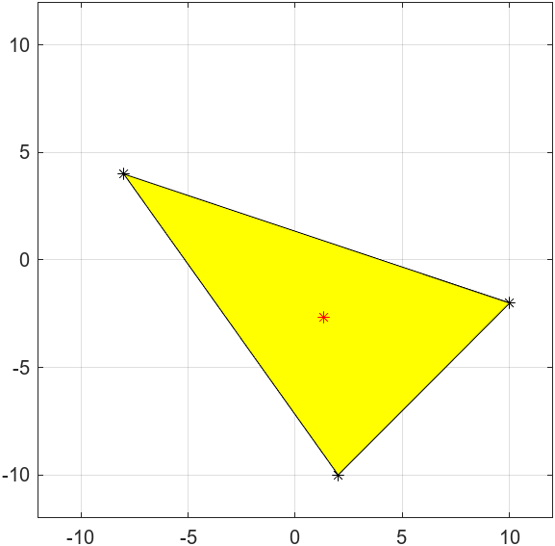
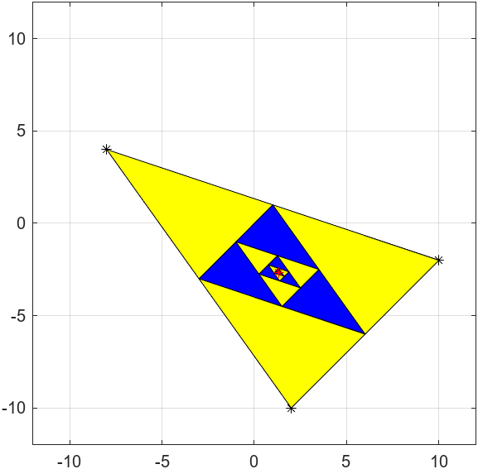


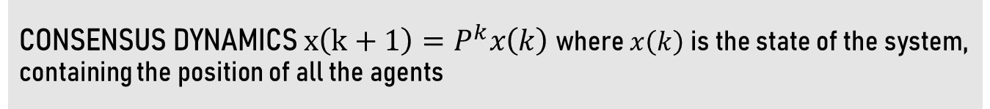
CONSENSUS
CONSENSUS DYNAMICS $x\left(k+1\right)=P^{k}x\left(k\right)$ where $x\left(k\right)$ is the state of the system, containing the position of all the agents
HOW DO WE CHOOSE THE P MATRIX ?
We need Primitive and doubly stochastic P
Average consensus in one step
Average consensus
$$P=\left[\begin{matrix}1/3 & 1/3 & 1/3 \\ 1/3 & 1/3 & 1/3 \\ 1/3 & 1/3 & 1/3\end{matrix}\right]$$
$$P=\left[\begin{matrix}1/2 & 0 & 1/2 \\ 1/2 & 1/2 & 0 \\ 0 & 1/2 & 1/2\end{matrix}\right]$$

Slide 6
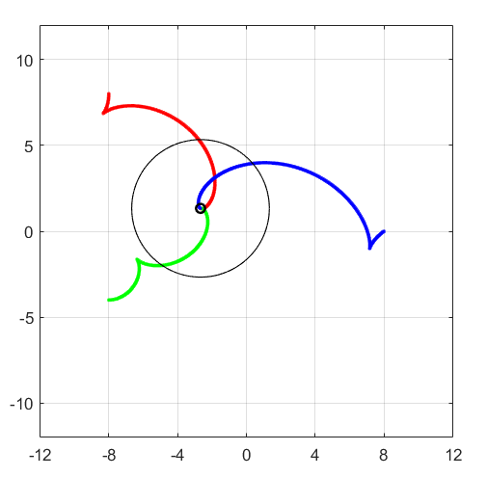
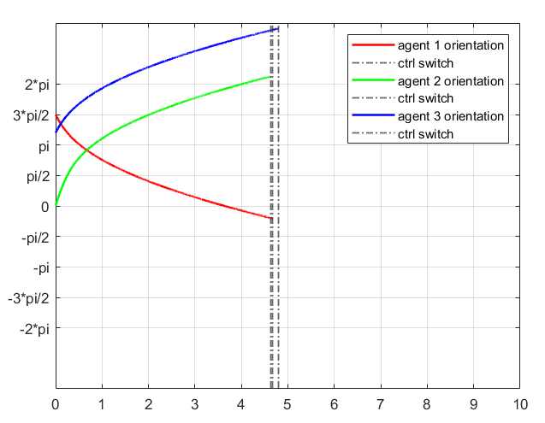
REGULATION - CARTESIAN
GOAL: reach the desired target configuration
q = [0, 0, ?]

Slide 7
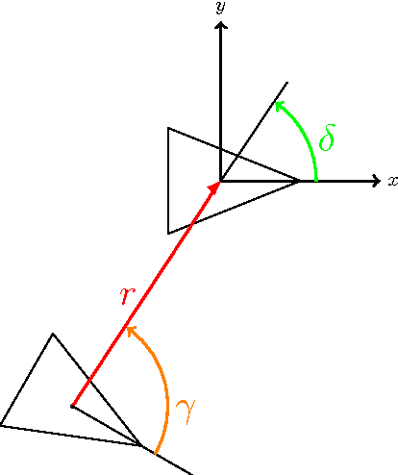
REGULATION - POSTURE
GOAL: reach the desired target configuration
q = [0, 0, 0]
TWO OPTIONS:
Control Law with singularity at the origin
Control Law without singularity at the origin
In our scenario we will implement the latter

Slide 8
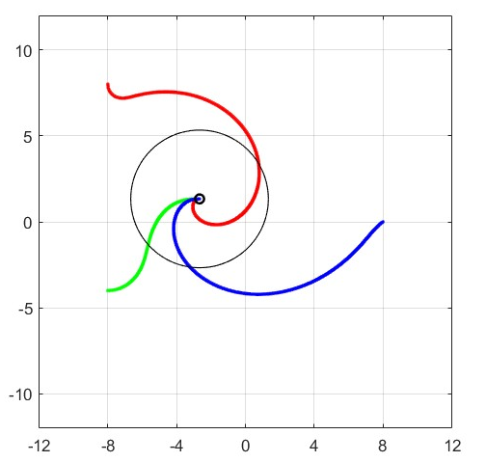
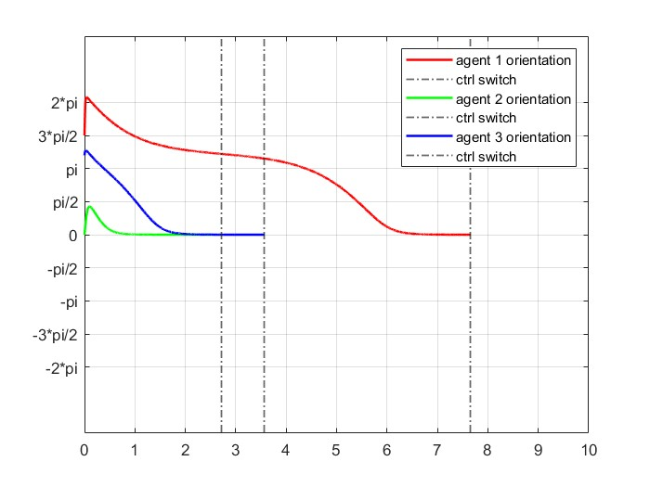
REGULATION - POSTURE
Desired behaviour is accomplished since we reach consensus point with final orientation equal to zero and at most the trajectory presents one backup manuever.

Slide 9
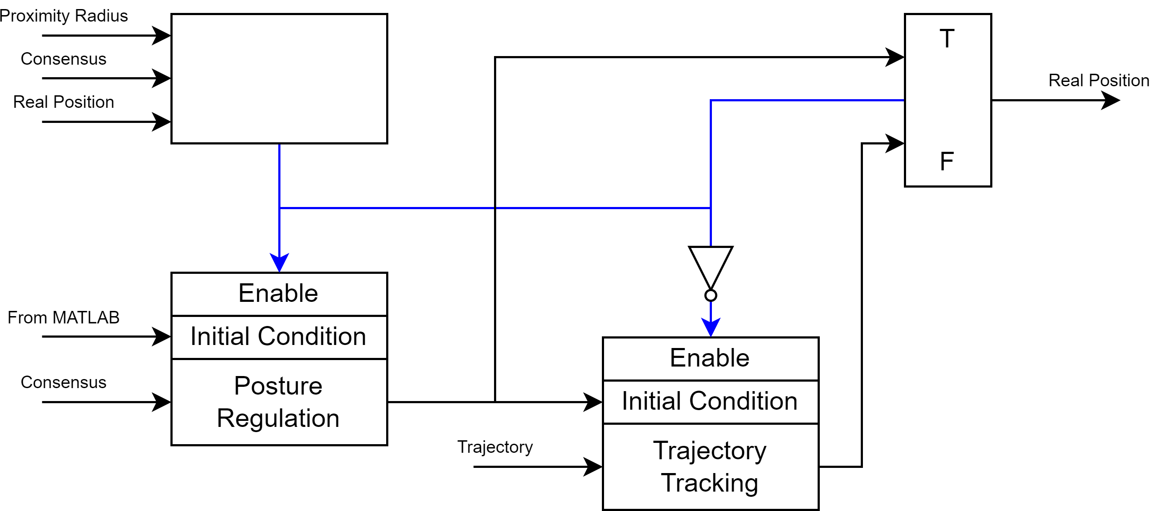



CONTROLLER SWITCH
How do we switch between posture regulation and tracking control ?
$$q$$
IMPLEMENTATION PROBLEM:
Posture regulation and tracking control are two different subsystems in Simulink !
The tracking subsytem must inherit initial conditions from the last iteration of the regulation subsystem.
Transition between controllers must be smooth. We should avoid sudden changes in orientation and velocity.
$$\left|p_{d}−p\right|≥r$$
$$q$$

Slide 10
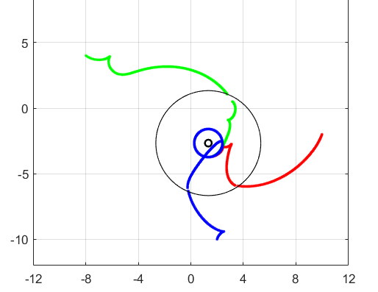
CONTROLLER SWITCH
EXAMPLE OF NON SMOOTH TRANSITION
THIS CAN BE AVOIDED WITH PROPER TUNING
NOTA: si riesce ad avere degli zoom delle discontinuità?

Slide 11
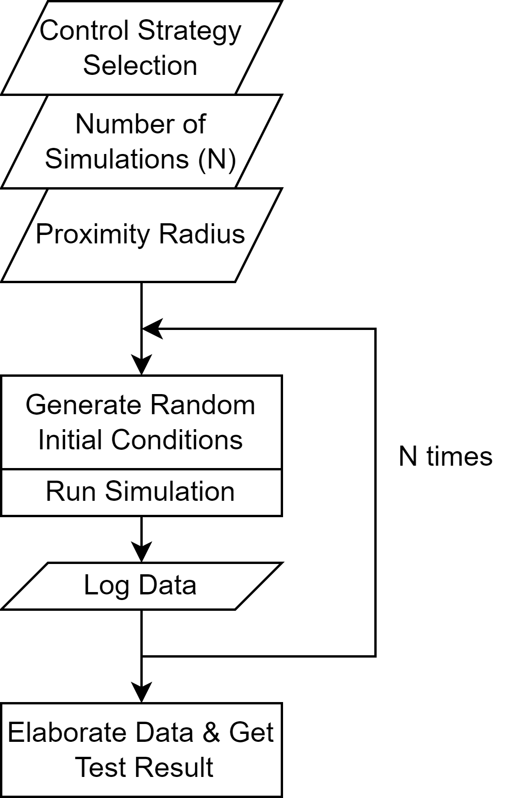
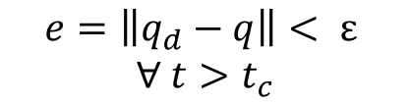
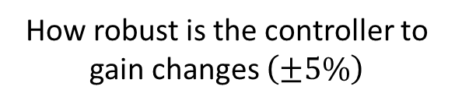
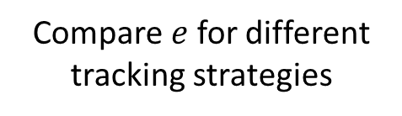
TESTS & EVALUATION PROCEDURE
CONVERGENCE TEST – tests if the controller strategy works and how quickly the agents move to the desired position/trajectory
SMOOTHNESS TEST – tests the smoothness of the agents paths
SENSITIVITY TEST – tests the robustness of the controllers to small changes of gain values
PROXIMITY TEST – tests how close the agents are to the desired trajectory
CONVERGENCE TEST:
$$e=\left\|q_{d}−q\right\|< ε$$
$∀ t>t_{c}$
PROXIMITY TEST:
Compare $e$ for different tracking strategies
SMOOTHNESS TEST:
Evaluate the agents’ path smoothness
SENSITIVITY TEST:
How robust is the controller to gain changes $\left(±5\%\right)$

Slide 12
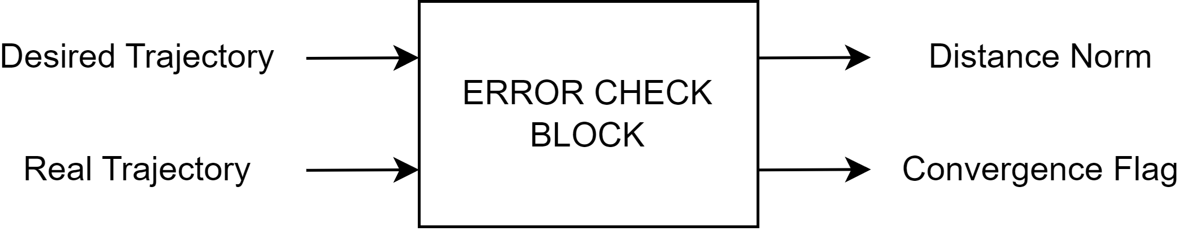
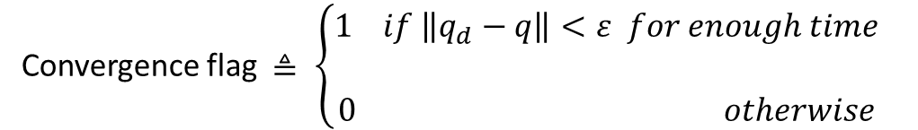

ERROR CHECK BLOCK
For easy and automatic evaluation of controller functionality a simple block is implemented:
Convergence flag $≜ \left\{\begin{aligned}1 if \left\|q_{d}−q\right\|<ε for enough time \\ \\ 0 otherwise\end{aligned}\right.$
We set $ε=1$

Slide 13

CONVERGENCE AND PROXIMITY TESTS
1
Perform N simulations starting from random initial positions and for each simulation collect the output of error check block
2
Convergence score is given by the following equation:
$$Score=\frac{Successful Runs}{N}$$
3
Compute the average time to reach proper tracking and average distance from desired trajectory at flag switch
ONLY USE SUCCESSFUL RUNS!

Slide 14

SENSITIVITY TEST
1
Perform N simulations
starting from random initial positions
Slightly changing control parameters
for each simulation collect the output of
error check block
2
Convergence score is given by the following equation:
$$Score=\frac{Successful Runs}{N}$$

Slide 15
SMOOTHNESS TEST
Since the description of «smooth path» can be very generic and its definition can become cumbersome and hard to automate, the evaluation of this property is performed manually in a small number of runs.
Path characteristics that are considered for the evaluation:
Inversion manouvers
Sudden changes to speeds
Discontinuities (due to improper gain tuning)
Solution proposal:
sudden velocity changes may be mitigated by cascading a low-pass filter to the command speeds.

Slide 16
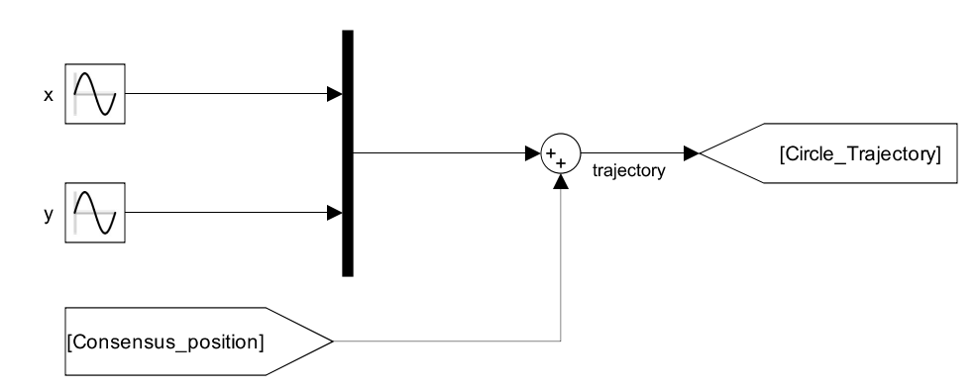





TRACKING: CIRCULAR TRAJECTORY
p_{d} = (x_{d} , y_{d})
(x_{C} , y_{C})
$Consensus position=(x_{c}$, $y_{c})$
$r=1 [m]$
CENTER
RADIUS
$$\left\{\begin{aligned}&x_{d}=x_{c}+sin⁡(t) \\ &y_{d}= y_{c}+sin⁡(t+\frac{π}{2})\end{aligned}\right.$$
$$ω=1 [\frac{rad}{s}]$$
FREQUENCY
TRAJECTORY

Slide 17
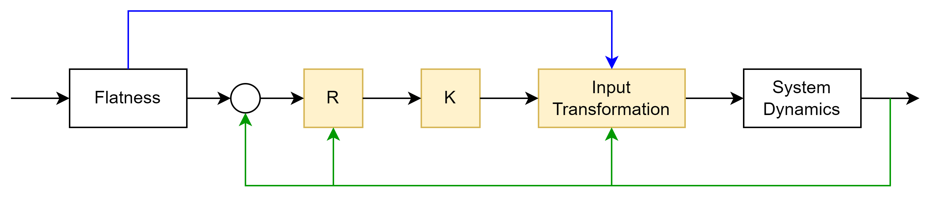



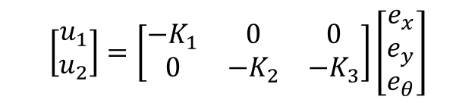





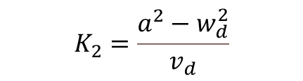





LINEAR CONTROLLER - IMPLEMENTATION
$$v_{d},ω_{d}$$
$$p_{d}$$
$$+$$
$$e$$
$$u$$
$$v,ω_{ }$$
$$q$$
$$q_{d}$$
$$−$$
$$θ$$
$$θ$$
$$\left[\begin{matrix}u_{1} \\ u_{2}\end{matrix}\right]=\left[\begin{matrix}{−K}_{1} & 0 & 0 \\ 0 & −K_{2} & {−K}_{3}\end{matrix}\right]\left[\begin{matrix}e_{x} \\ e_{y} \\ e_{θ}\end{matrix}\right]$$
CONTROL LAW
We expect asymptotically stable control law from application of Barbalat’s Lemma and since we have a circular trajectory to follow
$$K_{1}=K_{3}=2εa$$
CONTROL GAINS
$$K_{2}=\frac{a^{2}−w_{d}^{2}}{v_{d}}$$
$$\left\{\begin{aligned}&v=v_{d}cose_{θ}−u_{1} \\ &w= w_{d}−u_{2}\end{aligned}\right.$$
INPUT TRANSFORMATION

Slide 18
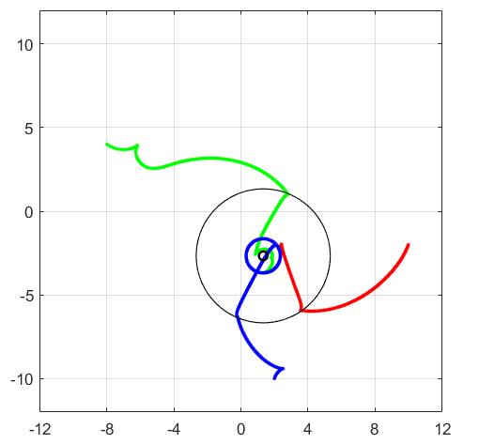
LINEAR CONTROLLER - RESULTS
CONVERGENCE TEST
90%
SENSITIVITY TEST
86.67%
PROXIMITY TEST (avg norm distance)
0.240

Slide 19
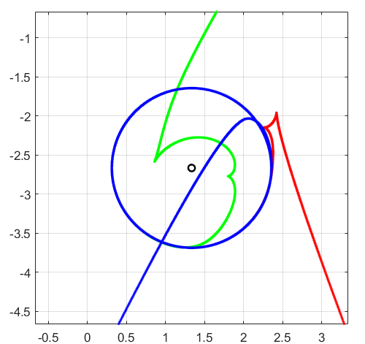
LINEAR CONTROLLER - RESULTS

Slide 20
LINEAR CONTROLLER – IMPLEMENTATION ISSUES
UNWRAP in differential flatness block for angle theta computation
DERIVATIVES computation in differential flatness block
ALPHA tuning via trial and error method

Slide 21
THIS IS THE EXPLANATION – HIDDEN SLIDE
Unwrap: used to avid discontinuity in angle computation. Discontinuities lead to unexpected behaviour of the system.
First order high pass filter.
Large alphas increase the control action. Excessive control action leads to slow convergence time to the desired trajectory and more backup manuevers.

Slide 22
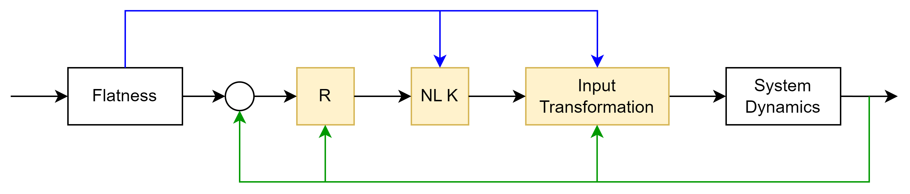







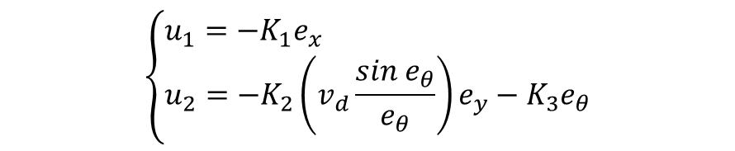




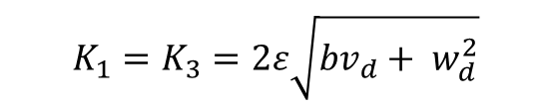


NON-LINEAR CONTROLLER - IMPLEMENTATION
$$v_{d},ω_{d}$$
$$p_{d}$$
$$+$$
$$e$$
$$u$$
$$v,ω_{ }$$
$$q$$
$$q_{d}$$
$$−$$
$$θ$$
$$θ$$
$$\left\{\begin{aligned}&u_{1}={−K}_{1}e_{x} \\ &u_{2}={−K}_{2}\left(v_{d}\frac{sin e_{θ}}{e_{θ}}\right)e_{y}−K_{3}e_{θ}\end{aligned}\right.$$
CONTROL LAW
We expect asymptotically stable control law from application of Barbalat’s Lemma
$$K_{1}=K_{3}=2ε\sqrt{bv_{d}+ w_{d}^{2}}$$
CONTROL GAINS
$$K_{2}=b$$
$$\left\{\begin{aligned}&v=v_{d}cose_{θ}−u_{1} \\ &w= w_{d}−u_{2}\end{aligned}\right.$$
INPUT TRANSFORMATION

Slide 23
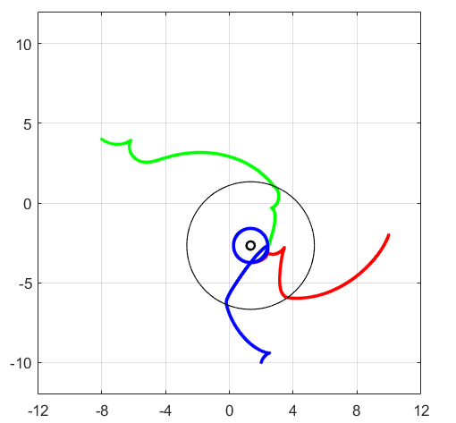
NON-LINEAR CONTROLLER - RESULTS
CONVERGENCE TEST
100%
SENSITIVITY TEST
100%
PROXIMITY TEST (avg error)
0.235

Slide 24
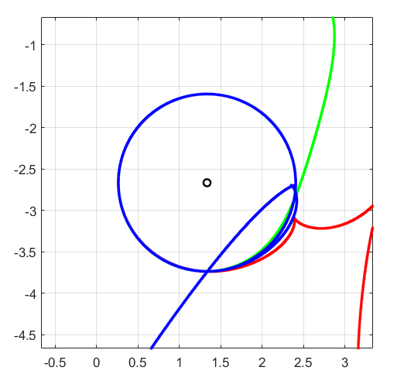
NON-LINEAR CONTROLLER - RESULTS

Slide 25
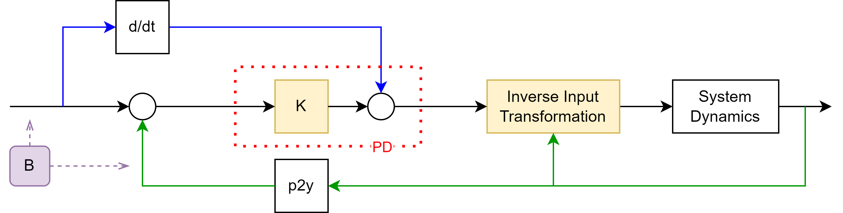


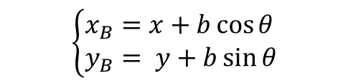


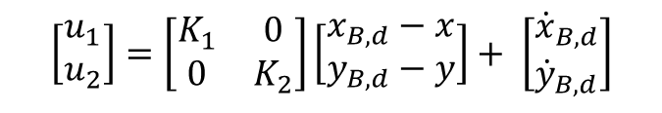





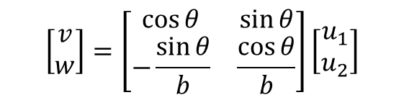


SAGITTAL CONTROLLER - IMPLEMENTATION
$$\dot{y_{d}}$$
$$y_{d}$$
$$+$$
$$e_{y}$$
$$u_{ }$$
$$v,ω_{ }$$
$$q$$
$$+$$
$$−$$
$$y$$
$$θ$$
$$\left\{\begin{aligned}&x_{B}=x+b\cos{θ} \\ &y_{B}= y+b\sin{θ}\end{aligned}\right.$$
We expect smooth trajectory and tuning flexibility, since we have decoupled dynamics and feedforward action
P2B TRANSFORMATION
$$\left[\begin{matrix}u_{1} \\ u_{2}\end{matrix}\right]=\left[\begin{matrix}K_{1} & 0 \\ 0 & K_{2}\end{matrix}\right]\left[\begin{matrix}x_{B,d}−x \\ y_{B,d}−y\end{matrix}\right]+ \left[\begin{matrix}{\dot{x}}_{B,d} \\ {\dot{y}}_{B,d}\end{matrix}\right]$$
CONTROL LAW
$$\left[\begin{matrix}v \\ w\end{matrix}\right]=\left[\begin{matrix}\cos{θ} & \sin{θ} \\ −\frac{\sin{θ}}{b} & \frac{\cos{θ}}{b}\end{matrix}\right]\left[\begin{matrix}u_{1} \\ u_{2}\end{matrix}\right]$$
INPUT TRANSFORMATION

Slide 26

SAGITTAL CONTROLLER - RESULTS
CONVERGENCE TEST
100%
SENSITIVITY TEST
99.33%
PROXIMITY TEST (avg error)
0.300

Slide 27
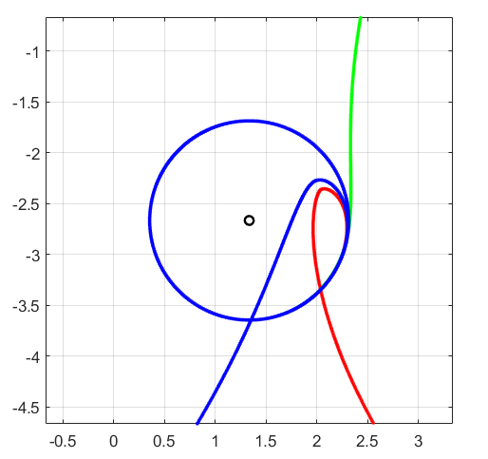
SAGITTAL CONTROLLER - RESULTS

Slide 28















D. DERIVATIVE CONTROLLER - IMPLEMENTATION
$$\dot{z_{d}}$$
$$z_{d}$$
$$+$$
$$e_{z}$$
$$u_{ }$$
$$v,ω_{ }$$
$$q$$
$$+$$
$$−$$
$$z$$
$$θ,v$$
$$\left\{\begin{aligned}&z_{1}=x \\ &z_{2}=y \\ &z_{3}=\dot{x} \\ &z_{4}=\dot{y}\end{aligned}\right.$$
P2Z TRANSFORMATION
We expect smooth trajectory and even more control flexibility
$$\left[\begin{matrix}u_{1} \\ u_{2}\end{matrix}\right]=\left[\begin{matrix}K_{1} & 0 & K_{3} & 0 \\ 0 & K_{2} & 0 & K_{4}\end{matrix}\right]\left[\begin{matrix}x_{d}−x \\ y_{d}−y \\ {\dot{x}}_{d}−\dot{x} \\ {\dot{y}}_{d}−\dot{y}\end{matrix}\right]+ \left[\begin{matrix}{\ddot{x}}_{d} \\ {\ddot{y}}_{d}\end{matrix}\right]$$
CONTROL LAW
$$\left[\begin{matrix}a \\ w\end{matrix}\right]=\left[\begin{matrix}\cos{θ} & \sin{θ} \\ −\frac{\sin{θ}}{v} & \frac{\cos{θ}}{v}\end{matrix}\right]\left[\begin{matrix}u_{1} \\ u_{2}\end{matrix}\right]$$
INPUT TRANSFORMATION

Slide 29
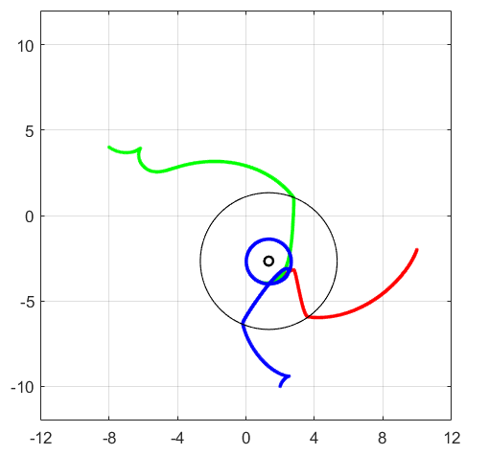
D. DERIVATIVE CONTROLLER - RESULTS
CONVERGENCE TEST
94%
SENSITIVITY TEST
78%
PROXIMITY TEST (avg error)
0.262

Slide 30
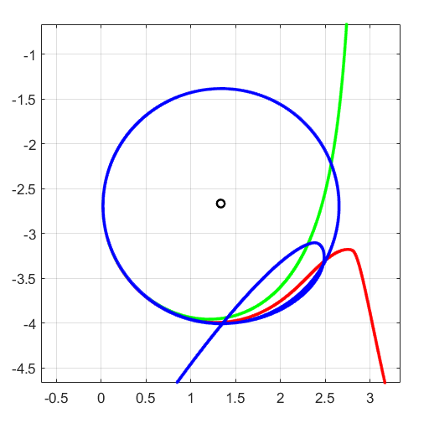
D. DERIVATIVE CONTROLLER - RESULTS

Slide 31
D. DERIVATIVE CONTROLLER - ISSUES
DERIVATIVE of STATE
Continuous time block:
Instability issues, exploding values of derivative
First order high pass filter:
Filtering high frequency components and thus avoiding too sudden variations

Slide 32

D. DERIVATIVE CONTROLLER - ISSUES
LINEAR VELOCITY
Linear velocity must be different from zero to ensure non singularity of the matrix
$$T^{−1}=\left[\begin{matrix}\cos{θ} & \sin{θ} \\ −\frac{\sin{θ}}{v} & \frac{\cos{θ}}{v}\end{matrix}\right]$$
Solution: Set the minimum linear velocity to 1e-4

Slide 33
CONTROLLER COMPARISON
 | LINEAR | NON-LINEAR | SAGITTAL | D.DERIVATIVE
TUNING | EASY | HARD | EASY | HARD
SMOOTHNESS | POOR | POOR | GOOD | GOOD
IMPL. ISSUES | FEW | FEW | FEW | MANY
CONV. TIME | 3.915 | 2.876 | 2.268 | 3.319
SENSITIVITY | MEDIUM | LOW | LOW | HIGH

Slide 34
FINAL CONSIDERATIONS
 | PRO | CONS
LINEAR | Linear dynamics Poles allocation rule | Approximation around equilibrium Differential Flatness needed Stability only for specific conditions
NON-LINEAR | No approximation needed Robustness | Non-linear dynamics Differential Flatness needed
SAGITTAL | Decoupled dynamics No differential flatness Linear control law Feedforward action | Smooth desired trajectory Theta is not controllable Choice of parameter b
DOUBLE DERIVATIVES | Decoupled dynamics No differential flatness Linear control law Feedforward action | Relies on second order derivatives Constraint on linear velocity v Sensitivity

