Slide 1
Robotics and Control 2
Cristian Lorenzi – IL GOAT
Filippo Gottardo – THE DUNGEON MASTER
Giulia Pegoraro – THE C1 ENGLISH TEACHER
Edoardo Di Pietrantonio

Slide 2
THE PROBLEM
3 mobile robotic agents should agree on a rendez-vous point, then, when in proximity of such point, they start a tracking task over a circular trajectory.
SCENARIO SPECIFICS
All agents are unicycles;
All agents are independent from each other;
ADDITIONAL CONSTRAINTS
Agents live in a 2D grid 12x12;
Initial conditions of the agents can be randomly chosen (both position and orientation);
The final target trajectory is a circle of radius 1;
The proximity circle radius is 4 or 0.5;

Slide 3
SOLUTION APPROACH
THREE STEPS PROCEDURE:
Consensus - before moving
Regulation – until proximity to rendez-vouz point
Tracking – until the end of the simulation
This algorithm is applied to each agent INDEPENDENTLY.
REGULATION CONTROL will be validated before applying it to the final solution system.
TRACKING CONTROL will be implemented using different control strategies:
Linearization of state error dynamics
Non-linear controller of state error dynamics
Feedback linearization based on a reference point on the sagittal axis
Feedback linearization based on second order derivatives
Each one will be validated using the same methodologies and compared in order to draw final conclusions.

Slide 4
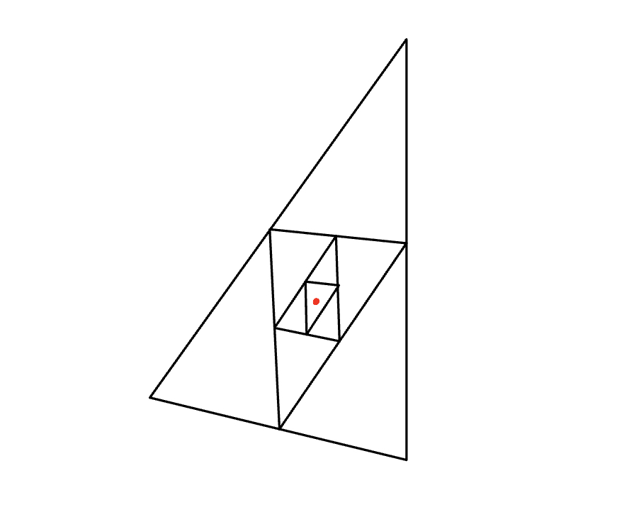
CONSENSUS
The adopted strategy is AVERAGE CONSENSUS.
Consensus is computed before starting control action and does not change over time

Slide 5


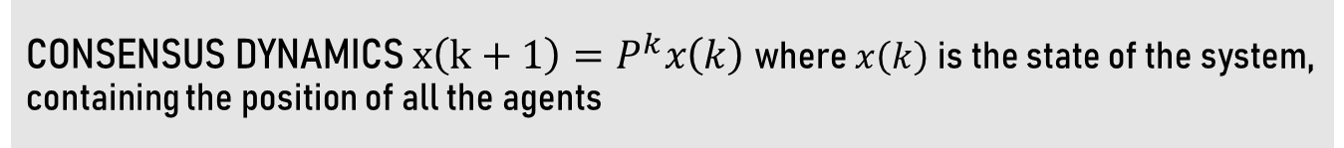
CONSENSUS
CONSENSUS DYNAMICS $x\left(k+1\right)=P^{k}x\left(k\right)$ where $x\left(k\right)$ is the state of the system, containing the position of all the agents
HOW DO WE CHOOSE THE P MATRIX ?
We need doubly stochastic P
$$P=\left[\begin{matrix}1/3 & 1/3 & 1/3 \\ 1/3 & 1/3 & 1/3 \\ 1/3 & 1/3 & 1/3\end{matrix}\right]$$
Average consensus in one step
$$P=\left[\begin{matrix}1/2 & 0 & 1/2 \\ 1/2 & 1/2 & 0 \\ 0 & 1/2 & 1/2\end{matrix}\right]$$
Average consensus

Slide 6
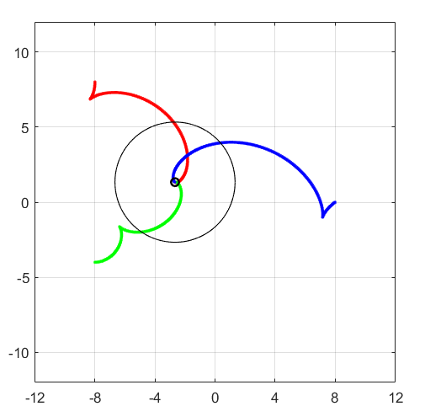
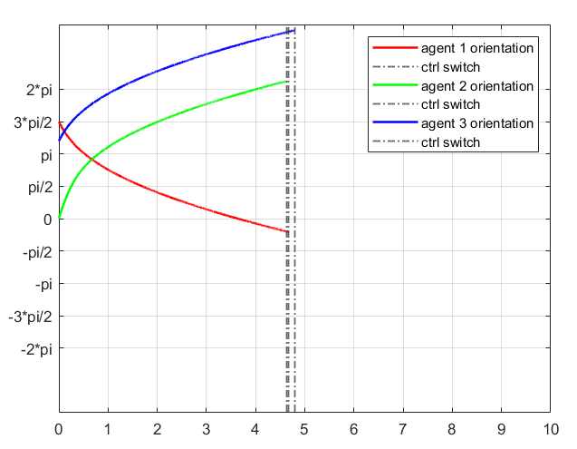
REGULATION - CARTESIAN
GOAL: reach the desired target configuration
q = [0, 0, ?]

Slide 7
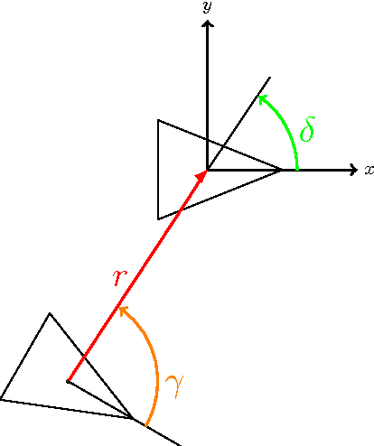
REGULATION - POSTURE
GOAL: reach the desired target configuration
q = [0, 0, 0]
TWO OPTIONS:
Control Law with singularity at the origin
Control Law without singularity at the origin
In our scenario we will implement the latter

Slide 8
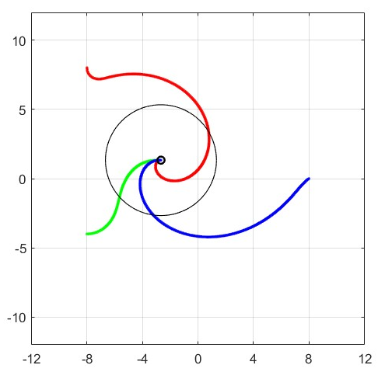
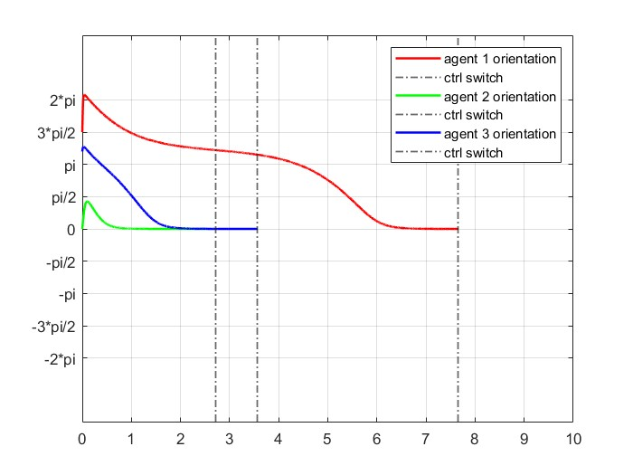
REGULATION - POSTURE
Desired behaviour is accomplished since we reach consensus point with final orientation equal to zero and at most the trajectory presents one backup manuever.

Slide 9
CONTROLLER SWITCH
How do we switch between posture regulation and tracking control?
IMPLEMENTATION PROBLEMS
Posture regulation and tracking control are two different subsystems in Simulink.
The tracking subsytem must inherit initial conditions from the last iteration of the regulation subsystem.
Transition between controllers must be smooth. We should avoid sudden changes in orientation and velocity.
Proximity radius is set to 4
CONTROL SWITCH is managed by a SIMULINK SUBSYSTEM

Slide 10
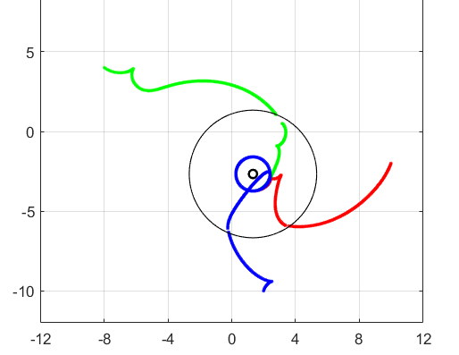
CONTROLLER SWITCH
EXAMPLE OF NON SMOOTH TRANSITION – CAN BE AVOIDED WITH PROPER TUNING

Slide 11
TESTING PROCEDURE
CONVERGENCE AND PROXIMITY TEST
SMOOTHNESS TEST
SENSITIVITY TEST
CONVERGENCE TEST – tests if the controller strategy works and how quickly the agents move to the desired position/trajectory
SMOOTHNESS TEST – tests the smoothness of the agents paths
SENSITIVITY TEST – tests the robustness of the controllers to small changes of gain values
PROXIMITY TEST – tests how close the agents are to the desired trajectory

Slide 12
CONVERGENCE AND PROXIMITY TESTS
ERROR CHECK BLOCK
Desired trajectory
Distance norm
Actual trajectory
Tracking flag
1
Perform N simulations starting from random initial positions: for every simulation collect output of error check block
2
Tracking flag is 1 if every agent is very close to the desired trajectory.
Convergence score is give n by:
SCORE = NUMBER OF SUCCESSFUL SIMULATION / N
3
Compute the avg time to reach proper tracking and the avg distance from desired trajectory when flag = 1.
Use only successful simulations

Slide 13
SENSITIVITY TEST
ERROR CHECK BLOCK
Desired trajectory
Distance norm
Actual trajectory
Tracking flag
1
Perform N simulation:
Starting from random initial positions
Slightly changing control parameters
for every simulation collect output of error check block
2
Tracking flag is 1 if every agent is very close to the desired trajectory.
Convergence score is give n by:
SCORE = NUMBER OF SUCCESSFUL SIMULATION / N

Slide 14
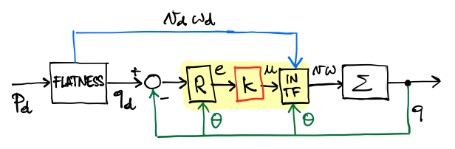
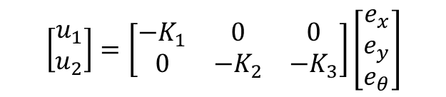

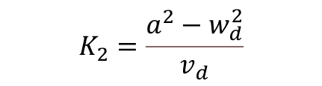

LINEAR CONTROLLER - IMPLEMENTATION
We expect asympatotically stable control law from application of Barbalat’s Lemma and since we have a circular trajectory to follow
$$\left[\begin{matrix}u_{1} \\ u_{2}\end{matrix}\right]=\left[\begin{matrix}{−K}_{1} & 0 & 0 \\ 0 & −K_{2} & {−K}_{3}\end{matrix}\right]\left[\begin{matrix}e_{x} \\ e_{y} \\ e_{θ}\end{matrix}\right]$$
CONTROL LAW
$$K_{1}=K_{3}=2εa$$
CONTROL GAINS
$$K_{2}=\frac{a^{2}−w_{d}^{2}}{v_{d}}$$
$$\left\{\begin{aligned}&v=v_{d}cose_{θ}−u_{1} \\ &w= w_{d}−u_{2}\end{aligned}\right.$$
INPUT TRANSFORMATION

Slide 15
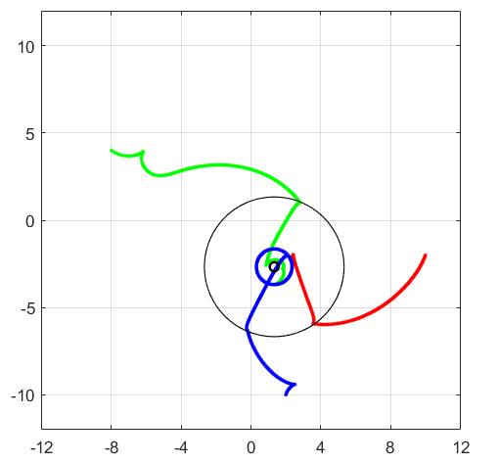
LINEAR CONTROLLER - RESULTS
CONVERGENCE TEST
90%
SENSITIVITY TEST
86.67%
PROXIMITY TEST (avg norm distance)
0.240

Slide 16
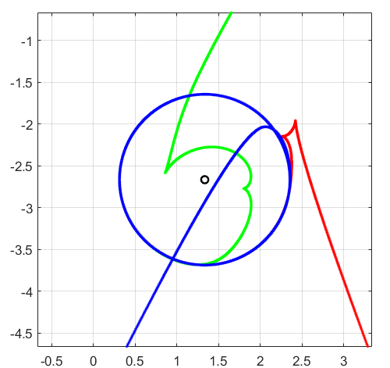
LINEAR CONTROLLER - RESULTS

Slide 17
LINEAR CONTROLLER – IMPLEMENTATION ISSUES
UNWRAP in differential flatness block for angle theta computation
DERIVATIVES computation in differential flatness block
ALPHA tuning via trial and error method

Slide 18
THIS IS THE EXPLANATION – HIDDEN SLIDE
Unwrap: used to avid discontinuity in angle computation. Discontinuities lead to unexpected behaviour of the system.
First order high pass filter
Large alphas increase the control action. Excessive control action leads to slow convergence time to desired trajectory and more backup manuevers

Slide 19
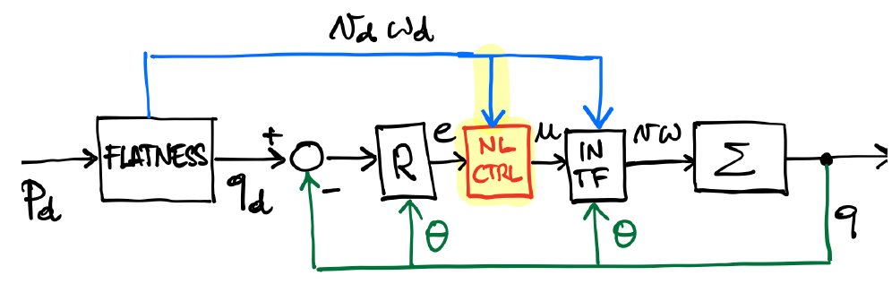
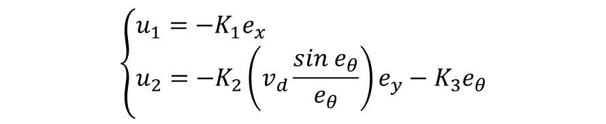

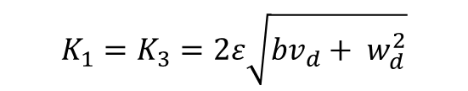

NON-LINEAR CONTROLLER - IMPLEMENTATION
We expect asympatotically stable control law from application of Barbalat’s Lemma
$$\left\{\begin{aligned}&u_{1}={−K}_{1}e_{x} \\ &u_{2}={−K}_{2}\left(v_{d}\frac{sin e_{θ}}{e_{θ}}\right)e_{y}−K_{3}e_{θ}\end{aligned}\right.$$
CONTROL LAW
$$K_{1}=K_{3}=2ε\sqrt{bv_{d}+ w_{d}^{2}}$$
CONTROL GAINS
$$K_{2}=b$$
$$\left\{\begin{aligned}&v=v_{d}cose_{θ}−u_{1} \\ &w= w_{d}−u_{2}\end{aligned}\right.$$
INPUT TRANSFORMATION

Slide 20
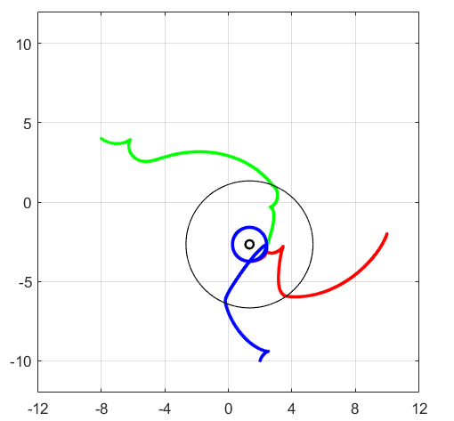
NON-LINEAR CONTROLLER - RESULTS
CONVERGENCE TEST
100%
SENSITIVITY TEST
100%
PROXIMITY TEST (avg error)
0.235

Slide 21
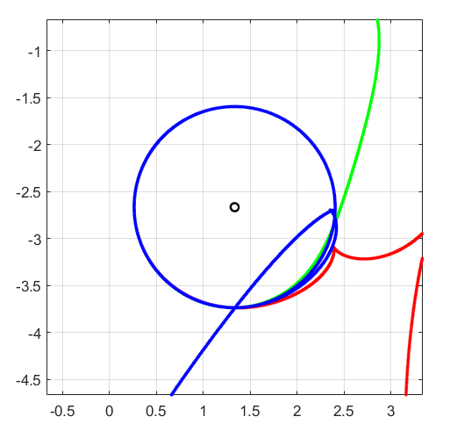
NON-LINEAR CONTROLLER - RESULTS

Slide 22
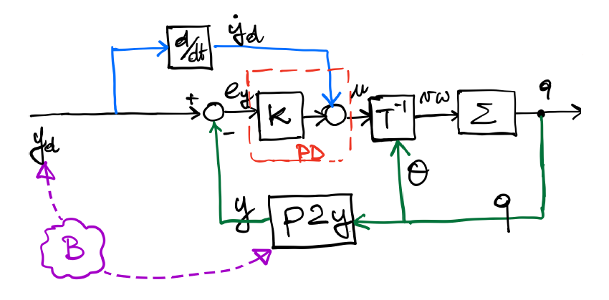
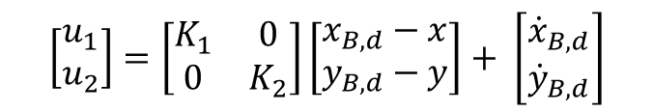
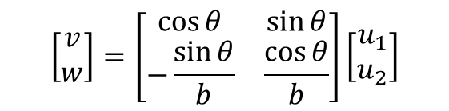
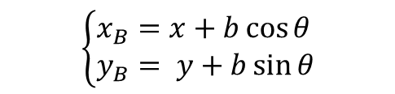
SAGITTAL CONTROLLER - IMPLEMENTATION
We expect smooth trajectory and tuning flexibility, since we have decoupled dynamics and feedforward action
$$\left\{\begin{aligned}&x_{B}=x+b\cos{θ} \\ &y_{B}= y+b\sin{θ}\end{aligned}\right.$$
P2B TRANSFORMATION
$$\left[\begin{matrix}u_{1} \\ u_{2}\end{matrix}\right]=\left[\begin{matrix}K_{1} & 0 \\ 0 & K_{2}\end{matrix}\right]\left[\begin{matrix}x_{B,d}−x \\ y_{B,d}−y\end{matrix}\right]+ \left[\begin{matrix}{\dot{x}}_{B,d} \\ {\dot{y}}_{B,d}\end{matrix}\right]$$
CONTROL LAW
$$\left[\begin{matrix}v \\ w\end{matrix}\right]=\left[\begin{matrix}\cos{θ} & \sin{θ} \\ −\frac{\sin{θ}}{b} & \frac{\cos{θ}}{b}\end{matrix}\right]\left[\begin{matrix}u_{1} \\ u_{2}\end{matrix}\right]$$
INPUT TRANSFORMATION

Slide 23

SAGITTAL CONTROLLER - RESULTS
CONVERGENCE TEST
100%
SENSITIVITY TEST
99.33%
PROXIMITY TEST (avg error)
0.300

Slide 24
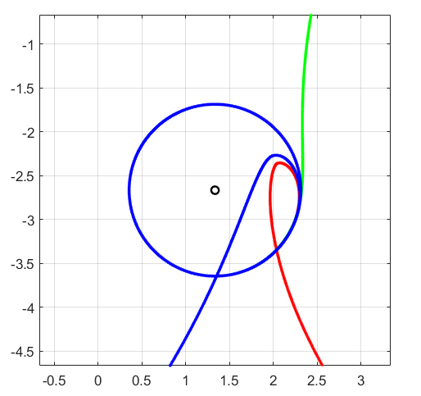
SAGITTAL CONTROLLER - RESULTS

Slide 25
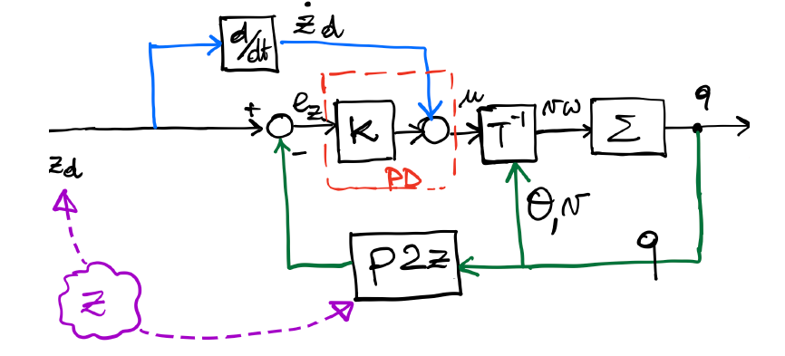



D. DERIVATIVE CONTROLLER - IMPLEMENTATION
We expect smooth trajectory and even more control flexibility since
$$\left\{\begin{aligned}&z_{1}=x \\ &z_{2}=y \\ &z_{3}=\dot{x} \\ &z_{4}=\dot{y}\end{aligned}\right.$$
P2Z TRANSFORMATION
$$\left[\begin{matrix}u_{1} \\ u_{2}\end{matrix}\right]=\left[\begin{matrix}K_{1} & 0 & K_{3} & 0 \\ 0 & K_{2} & 0 & K_{4}\end{matrix}\right]\left[\begin{matrix}x_{d}−x \\ y_{d}−y \\ {\dot{x}}_{d}−\dot{x} \\ {\dot{y}}_{d}−\dot{y}\end{matrix}\right]+ \left[\begin{matrix}{\ddot{x}}_{d} \\ {\ddot{y}}_{d}\end{matrix}\right]$$
CONTROL LAW
$$\left[\begin{matrix}a \\ w\end{matrix}\right]=\left[\begin{matrix}\cos{θ} & \sin{θ} \\ −\frac{\sin{θ}}{v} & \frac{\cos{θ}}{v}\end{matrix}\right]\left[\begin{matrix}u_{1} \\ u_{2}\end{matrix}\right]$$
INPUT TRANSFORMATION

Slide 26
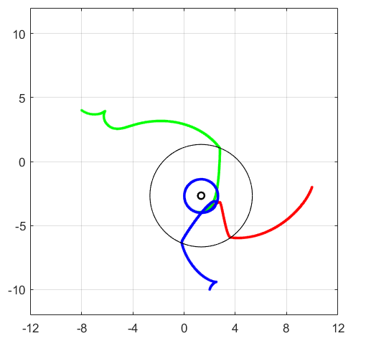
D. DERIVATIVE CONTROLLER - RESULTS
CONVERGENCE TEST
94%
SENSITIVITY TEST
78%
PROXIMITY TEST (avg error)
0.262

Slide 27
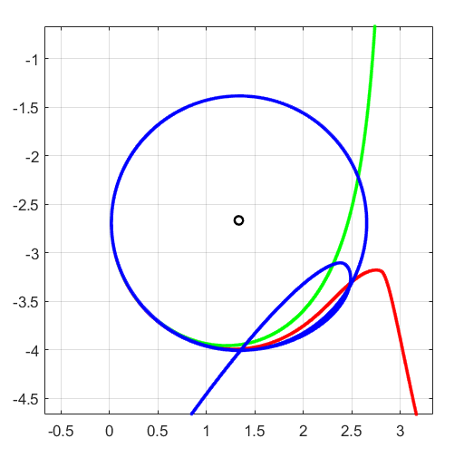
D. DERIVATIVE CONTROLLER - RESULTS

Slide 28
D. DERIVATIVE CONTROLLER - ISSUES
DERIVATIVE of STATE
Continuous time block:
Instability issues, exploding values of derivative
First order high pass filter:
Filtering high frequency components and thus avoiding too sudden variations

Slide 29

D. DERIVATIVE CONTROLLER - ISSUES
LINEAR VELOCITY
Linear velocity must be different from zero to ensure non singularity of the matrix
$$T^{−1}=\left[\begin{matrix}\cos{θ} & \sin{θ} \\ −\frac{\sin{θ}}{v} & \frac{\cos{θ}}{v}\end{matrix}\right]$$
Solution: Set the minimum linear velocity to 1e-4

Slide 30
CONTROLLER COMPARISON
 | LINEAR | NON-LINEAR | SAGITTAL | D.DERIVATIVE
TUNING | EASY | HARD | EASY | HARD
SMOOTHNESS | POOR | POOR | GOOD | GOOD
IMPL. ISSUES | FEW | FEW | FEW | MANY
CONV. TIME | 3.915 | 2.876 | 2.268 | 3.319
SENSITIVITY | MEDIUM | LOW | LOW | HIGH

Slide 31
FINAL CONSIDERATIONS
 | PRO | CONS
LINEAR | Linear dynamics Poles allocation rule | Sensitivity Approximation around equilibrium Differential Flatness needed Stability only for specific conditions
NON-LINEAR | No approximation needed Non linear control law | Non-linear dynamics Differential Flatness needed
SAGITTAL | Decoupled dynamics No differential flatness Linear control law Feedforward action | Smooth desired trajectory Theta is not controllable Constraint on b
DOUBLE DERIVATIVES | Decoupled dynamics No differential flatness Linear control law Feedforward action | Relies on second order derivatives Constraint on linear velocity v

