Slide 1
Robotics and Control 2
Cristian Lorenzi, Filippo Gottardo, Giulia Pegoraro, Edoardo Di Pietrantonio

Slide 2
THE PROBLEM
3 mobile robotic agents should agree on a rendez-vous point, then, when in proximity of such point, they start a tracking task over a circular trajectory.
SCENARIO SPECIFICS
All agents are unicycles;
All agents are independent from each other;
ADDITIONAL CONSTRAINTS
Agents live in a 2D grid 12x12;
Initial conditions of the agents can be randomly chosen (both position and orientation);
The final target trajectory is a circle of radius 1;
The proximity circle radius is 4;

Slide 3
SOLUTION APPROACH
THREE STEPS PROCEDURE:
Consensus - before moving
Regulation – until proximity to rendez-vouz point
Tracking – until the end of the simulation
This algorithm is applied to each agent INDEPENDENTLY.
REGULATION CONTROL will be validated before applying it to the final solution system.
TRACKING CONTROL will be implemented using different control strategies:
Linearization of state error dynamics
Non-linear controller of state error dynamics
Feedback linearization based on a reference point on the sagittal axis
Feedback linearization based on second order derivatives
Each one will be validated using the same methodologies and compared in order to draw final conclusions.

Slide 4
CONSENSUS
The consensus point is computed before any movement, based on the initial position of each agent.
The adopted strategy is AVERAGE CONSENSUS, meaning we compute the center of mass of the agents as rendez-vous point.
MISSING IMAGE
Future improvement - Consensus could be dynamically computed at every step of the iteration until every agent is in its proximity.

Slide 5
REGULATION - CARTESIAN

Slide 6
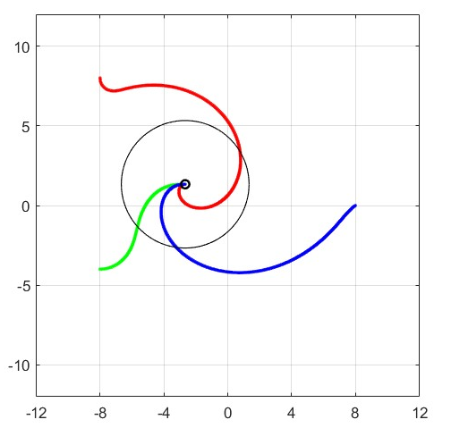
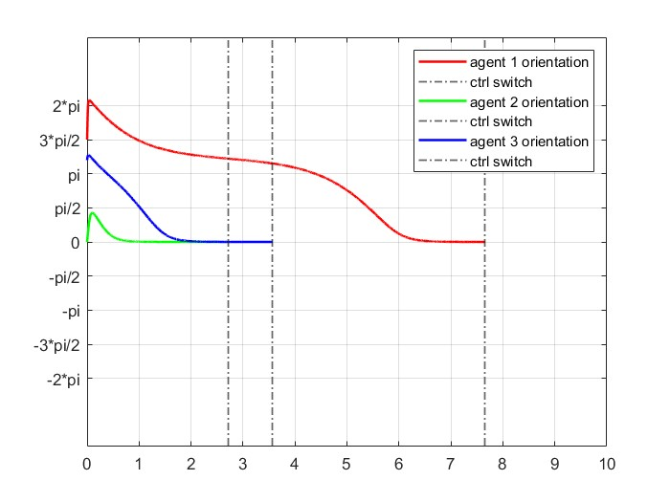
REGULATION - POSTURE
EXPLAIN THE REASONS

Slide 7
CONTROLLER SWITCH
How do we switch between posture regulation and tracking control?
A simulink block is responsible for checking if we are inside a fixed proximity radius, in which case it switches controller
Proximity radius is set to 4
IMPLEMENTATION PROBLEMS
Posture regulation and tracking control are two different subsystems in Simulink.
The tracking subsytem must inherit initial conditions from the last iteration of the regulation subsystem.
Transition between controllers must be smooth. We should avoid sudden changes in orientation and velocity.

Slide 8
TESTING PROCEDURE
CONVERGENCE TEST – tests if the controller strategy works and how quickly the agents move to the desired position/trajectory
SMOOTHNESS TEST – tests the smoothness of the agents paths
SENSITIVITY TEST – tests the robustness of the controllers to small changes of gain values
PROXIMITY TEST – tests how close the agents are to the desired trajectory
Each test (except for the smoothness test) is automated via MatLab livescript.
The smoothness test was impossible to automate since the final results could only be interpreted by a human depending on his needs (trajectory path).
Each trajectory tracking controller was tested using this procedure.

Slide 9
LINEAR CONTROLLER - IMPLEMENTATION
Controller scheme/formulas

Slide 10
LINEAR CONTROLLER - RESULTS
CONVERGENCE TEST
94%
Smoothness image
SENSITIVITY TEST
80/100
PROXIMITY TEST (avg error)
2.58

Slide 11
NON-LINEAR CONTROLLER - IMPLEMENTATION
Controller scheme/formulas

Slide 12
NON-LINEAR CONTROLLER - RESULTS
CONVERGENCE TEST
94%
Smoothness image
SENSITIVITY TEST
80/100
PROXIMITY TEST (avg error)
2.58

Slide 13
SAGITTAL CONTROLLER -IMPLEMENTATION
Controller scheme/formulas

Slide 14
SAGITTAL CONTROLLER - RESULTS
CONVERGENCE TEST
94%
Smoothness image
SENSITIVITY TEST
80/100
PROXIMITY TEST (avg error)
2.58

Slide 15
DOUBLE DERIVATIVE CONTROLLER - IMPLEMENTATION
Controller scheme/formulas

Slide 16
DOUBLE DERIVATIVE CONTROLLER - RESULTS
CONVERGENCE TEST
94%
Smoothness image
SENSITIVITY TEST
80/100
PROXIMITY TEST (avg error)
2.58

Slide 17
CONTROLLER COMPARISON
TABLE OF RESULTS FOR COMPARISON

Slide 18
FINAL CONSIDERATIONS
TABLE OF RESULTS FOR COMPARISON

