Slide 1
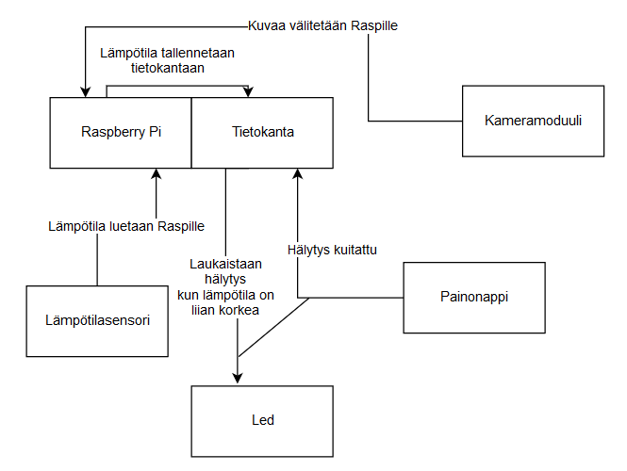
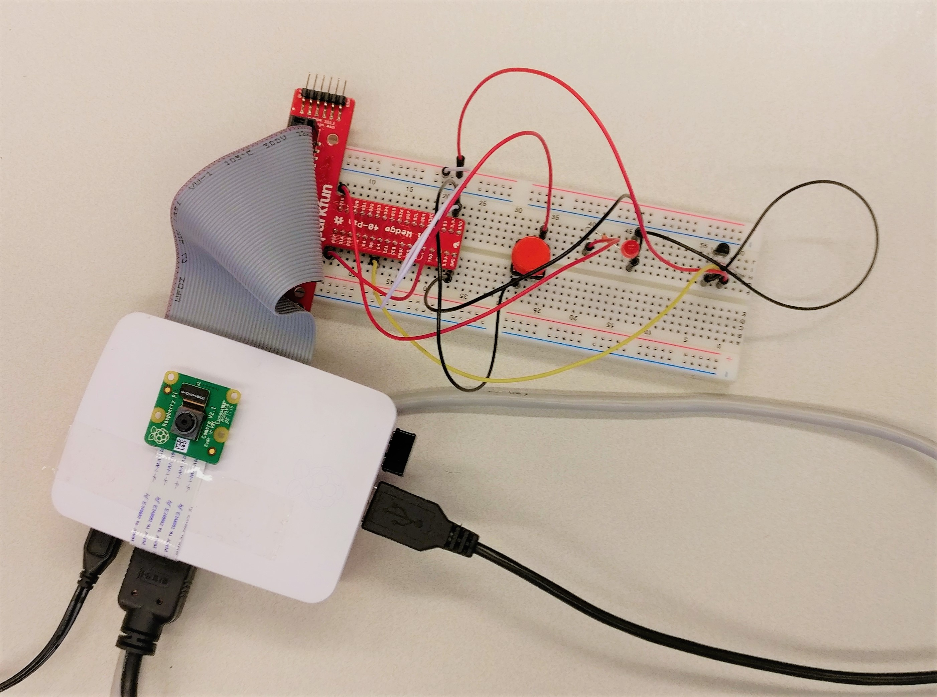
Valvontasofta
Artti Paasonen, Pipsa Korkiakoski, Jyri Neuvonen, Miina Puuronen TVT17SPO
Tieto- ja viestintätekniikka, Informaatioteknologian osasto
Introduction
The aim of this project was to make a surveillance application that monitors surroundings and temperature.
Temperature information was saved to a database, and an alarm system was keeping track of the changes in temperature. When the temperature rises too high, led starts blinking to alert the user. The alarm can be switched off by pressing a button. External camera is used to show live video feed from the wanted environment.
FIGURE 1. Wiring of the product
Objectives
Since the project was part of the IoT-course, the database was designed to be accessible from various platforms.
Methods
Hardware we used consisted of Raspberry Pi, digital thermometer DS18B20, a red led, pushbutton and a Raspberry Pi camera module V2. Database was provided by MariaDB. We chose Python 3 as the main coding language. Website was made with PHP and Javascript.
Results
In the end everything worked smoothly.
The information on the database was shown on a PHP/HTML-page, and it was reloaded every second by a script.
FIGURE 2. Diagram of the product
Conclusions
Our original plan was to use a database located in a student server, which is hosted by our school, but we encountered some problems when trying to connect the Raspberry to school’s network. Because of that we decided to switch to MariaDB database instead. None of us had used it before so the whole project took a little more time than we first predicted.
Project
ECTS credits: 3
Date of publication: 2019, Spring
Instructor Pertti Heikkilä

