Slide 1

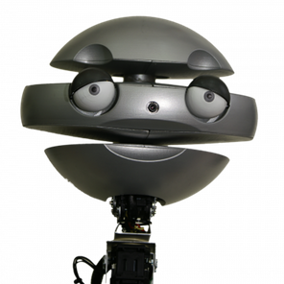
EMYS: a social robot that plays “Sueca”
69930 - Filipa Isabel Nogueira Correia

Slide 2
Outline
Related Work
Social player
Conclusions
Motivation
AI
User studies

Slide 3
Related Work
Social player
Conclusions
Motivation
AI
User studies

Slide 4


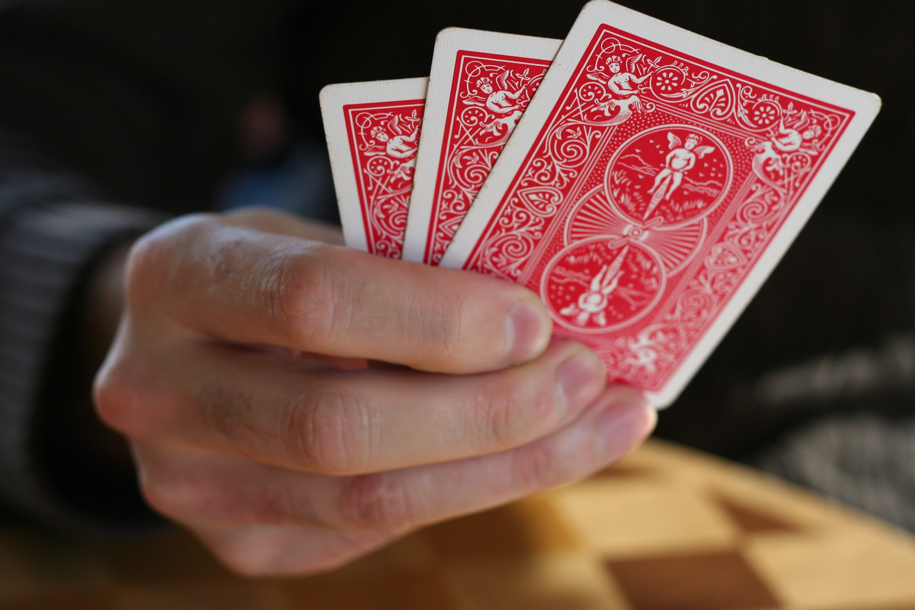
Motivation
Complexity
4

Slide 5
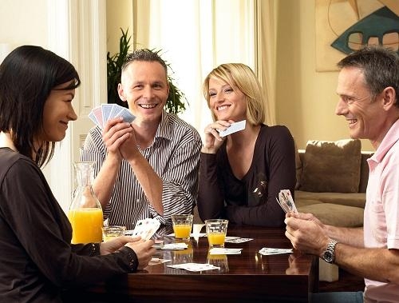
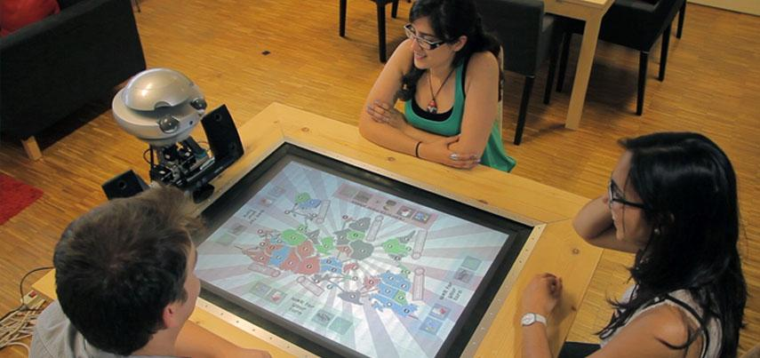
Motivation
Can an artificial player be social?
5

Slide 6
Motivation
AI for Sueca
A social robot that plays Sueca
Social behaviours
W
H
Y
?
Well known by the elderly
6

Slide 7
Related Work
Social player
Conclusions
Motivation
AI
User studies

Slide 8
Related Work
Social player
Conclusions
Motivation
AI
User studies
Card games
HRI

Slide 9
Card games
Solving hidden information games
Monte Carlo Methods
Nash equilibrium
Belief distributions
PIMC
ISMCTS
IIMC
9

Slide 10
Related Work
Social player
Conclusions
Motivation
AI
User studies
Card games
HRI in games

Slide 11
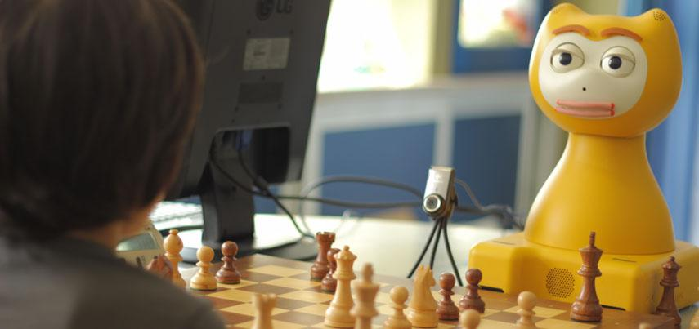
HRI in games
EMYS, the Risk player
iCat, the chess tutor
Topology of speeches
Relevance value of a move
Power of a player
Simulation of roles
Luck perception
Children tutor
Careful advices
Long-term interactions
11

Slide 12
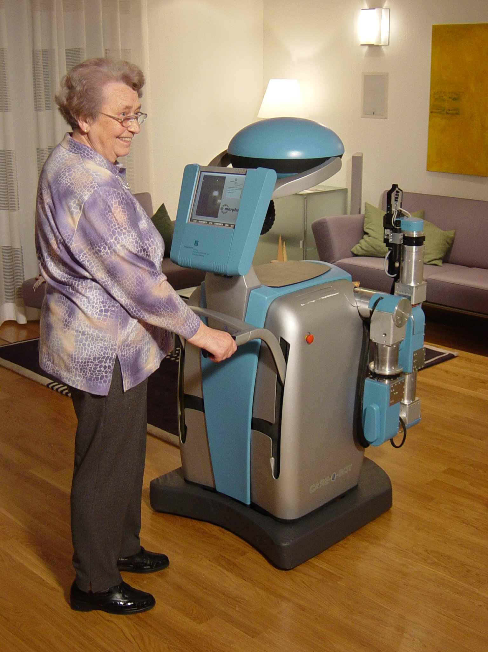
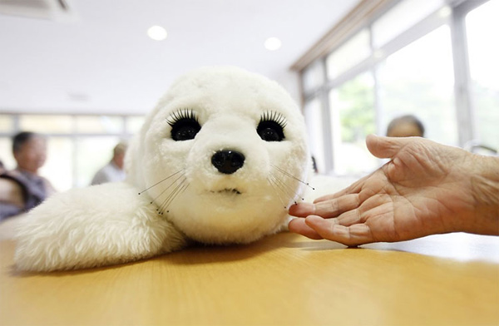
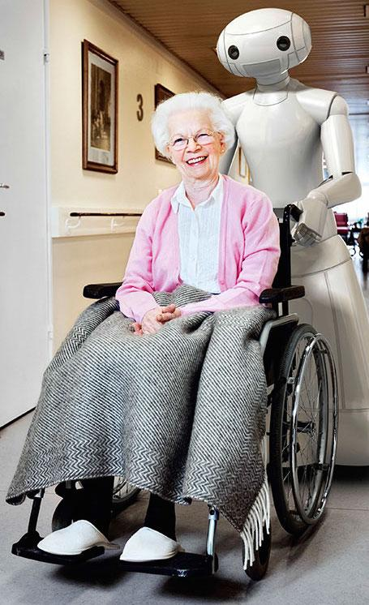
HRI in games
There is a gap in companion robots for older adults without serious health problems
12

Slide 13
Related Work
Social player
Conclusions
Motivation
AI
User studies

Slide 14
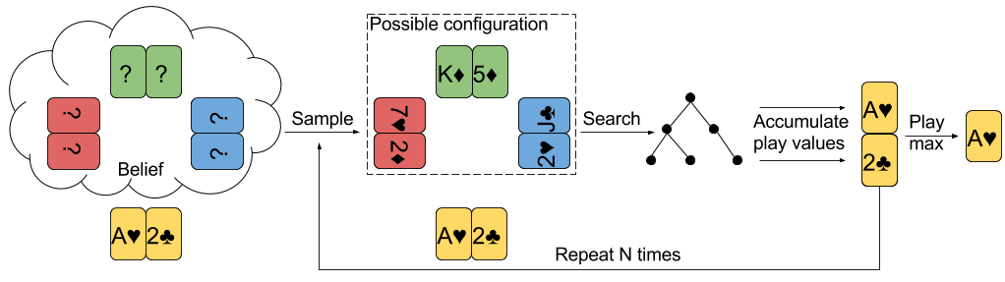
AI
PIMC concept
14

Slide 15
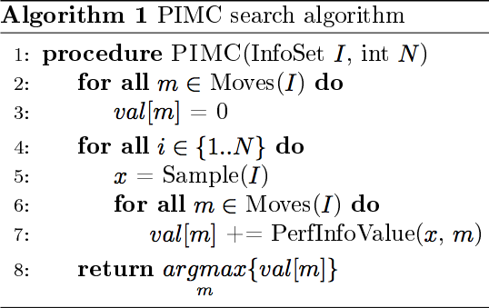
AI
15

Slide 16
AI
Information set
Deck
Suits per player
16

Slide 17
AI
Min Max
αβ pruning
Depth limit
Ordering heuristic
Transposition table
Equivalent states removal
17

Slide 18
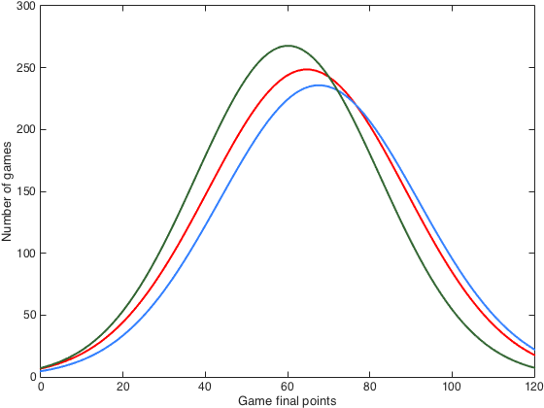
AI
Benchmark: Rule-based Player
 | FGR
2RB vs 2RB | 50,4%
1RB 1Rand vs 2Rand | 53,4%
2RB vs 2Rand | 62,9%
Team impact!
18

Slide 19
AI
Low FGR? Why?
Luck? Which initial features affect results?
Linear regression (features → team final points)
poor predictors, however significant!
Team aces number
Team sevens number
Team trumps number
Hard, medium and easy initial conditions for the team
19

Slide 20


AI
Implementing PIMC...
20

Slide 21
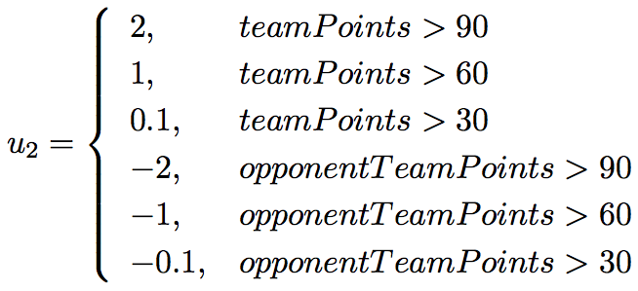
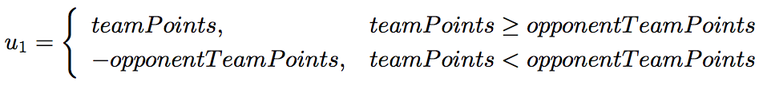
AI
Parametrizing...
Trick Player
Utility func.: u₁
Depth limit: 1 trick
Deep-1 Player
Utility func.: u₁
Depth limit depends on the tree size
Deep-2 Player
Utility func.: u₂
Depth limit depends on the tree size
21

Slide 22
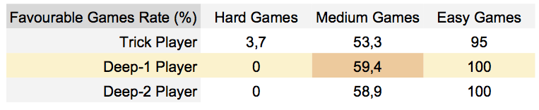
AI
Most significant rate
22

Slide 23
Related Work
Social player
Conclusions
Motivation
AI
User studies

Slide 24
Related Work
Social player
Conclusions
Motivation
AI
User studies
User centred-studies
EMYS: the Sueca player

Slide 25
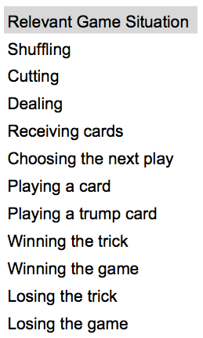
User centred-studies
4 participants from a day-home care institution playing Sueca
Verbal and nonverbal behaviours
25

Slide 26
Related Work
Social player
Conclusions
Motivation
AI
User studies
User centred-studies
EMYS: the Sueca player

Slide 27
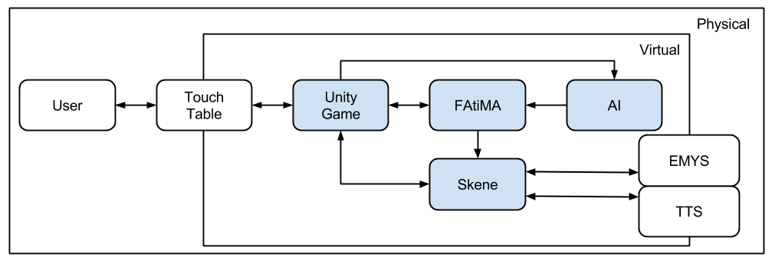
EMYS: the Sueca player
27

Slide 28
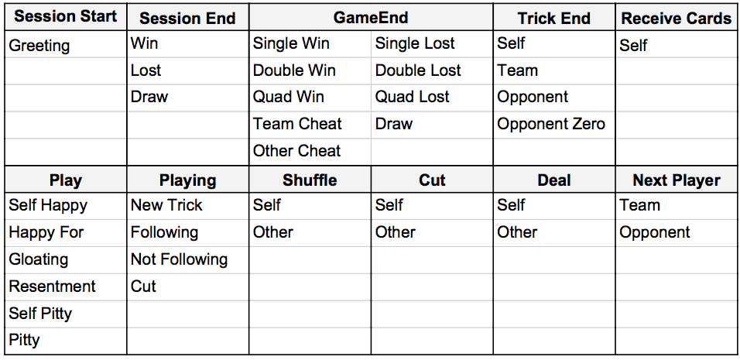
EMYS: the Sueca player
28

Slide 29
EMYS: the Sueca player
Human-like behaviours:
speech frequency
emotional state (FAtiMA)
posture
subcategory of some utterances
competitive to the opponent
encouraging to the partner
29

Slide 30
Related Work
Social player
Conclusions
Motivation
AI
User studies

Slide 31

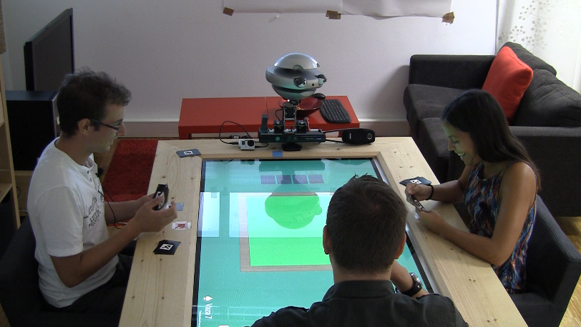
User studies
60 participants
(1) Pre-questionnaire
PANAS
Human-Robot Trust
(2) Playing with EMYS
(3) Pos-questionnaire
PANAS
Human-Robot Trust
Networked Minds
31

Slide 32
User studies
?
Trust in the partner
Social Presence of the partner
Affect felt
32

Slide 33
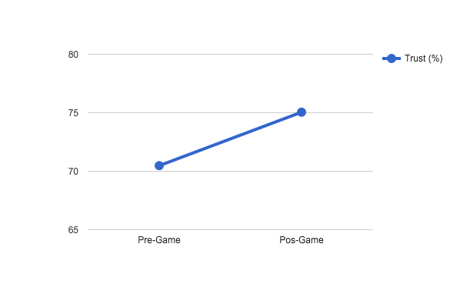
User studies
Trust
Are there changes in trust after the experience of interacting with the Sueca partner?
[Mixed ANOVA test]
Answer:
time → Trust (p=0.03)
[time, partner] ↛ Trust (p=0.65)
33

Slide 34
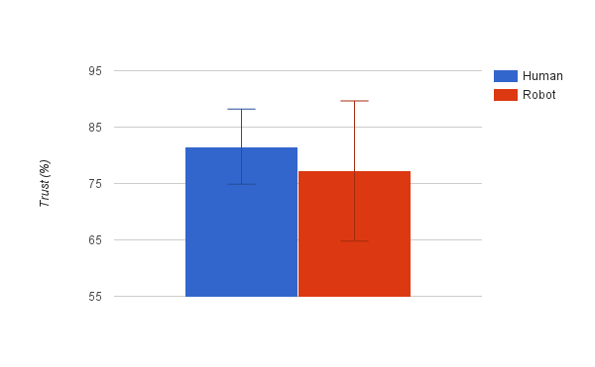
User studies
Trust
Are the trust levels influenced by the partner (robot or human)?
[Welch test]
Answer:
partner → Trust (p=2x10⁻⁶)
34

Slide 35
User studies
Trust
Are the trust levels influenced by the game results?
[Two-way ANOVA test]
Answer:
game result ↛ Trust (p=0.065)
[game result, partner] ↛ Trust (p=0.507)
35

Slide 36
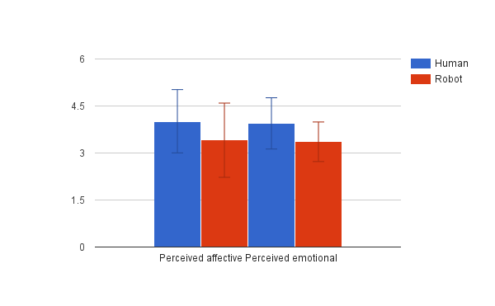
User studies
Social Presence
Is the social presence influenced by the Sueca partner (robot or human)?
[One-way ANOVA test]
Note: Networked Minds Questionnaire has 6 dimensions
Answer:
partner ↛ co-presence (p=0.217)
partner ↛ attentional allocation (p=0.965)
partner ↛ perceived message understanding (p=0.777)
partner → perceived affective understanding (p=0.007)
partner → perceived emotional interdependence (p=0.046)
partner ↛ perceived behavioural interdependence (p=0.406)
36

Slide 37
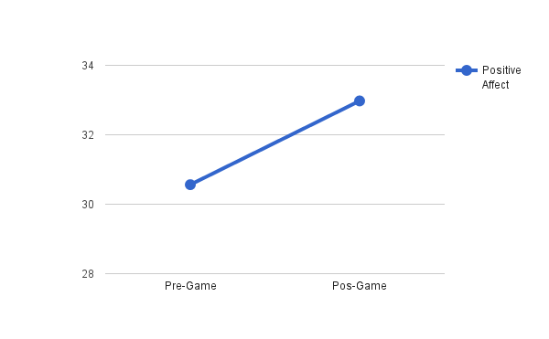
User studies
Affect
Are there changes in positive/negative affect after interacting with the Sueca partner?
[Mixed ANOVA test]
Answer:
time → positive affect (p=0.008)
[time, partner] ↛ positive affect (p=0.488)time time ↛ negative affect (p=0.267)
[time, partner] ↛ negative affect (p=0.184)
37

Slide 38
User studies
The robot team won 12 and drawn 1 sessions out of 20
60%
5%
FGR: 65%
38

Slide 39
Related Work
Social player
Conclusions
Motivation
AI
User studies

Slide 40
Conclusions
2 main contributions
AI for Sueca
Social robotic player
Can beat the rule-based players
Social presence can be comparable to human partners
Trust levels towards robot partner are lower than towards human partners
Positive affect increased after the experience
40

Slide 41
Future Work
Technical improvements:
to create a heuristic for the utility function
machine learning from collected games to infer a current world approximation
to improve the linear regression of the final points
transposition table as LFU or LRU
to generate games of different initial conditions
to explore other emotions of FAtiMA
to avoid redundancy of utterances during the session
HRI next steps:
expand the scenario for an older audience
41

Slide 42
Thank you!

