Slide 1
EMYS: A SOCIAL ROBOT THAT PLAYS “SUECA”

Slide 2
OUTLINE
Motivation
Goals
Background
Related Work
AI in Games
HRI
Proposed Architecture
Evaluation
Conclusion

Slide 3
MOTIVATION

Slide 4
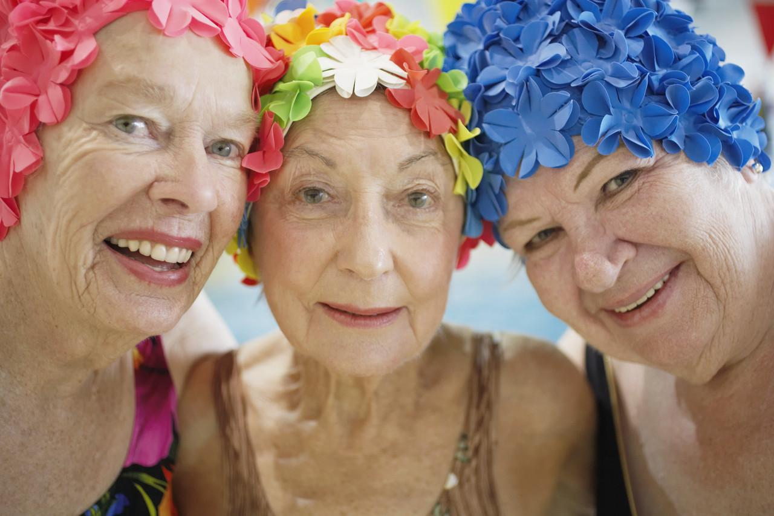
MOTIVATION

Slide 5
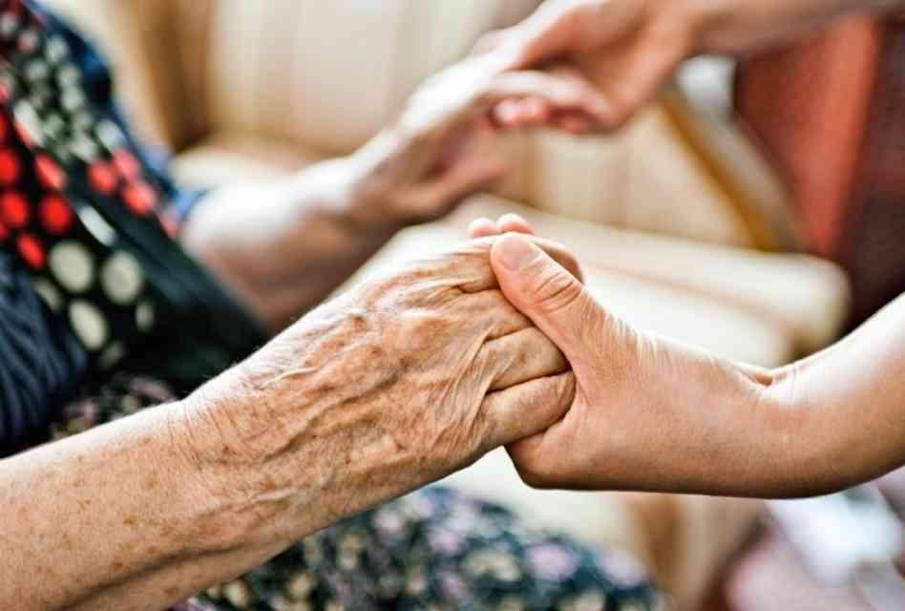
MOTIVATION

Slide 6
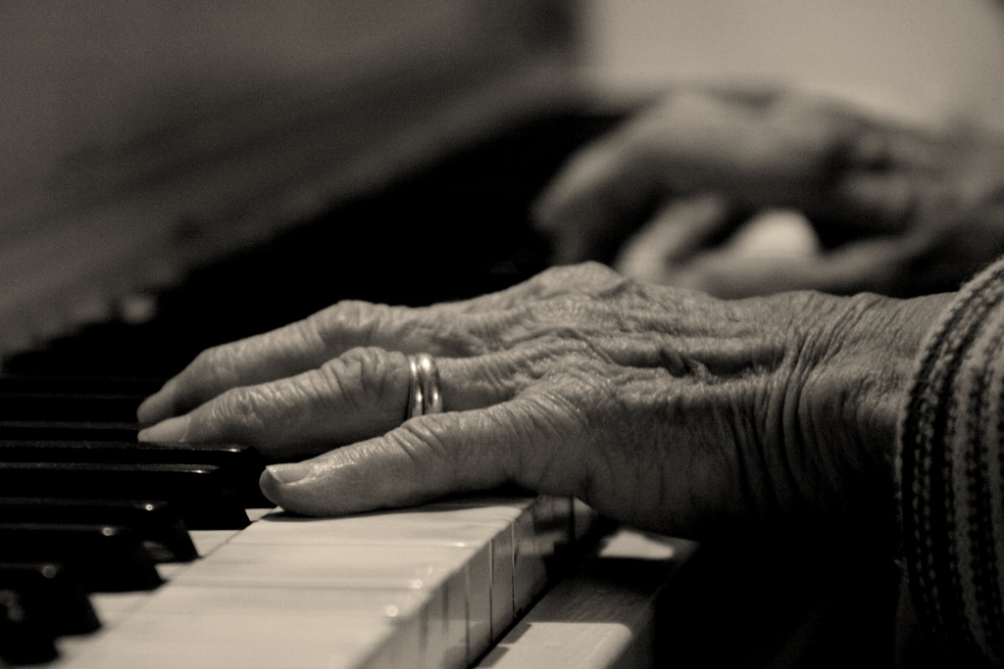
MOTIVATION

Slide 7
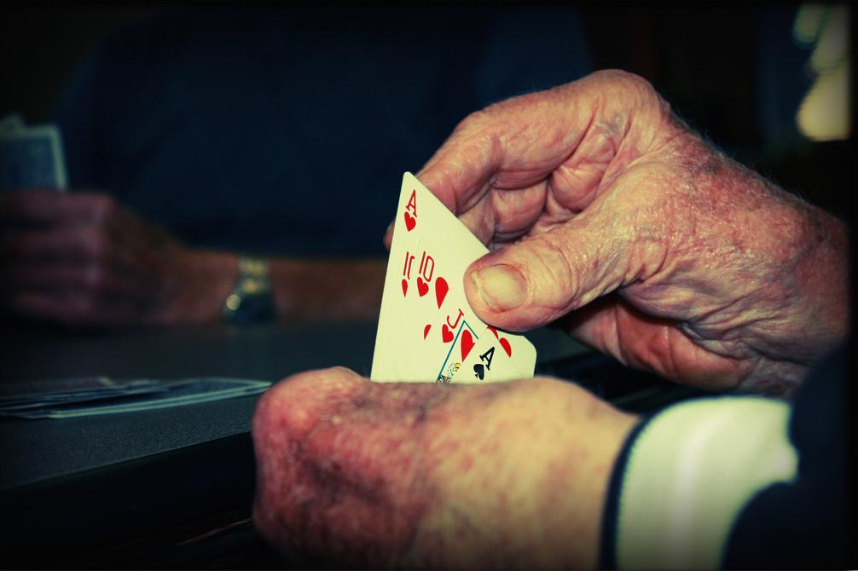
MOTIVATION

Slide 8
2. GOALS

Slide 9
GOALS
Integrate a social robot with aged humans in a card game scenario
Develop an agent that plays competently Sueca
Develop a socially present embodied agent
Evaluate the correctness of the system

Slide 10
3. BACKGROUND

Slide 11
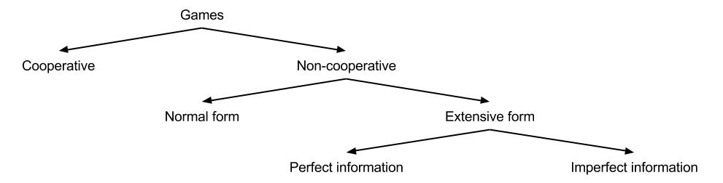
BACKGROUND

Slide 12
BACKGROUND
Sueca

Slide 13
BACKGROUND
Hidden information?
Information Set!

Slide 14
BACKGROUND
Monte-Carlo Tree Search
Selection
Expansion
Simulation
Backpropagation

Slide 15
4. RELATED WORK

Slide 16
4.1. AI IN GAMES

Slide 17
AI IN GAMES
Solving hidden information games...
Monte-Carlo Methods
Nash-Equilibrium Strategy
Belief distributions

Slide 18
AI IN GAMES
Solving hidden information games...
Monte-Carlo Methods
Nash-Equilibrium Strategy
Belief distributions

Slide 19
AI IN GAMES
MONTE-CARLO METHODS
How to deal with hidden information?
PIMC
ISMCTS
IIMC

Slide 20
AI IN GAMES
MONTE-CARLO METHODS
PIMC
Domains | Pros / Cons | Hidden Information
Bridge Skat | Simpler to implement Strategy fusion Non-locality | Determinization

Slide 21
AI IN GAMES
MONTE-CARLO METHODS
ISMCTS
Domains | Pros / Cons | Hidden Information
Dou Dizhu | Computational Budget Strategy fusion (less) Non-locality Harder to implement | Information Set

Slide 22
AI IN GAMES
MONTE-CARLO METHODS
IIMC
Domains | Pros / Cons | Hidden Information
Skat | Player Module Strategy fusion (less) Non-locality Harder to implement | Recursive Determ.

Slide 23
AI IN GAMES
BELIEF DISTRIBUTIONS
Domain | Technique | Goal | Suitable
Skat | Determine the winning probability of a hand | Improve the bidding | N
Skat | Fastest-cut-first heuristic | Order moves | Y
Skat | Considering similar states equally | Reduce tree exploration | Y
Skat | Calculate the mistake rate of each player | Improve the bidding | ~
Poker | Opponent model | Improve MCTS policies | Y

Slide 24
4.2. HRI

Slide 25
HRI
Integrate a social robot with aged humans in a card game scenario
Robots in elderly care
Social robots in games

Slide 26
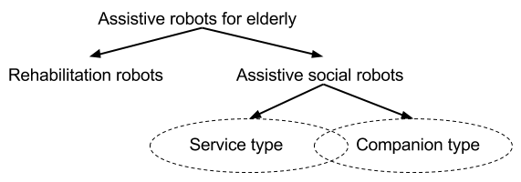
HRI
ROBOTS IN ELDERLY CARE

Slide 27
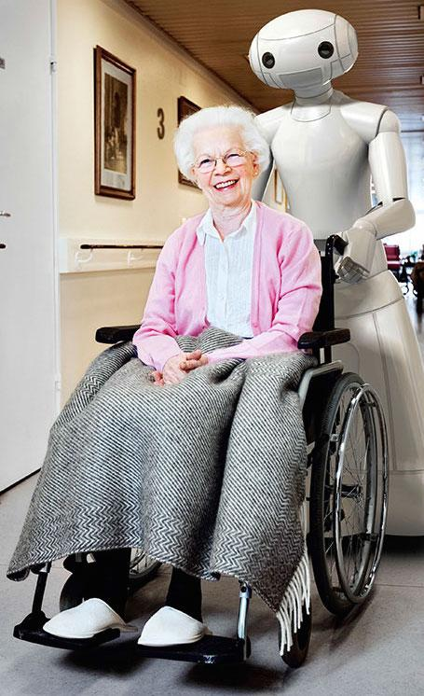
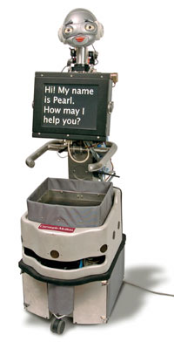
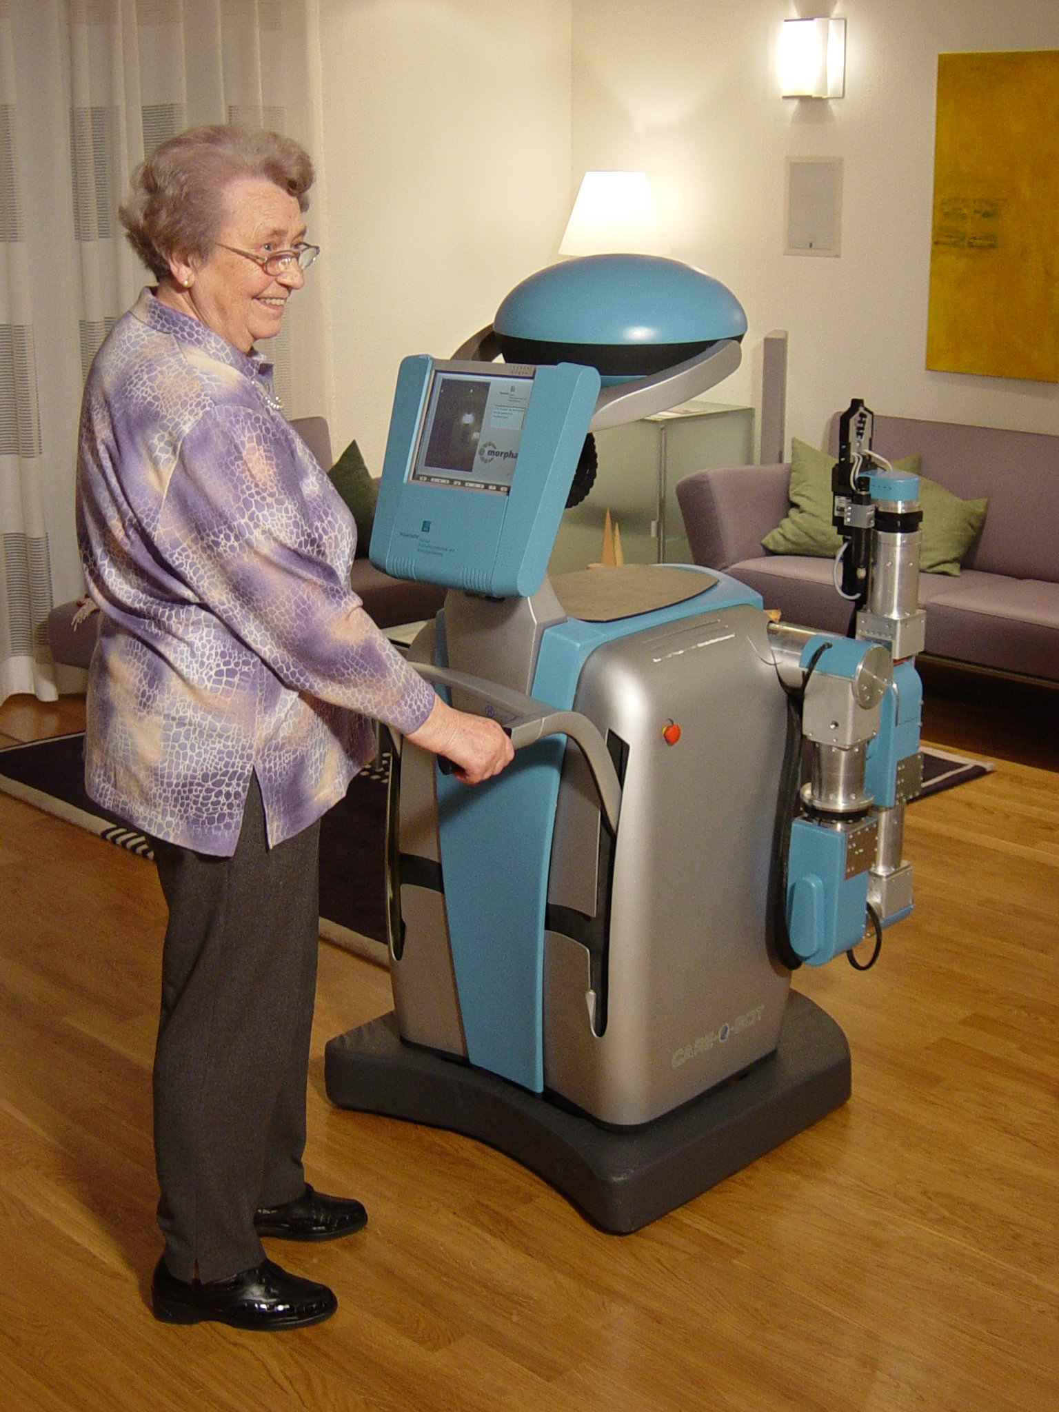
HRI
ROBOTS IN ELDERLY CARE

Slide 28
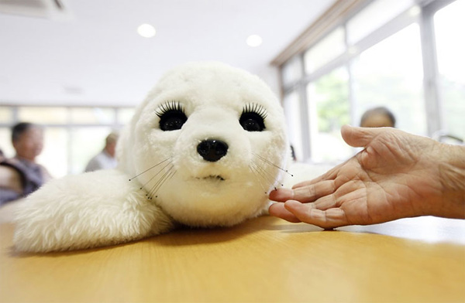
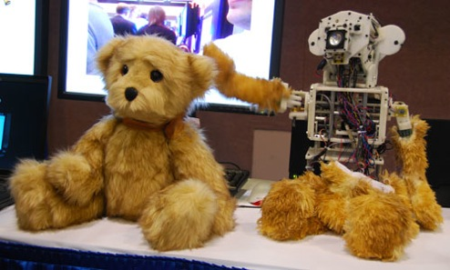
HRI
ROBOTS IN ELDERLY CARE

Slide 29
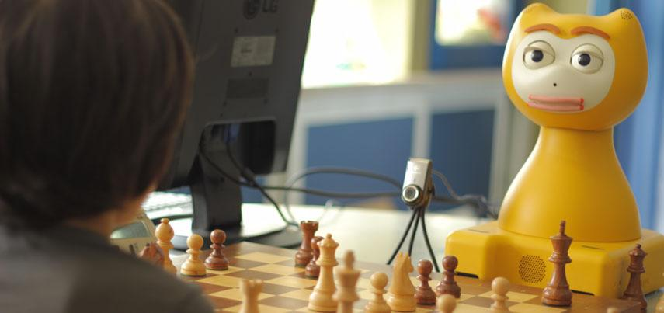
HRI
SOCIAL ROBOTS IN GAMES
Children tutor
Careful advices
Long-term interactions

Slide 30
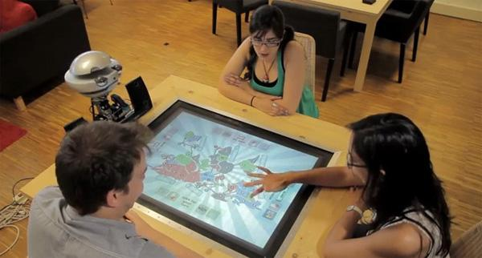
HRI
SOCIAL ROBOTS IN GAMES
Improved social presence:
Topology of speeches
Relevance value of a move
Power of a player
Simulation of roles
Luck perception

Slide 31
5. PROPOSED ARCHITECTURE

Slide 32
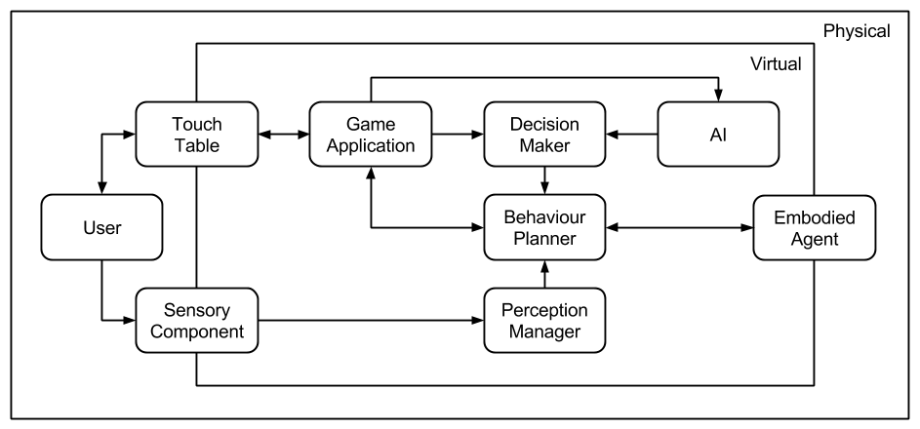
PROPOSED ARCHITECTURE

Slide 33
PROPOSED ARCHITECTURE
AI MODULE
PIMC
Opponent model
Cards' predictions
Actions' predictions
How to collect data?
Ask for it
Collect it! (it requires a platform)

Slide 34
6. EVALUATION

Slide 35
EVALUATION
Develop an agent that plays competently Sueca
Performance measures
Game points
Offline pre-computation time
These measures will be compared to different parametrizations and a naive approach
University community will test it

Slide 36
EVALUATION
Develop a socially present embodied agent
Two conditions
Few or nonexisting social behaviours
Several behaviours from the game state
The elderly will test it
Godspeed - participants’ perception of the robot
Networked Minds - presence perception

Slide 37
THANK YOU!

