Slide 1



Group Intelligence on Social Robots
Filipa Correia, Francisco S. Melo and Ana Paiva
INESC-ID & Lisbon Tech, University of Lisbon, Portugal
Notes:
Good morning everyone, my name is Filipa and I would like to briefly talk about my phd project on Group Intelligence on Social Robots. I have just started my third year out of four and my supervisors are Ana Paiva and Francisco Melo. And my background is computer science.

Slide 2
Motivation
Notes:
The motivation behind this project is related with group interactions.

Slide 3
Motivation
“How can robots improve the performance of work groups and teams by acting on social processes?” [1]
[1] M. F. Jung, S. Šabanovic ́, F. Eyssel, and M. Fraune, “Robots in groups and teams”, in Companion of the 2017 ACM Conference on Computer Supported Cooperative Work and Social Computing. ACM, 2017, pp. 401–407.
Notes:
Inline with what Jung et al. mentioned very recently, we envision a robot that can improve the performance of work groups or teams where robots collaborate with humans.

Slide 4
Goal
Notes:
One particular goal that can be explored in group interactions is...

Slide 5
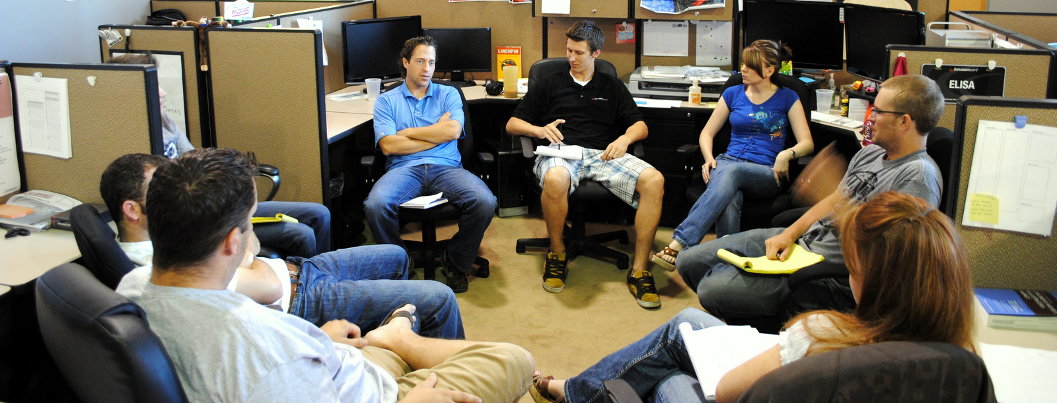

Goal
Notes:
… how can a robot accommodate the individual differences of each group member and adapt its behaviour accordingly, which I identified as group intelligence.

Slide 6
Research Plan
Notes:
So the research plan...

Slide 7
Research Plan
Group Intelligence
Notes:
… to explore this notion of group intelligence

Slide 8
Research Plan
Group Intelligence
Group Awareness
Notes:
includes a group awareness, which stands for the perception and evaluation the group.

Slide 9
Research Plan
Group Intelligence
Group Awareness
Behavioural Adaptation
Notes:
And also a behavioural adaptation that tries to optimise the dynamics of the group.

Slide 10
Previous Work
Notes:
My previous work...

Slide 11
Previous work
Group Intelligence
Group Awareness
Behavioural Adaptation
Notes:
Has been mainly focused on the group awareness part.

Slide 12
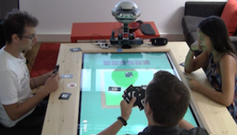
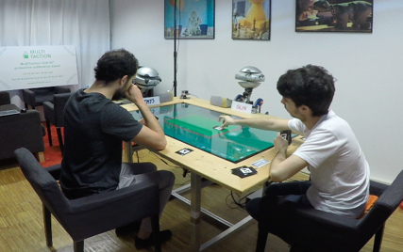
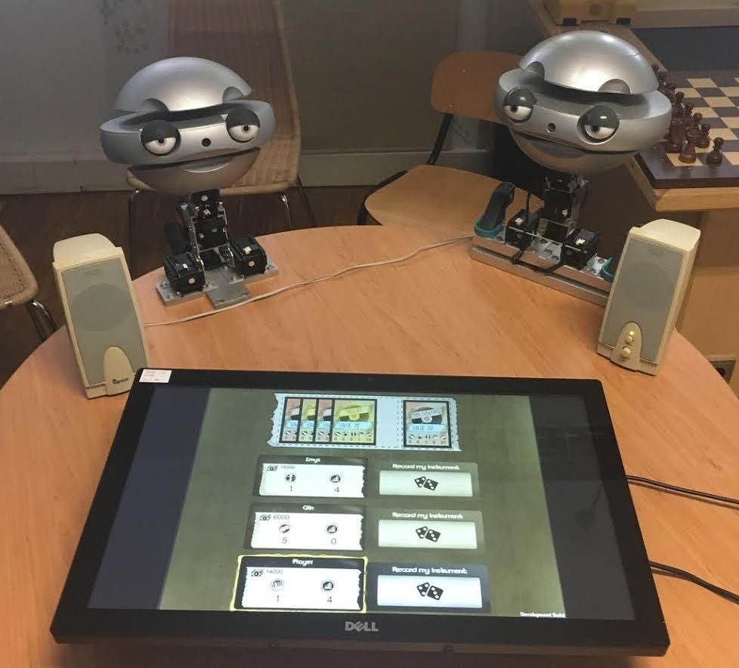
Previous work
Trust
Group Identity
Group-based Emotions
Group Awareness
Team Formation
Notes:
In particular, I explored, in game scenarios, how robotic team players were perceived by their partners using different measures such as trust or group identity and by manipulating behavioural social mechanisms such as the display of group-based emotions.

Slide 13
Future Work
Notes:
For the future work...

Slide 14
Future work
Group Intelligence
Group Awareness
Behavioural Adaptation
Notes:
I would like to explore the behavioural adaptation...

Slide 15
Future work
Predict group measures in real-time
Behavioural Adaptation
Notes:
Which will require some instrument to predict group measures in real-time

Slide 16
Future work
Emotional Expressions
Posture
Voice
Predict group measures in real-time
Behavioural Adaptation
Notes:
Some examples I am planning to use are voice, body posture, emotional expressions...

Slide 17
Future work
Emotional Expressions
Other?!
Posture
Voice
Predict group measures in real-time
Behavioural Adaptation
Notes:
In any case, I am looking forward to get to know your feedback, opinions, ideas and maybe update this scheme with some more pieces.

