Slide 1



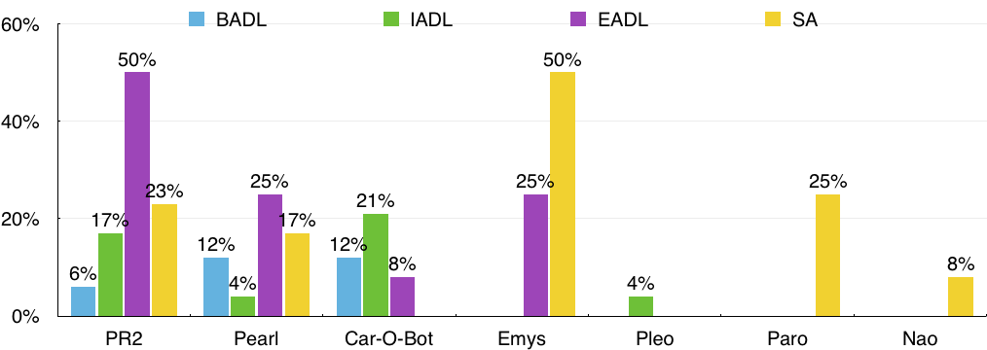
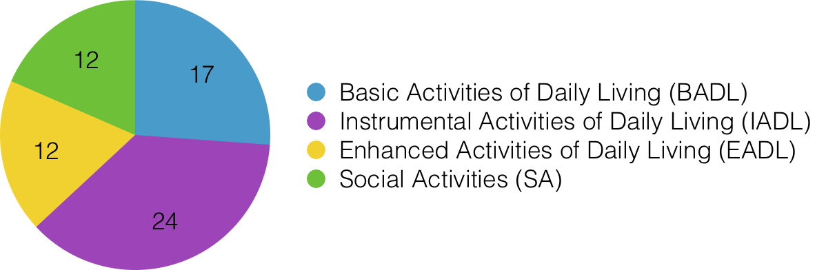
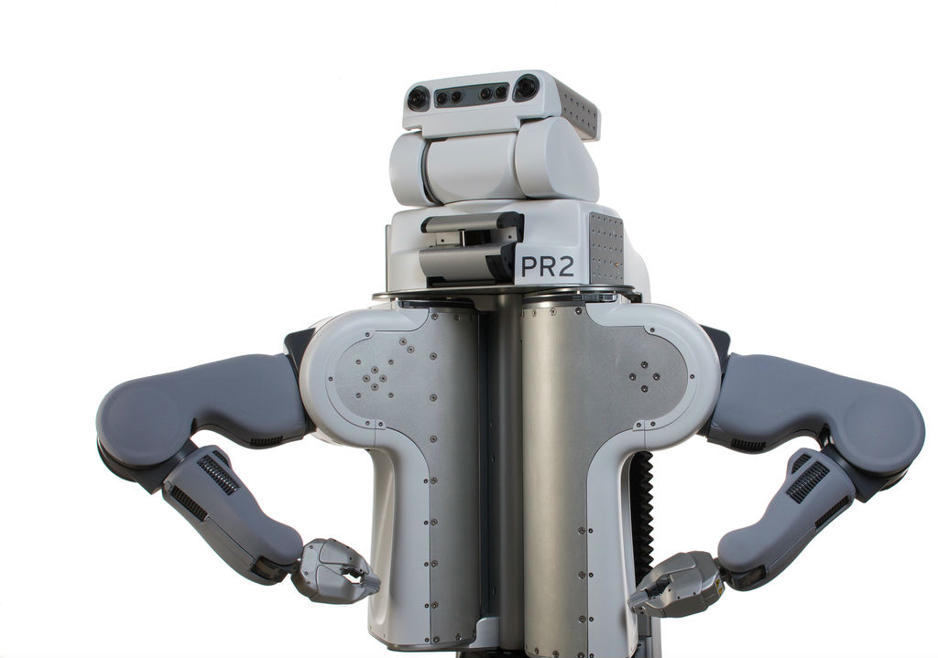
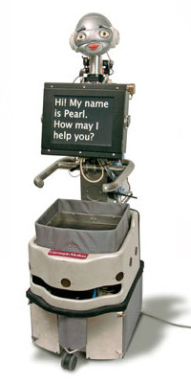
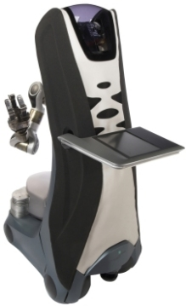
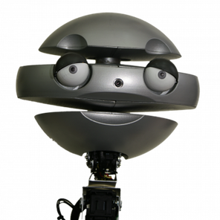


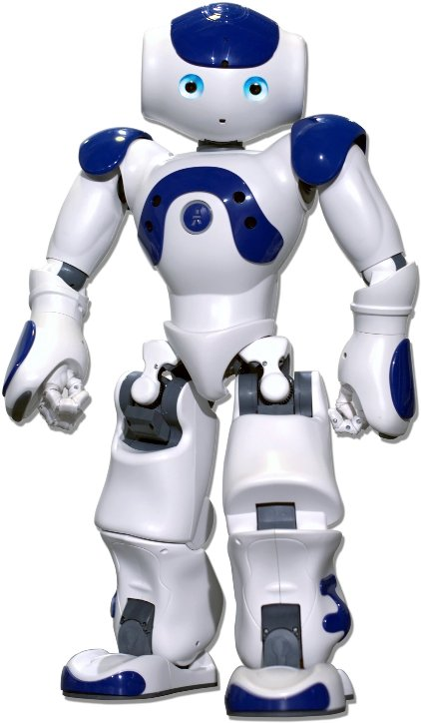
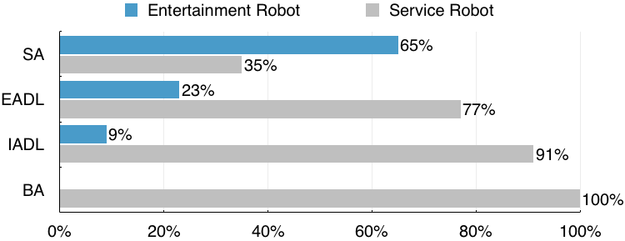




Social robots for older adults: exploring different activities
Patrícia Alves-Oliveira, Sofia Petisca, Filipa Correia, Nuno Maia, and Ana Paiva
INESC-ID & Instituto Superior Técnico, Universidade de Lisboa, Portugal
A qualitative design through a focus group method pointed that there are some activities in which independent-living older adults, i.e., older adults that do not depend upon anyone to carry out their activities, require a robot.
Methodology
▶ 16 participants (12 females, 4 males; M age = 78.69, σ = 12.20) from a day-home care institution in Lisbon
▶ Focus group methodology with three phases:
Basic Activities of Daily Living (BADL)
“Help bathing, specially washing the feet and the back.”
“Help open taps, like bath taps because it’s hard for me to open them.”
Instrumental Activities of Daily Living (IADL)
“Memorize what I eat. I do not always remember when to eat or what I eat, so I end up having a bad diet.”
“Make the bed and change the bed sheets. also, do the laundry and then hang it on a clothesline. Oh yes, and then iron it!”
Enhanced Activities of Daily Living (EADL)
“Make emergency calls to the police, ambulance, or family.”
“Have an informative dialogue, by providing meteorological, time and news informations.”
Social Activities (SA)
“Read stories. I like novels very much, but my eyes are not able to see words now. I would be so happy if the robot could read me stories at night.”
“Cheer people, communicate or talk. the robot should be able to share its own ideas, even when they are different from ours.”
➀ Information and sensitizing ➁ Brainstorming session ➂ Choosing Robots
Results
The yield activities categorized according to their primary goal and context.
Help bathing, specially washing the feet and the back. [BADL]
Memorize what I eat. I do not always remember when to eat or what I eat, so I end up having a bad diet. [IADL]
Have an informative dialogue, by providing meteorological, time and news informations.
[EADL]
Cheer people, communicate or talk. the robot should be able to share its own ideas, even when they are different from ours. [SA]
Conclusions
▶ The majority of different activities refers to IADL, where the robot would be an extra help.
▶ A large number of activities concerns BADL related with personal hygiene.
▶ EADL and SA emerged as the activities in which older adults require the robot for communicating with the outside world.
▶ Service robots were chosen to perform all types of activities due to their physicality since they are perceived as able to accomplish multiple tasks.

