Slide 1



Just follow the suit!
Trust in Human-Robot Interactions
during Card Game Playing
Filipa Correia, Patrícia Alves-Oliveira, Nuno maia,
Tiago Ribeiro, Sofia Petisca, Francisco S. Melo and Ana Paiva

Slide 2
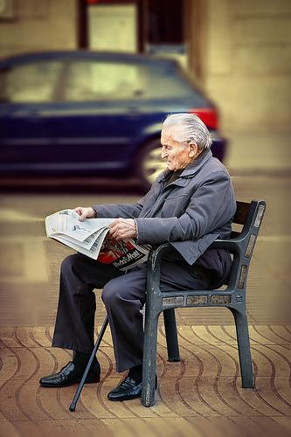
Motivation
Aging population
Technology can contribute to their Quality of Life

Slide 3
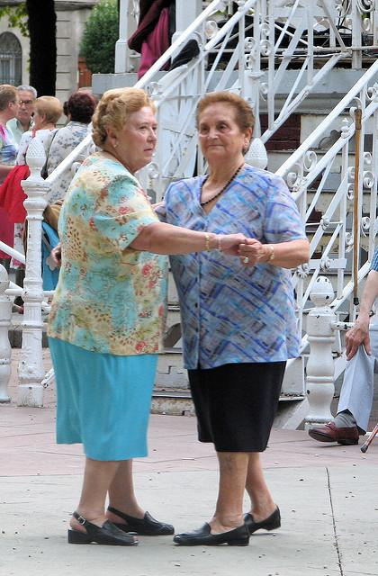
Motivation
Social isolation
Free time with entertaining activities

Slide 4
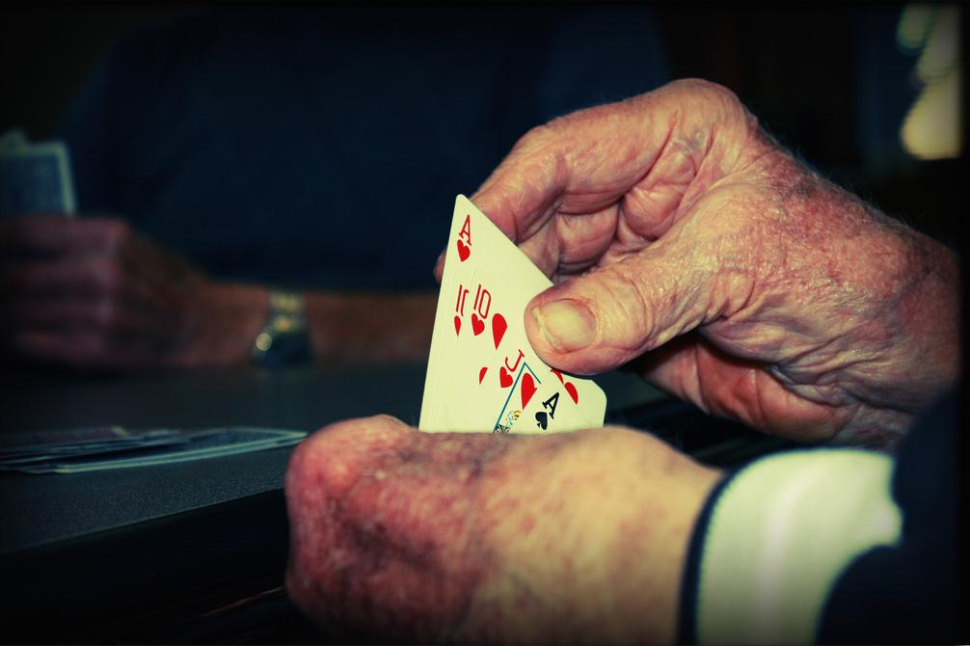
Motivation
Older adults like to play card games...

Slide 5

Motivation
Develop a robotic card game player to help reconnecting people

Slide 6
Motivation
Sueca is a portuguese well-known card game among the elder population
Hidden-information game
2 teams
Win the game
Partnership and trust

Slide 7
Goal
Create an autonomous social robot that plays a card game
Evaluate trust levels of participants towards their partners!!
We want to compare trust...
human-robot interaction VS human-human interaction

Slide 8
Design
How do we play Sueca?
User-centered study
Players’ behaviour
Physical space

Slide 9
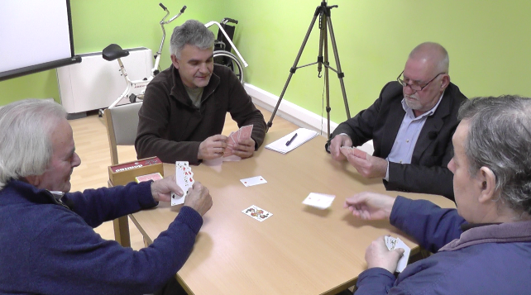
Design
User-centered study:
It took place in an Elder Care Center
4 male participants played 10 games during 30 minutes

Slide 10
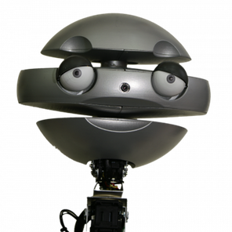
Design - Behavior
Behavioral analysis of the videos:
Verbal and non-verbal behaviors
Relevant game events
Different tones while interacting
Encouragement towards partners
Competitiveness towards opponents

Slide 11


Development
SERA Ecosystem
The Social Robotic player
PLAY
(PIMC algorithm)
INTERACT
Utterances

Slide 12
Evaluation
Study 1 - Lab study
Study 2 - Into-the-wild study

Slide 13
(1) Lab study
Controlled lab setting
Participants’ trust towards partners
Sueca...
...team game!

Slide 14
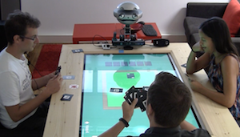
(1) Lab study
Each session:
3 participants
1 hour
X 20
60 participants
(M=24.31, SD=3.852;
20 females, 39 males, 1 unknown)

Slide 15
(1) Lab study
Procedure:
Draw to choose partner
First questionnaire
Explain the game rules
Play 5 games
Final questionnaire

Slide 16
(1) Lab study
Measures:
Human-Robot Trust Questionnaire [Schaefer, K., 2013]
PANAS Questionnaire [Egloff, B., 1998]
Demographic questions
Previous knowledge of partner

Slide 17
Results
Robot team won
12 sessions out 20 (60%)

Slide 18
Trust results

Slide 19
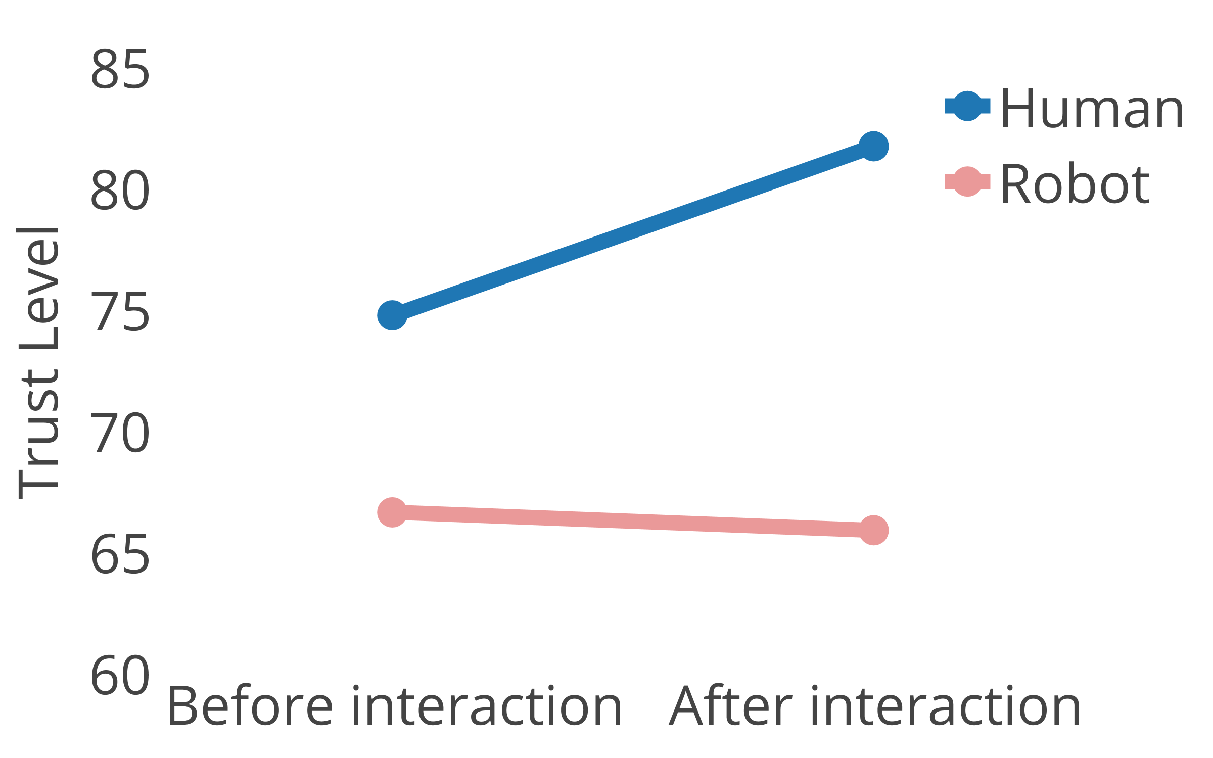
Trust results
Participants that did not know their partners before the game
F(1;49)=7.093, sig=.010]

Slide 20
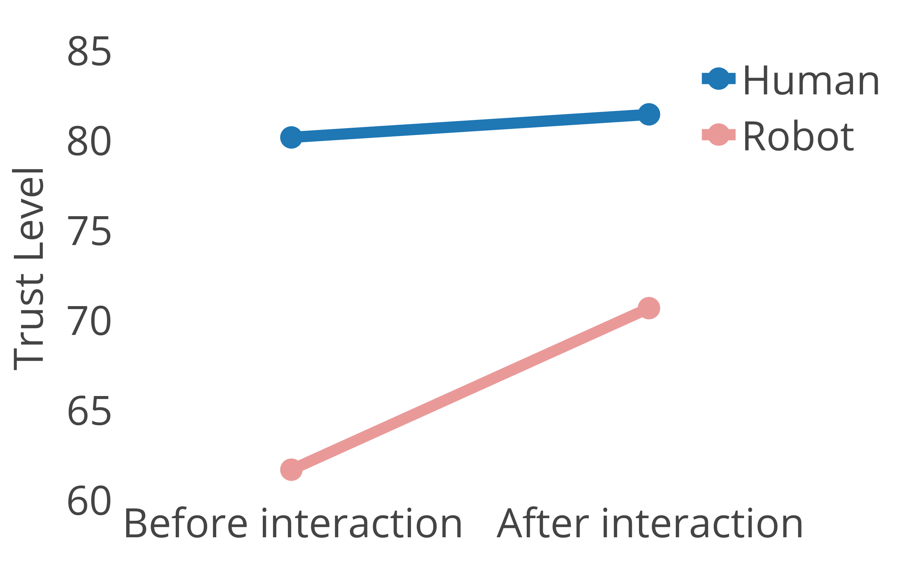
Trust results
Participants that already knew their partners before the game
F(1;49)=7.093, sig=.010]

Slide 21
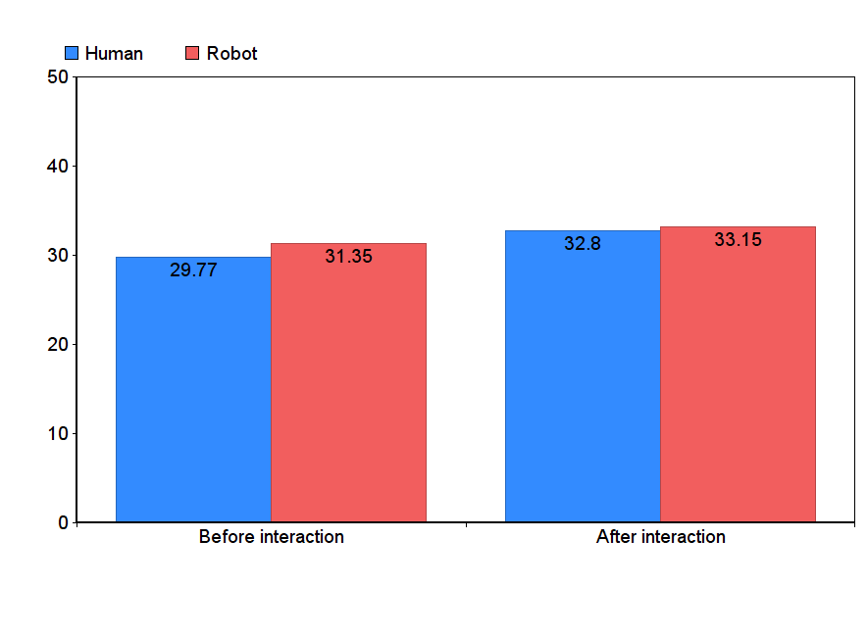
Positive Affect Results
p<0.05

Slide 22
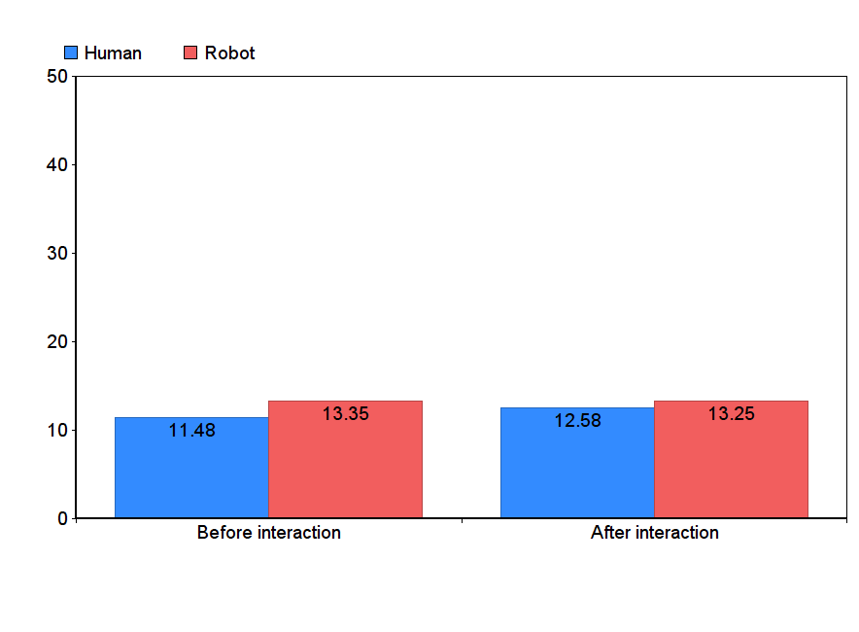
Negative Affect Results
p>0.05

Slide 23
Sueca Tournament
Sueca Tournament
Uncontrolled environment
Expert users during the tournament

Slide 24
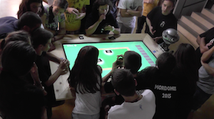
(2) Sueca Tournament
15 subjects played 13 games with EMYS (~2 hours)

Slide 25
(2) Sueca Tournament
Questionnaire:
EMYS played well
Without mistakes
Although with some differences...

Slide 26
(2) Sueca Tournament
Sueca champions did not want to play with EMYS…
...“not willing to lose their reputation by losing with a robot”.

Slide 27
Conclusions
Humans trust a robot as a partner, but the trust level varies according to their previous knowledge of the same robot
The development of trust towards robots may need longer interactions
The scenario meet some of the needs of the elderly population related with social isolation and, the next step is to test with older adults!

Slide 28
Thank you!
Questions?
Filipa Correia ~ filipacorreia@tecnico.pt

