Slide 1
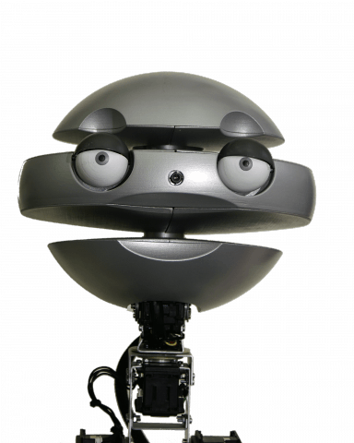
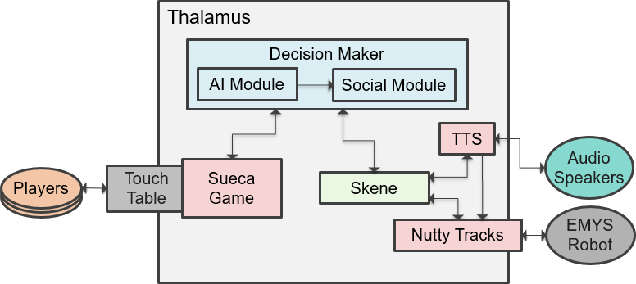
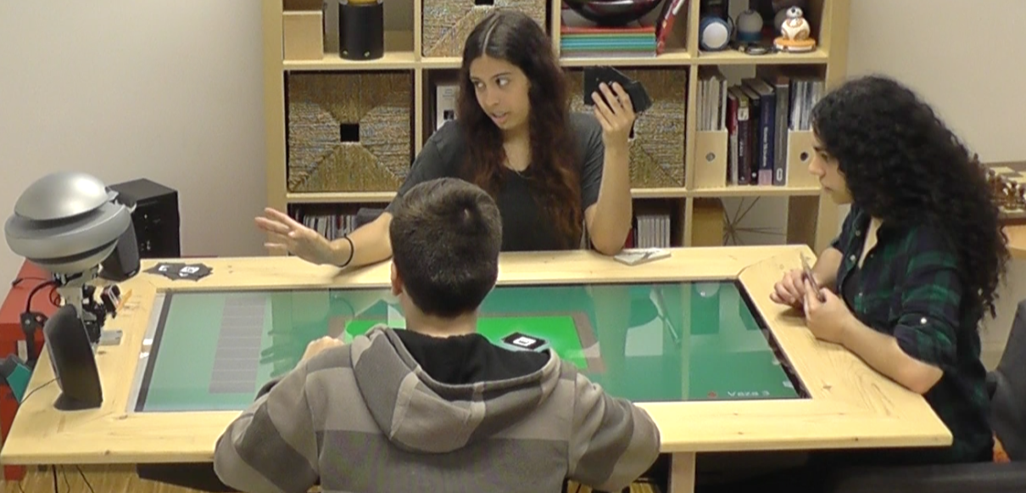
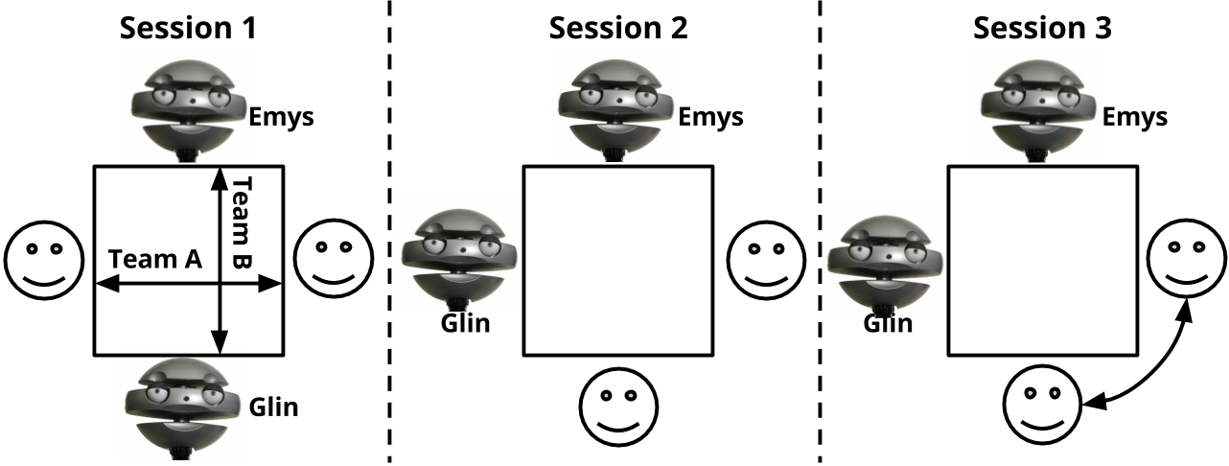
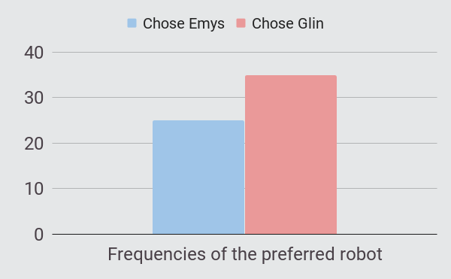
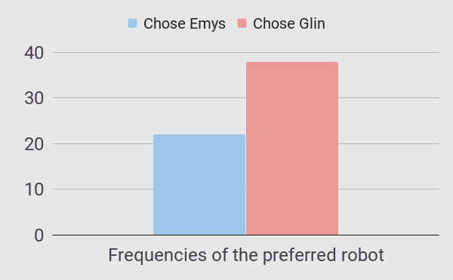
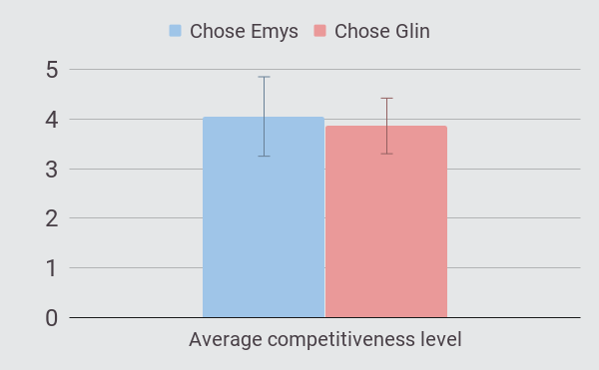
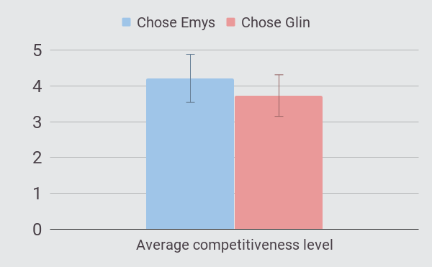







Groups of humans and robots
Understanding membership preferences and team formation
Filipa Correia, Sofia Petisca, Patrícia Alves-Oliveira, Tiago Ribeiro, Francisco S.Melo, Ana Paiva
Team formation
Membership preferences
Multi-party game context
Learning Goal Theory
Which robot will people prefer to partner with?
...and why?
Competitive
Relationship-driven
Creating two characters
Emys
Glin
Development
Two-phase handshake protocol for Robot-Robot Interaction:
to inform of an intention to speak;
to respond to an intention to speak
to inform that an utterance has started;
to inform that an utterance has finished.
PIMC algorithm
for both characters
same performance
More competitive, fostering the best score, blaming others
More supportive, encouraging, uttering hope
Game State | Emys | Glin
End game (loss) | “This cannot continue like this! You have to play better!” | “No worries partner, next time we will do better!”
Playing | “Watch and learn how this is played.” | “I am so proud of being in your team!”
2. Validation (Study 1)
✴ p < 0,05
Questionnaire dimensions |  | Emys | Glin
 | Competitiveness Index ✴ | 4,57 ± 0,40 | 3,86 ± 0,33
 | Help ✴ | 3,78 ± 0,89 | 4, 51 ± 0,81
 | Motivation ✴ | 3,79 ±1,00 | 4,95 ± 0,69
 | Emotional Security ✴ | 3,26 ±1,09 | 4,37 ± 0,77
 | Relationship Quality ✴ | 4,41 ±0,52 | 5,32 ± 0,38
 | Perceived Intelligence | 4,59 ±0,74 | 4,93 ± 0,49
 | Likeability ✴ | 10,70 ± 0,88 | 20,30 ± 0,88
30 participants
M = 23,03 ± 4,21
McGill
Godspeed
3. Analysing preferences (Study 2)
61 participants
M = 23,66 ± 3,24
4th Questionnaire
Choosing partner (Emys or Glin)
1st Questionnaire
2nd Questionnaire
Choosing partner (Emys or Glin)
3rd Questionnaire
X²(1) = 1,667 p = 0,197
X²(1) = 4,267
p = 0,039
t(58) = 1,242 p = 0,219
Winning robot perception
p = 0,008
Last choice of robot
t(58) = 2,953 p = 0,005

