Slide 1
Project Title – ResearchPilot AI
Domain of Project – Artificial Intelligence / Generative AI
Student Name | Roll No | Email ID | Mobile number [WhatsApp]
Pirajan M | 2024103549 | niroshanpirajan@gmail.com | 6374657775

Slide 2
Problem Statement
Challenges in Academic & Professional Research
Information Overload
Researchers spend excessive time manually filtering through long PDFs and complex papers to find specific details.
Hallucination in LLMs
General-purpose AI tools often fabricate answers when summarizing or answering domain-specific technical questions.
Lack of Traceability
Traditional LLM responses lack source citations, making it impossible to verify the origin of the information in the original document.

Slide 3
Objectives & Scope
Project Goals and Limitations
Primary Objectives
- Build a highly accurate Retrieval-Augmented Generation (RAG) system.
- Process PDF documents efficiently and extract text with high fidelity.
- Provide strict grounded answers (refusing to answer if info is missing).
- Display source citations and page numbers for user verification.
Project Scope
- Supported Formats: Currently optimized for PDF documents.
- Focus: Single-document deep analysis rather than multi-doc cross-search.
- AI Models: Leverages gemini-3.5-flash for reasoning and generation.

Slide 4
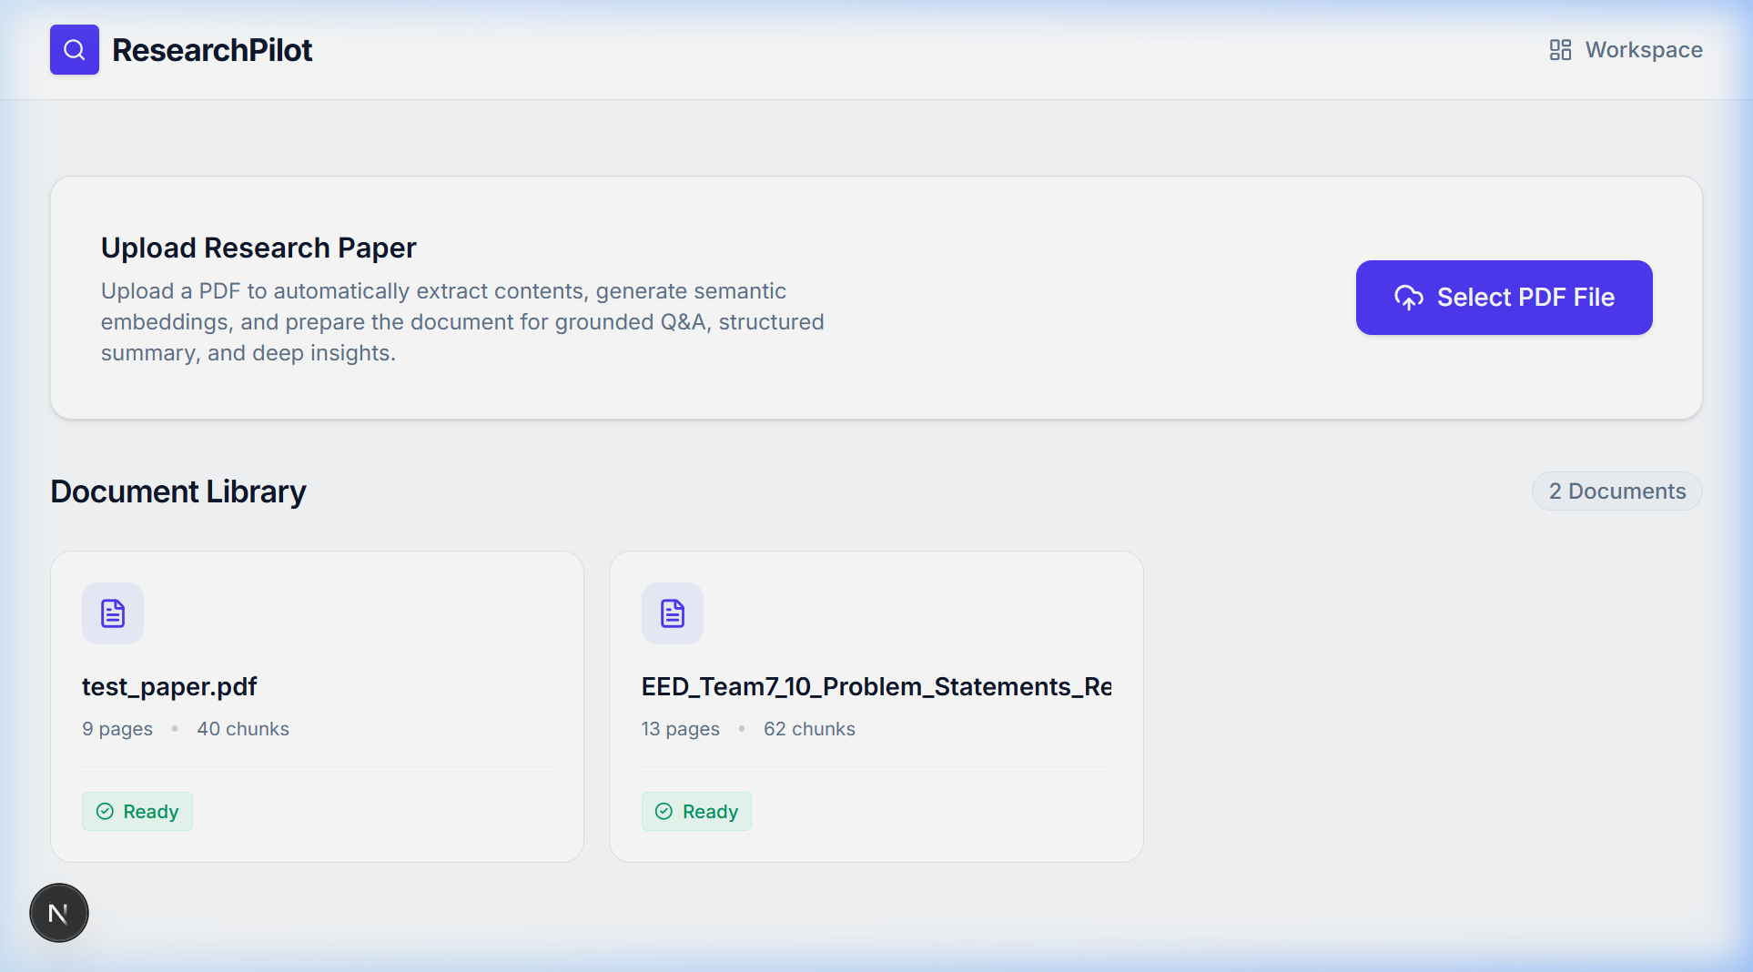
Proposed Solution
ResearchPilot AI Approach
The Solution
ResearchPilot AI provides an intuitive web interface for researchers to upload documents and interact with them securely.
It uses a localized vector database to store document embeddings and enforces strict context boundaries during generation to significantly reduce unsupported or hallucinated responses by strictly grounding generation in retrieved document context.

Slide 5
Key Features
Core Capabilities of the Platform
Secure Document Vault
Local processing and storage of research materials.
Semantic Search
Find concepts using meaning, not just exact keywords.
Grounded Q&A
Answers derived strictly from document context.
Source Citations
Transparent references to original page segments.
AI Summarization
Automatic generation of high-level document overviews.
Modern UI/UX
Responsive, intuitive React-based user interface.

Slide 6
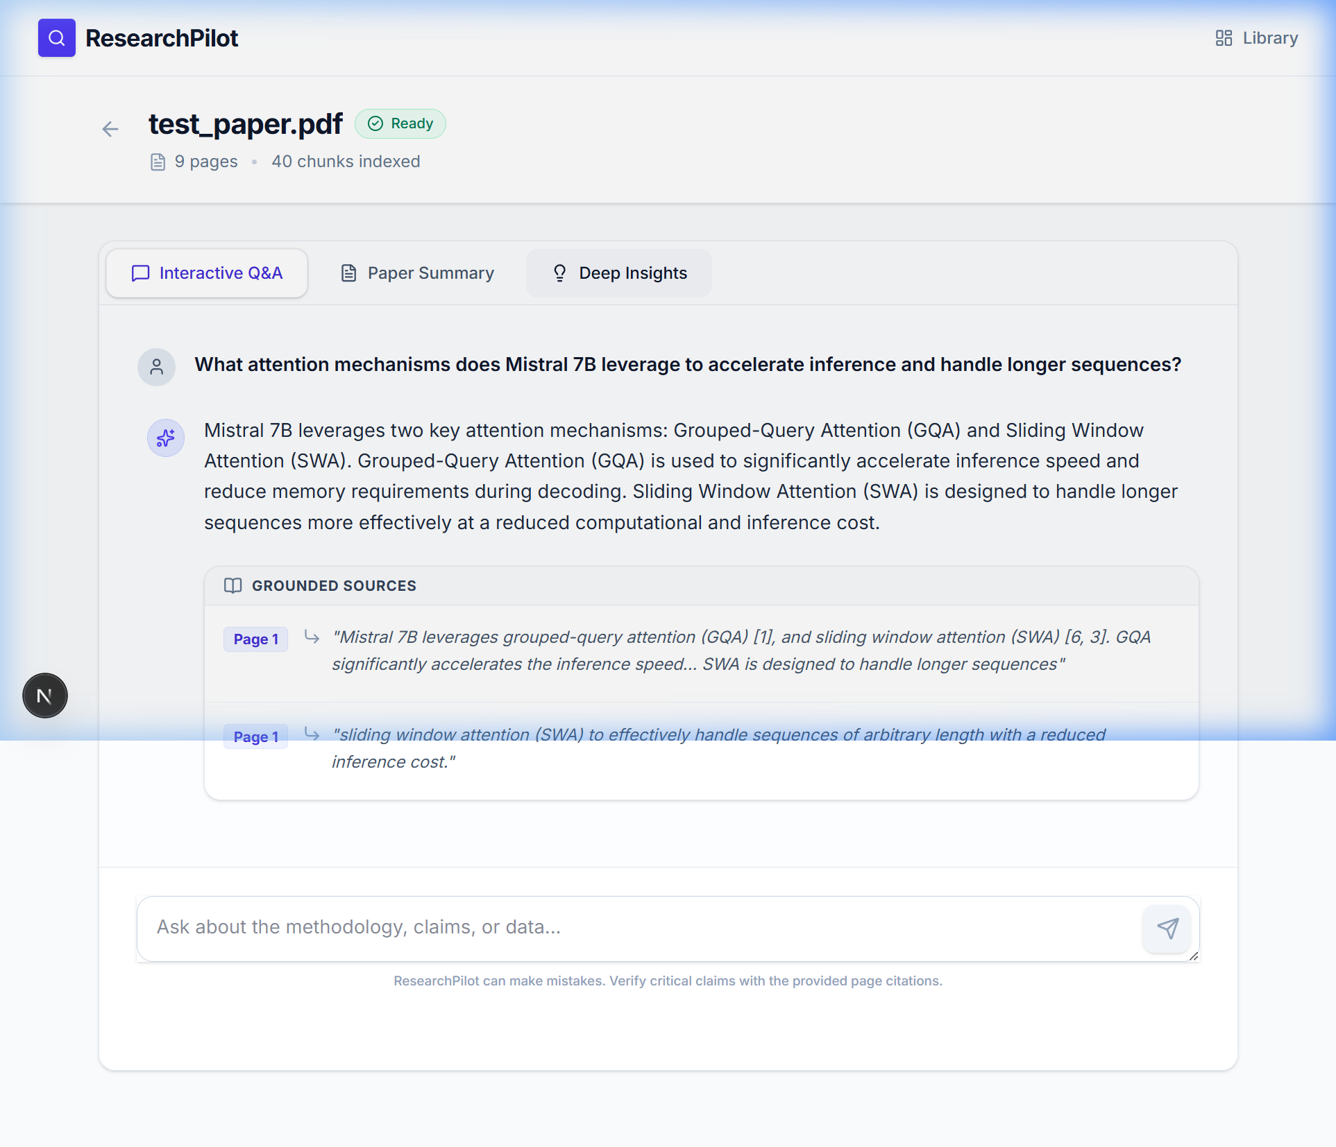
System Architecture
High-Level Component Interaction
User
Next.js 15 Frontend
FastAPI Backend
PDF Processing / RAG Services
PyMuPDF
Local Embeddings
ChromaDB
Grounded Retrieval
gemini-3.5-flash
Q&A / Summary / Insights

Slide 7
RAG Pipeline
Retrieval-Augmented Generation Flow
Production RAG Architecture
INGESTION / INDEXING
- PDF Document Upload
- PyMuPDF text extraction
- RecursiveCharacterTextSplitter (chunk size=800, overlap=150)
- Local all-MiniLM-L6-v2 embeddings
- ChromaDB persistent vector store
QUERY / GENERATION
- User question received
- Embedding generation & semantic similarity retrieval
- Grounded prompt construction with relevant context
- gemini-3.5-flash LLM invocation
- Grounded Q&A / Structured Summary / Paper Insights generated
- Response with explicit source/page citations

Slide 8
Technology Used
Core Stack & Libraries
Frontend
- Next.js 15
- React
- TypeScript
- Tailwind CSS
- Lucide Icons
- TanStack Query
Backend
- FastAPI
- Python 3.11
- Pydantic
- Uvicorn
- PyMuPDF
AI / Data
- gemini-3.5-flash
- LangChain
- Langflow (academic workflow visualization)
- ChromaDB
- Sentence Transformers
- all-MiniLM-L6-v2

Slide 9
Langflow Components
Visual Prototyping Pipeline
Langflow Academic Workflow Demonstration
Chat Input
Knowledge
Parser
Prompt
Agent (gemini-3.5-flash)
Chat Output
- Chat Input: receives research query
- Knowledge: vector retrieval (ChromaDB layer)
- Parser: formats retrieved context
- Prompt: combines context and query
- Agent: gemini-3.5-flash generation
- Chat Output: returns grounded response
* Production application is implemented in FastAPI + LangChain; Langflow is used here for academic workflow visualization.

Slide 10
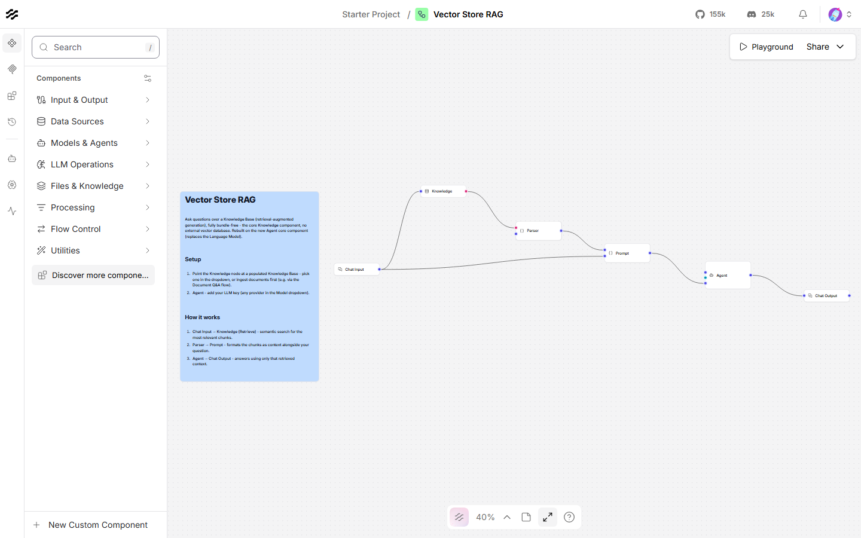
Langflow Workflow
Visualizing Data Flow & Logic
Visual Langflow RAG Pipeline: Chat Input -> Knowledge (Vector Store) -> Parser -> Prompt -> Agent (LLM) -> Chat Output

Slide 11
Application Workflow
End-to-End User Journey
Upload ➔ Processing ➔ Workspace ➔ Interaction ➔ Insights
The user seamlessly transitions from uploading raw documents to interrogating the extracted knowledge base.

Slide 12
Dashboard & Upload
Initial User Interface

Slide 13
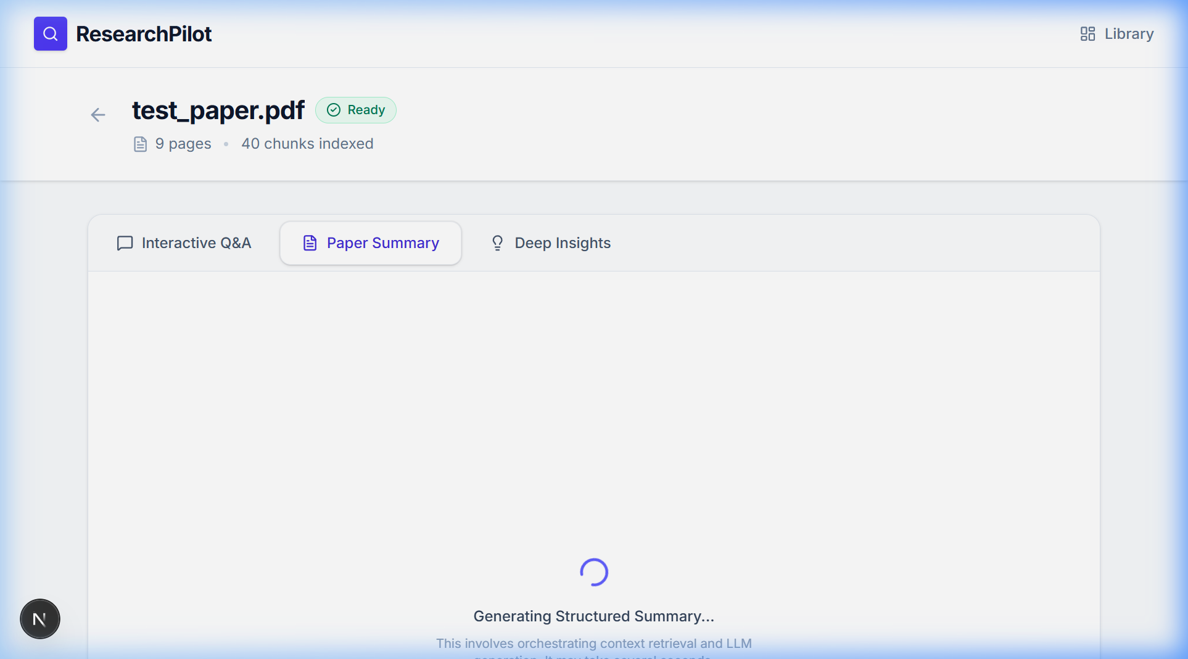
Document Processing
Document Ready & Analysis Generation

Slide 14
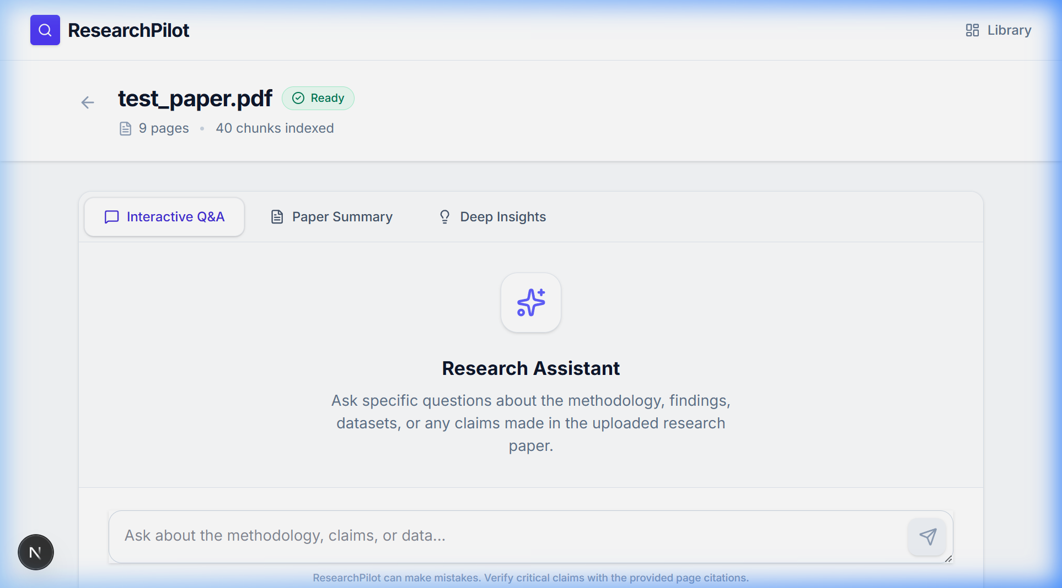
Document Workspace
Interactive Analysis Environment

Slide 15
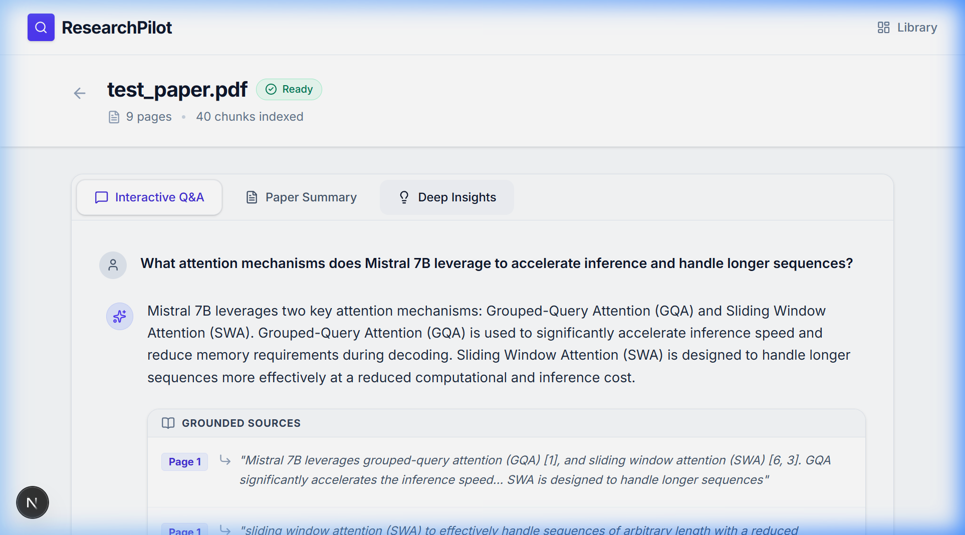
Grounded Q&A
Strict Contextual Answers
Grounded answer generated from the uploaded paper
Source citations with page/chunk evidence

Slide 16
Summary & Insights
Automated Document Overview
9 Summary Dimensions
1. Paper Overview
2. Research Problem
3. Objectives
4. Methodology
5. Dataset / Materials
6. Key Findings
7. Limitations
8. Conclusion
9. Future Research Direction
7 Deep Insights Dimensions
1. Research Problem
2. Methodology
3. Dataset
4. Main Contribution
5. Key Findings
6. Limitations
7. Future Direction

Slide 17
Testing & Validation
Ensuring System Reliability
Automated Test Coverage
- 148 / 148 backend tests passed successfully.
- Frontend linting and production build passed without errors.
Core Pipeline Validation (Verified)
- PDF Extraction & Indexing: Verified accurate chunking and vector storage.
- Grounded Q&A: Successfully answers queries strictly using context, with page/chunk citations.
- Error Handling: Invalid file uploads, empty query validation, and fake document 404 handling verified.
- Cache Verification: Analysis results are successfully cached to optimize API calls.

Slide 18
Security & Reliability
Data Protection
- Localized Document & Vector Storage: Uploaded PDFs and vector indexes are stored locally; only the retrieved context required for LLM generation is sent to Gemini.
- API Key Security: Managed solely via backend environment variables; never exposed to the frontend.
- Reduced Hallucination Risk: Generation is restricted strictly to retrieved document context with explicit source/page/chunk evidence.
- Graceful Error Handling & Validation: Invalid files and unanswerable queries are safely intercepted.
- Analysis Result Caching: Caching of summaries and insights prevents redundant API calls and preserves quotas.

Slide 19
Future Scope
Planned / Not Implemented Features
(PLANNED / NOT IMPLEMENTED)
- Multi-document synthesis and comparative analysis
- Collaborative research workspaces for team sharing
- Extended format support (Word, LaTeX, EPUB)
- External academic and web source ingestion
- Citation network analysis and knowledge graphs
- Trend analysis across research topics

Slide 20
Conclusion
Project Summary
ResearchPilot AI successfully demonstrates a robust, grounded approach to document intelligence.
By strictly tying LLM generation to local document context, we significantly reduce unsupported or hallucinated responses and provide researchers with a trustworthy tool to accelerate their work.
The combination of modern web technologies and advanced AI models yields a highly effective solution for information overload.

Slide 21
Reference / GitHub Link
Source Code & Implementation
GitHub Repository: https://github.com/Pirajan-07/ResearchPilot-AI

Slide 22
Questions & Answers
Thank you for your attention.

