Slide 1
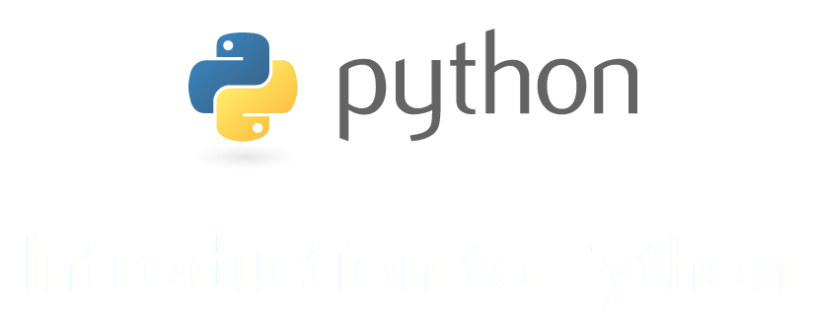
Monty Python's Flying Circus
Guido van Rossum

Slide 2
Why Python?
pleasant
flexible
powerful
#swag

Slide 3
Overview
Compiled vs Interpreted
Strongly vs Weakly Types
Immutable Objects
Data structures
List Comprehension
Pip
Demos

Slide 4
Compiled vs Interpreted

Slide 5
Strongly vs Weakly Types
In python everything can be everything.
But … Everything is an Object.

Slide 6
Data structures
Numbers
Strings
Tuples
Lists
Dictionaries
Enumerations

Slide 7
Immutable Objects
Tuples
Strings
Numbers, WOT !?

Slide 8
Tips
for syntax and incrementations
range, xrange
id(), == vs is
X = [0] * 2
X = [{}] * 4
a, b = b, a
lambda functions a = lambda x: x**2
map, filter …

Slide 9
List Comprehension
o_lista = [0 for _ in o_lista]

Slide 10
Modules
A module is ... a simple python file

Slide 11
Pip
Pip it like a pimp.

Slide 12
Demos
Our own zip tool
Surprise

