Slide 1
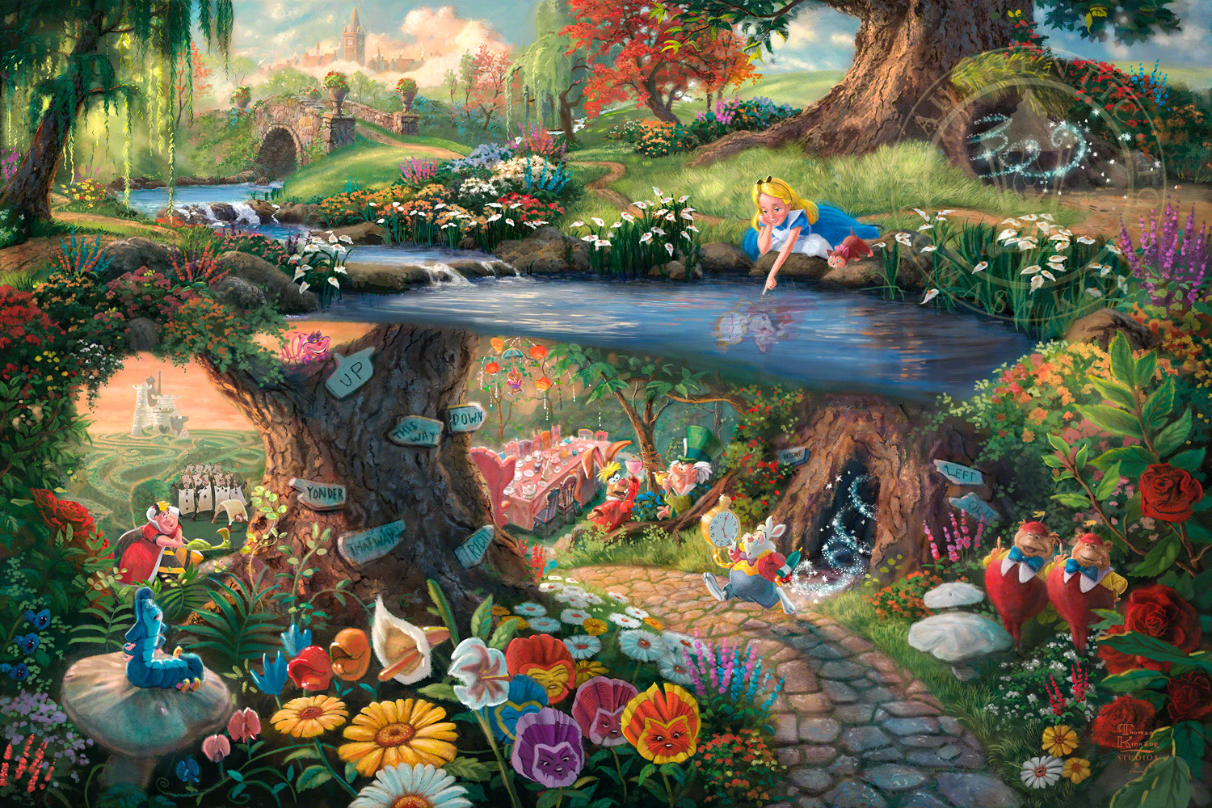

Rabbit in NederLand
A fun way to learn how to assignment numbers to quantity
1 | 2 | 3 | 4 | 5

Slide 2
Congratulations!!!!

