Slide 1

Basic Details of the Team and Problem Statement
Ministry/Organization Name: State Ministry
PS Code: SIH1519
Problem Statement Title: Generation of Hazard Map
Team Name: Valtreyak Sprryzen
Team Leader Name: Rahul Kumar Singh
Institute Code (AISHE): U-0954
Institute Name: Indian Institute of Information Technology, Surat
Theme Name: Space Technology (Software)

Slide 2
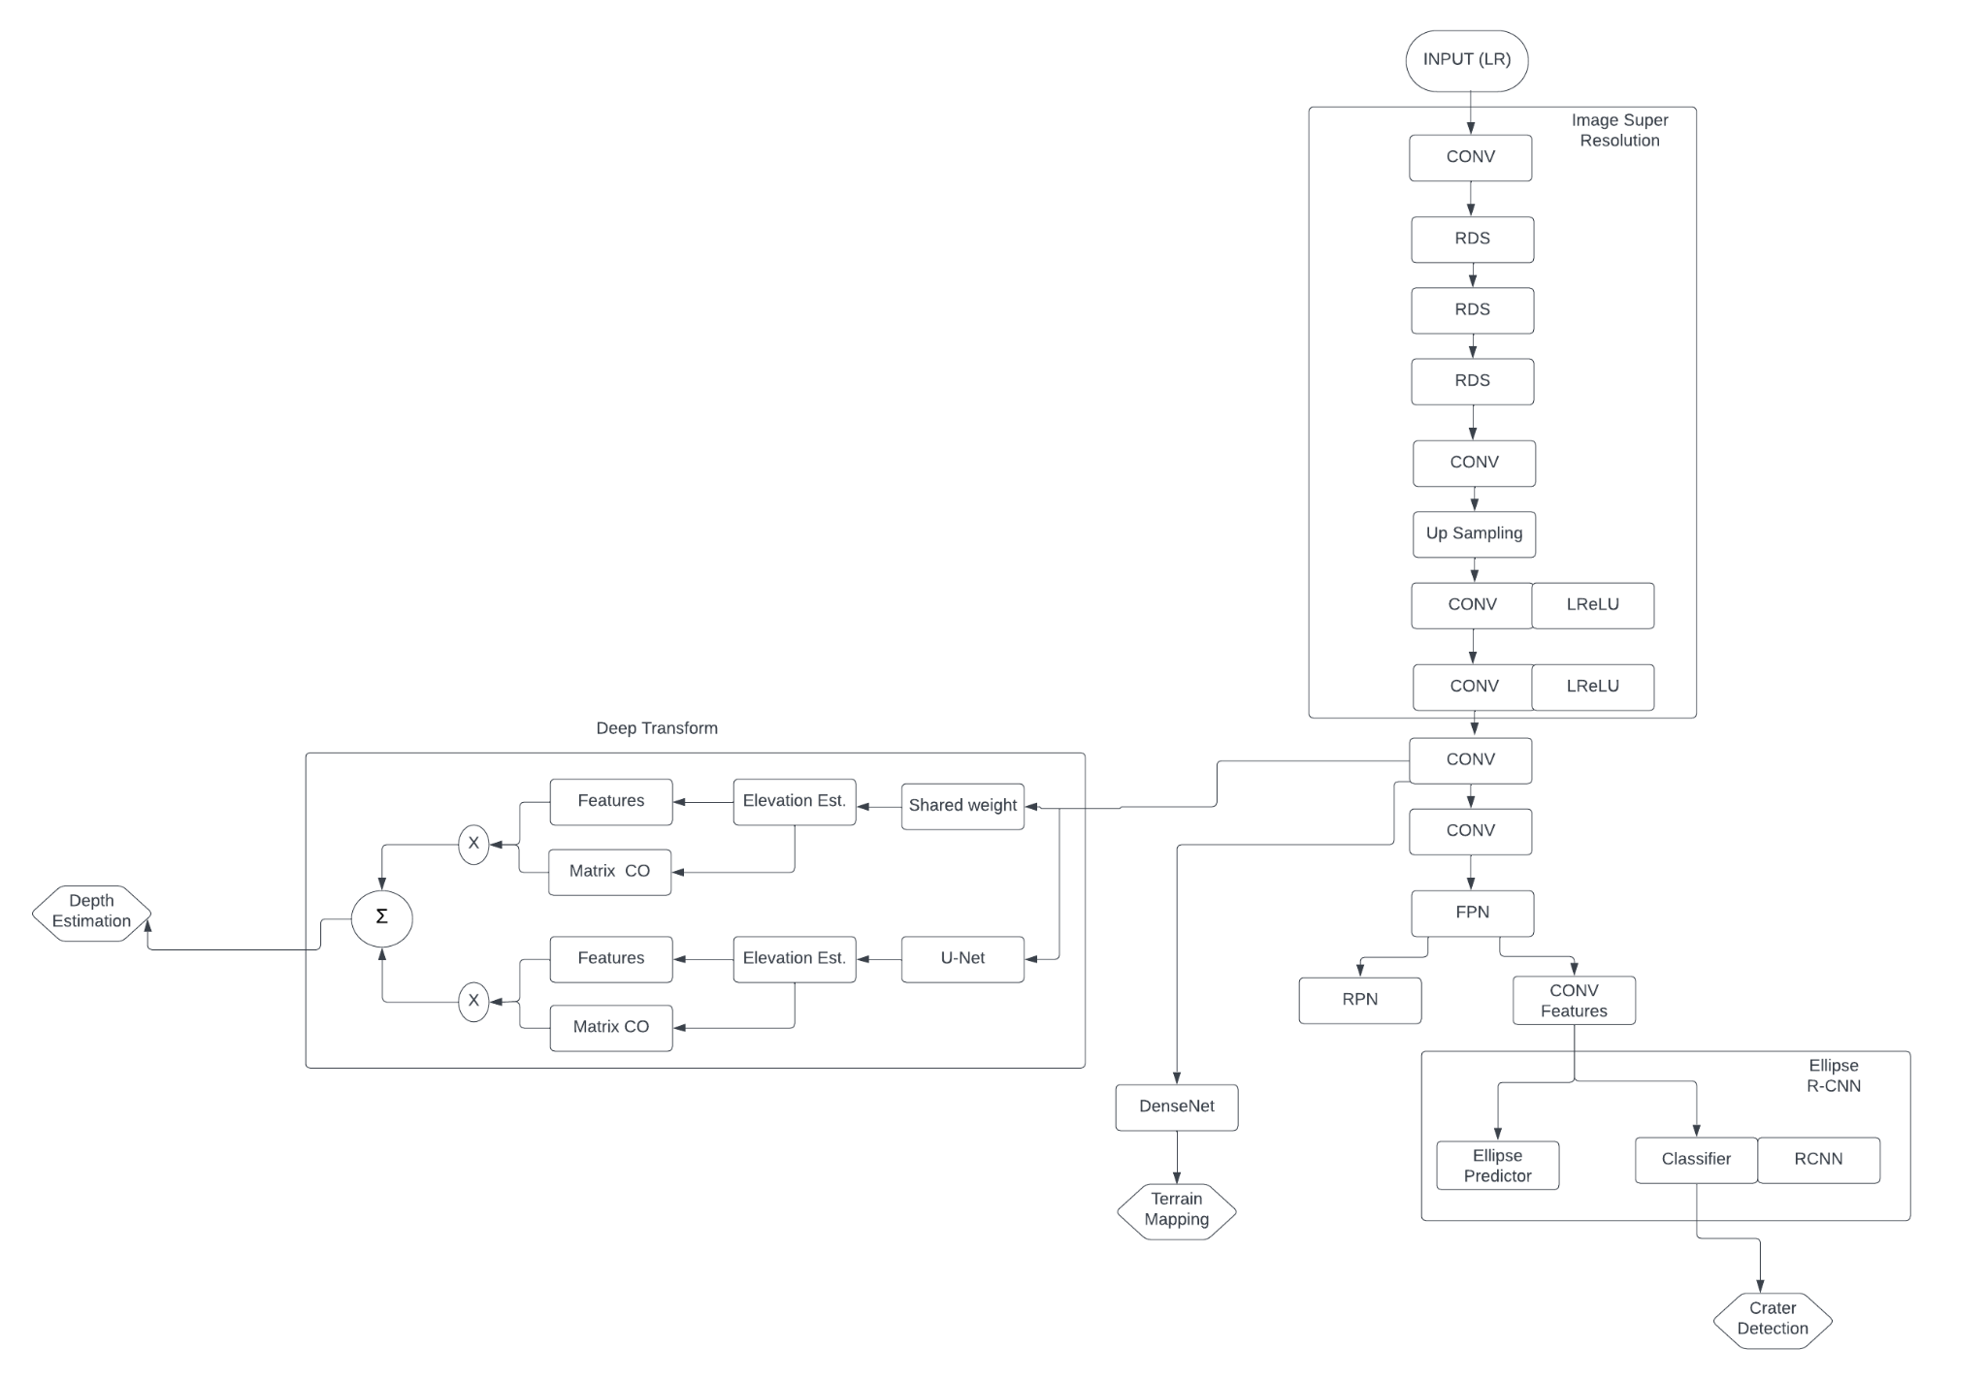
Idea/Approach Details
Describe your idea/Solution/Prototype here:
Aim: To provide create hazard map (crater detector)
Reasons: To help with safe navigation of lander.
Solutions:
Super Resolution: To upscale the image resolution for further processing.
Crater Detection: To detect crater help in securing a safe route avoiding the craters.
Terrain Mapping : To map the terrain and get all the geographical information about the moon.
Hazard Map: Creation of Hazard map using the results from Crater Detection and Terrain Relative Navigation.
Crater Mapping: To identify the pattern in the craters to provide faster crater recognition.
Terrain Classification: It is useful for route planning and obstacle avoidance.
Depth Estimation: Pix2Pix - GANs are used for depth estimation of moon's surface from the relative position at which the image was captured.
Describe your Technology stack here:
Python → Foundation for the given models.
Ellipse R-CNN → Used for Crater Detection..
GANS → Used for Super Resolution and Depth Estimation.
OpenCV → For using pre-trained Computer Vision Models.
DenseNet → Terrain Classification
Keras → Used for Deep Feature Extraction

Slide 3
Idea/Approach Details
Describe your Use Cases here
Describe your Dependencies / Show stopper here
Identifying Lunar Surface Features like craters depth, boulder, rifts, slope to help avoid hazards during lunar navigation.
Image Super Resolution: To upscale and improve the quality of low resolution images taken by terrain mapping cameras
Crater Detection: To Identify crater rim from the high resolution images (from ISR).
Elliptical R-CNN includes two components - Mask R-CNN for elliptical Object retrieval and U-Net Semantic Segmentation) for learning different occlusion patterns
Terrain Classification: DenseNet is used to segregate the images into different segments based on CNN.
Depth Estimation: Pix2Pix and GANs are used for depth estimation of moon's surface
Task Dependencies:
ML models (Deep Learning Models).
Computational Resources.
Fine tuning of Generative models.
Image Processing.
Show Stopper:
Feature-based transform is harder to train, and require some hyperparameter tuning and loss balancing
Lighting Conditions: Moon's surface has areas of permanent shadow or of strong sunlight.
Regular Updates: Due to the dynamic environment of the moon.
To improve the resolution of the images from terrain relative cameras.

Slide 4
Team Member Details
Team Leader Name: Rahul Kumar Singh
Branch : B.Tech Stream : CSE Year : III
Team Member 1 Name: Vipin Sharma
Branch : B.Tech Stream : CSE Year : III
Team Member 2 Name: Hamesh Kumar Puniya
Branch : B.Tech Stream : CSE Year : III
Team Member 3 Name: Sushant Matnani
Branch : B.Tech Stream : CSE Year : III
Team Member 4 Name: Rohit Raj
Branch : B.Tech Stream : ECE Year : III
Team Member 5 Name: Anjali
Branch : B.Tech Stream : CSE Year : I
Team Mentor 1 Name: Rajesh K. Ahir
Category : Academic Expertise : ML Domain Experience : 4 years

