Slide 1
Virtualization

Slide 2
Virtualization
Use to create virtual representations of servers, storage, networks, and other physical machines.
Virtual software mimics the functions of physical hardware to run multiple virtual machines simultaneously on a single physical machine.
Businesses use virtualization to use their hardware resources efficiently and get greater returns from their investment.
It also powers cloud computing services that help organizations manage infrastructure more efficiently.
Organizations can switch between different operating systems on the same server without rebooting.
The virtual machine is going to create is known as Host Machine and that virtual machine is referred as a Guest Machine

Slide 3
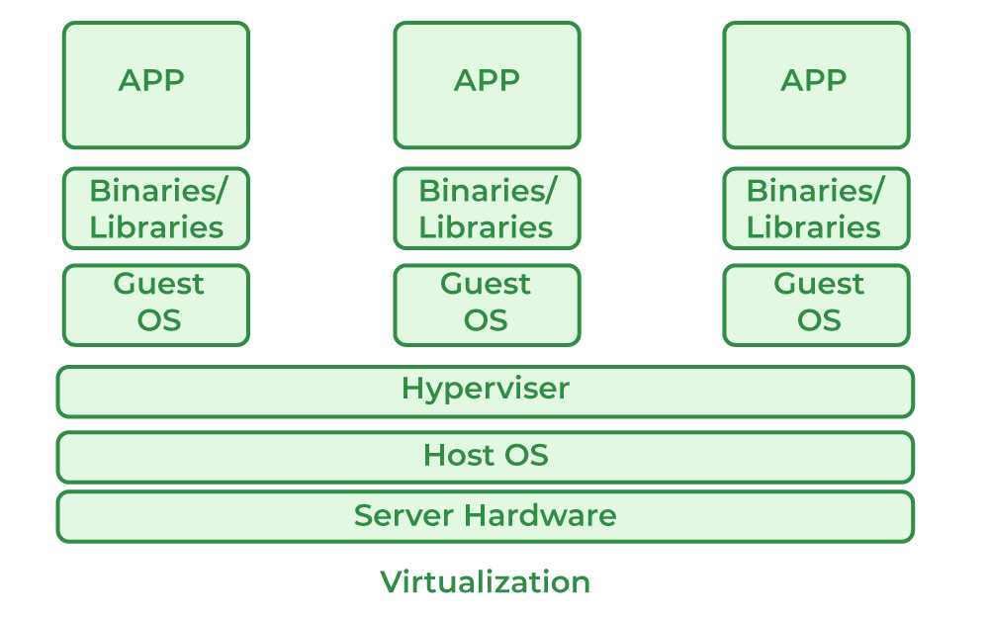

Slide 4
Terminologies
Virtual machine
Hypervisor
Container
Virtual network
Virtualization software

Slide 5
Virtual machines and hypervisors are two important concepts in virtualization.

Slide 6
Virtual machine
A virtual machine is a software-defined computer that runs on a physical computer with a separate operating system and computing resources.
The physical computer is called the host machine and virtual machines are guest machines.
Multiple virtual machines can run on a single physical machine.
Virtual machines are abstracted from the computer hardware by a hypervisor.

Slide 7
Hypervisor
The hypervisor is a software component that manages multiple virtual machines in a computer.
It ensures that each virtual machine gets the allocated resources and does not interfere with the operation of other virtual machines.
There are two types of hypervisors.
Type 1 hypervisor
Type 1 hypervisor, or bare-metal hypervisor, is a hypervisor program installed directly on the computer’s hardware instead of the operating system.
Type 1 hypervisors have better performance and are commonly used by enterprise applications.
KVM uses the type 1 hypervisor to host multiple virtual machines on the Linux operating system.
Type 2 hypervisor
Also known as a hosted hypervisor.
The type 2 hypervisor is installed on an operating system.
Type 2 hypervisors are suitable for end-user computing.

Slide 8
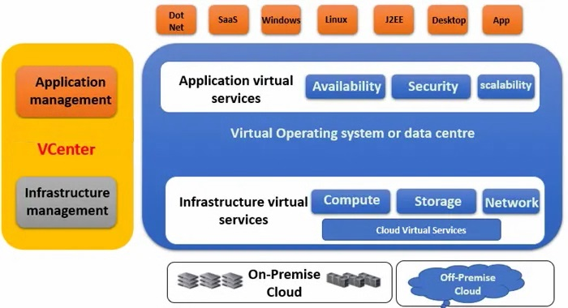
Architecture of Virtualization

Slide 9
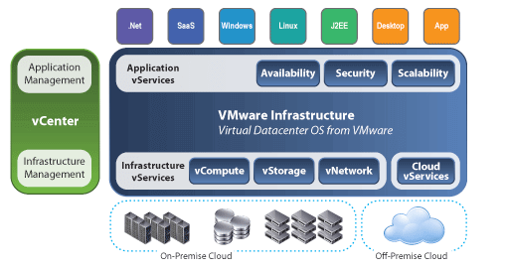
How Virtualization work in cloud computing
Virtualization plays a very important role in the cloud computing technology.
Users share the data present in the clouds like application etc, but actually with the help of virtualization users shares the Infrastructure.

Slide 10
Role of Virtualization in Cloud Computing
It also provides a virtual and isolated networking, storage, and memory area environment.
Hardware virtualization plays a critical role by delivering infrastructure as a service solution most efficiently and effectively under a Cloud Computing process.
Virtualization ensures portability. The guest machine is packaged as a virtual instance of an image, and such virtual images can be removed easily as and when the need arises.

Slide 11
Characteristics of Virtualization
Distribution of resources: Virtualization and Cloud Computing technology ensure end-users develop a unique computing environment. It is achieved through the creation of one host machine. Through this host machine, the end-user can restrict the number of active users. By doing so, it facilitates easy of control. They can also be used to bring down power consumption.
Accessibility of server resources : Virtualization delivers several unique features that ensure no need for physical servers. Such features ensure a boost to uptime, and there is less fault tolerance and availability of resources.
Resource Isolation:
Virtualization provides isolated virtual machines. Each virtual machine can have many guest users, and guest users could be either operating systems, devices, or applications.
The virtual machine provides such guest users with an isolated virtual environment. This ensures that the sensitive information remains protected, and, at the same time, guest users remain inter-connected with one another.
Security and authenticity: The virtualization systems ensure continuous uptime of systems, and it does automatic load balancing and ensures there is less disruption of services.
Aggregation: Aggregation in Virtualization is achieved through cluster management software. This software ensures that the homogenous sets of computers or networks are connected and act as one unified resource.

Slide 12
Types of virtualization
Server virtualization
Storage virtualization
Network virtualization
Data virtualization
Application virtualization
Desktop virtualization

Slide 13
Uses of Virtualization
Data-integration
Business-integration
Service-oriented architecture data-services
Searching organizational data

Slide 14
Benefits of Virtualization
More flexible and efficient allocation of resources.
Enhance development productivity.
It lowers the cost of IT infrastructure.
Remote access and rapid scalability.
High availability and disaster recovery.
Pay peruse of the IT infrastructure on demand.
Enables running multiple operating systems.

Slide 15
Drawback of Virtualization
High Initial Investment
Learning New Infrastructure
Risk of Data

