Slide 1
Authentication in DS

Slide 2
A distributed system is susceptible to a variety of security threats.
A principal can impersonate other principle and authentication becomes an important requirement .
Authentication is a process by which one principal verifies the identity of other principal.
In one-way authentication, only one principal verifies the identity of the other principal
In mutual authentication, both communicating principals verifies each other identity.

Slide 3
Authentication is a process of verifying the principals identity is as claimed.
Authentication is based on the possession of some secret information, like password, known to the entities participating in the authentication.
When an entity wants to authenticate another entity, the former will verify if the latter possesses the knowledge of the secret.

Slide 4
Classification of Authentication Protocols
Classified based on the cryptographic technique used.
There are two basic types of cryptographic techniques: symmetric ("private key") and asymmetric ("public key").
Symmetric cryptography uses a single private key to both encrypt and decrypt data. (Let { X }k denote the encryption of X using a symmetric key k and { Y }k¹ denote the decryption of Y using a symmetric key k.)
Asymmetric cryptography, also called Public-key cryptography, uses a secret key (private key) that must be kept from unauthorized users and a public key that is made public.
Data encrypted with the public key can be decrypted only by the corresponding private key, and data signed with the private key can only be verified with the corresponding public key.

Slide 5
Authentication protocols with symmetric cryptosystem
In a symmetric cryptosystem, authentication protocols can be designed using to the following principle:
"If a principal can correctly encrypt a message using a key that the verifier believes is known only to a principal with the claimed identity (outside of the verifier), this act constitutes sufficient proof of identity."

Slide 6
Case Studies
KERBEROS PROTOCOL
SECURE SOCKET LAYER (SSL) PROTOCOL

Slide 7
Kerberos Protocol
kerberos primarily addresses client-server authentication using a symmetric cryptosystem. Kerberos is an authentication system designed for MIT's Project Athena.
The goal of Project Athena was to create an educational computing environment based on high-performance workstations, high-speed networking, and servers of various types.
Researchers envisioned a large-scale (10,000 workstations to 1,000 servers) open network computing environment in which individual workstations could be privately owned and operated.
Therefore, a workstation cannot be trusted to identify its users correctly to network services. Kerberos is not a complete authentication service required for secure distributed computing in general; it only addresses issues of client-server interactions.

Slide 8
Here, we will see the Kerberos authentication protocol.
Kerberos' design is based on the use of a symmetric cryptosystem together authentication servers. with trusted third-party
The basic components include:
i) Authentication Servers (Kerberos servers) and
ii) Ticket-Granting Servers (TGSs).

Slide 9
Initial registration
Every client/user registers with the Kerberos server by providing its user i.d., U, and a password, passwordu.
The Kerberos server computes a key ku = f(passwordu) using a one-way function f and stores this key in a database.
Note that ku is a secret key that depends on the password of the user and is shared by client U and the Kerberos server only.

Slide 10
Authentication protocol
Authentication in Kerberos proceeds in three steps:
1. Initial authentication at login: The Kerberos server authenticates user login at a host and installs a ticket for the ticket-granting server, TGS, at the login host.
2. Obtain a ticket for the server: Using the ticket for the ticket- granting server, the client requests the ticket-granting server, TGS, for a ticket for the server.
3. Requesting service from the server: The client uses the server ticket obtained from the TGS to request services from the server.

Slide 11
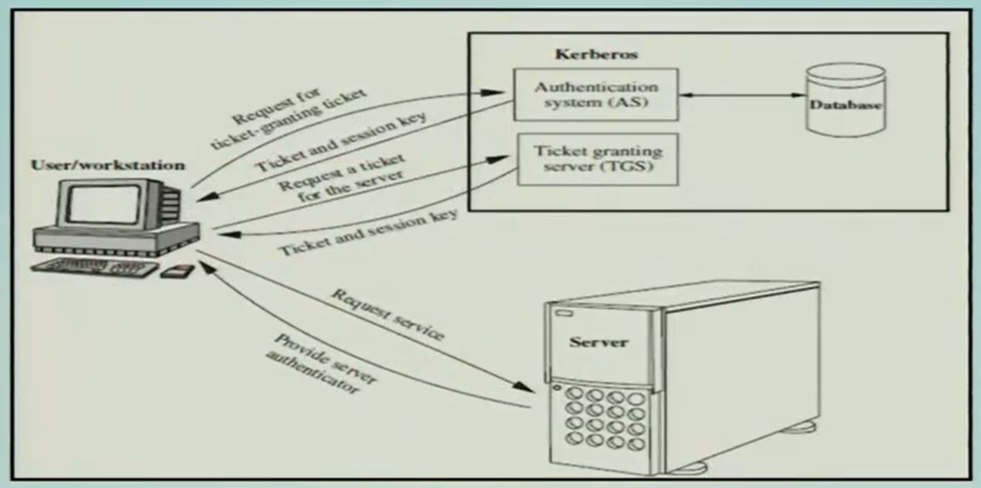
Fig: Steps in authentication in kerberos

Slide 12
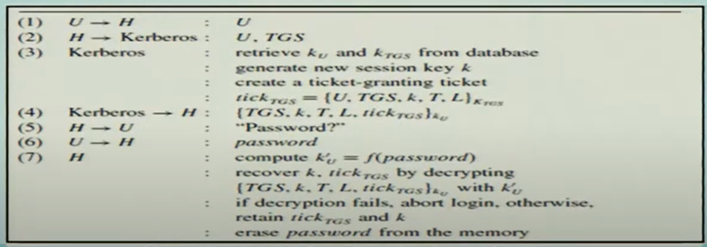
Step1: Initial authentication at login
Initial authentication at login uses a kerboros server and is shown in Algorithm 1. Let U be a user who is attempting to log into a host H.

Slide 13
In step 1, user U initiates login by entering his/her username.
In step 2, the login host H forwards the login request and the i.d. of the TGS to a Kerberos server.
In step 3, the Kerberos server retrieves ku and KTGS from the database, generates a new session key k and creates a ticket- granting ticket tickTGS = {U, TGS, k, T, L}KTGS where U is the identity of the user who wishes to communicate with the server, TGS is the identity of the ticket granting server, k is the session key, T is a timestamp, L is the ticket's lifetime and KTGS is the key shared between the TGS and the Kerberos server.

Slide 14
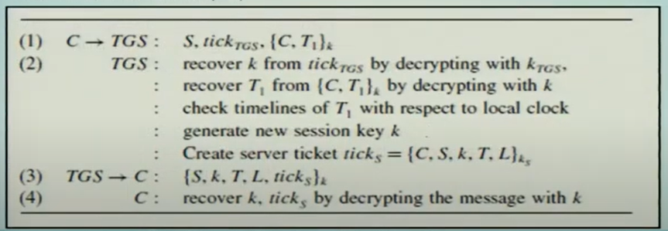
Step 2: Obtain a ticket for the server
The client executes the steps shown in Algorithm 2 to request a ticket for the server from the TGS. Basically, the client sends the ticket tickTGS to the TGS, requesting a ticket for the server S. (T1 and T2 are timestamps.)

Slide 15
Because a ticket is susceptible to interception and replay, it does not by itself constitute sufficient proof of identity.
For authentication, a principal presenting a ticket must also demonstrate the knowledge of the session key k named in the ticket. An authenticator, {C, T}k, where C is the client identity, T is the timestamp, and k is the session key, provides the demonstration.

Slide 16
In step 1, to request a ticket for server S, client C presents its ticket- granting ticket tickTGS along with the authenticator to the TGS. C's knowledge of k is demonstrated using the authenticator {C, T1}k.
In step 2, the TGS decrypts tickTGS with KTGS to recover k, verifies the authenticity of the authenticator by decrypting CT1k with k, and checks the timeliness of T1 in the authenticator and T in tickTGS.
If both decryptions in step 2 are successful and T1 is timely, the TGS is convinced of the authenticity of the ticket, and creates a ticket ticks ={C, S, k, T, Lks) for server S, where C is the identity of the client, S is the server identity, k is the new session key, T is the timestamp of the TGS, L is the lifetime of the ticket, and ks is the key shared between the TGS and server S.
This ticket is returned to C in step 3. In step 4, C recovers k and ticks from {S, k, T, L, ticks}k by decrypting it with k.

Slide 17
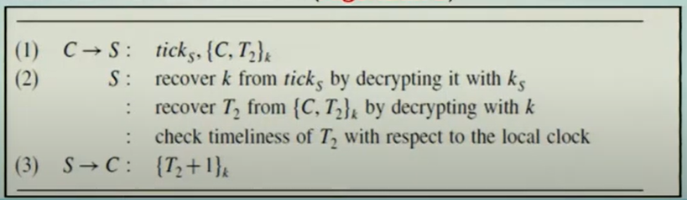
Step 3: Requesting service from the server
Client C sends the ticket and the authenticator to server. The server decrypts ticks and recovers k. It then uses k to decrypt the authenticator {C, T2}k and checks if the timestamp is current and the client identifier matches with that in the ticks before granting service to the client. If mutual authentication is required, the server returns an authenticator (Algorithm 3).

Slide 18
Weaknesses of Kerberos
Kerberos makes no provisions for host security; it assumes that it is running on trusted hosts with an untrusted network.
If host security is compromised, then Kerberos is compromised as well.
Kerberos uses a principal's password (encryption key) as the fundamental proof of identity.
If a user's Kerberos password is stolen by an attacker, then the attacker can impersonate that user with impunity.
Since the Kerberos' password database holds all the passwords for all of the principals in a realm, if the host security on the database is compromised, then the entire realm is compromised.

Slide 19
In Kerberos version 4, authenticators are valid for a particular time. If an attacker sniffs the network for authenticators, they have a small time window in which they can re-use it and gain access to the same service.
Kerberos version 5 introduced a replay cache that prevents any authenticator from being used more than once.
Since anybody can request a ticket-granting ticket for any user, and that ticket is encrypted with the user's secret key (password), it is simple to perform an offline attack on this ticket by trying to decrypt it, say using the dictionary attack.
Kerberos version 5 introduced pre-authentication to solve this problem.

Slide 20
Secure sockets layer (SSL) Protocol

Slide 21
SSL Protocol
The secure sockets layer (SSL) protocol was developed by Netscape and is the standard Internet protocol for secure communications.
The secure hypertext transfer protocol (HTTPS) communications protocol designed to transfer encrypted information between computers over the World Wide Web.
HTTPS is http using a secure socket layer (SSL). SSL resides between TCP/IP and upper-layer applications, requiring no changes to the application layer.
SSL is used typically between server and client to secure the connection. One advantage of SSL is that it is application protocol independent. A higher-level protocol can layer on top of the SSL protocol transparently.

Slide 22
SSL Features
SSL protocol allows client-server applications to communicate in a way so that eavesdropping, tampering, and message forgery are prevented.
The SSL protocol, in general, provides the following features:
End point authentication: The server is the "real" party that a client wants to talk to, not someone faking the identity.
Message integrity: If the data exchanged with the server has been modified along the way, it can be easily detected.
Confidentiality: Data is encrypted. A hacker cannot read your information by simply looking at the packets on the network.

Slide 23
SSL Record Protocol
The record protocol takes an application message to be transmitted, fragments the data into manageable blocks, optionally compresses the data, applies MAC, encrypts, adds a header, and transmits the resulting unit into a TCP segment.
Received data are decrypted, verified, decompressed, and reassembled, and then delivered to high-level users.

Slide 24
SSL Handshake Protocol
The SSL handshake protocol allows the server and client to authenticate each other and to negotiate an encryption algorithm and cryptographic keys before the application protocol transmits or receives its first byte of data.

Slide 25
Steps for SSL Handshake Protocol
The following steps, shown in Figure 2, are involved in the SSL handshake:
1. The SSL client sends a "client hello" message that lists cryptographic information such as the SSL version and, in the client's order of preference, the CipherSuites supported by the client. The message also contains a random byte string that is used in subsequent computations.
2. The SSL server responds with a "server hello" message that contains the CipherSuite chosen by the server from the list provided by the SSL client, the session ID, and another random byte string. The SSL server also sends its digital certificate. If the server requires a digital certificate for client authentication, the server sends a "client certificate request" that includes a list of the types of certificates supported and the distinguished names of acceptable certification authorities (CAs).

Slide 26
3. The SSL client verifies the digital signature on the SSL server's digital certificate and checks that the CipherSuite chosen by the server i acceptable.
4. The SSL client, using all data generated in the handshake so far, create a premaster secret for the session that enables both the client and the server to compute the secret key to be used for encrypting subsequent message data. The premaster secret itself is encrypted with the server' public key.
5. If the SSL server sent a "client certificate request," the SSL client sends another signed piece of data which is unique to this handshake and know only to the client and server, along with the encrypted premaster secret and the client's digital certificate, or a "no digital certificate alert." This alert is only a warning, but with some implementations the handshake fail if client authentication is mandatory.

Slide 27
6. The SSL server verifies the signature on the client certificate.
7. The SSL client sends the SSL server a "finished" message, which is encrypted with the secret key, indicating that the client part of the handshake is complete.
8. The SSL server sends the SSL client a "finished" message, which is encrypted with the secret key, indicating that the server part of the handshake is complete.
9. For the duration of the SSL session, the SSL server and SSL client can now exchange messages that are encrypted with the shared symmetric secret key.

Slide 28
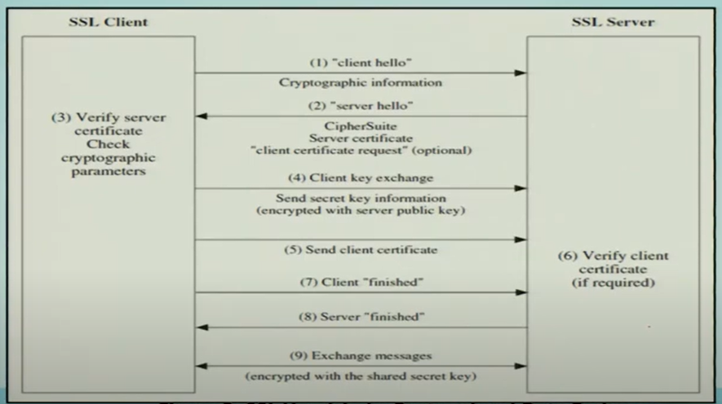

Slide 29
How SSL provides authentication
During both client and server authentication, there is a step that requires data to be encrypted with one of the keys in an asymmetric key pair and is decrypted with the other key of the pair.
For server authentication, the client uses the server's public key to encrypt the data that is used to compute the secret key. The server can generate the secret key only if it can decrypt that data with the correct private key.
For client authentication, the server uses the public key in the client certificate to decrypt the data the client sends during step 5 of the handshake. The exchange of finished messages that are encrypted with the secret key (steps 7 and 8 in the overview) confirms that authentication is complete.

Slide 30
If any of the authentication steps fails, the handshake fails and the session terminates.
The exchange of digital certificates during the SSL handshake is a part of the authentication process. The certificates required are as follows, where CA X issues the certificate to the SSL client, and CA Y issues the certificate to the SSL server:
For server authentication only, the SSL server needs the following:
The personal certificate issued to the server by CAY.
The server's private key.

Slide 31
The SSL client needs
The CA certificate for CA Y or the personal certificate issued to the server by CAY.
If the SSL server requires client authentication, the server verifies the client's identity by verifying the client's digital certificate with the public key for the CA that issued the personal certificate to the client, in this case CA X. For both server and client authentication, the SSL server needs:
The personal certificate issued to the server by CAY.
The server's private key.
The CA certificate for CA X or the personal certificate issued to the client by CА Х.

