Slide 1
ADBMS

Slide 2
After going through this, you will be able to:
understand what Distributed database is.
define what is Distributed Database Management System
describe features of DDBMS its advantages and disadvantages
Illustrate Distributed transparent system
Classify Distributed transparent System.

Slide 3
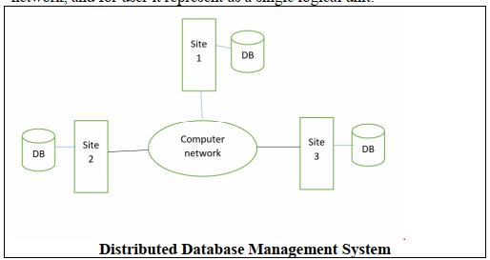
Distributed Database Management System
Distributed Database Management System is a software system that manages a distributed database which is partitioned and placed on different location. Its objective is to hide data distribution and appears as one logical database system to the clients.

Slide 4
Features of DDBMS
DDBMS software maintain CRUD (create, retrieve, Update, Delete) functions.
It covers all application areas where huge volume of data are processed and retrieved simultaneously by n number of users.
It ensure that data modified at any location update universally.
It ensures confidentiality and data integrity which is important feature in transaction management.
It can handle heterogeneous data platforms

Slide 5
Advantages of DDBMS
Reliable: Incase of centralized DBMS if database fails entire system comes to a halt whereas in DDBMS when a component fails may be reduce performance but it will not stop fully.
Easy Expansion In centralized database system if system needs to be expanded, the implementation require extensive efforts and interruption in the existing functionality. However in DDBMS no disturbance in current functioning.
Faster Response In centralized database all queries are passing through central data repository because of that response time is more although in DDBMS data is distributed in well-organized, so it runs faster response on queries

Slide 6
Disadvantages of DDBMS
Complex and Expensive DDBMS provides data transparency and work on different sites so it may require complex and expensive software for proper working.
Overheads Simple and complex operation and queries may require large communication and calculation.
Responsiveness is largely dependent upon appropriate data distribution. Improper data distribution often leads to slow response to user requests.
Integrity As data is on multiple sites it may create problem in updating data and maintaining data integrity.

Slide 7
Reasons to Boosting DDBMS
Distributed Nature of Structural Units
Data sharing Need
Provision for OLTP and OLAP
Database Retrieval
Useful in Multiple Application Software

Slide 8
Databases Types
Homogeneous Database
all diverse sites collect data identically. At all the sites same operating system, database management system and the data structures used is being used. Therefore, they are easy to manage.
Heterogeneous Database
all diverse sites collect data identically. At all the sites same operating system, database management system and the data structures used is being used. Therefore, they are easy to manage.
particular site might be completely uninformed of the other sites. Diverse computers may use a different operating system, different database application.

Slide 9
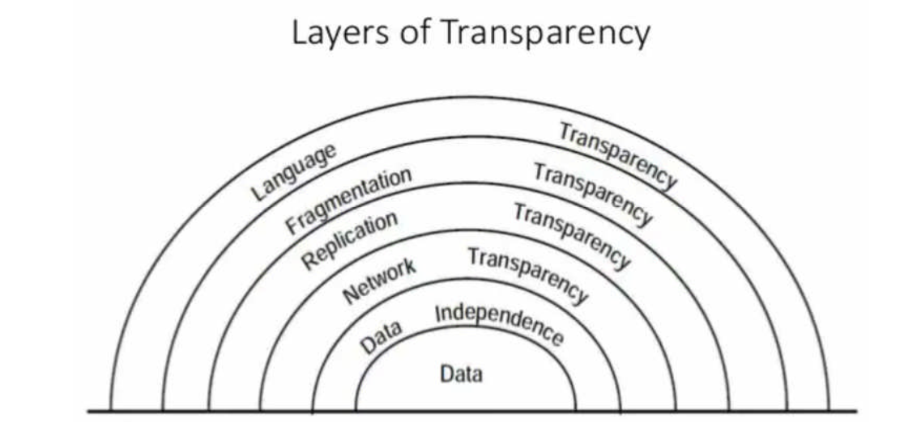
DISTRIBUTED TRANSPARENT SYSTEM
DDBMS hides all the distributed complexities and allow users to feel that they are working on single and centralized database.

Slide 10
Levels of Distributed Transparent System
Fragmentation Transparency
Fragments are created to store the data in distributed way and should stay transparent. In this all the data administration work necessarily control by the system, not by the user.
When a user sets a query, the global query is distributed in many sites to get data from fragments and this data is place together at the end to produce the result.

Slide 11
Levels of Distributed Transparent System
Location Transparency
Location transparency confirms that the user can fire query on any relation or fragment of a relation like they are stored locally on user’s place.
But the table or its fragments are kept at isolated site in the distributed database system, should be completely unaware to the user. The address and access mechanism of the remote site are completely hidden.
In order to integrate location transparency, DDBMS must have access to restructured and perfect data dictionary and DDBMS directory which contains the details of locations of data.

Slide 12
Levels of Distributed Transparent System
Replication Transparency
Replication transparency certifies that duplication of databases are concealed from the users. It permits users to query upon a relation as if only a single copy of the table is in place.
Replication transparency is connected with concurrency transparency and failure transparency. At any time a user updates a data element, the update is replicated in all the replicas of the table. Though, this process should not be identified to the user. This is known as concurrency transparency.

Slide 13
Functions of Distributed database system
Keeping track of data
Distributed Query Processing
Replicated Data Management
Distributed Database Recovery
Security
Distributed Directory Management
Distributed Transaction Management

Slide 14
Distributed Data Storage
Replication : The entire relationship is stored redundantly at 2 or more sites. If the entire database is available at all sites, it is a fully redundant database.
Fragmentation: The relations are fragmented and each of the fragments is stored in different sites where they’re required.
It must be made sure that the fragments are such that they can be used to reconstruct the original relation.
Advantageous as it doesn’t create copies of data, consistency is not a problem.
Fragmentation of relations can be done in two ways:
Horizontal fragmentation (Sharding)
Vertical fragmentation

Slide 15
Advantages of Distributed Database System
There is fast data processing as several sites participate in request processing.
Reliability and availability of this system is high.
It possess reduced operating cost.
It is easier to expand the system by adding more sites.
It has improved sharing ability and local autonomy.

Slide 16
Disadvantages of Distributed Database System
The system becomes complex to manage and control.
The security issues must be carefully managed.
The system require deadlock handling during the transaction processing otherwise the entire system may be in inconsistent state.
There is need of some standardization for processing of distributed database system.

Slide 17
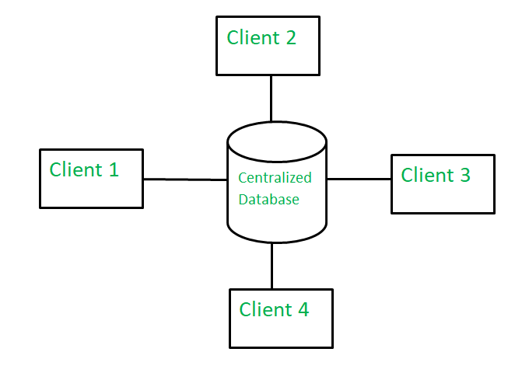
Centralized Database
Centralized database management system is the system in which all the data is stored and managed in a single unit.

Slide 18
Functions of centralized database
Distributed query processing
Single central unit
Transparency
Scalable

Slide 19
Advantage of centralized database system
Data integrity
Data redundancy
Data security
Scalability and localization
Data portability
Lesser cost and maintenance

Slide 20
Disadvantage of centralized database system
Slow processing
Less efficiency
Loss of data

Slide 21
Centralized Vs Distributed DBMS
Definition
Access time
Management of data
View
Data Consistency
Failure
Cost
Maintenance
Efficient
Response Speed
Advantages
Disadvantages

