Slide 2
Distributed Vs Centralized Database
Centralized DBMS | Distributed DBMS
In Centralized DBMS the database are stored in a only one site | In Distributed DBMS the database are stored in different site and help of network it can access it
If the data is stored at a single computer site, which can be used by multiple users | Database and DBMS software distributed over many sites, connected by a computer network
Database is maintained at one site | Database is maintained at a number of different sites
If centralized system fails, entire system is halted | If one system fails, system continues work with other site
It is a less reliable | It is a more reliable

Slide 3
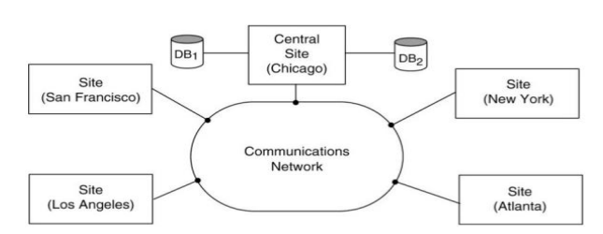
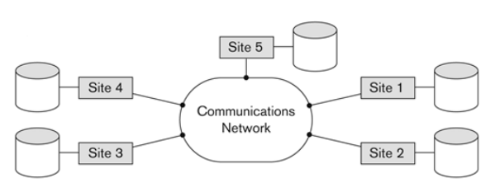
Centralized DBMS
Distributed DBMS

Slide 4
Principles of Distributed Databases
The principles of distributed databases include:
Scalability: Distributed databases should be able to handle increasing amounts of data and traffic by adding more resources or nodes.
Fault tolerance: Distributed databases need to be resilient to failures, ensuring that data remains available even if some nodes or components fail.
Consistency: Distributed databases should ensure that all nodes in the system have the most up-to-date data, maintaining consistency across the entire database.
Isolation: Transactions in distributed databases should be isolated from each other to prevent interference and maintain data integrity.
Durability: Changes to the database should be durable and not lost, even in the event of failures.
Partition tolerance: Distributed databases should continue to operate even if the network is experiencing partitions or communication disruptions between nodes.

Slide 5
Levels Of Distribution Transparency
Transparency in DBMS stands for the separation of high level semantics of the system from the low-level implementation issue.
High-level semantics stands for the endpoint user, and
Low level implementation concerns with complicated hardware implementation of data.
In Distributed database, there are three types of transparency:
Location transparency
Fragmentation transparency
Replication transparency

Slide 6
Location transparency
Location transparency ensures that the user can query on any table(s) or fragment(s) of a table as if they were stored locally in the user’s site.
The fact that the table or its fragments are stored at remote site in the distributed database system, should be completely oblivious to the end user.
The address of the remote site(s) and the access mechanisms are completely hidden.
In order to incorporate location transparency, DDBMS should have access to updated and accurate data dictionary and DDBMS directory which contains the details of locations of data.

Slide 7
Fragmentation transparency
Fragmentation transparency enables users to query upon any table as if it were unfragmented. Thus, it hides the fact that the table the user is querying on is actually a fragment or union of some fragments.
It also conceals the fact that the fragments are located at diverse sites.
This is somewhat similar to users of SQL views, where the user may not know that they are using a view of a table instead of the table itself.

Slide 8
Replication transparency
Replication transparency ensures that replication of databases are hidden from the users. It enables users to query upon a table as if only a single copy of the table exists.
Replication transparency is associated with concurrency transparency and failure transparency.

Slide 9
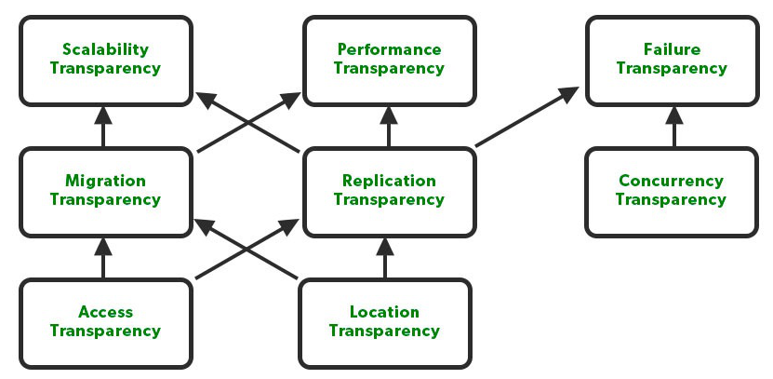

Slide 10
Distributed DBMS Architectures
DDBMS architectures are developed depending on three parameters:
Distribution − It states the physical distribution of data across the different sites.
Autonomy − It indicates the distribution of control of the database system and the degree to which each constituent DBMS can operate independently.
Heterogeneity − It refers to the uniformity or dissimilarity of the data models, system components and databases.

Slide 11
Architectural Models
Client - Server Architecture for DDBMS
Peer - to - Peer Architecture for DDBMS
Multi - DBMS Architecture

Slide 12
Client - Server Architecture
Two-level architecture where the functionality is divided into servers and clients.
server functions and client functions.
Server does most of the data management work
query processing –
data management
Optimization
Transaction management etc
Client performs :
Application
User interface
DBMS Client mode

Slide 13
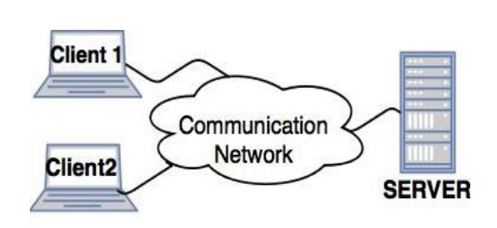
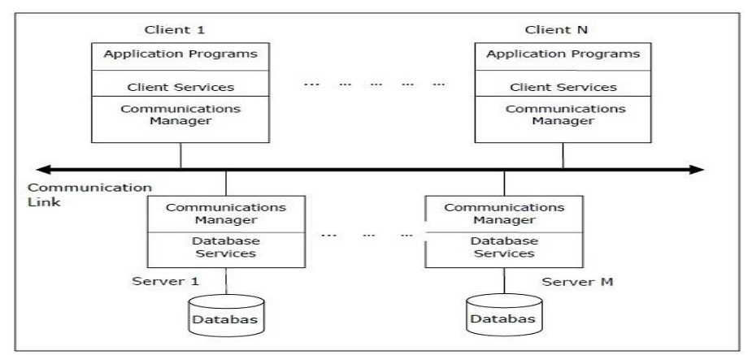
Types of Client - Server Architecture
The two different client - server architecture are:
Single Server Multiple Client
Multiple Server Multiple Client

Slide 14
Peer- to-Peer Architecture
Each peer acts both as a client and a server for imparting database services.
The peers share their resource with other peers and co-ordinate their activities.
P2P has four levels of schemas:
local internal schema
global conceptual schema
local conceptual schema.
external schemas

Slide 15
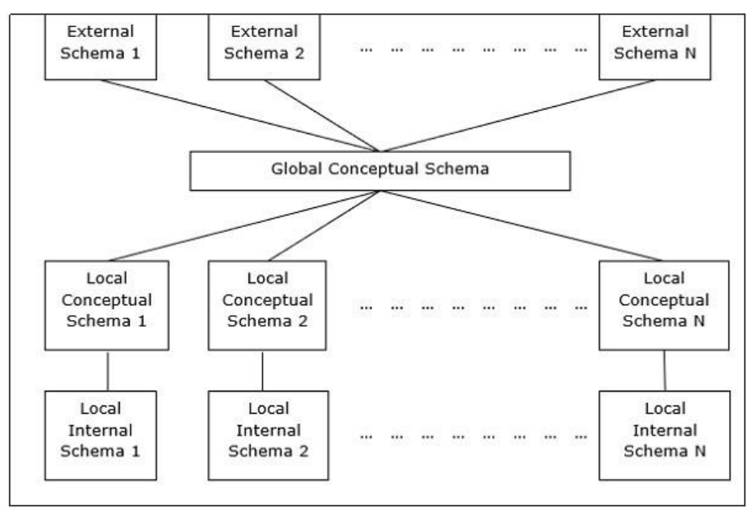
Schema Framework for P2P

Slide 16
Components of P2P
Major Components of a Peer-to-Peer System :
User Processor
User-interface handler
responsible for interpreting user commands, and formatting the result data
Semantic data controller
checks if the user query can be processed.
Global Query optimizer and decomposer
determines an execution strategy
Translates global queries into local one.
Distributed execution
Coordinates the distributed execution of the user request
Data processor
Local query optimizer
Acts as the access path selector
Responsible for choosing the best access path
Local Recovery Manager
Makes sure local database remains consistent
Run-time support processor

Slide 17
Multi - DBMS Architectures
This is an integrated database system formed by a collection of two or more autonomous database systems.
Multi-DBMS can be expressed through six levels of schemas
Multi-database View Level − Depicts multiple user views comprising of subsets of the integrated distributed database.
Multi-database Conceptual Level − Depicts integrated multi-database that comprises of global logical multi-database structure definitions.
Multi-database Internal Level − Depicts the data distribution across different sites and multi-database to local data mapping.
Local database View Level − Depicts public view of local data.
Local database Conceptual Level − Depicts local data organization at each site.
Local database Internal Level − Depicts physical data organization at each site.

Slide 18
