Slide 1
Benefits of virtualization
Virtualization has many benefits that can help IT managers and organizations in the following aspects:
Minimizes downtime and facilitates disaster recovery
Increases productivity and efficiency
Allows better testing
Reduces carbon footprint

Slide 2
Virtualization Software
Listed of top five virtualization software for personnel or businesses
Parallels Desktop
VMWare Fusion/Workstation Player
Oracle VM Virtual Box
V2 Cloud
QEMU

Slide 3
Virtualization Technique
Para Virtualization
Full Virtualization
OS Level Virtualization

Slide 4
Virtual Machine

Slide 5
Virtual Machine (VM)
A VM is a virtualized instance of a computer that can perform almost all of the same functions as a computer, including running applications and operating systems.
VM play a primary role in creating any application, tool, or environment for virtual machines online and on-premises.
Virtual machines used for:
Testing
Running software designed for other OS
Running outdated software
Browser isolation
Cloud computing use virtual machines for:
Running SaaS applications
Backing up data
Hosting services like email and access management
Browser isolation

Slide 6
Types of Virtual Machine
There are two type of virtual machine:
System Virtual Machine
Process Virtual Machine

Slide 7
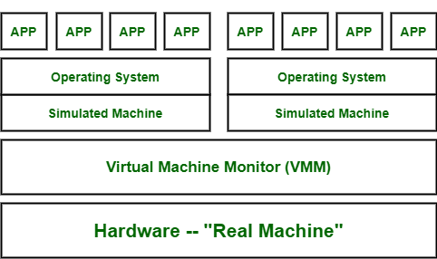
System Virtual Machine
System virtual machines gives us complete system platform and gives the execution of the complete virtual operating system.
E.g. Virtual Box

Slide 8
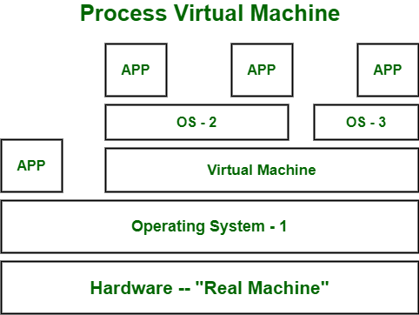
Process Virtual Machine
It creates virtual environment of that OS while using some app or program and this environment will be destroyed as soon as we exit from that app.
A process virtual machine is sometimes known as MRE (Manages Runtime Environment) or application virtual machine.
E.g.: Wine software in Linux, JVM.

Slide 9
Virtual Machine Monitor (VMM)
A virtual machine monitor (VMM), also known as a hypervisor, is a software, hardware, or firmware-based process that manages the creation and operation of virtualized environments from the host system.
The virtualization layer allows IT managers to control virtual machines running on the hypervisor as guest systems.
Hypervisors make it possible to run multiple virtual machines on one main system and help manage the allocation of resources.
Virtual machine monitoring allows for the monitoring of availability and performance.

Slide 10
Functions of a Virtual Machine Monitor
Virtualization of Hardware
VM Creation and Management
Resource Allocation and Scheduling
Isolation and Security
Live Migration
Snapshots and Backup

Slide 11
Types of Virtual Machine Monitors
Type 1 Hypervisor (Bare-Metal Hypervisor):
Type 1 hypervisors run directly on the physical hardware without the need for an underlying operating system.
They have direct access to the hardware resources, making them more efficient and providing higher performance.
Examples of Type 1 hypervisors include VMware ESXi, Microsoft Hyper-V Server, and Xen.
Type 2 Hypervisor (Hosted Hypervisor):
Type 2 hypervisors run on top of an existing operating system, which acts as the host.
The Type 2 hypervisor relies on the host OS to manage hardware resources.
While they are typically easier to install and set up, Type 2 hypervisors may have slightly lower performance compared to Type 1 hypervisors.
Examples of Type 2 hypervisors include VMware Workstation, Oracle VirtualBox, and Parallels Desktop.

Slide 12
Uses and Benefits of VMM
Server Virtualization
Desktop Virtualization
Software Testing and Development
Legacy Application Support
Cloud Computing

