Slide 1
R Markdown and Git for Collaborative Actuarial Research and Analysis
Brian A. Fannin
Daniel Murphy
Kirsten Singer

Slide 2

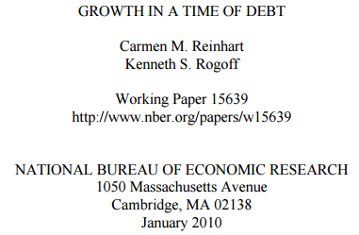


Notes:
* In May 2006, researchers at Duke University, published the results of a promising new cancer diagnostic technique. Patients would have an 80% assurance that their treatment was specific to their form of cancer.
* In January, 2010, as the world grappled with recession, two researchers published findings about the relationship between public debt and economic growth.
* In September 2014, Vista Equity Partners purchased Tibco. Goldman Sachs had estimated Tibco’s value at $4.2 billion.

Slide 3
The analysis was done by highly trained, experienced professionals.
The economic and/or social impact of the analysis was significant.
And …

Slide 4
All of the results contained material errors
Notes:
Animate text to fade

Slide 5
Common themes
Multiple iterations of data collection and analysis
Movement of analysis and files across systems
Collaboration
Must be easily peer reviewed
High financial stakes
Duty to the public

Slide 6
Sound like what you do?

Slide 7
It also sounds like enterprise risk
Sarbanes/Oxley
Solvency II/ORSA
Actuarial Standards of Practice

Slide 8
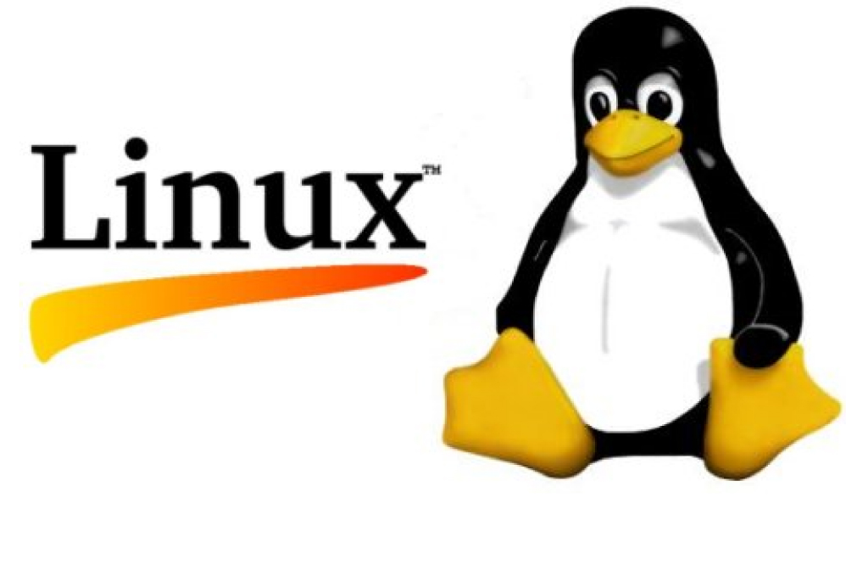

Another massive collaboration
Notes:
Animate appearance of git logo

Slide 9
Why git?
Collaboration
Easy to move whole sets of files
Track changes in a secure way

Slide 10
Live demo

Slide 11
How about documentation?

Slide 12
Document results
Analyze data
Fetch data and paste into spreadsheet
Each step is likely repeated over and over again.
Notes:
Each of these steps is likely repeated over and over again.

Slide 13
Have you ever forgotten to update your documentation with the latest stage of analysis?

Slide 14
R Markdown to the rescue!

Slide 15
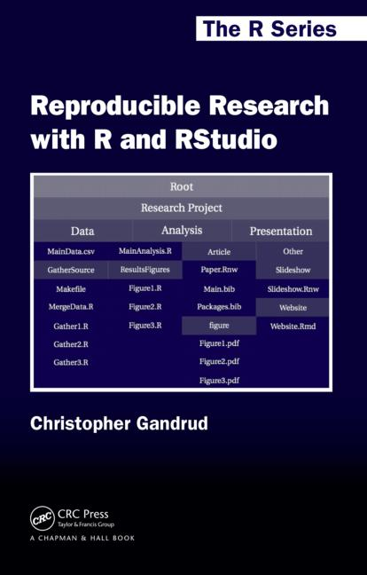
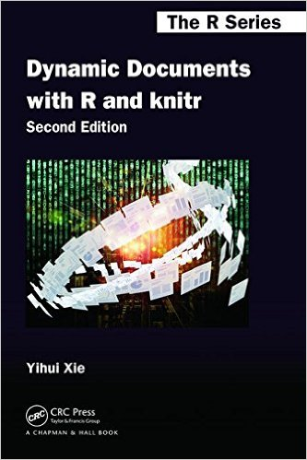

Slide 16
R Markdown
R code and documentation are contained in a single document.
Easy to use with git, particularly if you’re using R Studio.
“Literate programming” means that the code exists alongside explanations of what’s going on.
Visual output appears in the document automatically.
Output to Word, PDF or HTML.

Slide 17
Live demo

Slide 18
Conclusion
git facilitates collaboration and tracking of analysis changes
R Markdown streamlines the work cycle

Slide 19
Thank you!

