Slide 1


Technical Answers for Real Word Problems (TARP)(CSE1901)
AI CROP MANAGEMENT AND MONITORING SYSTEM
AND FARMERS SUICIDAL PREDICTION SYSTEM
By:
ANUPAM KUNWAR – 19BCE1369
DIVYANSH – 19BCE1610

Slide 2
ABSTRACT-
In a survey report 800,000 of individuals have committed suicide in 2016 , according to World Health Organization .People between 15 and 29 years of age are major category of suicidal death. This survey tells about the machine learning methods which is used for suicide detection on social network. Scoping review was implemented whose aim was to identify the machine learning techniques used to predict suicide risk based on information posted on social networks.
Agriculture is the primary source of livelihood for about 58% of India’s population. Indian farmers are the backbone of our nation’s economy as the Indian economy is primarily Agriculture based. Some farmers in the agricultural industry manage so many acres of land, it’s almost impossible to get prompt updates and alerts about potential problems without help from technology.
To get access to this technology, they need to spend money which is a huge burden to farmers. In the case of soil testing farmers need to take the sample and get it tested for free from a government lab, but now these governments are not at all taking care which is leading farmers to private companies where they meet cost expenses.
So to pull farmers out of this problem, in this project we are planning to design an IoT based smart agriculture monitor whose data is collected and further analyzed to predict the soil suitability for crop plantation which helps the farmers to make a better choice and improve the crop yield.
Data has become a fundamental aspect in modern agriculture to assist producers with essential decision-making, and current developments in data management are causing Smart Farming to increase tremendously. With objective information obtained by sensors with the goal of maximizing production and sustainability, significant advantages emerge. This type of data-driven farm management relies on data to boost efficiency while reducing resource waste and pollution of the environment. Data-driven agriculture, combined with robotic solutions that incorporate artificial intelligence approaches, lays the foundation for future sustainable agriculture.

Slide 3
INTRODUCTION-
In a study report 800,000 of people have ended it all in 2016 , as per World Health Organization .People somewhere in the range of 15 and 29 years old are significant class of self-destructive demise. This overview tells about the AI techniques which is utilized for self destruction identification on informal community. Perusing audit was executed whose point was to recognize the AI strategies used to foresee self destruction hazard in light of data posted on interpersonal organizations.
In many regions of the planet there exists a major issue, alluded to as "Rancher Suicide". Such occasions shock the public authority as well as the overall population.
Ranchers are the food makers of the world and them submitting suicides prompts deficiency in food grains which further prompts trouble among general society.
The rancher's self destruction rate in India had run somewhere in the range of 1.4 and 1.8 per 100,000 absolute populace, north of a 10-year time span through 2005, nonetheless, the figures in 2017 and 2018 showed a normal of in excess of 10 suicides every day or 5760 suicides each year.
5,579 Indian ranchers kicked the bucket by self destruction in 2020, Union Minister of Agriculture and Farmers Welfare Narendra Singh Tomar,.The figures are as indicated by the National Crime Records Bureau (NCRB).

Slide 4
Factors for farmer’s suicide-
• Indebtedness-
Indebtedness is the predominant single factor associated with farmer suicides [1], [2]. Dongre and Deshmukh observed that ranchers in the Vidarbha district of Maharashtra positioned obligation as the main justification behind rancher suicides, trailed by addictions, environmental problems, and price issues, amongst others [3]
• Cash Crops-
The expanded utilization of cash crops (which are a greater expense and developed principally to be traded) rather than food crops (minimal expense and intended to be sold all the more locally) has been recognized as an issue in certain examinations [2]

Slide 5
LITERATURE SURVEY-
Mayur Surve et al. in 2020, [4] have fostered a model which gets the live pictures from Camera. Then, at that point, it applies various calculations for face discovery and face acknowledgment. They additionally made the GUI on single tick which gets the pictures, structure the dataset and teach the dataset. They utilized the Haar course calculation to perceive the face in the picture.
Jenif D Souza W S et al.in 2019, [5] has proposed a framework where picture handling methods is utilized for facial acknowledgment. The refined photograph is used to contrast and the fought inventory. The started technique was being effectuated with 4 modules like Image Capturing, Cleavage of gathering photograph and Face Detection, Face correlation and Recognition.
Depression Detection Micheal M. Tadesse et al. [6] , a near about 91% accuracy for depression detection was obtained using the Multilayer Perceptron (MLP) classifier to show the strength and effectiveness . Nafz Al Asad et al. the MLP works based of how users express their daily thoughts and activities on social networking sites such as Twitter and Facebook. It used the user name and it analyses the users social media posts to determine the extent of user vulnerability to depression. Subhan Tariq et al. [7] made the classification of the patients based on their stage of chronic mental illness diseases using the data collected from Reddit, a network community platform. Co-training techniques uses the discriminative power of widely used learning algorithms like Random Forest (RF), Support Vector Machine (SVM), and Naıve Bayes (NB).
Renata L. Rosa et al. [8] ,had introduced a Knowledge Based Recommendation System (KBRS), which comes with an emotional health monitoring system for the detection of users with potential psychological disturbances, depression and stress. On the basis of final results, the KBRS based on d sentiment analysis is activated to send some sweet, calm, relaxing, or motivational messages to the users suffering from psychological disturbances . It also had a mechanism which sends alert messages to authorized persons, in case a depression is detected by KBRS.

Slide 6
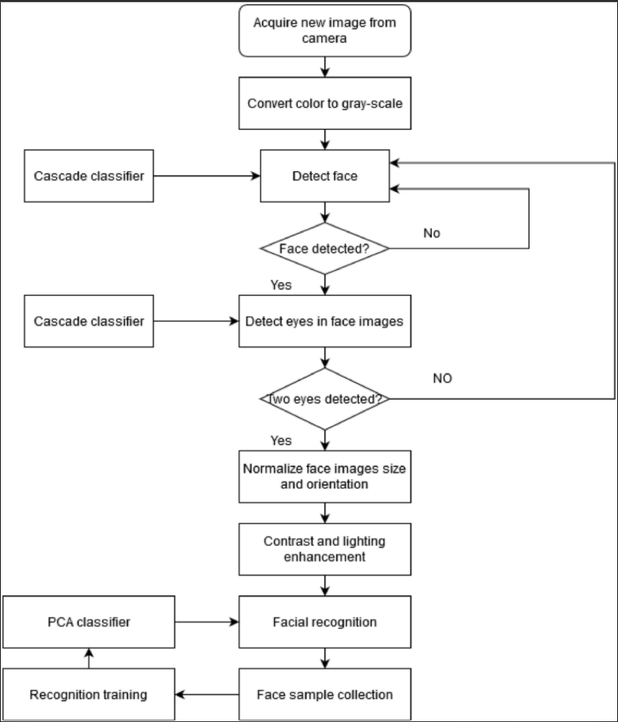

Slide 7
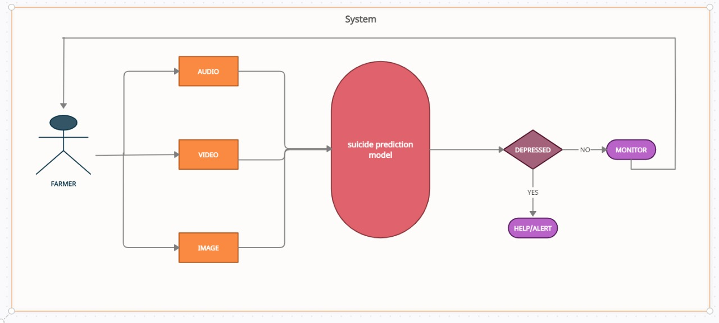

Slide 8
REAL TIME SOLUTION
➢ The Crop Monitoring system will measure and record various soil parameters necessary for agriculture, like soil moisture, pH levels, temperature etc.
➢ The data collected from the sensor will be sent to a cloud server via a WIFI module, this data can be accessed by the service provider to perform the necessary analysis and draw efficient conclusions.
➢ Only collecting the data isn’t important, we also need to make it ready for analysis. Data preprocessing is a very important first step for anyone dealing with data sets. That's because it leads to better data sets, that are cleaner and are more manageable, a must for any business trying to get valuable information from the data it gathers.
➢ After we have processed the collected data, we will decide what kind of output we want for which soil characteristics, for example qualitative, quantitative, predictive etc.
➢ As we manipulate and organize your data, we may need to traverse your steps again from the beginning, where we may need to modify our question, redefine parameters, and reorganize our data.
➢ Finally, we need to review if we have considered all parameters for making the decision, review if there is any hindering factor for implementing the decision. Choose data visualization techniques to communicate the message better. These visualization techniques may be charts, graphs, color coding, and more.

Slide 9
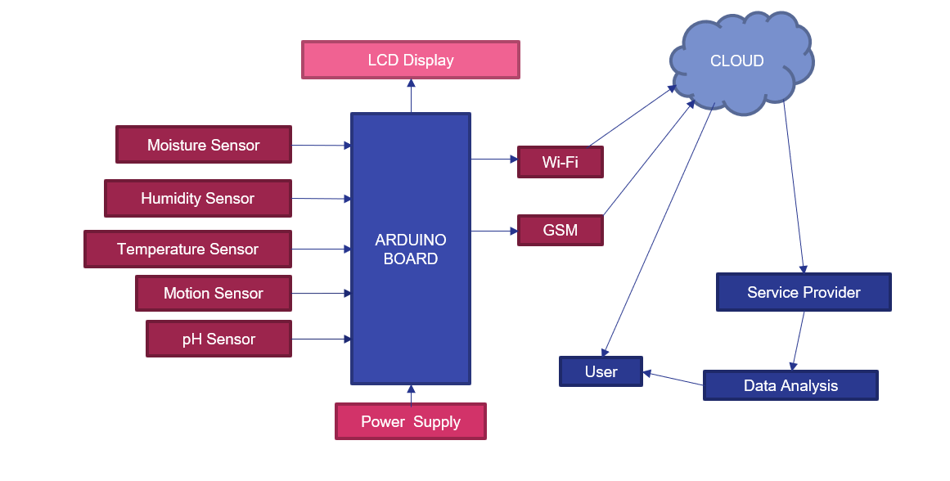
BLOCK DIAGRAM OF SYSTEM DESIGN

Slide 10
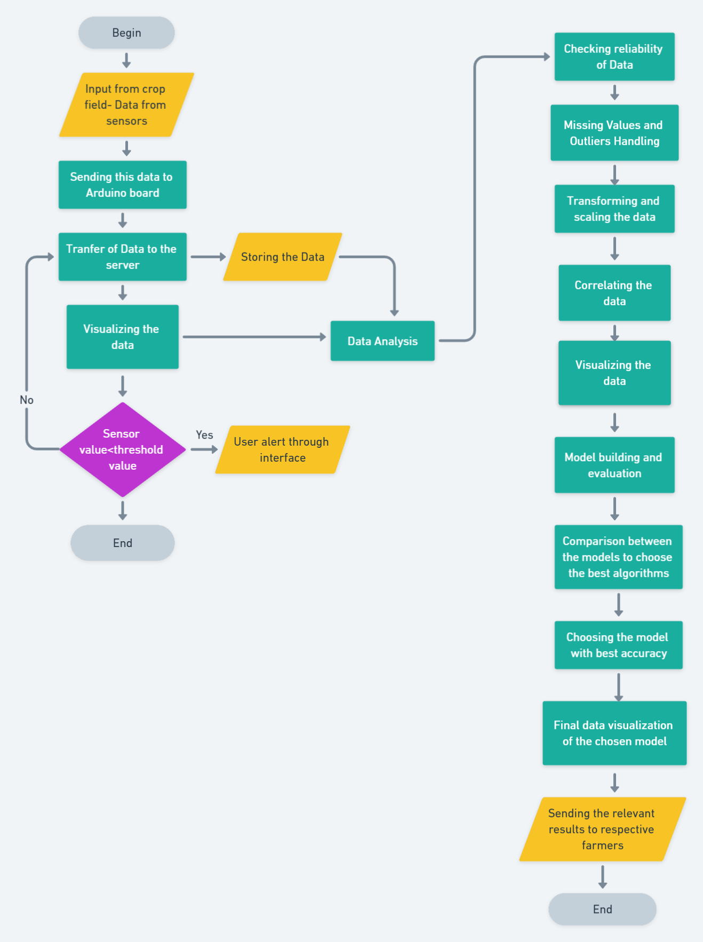
OVERALL FLOW DIAGRAMS

Slide 11
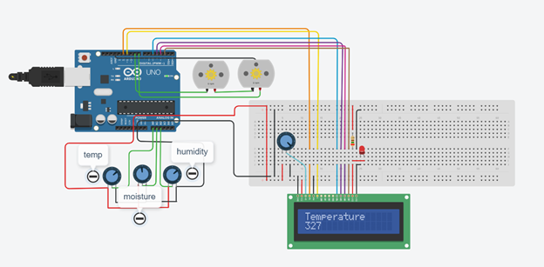
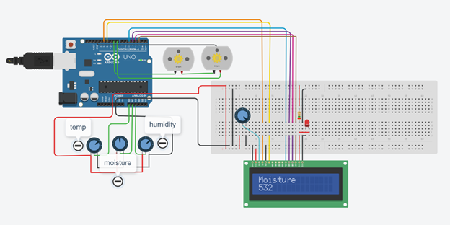
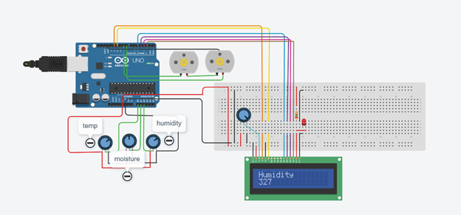

Slide 12
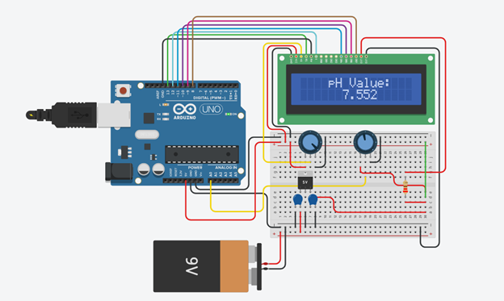
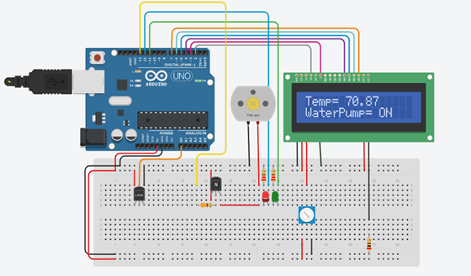

Slide 13
THANK YOU

