Slide 1
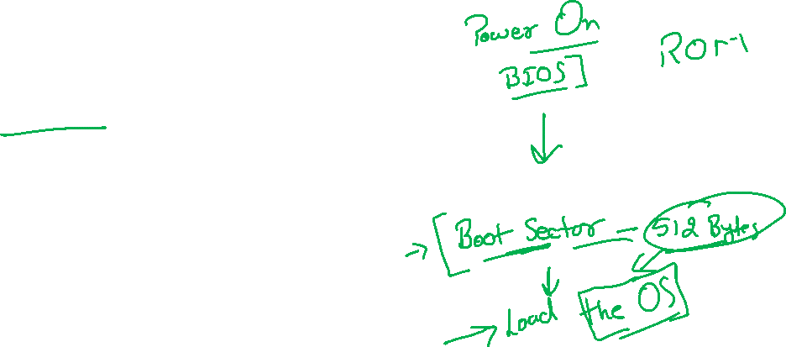
Bootloader

Slide 2

Tools
Text Editor
Nsam
Virtual Box
Assembly Language

Slide 3
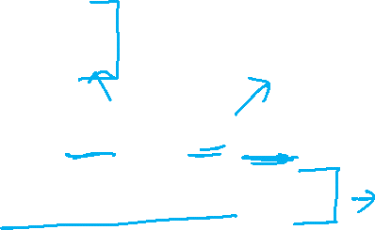
NSAM
Assembly to Machine
sudo apt-get install nasm

Slide 4
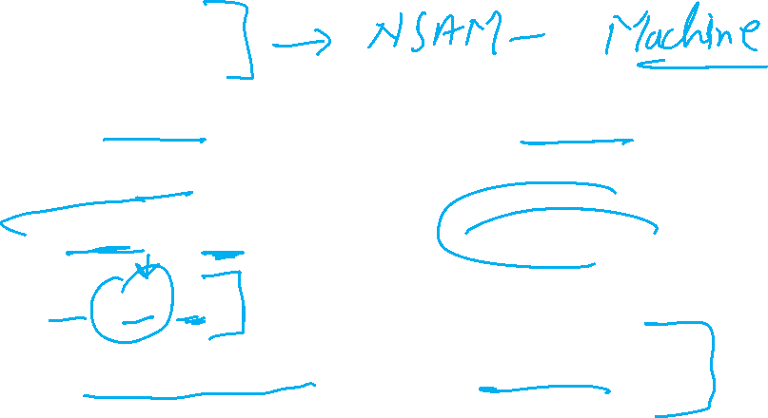
Assembly
a textual way of representing the instructions that a CPU executes
11001001 01101110 ????????
mov ax, 30
is a list of instructions followed in order

Slide 5

Assembly
You can't just print "Hello world" to the screen - the CPU has no concept of what a screen is! Instead, you work with memory, manipulating chunks of RAM, performing arithmetic on them and putting the results in the right place.

Slide 6
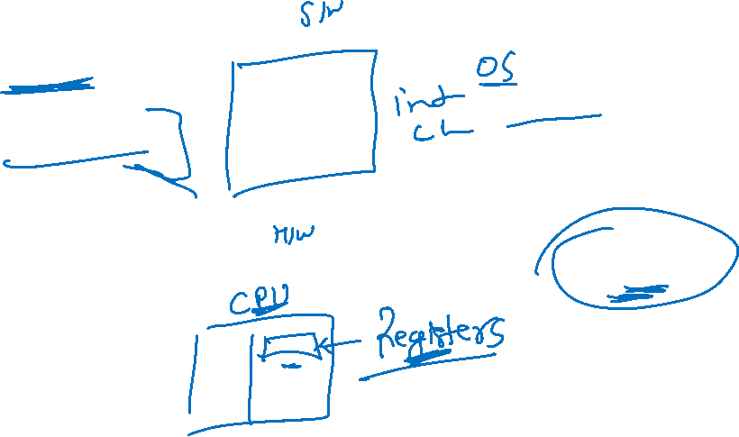
Assembly
No variables
What you do have, however, is a set of registers,

Slide 7
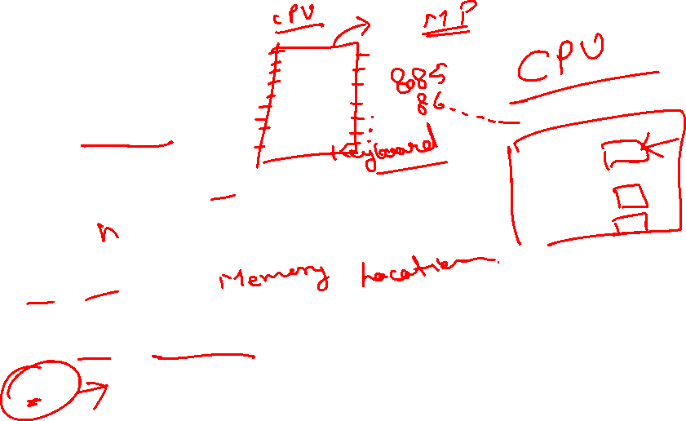
Assembly
General purpose
AX, BX, CX, DX
Source abd destination index registers
SI, DI
Instruction or code pointer
IP

Slide 8
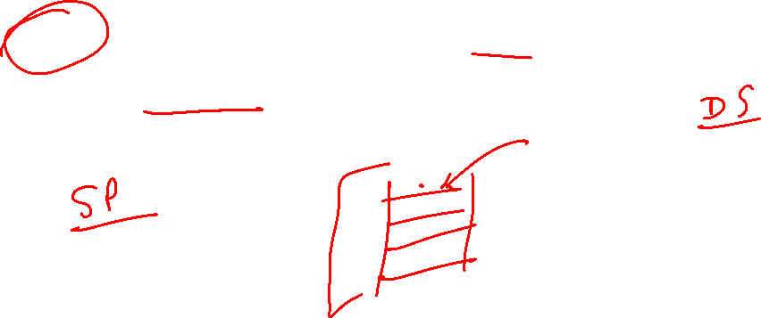
Assembly
Stack is an area of your main RAM used for storing temporary information

Slide 9
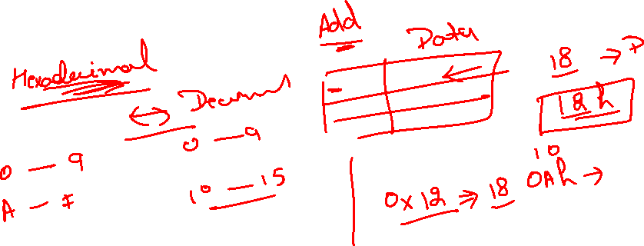
Memory

Slide 10
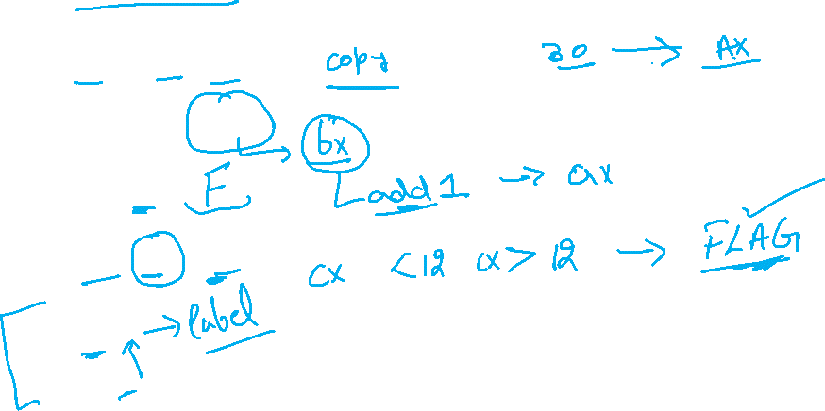
Some Instructions
mov ax, 30
mov ax, [bx]
add ax, Ffh
cmp cx, 12
jump
int

Slide 11
Demo

Slide 12
CODE
BITS 16] ;tell the assembler that its a 16 bit code
[ORG 0x7C00] ;Origin, tell the assembler that where the code will
;be in memory after it is been loaded
JMP $ ;infinite loop
TIMES 510 - ($ - $$) db 0 ;fill the rest of sector with 0
DW 0xAA55 ; add boot signature at the end of bootloader

Slide 13
CODE
MOV AH, 0x0E ;Tell BIOS that we need to print one charater on screen.
MOV BH, 0x00 ;Page no.
MOV BL, 0x07 ;Text attribute 0x07 is lightgrey font on black background
INT 0x10 ;Call video interrupt
RET ;Return to calling procedure
TIMES 510 - ($ - $$) db 0 ;Fill the rest of sector with 0
DW 0xAA55 ;Add boot signature at the end of bootloader
[BITS 16] ;Tells the assembler that its a 16 bit code
[ORG 0x7C00] ;Origin, tell the assembler that where the code will
;be in memory after it is been loaded
MOV AL, 65
CALL PrintCharacter
JMP $ ;Infinite loop, hang it here.
PrintCharacter: ;Procedure to print character on screen
;Assume that ASCII value is in register AL

Slide 14
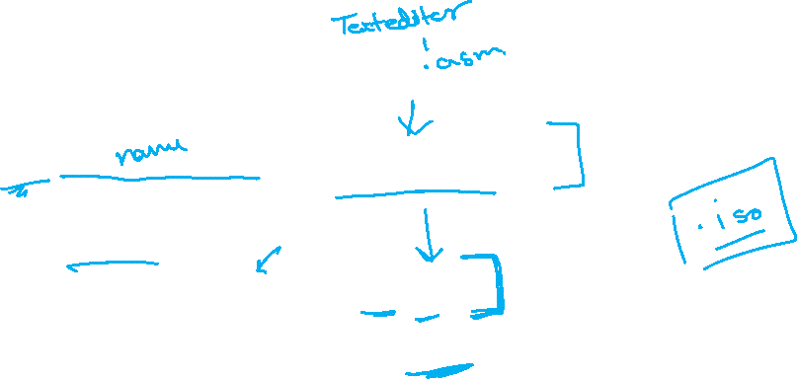
Execution
Compile
nasm first_bootLoader.asm -f bin -o boot.bin
Create a floppy disk image.
dd if=boot.bin bs=512 of=floppy1.img
Attach the floppy image to the Virtual machine and boot. You should see a blank screen

