Slide 1
Minute Miner
Seung Kwon An
Shichiji Ishiyama

Slide 2
What is it?
Process of analyzing large amounts of data via a computer to extract into useful data
Different perspective data analysis
Grants businesses to make productive business decisions via analyzed data knowledge

Slide 3
Purpose of Application
Ease of use
No extensive knowledge of data mining required
Analyze existing data directly from online websites
Suggestions of similar data will be presented to the user
Enable non-professional users to explore data in depth

Slide 4
Enhanced GUI
Clear, concise display of extracted data
Display filtered data (remove unnecessary outlying data)
Visually create a storyline with extraction

Slide 5
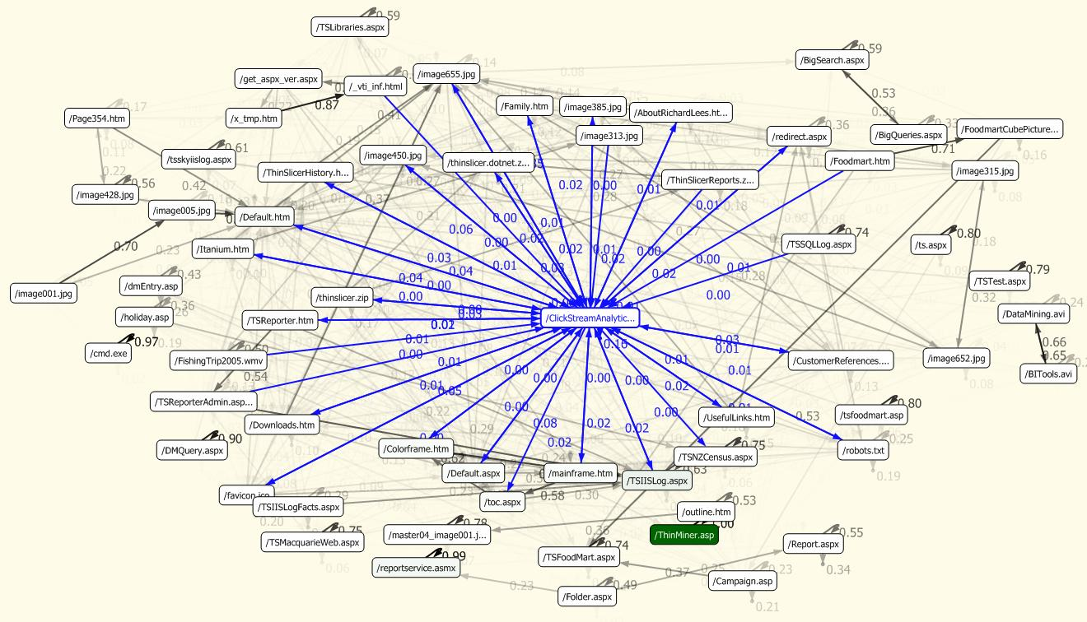

Slide 6
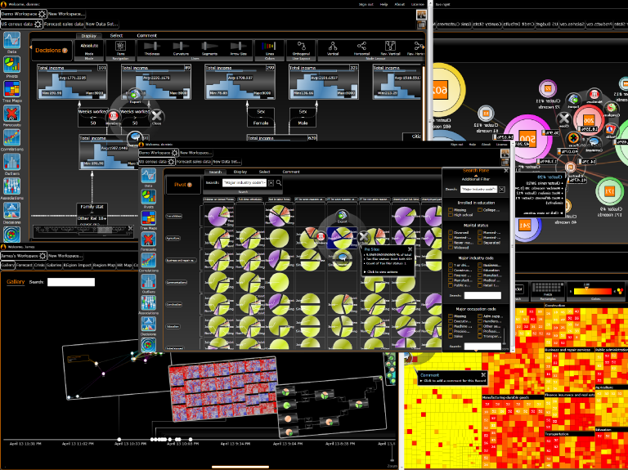

Slide 7
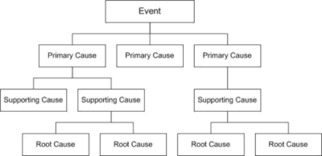
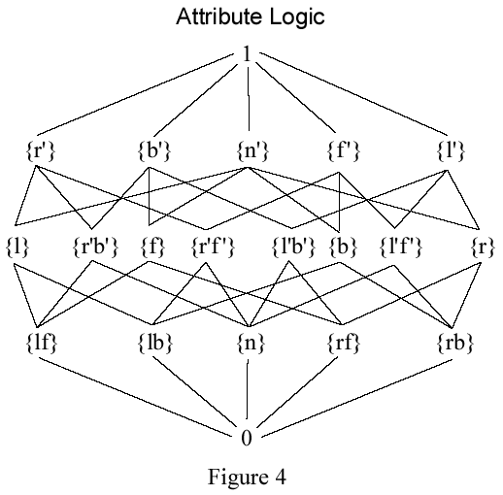
Design Process

Slide 8
Algorithm
Extract HTML Data into .txt file
Visual Representations (Graphs, charts, etc.) to find outliers & concentrated area
Analyze HTML header & metadata information
Count & Highlight frequently used terms (Determine Criteria)
Outlier Examination
Determine keywords/terms from extracted data
Provide data matching sources using keywords

Slide 9
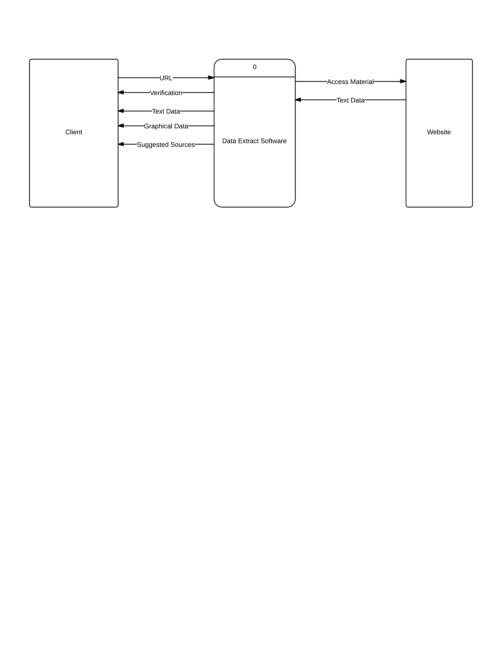
Context

Slide 10
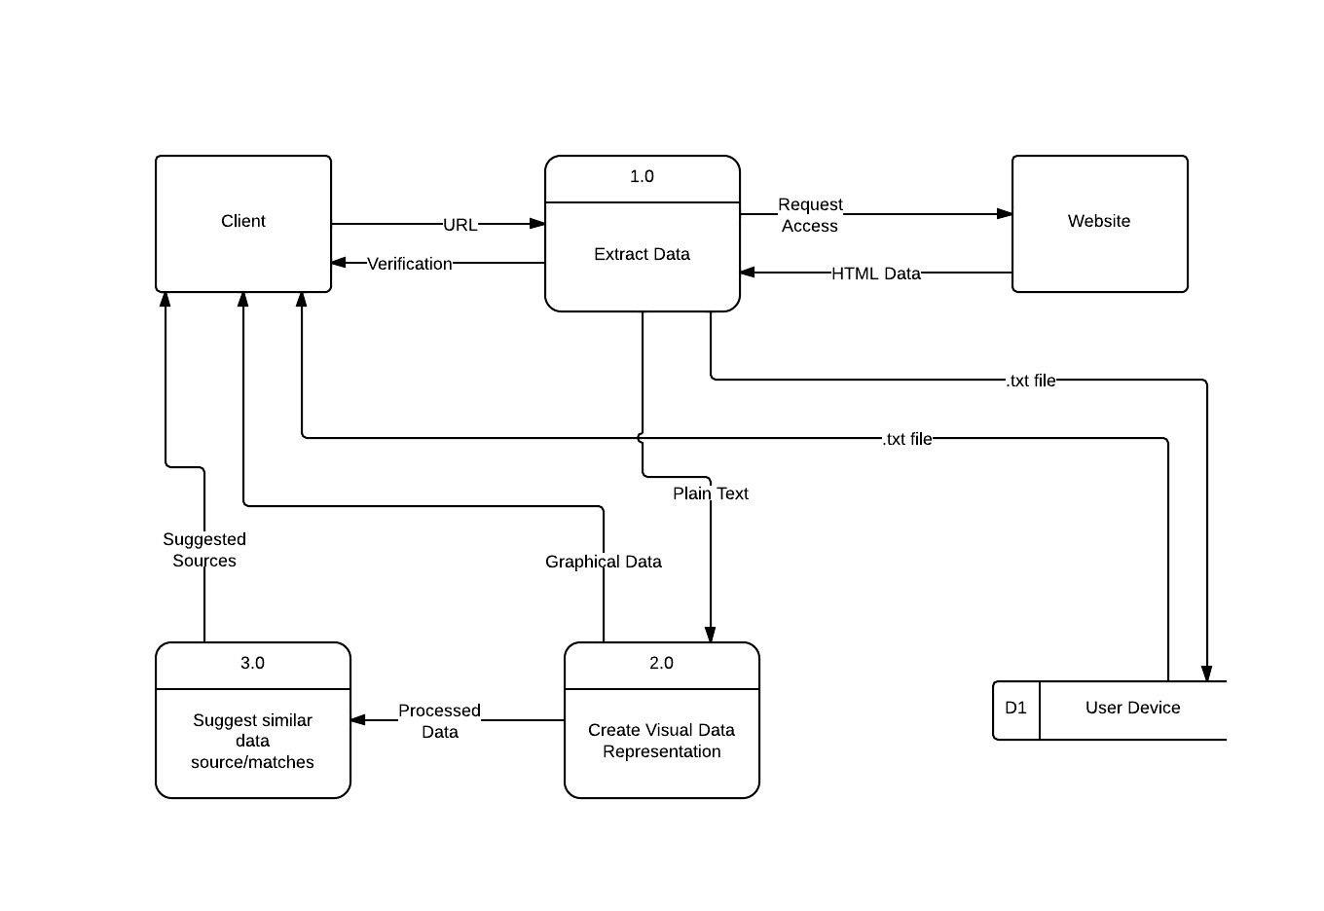
Inside the System

Slide 11
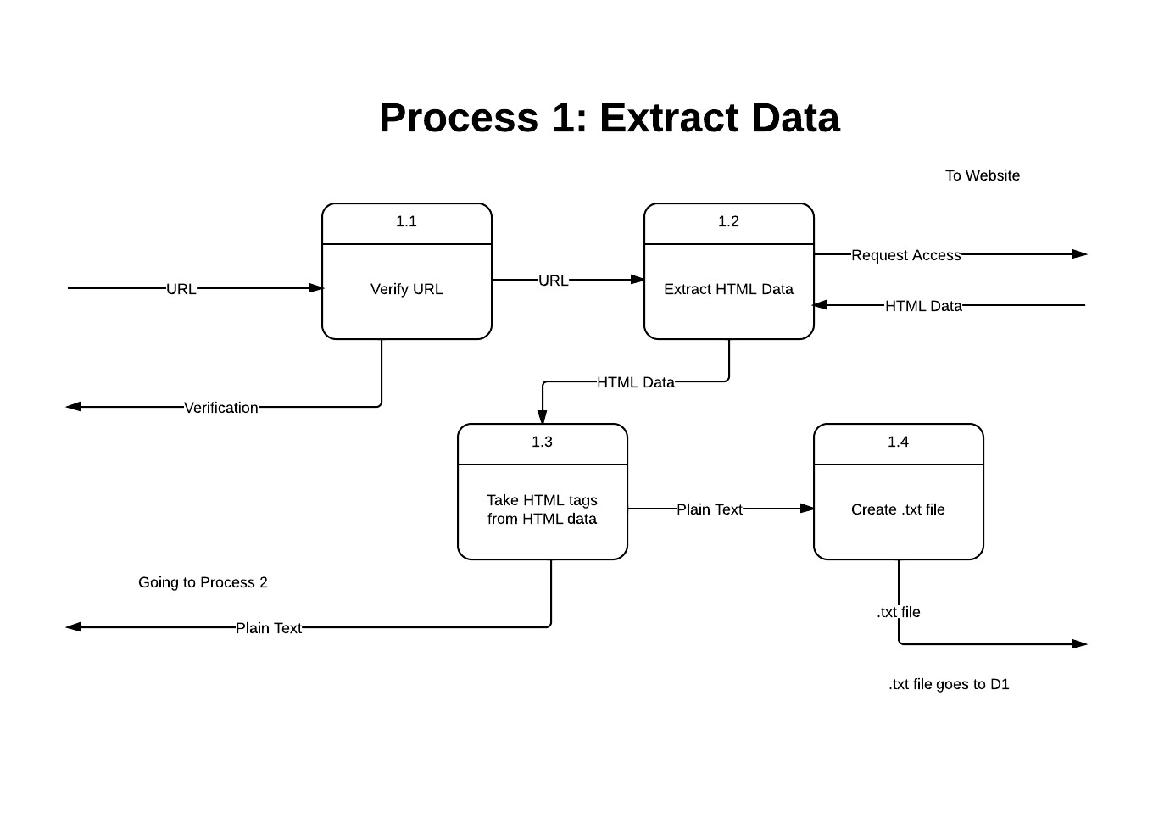
Process 1: Extract Data

Slide 12
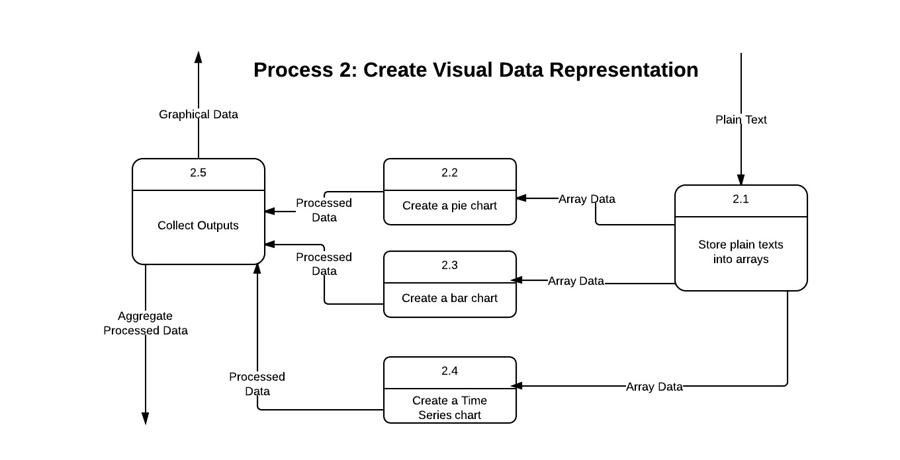
Process 2: Create Visual Data Representation

Slide 13
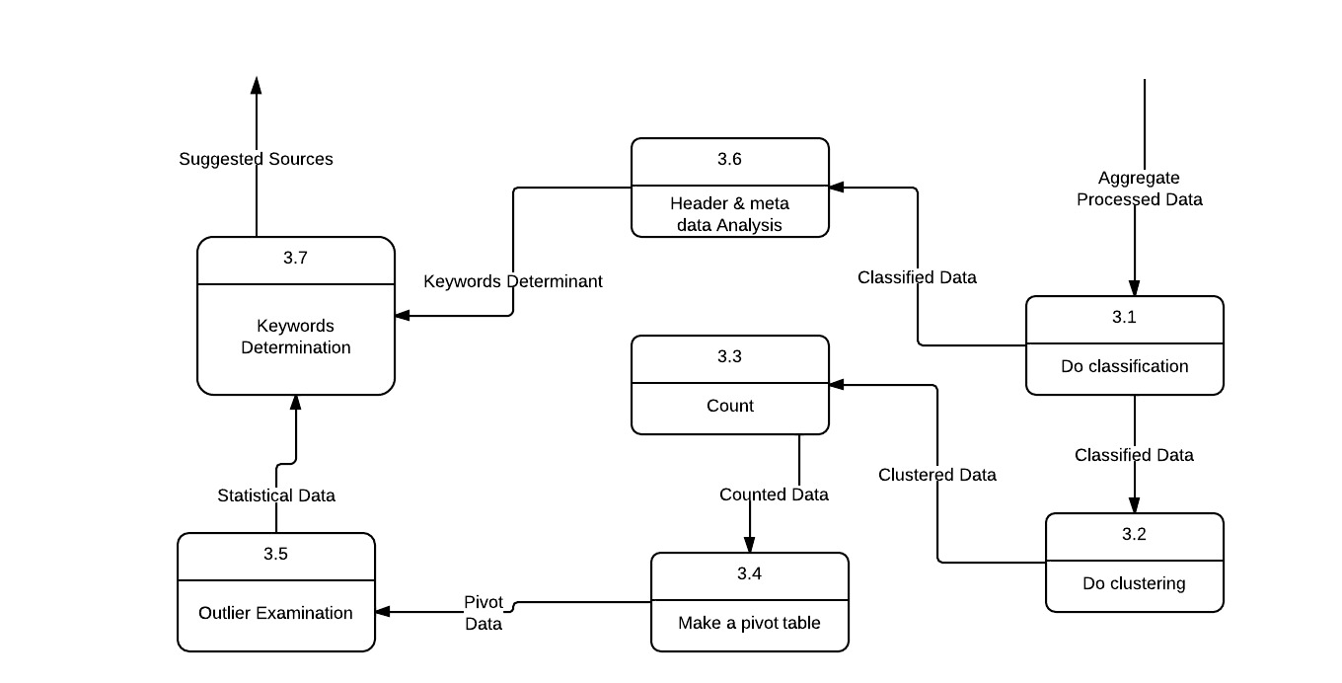
Process 3: Suggest similar data source/matches

Slide 14
Algorithm Summary (Easy)
Extract Data from Website
Give Visual Representations
Give Some Additional Data and Source

Slide 15
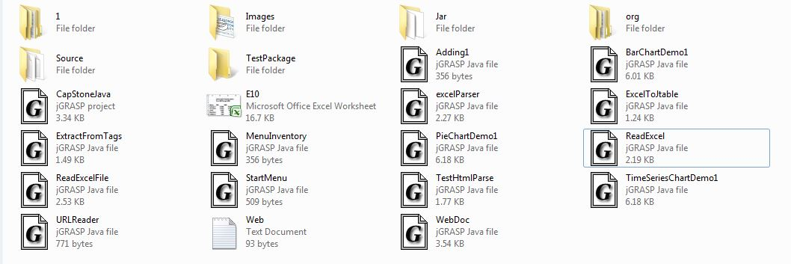

Class Files

Slide 16
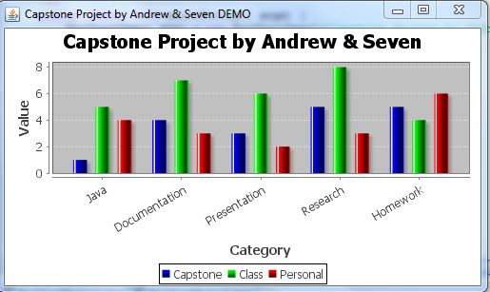
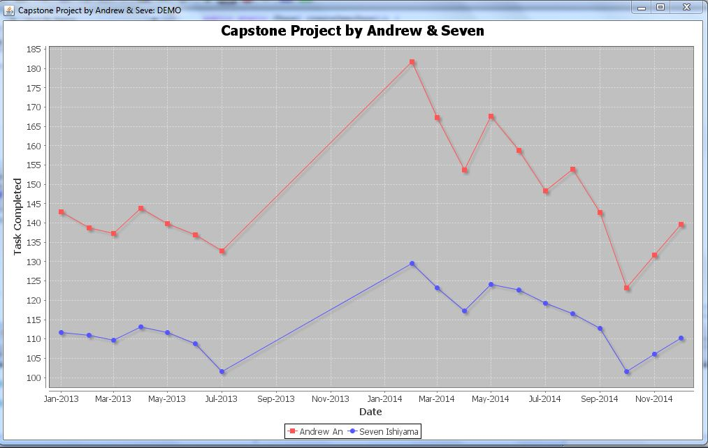
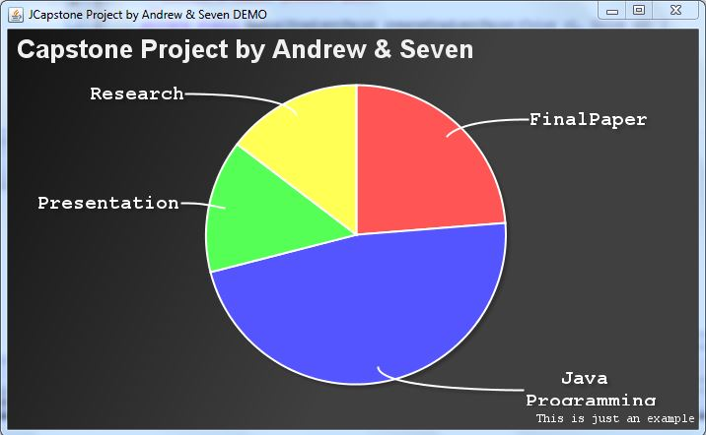
Visual Representations

Slide 17

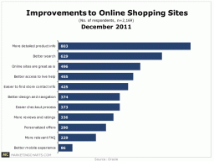
Integration into GUI

Slide 18
We still have a month…..
Minute Miner is written in Java.

Slide 19
Reference
http://www.oracle.com/us/technologies/java/enterprise-edition/overview/index.html
http://stackoverflow.com/
http://www.jfree.org/jfreechart/
http://commons.apache.org/proper/commons-logging/
http://jdmp.eu/
http://htmlcleaner.sourceforge.net/download.php
http://poi.apache.org/download.html
http://jexcelapi.sourceforge.net/
http://www.jgrasp.org/
Corbitt, T. (2003). Business intelligence and data mining. Management Services, 47(11), 18. Retrieved from http://search.proquest.com/docview/234332816?accountid=11243
Frank, E., Holmes, G., Kirkby, R., and Hall, M. (2002). Racing committees for large datasets. In Proceedings of the International Conference on Discovery Science, pages 153–164. Springer-Verlag.
Froelich, J., Ananyan, S., & Olson, D. L. (2005, Winter). Business intelligence through text mining. Business Intelligence Journal, 10, 43-50. Retrieved from http://search.proquest.com/docview/222638608?accountid=11243
Hornik, K., Buchta, C., & Zeileis, A. (2009). Open-source machine learning: R meets weka. Computational Statistics, 24(2), 225-232. doi:http://dx.doi.org/10.1007/s00180-008-0119-7
Sauban, M. and Pfahringer, B. (2003). Text categorisation using document profiling. In Proceedings of the 7th European Conference on Principles and Practice of Knowledge Discovery in Databases, pages 411–122. Springer.

