Slide 1
Remote control PI
This is a project based on my interest.
By wangkangluo1@gmail.com
2013/03/26

Slide 2
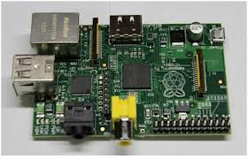
Hardware requirement
1.Raspberry pi
2. A android device, I use nexus s.

