Slide 1
Applied Data Science Capstone – Final Week5
Piriyapong W

Slide 2
Introduction
Bangkok is one of the best places to eat tasty and authentic Thai food. So many restaurants and street vendors selling Thai food are welcoming locals and foreigners every day
Restaurant categories will be classified. Then we will make a recommendation on what types of restaurant are popular for clusters, where we recommend that entrepreneur open and where contractors would setup their office.

Slide 3
Business Problem
We need to search for the perfect and right place to solve our business problems as the following:
To search for the best locations with popular Thai restaurants
To list the locations of all areas and streets in Bangkok which have great Thai restaurants.
To find the best place to live close to fancy food choice
To recommend entrepreneurs or vendors about locations with potential food business and companies that want to find new location based on choice of foods

Slide 4
Data Section:
List of Bangkok areas and neighborhoods
Data source: https://en.wikipedia.org/wiki/Category:Neighbourhoods_of_Bangkok
Description: This set of data contains the required information and will be used to explore all neighborhoods of this city
Thai restaurants and food streets in Bangkok neighborhoods.
Description: To use API we will be able to get all the streets in each neighborhood. Then we will be able to segment Thai restaurants.
Data source: Foursquare API
GeoSpace data
Description: This geo space data will get us all areas, boundaries and streets which help us visualize the map.

Slide 5
Methodology
Collect data of Bangkok areas and neighborhoods from https://en.wikipedia.org/wiki/Category:Neighbourhoods_of_Bangkok
Use Foursquare API to get neighborhood location, latitude and longitude data using geocoder
Categorize vendor’s names and categories for each neighborhood area
Apply K-Means algorithm to cluster the restaurants
Plot the map using Folium to visualize clusters

Slide 6
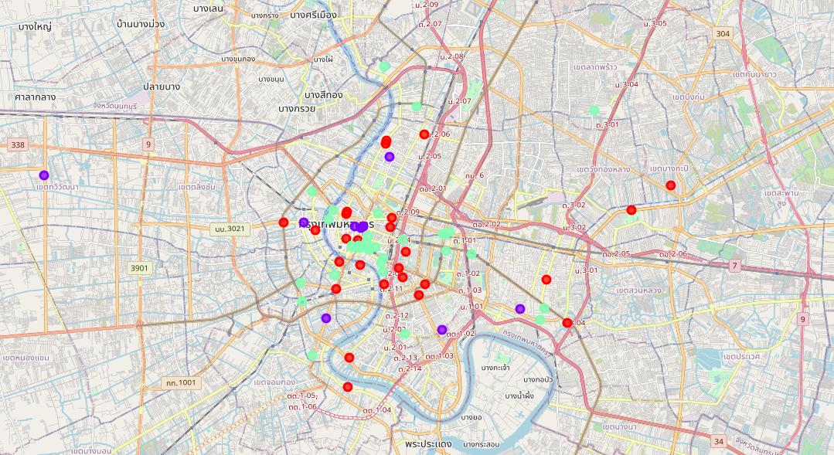
Result
Purple: Low number of Thai restaurants
Red: Moderate number of Thai restaurants
Green: High number of Thai restaurants

