Slide 1

The Possibility to open a New Restaurant in Helsinki

Slide 2
It is a big decision to open a Restaurant in Helsinki
The minimum success criterias are:
The restaurant should be in a neighborhood where population will grow at least 10000 inhabitants until year 2030
Not too many competitors in the same neighborhood at this time
If the transport connections are good would also help.

Slide 3
Data needed
List of Helsinki neighborhoods
Geolocator to get coordinates of neighborhoods.
A table where is the Helsinki population growth from year 2019 to year 2030
The explore function is used to get the most common venue categories in each neighborhood of Helsinki
Clustering neighborhoods is used to give similarity information
Top venue categories in neighborhoods
The amount of competitors

Slide 4
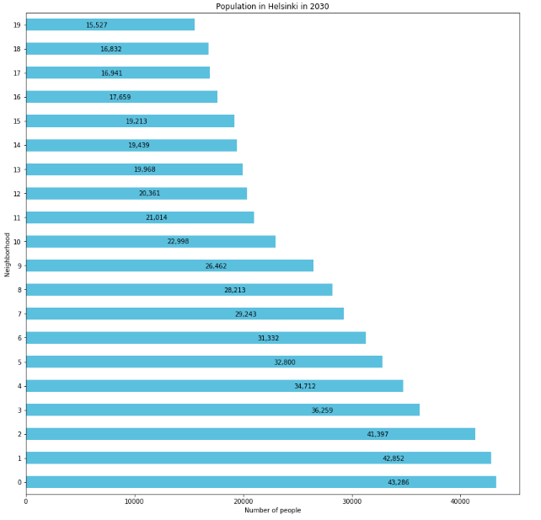
How to do the analysis
The population difference is big between Helsinki neighborhoods in 2030.

Slide 5
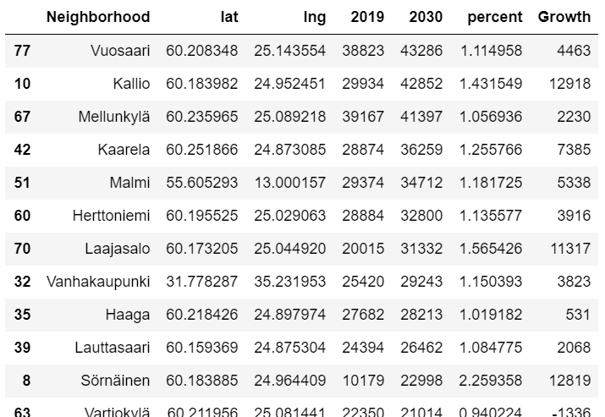
How to do the analysis
We calculate the percentage and sum of he population growth
Only the largest increases are taken into account

Slide 6
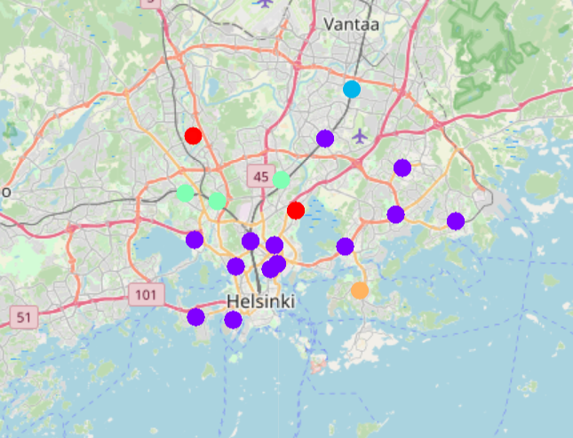
How to do the analysis
The neighborhoods were clustered into 5 clusters by k-means and the values and a map is produced

Slide 7
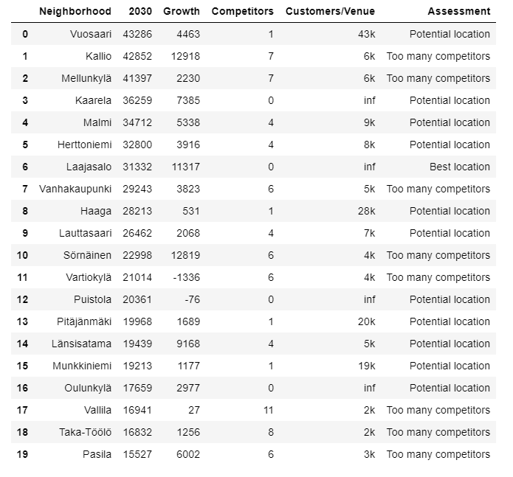
How to do the analysis
The competing were identified and counted and the results are presented in a table

Slide 8
Conclusions
There is not much data from Helsinki in Foursquare. For effective data analysis it would need even more venues in Foursquare
The decision should not be made on the basis of this study alone because the results are always indicative only.
You should also go on site to ensure that the environment also meets expectations.
At this moment no one knows how COVID-19 will affect the future.

