Slide 1
TEAM 17: Julia Janicki, Yucheng Tu, Laura Kerzman
CS-570 INTRODUCTION TO HUMAN-COMPUTER INTERACTION
TRAVEL DESTINATION RECOMMENDATION
and/or TRAVEL BUDDY MATCHING SITE
Purpose:
Design a website that will recommend people travel destinations if they don’t have one in mind
Users:
General public, whoever travels for fun
SETTING: Home, coffee shops
SITE(S):

Slide 2
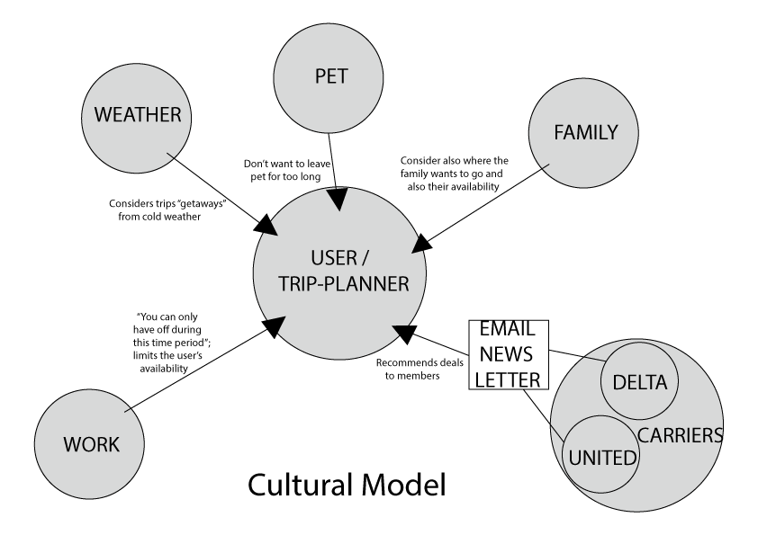
Work model examples

Slide 3
Observations and Design Ideas
Breakdowns and Workarounds
- Cannot find what they are looking for - Cannot see clearly
- Uses search box instead
Design Ideas and Good Functionalities
Large enough font size
Accessible, obvious and simple menu tabs and icons
Add a search box
Add a photo gallery
Add an event calendar
Allow people to have options
People really consider deals and prices, so include that

Slide 4
