Slide 1
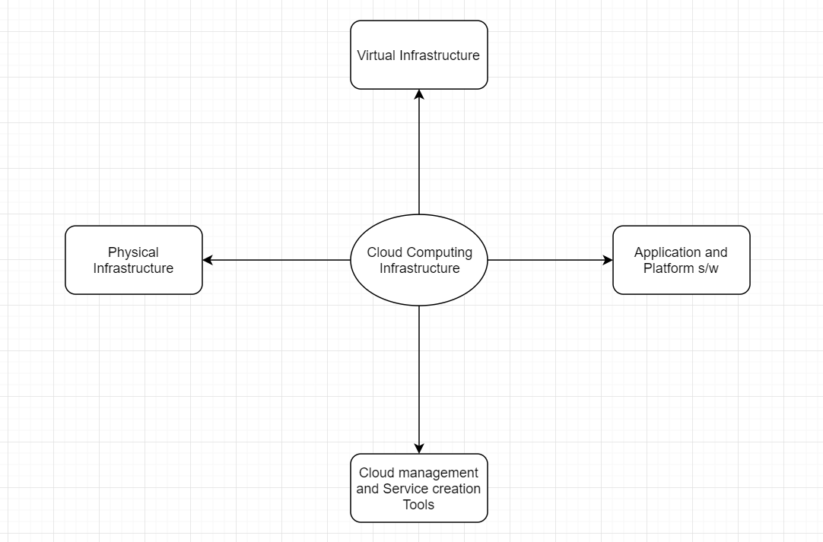

Slide 2
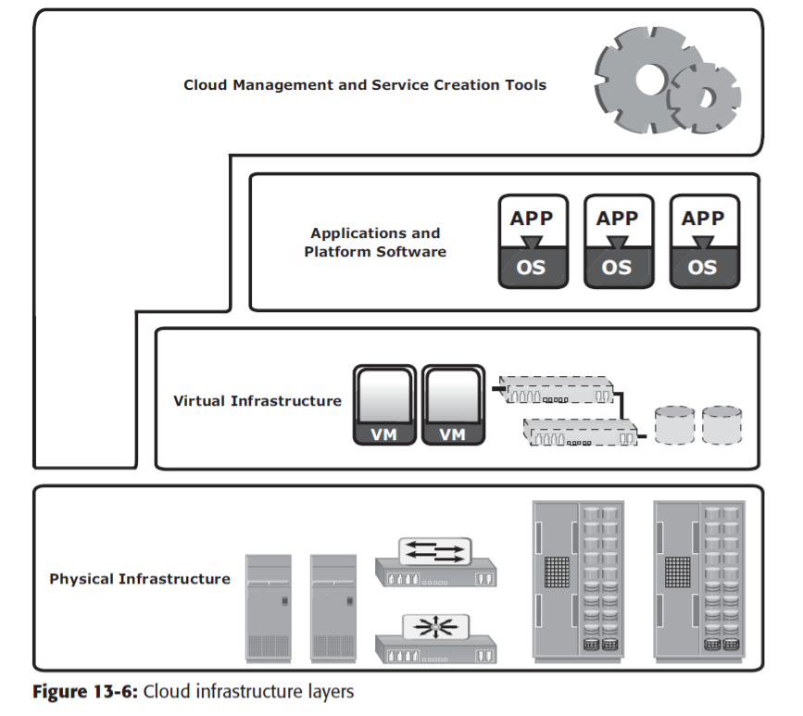

Slide 3
Physical Infrastructure
Included physical computing resources such as
Physical Servers
Storage Systems
N/Ws (IP, IP SAN, FC SAN, FCoE)

Slide 4
Virtual Infrastructure
Virtual infrastructure is built on top of the physical layer
Allows for:
Resource pooling
Rapid elasticity
Helps reduce the cost of providing cloud services
Multiple CPUs at the physical layer may be consolidated together at the virtual layer to provide computing resource pool
Similarly there is memory pool (RAM), N/W pool, and storage pool

Slide 5
Applications and Platform Software
Applications and platform are hosted on virtual M/Cs to create:
PaaS (Only platform services are given)
SaaS (Both application and platform are provided)
PaaS- operating system, programming language execution environment, database, web server etc.
Examples: AWS Elastic Beanstalk, Windows Azure, Heroku, Force.com, Google App Engine, Apache Stratos
SaaS Examples: Microsoft Office Suite

Slide 6
Cloud management and Service Creation Tools
They include 3 types of s/w:
Physical and virtual infrastructure management s/w
Unified management s/w
User-access management s/w
Physical and virtual infrastructure management s/w provides interface to construct a virtual infrastructure from the underlying physical infrastructure
Unified management s/w allows an administrator to monitor performance, capacity, and availability of physical and virtual resources.
User-access management s/w provides a web based user interface to consumers where they can view the catalogue and request cloud services.

Slide 7
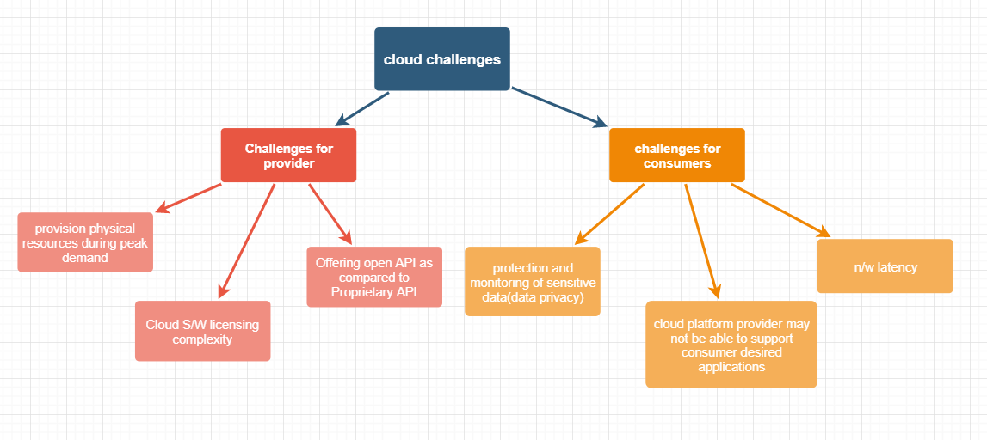
Cloud Challenges

Slide 8
Cloud adoption considerations
Selection of deployment model:
Public cloud (individuals; backup, archive and testing of companies)
Private cloud (large companies that use OLTP[Online Transaction Processing])
Hybrid cloud (medium size companies)
Application suitability:
n/w traffic intensive applications may not be suitable
Non-proprietary and non-mission critical applications are suitable
Financial advantage:
They should consider cost of deployment and maintenance
CAPEX (Capital Expenditure) and OPEX(Operational Expenditure)
Basically ROI (Return Of Investment) should be high
Selection of cloud service provider:
Reliability
Ease of migration
Security, legal and privacy requirements
SLA(Service Level Agreement)
QOS (Quality Of Service)- throughput and uptime
Check if QOS is good or not

