Slide 1
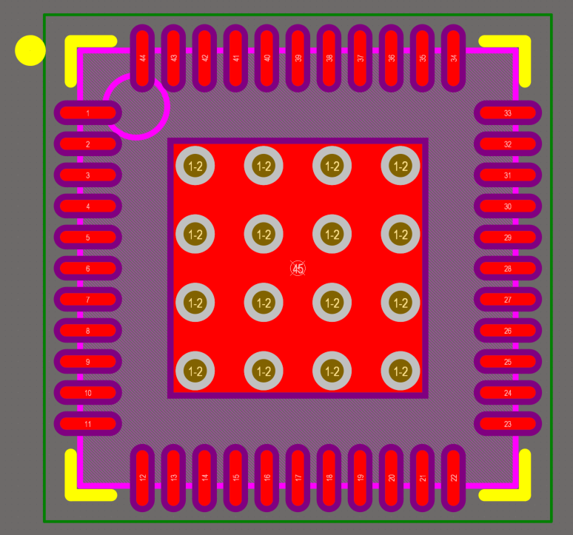
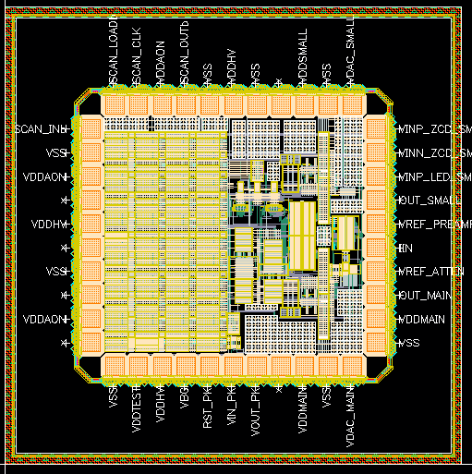
Chip Dimensions: 2.5mm x 2.5mm
Chip Pads: 100μm x 100μm, 130μm Pitch,
Footprint: QFN, 44-Leads, Body 7.00x7.00mm, Pitch 0.50mm, Thermal Pad 4.00x4.00mm, IPC Medium Density

