Slide 2
Alkalmazásfejlesztés Oracle-ben az NI-nál
Erdős Péter

Slide 3
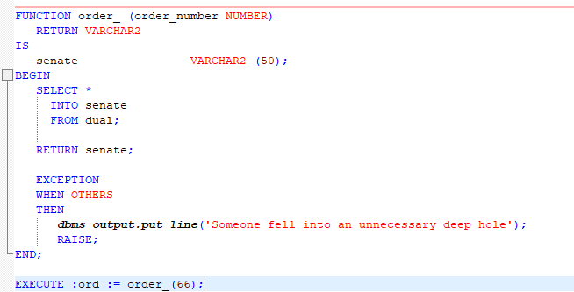
Agenda
SQL
PL/SQL
ERP rendszerek
Oracle EBS

Slide 4
SQL
Structured Query Language
Standard language to access relational databases
The most basic syntax of SQL starts with a SELECT clause and a FROM clause. A SELECT clause tells the database WHAT you want to select. A FROM clause tells the database where to find that data.
SELECT table_name
FROM all_tables
ORDER BY table_name;

Slide 5
SQL - DML
DML are the keywords you use to access and manipulate data
SELECT, UPDATE, INSERT, MERGE, DELETE, etc
INSERT INTO whatever (column1, column2, column3)
VALUES (1, 'Text Data', sysdate );
SELECT column1, column2, column3
FROM whatever;
COMMIT;

Slide 6
SQL - DDL
DDL are the keywords you use to create objects such as views, tables and procedures etc.
CREATE TABLE, ALTER VIEW, CREATE OR REPLACE PROCEDURE, etc.
CREATE TABLE whatever (
column1 NUMBER NOT NULL,
column2 VARCHAR2(10),
column3 DATE );

Slide 7
PL/SQL
PL/SQL is the Oracle native programming language that provides database-centric application development. It can natively call static SQL and provides multiple methods of calling dynamic SQL
PL/SQL is a procedural language like C++, Java, ADA, etc. It has variables and variable declarations, conditional controls like IF and CASE. It has looping structures such as LOOP, FOR LOOP and the WHILE LOOP. PL/SQL uses SQL to use, manipulate and save data to the database.
BEGIN
-- A PL/SQL cursor
FOR c1 IN (
SELECT * FROM whatever ) -- This is SQL called by PL/SQL
LOOP
DBMS_OUTPUT.PUT_LINE( 'Column1 is: ' ||TO_CHAR(c1.column1) ||
', Column2 is: ' || c1.column2 ||
', Column3 is: ' || TO_CHAR(c1.column3 ) );
END LOOP;
END;

Slide 8
Differences between SQL and PL/SQL
SQL is a data-oriented language for selecting and manipulating sets of data. PL/SQL is a procedural language to create applications. You don't normally have a "SQL application". You normally have an application that uses SQL and a relational database on the back-end. PL/SQL can be the application language just like Java or PHP can. SQL may be the source of data for your screens, web pages and reports. PL/SQL might be the language you use to build, format and display those screens, web pages and reports.

Slide 9
PL/SQL - Declarations
Variables are placeholders that store the values that can change through the PL/SQL Block.
Local variables - These are declared in a inner block and cannot be referenced by outside Blocks.
Global variables - These are declared in a outer block and can be referenced by its itself and by its inner blocks.
DECLARE
var_num1 number;
var_num2 number;
BEGIN
var_num1 := 100;
var_num2 := 200;
DECLARE
var_mult number;
BEGIN
var_mult := var_num1 * var_num2;
END;
END;
/

Slide 10
PL/SQL - Statements
IF THEN ELSE STATEMENT
1)
IF condition
THEN
statement 1;
ELSE
statement 2;
END IF;
2)
IF condition 1
THEN
statement 1;
statement 2;
ELSIF condtion2 THEN
statement 3;
ELSE
statement 4;
END IF;

Slide 11
PL/SQL - Statements
Iterative Statements are used when we want to repeat the execution of one or more statements for specified number of times.
There are three types of loops in PL/SQL:
Simple Loop
LOOP
statements;
EXIT;
{or EXIT WHEN condition;}
END LOOP;

Slide 12
PL/SQL - Statements
Iterative Statements are used when we want to repeat the execution of one or more statements for specified number of times.
There are three types of loops in PL/SQL:
While Loop
WHILE <condition> LOOP
statements;
END LOOP;

Slide 13
PL/SQL - Statements
Iterative Statements are used when we want to repeat the execution of one or more statements for specified number of times.
There are three types of loops in PL/SQL:
For Loop
FOR counter IN val1..val2
LOOP statements;
END LOOP;
val1 - Start integer value.
val2 - End integer value.

Slide 14
PL/SQL – Dynamic SQL
Dynamic SQL is a programming methodology for generating and running SQL statements at run time. It is useful when writing general-purpose and flexible programs like ad hoc query systems, when writing programs that must run database definition language (DDL) statements, or when you do not know at compilation time the full text of a SQL statement or the number or data types of its input and output variables.
For example, a SELECT statement that includes an identifier that is unknown at compile time (such as a table name) or a WHERE clause in which the number of subclauses is unknown at compile time
The EXECUTE IMMEDIATE statement builds and runs a dynamic SQL statement in a single operation.

Slide 15
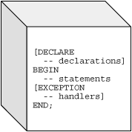
PL/SQL – Blocks
A PL/SQL block has three basic parts:
a declarative part (DECLARE),
an executable part (BEGIN .. END),
and an exception-handling (EXCEPTION) part that handles error conditions.
Only the executable part is required. The optional declarative part is written first, where you define types, variables, and similar items. These items are manipulated in the executable part. Exceptions raised during execution can be dealt with in the exception-handling part.

Slide 16
PL/SQL – Procedure
A subprogram is a program unit/module that performs a particular task. These subprograms are combined to form larger programs. This is basically called the 'Modular design'. A subprogram can be invoked by another subprogram or program which is called the calling program.
A subprogram can be created:
At schema level
Inside a package
Inside a PL/SQL block
CREATE OR REPLACE PROCEDURE greetings AS
BEGIN
dbms_output.put_line('Hello World!');
END;
/

Slide 17
PL/SQL – Function
A PL/SQL function is same as a procedure except that it returns a value.
CREATE OR REPLACE FUNCTION totalCustomers RETURN number IS
total number(2) := 0;
BEGIN
SELECT count(*) into total
FROM customers;
RETURN total;
END;
/

Slide 18
PL/SQL – Package
PL/SQL lets you bundle logically related types, variables, cursors, and subprograms into a package, a database object that is a step above regular stored procedures. The packages defines a simple, clear, interface to a set of related procedures and types that can be accessed by SQL statements.
Packages usually have two parts: a specification and a body. The specification defines the application programming interface; it declares the types, constants, variables, exceptions, cursors, and subprograms. The body fills in the SQL queries for cursors and the code for subprograms.

Slide 19
PL/SQL – Exception Handling
In PL/SQL, a warning or error condition is called an exception.
Exceptions can be internally defined (by the run-time system) or user defined. Examples of internally defined exceptions include division by zero and out of memory.
When an error occurs, an exception is raised. That is, normal execution stops and control transfers to the exception-handling part of your PL/SQL block or subprogram.
Internal exceptions are raised implicitly (automatically) by the run-time system.
User-defined exceptions must be raised explicitly by RAISE statements, which can also raise predefined exceptions.
To handle raised exceptions, you write separate routines called exception handlers.
After an exception handler runs, the current block stops executing and the enclosing block resumes with the next statement.
If there is no enclosing block, control returns to the host environment.

Slide 20

Oracle E-Business Suite

Slide 21
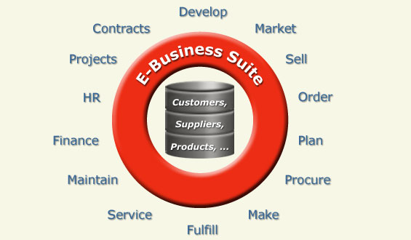
Integrált vállalatirányítási rendszer
Notes:
ERP: olyan integrált vállalatirányítási rendszer amely elősegíti egy cég profitorientált működését. (információ=pénz). Ma a világban több ERP rendszer közül lehet választani, a legnagyobbak az Oracle, az SAP, illetve a Microsoft termékei. De található a piacon egyéb, akár ingyenes rendszerek is. Az oracle vállalatirányitási rendszerét az EBS-t a világpiac kb ¼-e választja, köztük az NI is. Változatos, mindent kielégítő modulok, jó Support kapcsolat, kedvezmények stb.
Egy ERP rendszer modulokkal fedi le a működési területeket, pár példa a modulokra:
Néhány ERP modul: - termelésirányítás, gyártás - kereskedelem: beszerzés, értékesítés, visszáru-kezelés - készletnyilvántartás és kezelés - emberi erőforrás gazdálkodás - pénzügy - ügyfélkapcsolat kezelés - üzleti elemzés, adatbányászat - vállalati portál (pl: webáruház)

Slide 22
ERP systems
ERP = Enterprise Resource Planning
Data of the business processes are collected in one system
Automates the tasks generated by business processes
Based on database
Unified user interface (GUI)
Built of modules in most cases (e.g. financial, customer, supplier, manufacturing data), generally these can be bought and installed independently from each other
Customizable
Appropriate for making integrated analysis, executive summary
Can be useful for small companies
Expected for big companies

Slide 23
ERP systems
Well-known ERP systems:
Oracle Applications (Oracle)
SAP / Small Business One (SAP SBO)
AXAPTA (Microsoft)
Navision (Microsoft)
IFS Applications (Swedish)
LIBRA (Hungarian: Volán Elektronika)
Microsoft Dynamics
etc.

Slide 24
Modules (applications) in Oracle Applications
Oracle Applications is an ERP system made up of modules that can be purchased and installed independently from each other
These applications cover the business processes of the given business areas
Modules can be divided into 2 groups:
ERP: Financials, Manufacturing, Order Management, Purchasing, Supply Chain Planning, HRMS (human resource management)
CRM: Business Intelligence, Marketing, Sales, Call Center

Slide 25
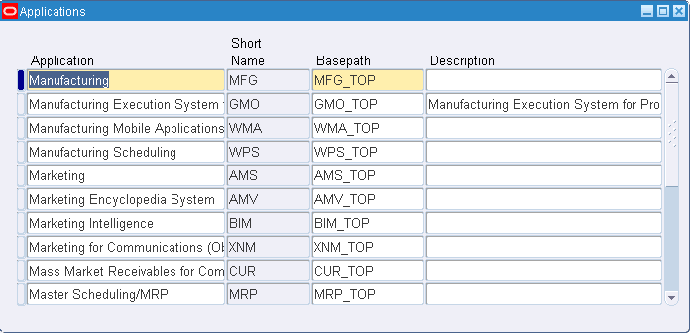
Modules (applications) in Oracle Applications
Oracle applications:
Inventory (INV)
Bill of Material (BOM)
Manufacturing (MFG)
Order Entry (OE)
Purchasing (PO)
Work in Process (WIP)
etc.
Custom applications:
NIINV, NIBOM, NIMFG, NIOE, NIPO, NIWIP, NIMRP, NIMSC etc.

Slide 26
Bevezetés az Oracle EBS világába
ERP systems
Oracle Applications
Logging in, menu, responsibility
GUI (LOV, flexfields, querying data etc.)
Modules (applications)
AOL objects Value set, Oracle Alert, Quick code, Flexfield, Concurrent program, Request set
How to create a new Concurrent program (form, function, menu)
Accessible programs and forms for a user (user, responsibility, request group, menu)

Slide 27
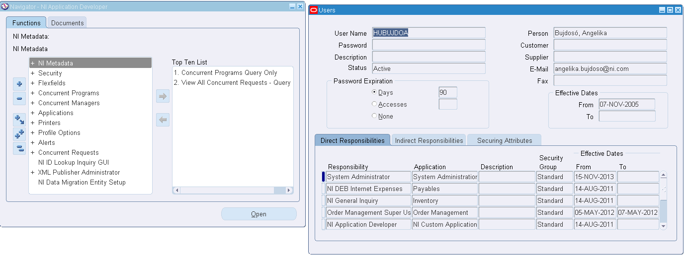
Menu, Responsibilities
Once you open a form a new menu window opens as well...

Slide 28
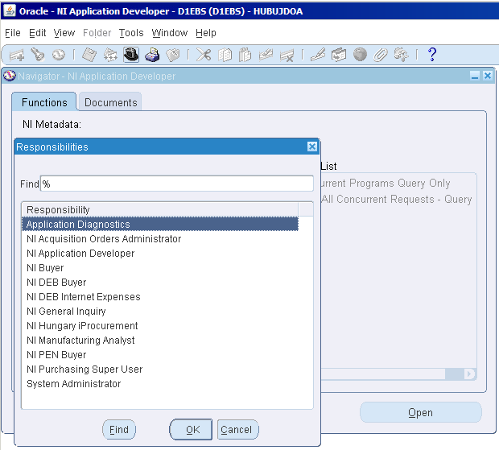
Changing responsibility
Click on the top hat icon and choose another responsibility assigned to the current user

Slide 29
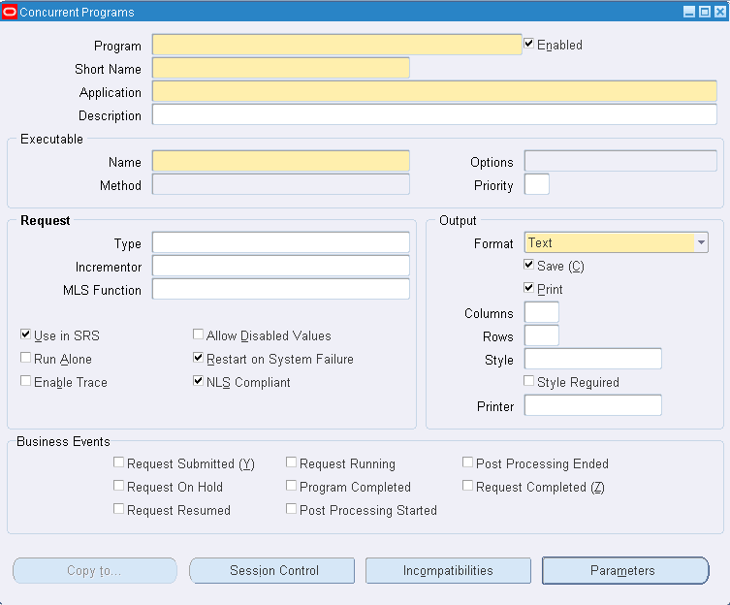
Oracle Applications GUI
Meaning of colors:
Mandatory: yellow
Optional: white
Disabled: grey

Slide 30
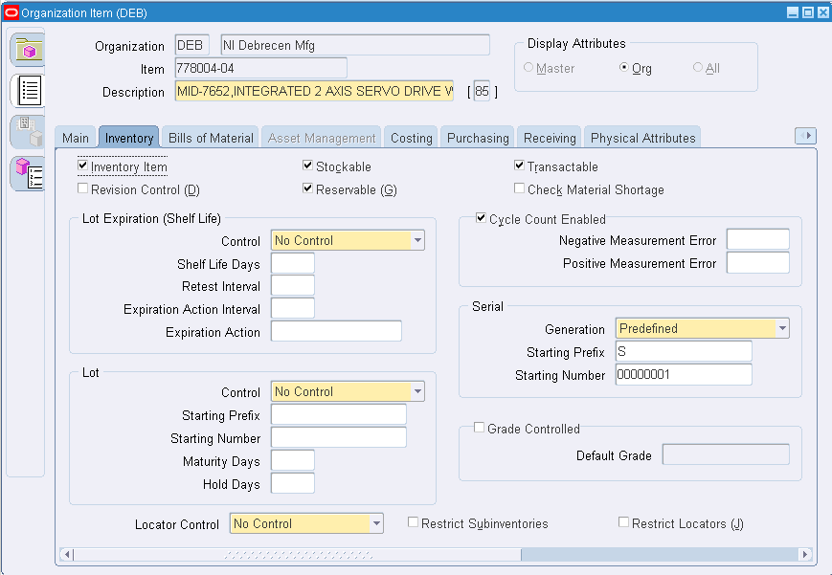
Oracle Applications GUI
User interface elements:
text boxes
buttons
checkboxes
radio buttons
tabs
scrollbars
list of values
combo boxes
etc.

Slide 31
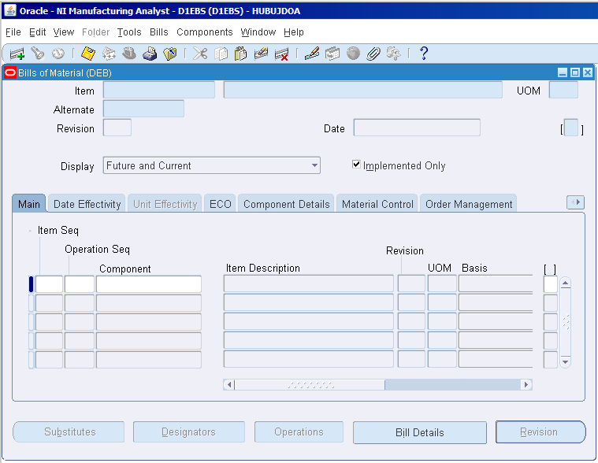
Querying Data
Entering „Enter Query” mode:
F11
Executing the query:
CTRL + F11
Leaving „Enter Query” mode:
F4

Slide 32
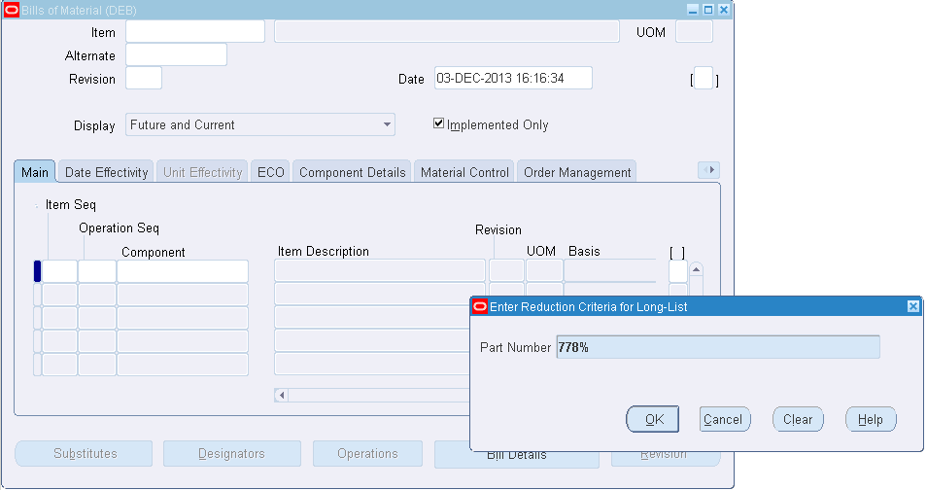
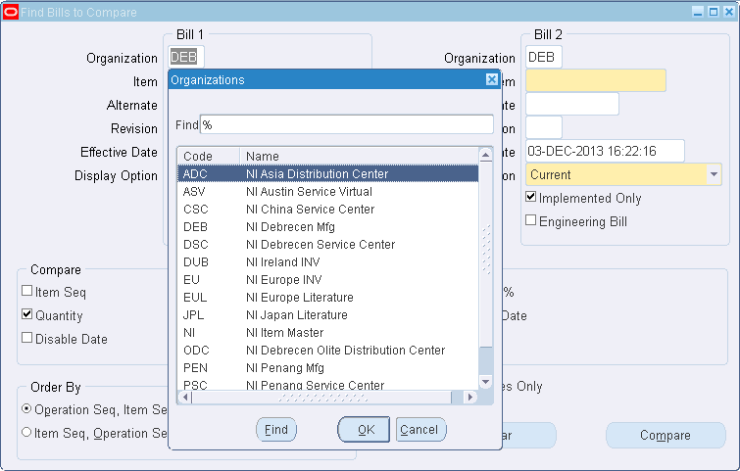
List Of Values (LOV)
Opening a list of values (LOV): clicking on the „…” button next to the field

Slide 33
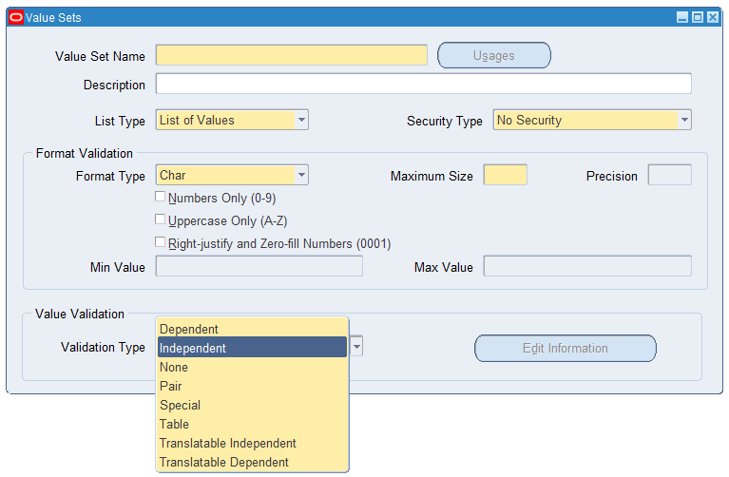
Value Sets
Notes:
Value sets define what values can be assigned to certain objects (concurrent program parameters, flexfield segments, metadata etc.).
- a container of values, values can be of any data type (char, number etc.)
- used to restrict the values entered by the users
- can be used for flexfield segments, concurrent program parameters, metadata used_by and values

Slide 34
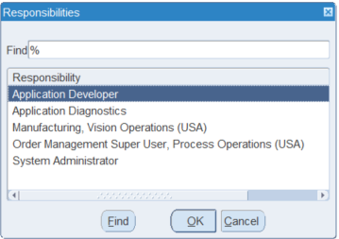
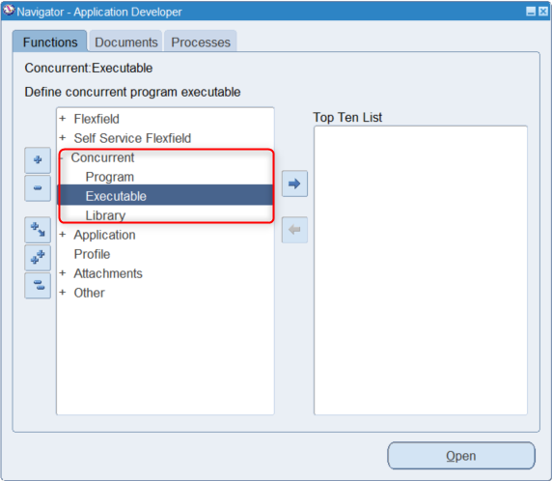
Executables
Notes:
The execution file is either a procedure stored in the database or a file existing in the file system.

Slide 35
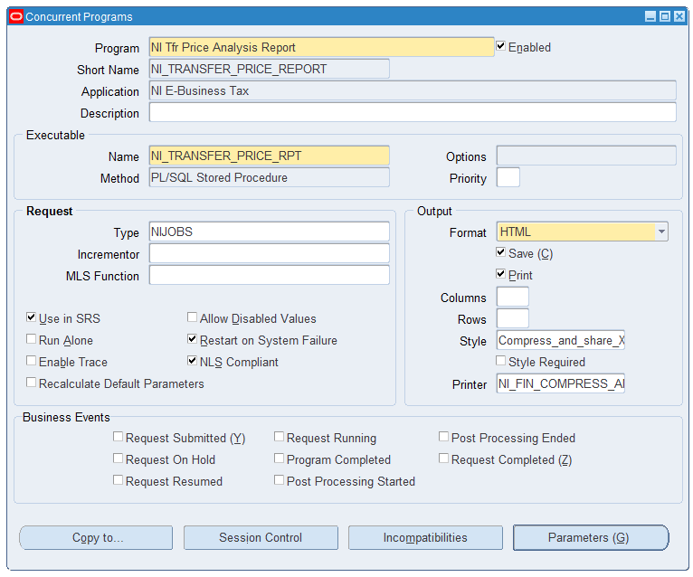
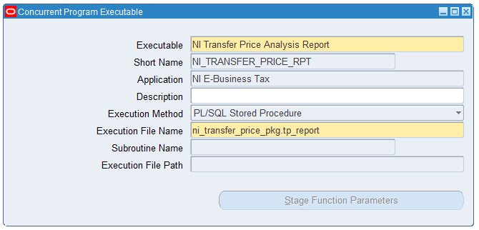
Concurrent Programs - Executable
Notes:
In Oracle Applications, concurrent programs are system batch jobs that retrieve and push data between Oracle applications and the database. Concurrent programs can be comprised of a single request or a request set containing more than one concurrent program. Concurrent programs usually have logs associated them that provide details of the concurrent program data.

