Slide 1
Sugar & splice support for pistoia helm
Roger Sayle
NextMove Software, Cambridge, UK
HELM Showcase Webinar, Wednesday 9th July 2014

Slide 2
Executive summary
Sugar & Splice is NextMove Software’s toolkit for registering/working with biopolymers.
  (Non-standard) Oligopeptides, oligosaccharides, oligonucleotides, antibodies and drug conjugates.
Perception and file format conversion.
  Structure-to-name, Name-to-structure & 2D depictions.
Complements Pistoia HELMs Editor GUI and standard exchange format.
HELM Showcase Webinar, Wednesday 9th July 2014

Slide 3

Perception engine
Pistoia HELM
PDB
IUPAC Condensed
MOL
PLN
SMILES
IUPAC NAME
inchi
2D DEPICTIONS
FASTA/SEQUENCE
Uniprot record
aB isotype/cdrs
HELM Showcase Webinar, Wednesday 9th July 2014

Slide 4
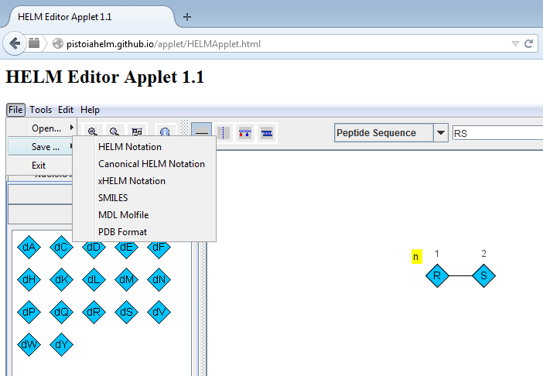
helm editor shared ancestry
COMPND UNNAMED
AUTHOR GENERATED BY OPEN BABEL 2.3.2
ATOM 1 H1 ARG A 1 1.941 -0.478 -0.111 1.00
ATOM 2 N ARG A 1 2.847 -0.028 -0.258 1.00
ATOM 3 CA ARG A 1 2.915 0.458 -1.654 1.00
ATOM 4 HA ARG A 1 2.849 -0.408 -2.322 1.00
ATOM 5 CB ARG A 1 1.782 1.449 -1.979 1.00
ATOM 6 CG ARG A 1 0.382 0.829 -1.898 1.00
ATOM 7 CD ARG A 1 -0.705 1.847 -2.251 1.00
ATOM 8 NE ARG A 1 -2.003 1.210 -2.163 1.00
ATOM 9 CZ ARG A 1 -2.619 0.563 -3.173 1.00
ATOM 10 NH1 ARG A 1 -3.808 0.055 -2.801 1.00
ATOM 11 NH2 ARG A 1 -2.201 0.372 -4.367 1.00
ATOM 12 C ARG A 1 4.287 1.130 -1.909 1.00
ATOM 13 O ARG A 1 4.787 1.184 -3.029 1.00
ATOM 14 N SER A 2 4.852 1.758 -0.823 1.00
ATOM 15 CA SER A 2 6.147 2.457 -0.888 1.00
ATOM 16 HA SER A 2 6.700 2.059 -1.747 1.00
ATOM 17 CB SER A 2 5.953 3.974 -1.050 1.00
ATOM 18 OG SER A 2 5.243 4.317 -2.241 1.00
ATOM 19 C SER A 2 7.010 2.222 0.355 1.00
ATOM 20 O SER A 2 6.388 1.499 1.318 1.00
ATOM 21 OXT SER A 2 8.136 2.637 0.542 1.00
END
chains.cpp - Parse for macromolecule chains and residues.
Copyright (C) 1998-2001 by OpenEye Scientific Software, Inc.
(original author, Roger Sayle, version 1.6, March 1998)
Some portions Copyright (C) 2001-2006 by Geoffrey R. Hutchison
This file is part of the Open Babel project.
For more information, see <http://openbabel.org/>
HELM Showcase Webinar, Wednesday 9th July 2014

Slide 5
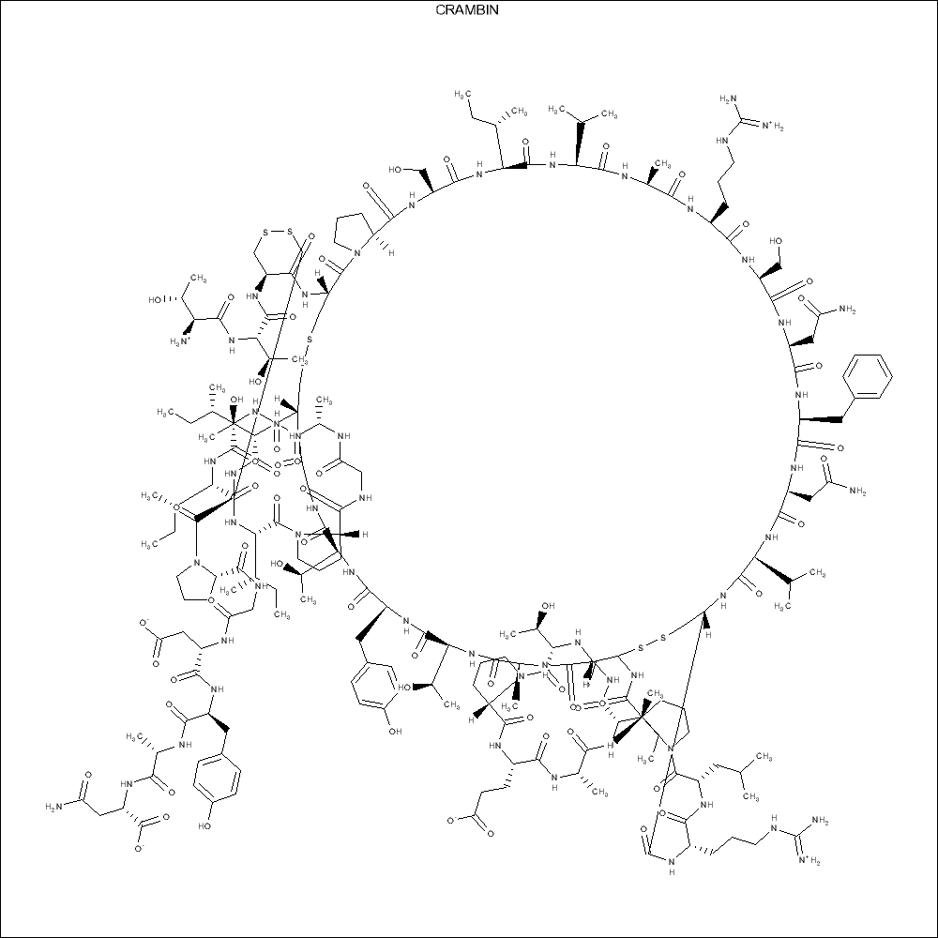
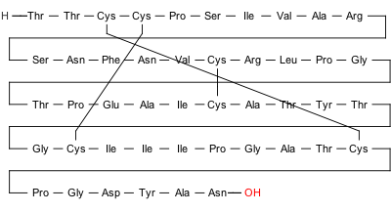
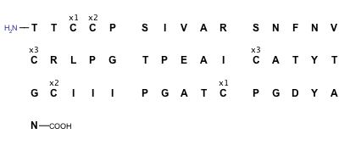
Original motivation: 2d depiction
IUPAC
Typical All-Atom Depiction
FDA
HELM Showcase Webinar, Wednesday 9th July 2014

Slide 6
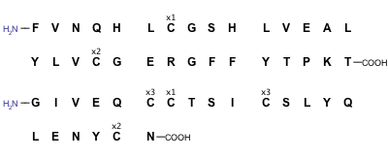
Perception from connectivity
CC[C@H](C)[C@H]1C(=O)N[C@H]2CSSC[C@@H](C(=O)N[C@@H](CSSC[C@@H](C(=O)NCC(=O)N[C@H
](C(=O)N[C@H](C(=O)N[C@H](C(=O)N[C@H](C(=O)N[C@H](C(=O)N[C@H](C(=O)N[C@H](C(=O)N
[C@H](C(=O)N[C@H](C(=O)N[C@H](C(=O)N[C@@H](CSSC[C@H](NC(=O)[C@@H](NC(=O)[C@@H](N
C(=O)[C@@H](NC(=O)[C@@H](NC(=O)[C@@H](NC(=O)[C@@H](NC(=O)[C@@H](NC(=O)[C@@H](NC2
=O)CO)CC(C)C)CC3=CC=C(C=C3)O)CCC(=O)N)CC(C)C)CCC(=O)O)CC(=O)N)CC4=CC=C(C=C4)O)C(
=O)N[C@@H](CC(=O)N)C(=O)O)C(=O)NCC(=O)N[C@@H](CCC(=O)O)C(=O)N[C@@H](CCCNC(=N)N)C
(=O)NCC(=O)N[C@@H](CC5=CC=CC=C5)C(=O)N[C@@H](CC6=CC=CC=C6)C(=O)N[C@@H](CC7=CC=C(
C=C7)O)C(=O)N[C@@H]([C@@H](C)O)C(=O)N8CCC[C@H]8C(=O)N[C@@H](CCCCN)C(=O)N[C@@H]([
C@@H](C)O)C(=O)O)C(C)C)CC(C)C)CC9=CC=C(C=C9)O)CC(C)C)C)CCC(=O)O)C(C)C)CC(C)C)CC2
=CN=CN2)CO)NC(=O)[C@H](CC(C)C)NC(=O)[C@H](CC2=CN=CN2)NC(=O)[C@H](CCC(=O)N)NC(=O)
[C@H](CC(=O)N)NC(=O)[C@H](C(C)C)NC(=O)[C@H](CC2=CC=CC=C2)N)C(=O)N[C@H](C(=O)N[C@
H](C(=O)N1)CO)[C@@H](C)O)NC(=O)[C@H](CCC(=O)N)NC(=O)[C@H](CCC(=O)O)NC(=O)[C@H](C
(C)C)NC(=O)[C@H]([C@@H](C)CC)NC(=O)CN Human Insulin
HELM Showcase Webinar, Wednesday 9th July 2014

Slide 7
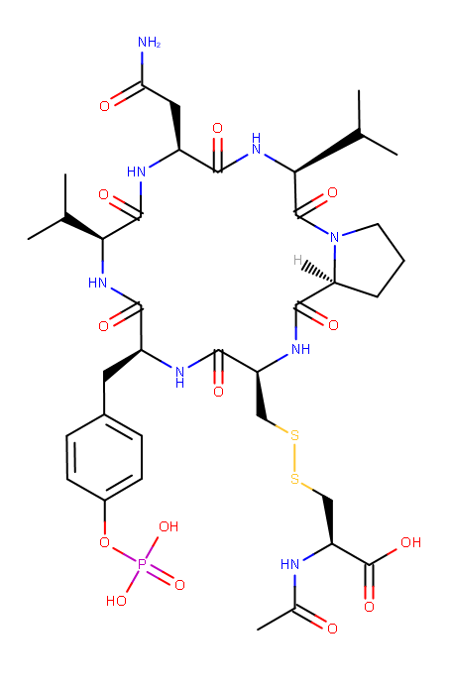
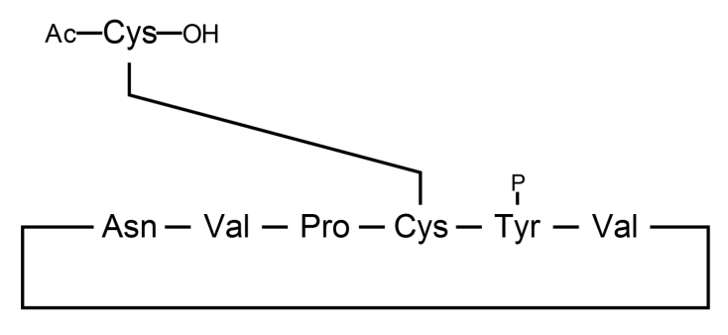
Comparison of representations: CID10033747
IUPAC depiction
IUPAC Condensed
cyclo[Asn-Val-Pro-Cys(1)-Tyr(PO3H2)-Val].
Ac-Cys(1)-OH.
(New inline) HELM
PEPTIDE1{[ac].C}.PEPTIDE2{[{*N[C@@H](Cc1ccc(cc1)OP(=O)(O)O)C(=O)* |$_R1;;;;;;;;;;;;;;;;;_R2$|].V.N.V.P.C}$
PEPTIDE1,PEPTIDE2,2:R3-6:R3|
PEPTIDE2,PEPTIDE2,6:R2-1:R1$$$
SMILES
CC(C)[C@H]1C(=O)N[C@H](C(=O)N[C@H](C(=O)N2CCC[C@H]2C(=O)N[C@H](C(=O)N[C@H](C(=O)N1)CC3=CC=C(C=C3)OP(=O)(O)O)CSSC[C@@H](C(=O)O)NC(=O)C)C(C)C)CC(=O)N
An earlier (2013 ACS) version of
this slide motivated in-line HELM
HELM Showcase Webinar, Wednesday 9th July 2014

Slide 8
Technical summary
Originally based upon PDB residue perception.
Alas, monomer dictionaries don’t scale sufficiently well in practice [PubChem contains over 125K AAs].
Monosaccharides require more than 2³² entries.
Switched to “generative” monomer naming.
Handle D-, L- and DL- forms, and N-methyl forms.
Non-canonical backbones (aminobenzoic acids, Ac5c, gamma-glumatic acids), depsi-peptides, Peptidream cyclizations, alpha-substituents, thiono variants…
HELM Showcase Webinar, Wednesday 9th July 2014

Slide 9
Example Peptide naming (chembl)
The following identifiers are Sugar & Splice generated
H-Cys-Pro-Trp-His-Leu-Leu-Pro-Phe-Cys-OH CHEMBL501567
H-Tyr-Pro-Phe-Phe-OtBu CHEMBL500195
cyclo[Ala-Tyr-Val-Orn-Leu-D-Phe-Pro-Phe-D-Phe-Asn] CHEMBL438006
H-Nle(Et)-Tyr-Pro-Trp-Phe-NH2 CHEMBL500704
H-DL-hPhe-Val-Met-Tyr(PO3H2)-Asn-Leu-Gly-Glu-OH CHEMBL439086
cyclo[Phe-D-Trp-Tyr(Me)-D-Pro] CHEMBL507127
H-D-Pyr-D-Leu-pyrrolidide CHEMBL1181307
Ac-DL-Phe-aThr-Leu-Asp-Ala-Asp-DL-Phe(4-Cl)-OH CHEMBL1791047
H-D-Cys(1)-D-Asp-Gly-Tyr(3-NO2)-Gly-Hyp-Asp-D-Cys(1)-NH2 CHEMBL583516
Boc-Tyr-Tyr(3-Br)-OMe CHEMBL1976073
HELM Showcase Webinar, Wednesday 9th July 2014

Slide 10
Standard (3AA) Peptide notation
Examples from NCBI Pubchem supplier synonyms.
Boc-Asp(OtBu)-Pro-OH CID57383532
Tyr-D-Ala-Gly-NMePhe CID45483974
Tyr-D-Pro-Gly-Trp-NMeNle-Asp-Phe-NH2 CID11693641
Ac-Cys-Ile-Tyr-Lys-Phe(4-Cl)-Tyr CID44412001
deamino-Cys-D-Tyr(Et)-Ile-Thr-Asn-Cys-Pro-Orn-Gly-NH2 CID68613
H-Arg(NO2)-OMe.HCl CID135193
Unlike HELM or PLN, 3AA used in publications.
120K peptide database extracted from text of USPTO patent applications between 2002 and 2014.
HELM Showcase Webinar, Wednesday 9th July 2014

Slide 11
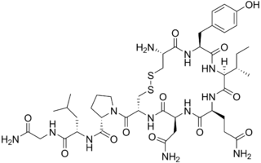


SMILES
PEPTIDE1{C.Y.I.Q.N.C.P.L.G.[am]}$PEPTIDE1,PEPTIDE1,1:R3-6:R3$$$
[C@H]1(CCCN1C(=O)[C@@H]1CSSC[C@@H](C(=O)N[C@@H](Cc2ccc(cc2)O)C(=O)N[C@@H]([C@H](CC)C)C(=O)N[C@@H](CCC(=O)N)C(=O)N[C@@H](CC(=O)O)C(=O)N1)N)C(=O)N[C@@H](CC(C)C)C(=O)NCC(=O)N
helm
OH
Sugar & SPLICE
PLN
H-C(1)YIQDC(1)PLG-[NH2]
common NAME
DEPICTIONS
[5-L-aspartic acid]oxytocin
PDB
L-Cys(1)-L-Tyr-L-Ile-L-Gln-L-Asp-L-Cys(1)-L-Pro-L-Leu-Gly-NH2
IUPAC NAME
IUPAC Condensed
L-cysteinyl-L-tyrosyl-L-isoleucyl-L-glutaminyl-L-alpha-aspartyl-L-cysteinyl-L-prolyl-L-leucyl-glycinamide (1->6)-disulfide

Slide 12
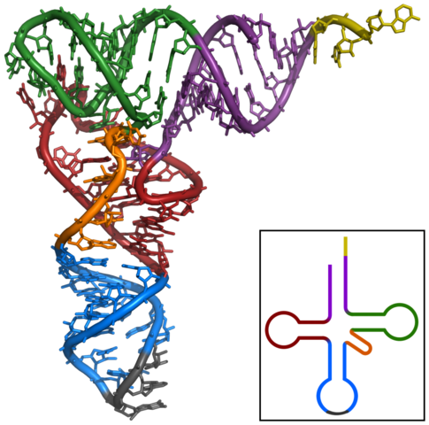
Cc1cn(c(=O)[nH]c1=O)[C@H]2[C@@H]([C@@H]([C@H](O2)CO[P@@](=O)([O-])O[C@@H]3[C@H](
O[C@H]([C@@H]3O)n4cnc5c4nc([nH]c5=O)N)CO[P@@](=O)([O-])O[C@@H]6[C@H](O[C@H]([C@@
H]6O)n7ccc(=O)[nH]c7=O)CO[P@@](=O)([O-])O[C@@H]8[C@H](O[C@H]([C@@H]8O)n9cnc1c9nc
([nH]c1=O)N)CO[P@@](=O)([O-])O[C@@H]1[C@H]… (4984 characters)
SMILES
PDB
Sugar & SPLICE
IUPAC NAME
…-5'-cytidylyl)-5-methyl-5'-cytidylyl)-5'-uridylyl)-5'-guanylyl)-5'-uridylyl)-5'-guanylyl)-5-methyl-5'-uridylyl)-1-uracil-5-yl-1-deoxy-beta-D-ribofuranos-O5-yl)(hydroxy)phosphoryl)-5'-cytidylyl)-5'-guanylyl)-1-(6-imino-1-methyl-purin-9-yl)-1-deoxy-beta-D-ribofuranos-O5-yl)(hydroxy)phosphoryl)-5'-uridylyl)-5'-cytidylyl)-5'-cytidylyl…
tRNA(Phe)
IUPAC Condensed
P-rGuo-P-rCyd-P-rGuo-P-rGuo-P-rAdo-P-rUrd-P-rUrd-P-rUrd-P-rAdo-P-m2Gua-Rib-P-rCyd-P-rUrd-P-rCyd-P-rAdo-P-rGuo-P-rUrd-P-rUrd-P-rGuo-P-rGuo-P-rGuo-P-rAdo-P-rGuo-P-rAdo-P-rGuo-P-rCyd-P-m22Gua-Rib-P-rCyd-P-rCyd-P-rAdo-P-rGuo-P-rAdo-P-Cyt-Rib2Me-P-rUrd-P-Gua-Rib2Me-P-rAdo-P-rAdo-P-rWyb-P-rAdo-P-rPrd-P-m5Cyt-Rib-P-rUrd-P-rGuo-P-rGuo-P-rAdo-P-rGuo-P-m7Gua-Rib-P-rUrd-P-rCyd-P-m5Cyt-Rib-P-rUrd-P-rGuo-P-rUrd-P-rGuo-P-m5Ura-Rib-P-rPrd-P-rCyd-P-rGuo-P-m1Ade-Rib-P-rUrd-P-rCyd-P-rCyd-P-rAdo-P-rCyd-P-rAdo-P-rGuo-P-rAdo-P-rAdo-P-rUrd-P-rUrd-P-rCyd-P-rGuo-P-rCyd-P-rAdo-P-rCyd-P-rCyd-P-rAdo
PDB
Mark BOTH as BGC
ATOMS as C1-C6, O1-O6
common NAME
cellobiose
Notes:
m5Cyt → methylCytosine

Slide 13
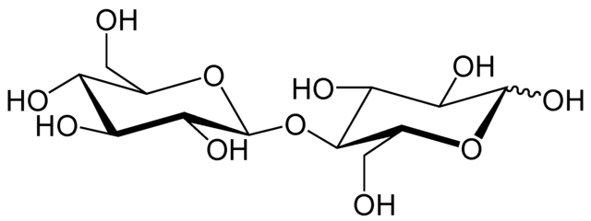
SMILES
[C@@H]1([C@H](O)[C@@H](O)[C@H](O)[C@H](O1)CO)O[C@H]1[C@@H]([C@H](C(O)O[C@@H]1CO)O)O
Sugar & SPLICE
common NAME
cellobiose
IUPAC Condensed
Glc(b1-4)Glc
IUPAC NAME
beta-D-gluco-hexopyranosyl-(1->4)-D-gluco-hexopyranose
LINUCS
[][D-Glcp]{
[(4+1)][b-D-Glcp]{}
}
DEPICTION
PDB
Mark BOTH as BGC
ATOMS as C1-C6, O1-O6
HELM Showcase Webinar, Wednesday 9th July 2014

Slide 14
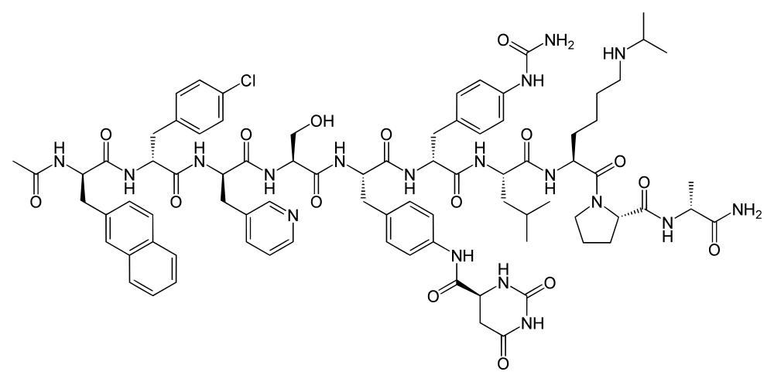
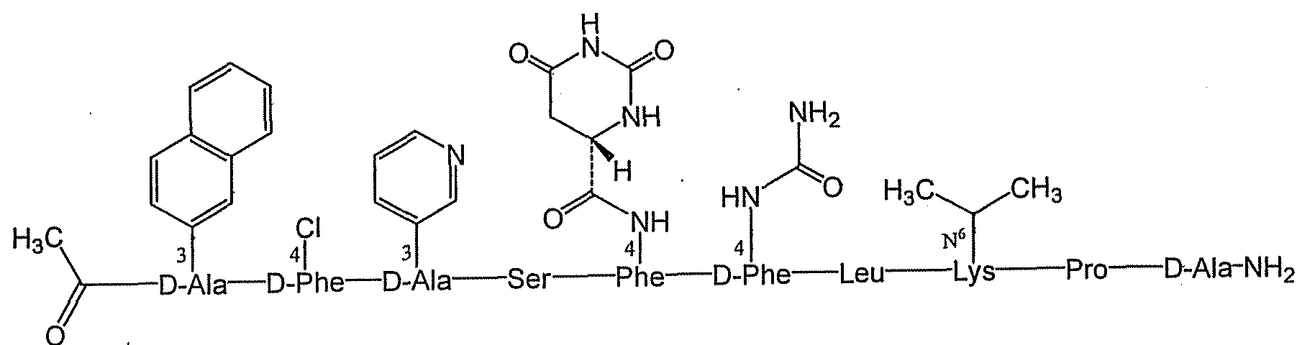
Understanding complex peptides
Structure of Degarelix from wikipedia: http://en.wikipedia.org/wiki/Degarelix
Degarelix as shown in WO2011066386A1
HELM Showcase Webinar, Wednesday 9th July 2014

Slide 15
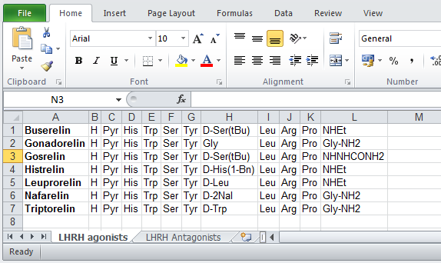
Qsar of Complex peptides
Comparing line notation representations simplifies the task of explaining variant/mutant activities.
Ac-D-2Nal-D-Phe(4-Cl)-D-3Pal-Ser-Phe(4-S-dihydroorotamido)-D-Phe(4-ureido)-Leu-Lys(iPr)-Pro-D-Ala-NH2 Degarelix
Ac-D-2Nal-D-Phe(4-Cl)-D-3Pal-Ser-N(Me)Tyr-D-Asn-Leu-Lys(iPr)-Pro-D-Ala-NH2 Abarelix
Ac-D-2Nal-D-Phe(4-Cl)-D-3Pal-Ser-Tyr-D-Cit-Leu-Arg-Pro-D-Ala-NH2 Cetrorelix
HELM Showcase Webinar, Wednesday 9th July 2014

Slide 16
Antibody perception examples
DavesADC.mol
SciTegic10231309212D
Courtesy of Keith Taylor, Ladera
0 0 0 0 0 0 999 V3000
M V30 BEGIN CTAB
M V30 COUNTS 10256 10536 0 0 1
M V30 BEGIN ATOM
SNSIsotyper can be used to check
that an antibody has been correctly
registered [bridges, glycans, etc.].
DavesADC_H: 450 AA Isotype: Ig gamma-1 [human] IMGT CDR lengths: [8.8.13]
..SCAAS[GFNIKDTY]IHWVR..EWVAR[IYPTNGYT]RYADS..AVYYC[SRWGGDGFYAMDY]WGQGT..
DavesADC_L: 213 AA Isotype: Ig kappa [human] IMGT CDR lengths: [6.3.9]
..TCRAS[QDVNTA]VAWYQ..KLLIY[SAS]FLYSG..ATYYC[QQHYTTPPT]FGQGT..
HC heavy chain: 446 AA Isotype: Ig gamma-1 [human] IMGT CDR lengths: [8.7.10]
..TCTVS[GGSISGYY]WSWIR..EWIGR[IYTSGST]NYNPS..AVYYC[ARGRFTYFDY]WGQGT..
LC light chain: 215 AA Isotype: Ig kappa [human] IMGT CDR lengths: [7.3.9]
..SCRAS[QIVSSAY]LAWYQ..RLLMF[GSS]SRATG..AVYYC[QQYGSSQGT]FGPGT..
HELM Showcase Webinar, Wednesday 9th July 2014

Slide 17
Antibody perception examples
LC light chain: 215 AA
Isotype: Ig kappa [human]
Aligning against Adalimumab_L (214 AA)
Identity: 81.78% (175/214)
Similarity: 91.59% (196/214)
Ref DIQMTQSPSSLSASVGDRVTITCRASQGIRN-YLAWYQQKPGKAPKLLIYAASTLQSGVP 59
:| :||||::|| | |:| |::||||| : : ||||||||||:||:||:: :|: :|:|
Qry EIVLTQSPATLSLSPGERATLSCRASQIVSSAYLAWYQQKPGQAPRLLMFGSSSRATGIP 60
Ref SRFSGSGSGTDFTLTISSLQPEDVATYYCQRYNRAPYTFGQGTKVEIKRTVAAPSVFIFP 119
|||||||||||||||| |:||| | ||||:| : ||| ||||:||||||||||||||
Qry DRFSGSGSGTDFTLTISRLEPEDFAVYYCQQYGSSQGTFGPGTKVDIKRTVAAPSVFIFP 120
Ref PSDEQLKSGTASVVCLLNNFYPREAKVQWKVDNALQSGNSQESVTEQDSKDSTYSLSSTL 179
||||||||||||||||||||||||||||||||||||||||||||||||||||||||||||
Qry PSDEQLKSGTASVVCLLNNFYPREAKVQWKVDNALQSGNSQESVTEQDSKDSTYSLSSTL 180
Ref TLSKADYEKHKVYACEVTHQGLSSPVTKSFNRGEC 214
|||||||||||||||||||||||||||||||||||
Qry TLSKADYEKHKVYACEVTHQGLSSPVTKSFNRGEC 215
Anchor positions: 25, 33, 49, 53, 88, 98
IMGT CDR lengths: [7.3.9]
..SCRAS[QIVSSAY]LAWYQ..RLLMF[GSS]SRATG..AVYYC[QQYGSSQGT]FGPGT..

Slide 18
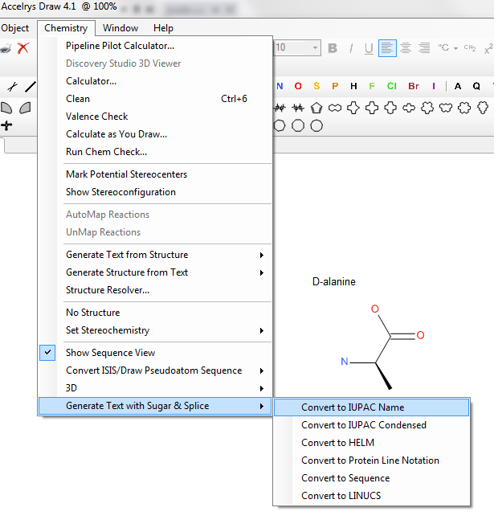
Serving suggestion: accelrys draw
HELM Showcase Webinar, Wednesday 9th July 2014

Slide 19
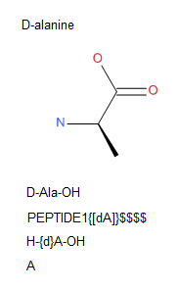
Accelrys draw add-in
HELM Showcase Webinar, Wednesday 9th July 2014

Slide 20
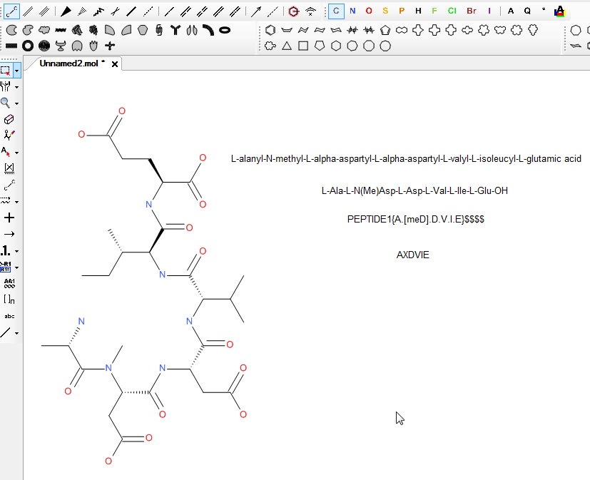
Accelrys draw add-in
HELM Showcase Webinar, Wednesday 9th July 2014

Slide 21
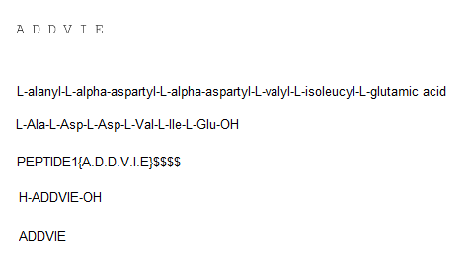
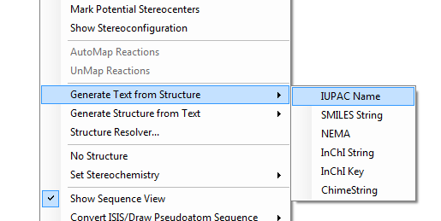
Accelrys draw: sequence tool
Accelrys Draw can also generate IUPAC names…
(2S)-2-[[(2S,3S)-2-[[(2S)-2-[[(2S)-2-[[(2S)-2-[[(2S)-2-aminopropanoyl]amino]-
4-hydroxy-4-oxo-butanoyl]amino]-4-hydroxy-4-oxo-butanoyl]amino]-3-methyl-
butanoyl]amino]-3-methyl-pentanoyl]amino]pentanedioic acid

Slide 22
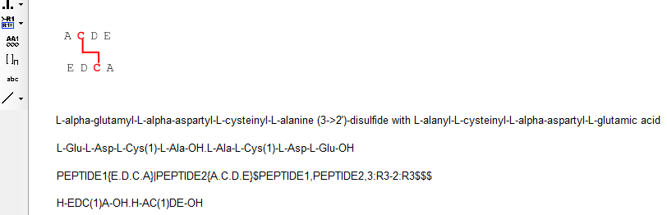
Accelrys draw: cross-linking
HELM Showcase Webinar, Wednesday 9th July 2014

Slide 23
Hopefully I’ve not overrun
Thank you very much for your time.
Acknowledgements
  Daniel Lowe & Noel O’Boyle, NextMove Software, UK.
  Lisa Sach-Peltason, Hoffmann-La Roche, Basel, Switzerland.
  Evan Bolton, PubChem project, NCBI, Bethesda, MD, USA.
  Greg Landrum, Novartis, Basel, Switzerland.
Any (time for) questions?
HELM Showcase Webinar, Wednesday 9th July 2014

