Slide 1

HELM notation
Tianhong Zhang – Technical Lead
Notes:
Opening title slide

Slide 2
Hierarchical Editing Language for Macromolecules
Macromolecules
non small molecules, biologic molecules
oligonucleotides, peptides, proteins…
Editing Language
notation system
grammar and vocabulary
Hierarchy
atom
monomer
simple polymer
complex polymer

Slide 3
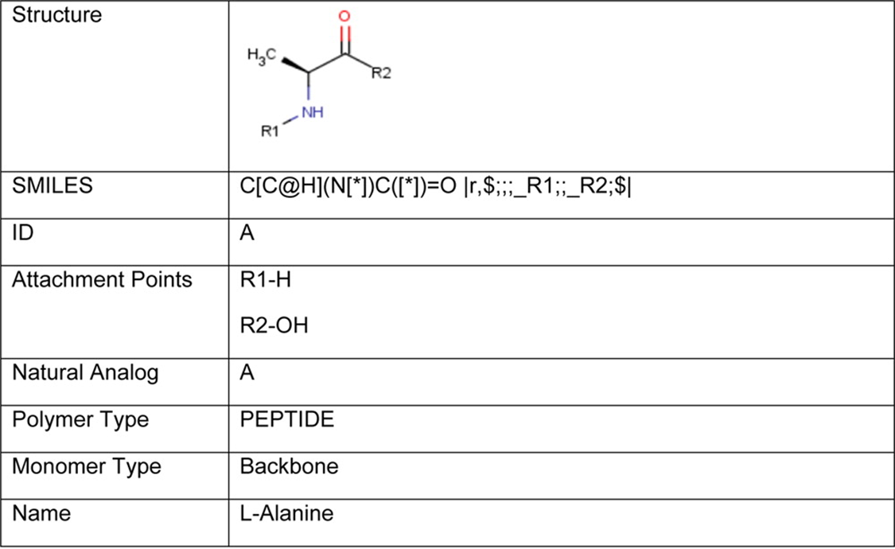
Monomer
Leverages small molecule informatics toolkit
Defines building blocks for simple polymers

Slide 4
Simple Polymer
Notation: M1.[M2].M3(M4)M5.M6
Connection: R1-M1-R2 R1-M2-R2 R1-M3-R2 R1-M5-R2 R1-M6-R2
I
R3
R1
|
M4
Symbol | Meaning
[] | Non-Natural Monomer
() | Branch
. | Group Delimiter
Simple polymer notation is monomer ID based
Backbone chain extension from R2 to R1
Branching from R3 to R1
Directional, M1.M2 is different from M2.M1
Linear chain, no cycles, no extended side chains
Simple polymer notation is convertible to atom/bond notation

Slide 5
Complex Polymer
Notation: SP1{SPN}|SP2{SPN}|SP3{SPN}$
SP1,SP2,MP:AP-MP:AP|SP2,SP3, MP:AP-MP:AP$
SP1,SP3,MP:pair-MP:pair| SP1,SP3,MP:pair-MP:pair $
SP2{annotation}|SP3{annotation}$
Symbol | Meaning
$ | Section Delimiter
{} | Simple Polymer Notation (SPN) or Annotation
| | List Delimiter
, | Connection Delimiter
: | Monomer Position (MP) and Attachment Point (AP) Separator
- | Connection Linker
Simple Polymers (SP)
Nucleic Acid (RNA)
Protein (PEPTIDE)
Chemical Linker (CHEM)
….
Sections:
List of Simple Polymers
List of Connections
List of Hydrogen Bonds
List of Annotations

Slide 6
Complex Polymer
A complex polymer contains
one or more simple polymers
zero or more connections
zero or more hydrogen bonds
zero or more annotations
A connection is formed between two connectors each of which is described by the attachment point, the containing monomer, and the containing simple polymer
A cyclic polymer contains one simple polymer and one connection
Complex polymer notation is convertible to atom/bond notation to integrate with cheminformatics tools
Complex polymer notation is convertible to sequences to integrate with bioinformatics tools

Slide 7
HELM Vocabulary: Monomers
Monomers to HELM is atoms to SMILES
Atoms are static, but monomers are dynamic
When HELM notation is used for data exchange, the definitions of any custom monomers must be made available to the receiver

Slide 8
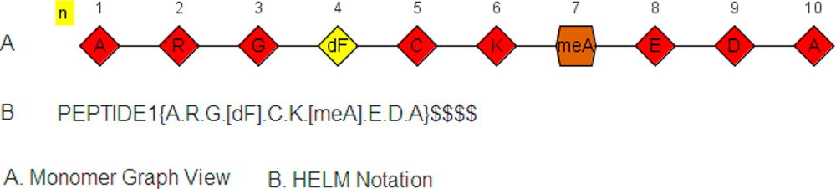
Example: Linear Peptide

Slide 9
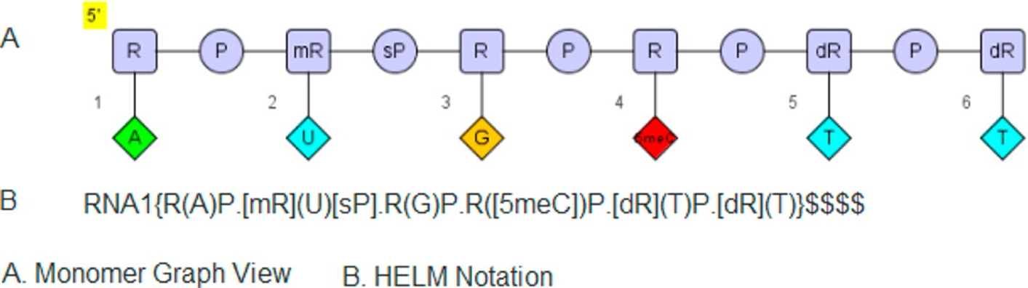
Example: Linear Oligonucleotide

Slide 10
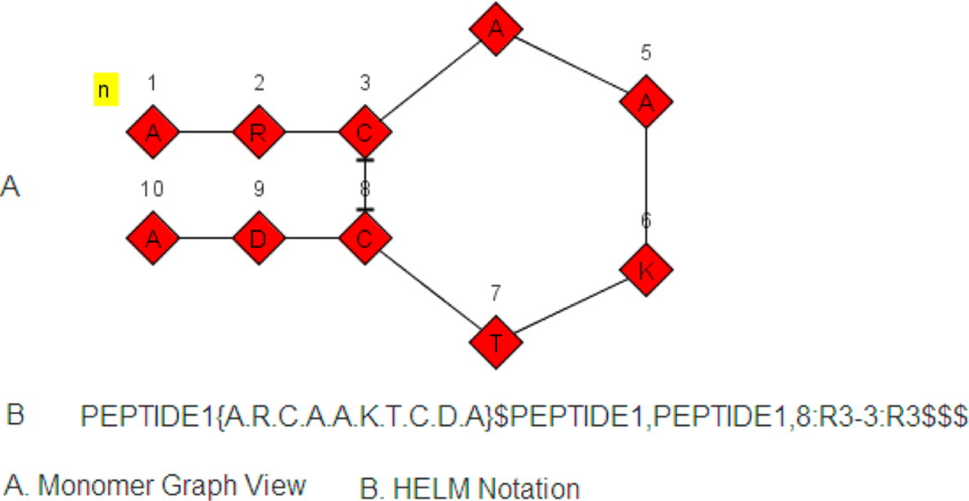
Example: Cyclic Peptide

Slide 11
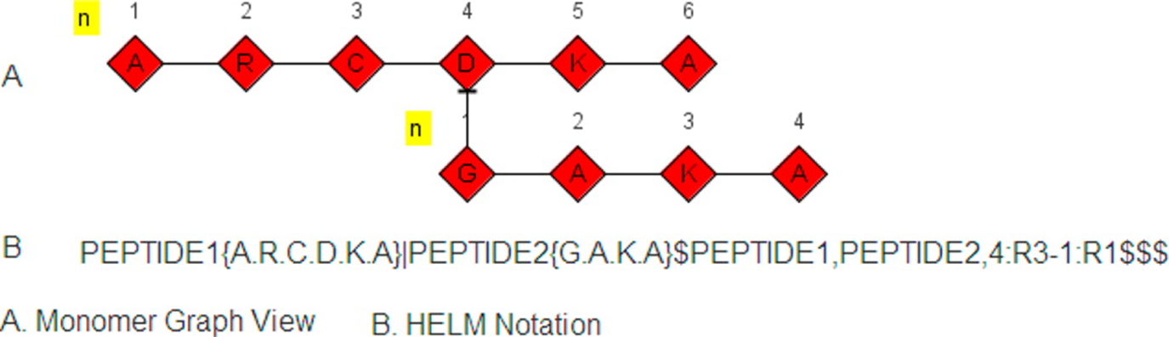
Example: Branched Peptide

Slide 12
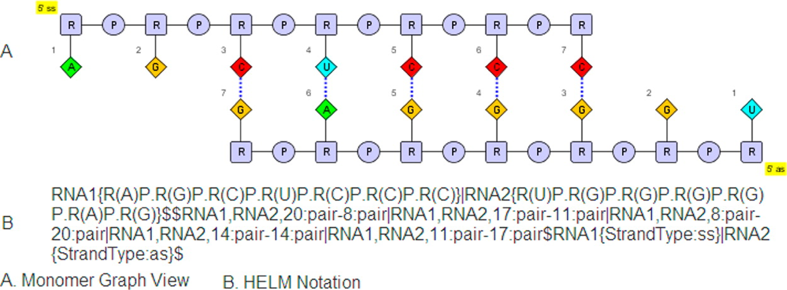
Example: Double Stranded RNA (siRNA)

Slide 13
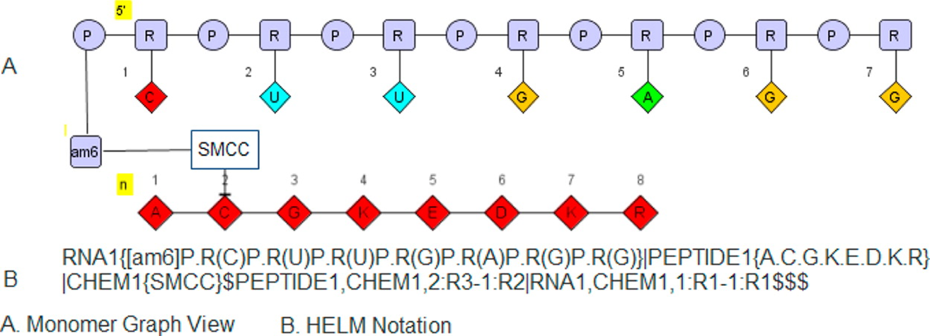
Example: Oligonucleotide Peptide Conjugate

Slide 14
HELM
For more information please visit
http://openhelm.org
or contact us at info@openhelm.org

Slide 15
Thank you
info@openhelm.org
@pistoiaalliance
www.pistoiaalliance.org
Notes:
Closing slide

