Slide 1

Exchangeable HELM
Markus Weisser

Slide 2
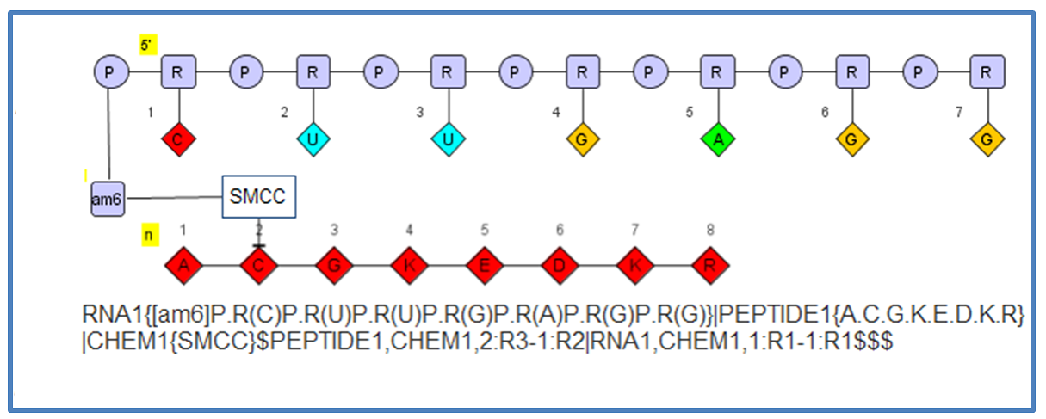


Status quo HELM notation
flexible for different types of biomolecules
compact notation
human readable
not self-contained

Slide 3


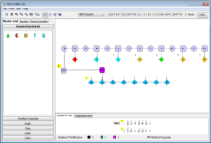
HELM use case pharma company
Monomer database

Slide 4


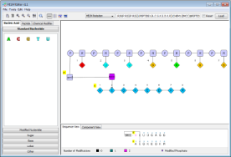
HELM use case in small organizations
Local Monomer Store
Local Monomer Store

Slide 5
Collaboration between pharma and CRO
Monomer database
Local Monomer Store

Slide 6
Request for proposal for Exchangeable HELM from Pistoia Alliance
Definition of exchangeable HELM notation (xHELM)
Modification HELM editor for exchangeable HELM
Support inline SMILES notation for all types of monomers
Registration of new monomers from exchangeable HELM

Slide 7

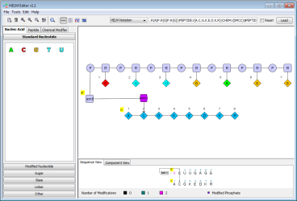
Status quo HELM toolkit/editor
Local Monomer Store
Create, edit, load and save HELM notation
Register monomers in local ‘database’ (xml document)
Modify chemical monomers (inline SMILES)

Slide 8

Exchangeable HELM – XML container for HELM notation and monomer information
xHELM
HELM notation
Local Monomer Store
Monomers
HELM Specification 1_1.doc http://www.openhelm.org/HELM_Notation

Slide 9
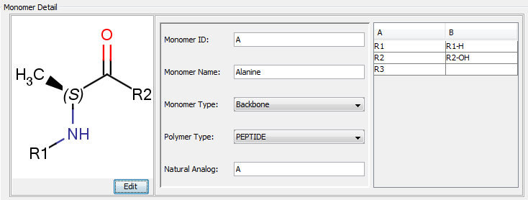
xHELM structure
Xhelm
HelmNotation
Monomers
Monomer
MonomerID
MonomerSmiles
MonomerMolFile
MonomerType
PolymerType
NaturalAnalog
MonomerName
Attachments
Attachment
AttachmentID
AttachmentLabel
CapGroupName
CapGroupSmiles

Slide 10

xHELM example
<?xml version="1.0" encoding="UTF-8"?>
<Xhelm>
<HelmNotation>PEPTIDE1{A.G}$$$$</HelmNotation>
<Monomers>
<Monomer>
<MonomerID>A</MonomerID>
<MonomerSmiles>C[C@H](N[*])C([*])=O |$;;;_R1;;_R2;$|</MonomerSmiles>
<MonomerMolFile>H4sIAAAAAA…</MonomerMolFile>
<MonomerType>Backbone</MonomerType><PolymerType>PEPTIDE</PolymerType>
<NaturalAnalog>A</NaturalAnalog><MonomerName>Alanine</MonomerName>
<Attachments>
<Attachment>
<AttachmentID>R2-OH</AttachmentID><AttachmentLabel>R2</AttachmentLabel>
<CapGroupName>OH</CapGroupName><CapGroupSmiles>O[*] |$;_R2$|</CapGroupSmiles>
</Attachment>
<Attachment>
<AttachmentID>R1-H</AttachmentID><AttachmentLabel>R1</AttachmentLabel>
<CapGroupName>H</CapGroupName><CapGroupSmiles>[*][H] |$_R1;$|</CapGroupSmiles>
</Attachment>
</Attachments>
</Monomer>
<Monomer>
<MonomerID>G</MonomerID>
<MonomerSmiles>[*]NCC([*])=O |$_R1;;;;_R2;$|</MonomerSmiles>
<MonomerMolFile>H4sIAAAAAAAAAKWSP…</MonomerMolFile>
<MonomerType>Backbone</MonomerType><PolymerType>PEPTIDE</PolymerType>
<NaturalAnalog>G</NaturalAnalog><MonomerName>Glycine</MonomerName>
<Attachments>
<Attachment>
<AttachmentID>R2-OH</AttachmentID><AttachmentLabel>R2</AttachmentLabel>
<CapGroupName>OH</CapGroupName><CapGroupSmiles>O[*] |$;_R2$|</CapGroupSmiles>
</Attachment>
<Attachment>
<AttachmentID>R1-H</AttachmentID><AttachmentLabel>R1</AttachmentLabel>
<CapGroupName>H</CapGroupName><CapGroupSmiles>[*][H] |$_R1;$|</CapGroupSmiles>
</Attachment>
</Attachments>
</Monomer>
</Monomers>
</Xhelm>

Slide 11
xHELM support in HELM toolkit and editor
Load and save HELM as well as xHELM
HELM
xHELM

Slide 12
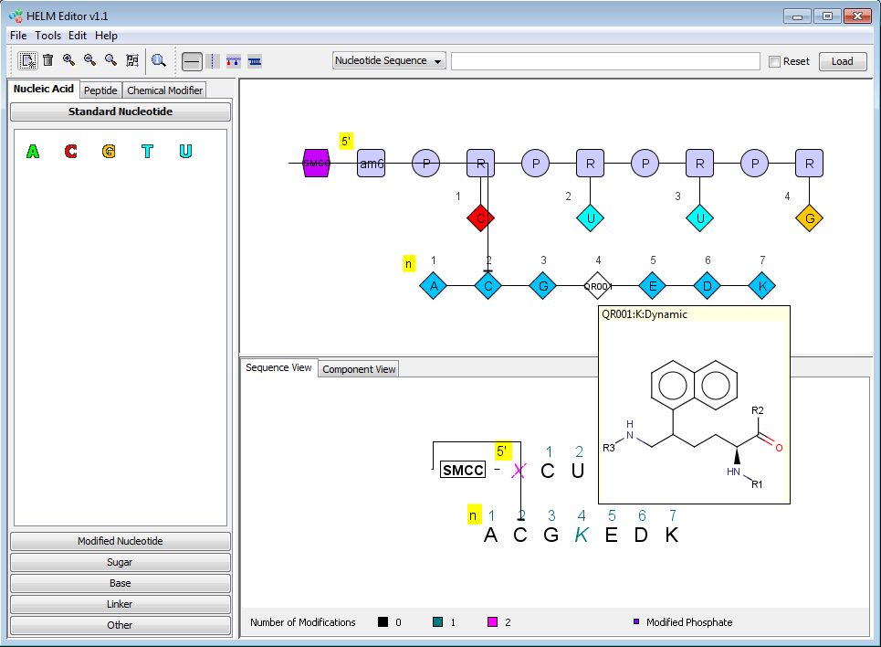
New monomers from xHELM

Slide 13
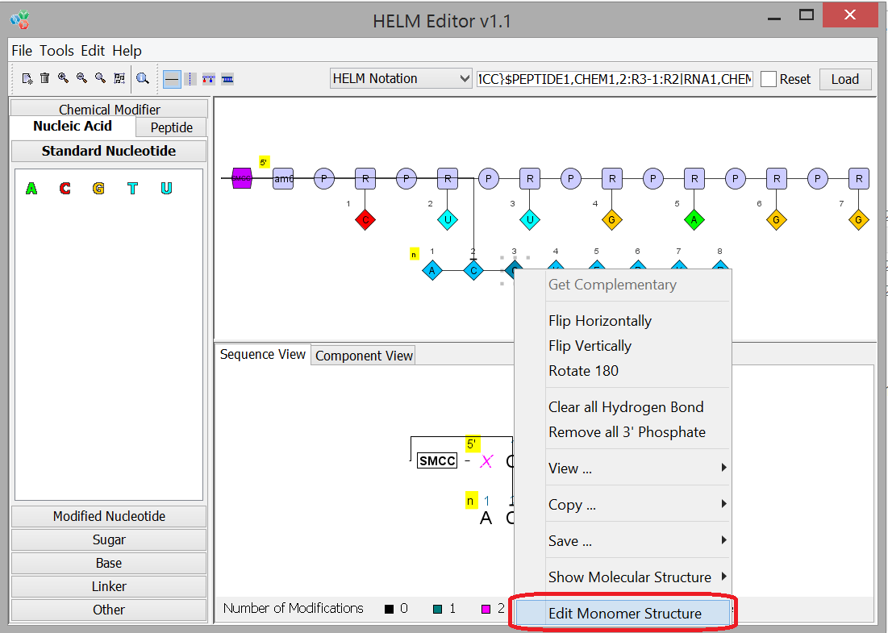
Monomer Modification and inline SMILES notation

Slide 14
HELM inline SMILES notation
Existing SMILES inline notation for chemical monomers extended for all monomer types.
Extended SMILES notation in square brackets
Example: PEPTIDE1{G.A.T}$$$$ → PEPTIDE1{G.[C[13C@H](N[*])C([*])=O |$;;;_R1;;_R2;$|].T}$$$$

Slide 15
Monomer Registration from xHELM and inline SMILES
Checking for mismatches and uniqueness
xHELM
Local Monomer Store
Inline SMILES

Slide 16
Collaboration between pharma and CRO
xHELM
Local Monomer Store
Monomer database

Slide 17
Project Summary
Definition and implementation of exchangeable HELM format
HELM toolkit and editor support for xHELM
Definition and implementation of inline SMILES for all monomer types
Inline editing of all types of monomers in editor
Registration of new monomers out of xHELM and inline SMILES notation

Slide 18
Acknowledgments
Stefanie Maisel, Marco Lanig (quattro research)
Roland Knispel (ChemAxon)
Matthias Nolte (BMS)
Tianhong Zhang (Pfizer)
Claire Bellamy (Pistoia Alliance)
Thank you !
email: weisser@quattro-research.com

