Slide 1
Abstract
HELM: an Open Standard for Biomolecule Structure Representation and Exchange
Over the past decade, the biopharmaceutical industry has dramatically increased its focus and investment in biomolecular therapeutic modalities. Entities such as antisense oligonucleotides (ASO), short interference RNAs (siRNA), peptides, proteins, antibodies, and antibody drug conjugates (ADC), have become increasingly commonplace, comprising an ever larger proportion of the drug pipelines of biopharmaceutical companies. The scientific informatics capabilities required to rigorously represent and systematically capture these types of molecules computationally, however, has not kept up with needs and the exchange of biomolecule data between organizations has remained a challenge. In this presentation, we will describe the problems, along with the Pistoia Alliance HELM project’s approach to tackling them in an open and collaborative manner. We will present the key features of the HELM standard (Hierarchical Editing Language for Macromolecules), the reference implementation of a notation toolkit and structure editor, and the emerging HELM ecosystem.

Slide 2
HELM: an Open Standard for Biomolecule Structure Representation and Exchange
Matthias Nolte
20th August 2017

Slide 3
Current challenges regarding the representation of biomolecules What is HELM? HELM in practice HELM in practice HELM in practice The HELM ecosystem Current activities

Slide 4
Current challenges regarding the representation of biomolecules What is HELM? HELM in practice HELM in practice HELM in practice The HELM ecosystem Current activities

Slide 5
Why Now?
Best selling pharmaceuticals 2015
Rank | Drug | Trade name | Type | Main indications | Company | Sales (USD millions/year) | ∆ vs 2014
1 | Adalimumab | Humira | Biologic | Rheumatoid arthritis | AbbVie Inc. | 14,012 | 1,469
2 | Ledipasvir/sofosbuvir | Harvoni | Small molecule | Hepatitis C | Gilead Sciences | 13,864 | 11,737
3 | Etanercept | Enbrel | Biologic | Rheumatoid arthritis | Amgen Pfizer | 8,697 | 4,009
4 | Infliximab | Remicade | Biologic | Crohn's Disease Rheumatoid Arthritis | Johnson & Johnson | 8,355 | 1,487
5 | Rituximab | Mabthera Rituxan | Biologic | Lymphoma Leukemia Autoimmune disorders | Roche | 7,115 | 1,456
6 | Insulin glargine | Lantus | Biologic | Diabetes mellitus | Sanofi | 7,029 | 51
7 | Bevacizumab | Avastin | Biologic | Metastatic cancers | Roche | 6,751 | 270
8 | Trastuzumab | Herceptin | Biologic | Breast cancer | Roche | 6,603 | 265
9 | Lenalidomide | Revlimid | Small molecule | Multiple myeloma Myelodysplastic syndromes | Celgene | 5,801 | 821
10 | Sofosbuvir | Sovaldi | Small molecule | Hepatitis C | Gilead Sciences | 5,276 | (5,007)
Source Wikipedia
Notes:
70% are biologics

Slide 6
Why Now?
Best selling pharmaceuticals 2015
Rank | Drug | Trade name | Type | Main indications | Company | Sales (USD millions/year) | ∆ vs 2014
1 | Adalimumab | Humira | Biologic | Rheumatoid arthritis | AbbVie Inc. | 14,012 | 1,469
2 | Ledipasvir/sofosbuvir | Harvoni | Small molecule | Hepatitis C | Gilead Sciences | 13,864 | 11,737
3 | Etanercept | Enbrel | Biologic | Rheumatoid arthritis | Amgen Pfizer | 8,697 | 4,009
4 | Infliximab | Remicade | Biologic | Crohn's Disease Rheumatoid Arthritis | Johnson & Johnson | 8,355 | 1,487
5 | Rituximab | Mabthera Rituxan | Biologic | Lymphoma Leukemia Autoimmune disorders | Roche | 7,115 | 1,456
6 | Insulin glargine | Lantus | Biologic | Diabetes mellitus | Sanofi | 7,029 | 51
7 | Bevacizumab | Avastin | Biologic | Metastatic cancers | Roche | 6,751 | 270
8 | Trastuzumab | Herceptin | Biologic | Breast cancer | Roche | 6,603 | 265
9 | Lenalidomide | Revlimid | Small molecule | Multiple myeloma Myelodysplastic syndromes | Celgene | 5,801 | 821
10 | Sofosbuvir | Sovaldi | Small molecule | Hepatitis C | Gilead Sciences | 5,276 | (5,007)
Source Wikipedia
Notes:
70% are biologics,

Slide 7
So what is the problem?
Small molecule representation is well understood and has been used for many years.
Although there are still areas to talk about the fundamentals are established.
Most traditional pharma compounds can generally be handled
Biologics is a long way behind.
Many important substances cannot be represented fully with current tools
L-alanine
Mrv1597 08171714312D
6 5 0 0 1 0 999 V2000
0.8250 1.4289 0.0000 N 0 0 0 0 0 0 0 0 0 0 0 0
1.2375 0.7145 0.0000 C 0 0 1 0 0 0 0 0 0 0 0 0
2.0625 0.7145 0.0000 C 0 0 0 0 0 0 0 0 0 0 0 0
0.8250 0.0000 0.0000 C 0 0 0 0 0 0 0 0 0 0 0 0
1.2375 -0.7145 0.0000 O 0 0 0 0 0 0 0 0 0 0 0 0
0.0000 0.0000 0.0000 O 0 0 0 0 0 0 0 0 0 0 0 0
2 1 1 1 0 0 0
2 3 1 0 0 0 0
2 4 1 0 0 0 0
4 5 1 0 0 0 0
4 6 2 0 0 0 0
M END
O=C(O)[C@@H](N)C
InChI=1S/C3H7NO2/c1-2(4)3(5)6/h2H,4H2,1H3,(H,5,6)/t2-/m1/s1
Key: QNAYBMKLOCPYGJ-UWTATZPHSA-N

Slide 8

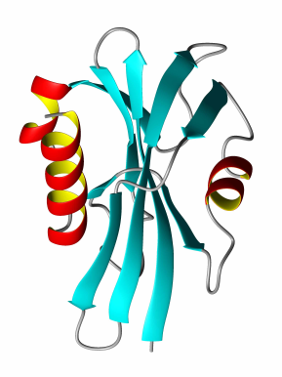

Biomolecules - Stuck in the middle…
GAP
Small Molecule Tools
Sequence-Based Tools
Small Molecules
Sequence
information
Biomolecules

Slide 9
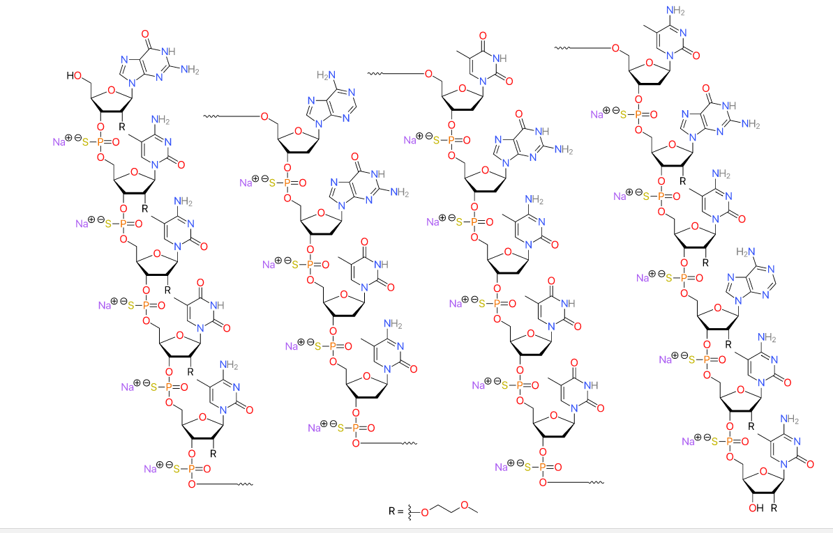
Mipomersen – As a Chemical Structure A homozygous familial hypercholesterolemia drug (IONIS)
Description
'second-generation' antisense oligonucleotide
nucleotides are linked with phosphorothioate linkages rather than the phosphodiester linkages for RNA and DNA,
sugar parts are deoxyribose in the middle part of the molecule and 2’-O-methoxyethyl-modified ribose at the two ends.
https://en.wikipedia.org/ikwi/Mipomersen

Slide 10
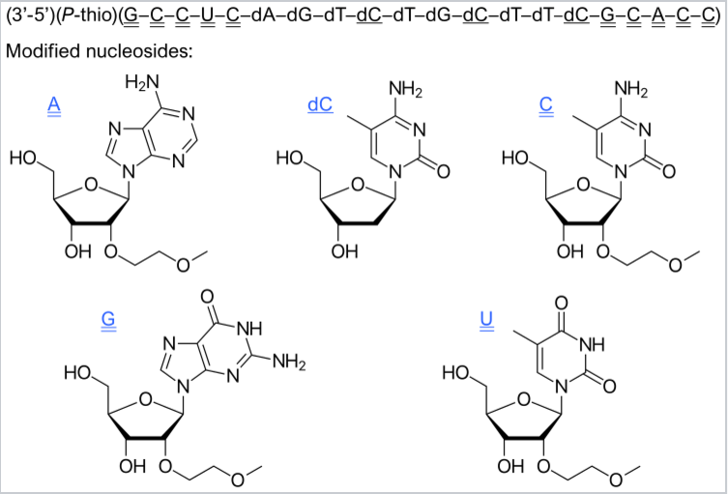
Mipomersen – As An Annotated Sequence
5’—G*—mC*—mC*—mU*—mC*—dA—dG—dT—dmC—dT—dG—dmC—dT—dT—dmC—G*—mC*—A*—mC*—mC*—3’
* = 2’-O-(2-methoxyethyl)
m = 5-methyl
d = 2’-deoxy
Compact, humanly understandable with adequate annotation.
GAP: automatic interpretation of notation
https://en.wikipedia.org/ikwi/Mipomersen

Slide 11
Mipomersen – As A HELM Representation
RNA1{[moe](G)[sp].[moe]([m5C])[sp].[moe]([m5C])[sp].[moe](T)[sp].[moe]([m5C])[sp].d(A)[sp].d(G)[sp].d(T)[sp].d([m5C])[sp].d(T)[sp].d(G)[sp].d([m5C])[sp].d(T)[sp].d(T)[sp].d([m5C])[sp].[moe](G)[sp].[moe]([m5C])[sp].[moe](A)[sp].[moe]([m5C])[sp].[moe]([m5C])}$$$$V2.0
moe : 2’-O-methoxyethyl-modified ribose
sp : Phosphorothioate
G : Guanin
m5C: 5-Methylcytosine

Slide 12
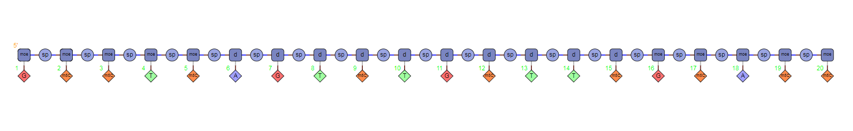
Mipomersen – As A HELM Representation
RNA1{[moe](G)[sp].[moe]([m5C])[sp].[moe]([m5C])[sp].[moe](T)[sp].[moe]([m5C])[sp].d(A)[sp].d(G)[sp].d(T)[sp].d([m5C])[sp].d(T)[sp].d(G)[sp].d([m5C])[sp].d(T)[sp].d(T)[sp].d([m5C])[sp].[moe](G)[sp].[moe]([m5C])[sp].[moe](A)[sp].[moe]([m5C])[sp].[moe]([m5C])}$$$$V2.0

Slide 13
Mipomersen – As A HELM Representation
RNA1{[moe](G)[sp].[moe]([m5C])[sp].[moe]([m5C])[sp].[moe](T)[sp].[moe]([m5C])[sp].d(A)[sp].d(G)[sp].d(T)[sp].d([m5C])[sp].d(T)[sp].d(G)[sp].d([m5C])[sp].d(T)[sp].d(T)[sp].d([m5C])[sp].[moe](G)[sp].[moe]([m5C])[sp].[moe](A)[sp].[moe]([m5C])[sp].[moe]([m5C])}$$$$V2.0
moe : 2’-O-methoxyethyl-modified ribose
sp : Phosphorothioate
G : Guanin
m5C: 5-Methylcytosine

Slide 14
Current challenges regarding the representation of biomolecules What is HELM? HELM in practice HELM in practice HELM in practice The HELM ecosystem Current activities

Slide 15
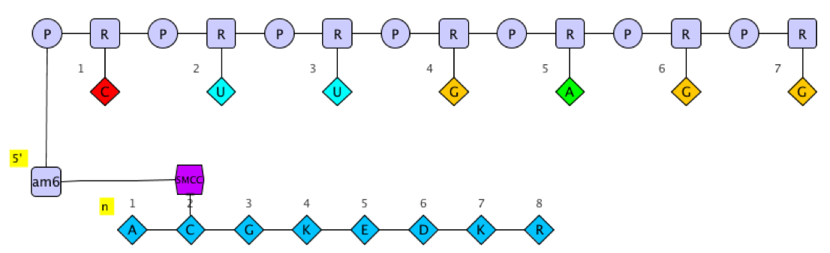
Hierarchical Editing Language for Macromolecules
Hierarchical
Biomolecules are “multi-level polymers”
Complex Polymer
Simple Polymer
Monomer
Atom

Slide 16
Hierarchical Editing Language for Macromolecules
Hierarchical
Biomolecules are “multi-level polymers”
Complex Polymer
Simple Polymer
Monomer
Atom

Slide 17
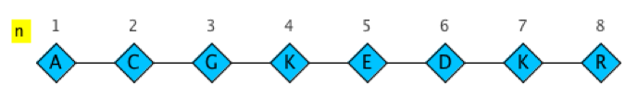
Hierarchical Editing Language for Macromolecules
Hierarchical
Biomolecules are “multi-level polymers”
Complex Polymer
Simple Polymer
Monomer
Atom

Slide 18
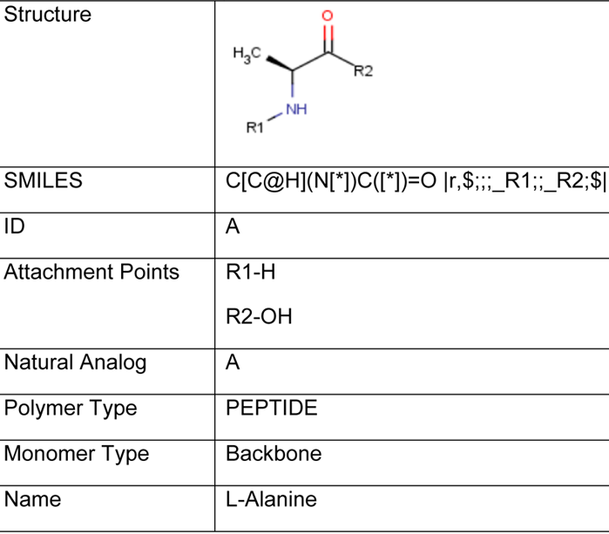

Hierarchical Editing Language for Macromolecules
Hierarchical
Biomolecules are “multi-level polymers”
Complex Polymer
Simple Polymer
Monomer
Atom

Slide 19
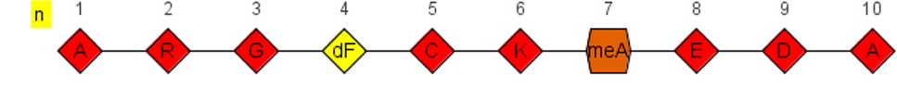
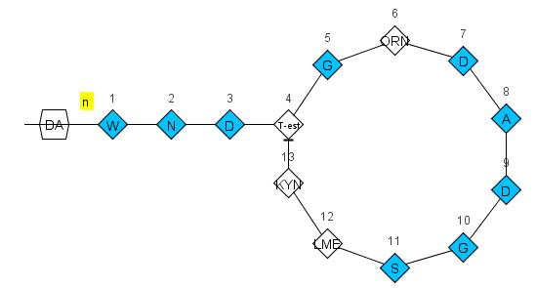
Notation Format
ListOfSimplePolymers$ListOfConnections$ListOfPolymerGroups$ExtendedAnnotation$
HELM notation: PEPTIDE1{A.R.G.[dF].C.K.[meA].E.D.A}$$$$
Daptomycin
PEPTIDE1{W.N.D.[T-est].G.[ORN].D.A.D.G.S.[LME].[KYN]}|
CHEM1{DA}$PEPTIDE1,PEPTIDE1,13:R2-4:R3|PEPTIDE1,
CHEM1,1:R1-1:R1$$$

Slide 20
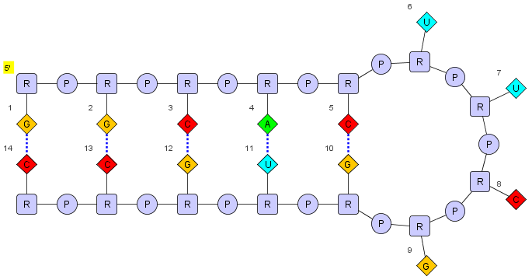
Notation Format
ListOfSimplePolymers$ListOfConnections$ListOfPolymerGroups$ExtendedAnnotation$
HELM notation
RNA1{R(G)P.R(G)P.R(C)P.R(A)P.R(C)P.R(U)P.R(U)P.R(C)P.R(G)P.R(G)P.R(U)P.R(G)P.R(C)P.R(C)}$$RNA1,RNA1,11:pair-32:pair|RNA1,RNA1,5:pair-38:pair|RNA1,RNA1,14:pair-29:pair|RNA1,RNA1,8:pair-35:pair|RNA1,RNA1,2:pair-41:pair$$

Slide 21
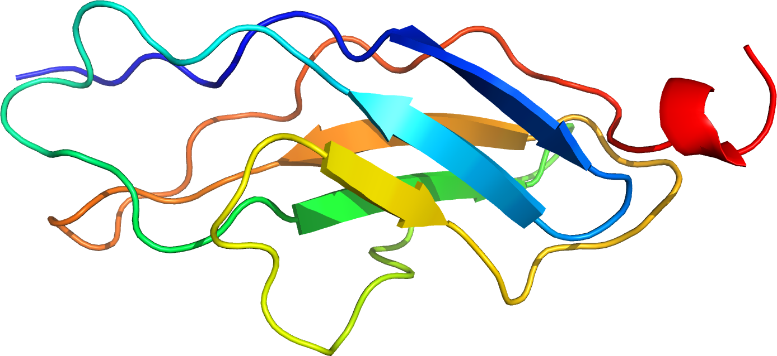
HELM…
…and very large molecules
Example: Connectin (Titin)
Human muscle protein out of 34,350 amino acids
=> 540,000 atoms
Creation and validation of HELM notation
from FASTA in < 1 s
…and exchanging information
HELM relies on the monomer definitions
Monomer information can be exchanged using xHELM, an XML file format that includes the monomers for the molecules in the file.
… and monomer bloat
In-line HELM allows the definition of ‘temporary’ monomers when you with only use a monomer once.

Slide 22
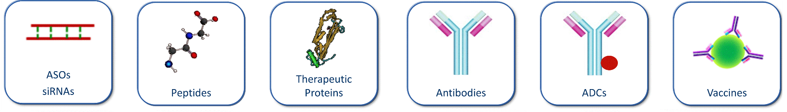
So… mission completed?
?
?
?
?
?
?
Unknown numbers of repeating elements
Various connection points of ADCs
Unknown elements in sequences
Unknown connections between polymers
Undefined polymers
...
Ambiguity is not something we handle well in either small or large molecule representation.

Slide 23
Monomer Ambiguity
* | 0..n unknown monomers | PEPTIDE1{A.*.G.C}$$$$V2.0
X | Single unknown amino acid in a PEPTIDE | PEPTIDE1{A.X.G.C}$$$$V2.0
N | Single unknown base in a RNA | RNA1{R(A)P.R(N)P.R(C)P.R(C)P.R(C)}$$$$V2.0
( , ) | One of a list of monomer is possible | PEPTIDE1{A.(A:10,G:90).G.C}$$$$V2.0
( + ) | Mixture of monomers | PEPTIDE1{A.(A+G+C).G.C}$$$$V2.0
_ | Deleted or missing single monomer | PEPTIDE1{A.(A,_).G.C}$$$$V2.0
´ ´ | Repeating monomers | PEPTIDE1{A.G.A.C.A‘5-30‘}$$$$V2.0
?
A
G
C

Slide 24
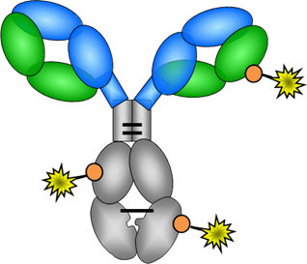
Other Ambiguity Types
Sequence or polymer type is unknown
BLOB1{Bead}”Aminated Polystyrene”|PEPTIDE1{A.G.T}$$$$
A
G
T
Connections are unknown

Slide 25
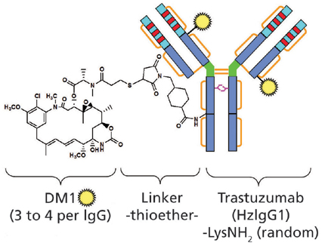
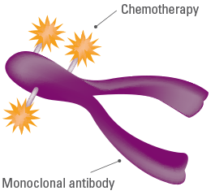
Ambiguity - Kadcyla
The connection between the drug and antibody is not well understood (Marcoux et al. 2015). Lysine-linked, but where?
Each trastuzumab molecule may be linked to zero to eight DM1 molecules (3.5 on average)
Glycosylation is present and not well understood

Slide 26
HELM notation - Kadcyla
ListOfSimplePolymers$ListOfConnections$ListOfPolymerGroups$ExtendedAnnotation$
PEPTIDE1{D.I.Q.M.T.Q.S.P.S.S.L.S.A.S.V.G.D.R.V.T.I.T.C.R.A.S.Q.D.V.N.T.A.V.A.W.Y.Q.Q.K.P.G.K.A.P.K.L.L.I.Y.S.A.S.F.L.Y.S.G.V.P.S.R.F.S.G.S.R.S.G.T.D.F.T.L.T.I.S.S.L.Q.P.E.D.F.A.T.Y.Y.C.Q.Q.H.Y.T.T.P.P.T.F.G.Q.G.T.K.V.E.I.K.R.T.V.A.A.P.S.V.F.I.F.P.P.S.D.E.Q.L.K.S.G.T.A.S.V.V.C.L.L.N.N.F.Y.P.R.E.A.K.V.Q.W.K.V.D.N.A.L.Q.S.G.N.S.Q.E.S.V.T.E.Q.D.S.K.D.S.T.Y.S.L.S.S.T.L.T.L.S.K.A.D.Y.E.K.H.K.V.Y.A.C.E.V.T.H.Q.G.L.S.S.P.V.T.K.S.F.N.R.G.E.C}|PEPTIDE2{E.V.Q.L.V.E.S.G.G.G.L.V.Q.P.G.G.S.L.R.L.S.C.A.A.S.G.F.N.I.K.D.T.Y.I.H.W.V.R.Q.A.P.G.K.G.L.E.W.V.A.R.I.Y.P.T.N.G.Y.T.R.Y.A.D.S.V.K.G.R.F.T.I.S.A.D.T.S.K.N.T.A.Y.L.Q.M.N.S.L.R.A.E.D.T.A.V.Y.Y.C.S.R.W.G.G.D.G.F.Y.A.M.D.Y.W.G.Q.G.T.L.V.T.V.S.S.A.S.T.K.G.P.S.V.F.P.L.A.P.S.S.K.S.T.S.G.G.T.A.A.L.G.C.L.V.K.D.Y.F.P.E.P.V.T.V.S.W.N.S.G.A.L.T.S.G.V.H.T.F.P.A.V.L.Q.S.S.G.L.Y.S.L.S.S.V.V.T.V.P.S.S.S.L.G.T.Q.T.Y.I.C.N.V.N.H.K.P.S.N.T.K.V.D.K.K.V.E.P.P.K.S.C.D.K.T.H.T.C.P.P.C.P.A.P.E.L.L.G.G.P.S.V.F.L.F.P.P.K.P.K.D.T.L.M.I.S.R.T.P.E.V.T.C.V.V.V.D.V.S.H.E.D.P.E.V.K.F.N.W.Y.V.D.G.V.E.V.H.N.A.K.T.K.P.R.E.E.Q.Y.N.S.T.Y.R.V.V.S.V.L.T.V.L.H.Q.D.W.L.N.G.K.E.Y.K.C.K.V.S.N.K.A.L.P.A.P.I.E.K.T.I.S.K.A.K.G.Q.P.R.E.P.Q.V.Y.T.L.P.P.S.R.D.E.L.T.K.N.Q.V.S.L.T.C.L.V.K.G.F.Y.P.S.D.I.A.V.E.W.E.S.N.G.Q.P.E.N.N.Y.K.T.T.P.P.V.L.D.S.D.G.S.F.F.L.Y.S.K.L.T.V.D.K.S.R.W.Q.Q.G.N.V.F.S.C.S.V.M.H.E.A.L.H.N.H.Y.T.Q.K.S.L.S.L.S.P.G.K}|PEPTIDE3{E.V.Q.L.V.E.S.G.G.G.L.V.Q.P.G.G.S.L.R.L.S.C.A.A.S.G.F.N.I.K.D.T.Y.I.H.W.V.R.Q.A.P.G.K.G.L.E.W.V.A.R.I.Y.P.T.N.G.Y.T.R.Y.A.D.S.V.K.G.R.F.T.I.S.A.D.T.S.K.N.T.A.Y.L.Q.M.N.S.L.R.A.E.D.T.A.V.Y.Y.C.S.R.W.G.G.D.G.F.Y.A.M.D.Y.W.G.Q.G.T.L.V.T.V.S.S.A.S.T.K.G.P.S.V.F.P.L.A.P.S.S.K.S.T.S.G.G.T.A.A.L.G.C.L.V.K.D.Y.F.P.E.P.V.T.V.S.W.N.S.G.A.L.T.S.G.V.H.T.F.P.A.V.L.Q.S.S.G.L.Y.S.L.S.S.V.V.T.V.P.S.S.S.L.G.T.Q.T.Y.I.C.N.V.N.H.K.P.S.N.T.K.V.D.K.K.V.E.P.P.K.S.C.D.K.T.H.T.C.P.P.C.P.A.P.E.L.L.G.G.P.S.V.F.L.F.P.P.K.P.K.D.T.L.M.I.S.R.T.P.E.V.T.C.V.V.V.D.V.S.H.E.D.P.E.V.K.F.N.W.Y.V.D.G.V.E.V.H.N.A.K.T.K.P.R.E.E.Q.Y.N.S.T.Y.R.V.V.S.V.L.T.V.L.H.Q.D.W.L.N.G.K.E.Y.K.C.K.V.S.N.K.A.L.P.A.P.I.E.K.T.I.S.K.A.K.G.Q.P.R.E.P.Q.V.Y.T.L.P.P.S.R.D.E.L.T.K.N.Q.V.S.L.T.C.L.V.K.G.F.Y.P.S.D.I.A.V.E.W.E.S.N.G.Q.P.E.N.N.Y.K.T.T.P.P.V.L.D.S.D.G.S.F.F.L.Y.S.K.L.T.V.D.K.S.R.W.Q.Q.G.N.V.F.S.C.S.V.M.H.E.A.L.H.N.H.Y.T.Q.K.S.L.S.L.S.P.G.K}|PEPTIDE4{D.I.Q.M.T.Q.S.P.S.S.L.S.A.S.V.G.D.R.V.T.I.T.C.R.A.S.Q.D.V.N.T.A.V.A.W.Y.Q.Q.K.P.G.K.A.P.K.L.L.I.Y.S.A.S.F.L.Y.S.G.V.P.S.R.F.S.G.S.R.S.G.T.D.F.T.L.T.I.S.S.L.Q.P.E.D.F.A.T.Y.Y.C.Q.Q.H.Y.T.T.P.P.T.F.G.Q.G.T.K.V.E.I.K.R.T.V.A.A.P.S.V.F.I.F.P.P.S.D.E.Q.L.K.S.G.T.A.S.V.V.C.L.L.N.N.F.Y.P.R.E.A.K.V.Q.W.K.V.D.N.A.L.Q.S.G.N.S.Q.E.S.V.T.E.Q.D.S.K.D.S.T.Y.S.L.S.S.T.L.T.L.S.K.A.D.Y.E.K.H.K.V.Y.A.C.E.V.T.H.Q.G.L.S.S.P.V.T.K.S.F.N.R.G.E.C}|CHEM1{[SMCC]}|CHEM2{[DM1]}$CHEM1,CHEM2,1:R2-1:R1|PEPTIDE1,PEPTIDE1,23:R3-88:R3|PEPTIDE2,PEPTIDE2,371:R3-429:R3|PEPTIDE4,PEPTIDE4,134:R3-194:R3|PEPTIDE1,PEPTIDE1,134:R3-194:R3|PEPTIDE3,PEPTIDE3,265:R3-325:R3|PEPTIDE3,PEPTIDE4,224:R3-214:R3|PEPTIDE2,PEPTIDE3,233:R3-233:R3|PEPTIDE2,PEPTIDE2,265:R3-325:R3|PEPTIDE2,PEPTIDE2,147:R3-203:R3|PEPTIDE2,PEPTIDE3,230:R3-230:R3|PEPTIDE2,PEPTIDE1,224:R3-214:R3|PEPTIDE3,PEPTIDE3,147:R3-203:R3|PEPTIDE2,PEPTIDE2,22:R3-96:R3|PEPTIDE3,PEPTIDE3,22:R3-96:R3|PEPTIDE3,PEPTIDE3,371:R3-429:R3|PEPTIDE4,PEPTIDE4,23:R3-88:R3|
G1,CHEM1,K:R3-1:R1$G1(PEPTIDE1+PEPTIDE2+PEPTIDE3+PEPTIDE4)|G2(CHEM1:3.5+G1:1)$$V2.0
Connected to a lysine, but could be any in the group
3.5:1 ratio of SMCC to antibody

Slide 27
Current challenges regarding the representation of biomolecules What is HELM? HELM in practice HELM in practice The HELM ecosystem Current activities

Slide 28
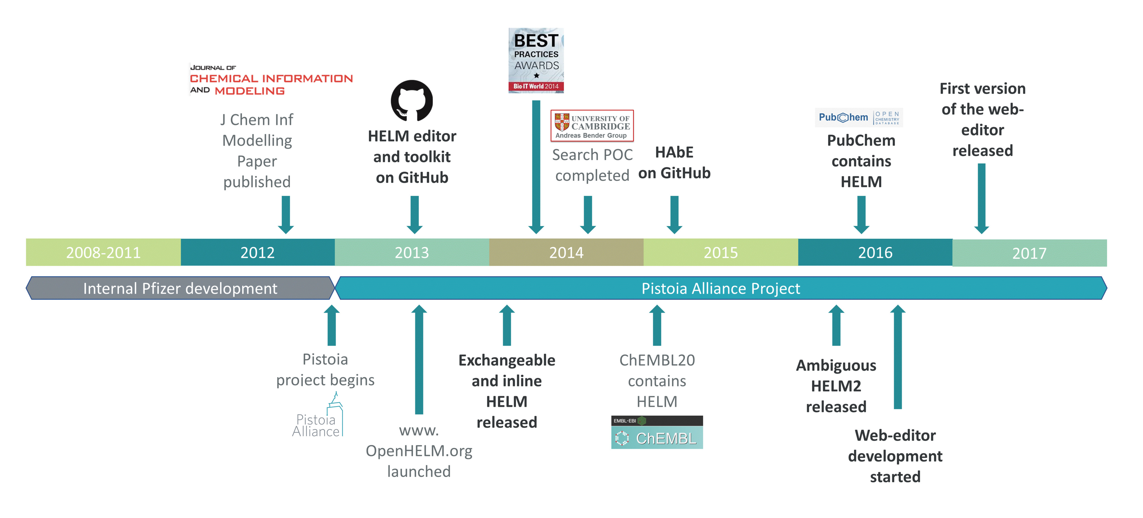
HELM Project

Slide 29
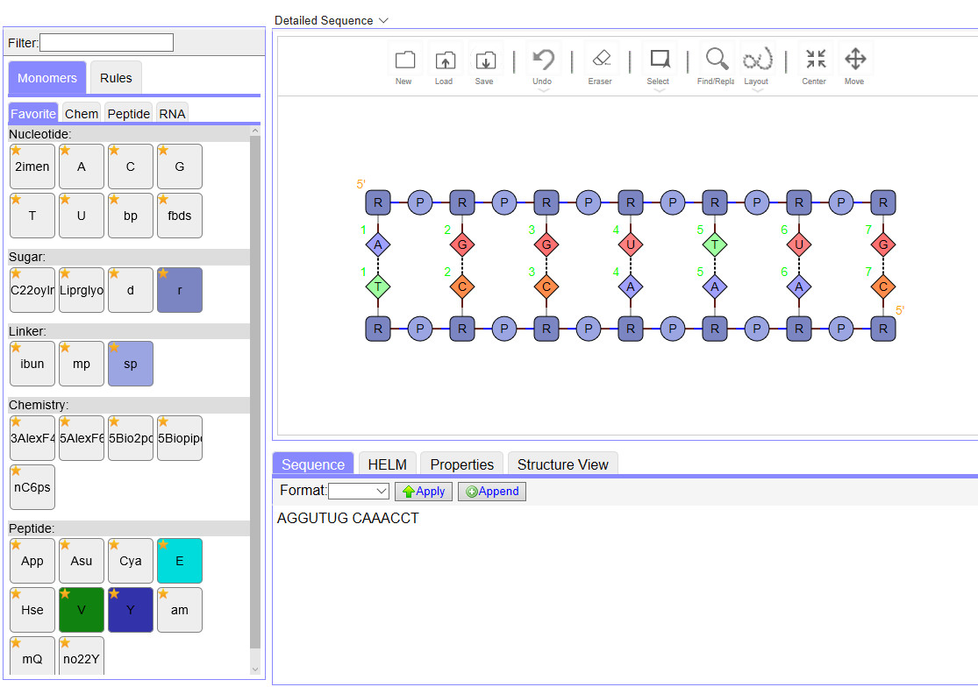
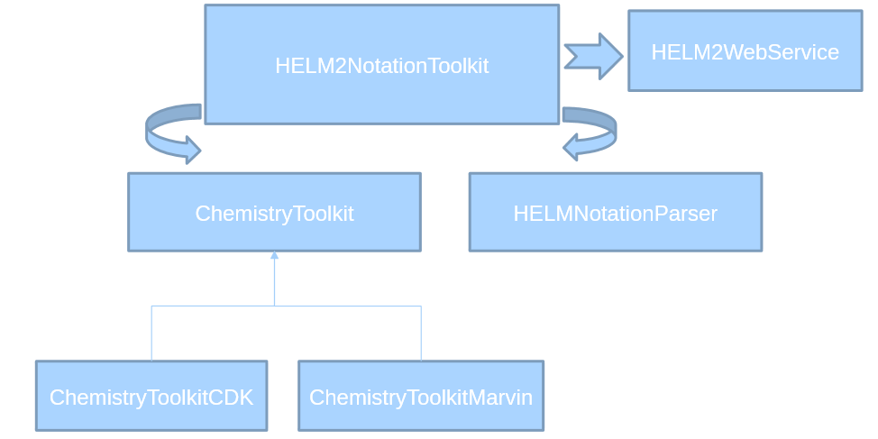
HELM Open Source Tools
Web-based editor – currently HELM1.
We are working on HELM2 and expect
to publish later this year.
HELM2 is implemented in the toolkit
and can be accessed via RESTful
web-services

Slide 30
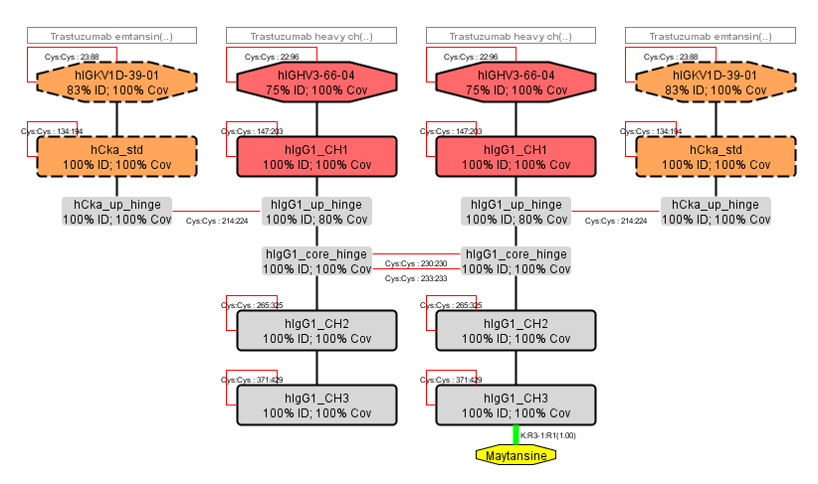
HELM Antibody Editor (HAbE)
HAbE (developed by Roche), will take in an antibody sequence, run a BLAST search and identify and display domains.
The initial domain assignment can be edited if the scientist believes it is incorrect and the editor can be used to adjust Cys-cys bonds and any other structural element.

Slide 31
Current challenges regarding the representation of biomolecules What is HELM? HELM in practice HELM in practice The HELM ecosystem Current activities

Slide 32

The HELM Ecosystem
Pharma / Biotech
BMS, GSK, Ionis, Merck, Novartis, Pfizer, Roche
Software vendors
ACD/Labs, BioMax, BIOVIA, ChemAxon, NextMove, PerkinElmer, Scilligence
Content / Service Providers
EBI (ChEMBL), NCBI (PubChem), quattro research
Regulatory
Acceptable format in ISO 11238 guidelines

Slide 33
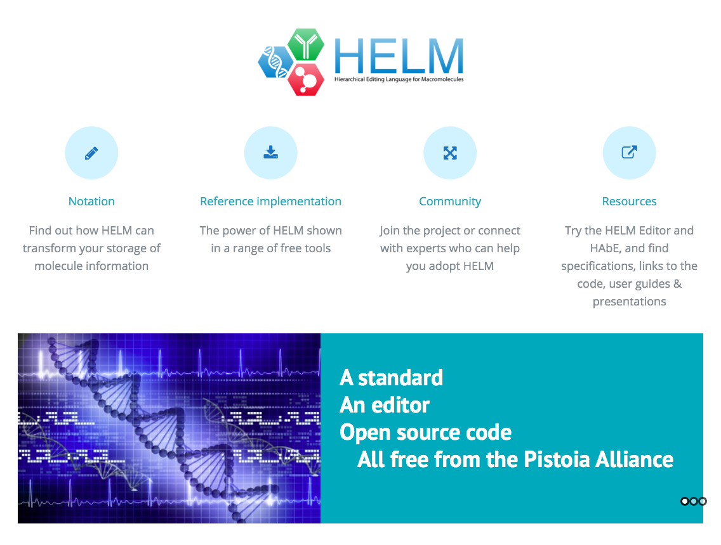


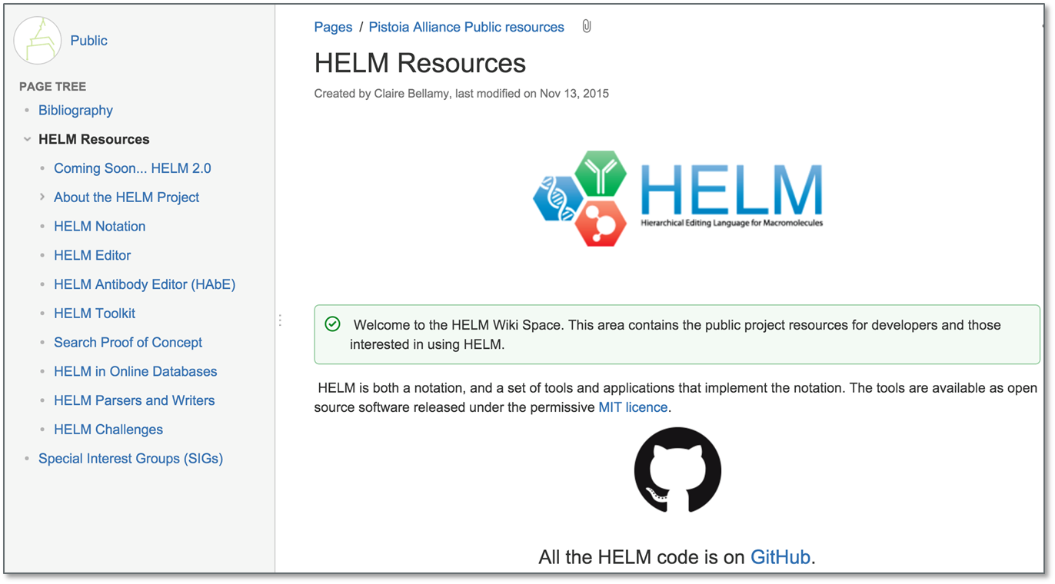
On-line information
www.OpenHelm.org
https://github.com/PistoiaHELM
Permissive MIT license
Wiki contains
Specifications
User guides
Presentations
Links to code

Slide 34
Current challenges regarding the representation of biomolecules What is HELM? HELM in practice HELM in practice The HELM ecosystem Current activities

Slide 35
Monomer naming
Monomers are identified by convention.
Natural monomers are limited in number and observed in plants and animals.
Unnatural monomers, are whatever is convenient for synthetic biology.
HELM allows the user to define whatever monomer they like and enables organisations to exchange them, however consistency makes everyone’s life easier.
Existing nucleotide conventions
IUPAC rules on biochemical nomenclature, Abbreviations and Symbols for Nucleic Acids, Polynucleotides and their Constituents

Slide 36
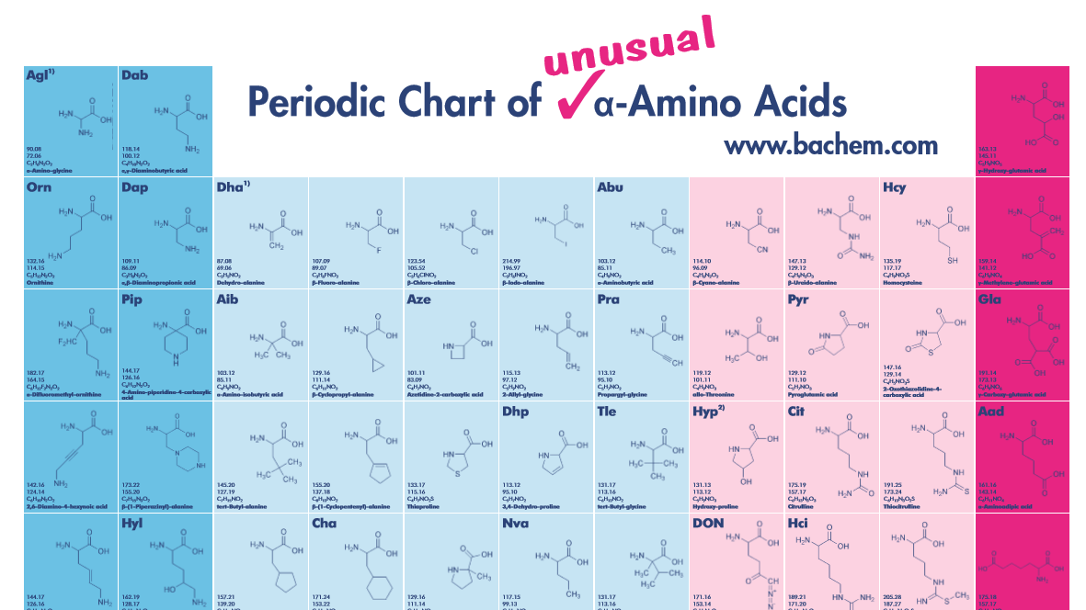
Monomer naming
Peptide monomers
IUPAC peptide and amino acid nomenclature
Good for D, L amino acids, but does not give much guidance for anything more complex
INSDC
has a nice table of amino acids and modified ones that use MeGly for N-methylglycine (consortium includes EMBL and GenBank)
Consistent naming conventions are in short supply.
In the absence of anything else – people will make stuff up.
Guidance from serious academic bodies would be helpful.

Slide 37
Ambiguity – a challenge
HELM has made a start, but we are only now building tools to use in ‘real-life’ and may find further areas to work on.
HELM2 can’t be converted into small molecule formats such as molfiles, SMILES and InChI as they can’t handle ambiguity.
InChI are interested in looking at ambiguity and the InChI positional isomers group could be a key enabler

Slide 38
Acknowledgements
Leadership
Sergio Rotstein (Pfizer) – Project Lead
Claire Bellamy (Pistoia Alliance) – Project Manager
Active Team
Jan Holst Jensen (Chembiofusion)
Stefan Klostermann (Roche)
Roland Knispel (ChemAxon)
Jeff Milton (Ionis)
Sven Neumeyer (Novartis)
Matthias Nolte (BMS)
Yohann Potier (Novartis)
Joann Precott-Roy (Novartis)
Eric Swayze (Ionis)
Markus Weisser (quattro)
Tianhong Zhang (Pfizer)
Steering Committee
Margret Assfalg (Roche)
David Nirschl (BMS)
Ranjeeva Ramasinghe (GSK)
Sergio Rotstein (Pfizer)
Eric Swayze (Ionis)
John Wise (Pistoia Alliance)
Quan Yang (Novartis)
Pfizer Team
Peter Henstock
David Klatte
Christine Lawrence
Frank Loganzo
Hongli Li
Sergio Rotstein
Simone Sciabola
Rob Stanton
Nathan Tumey
Simon Xi
Tianhong Zhang

Slide 39

Thank you!
Pistoia HELM contact:
Claire.Bellamy@pistoiaalliance.org
www.OpenHelm.org info@openhelm.org

Slide 40
Thank you
Claire.Bellamy@pistoiaalliance.org
@pistoiaalliance
www.pistoiaalliance.org

