Slide 1
HELM: monomer.org
What’s the structure of that biomolecule?
Tianhong Zhang
23rd October 2020
Notes:
Opening title slide

Slide 2
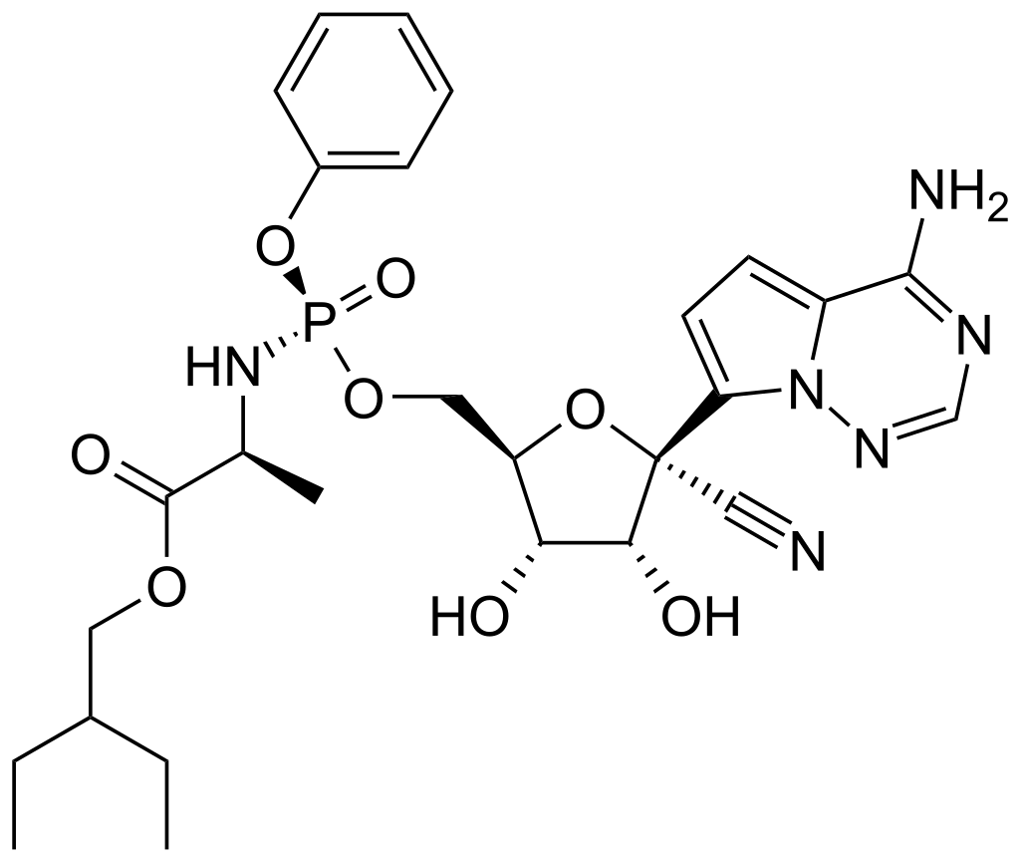
Remdesivir
A medication to treat COVID-19
Representation
An RNA replication inhibitor
A nucleotide analog
SMILES
InChi
Molfile
A small molecule drug
Cheminformatics
Toolkit
SAR

Slide 3
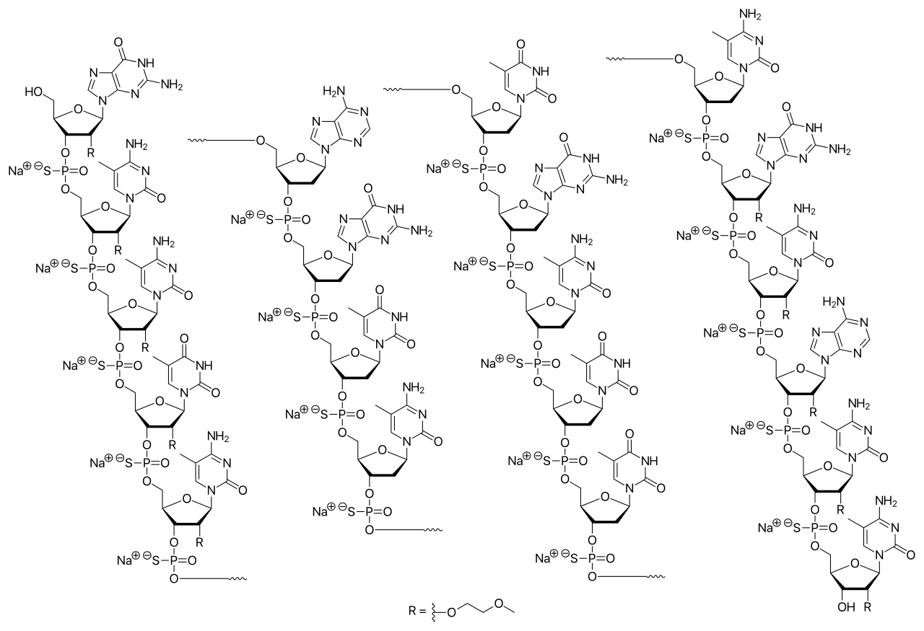
Mipomersen
A medication to treat homozygous familial hypercholesterolemia
Representation
A mRNA binder
(ApoB-100)
A modified oligonucleotide
SMILES
InChi
Molfile
A large molecule (biologics) drug
Cheminformatics
Toolkit
SAR

Slide 4
Mipomersen (Sequence View)
5’—G*—mC*—mC*—mU*—mC*—
dA—dG—dT—dmC—dT—dG—dmC—dT—dT—dmC—
G*—mC*—A*—mC*—mC*—3’
Sugar:
* = 2’-O-(2-methoxyethyl)
d = 2’-deoxy
Base:
m = 5-methyl
Linker:
— = phosphorothioate
Easy to understand the oligonucleotide sequence and modifications
Need secondary annotations to interpret the structure
Need atom-bond representation to calculate molecular properties (MF/MW)

Slide 5
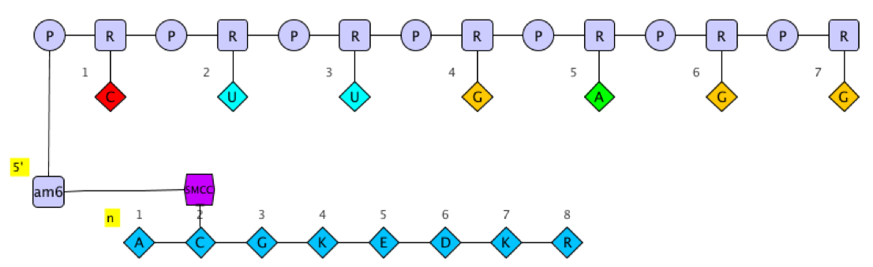
Hierarchical Editing Language for Macromolecules
A multi-level approach to represent biopolymers
Complex polymer is a container of simple polymers and handles connections among them
Complex Polymer
Simple Polymer
Monomer
Atom
5

Slide 6
Hierarchical Editing Language for Macromolecules
A multi-level approach to represent biopolymers
Simple polymer is a sequence of monomers of the same polymer type
Complex Polymer
Simple Polymer
Monomer
Atom
6

Slide 7
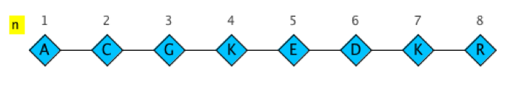
Hierarchical Editing Language for Macromolecules
A multi-level approach to represent biopolymers
Monomer is the building block of simple polymer
Complex Polymer
Simple Polymer
Monomer
Atom
7

Slide 8
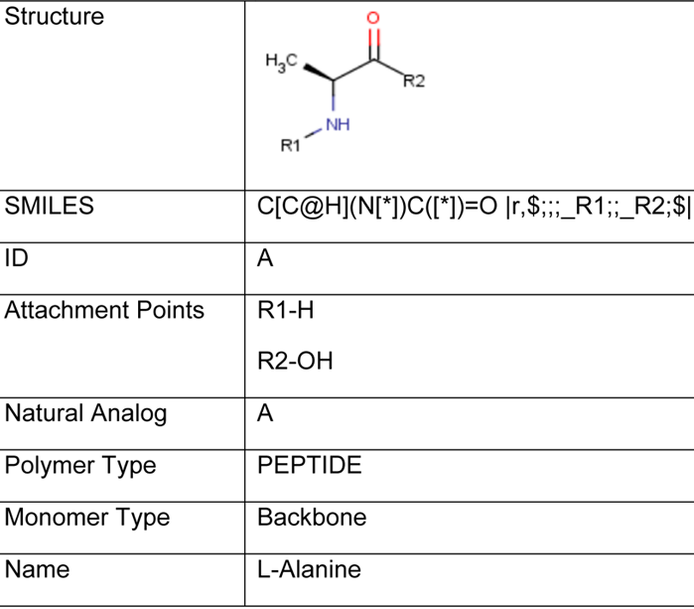

Hierarchical Editing Language for Macromolecules
A multi-level approach to represent biopolymers
The atom-bond representation of monomers are fully defined, allowing us to derive the chemical structure of simple polymers and complex polymers
Complex Polymer
Simple Polymer
Monomer
Atom
8

Slide 9
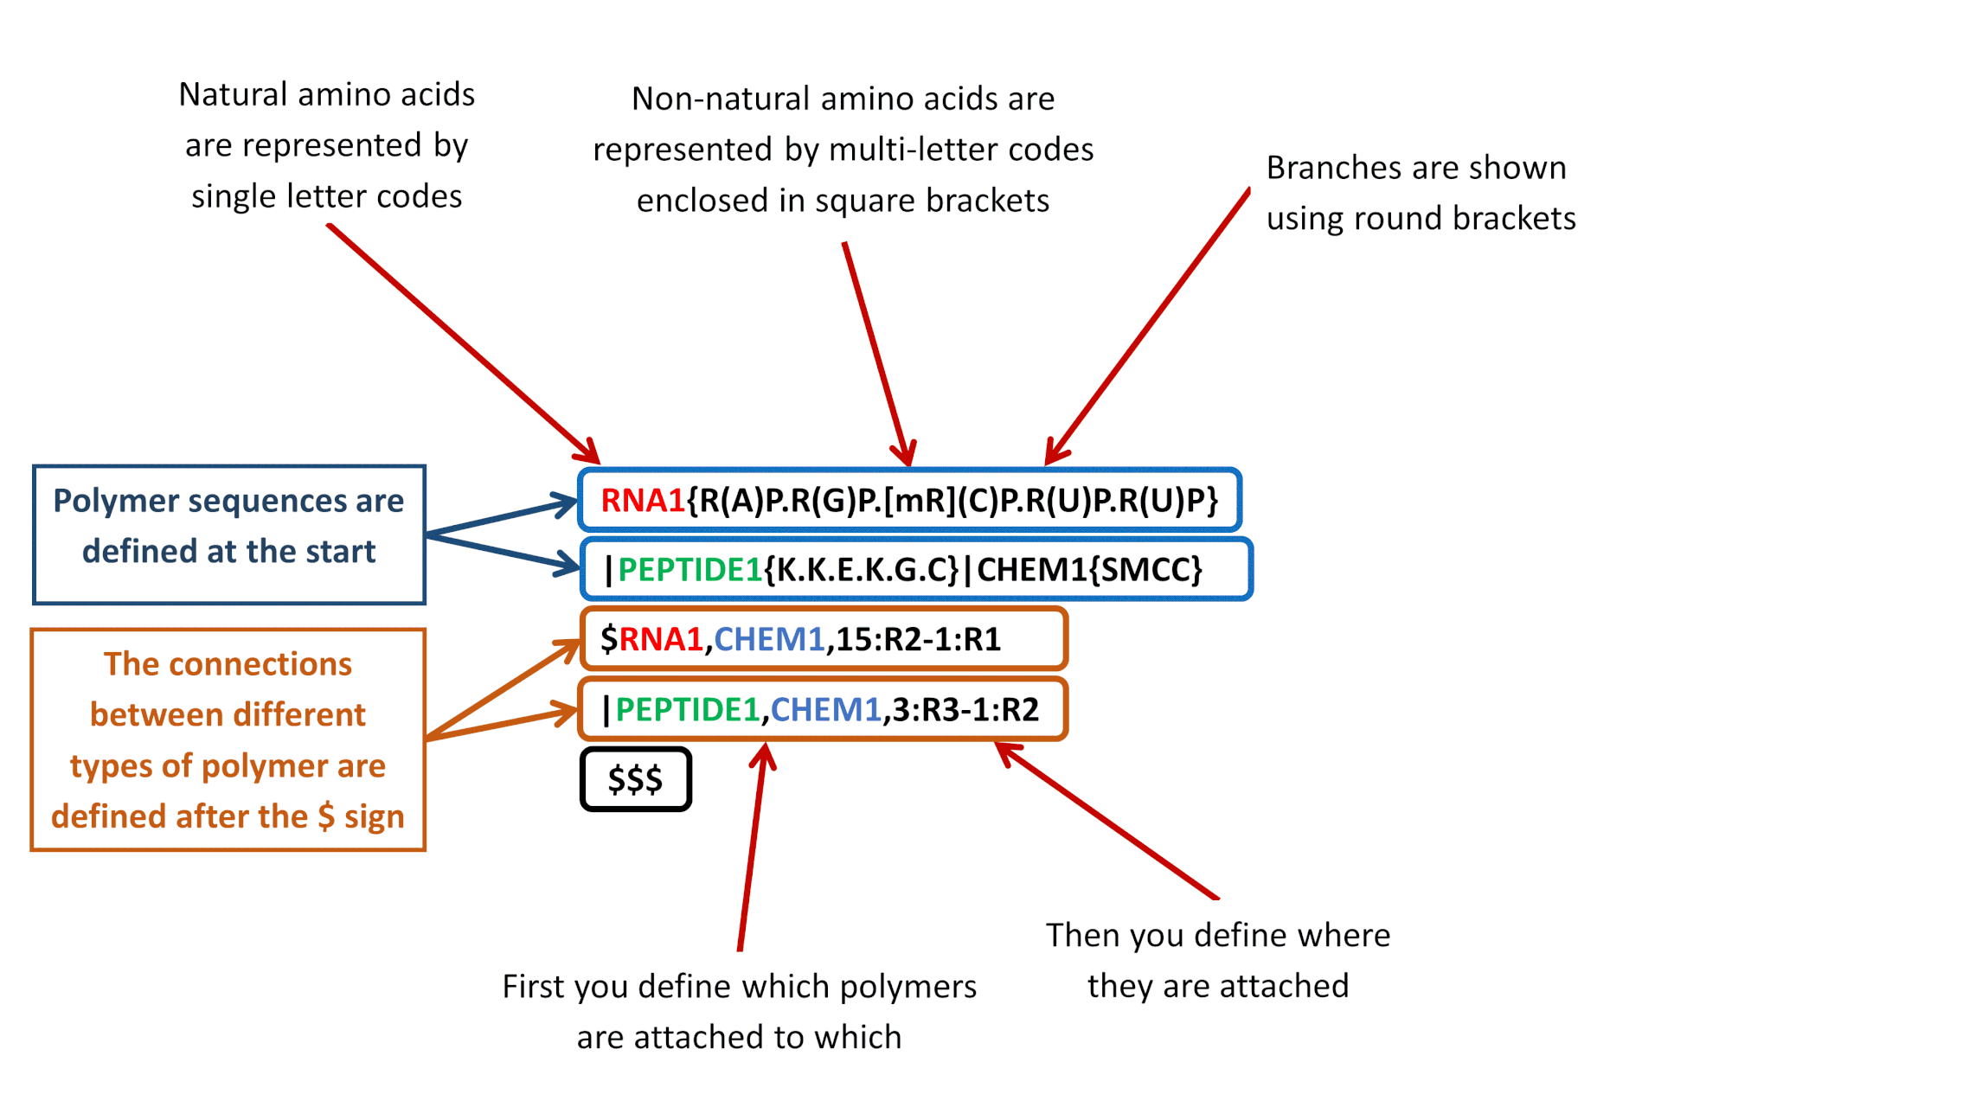
Hierarchical Editing Language for Macromolecules
9

Slide 10
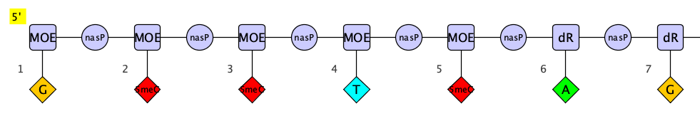
Mipomersen (with HELM)
RNA1{[MOE](G)[nasP].[MOE]([5meC])[nasP].[MOE]([5meC])[nasP].[MOE](T)[nasP].[MOE]([5meC])[nasP].[dR](A)[nasP].[dR](G)[nasP].[dR](T)[nasP].[dR]([5meC])[nasP].[dR](T)[nasP].[dR](G)[nasP].[dR]([5meC])[nasP].[dR](T)[nasP].
[dR](T)[nasP].[dR]([5meC])[nasP].[MOE](G)[nasP].[MOE]([5meC])[nasP].[MOE](A)[nasP].[MOE]([5meC])[nasP].
[MOE]([5meC])}$$$$
Molecular Formula | C₂₃₀H₃₀₅N₆₇Na₁₉O₁₂₂P₁₉S₁₉
Molecular Weight | 7594.76 g·mol⁻¹

Slide 11
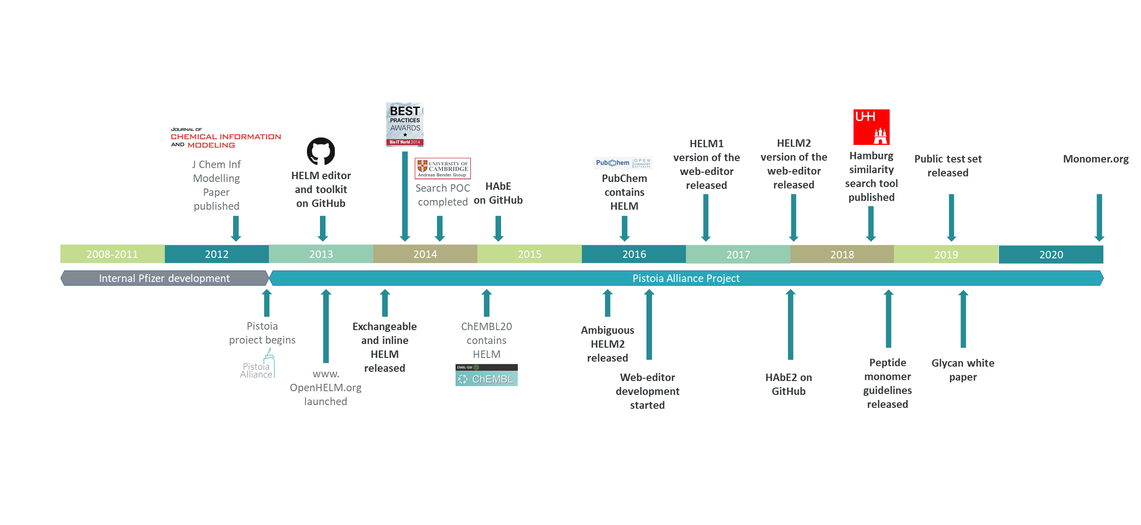
HELM History
11

Slide 12
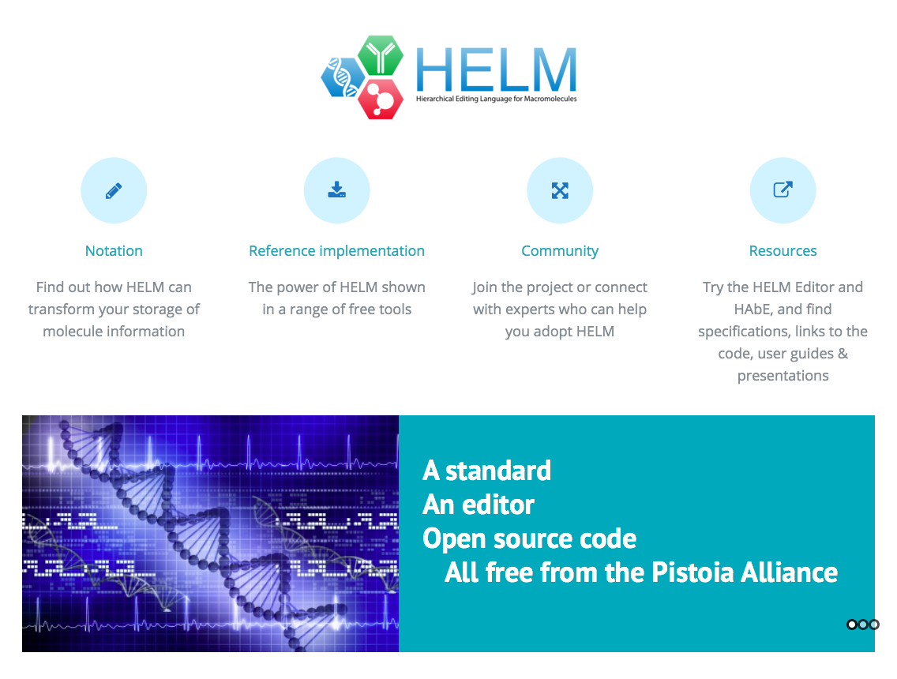


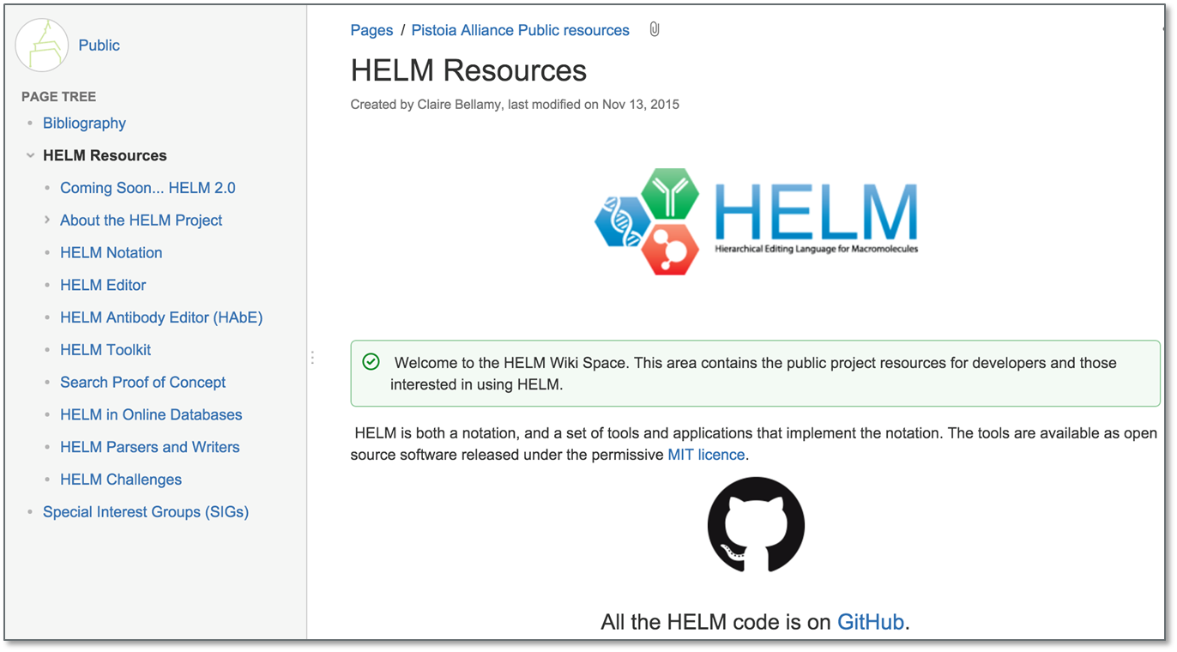
On-line information
www.OpenHelm.org
https://github.com/PistoiaHELM
Permissive MIT license
Wiki contains
Specifications
User guides
Presentations
Links to code
12

Slide 13
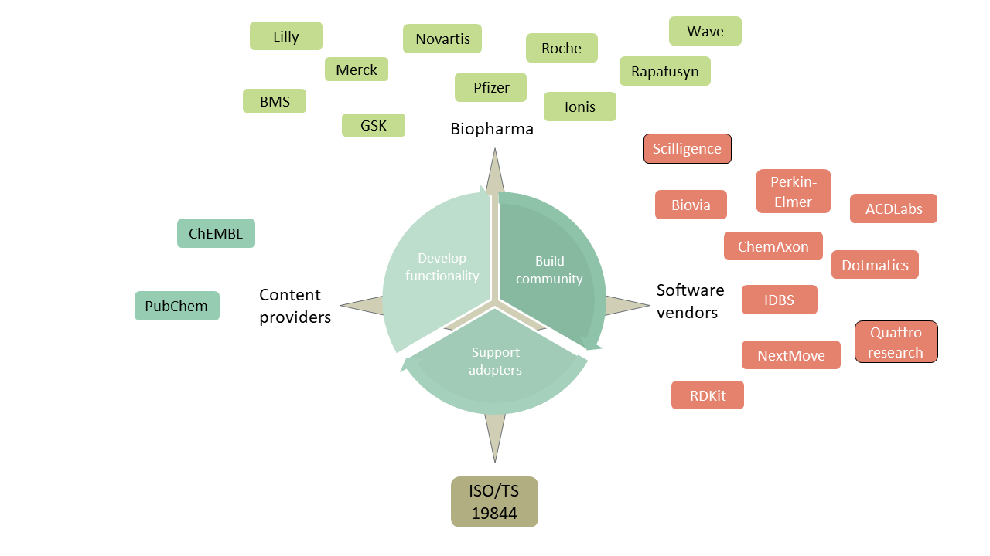
HELM Ecosystem
13

Slide 14
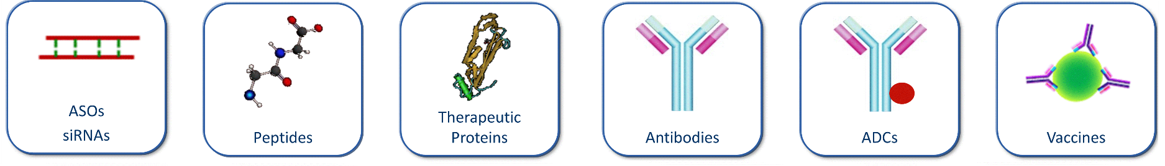
HELM Supported Modalities
How have you leveraged HELM to power your discovery workflows for these modalities?

Slide 15

HELM Ecosystem – who is missing?
HELM is still underused by some communities
Large pharma
Life science start-ups
Chem- informatics suppliers
Internally focussed
Public databases
Well used
Externally focussed
Academics
Biologics suppliers
Under-used
Journal publishers
15

Slide 16
Challenges with HELM adoption
If you just want to interpret the HELM string in a paper – why would you set up a HELM infrastructure?
If users base their HELM on different monomer library, they will interpret the HELM string differently.
Why not create a single definitive monomer library that everyone uses?
Researchers explore novel areas, so they will always want to create new monomers.
A fully comprehensive monomer library would be unwieldy.
PEPTIDE1{[ac].A.C.D.E.G.[am]}$$$$

Slide 17
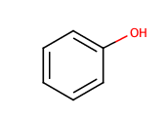
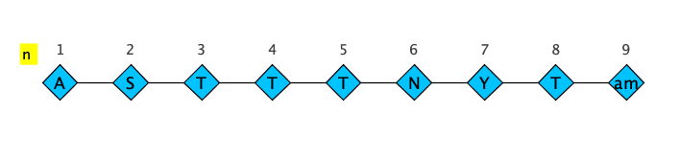
Vocabulary
Phenol | Peptide T Amide
OC1=CC=CC=C1 | PEPTIDE1{A.S.T.T.T.N.Y.T.[am]}$$$$
O, C | A, S, T, N, Y, am
Element Periodic Table | Monomer Library
Static | Dynamic, Evolving

Slide 18
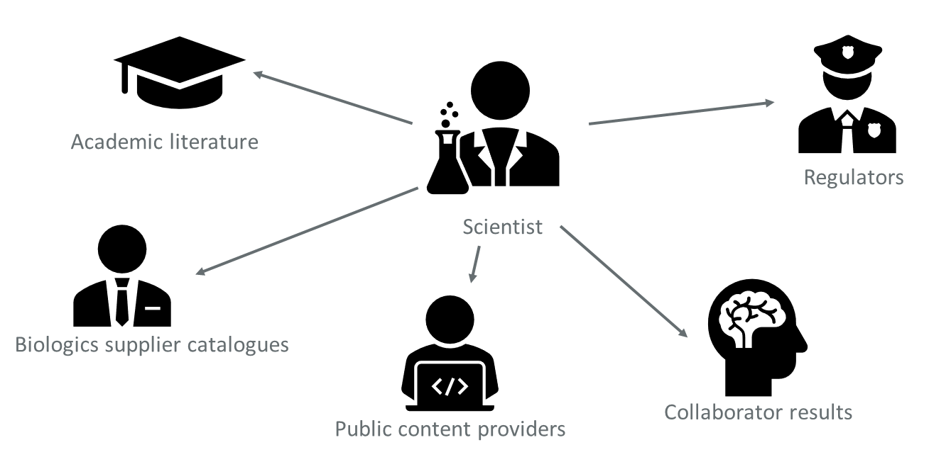
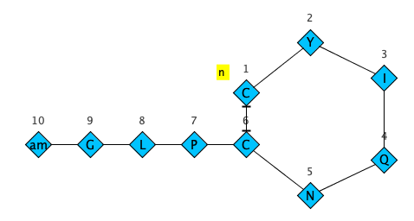
monomer.org: Universal Interpreter
A universal HELM viewer
PEPTIDE1{C.Y.I.Q.N.C.P.L.G.[am]}$
PEPTIDE1,PEPTIDE1,1:R3-6:R3$$$
MF | C43H66N12O12S2
MW | 1007.19
Library | helm_core.v1
No infrastructure for casual users
Supports multiple monomer libraries
18

Slide 19
monomer.org: Monomer Repository
A standard, well-curated, core monomer library based on the most common unnatural monomers to reduce variation in monomer definition
A hosting service for organizations to manage their monomer libraries
Monomer libraries will be versioned to allow update and backward compatibility
Monomer libraries can be designated as public or private
monomer.org - access to all monomers
Core
monomers
Organization specific monomers
Organization specific monomers

Slide 20


monomer.org: Cloud Platform
A viewer
View any HELM string, no matter what the source.
An editor
Create HELM strings using your choice of monomer libraries.
Monomer browser
Explore the available monomer libraries.
Monomer curation
Securely update and add monomers.
Publish new versions of libraries.
Ala
Leu
P
Provide webservice access to the data.
Webservices
Store multiple monomer libraries including a recommended standard set.
Monomers
Monomers
Monomers
Monomers
20

Slide 21
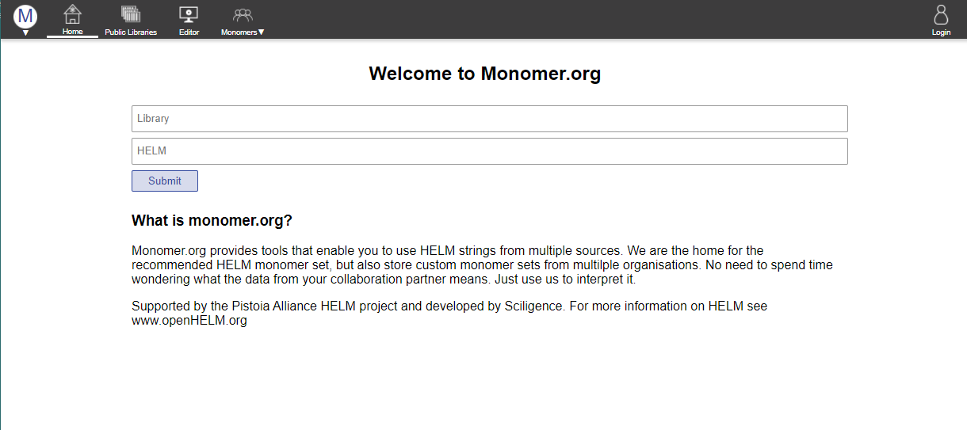
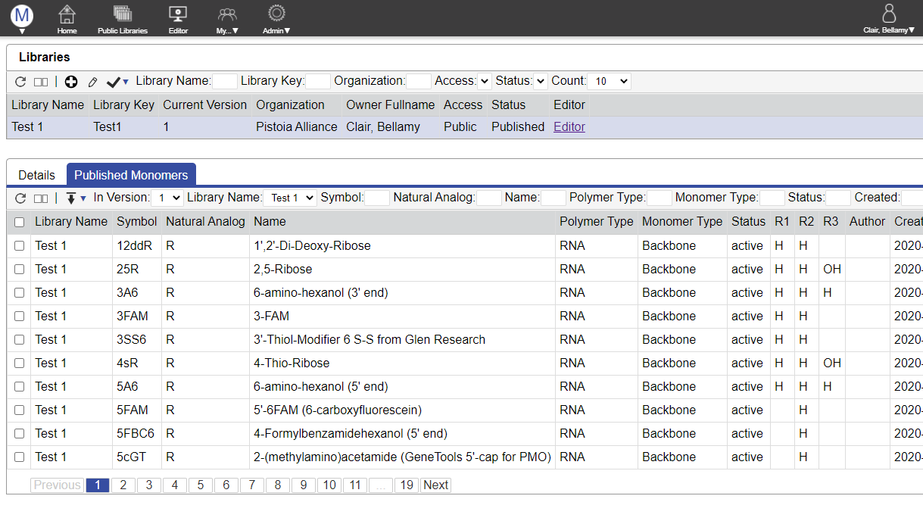

www.monomer.org
Testing in progress
Many thanks to Scilligence for providing the development effort

Slide 22
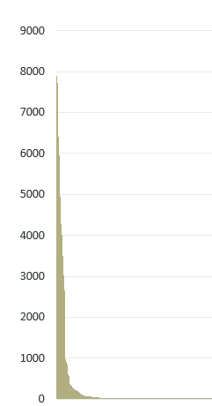
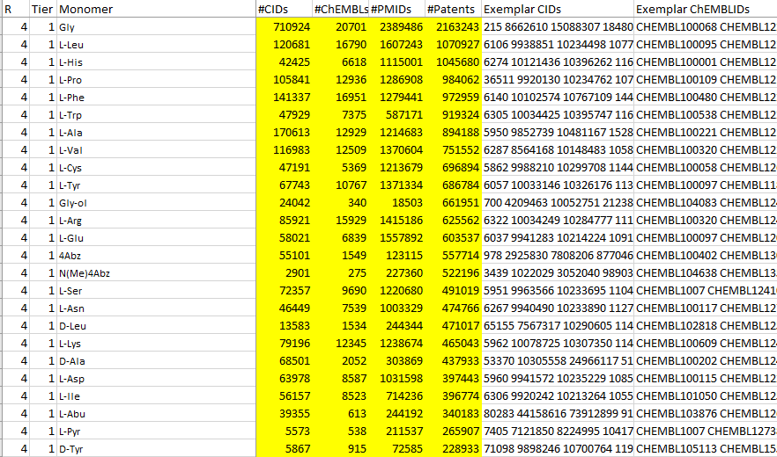
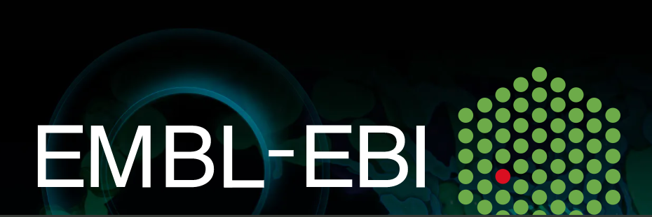

Core Monomer Library
Frequency analysis across PubChem, ChEMBL, literature and patents to determine the most useful monomers.
We want to acknowledge amazing support in data analysis and acquisition from
Anna Gaulton
Evan Bolton
And nucleotide support from Ionis
Core monomer database size
PEPTIDE: 322
Oligo: still under construction (approx. 350)
CHEM: 19

Slide 23
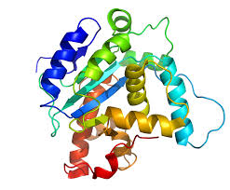
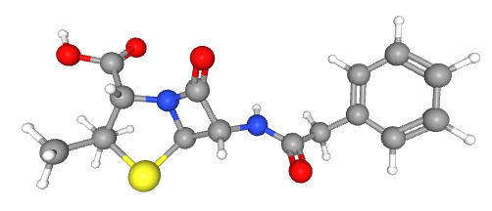
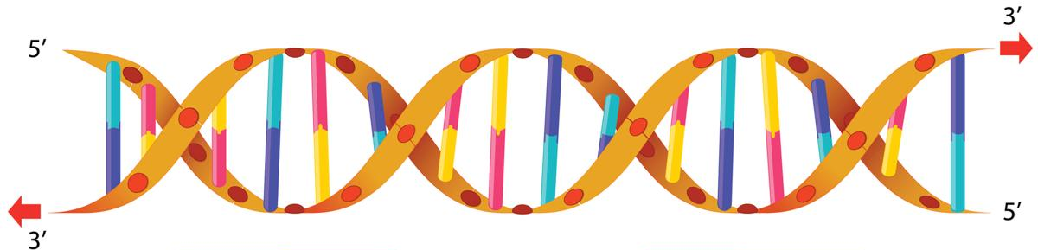
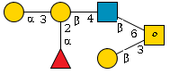
Interested in Glycan?
HELM was designed to be extensible from the beginning.
We currently cover three polymer types:
Peptides (PEPTIDE)
Nucleic Acid (RNA)
Small molecules (CHEM)
We have a white paper describing HELM can be extended to handle polysaccharides.
Looking for volunteer coders to help implement this in the open-source tools.
23

Slide 24
Acknowledgments
Andrey Yerin, ACDlabs
Hans de Bie, ACDlabs
Jan Holst Jensen , Biochemfusion
Dana Vanderwall, BMS
Mary Brawner , BMS
Matthias Nolte, BMS
Ramesh Durvasula, BMS
David Lowis, Certara
Akos Papp, ChemAxon
Alexander Drijver, ChemAxon
Roland Knispel, ChemAxon
Alex Allardyce, ChemAxon
Alastair Hodges, Dotmatics
Anna Gualton, EMBL-EBI
Andrew R Leach , EMBL-EBI
Dominic Clark, EMBL-EBI
John Overington, EMBL-EBI
Patricia Bento, EMBL-EBI
George Papadatos, EMBL-EBI
Leah O’Brien , GSK
Rama Bhamidipati , GSK
Michael Cui , GSK
John Smith, GSK
Simili Abhilash, Harvard University
Stephanie Dube, Harvard University
Thankam Girija, Harvard University
Sarah Leinicke, Harvard University
Chinedu Okongwu, Harvard University Justin Sanford, Harvard University
Stephen Heller, InChi Trust
Keith Taylor, Independent
Edward Currie, Infosys
Kirti Jindal, Infosys
Eric Swayze, Ionis
Jeff Milton, Ionis
Susan Turner , Merck
Thomas Gan, Merck
Chris Waller, Merck
Roger Sayle, Next Move Software
Noel O-Boyd, Next Move Software
John May, Next Move Software
Evan Bolton, NIH/Pubchem
Joann Prescott-Roy, Novartis
Yohann Potier, Novartis
Sven Neumeyer, Novartis
Quan Yang, Novartis
Pat Keller, Novartis
Boram Yi, Novartis
Pierre Morieux, Perkin Elmer
Andrew Smellie, Perkin Elmer
Philip Skinner, Perkin Elmer
Claire Bellamy, Pistoia Alliance
John Wise, Pistoia Alliance
Carmen Nitsche, Pistoia Alliance
Richard Holland, Pistoia Alliance
David Klatte, Pfizer
Hongli Li, Pfizer
Sergio Rotstein , Pfizer
Rob Stanton, Pfizer
Simon Xi, Pfizer
Tianhong Zhang , Pfizer
Bernhard Shirm, Quattro research
Markus Weisser, Quattro research
Anne Von Raven, Quattro research
Marco Lanig, Quattro research
Cathrin Mayer, Quattro research
Sabrina Hecht, Quattro research
Michael Braxenthaler, Roche
Margret Assfalg , Roche
Stefan Klostermann, Roche
Dennis Hansen, Roche
Jinbo Lee, Scilligence
Tony Yuan, Scilligence
Elrashid Elzein Sciligence
Bret Daniel, Sial
Ian Stott, Unilever
Jerry Winter, Unilever
Andreas Bender, University of Cambridge
Andrea Chlebkova, University of Cambridge
Eva Bultel, University of Hamburg
Clémentine Campart, University of Lille
Maude Pupin, University of Lille
Ken Longo, Wave Life Sciences
83 people across 28 organizations coming together for a common cause!!

Slide 25


www.OpenHelm.org info@openhelm.org

Slide 26
Backup slides

Slide 27

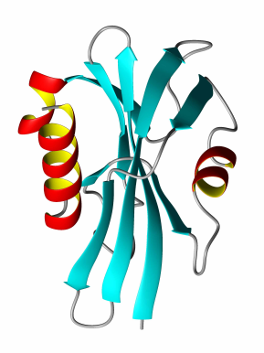

Biomolecules - Stuck in the middle…
GAP
Small Molecule Tools
Sequence-Based Tools
Small Molecules
Sequence
information
Biomolecules

Slide 28
Monomer Ambiguity
* | 0..n unknown monomers | PEPTIDE1{A.*.G.C}$$$$V2.0
X | Single unknown amino acid in a PEPTIDE | PEPTIDE1{A.X.G.C}$$$$V2.0
N | Single unknown base in a RNA | RNA1{R(A)P.R(N)P.R(C)P.R(C)P.R(C)}$$$$V2.0
( , ) | One of a list of monomer is possible | PEPTIDE1{A.(A:10,G:90).G.C}$$$$V2.0
( + ) | Mixture of monomers | PEPTIDE1{A.(A+G+C).G.C}$$$$V2.0
_ | Deleted or missing single monomer | PEPTIDE1{A.(A,_).G.C}$$$$V2.0
´ ´ | Repeating monomers | PEPTIDE1{A.G.A.C.A‘5-30‘}$$$$V2.0
?
A
G
C

Slide 29
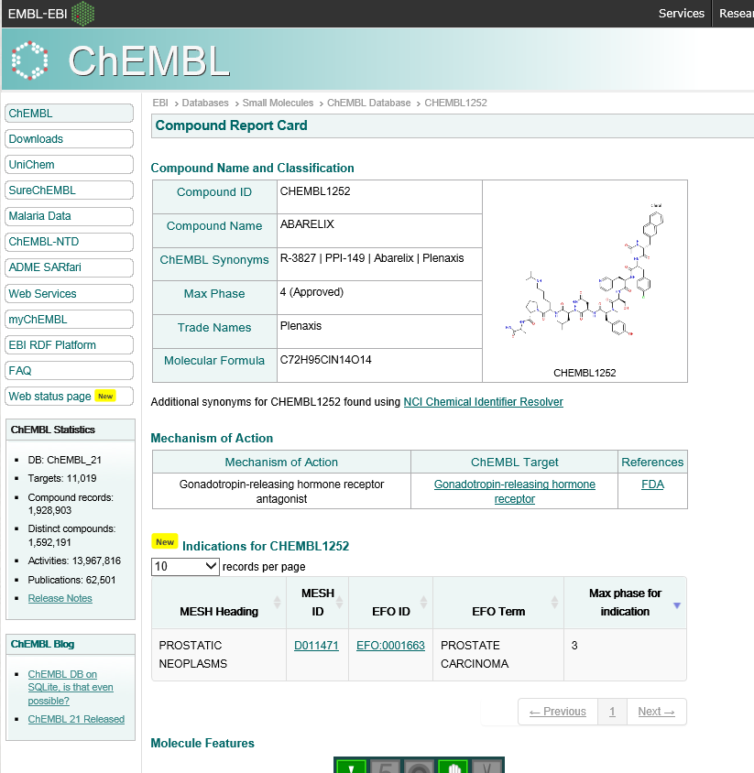
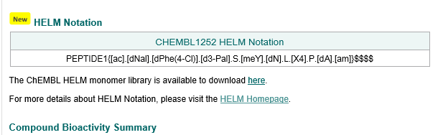
HELM in ChEMBL
ChEMBL20 onwards has HELM structures for 19K structures
As part of this work the EBI created a monomer database of ~2800 structures

Slide 30
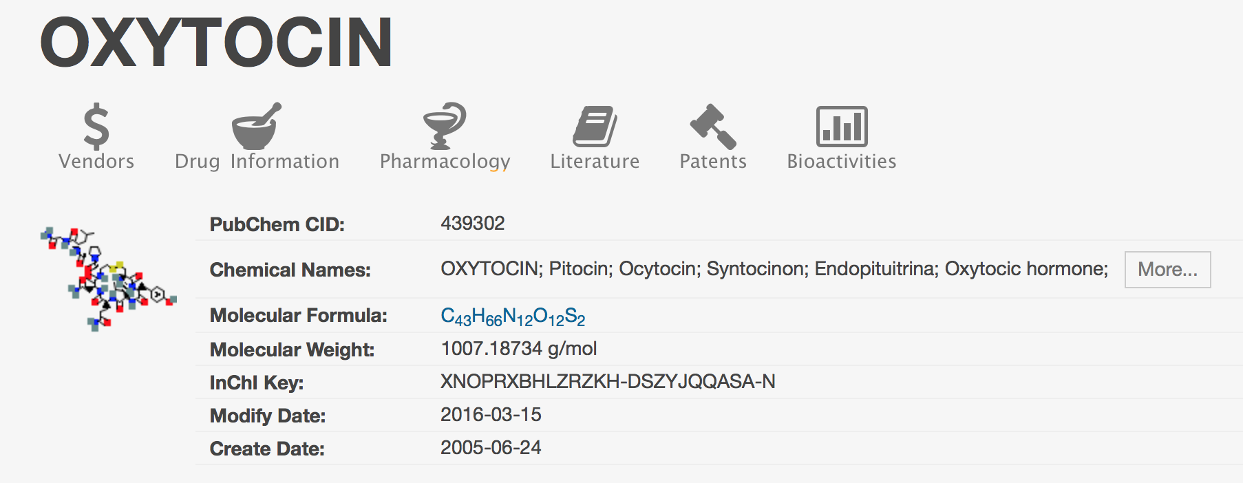
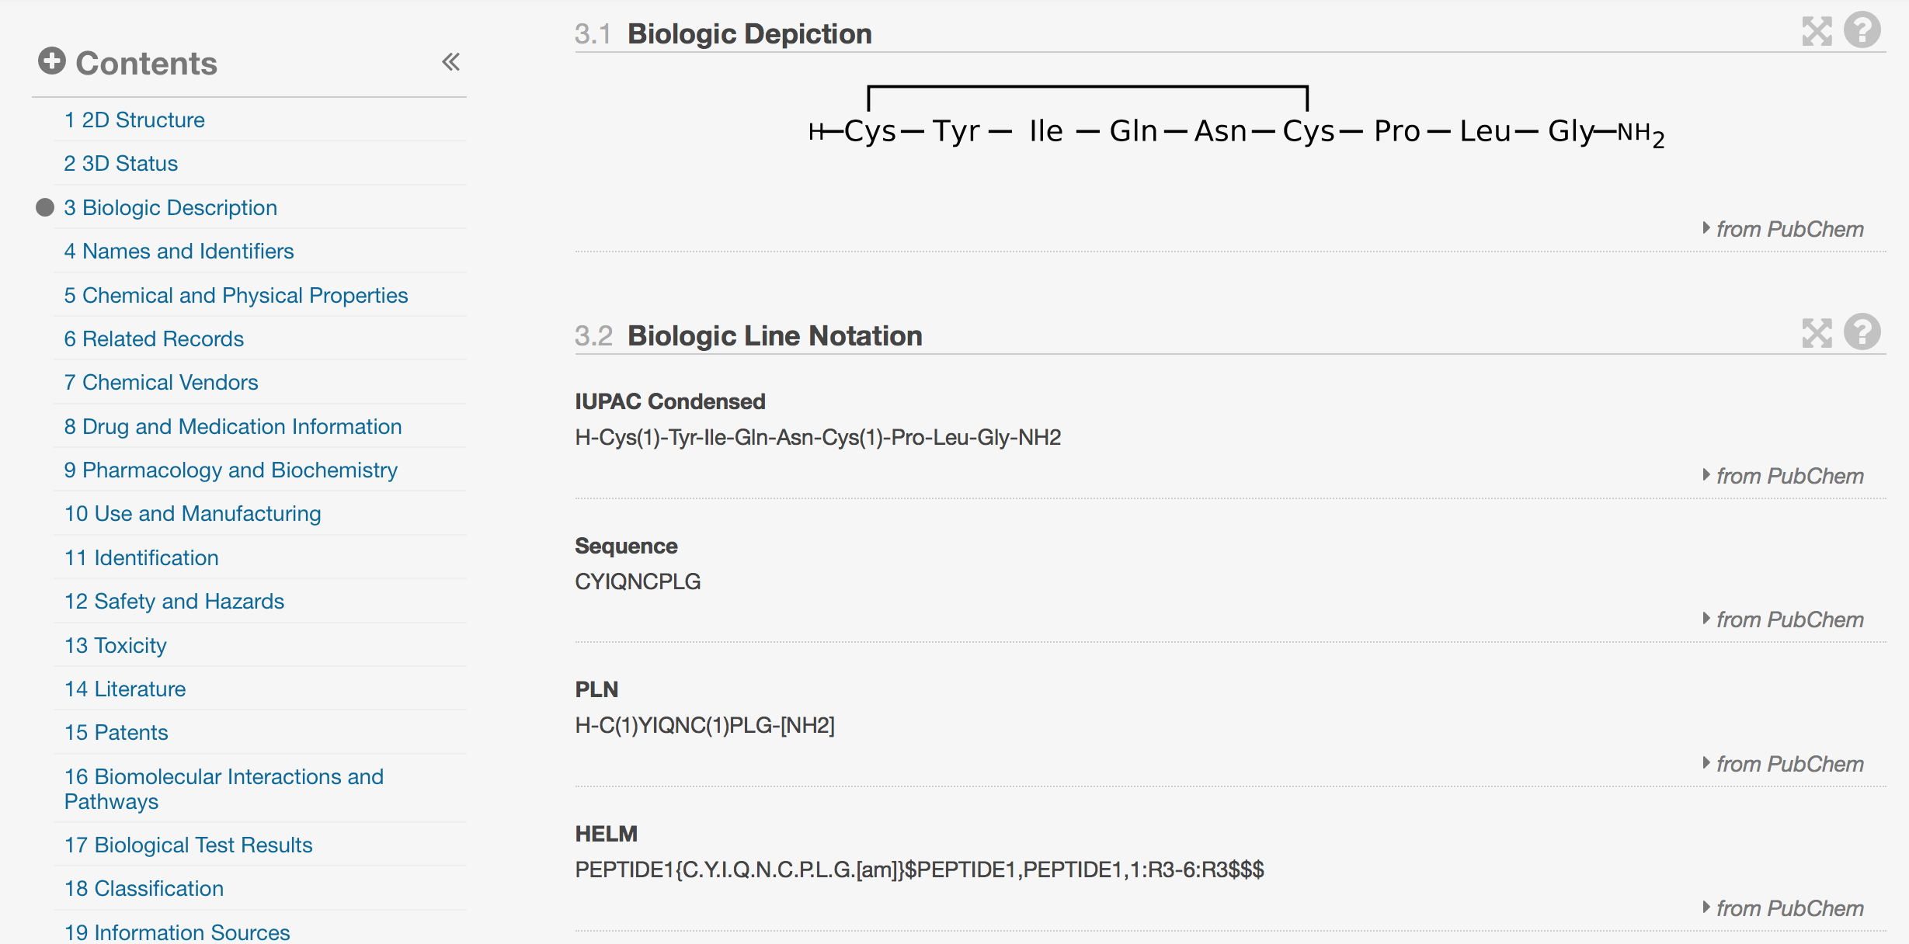
HELM at NCBI: PubChem
PubChem use a small monomer set and make extensive use of in-line HELM (SMILES)

