Slide 1

Embracing Ambiguity:
Representation of Macromolecules Using the Enhanced Standard HELM 2.0
Dr. Markus Weisser, Co-Founder and Managing Director quattro research GmbH

Slide 2
The Pistoia Alliance
The Pistoia Alliance is a global, non-profit alliance of life science companies, vendors, publishers, and academic groups that work together to solve common problems and lower barriers to innovation in R&D

Slide 3


























































Slide 4
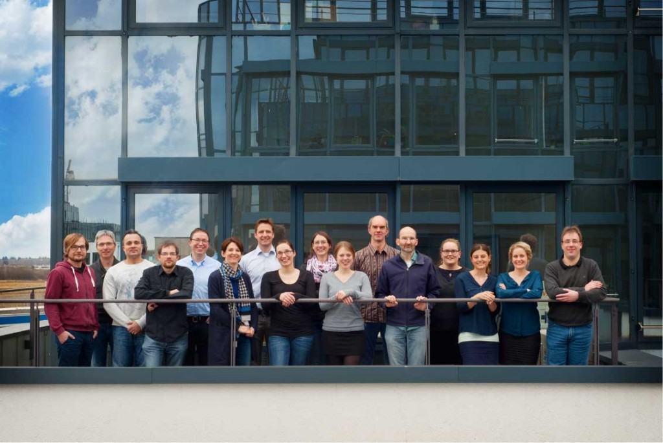
quattro research
Software and service company located in Munich, Germany
Tools and services for small and large molecules
HELM know-how
xHELM
HAbE
HELM 2.0

Slide 5
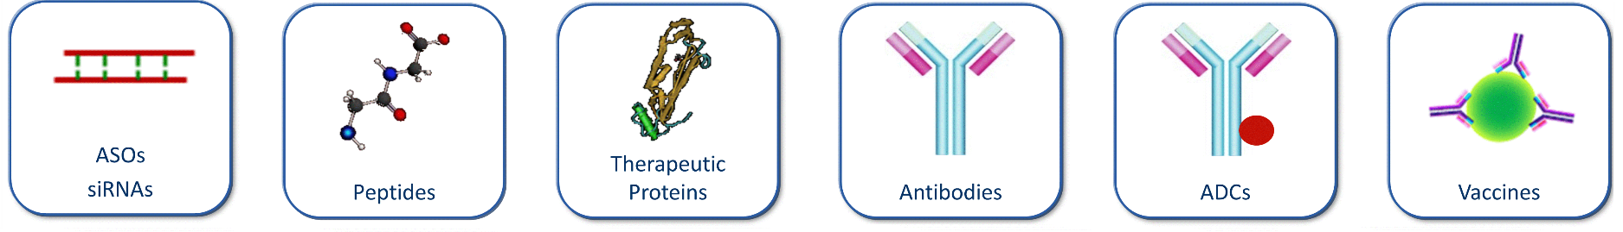
What is the HELM notation?
HELM is a line notation
that can encode the structure
of all biomolecules.

Slide 6

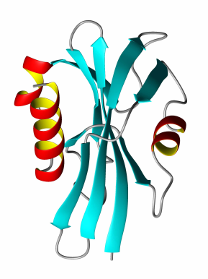

Why HELM notation?
GAP
Small Molecule Tools
Sequence-Based Tools
Small Molecules
Sequences
Biomolecules

Slide 7
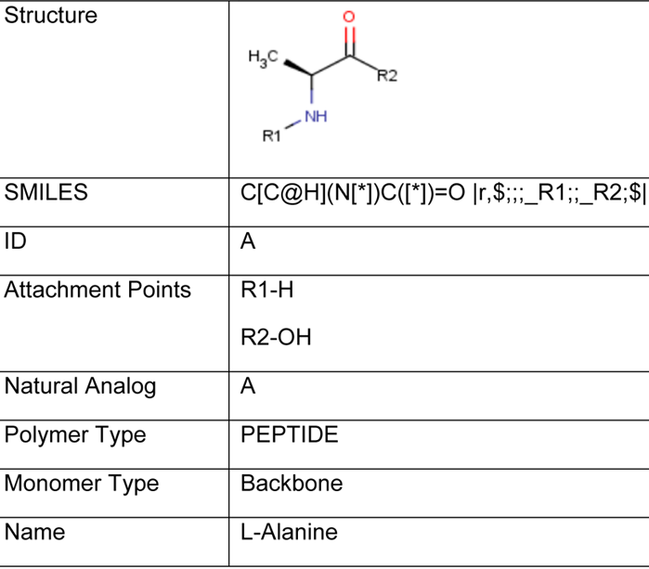

Structure of the HELM notation?
Hierarchical Editing Language for Macromolecules
Complex Polymer
Simple Polymer
Monomer
Atom
T. Zhang et al.
J.Chem. Inf. Model,
2012, 52(10), 2796

Slide 8
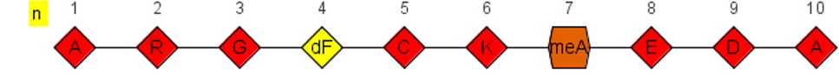
Syntax Elements
$ separate HELM sections ←polymers→$←connections→$←groupings→$←annotations→
. separate elements PEPTIDE1{A.R.G.G.C.A}
{}, [] and () are grouping characters
...
PEPTIDE1{A.R.G.[dF].C.K.[meA].E.D.A}$$$$

Slide 9
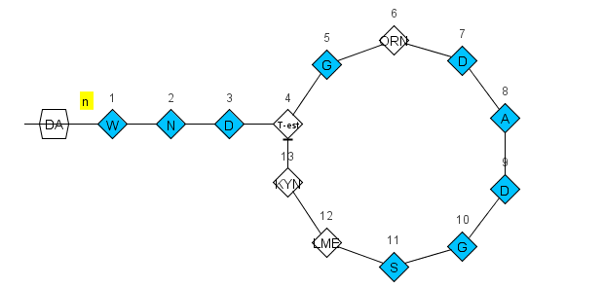
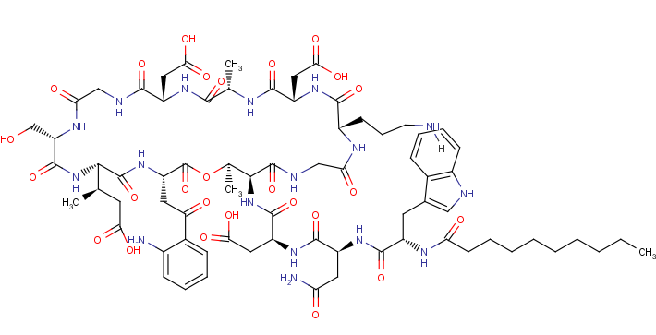
HELM Examples
Daptomycin
PEPTIDE1{W.N.D.[T-est].G.[OR].D.A.D.G.S.[LM].[KYN]}|CHEM1{DA}$
PEPTIDE1,PEPTIDE1,13:R2-4:R3|PEPTIDE1,CHEM1,1:R1-1:R1$$$

Slide 10
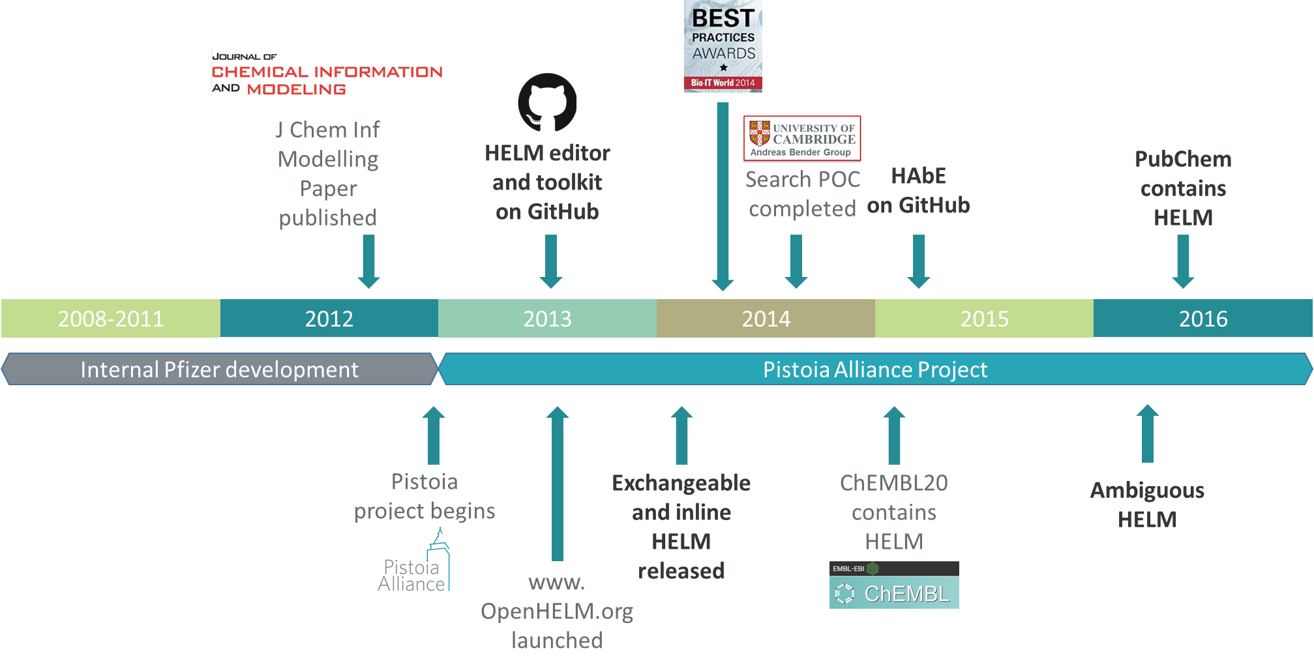
HELM history

Slide 11
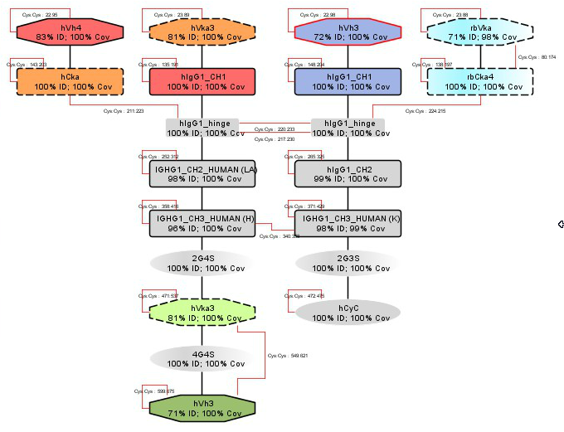
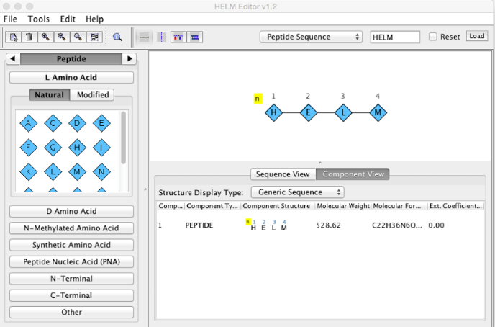
HELM software ecosystem
HAbE
HELM Editor
3rd Party Tools
ChemAxon
BioVia
PerkinElmer
Biochemfusion
ChEMBL
etc.
HELMNotationToolkit
HELM

Slide 12
Mission completed?
?
?
?
?
?
?
Unknown numbers of repeating elements
Mixtures of sequences
Unknown elements in sequences
Unknown connections between polymers
Undefined polymers
...

Slide 13
The HELM 2.0 project
Initiated and founded by the Pistoia Alliance
3 parts:
Support ambiguity for HELM
Remove dependency to closed source chemical toolkit
Switch to service oriented architecture by using REST services

Slide 14
Ambiguity in HELM 2.0
Monomer ambiguity Unknown monomers in a polymer
Polymer ambiguity Sequence or polymer type is unknown
Connection ambiguity The details of the connections between polymers are unknown
Grouping ambiguity Unknown details of a grouping

Slide 15
Monomer Ambiguity
* | 0..n unknown monomers | PEPTIDE1{A.*.G.C}$$$$V2.0
X | Single unknown amino acid in a PEPTIDE | PEPTIDE1{A.X.G.C}$$$$V2.0
N | Single unknown base in a RNA | RNA1{R(A)P.R(N)P.R(C)P.R(C)P.R(C)}$$$$V2.0
( , ) | One of a list of monomer is possible | PEPTIDE1{A.(A:10,G:90).G.C}$$$$V2.0
( + ) | Mixture of monomers | PEPTIDE1{A.(A+G+C).G.C}$$$$V2.0
_ | Deleted or missing single monomer | PEPTIDE1{A.(A,_).G.C}$$$$V2.0
´ ´ | Repeating monomers | PEPTIDE1{A.G.A.C.A‘5-30‘}$$$$V2.0
?
A
G
C

Slide 16
Polymer Ambiguity
Sequence or polymer type is unknown
BLOB1{Bead}”Aminated Polystyrene”|PEPTIDE1{A.G.T}$$$$
A
G
T

Slide 17
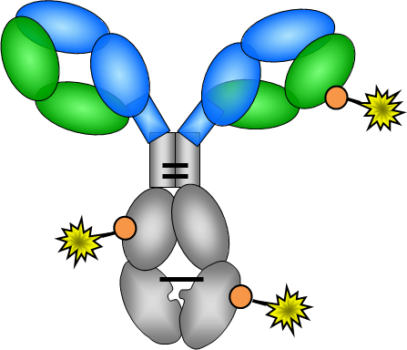
Connection Ambiguity
The details of the connections between polymers are unknown
A small molecule binds to any Cysteine at peptide 1. PEPTIDE1{A.A.A.A.A.A.C.A.A.A.A.A.A.A.A.A.A.A.A.A.A.C.D.D.D.D.D.D.D.D.D.D.D.D.D.D.D.D.D.D. D.D.E.E.E.E.E.E.E.E.E.E.E.C.E.E.E.E.E.E.E.E.E.E.E}|PEPTIDE2{G.G.G.G.G.G.G.G.G.G.G.G.G.G.G .G.G.G.G.G.G.G.G.G.G.C.S.S.S.S.S.S.S.S.S.P.P.P.P.P.P.P.P.P.K.K.K.K.K.K.K.K.K.K.K.K.K}|CHE M1{[*]SCCCc1ccccc1 |$_R1;;;;;;;;;;$|}$PEPTIDE1,CHEM1,C:R3-1:R1$$

Slide 18
HELM NotationToolkit Re-Engineering
New HELM parser
Remove Marvin Beans dependency
Service oriented architecture
REST service API
HELMNotationToolkit
HELM2NotationToolkit
MarvinBeans
Chemical Toolkit API
Marvin
Beans
CDK
3rd party library

Slide 19
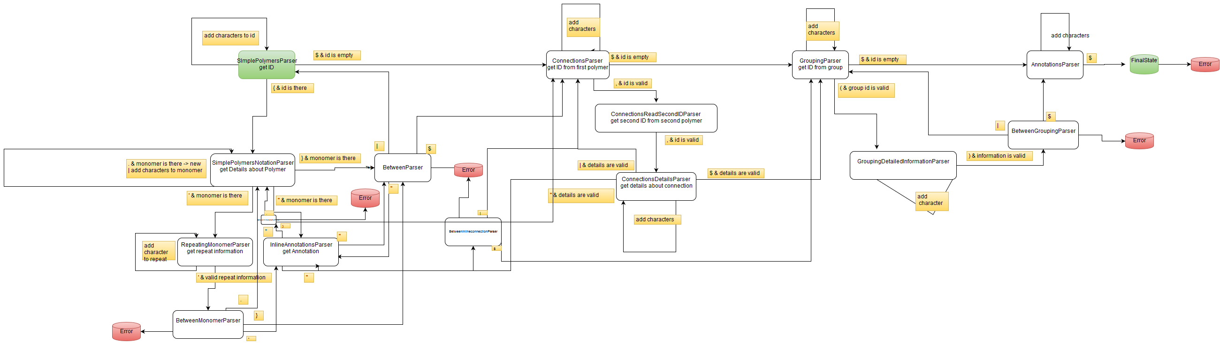
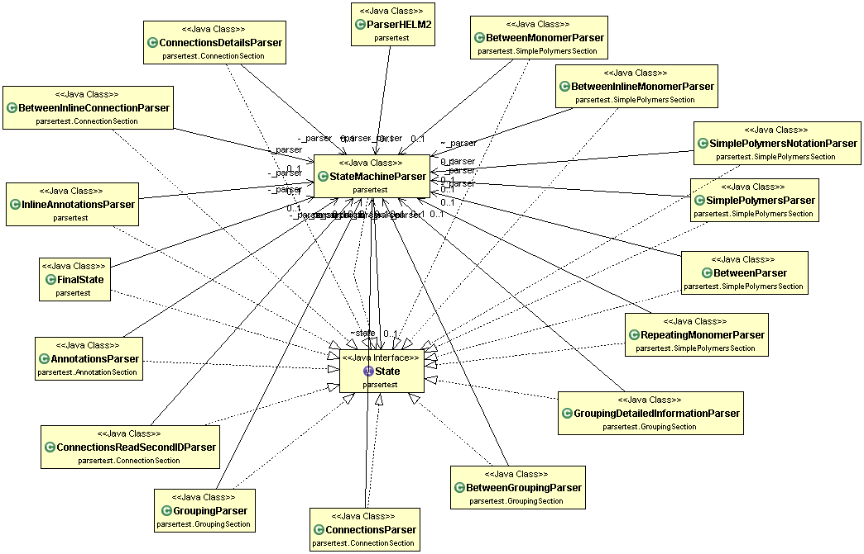
HELM State Machine Parser

Slide 20
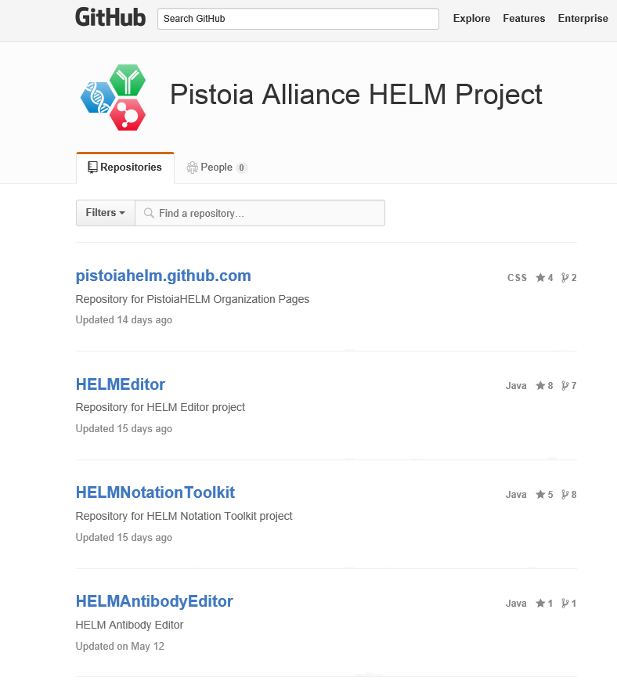


HELM Resources
https://github.com/PistoiaHELM

Slide 21
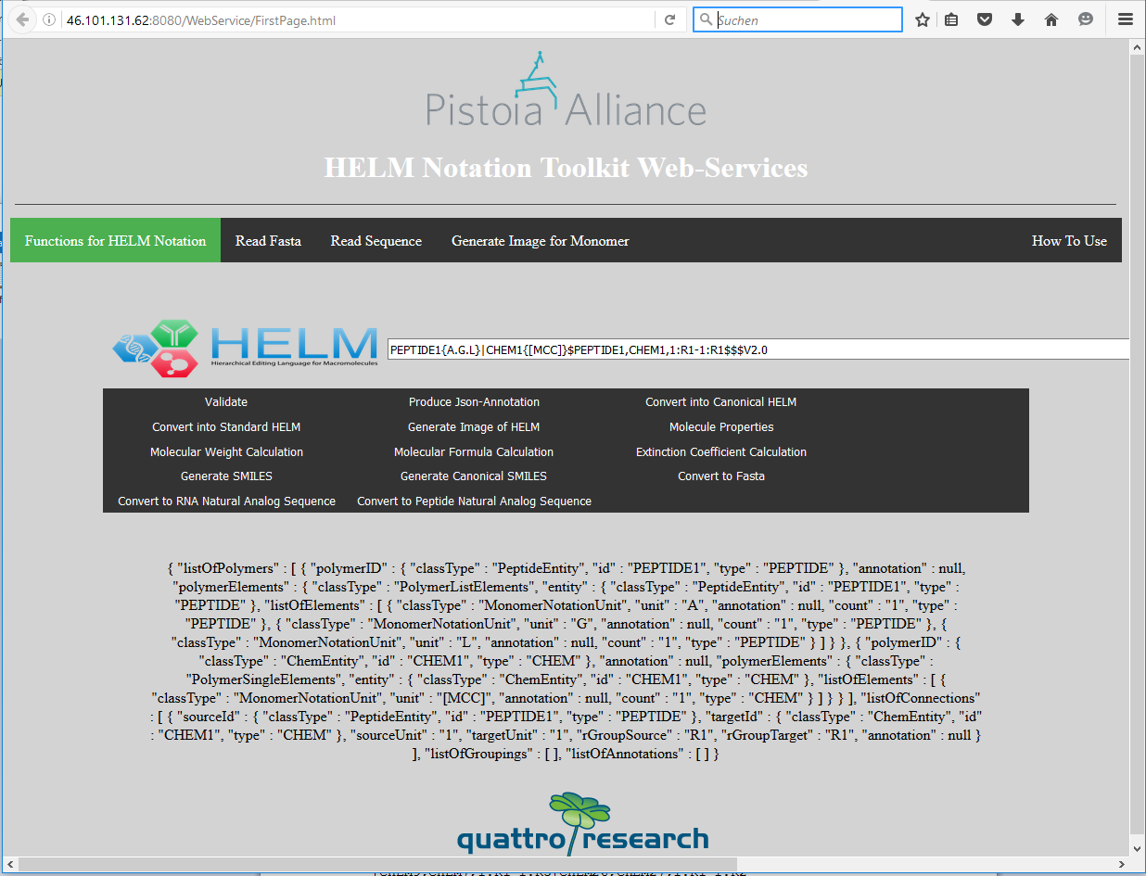
Example implementation

Slide 22
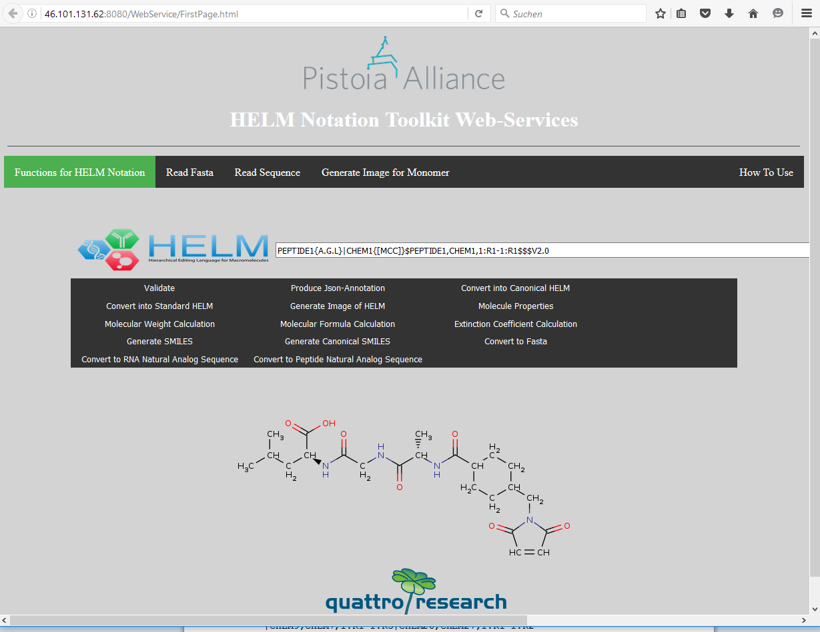
Example Implementation

Slide 23
Development Team
Development:
Markus Weisser (quattro research)
Sabrina Hecht (quattro research)
Dmitry Chistyakov (quattro research)
Managment:
Sergio Rotstein (Pfizer) – Domain Lead
Claire Bellamy (Pistoia Alliance) – Project Manager
Pistoia Alliance HELM Team Members:
Thomas Gan (Merck)
Jan Holst Jensen (biochemfusion)
Stefan Klostermann (Roche)
Roland Knispel (ChemAxon)
Jeff Milton (Ionis)
Sven Neumeyer (Novartis)
Matthias Nolte (BMS)
Yohann Potier (Novartis)
Eric Swayze (Ionis)
Bernhard Schirm (quattro research)
Tianhong Zhang (Pfizer)
Steering Committee Members:
Margret Assfalg (Roche)
Ramesh Durvasula (BMS)
Leah O'Brien (GSK)
Sergio Rotstein (Pfizer)
Eric Swayze (Ionis)
Chris Waller (Merck)
John Wise (Pistoia Alliance)
Quan Yang (Novartis)

Slide 24
References
Poster presentation in the exhibit hall
www.openhelm.org
https://github.com/PistoiaHELM
Zhang, Tianhong, et al. Journal of chemical information and modelling 52.10 (2012): 2796-2806 http://pubs.acs.org/doi/full/10.1021/ci3001925
Thank you!

