Slide 1

Registering chemically modified oligonucleotides: implementations and challenges
Novartis Institute for BioMedical Research
Yohann Potier, Ph.D.
ACS National Meeting, Boston
August 20, 2018

Slide 2
Agenda
Chemically modified entities
HELM introduction at NIBR
HELM landscape at NIBR
Architecture
Lessons learned
Notes:
I am going to speak about chemically modified oligos because it is the starting point of our HELM implementation. The talk is going to focus on the historical and technical implementation as well as what we learned along the way.
I am sure other talks will focus on HELM capabilities.

Slide 3
Novartis Institutes for BioMedical Research
NIBR is the innovation engine of Novartis
Collaboration
New technologies
Focus on therapeutic breakthrough
6000 people
6 campuses
Notes:
First a short introduction of the NIBR. It is the Research branch of Novartis with a focus on collaboration, new technologies and therapeutic breakthrough.
While I am located in Cambridge, US. There are 6 campuses worldwide for NIBR with around 6k people. There are around 400 research projects are currently ongoing looking for new molecular entities to be used in various disease area.
90 NME (New molecular entity)

Slide 4
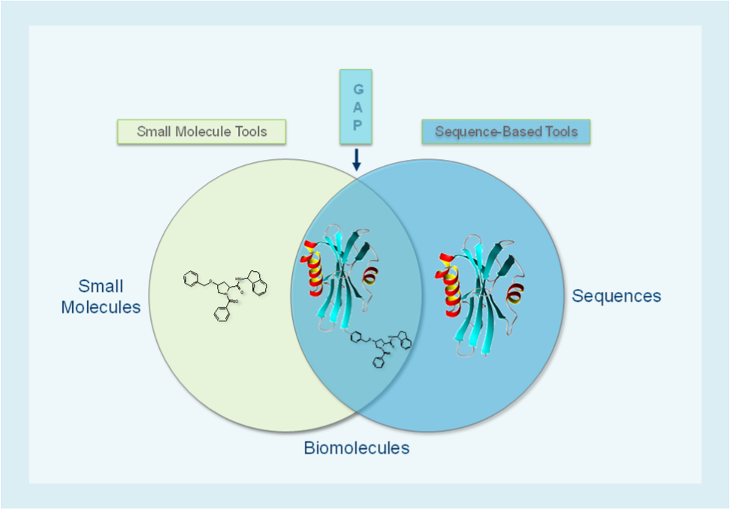
Chemically modified entities
Notes:
Some of these NME do not fit into the usual dogma of small molecules or polymeric molecules like proteins or oligos.
While we have tools to describe small molecules uniquely, as well as tools to describe protein sequence or naturally occurring oligos, there is gap for biomolecules that bridge these entities. In my case, I have mostly been working with various synthetic RNAs that fits into that category.
---
Registration of small molecules
Atom level description, Cartridge
Registration of biomolecules
Amino acid & nucleotides sequences
Gap
Macromolecules
Synthetic xNAs (CRISPR,..)
DNA encoded libraries
Synthetic peptides
ADCs

Slide 5
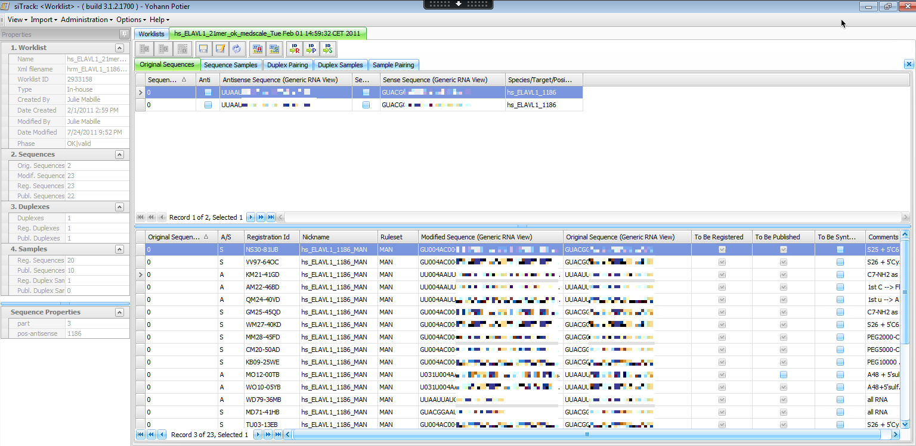
siRNA program
Structures of the siRNA strands and duplexes can be registered (ID, properties)
siTrack; in-silico design and modification of siRNAs
Notes:
In 2010, NIBR had a siRNA program. These small interfering RNA are double strand RNA that interferes with the expression of specific genes.
We needed to describe uniquely the structures and properties of these siRNA.
siTrack was developed internally using Oracle and .NET stack. Here is a screenshot where you can see the original sequence of that RNA. You could apply modifying rules to these original sequences and generate a large number of sequences with chemically modification that could be registered into the corporate registration system, to obtain a unique ID that would reference the sample used in the lab of that entity.
----
Small interfering RNA (siRNA), sometimes known as short interfering RNA, double-stranded RNA molecules, It interferes with the expression of specific genes with complementary nucleotide sequences by degrading mRNA after transcription,[1]preventing translation
target mRNA is introduced into cells with the intent to block gene expression through either translational inhibition or enzymatic cleavage of the mRNA target.
Examples: ELAVL1 gene (protein coding) : Embryonic Lethal, Abnormal Vision, Drosophila)-Like 1
.

Slide 6
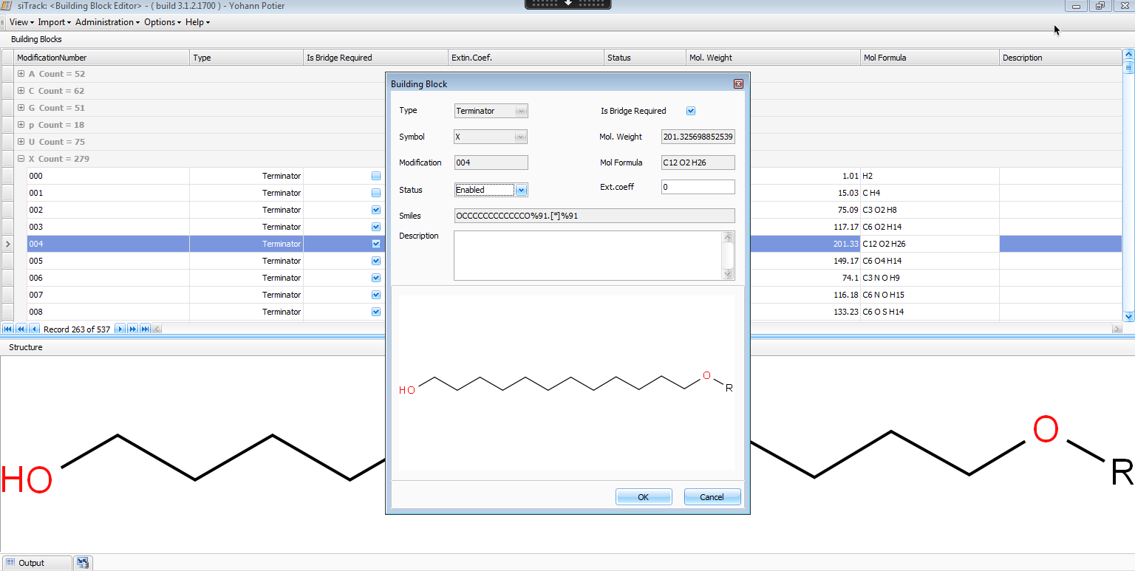
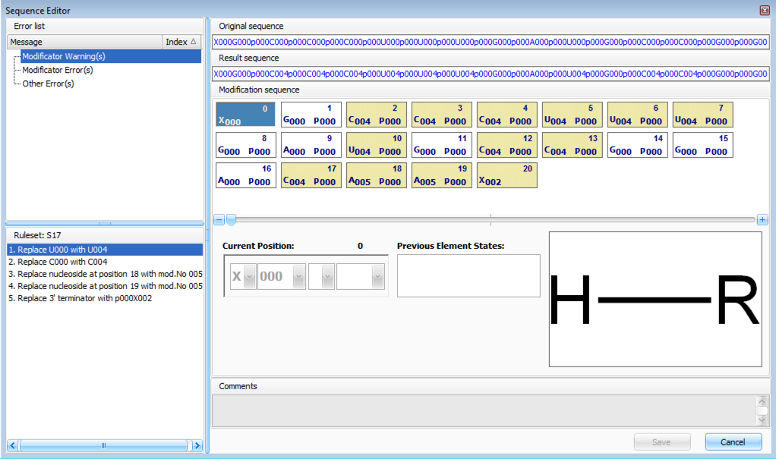
siTrack building blocks
Notes:
siTrack allowed to create so called building blocks using a mol file, an ID was created for each of these unique blocks. And putting these building blocks together in a sequence would create a siRNA sequence.
You can see an example of a sequence on the screen where each building block would correspond to a naturally occurring nucleotide or a modified one. The phosphate bridge was represented as well. You can see a very similar logic to HELM.

Slide 7
Beyond siRNAs
Accurate description
Uniqueness
Not generic
Sharing impossible
→ HELM
Notes:
The siTrack tool allowed users to accurately describe these entities uniquely. Which was the main goal of the application: referencing sample used in the lab accurately and uniquely.
However, siTrack was not generic enough to be extended to other kind of RNA or peptides, it was not a standard in the industry so it could not be used externally with collaborators or partners. And while it was communicating with the central registration system, it still required a heavy client to look at the details of the siRNA.
So When the siRNA program stopped, and new need came up for similar entities, it was decided to adopt a new notation. HELM became obvious, as the approach was similar, Novartis was already working with the Pistoia Alliance with controlled-substance-expert-community-cscs (CSCS). And of course, some team members already knew other companies using the notation and tools were available.
----
Need in registration:
Accurate description of entities
Duplex supported
Uniqueness
Communicate internally
siTrack was designed and implemented for siRNA:
Short sequence only
Not generic enough
Not standard
Sharing and communicate externally
---
HELM chosen and implemented in 2015
Novartis participated in Pistoia Alliance before
Know other in field
Notation and tools available
Pistoia: controlled-substance-expert-community-cscs (CSCS)

Slide 8
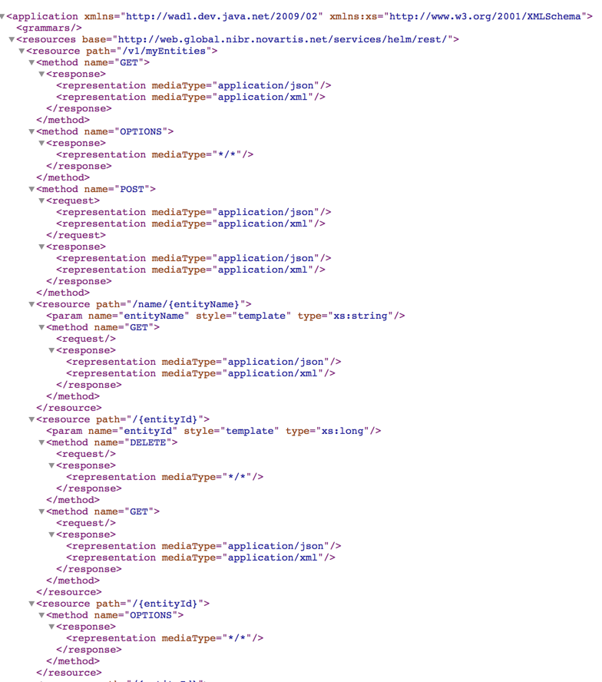
HELM introduction
mRNA Registration
HELM toolkit
Web services implementation
siTrack to HELM converter
Legacy data migration
https://www.nature.com/
Notes:
It was decided to do a pilot for the support of HELM to handle mRNA registration. Messenger RNA are a large family of RNA but they could be used as therapeutics or as tools for molecular biology.
mRNA registration selected because it was a limited scope, limited community impacted , we already had existing tools and UI so could focus on business logic and data.
We worked with the HELM toolkit v1 at the time and followed the technolog stack used at NIBR: Java for the code and Oracle for the database,
We implemented our own web services to handle monomers management, HELM creation and registration and a siTrack to HELM converter for legacy data.
Since then, we updated the HELM toolkit to v2 and Added web services from Pistoia/Quattro, I am going to show later on.
----
mRNA: Messenger RNA (mRNA) is a large family of RNA molecules that convey genetic information from DNA to the ribosome,
Much longer strand of nucleotides: single strand.
mRNA registration selected: limited scope, limited community impacted , existing tools UI -> could focus on business logic and data.
Choice of tech stack:
Standard at NIBR at the time: Oracle and Java
Implementation of our own web service to handle monomers, HELM validation and some level of management: no swagger yet but test pages for us
Including conversion tools for siTrack language
Since then, we updated the HELM toolkit to v2
Added web services from Pistoia/Quattro
- no swagger done at the time but we used Postman for REST services.
Implementation using Java Spring and Oracle

Slide 9
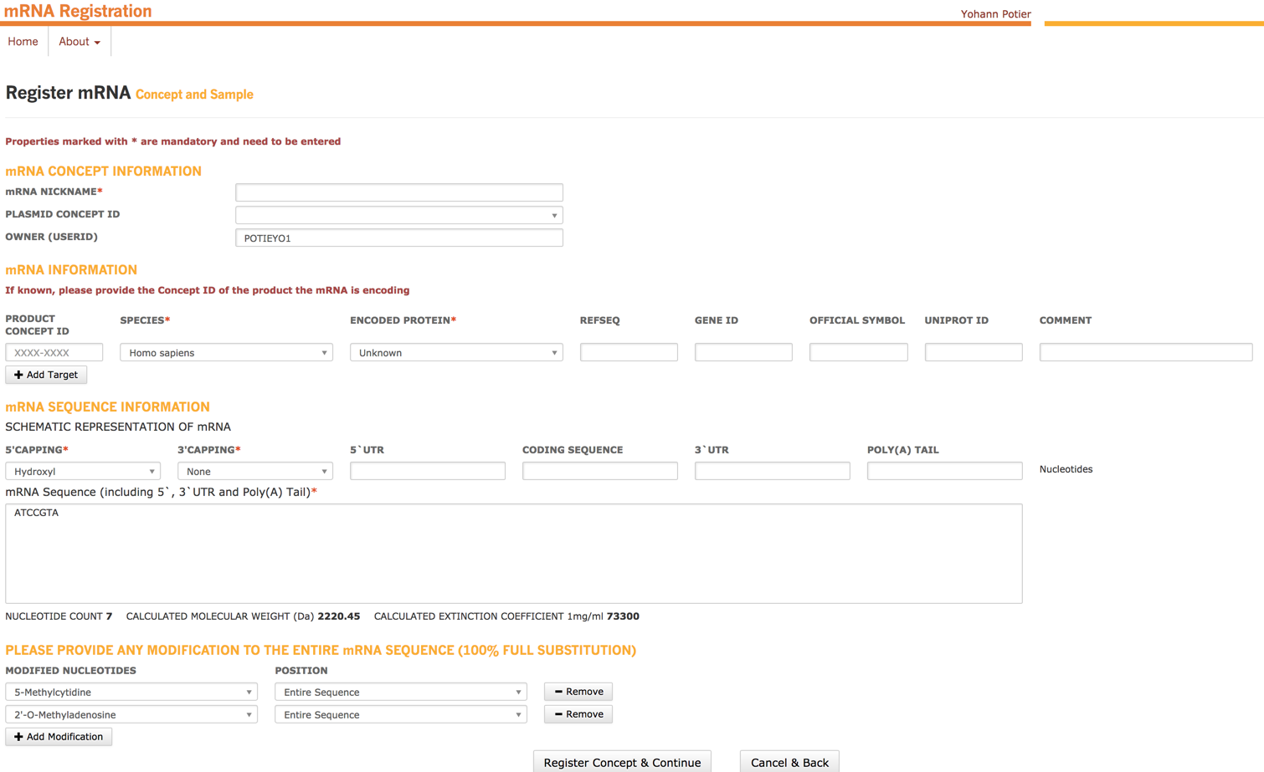
HELM landscape at NIBR
CHEM1{[A6OH]}|RNA1{R([meA])P.R(T)P.R([5meC])P.R([5meC])P.R(G)P.R(T)P.R([meA])}$CHEM1,RNA1,1:R2-1:R1$$$V2.0
Notes:
From the user perspective, nothing changed. Here is a screenshot of the mRNA registration web application. There is also an excel version for bulk registration
The user can enter general information about his specific mRNA: name, target, species, etc…
More relevant, the user usually enters the natural sequence of his RNA, he can choose capping from a dropdown menu. He can also select modification to that sequence, for example here, we used methyl Cytidine instead of Cytidine and 2 methyl Adenosine instead of adenosine. When registering, these capping and modification will be translated to the corresponding HELM sequence and registered into the Registration system.
Our first project allowed us to put in place the backend: web services for translation of the user request using the HELM toolkit then storing the information in the Oracle DB.

Slide 10
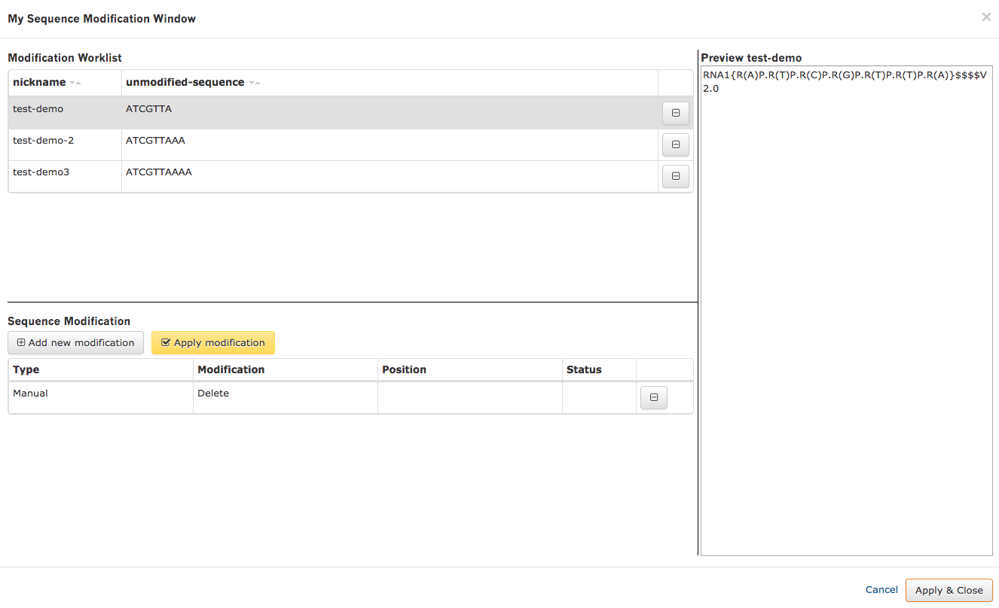
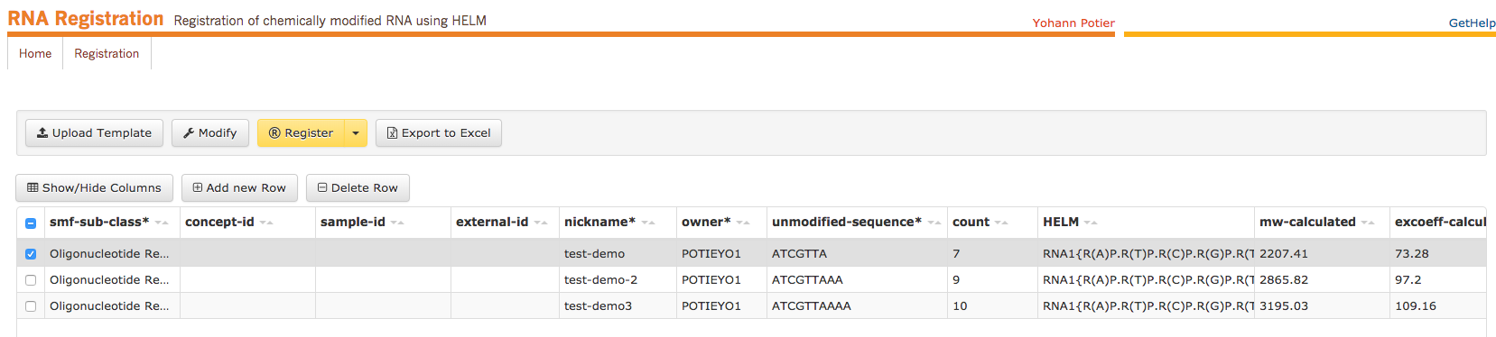
HELM landscape at NIBR
Notes:
Following that first application, we internalized the web services HELM v2 inside what became our reference architecture: the java spring framework and still relying on the Oracle database we have been using so far for monomers and HELM strings.
The expansion of the work around RNA and oligonucleotides called for a more generic sequence loader than the mRNA application, too custom.
Here we have a simple UI with possibility to upload an excel file to populate the table where one can enter a natural sequence: the HELM service will translate the sequence to a valide HELM and calculate the properties such as MW and ext coeff. Each cell can be edited and the HELM string will be validated: in case of error, a message will warn the user and no registration is possible.
We started implementing a bulk modifier of the sequence, the user can select sequence from the main table, then decide to apply a modification: delete, update, add to these sequence. The idea is to enable users to edit HELM string without knowing the details of HELM.
-----
CRISPR, an acronym that stands for clustered regularly interspaced short palindromic repeats, is an approach that allows scientists to precisely edit the genes of targeted cells.
We currently have a collaboration with Intellia Therapeutics that uses CRISPR technology in conjunction with hematopoietic stem cells to explore treatments for sickle cell disease and thalassemia. This work is in the preclinical stage.

Slide 11
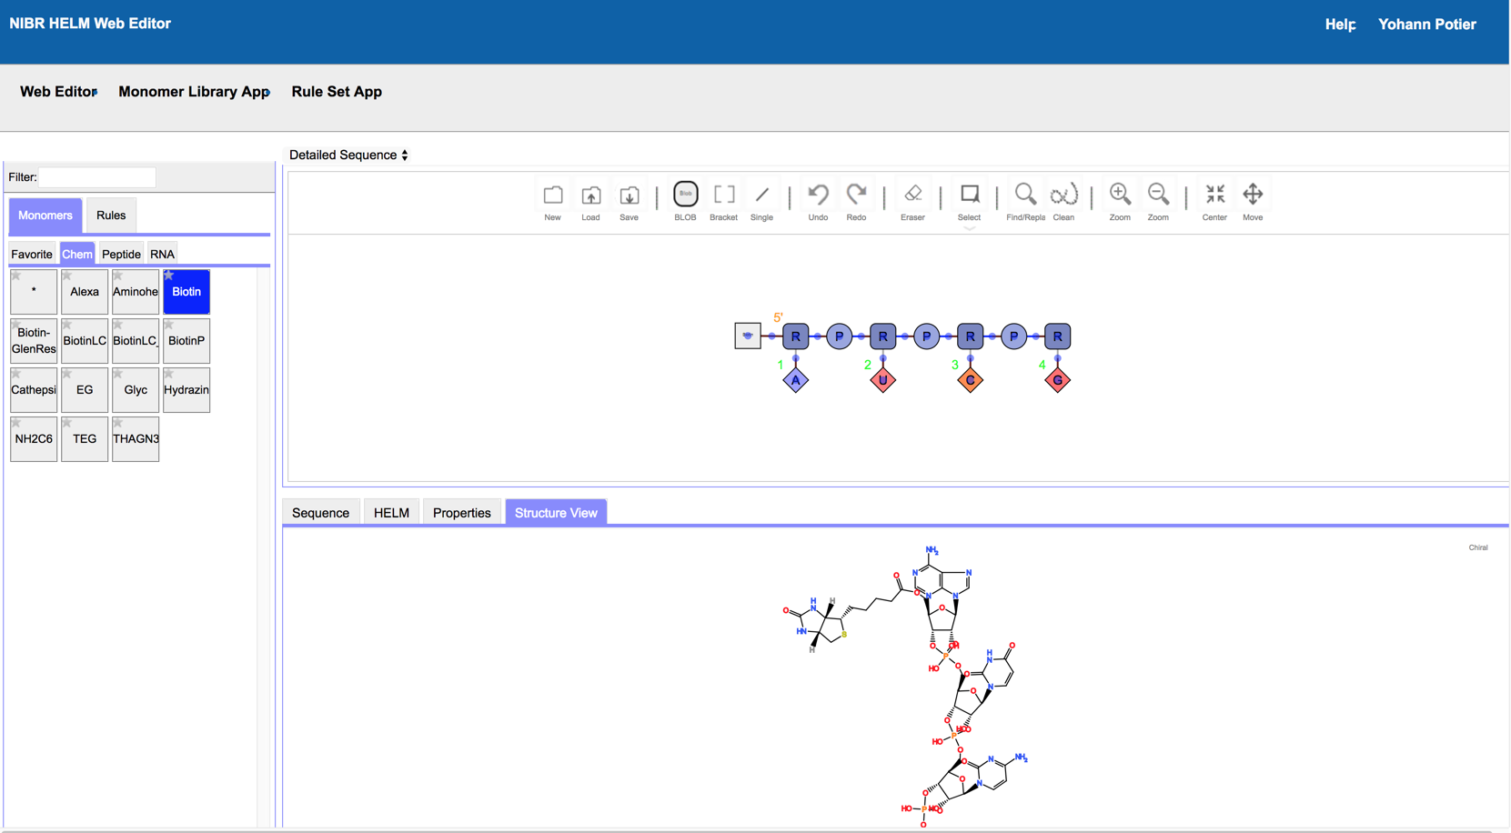
HELM web editor
Notes:
Of course, if the user want, they can now edit and modify their HELM string using the HELM web editor
We have access to our monomer set, the user can edit his sequence on the canvas and can check for properties and chemical structure in the lower frame. The editor is connected to the same web services as the other application I mentioned. We are currently hosting this editor in a s3 bucket in AWS.
The editor provide the flexibility to edit the HELM string easily, but more important: it allows monomer management with a UI. So far, we had to do that through web services and json is not the best format to check your chemistry! Here we can see the content of the monomer DB, and add to it easily.
----
Hosted on s3 bucket

Slide 12
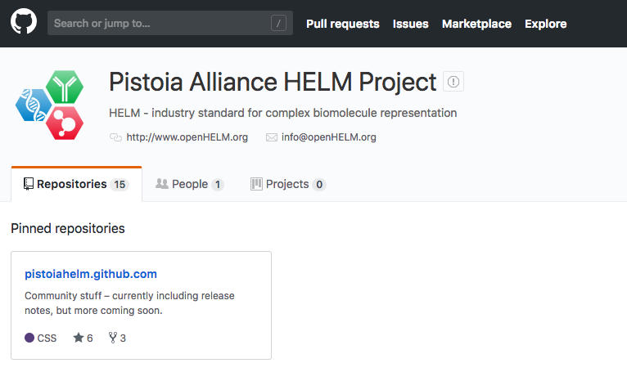
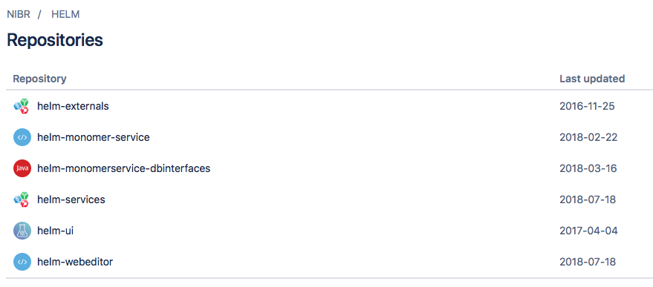
HELM implementation at NIBR
Notes:
I think it’s clear to the audience, but it is open source project for all Pistoia contribution and for us it was important to keep our internal release as close as possible from the Pistoia release: bug fixes and added features.
So from the GitHub repository to our internal repository, we have a copy of the external project and our own application and added implementations necessary to the integration.

Slide 13
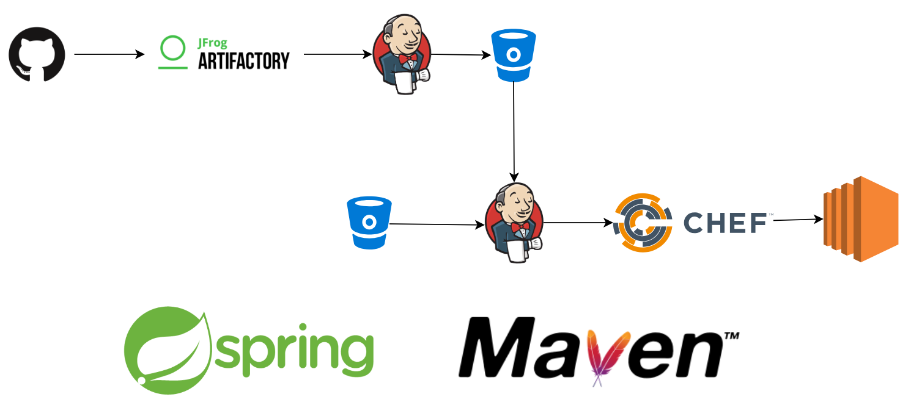
HELM deployment
Publish archive to artifactory
NIBR implementation
Get Pistoia Alliance code
Repackage interfaces
NIBR custom code
Produce archive
Automate deployment
AWS EC2/S3
Notes:
The workflow is slightly different for each application but the general workflow is the following for the HELM monomer services, which is the last piece we internalized together with the web editor.
We get the code from GtHub, publishe the war to artifactory. We use Jenkins (an automation tool) to repackage the necessary interface to connect to our database as a jar, Jenkins again will produce a war overlay with our custom code for deployment. We produce the archive. We then use CHEF to have an automatic deployment to the amazon cloud. In this case, the services are hosted on a tomcat on an EC2 instance. The editor is hosted on a s3 bucket on the same account.
----
Jenkins
Publish given war to Artifactory
Jenkins
Repackage given interfaces as a jar
Spring/Maven/Java
Implement given interfaces
Jenkins
Produce a war overlay
Jenkins
Archive the created war
Chef
Update chef recipe to automate deployment
Vordel
Add a Vordel mapping
Aware of publishing done

Slide 14
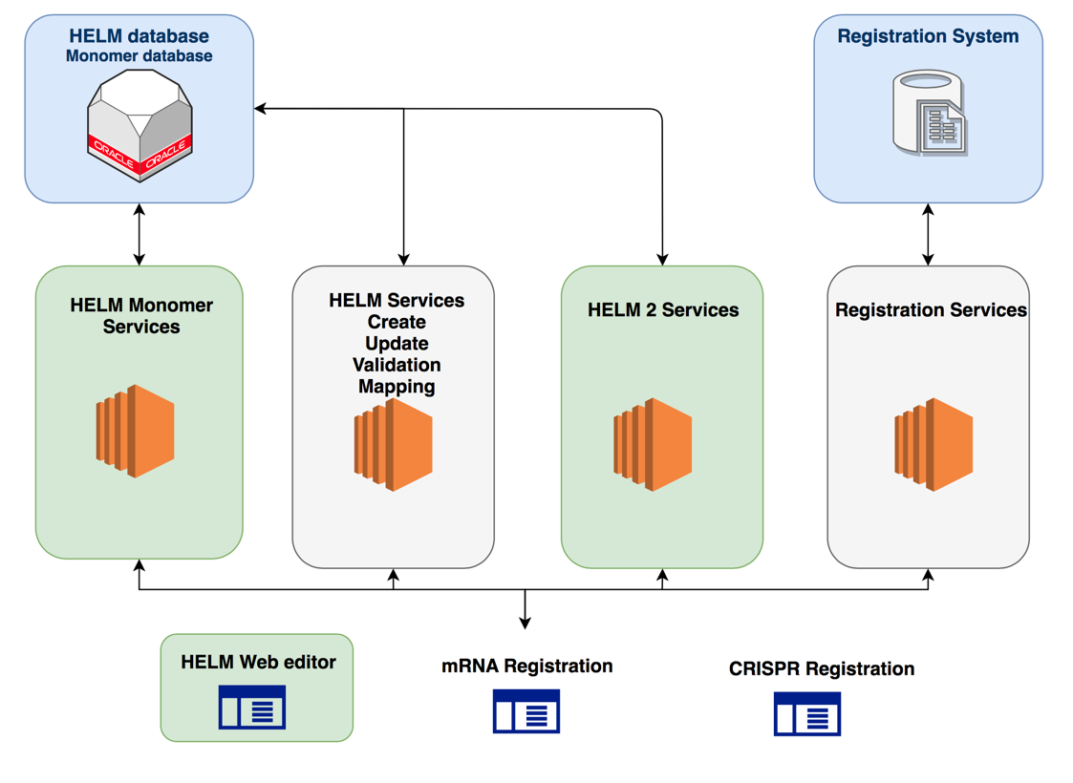
Architecture
Notes:
Before concluding, this is an overview of our architecture: the HELM monomer DB and HELM string are in an oracle database. We have a service layer managing the monomers, validation and management of monomer and HELm string living close to our internal registration services.
The application using HELM rely on these services. In gree, these are the Pistoia services and application internalized
Old v1 service
New Pistoia integrated, plus green tools

Slide 15
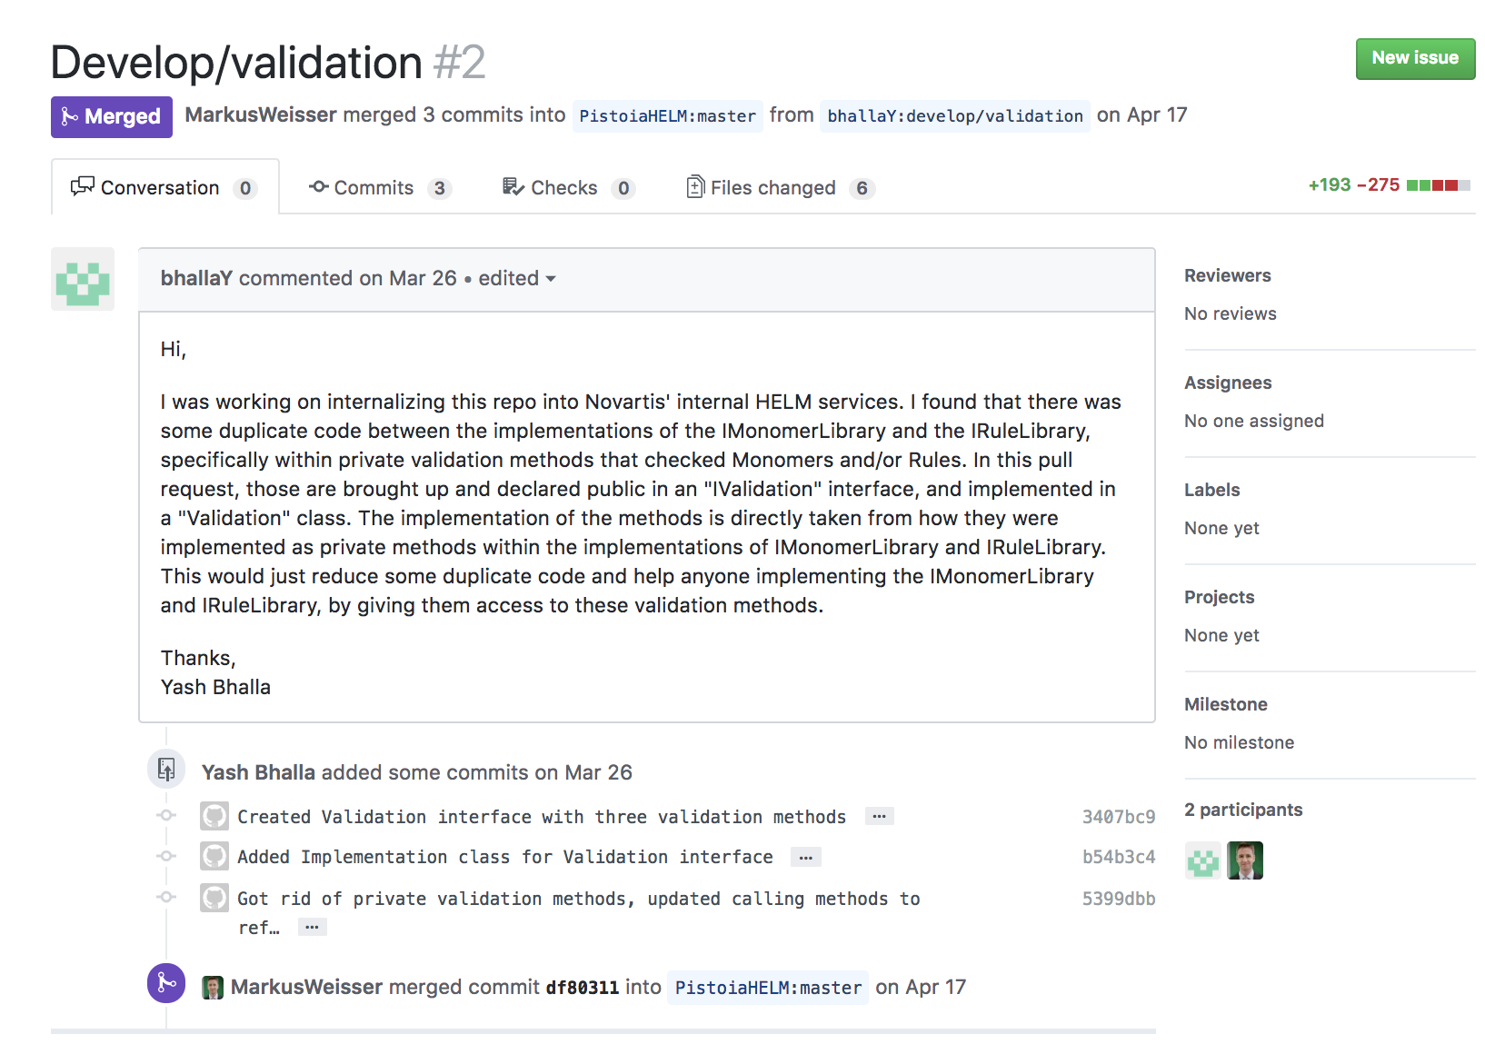
Community
Notes:
Like I said, it is open source. You can report issues or feature request. You can also contribute. A recent example is one of our intern from Northeastern doing a pull request on the Monomer services. Markus from Quattro reviewed and approved it. I hope we can do more of these in the future. We sometime get too focus on the internal delivery.

Slide 16
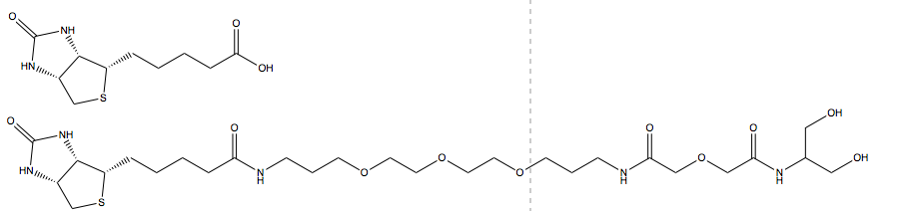
Limitations
Internalization lesson learned
HELM limited, even with xHELM
Monomers are not universal
Manual work required
Naming convention monomers
Notes:
I hope I showed you that while you could just take what is available through the Pistoia alliance and deploy it. If you have legacy application, a different internal architecture, you will need to work on this integration. This could look over engineered but it facilitate our internal support to use the same tech stack across most application. This requires analysis and engineering work.
HELM itself has issue: monomers are not universal and even if you can send xHELM to collaborators, if they are using HELM with a different set of monomers it will require some work. A simple example here with 2 biotin: they could be 2 different monomers or embracing the polymeric approach of HELM this second one could be 2 monomers reusing the first one. The fragmentation problem might be worked on at some point and facilite these issues.
Finally, naming conventions would be useful. It is an ongoing conversation with the Pistoia team but without standard our biologists do not agree with our chemists.

Slide 17
Future steps
Consolidation services
Integration with Registration
Automate everything!
Search, scripting, …
Expand to wider community
Notes:
Consolidation:

Slide 18
Acknowledgements
Elodie Sax
Bernd Rode
Alok Saldanha
Oskar Bero
Yash Bhalla
Sven Neumeyer
Quan Yang
Joann Prescott-Roy
Mike Tarselli
Claire Bellamy
Pistoia Alliance team
Notes:
Especially Markus, Tony and Tianhong

