Slide 1
Similarity analysis of oligonucleotides based on HELM notation
Dr. Markus Weisser, quattro research GmbH

Slide 2
Why Similarity?
„Similar compounds have similar properties”
Johnson, A. M.; Maggiora, G. M. (1990)

Slide 3
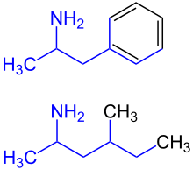
Example
Amphetamine
Methylhexanamine

Slide 4
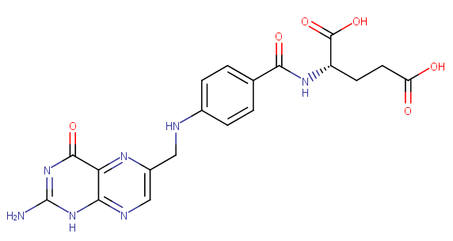
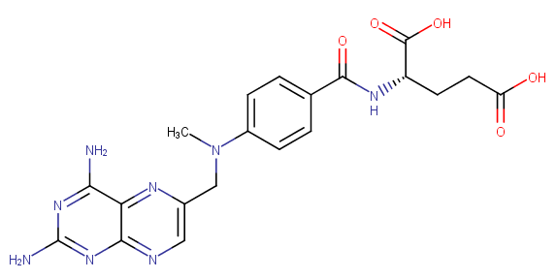
Opposite Effect
Folic Acid
Methotrexate

Slide 5
Studying Similarity
Find new therapeutic molecules
Understand mode of action
Identify core fragments

Slide 6
Similarity within Biomolecules
Atom and bonds
Sequence
Large number of elements
High level of similarity based on backbone
RNA (sugar-phosphate)
Peptide (amino-acid)
Unnatural amino acids
Branches
Complex molecules
RNA/PEPTIDE/CHEM combinations

Slide 7
HELM Similarity Library
Create fingerprint of molecules based on HELM notation
Calculate similarity based on Tanimoto coefficient
Consider natural analogs
Similarity search
Substructure filter
Example GUI

Slide 8
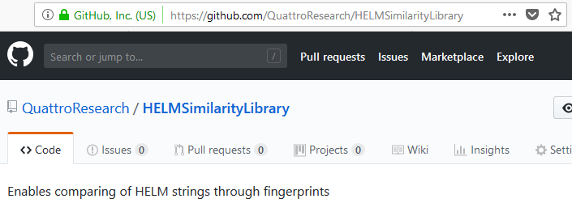
How to use the Library
Native Java class library:
https://github.com/QuattroResearch/HELMSimilarityLibrary

Slide 9
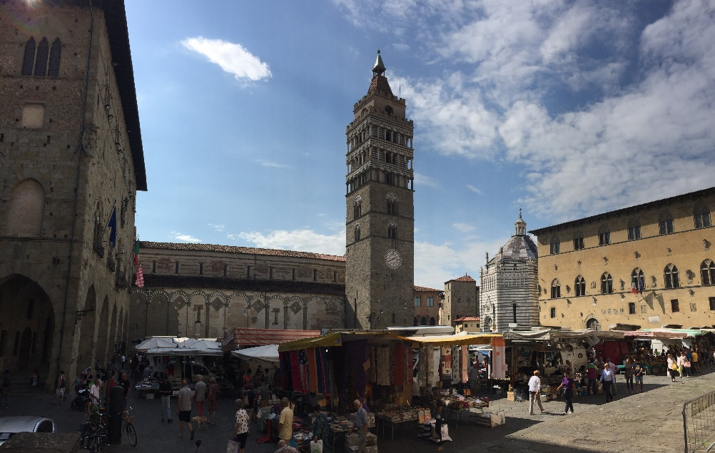

How to use the library
As a REST service:
https://github.com/PistoiaHELM/HELM2WebService

Slide 10

HELM2WebService
© Hireclout
{ REST }
HELM2Notation Toolkit
HELMNotation Parser
Chemistry Toolkit
HELMSimilarity Library

Slide 11
Python Example
import requests
base_url = 'http://localhost:8080/WebService/service/Calculation/Similarity/naturalAnalogs/'
oligo_1 = 'RNA1{R(A)P.R(C)P}$$$$V2.0'
oligo_2 = 'RNA1{R(A)P.R(G)P}$$$$V2.0'
r = requests.get(base_url + oligo_1 + '/' + oligo_2)
print(r.json())
{
'HELMNotation1': 'RNA1{R(A)P.R(C)P}$$$$V2.0',
'HELMNotation2': 'RNA1{R(A)P.R(G)P}$$$$V2.0',
'Similarity': 0.5238095238095238
}

Slide 12
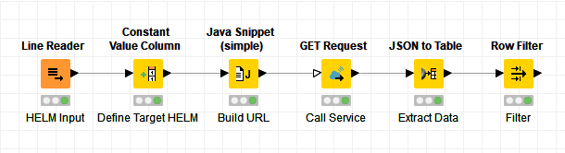
HELM Similarity with KNIME

Slide 13
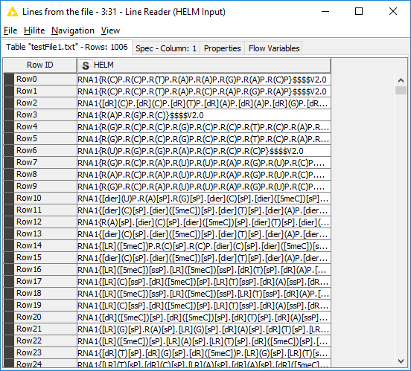
HELM Similarity with KNIME

Slide 14
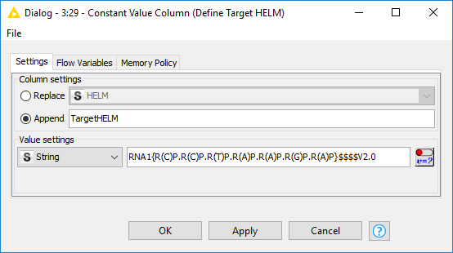
HELM Similarity with KNIME

Slide 15
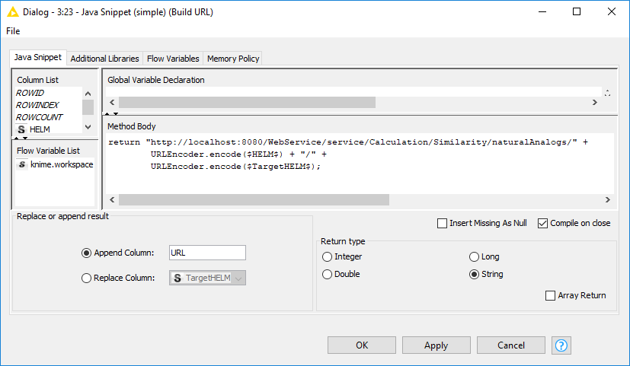
HELM Similarity with KNIME

Slide 16
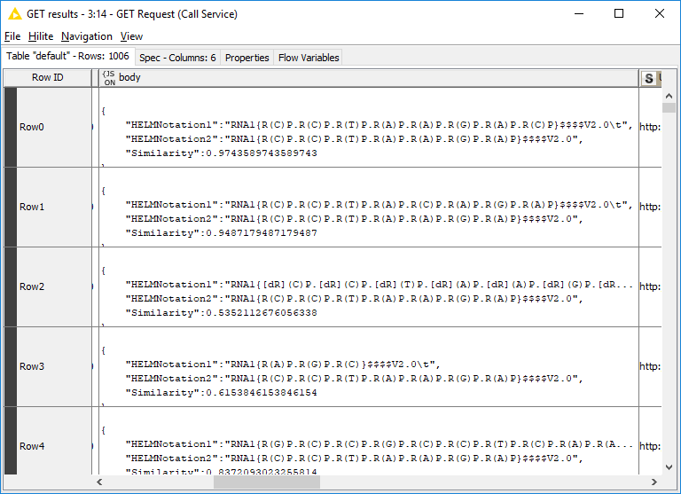
HELM Similarity with KNIME

Slide 17
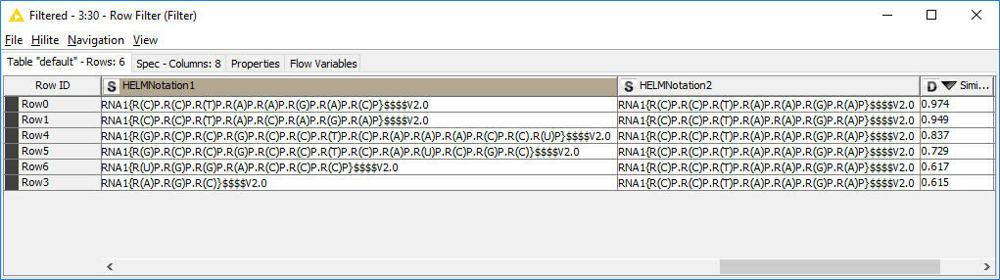
HELM Similarity with KNIME

Slide 18
HELM Similarity with KNIME

Slide 19
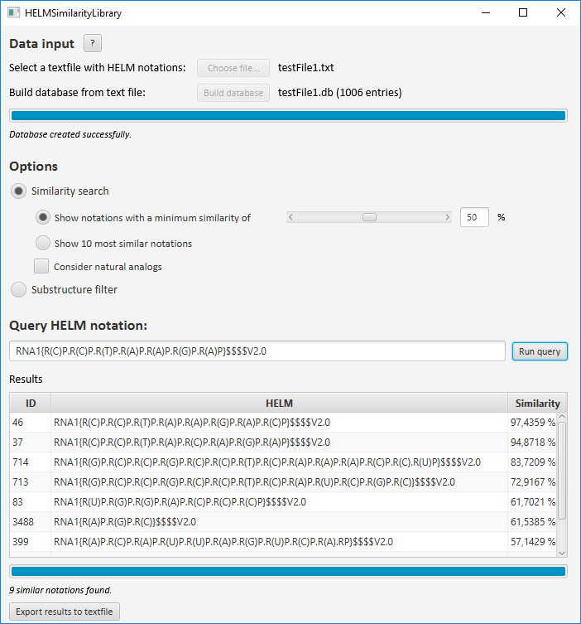
HELMSimilarity GUI

Slide 20
Summary
Java based open source HELMSimilarity library
REST interface to this library via Pistoia HELM2WebService
KNIME works very well with HELM2WebService
Search an filter oligonucleotide databases

Slide 21
Acknowledgement
Eva Bültel, quattro research
Dr. Anne von Raven, quattro research
Sabrina Hecht, quattro research
Prof. Dr. Matthias Rarey, University of Hamburg
Dennis Hansen, PhD, Roche Innovation Center Copenhagen
Thank you!

Slide 23
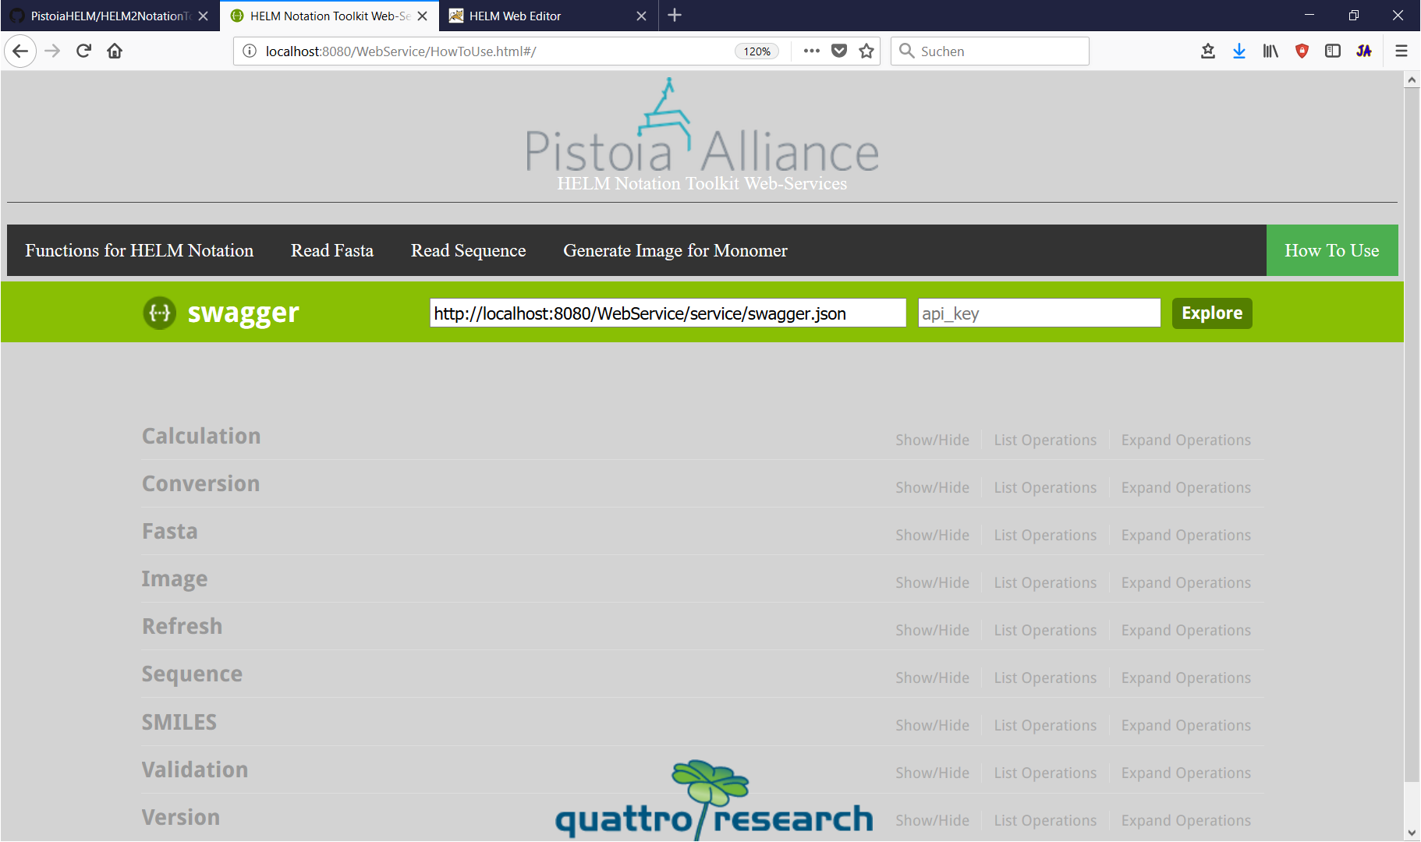
REST Service Documentation

Slide 24
Fingerprinting
Build molecule graph representation
Depth-first-search through graph
Find every path between 1 and 6 vertices
Generate fingerprint
Calculate Tanimoto

Slide 25
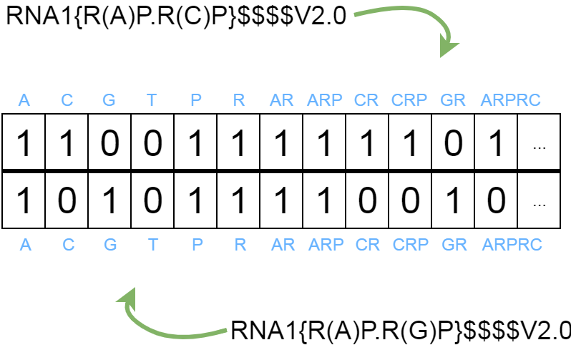
Example

Slide 26

Example
A
B
$$\sum{A=9}$$
$$\sum{B=7}$$
$$\sum{AB=5}$$
$$Tanimoto= \frac{5}{\left(9+7\right)−5}= \frac{5}{11}=0.4545=45.45 \% similarity$$

