Slide 1

monomer.org

Slide 2
Some 2018 Chemical Entities approved by the FDA
Cetrotide (Cetrorelix) A synthetic decapeptide, it is used is used in assisted reproduction to inhibit premature luteinizing hormone surges
Onpattro (Patisiran) For treatment of polyneuropathy in people with hereditary transthyretin-mediated amyloidosis
TEGSEDI (Inotersen) Received marketing authorization approval from the European Commission (EC) for the treatment of stage 1 or stage 2 polyneuropathy in adult patients with hereditary transthyretin amyloidosis (hATTR).
Mogamulizumab (Poteligeo) A humanized, afucosylated monoclonal antibody for two rare types of non-Hodgkin lymphoma

Slide 3
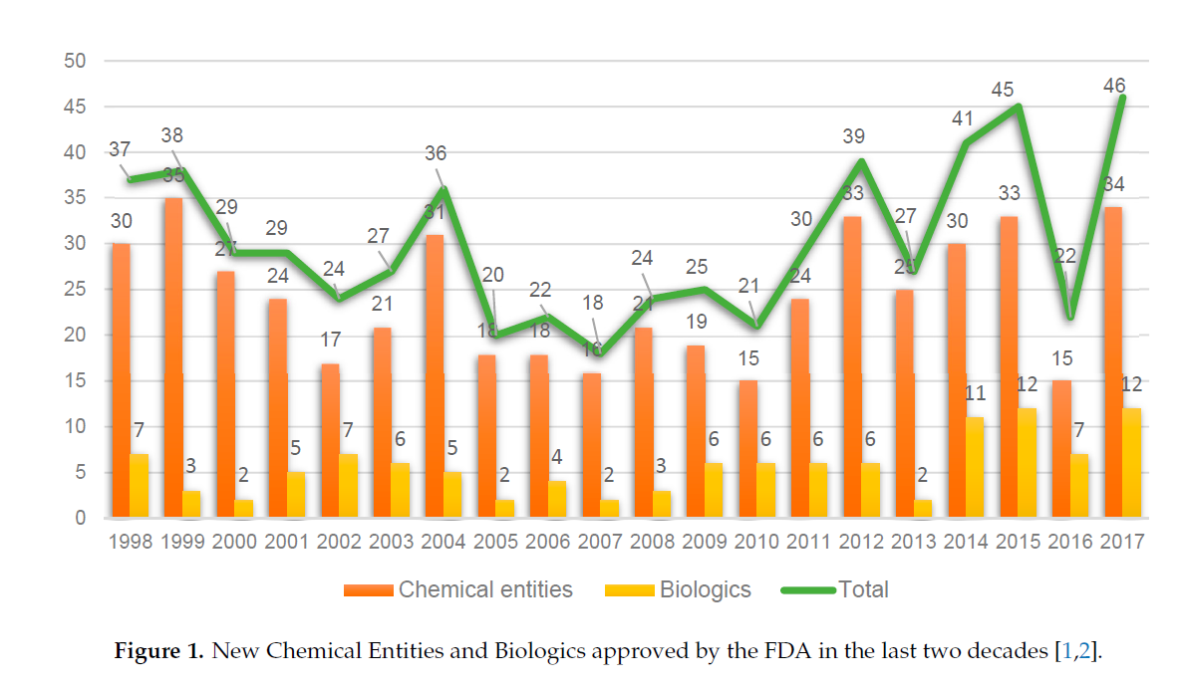

34 New Chemical Entities in 2017
Of the 12 biologics approved in 2017, nine are antibodies, one is an antibody-drug conjugate (ADC), and two are enzymes
1st ADC, Gemtuzumab ozogamicin (Mylotarg®) in 2000
The Pharmaceutical Industry in 2017. An Analysis
of FDA Drug Approvals from the Perspective
of Molecules
Beatriz G. de la Torre 1,* and Fernando Albericio 2,3,* ID
1 KRISP, College of Health Sciences, University of KwaZulu-Natal, Durban 4001, South Africa
2 School of Chemistry and Physics, University of KwaZulu-Natal, Durban 4001, South Africa
3 CIBER-BBN, Networking Centre on Bioengineering, Biomaterials and Nanomedicine,
Department of Organic Chemistry, University of Barcelona, 08028 Barcelona, Spain
* Correspondence: garciadelatorreb@ukzn.ac.za (B.G.d.l.T.); albericio@ukzn.ac.za (F.A.); Tel.: +27-614-009-144 (F.A.)
Received: 12 February 2018; Accepted: 26 February 2018; Published: 27 February 2018
Notes:
The Pharmaceutical Industry in 2017. An Analysis
of FDA Drug Approvals from the Perspective
of Molecules
Beatriz G. de la Torre 1,* and Fernando Albericio 2,3,* ID
1 KRISP, College of Health Sciences, University of KwaZulu-Natal, Durban 4001, South Africa
2 School of Chemistry and Physics, University of KwaZulu-Natal, Durban 4001, South Africa
3 CIBER-BBN, Networking Centre on Bioengineering, Biomaterials and Nanomedicine,
Department of Organic Chemistry, University of Barcelona, 08028 Barcelona, Spain
* Correspondence: garciadelatorreb@ukzn.ac.za (B.G.d.l.T.); albericio@ukzn.ac.za (F.A.); Tel.: +27-614-009-144 (F.A.)
Received: 12 February 2018; Accepted: 26 February 2018; Published: 27 February 2018

Slide 4
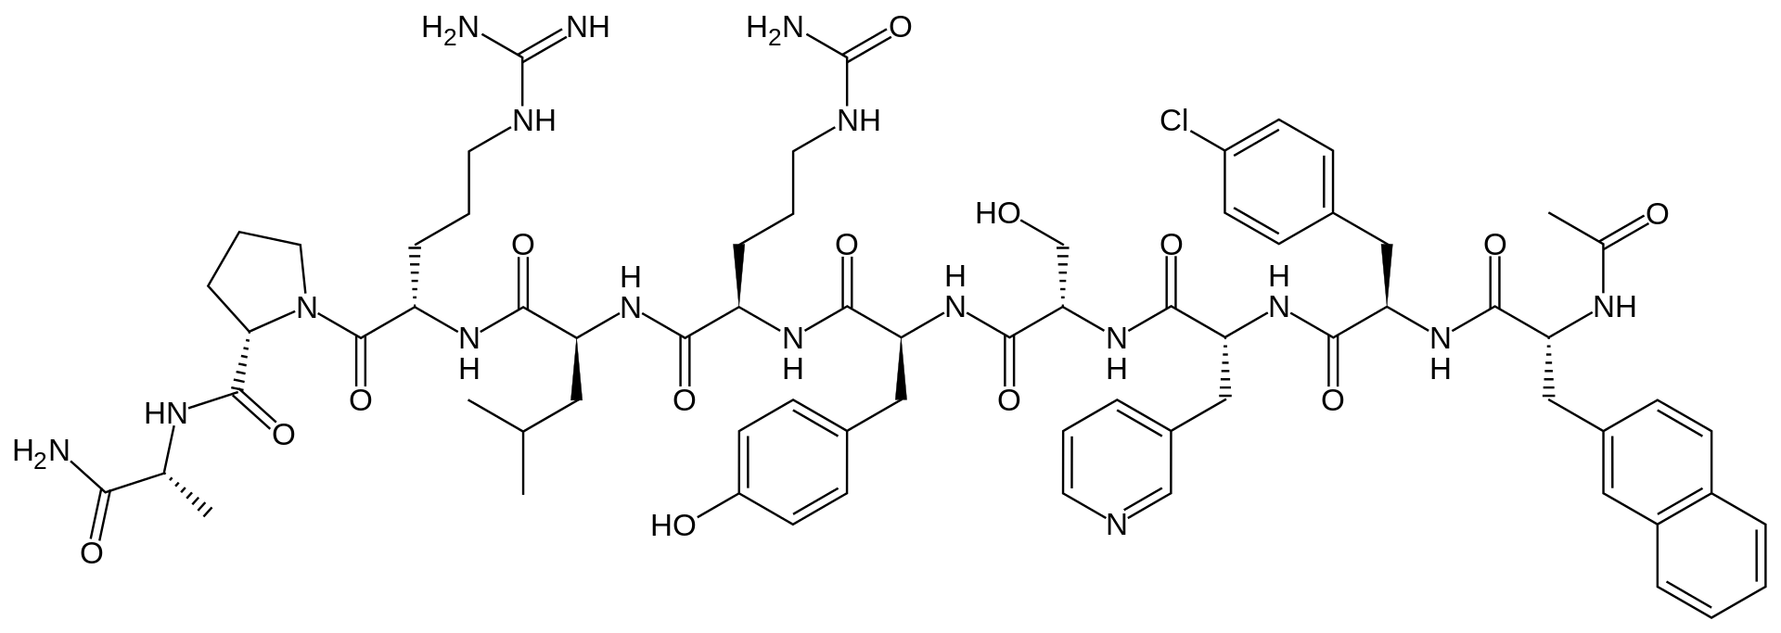
Cetrorelix
O=C(N[C@H](CC1=CN=CC=C1)C(N[C@@H](CO)C(N[C@@H](CC2=CC=C(O)C=C2)C(N[C@H](CCCNC(N)=O)C(N[C@@H](CC(C)C)C(N[C@@H](CCCNC(N)=N)C(N(CCC3)[C@@H]3C(N[C@H](C)C(N)=O)=O)=O)=O)=O)=O)=O)=O)[C@@H](CC4=CC=C(Cl)C=C4)NC([C@H](NC(C)=O)CC5=CC6=CC=CC=C6C=C5)=O
Notes:
A synthetic ten-membered oligopeptide comprising N-acetyl-3-(naphthalen-2-yl)-D-alanyl, 4-chloro-D-phenylalanyl, 3-(pyridin-3-yl)-D-alanyl, L-seryl, L-tyrosyl, N⁵-carbamoyl-D-ornithyl, L-leucyl, L-arginyl, L-prolyl, and D-alaninamide residues coupled in sequence. A gonadotrophin-releasing hormone (GnRH) antagonist, it is used for treatment of infertility and of hormone-sensitive cancers of the prostate and breast.
PEPTIDE1{[ac].[dNal].[dPhe(4-Cl)].[d3-Pal].S.Y.[dCit].L.R.P.[dA].[am]}$$$$

Slide 5
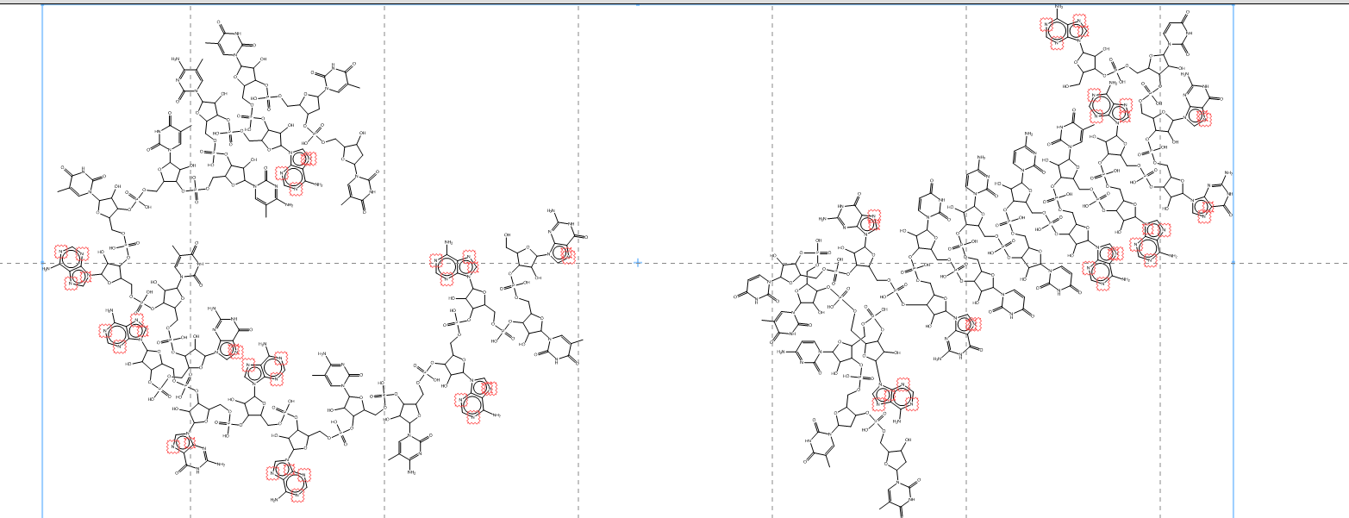
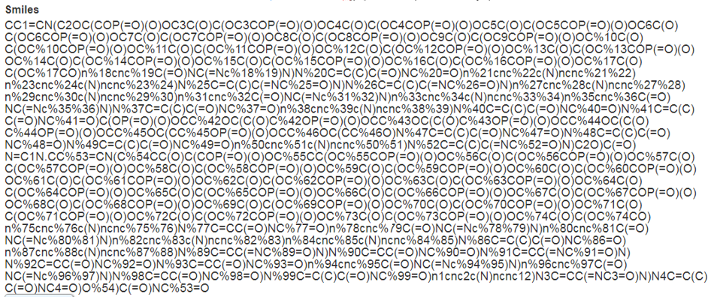
Patisiran

Slide 6
Mogamulizumab
(Heavy chain) EVQLVESGGD LVQPGRSLRL SCAASGFIFS NYGMSWVRQA PGKGLEWVAT ISSASTYSYY PDSVKGRFTI SRDNAKNSLY LQMNSLRVED TALYYCGRHS DGNFAFGYWG QGTLVTVSSA STKGPSVFPL APSSKSTSGG TAALGCLVKD YFPEPVTVSW NSGALTSGVH TFPAVLQSSG LYSLSSVVTV PSSSLGTQTY ICNVNHKPSN TKVDKKVEPK SCDKTHTCPP CPAPELLGGP SVFLFPPKPK DTLMISRTPE VTCVVVDVSH EDPEVKFNWY VDGVEVHNAK TKPREEQYNS TYRVVSVLTV LHQDWLNGKE YKCKVSNKAL PAPIEKTISK AKGQPREPQV YTLPPSRDEL TKNQVSLTCL VKGFYPSDIA VEWESNGQPE NNYKTTPPVL DSDGSFFLYS KLTVDKSRWQ QGNVFSCSVM HEALHNHYTQ KSLSLSPGK (dimer) (Light chain) DVLMTQSPLS LPVTPGEPAS ISCRSSRNIV HINGDTYLEW YLQKPGQSPQ LLIYKVSNRF SGVPDRFSGS GSGTDFTLKI SRVEAEDVGV YYCFQGSLLP WTFGQGTKVE IKRTVAAPSV FIFPPSDEQL KSGTASVVCL LNNFYPREAK VQWKVDNALQ SGNSQESVTE QDSKDSTYSL SSTLTLSKAD YEKHKVYACE VTHQGLSSPV TKSFNRGEC (dimer) (disulfide bridge: H22-H96; H146-H202; H222-L219; H228-H'228; H231-H'231; H263-H323; H369-H427; H'B22-H'96; H'146-H'202; H'222-L'219; H'263-H'323; H'369-H'427; L23-L93; L139-L199; L'23-L'93; L'139-L'199)
C6520H10072N1736O2020S42 MW: 146442.8849

Slide 7
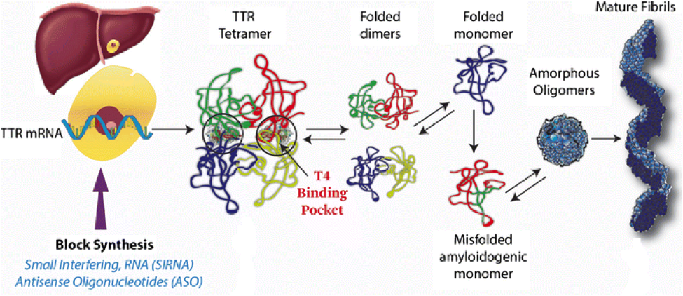
The case of two oligonucleotides
Patisiran (Alnylam)
Inotersen (IONIS)
Notes:
http://zon.trilinkbiotech.com/2018/08/07/two-oligonucleotide-drugs-for-ttr-attr/

Slide 8
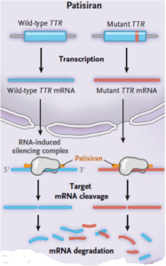
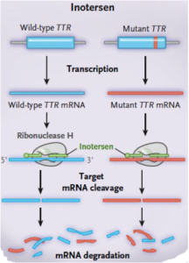
Taken from Buxbaum Journal of New England Medicine (2018)

Slide 9
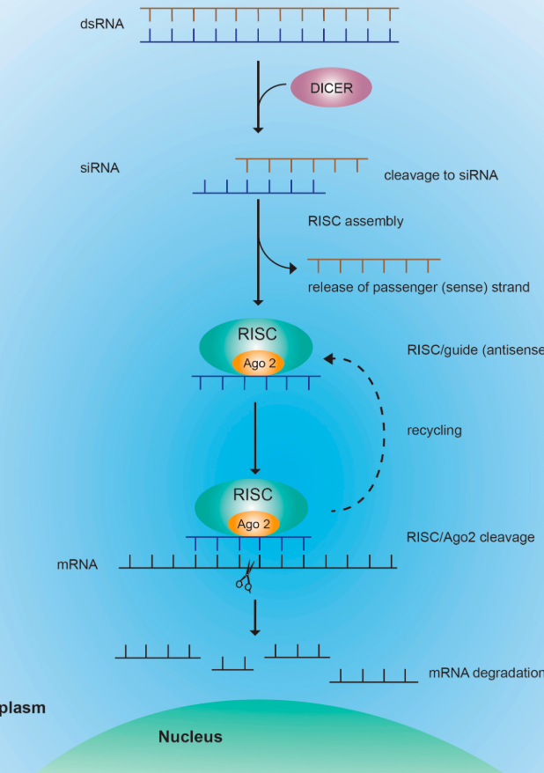
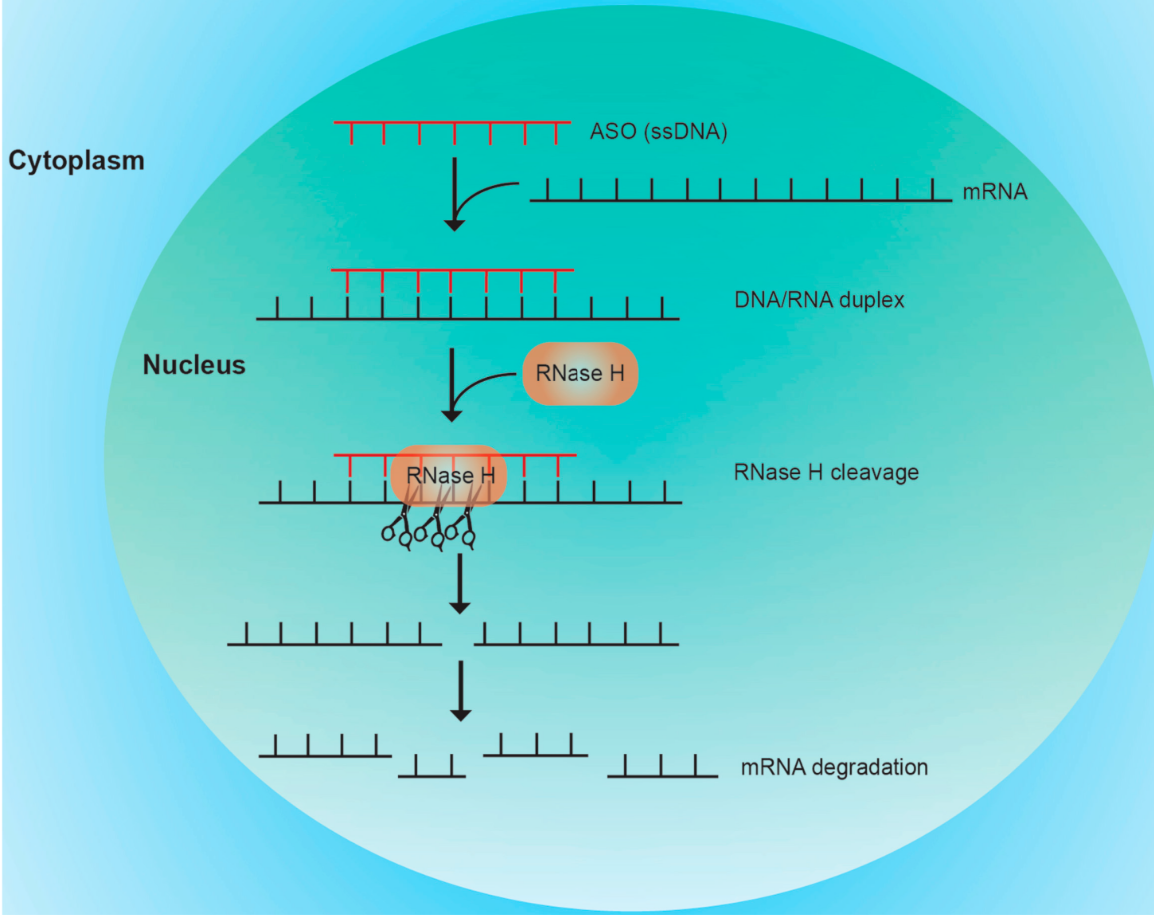

Slide 10
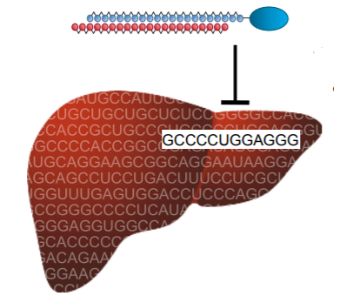
The Biology of Antisense and RNAi
Sequence defines target
Watson-Crick base pairing is central to the mechanism of action
Sequence determines off-target and potentially toxic profiles

Slide 11
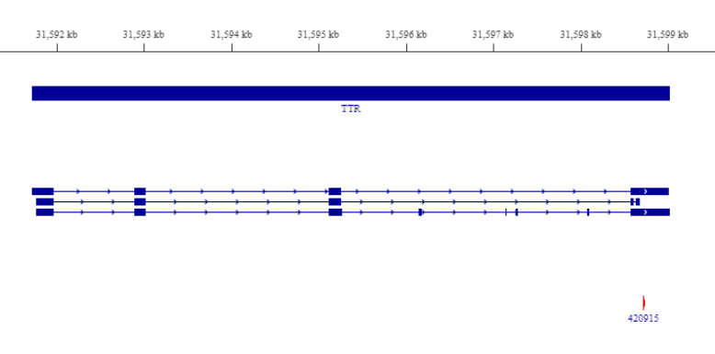
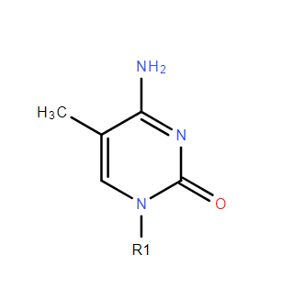
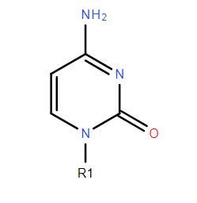
Human 88
5-methylcytosine
Cytosine
TCTTGGTTACATGAAATCCC

Slide 12
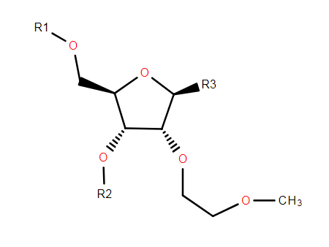
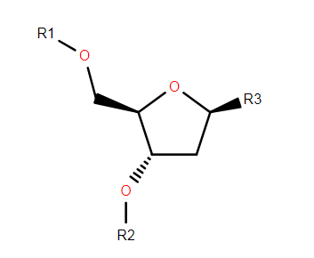
TEGSEDITM (inotersen)
Notes:
Add moe chemistry,
Show m5C chemistry

Slide 13
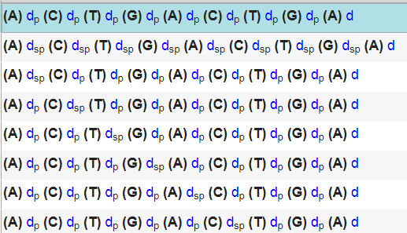
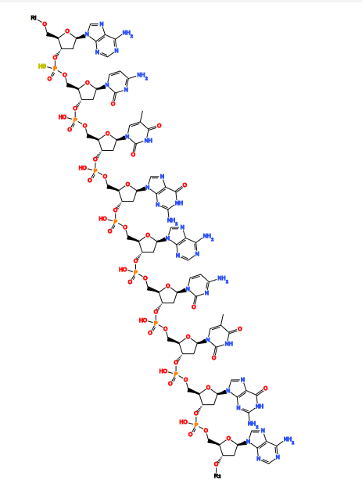
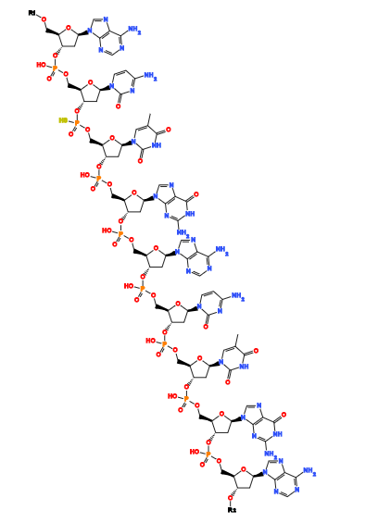
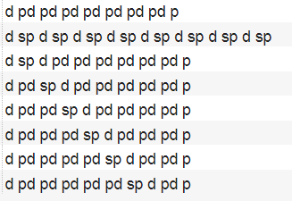
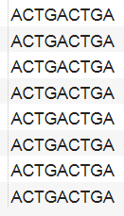


SARs are often at the polymer level

Slide 14
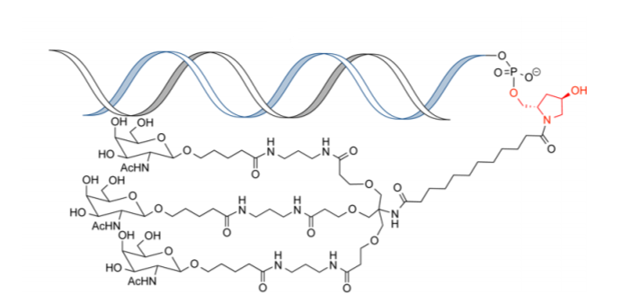
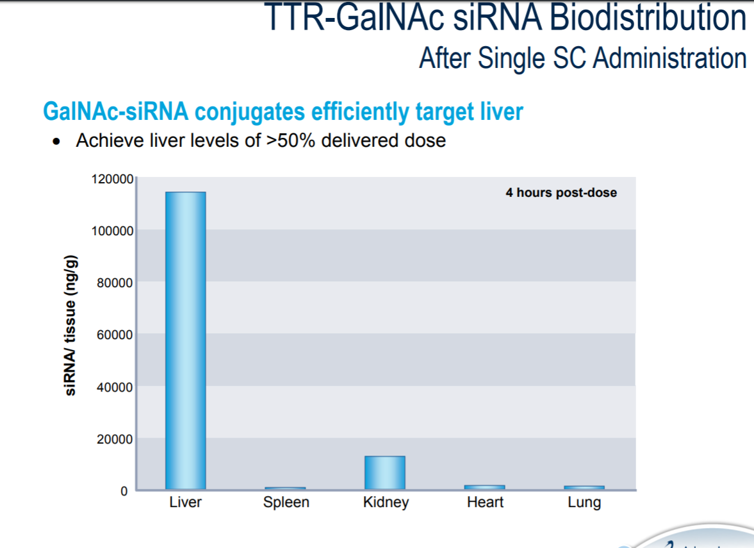
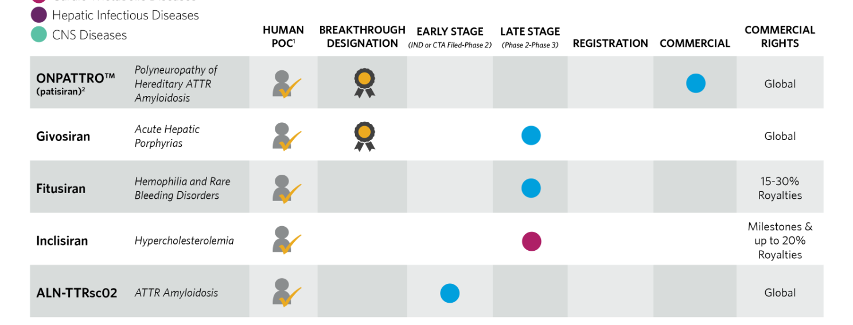
ALN-TTRsc02
Next generation drug…
Binds to hepatic asialoglycoprotein receptor (ASGPR)
Multivalent N‑Acetylgalactosamine-Conjugated siRNA Localizes in Hepatocytes and Elicits Robust RNAi-Mediated Gene Silencing Jayaprakash K. Nair,† Jennifer L. S. Willoughby,† Amy Chan,† Klaus Charisse,† Md. Rowshon Alam,† Qianfan Wang,† Menno Hoekstra,‡ Pachamuthu Kandasamy,† Alexander V. Kel’in,† Stuart Milstein,† Nate Taneja,† Jonathan O’Shea,† Sarfraz Shaikh,† Ligang Zhang,† Ronald J. van der Sluis,‡ Michael E. Jung,§ Akin Akinc,† Renta Hutabarat,† Satya Kuchimanchi,† Kevin Fitzgerald,† Tracy Zimmermann,† Theo J. C. van Berkel,‡ Martin A. Maier,† Kallanthottathil G. Rajeev,*,† and Muthiah Manoharan*,† † Alnylam Pharmaceuticals, 300 Third Street, Cambridge, Massachusetts 02142, United States ‡ Division of Biopharmaceutics, Leiden Academic Center for Drug Research, 2300 RA Leiden, The Netherlands § Department of Chemistry and Biochemistry, University of California, Los Angeles, California 90095, United States
Notes:
https://pdfs.semanticscholar.org/4e94/c15945fcb3b64af2a6863da46e3d4c710641.pdf

Slide 15
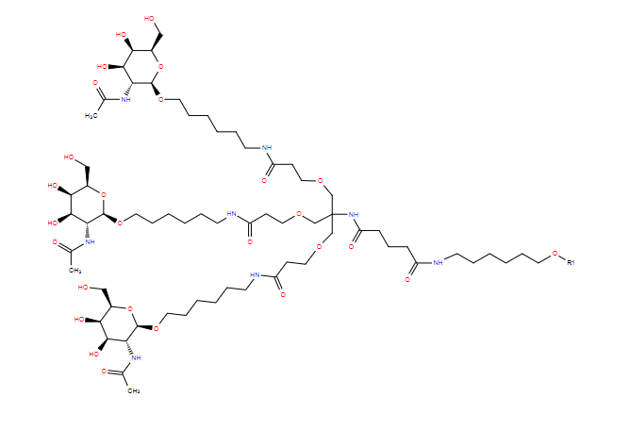
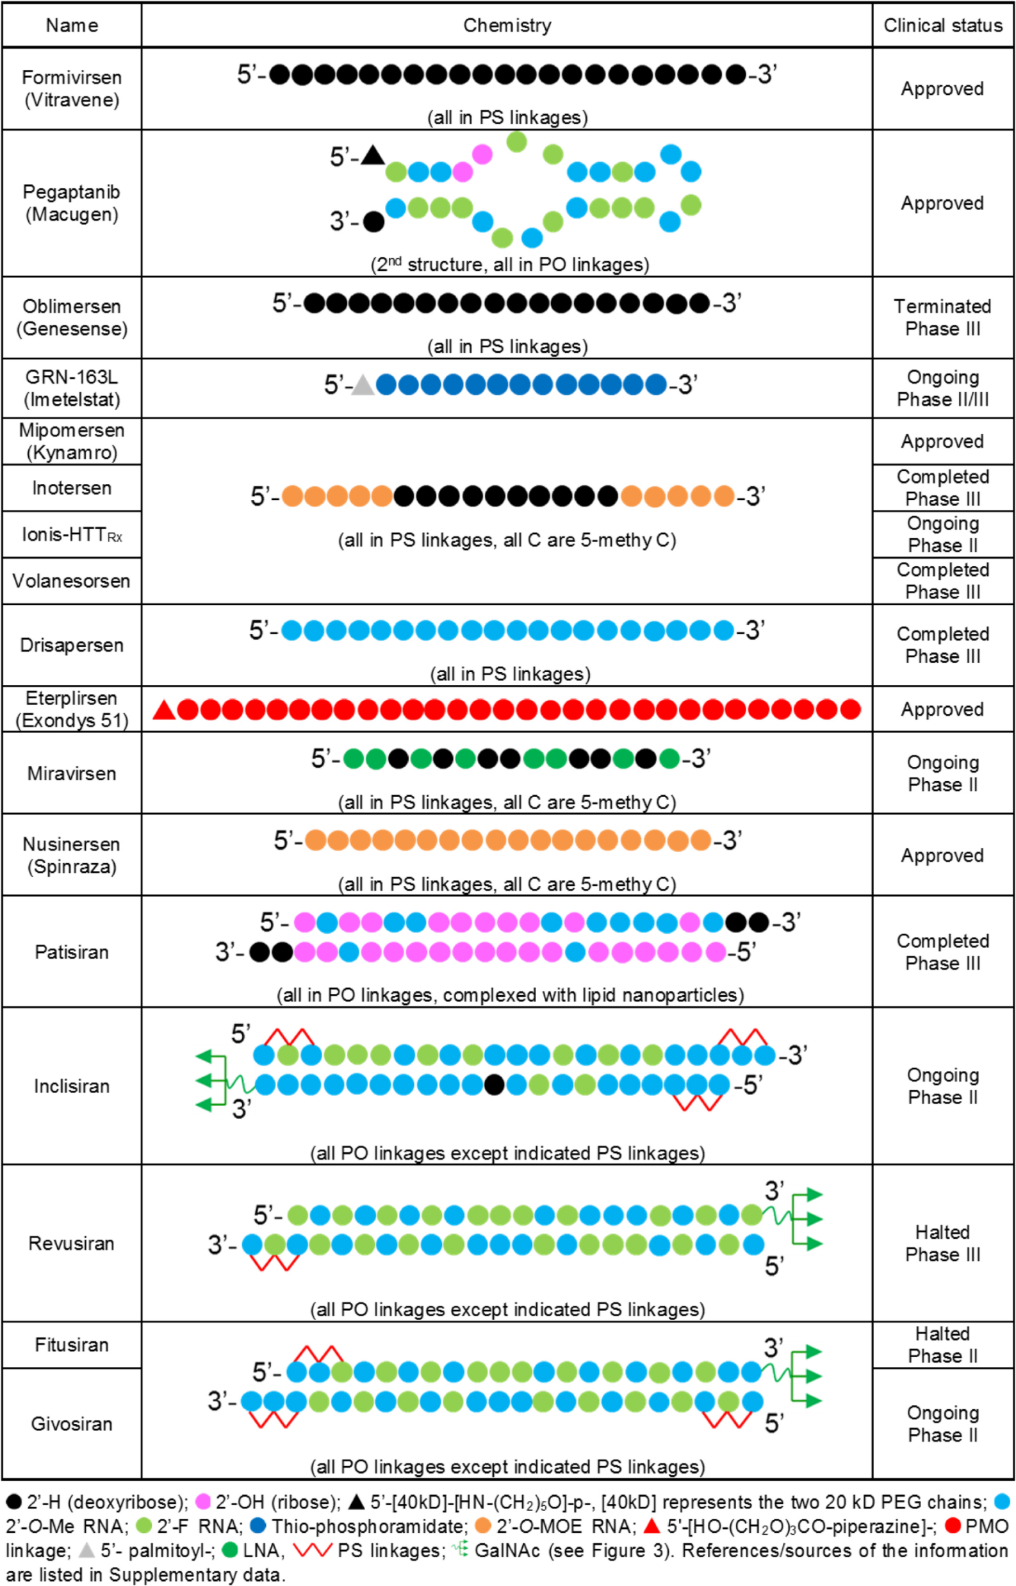
Prakash, T. P.; Yu, J.; Migawa, M. T.; Kinberger, G. A.; Wan, W. B.; Ostergaard, M. E.; Carty, R. L.; Vasquez, G.; Low, A.; Chappell, A.; Schmidt, K.; Aghajan, M.; Crosby, J.; Murray, H. M.; Booten, S. L.; Hsiao, J.; Soriano, A.; Machemer, T.; Cauntay, P.; Burel, S. A.; Murray, S. F.; Gaus, H.; Graham, M. J.; Swayze, E. E.; Seth, P. P. Comprehensive Structure-Activity Relationship of Triantennary N-Acetylgalactosamine Conjugated Antisense Oligonucleotides for Targeted Delivery to Hepatocytes. J. Med. Chem. 2016, 59, 2718-2733.
From: Chemistry, mechanism and clinical status of antisense oligonucleotides and duplex RNAs
Nucleic Acids Res. 2017;46(4):1584-1600. doi:10.1093/nar/gkx1239
Notes:
Figure 6. Design and clinical status of oligonucleotides drugs discussed in this review. Source material for this figure is cited as Supplementary Data. For Inclisiran, Fitusiran, and Givosiran, we could not locate publically available information and the structures shown below are based on the cited descriptions of this class of compound.
15

Slide 16
How have we managed this?
Notes:
Do we all have to create a monomer database in order to use HELM?

Slide 17
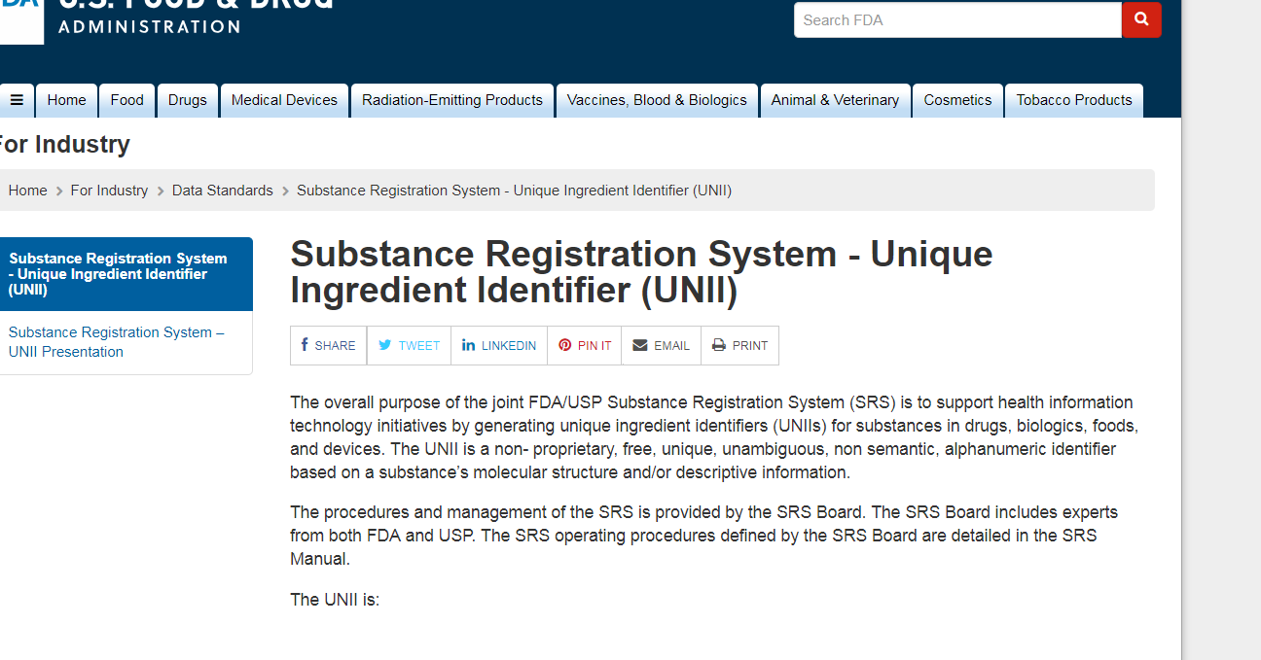

Slide 18
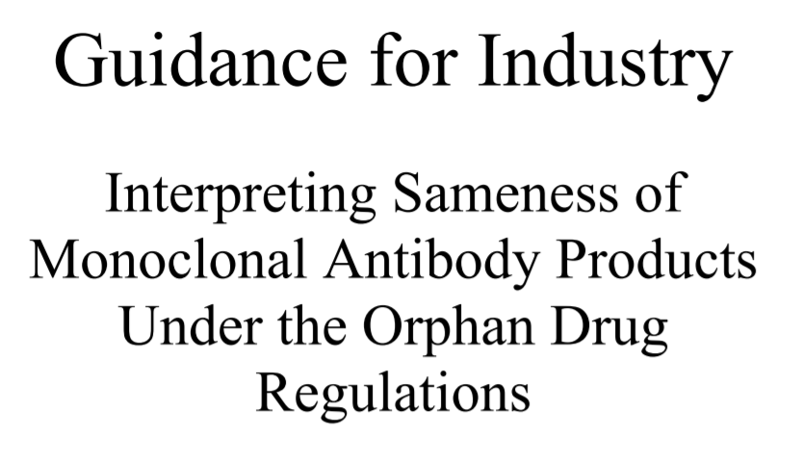
“FDA intends to interpret the applicable regulatory provisions such that the determination of sameness of such monoclonal antibodies will be based on a determination of sameness of the monoclonal antibody element and sameness of the functional element of the conjugated molecule”
Conversely, two monoclonal antibody conjugates or fusion proteins would be determined to be the same drug if both the CDR sequences of the antibody and the functional element of the conjugated molecule were the same
CDR = complementarity determining regions
Mixtures that contain greater than ten chemically defined substances are considered complex substances and chemical structures are not drawn. Substances that form non-covalent interactions with other added substances are not new substances or mixtures of substances; they are defined as separate substances
Notes:
https://www.fda.gov/downloads/BiologicsBloodVaccines/GuidanceComplianceRegulatoryInformation/Guidances/Blood/UCM170111.pdf

Slide 19
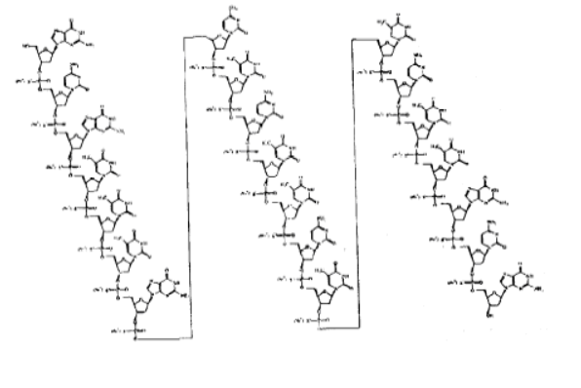

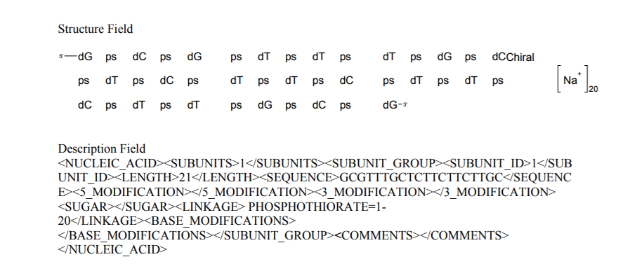

Slide 20
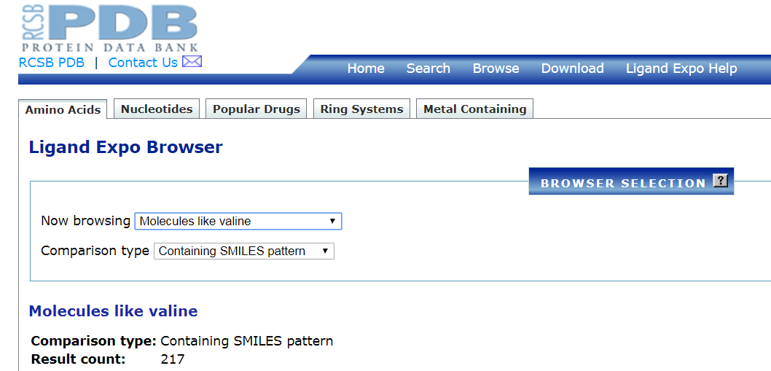
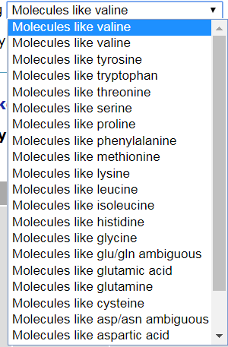

Slide 21
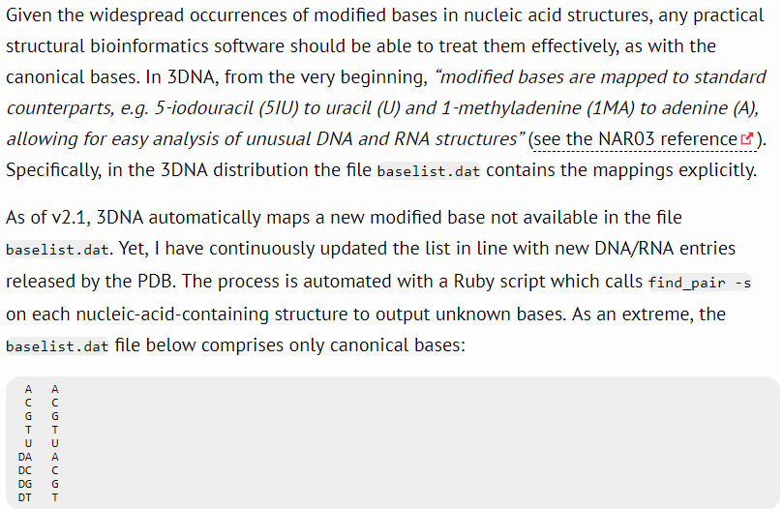
Example: Bioinformatics tools before HELM
3DNA: a software package for the analysis, rebuilding and visualization of three‐dimensional nucleic acid structures
3DNA: a software package for the analysis, rebuilding and visualization of three-dimensional nucleic acid structures Xiang-Jun Lu and Wilma K. Olson*
Nucleic Acids Research, 2003, Vol. 31, No. 17 DOI: 10.1093/nar/gkg680

Slide 22
Along comes HELM

Slide 23
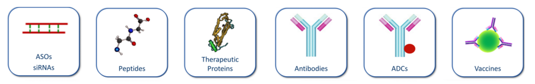
Hierarchical Editing Language for Macromolecules
HELM
It’s language (syntax) that captures both the chemistry and biology of biopolymers and other less well characterized macromolecules.
Hierarchical
Extensible
Able to handle entity complexity
Portable
Able to handle entity ambiguity

Slide 24
Syntax structure
SimplePolymers$Connections$PolymerGroups$FreeText$
SimplePolymers list all chains.
Connections describe inter-polymer interactions like hydrogen bonding or covalent bonds between chains.
PolymerGroups allow for defining mixtures and ratios of chains. For example, in the string “G1(PEPTIDE1+PEPTIDE2+PEPTIDE3+PEPTIDE4)
|G2(CHEM1+G1:3.4)”, the G1 group defines the relationship of four chains in an antibody and the G2 defines the relationship of a small molecule (CHEM1) and the antibody(G1). The relative abundance of the small molecule to the antibody is captured in this section.
Notes:
We don’t maintain atomic resolution in the line notation but we don’t lose track of this. i.e .it’s stored in a database

Slide 25
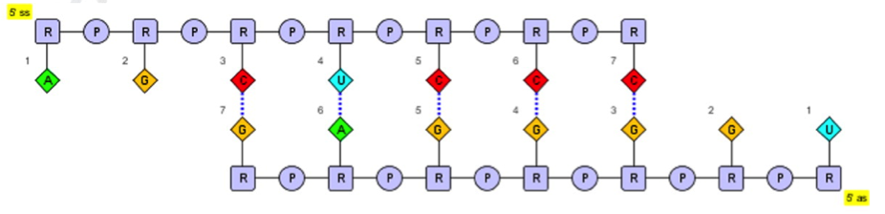
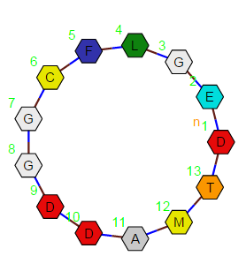
RNA1{r(A)p.r(G)p.r(C)p.r(U)p . . . }|RNA2{r(U)p.r(G)p.r(G)p.r(G)p . . . } $RNA1,RNA2,20:pair-8:pair|RNA1,RNA2,17:pair-11:pair|RNA1,RNA2,8:pair-20:pair|RNA1,RNA2,14:pair-14:pair|RNA1,RNA2,11:pair-17:pair$$$
PEPTIDE1{D.E.G.L.F.C.G.G.D.D.A.M.T}$PEPTIDE1,PEPTIDE1,1:R1-13:R2$$$

Slide 26
HELM: Help manage high-level complexity
Human readable
While somewhat complex at first the ability to see the line notation of biopolymers provides a great way to manage complexity
Computationally accessible
Parsing code as a polymer you’re able to more easily capture relevant features like the ‘Gap’ in an oligonucleotide.
Support for molecular and macromolecular drug design

Slide 27
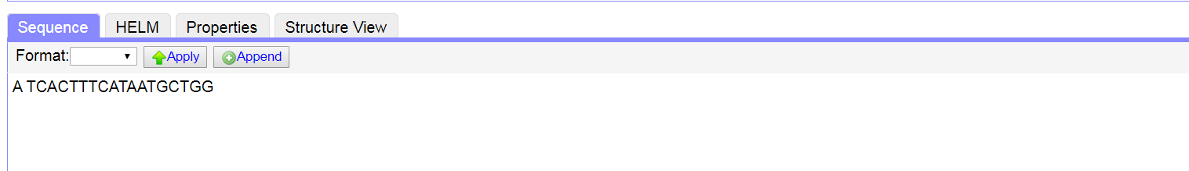
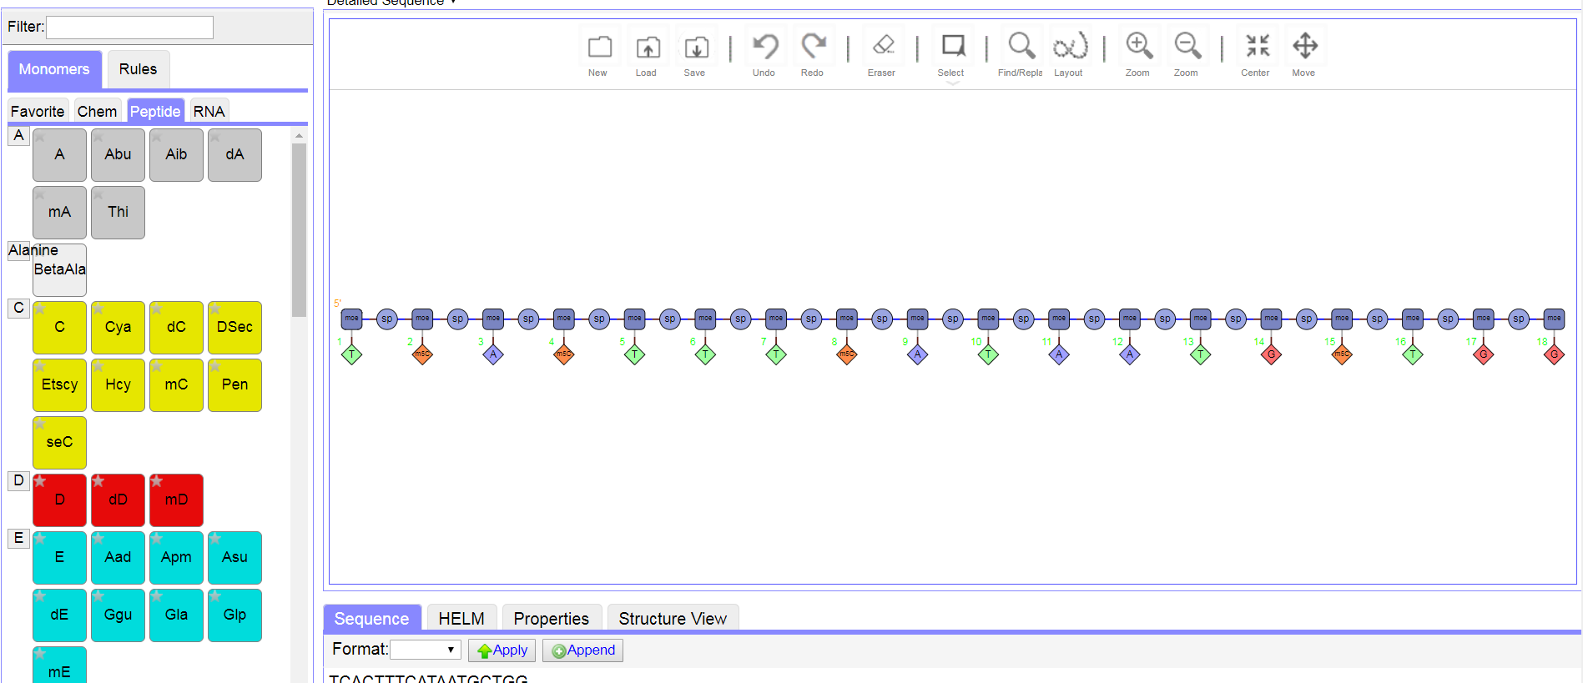
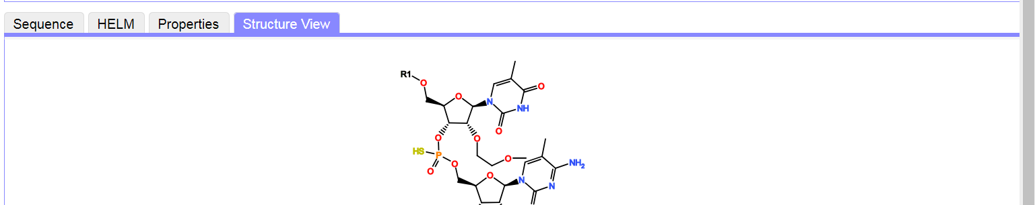
Nusinersen; Spinraza Approved (SMN - Spinal muscular atrophy)

Slide 28
Cetrotide (Cetrorelix)
O=C(N[C@H](CC1=CN=CC=C1)C(N[C@@H](CO)C(N[C@@H](CC2=CC=C(O)C=C2)C(N[C@H](CCCNC(N)=O)C(N[C@@H](CC(C)C)C(N[C@@H](CCCNC(N)=N)C(N(CCC3)[C@@H]3C(N[C@H](C)C(N)=O)=O)=O)=O)=O)=O)=O)=O)[C@@H](CC4=CC=C(Cl)C=C4)NC([C@H](NC(C)=O)CC5=CC6=CC=CC=C6C=C5)=O
PEPTIDE1{[ac].[dNal].[dPhe(4-Cl)].[d3-Pal].S.Y.[dCit].L.R.P.[dA].[am]}$$$$
Notes:
A synthetic ten-membered oligopeptide comprising N-acetyl-3-(naphthalen-2-yl)-D-alanyl, 4-chloro-D-phenylalanyl, 3-(pyridin-3-yl)-D-alanyl, L-seryl, L-tyrosyl, N⁵-carbamoyl-D-ornithyl, L-leucyl, L-arginyl, L-prolyl, and D-alaninamide residues coupled in sequence. A gonadotrophin-releasing hormone (GnRH) antagonist, it is used for treatment of infertility and of hormone-sensitive cancers of the prostate and breast.
PEPTIDE1{[ac].[dNal].[dPhe(4-Cl)].[d3-Pal].S.Y.[dCit].L.R.P.[dA].[am]}$$$$

Slide 29
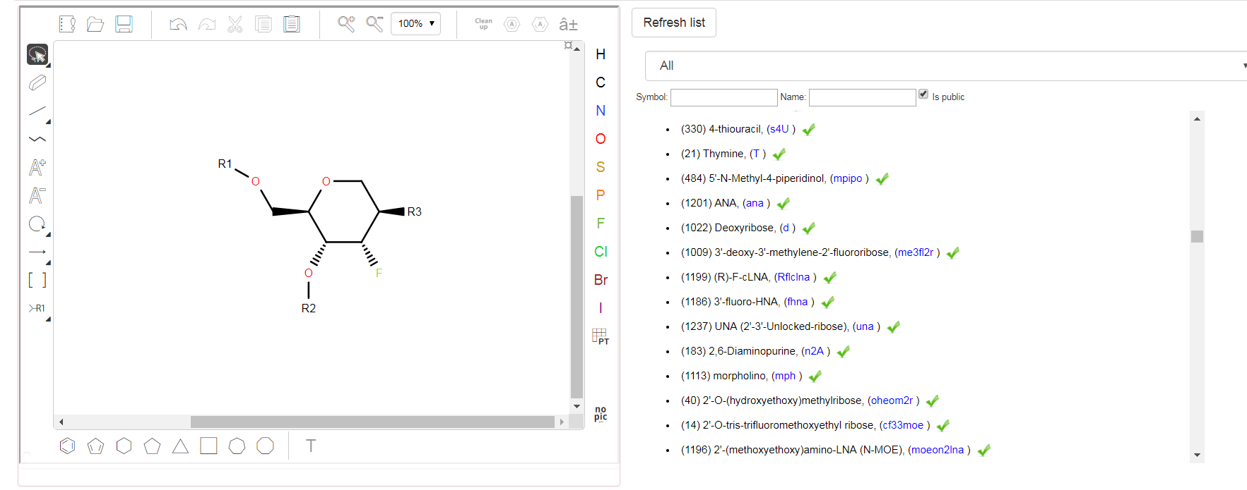
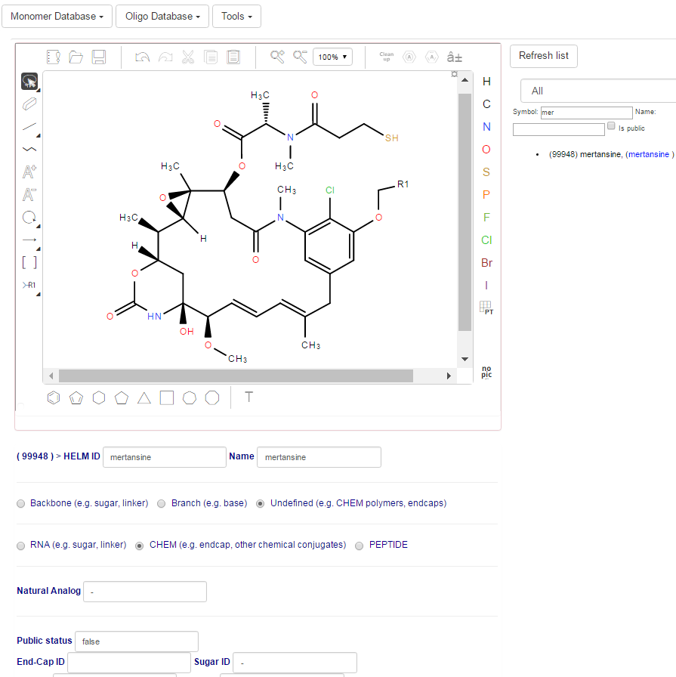

Attributes:
Polymer Type
Symbol
Name
Molecular structure
Defined ‘R’ groups with default values
Monomer Type
Monomer Database

Slide 30
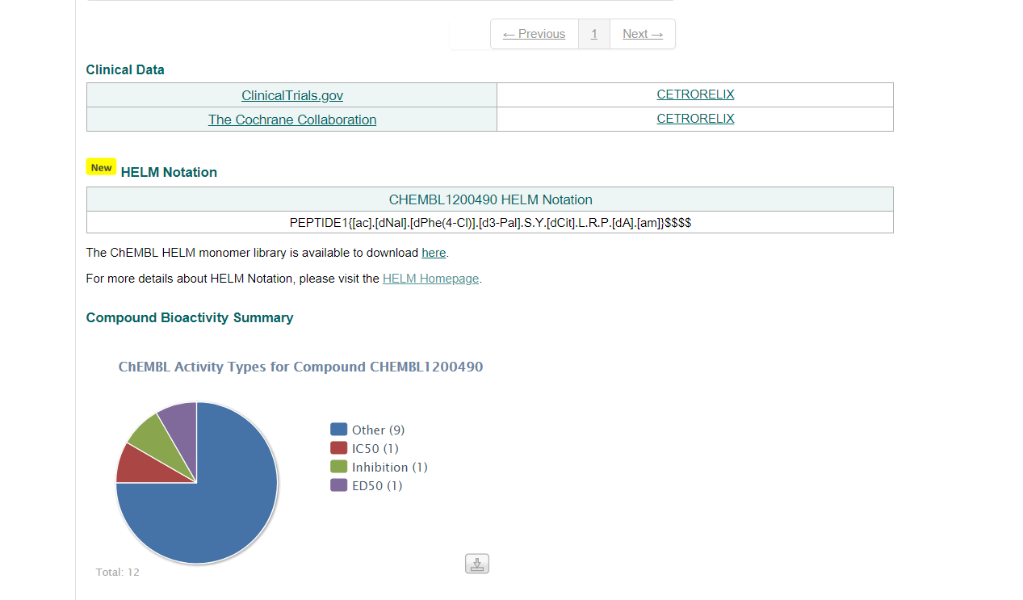
Notes:
Monomer library required to resolve chemistry
XML file with mol files in 64bit encoding
Peptide Sequence: you need to download and parse the entire library in order to get the natural analog
HELM community has moved on to JSON formatted with different attribute values (i.e. MonomerID should be symbol ).

Slide 31

It’s time to establish a worldwide monomer repository for biopolymer informatics
monomer.org

Slide 32
The world-wide monomer reference
System-of-record of all curated monomers
A natural extension of the new HELM specification
Primary data source for macromolecular informatics tools

Slide 33
Bringing simplicity to complex chemistry
Bio/Chem-informatics
Software
Construct and manage molecular complexity
HELM
Monomer.org
Structure Database

Slide 34

HUB for macromolecule information exchange
PDB
PubChem
FDA
USPTO
ChEMBL
Twist Bioscience
Ionis
Genentech
Integrated DNA Technologies
PerkinElmer
Thermo Fisher Scientific
etc
Bioautomation
monomer.org

Slide 35
Founding Board
Dave Yaron, Chairman
Professor of Computational Chemistry, Carnegie Mellon University
Sergio Rotstein
Director, Medicinal Sciences Business Technology, Pfizer, Inc.
Phil Bourne
Stephenson Chair of Data Science and Director of the Data Science Institute and Professor of Biomedical Engineering, UVA
Eric Swayze
VP Chemistry, Ionis Pharmaceuticals

Slide 36
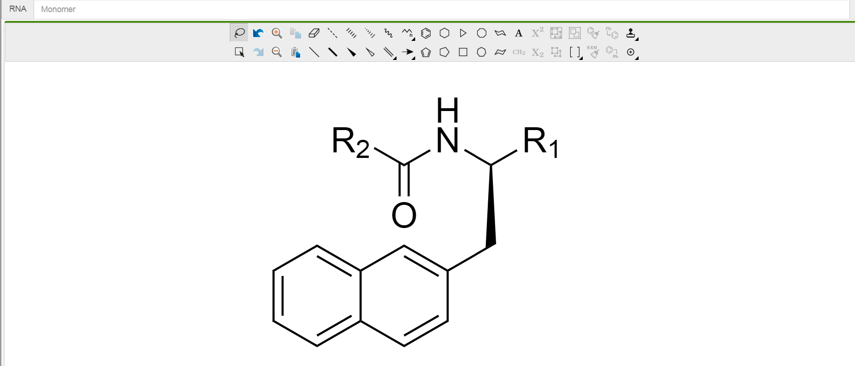

Curation Portal provided by ChemDraw

Slide 37
Reference database Scheduled launch in late 2018
Software Technology
RESTful services
Curation Portal
Jupyter/Python library
Initial ~500 monomers provided by Ionis Pharmaceuticals and peptides provided by the Norine project at Laboratoire d'Informatique Fondamentale de Lille & Institut National de Recherche en Informatique et en Automatique

Slide 38
Primary Mission: Capture and annotate all public monomers
RNA1{[moe](T)[sp].[moe]([m5C])[sp].[moe](A)[sp].[moe]([m5C])[sp].[moe](T)[sp].[moe](T)[sp].[moe](T)[sp].[moe]([m5C])[sp].[moe](A)[sp].[moe](T)[sp].[moe](A)[sp].[moe](A)[sp].[moe](T)[sp].[moe](G)[sp].[moe]([m5C])[sp].[moe](T)[sp].[moe](G)[sp].[moe](G)}$$$$
Monomer.org will contain a reference set of monomers that represent most “public domain” structures like FDA approved structures and commercial products etc…

Slide 39
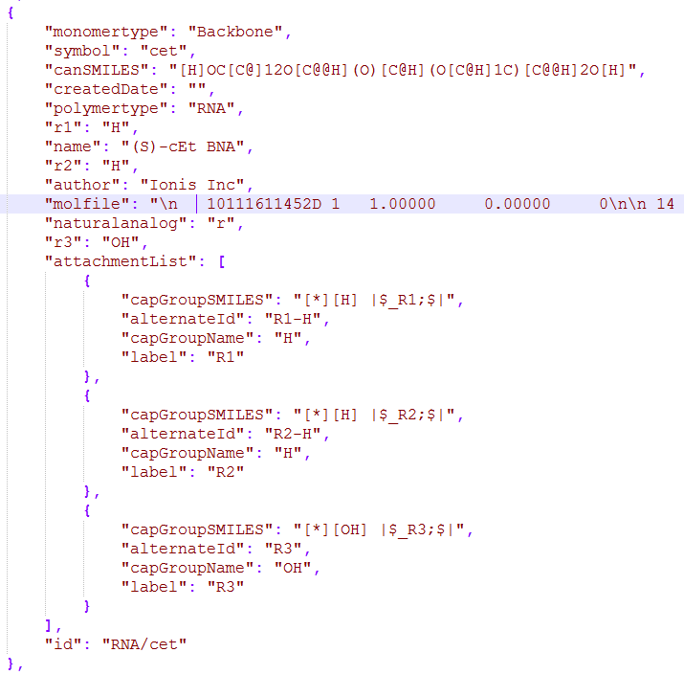
monomer.org reference set:
Reference set:
lib.monomer.org/RNA/cet
lib.monomer.org/PEPTIDE/a
lib.monomer.org/RNA [ …array of RNA monomers…]
lib.monomer.org [ …download all monomers in the reference…]

Slide 40
http://db.monomer.org/ionis

Slide 41
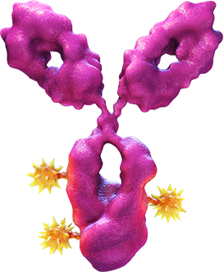
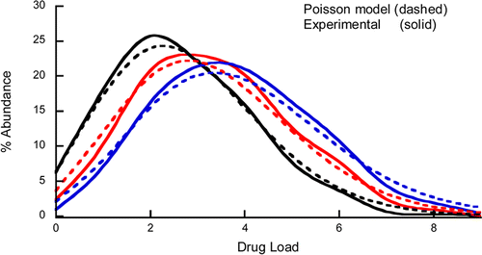
Trastuzumab with Emtansine
Target average drug to antibody ratio (DAR) of 3.5
PEPTIDE1{...light_chain_sequence...}|PEPTIDE2{...heavy_chain_sequence..}|PEPTIDE3{...light_chain_sequence....}|PEPTIDE4{..heavy_chain_sequence...}|CHEM1{[MCC]}$PEPTIDE1,PEPTIDE1,134:R3-194:R3|PEPTIDE2,PEPTIDE3,229:R3-229:R3|PEPTIDE4,PEPTIDE4,134:R3-194:R3|PEPTIDE1,PEPTIDE1,23:R3-88:R3|PEPTIDE3,PEPTIDE4,223:R3-214:R3|PEPTIDE3,PEPTIDE3,370:R3-428:R3|PEPTIDE2,PEPTIDE2,264:R3-324:R3|PEPTIDE3,PEPTIDE3,147:R3-203:R3|PEPTIDE4,PEPTIDE4,23:R3-88:R3|PEPTIDE2,PEPTIDE1,223:R3-214:R3|PEPTIDE2,PEPTIDE2,22:R3-96:R3|PEPTIDE3,PEPTIDE3,22:R3-96:R3|PEPTIDE2,PEPTIDE2,147:R3-203:R3|PEPTIDE2,PEPTIDE2,370:R3-428:R3|PEPTIDE3,PEPTIDE3,264:R3-324:R3|PEPTIDE2,PEPTIDE3,232:R3-232:R3$G1(PEPTIDE1+PEPTIDE2+PEPTIDE3+PEPTIDE4)|G2(CHEM1+G1:3.4)$db.monomer.org/Genentech$V2.0
Statistical Modeling of the Drug Load Distribution on Trastuzumab Emtansine (Kadcyla), a Lysine-Linked Antibody Drug Conjugate
Michael T. Kim*†, Yan Chen†, Joseph Marhoul‡, and Fred Jacobson†
†Departments of Protein Analytical Chemistry and ‡Biostatistics Genentech, Inc, South San Francisco, California 94080 United States
Bioconjugate Chem., 2014, 25 (7), pp 1223–1232
Notes:
Doing machine learning on large antibodies require a data model that capture relevant properties. For example stoichiometry between antibody and conjugate. If you had a large training set of compounds with this structure over time you might be able to find the best activity. The lower barrier to entry for this structure also allows for easy access for machine learning techniques.
i.e. Ipython notebooks is a very common way to pull data into AI tools

Slide 42
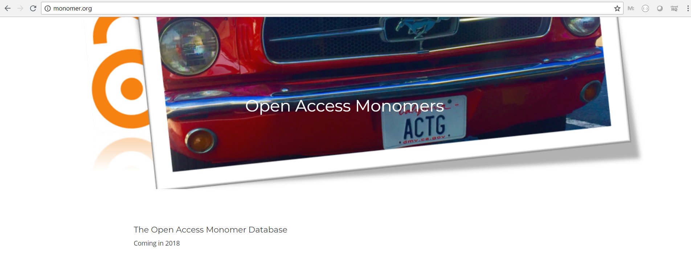





HELM & monomer.org reference library will serve as the standard for managing biopolymers
lib.monomer.org

Slide 43
A central reference set lowers the barrier to meta-analysis of chemical entities:
e.g.
Oligonucleotide backbone search of PTO structures
Machine Learning: algorithms require computationally tractable resources for training models
Large SAR assays need to be captured in a way that make it simple to understand relationships
e.g. Functional groups, peptides sequence, oligonucleotide backbone sequence , etc.

Slide 44
Libraries
Example:
from monomer.org import Monomers
ref = Monomers ()
idt = Monomers (‘idt’)
myStructure = ‘RNA1{d(G)p.d(A) …etc… }$$$$
idtStructure = ‘RNA1{[de](G)[po].[de](A) …etc… }$$$$
print (idt.structure ( idtStructure ) == ref.structure ( myStructure ) )
Notes:
We have an internet outage

Slide 45


Software User Interface
Software Scripting language

Slide 46
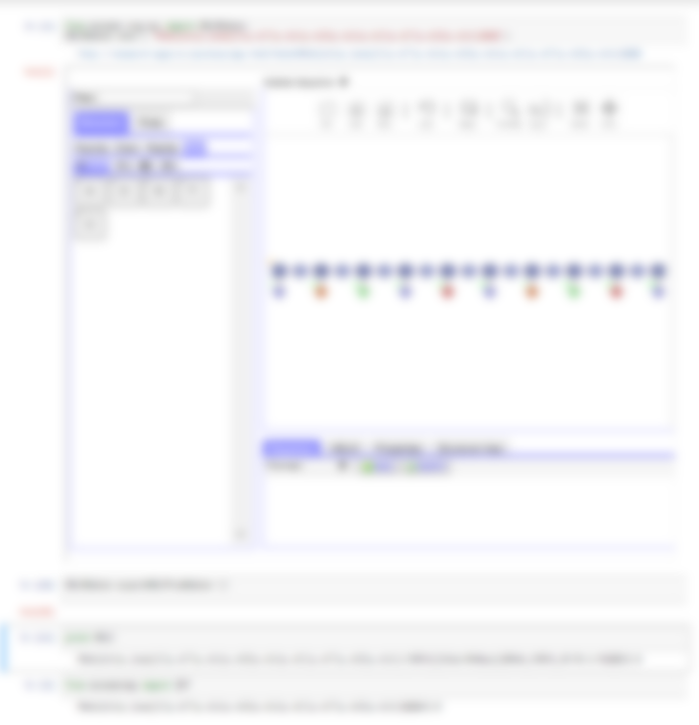

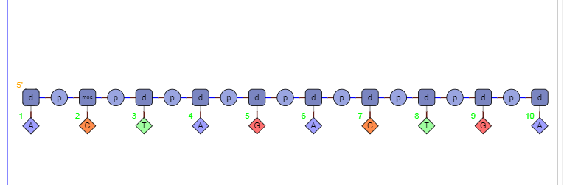
Monomer.org

Slide 47
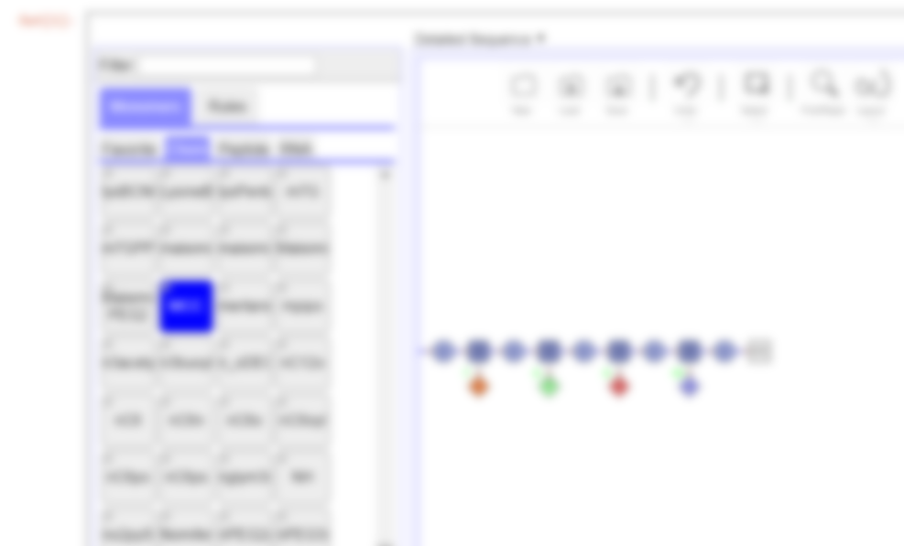
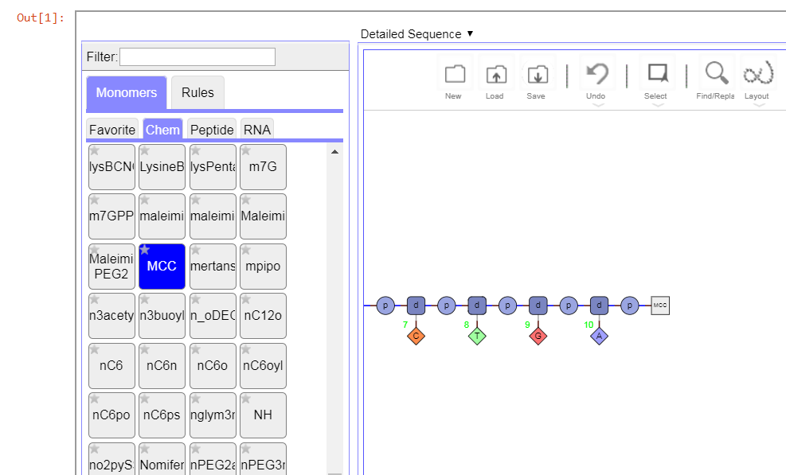


Slide 48
Come join us!
Jeff Milton jmilton@ionisph.com
Thank you!

Slide 49







Dave Yaron
Phil Bourne
Eric Swayze
Chris Hart
Michael Migawa
TP Prakash
Sergio Rotstein
Claire Bellamy
Tianhong Zhang
Tony Yongwen
Pierre Morieux
Andrew Smellie

