Slide 1
HELM: Continuing to set the standard for biomolecular representation
2018 ACS Meeting – Division of Chemical Information
Domain Lead – Sergio Rotstein
Project manager – Claire Bellamy
August 20th, 2018
Notes:
Opening title slide

Slide 2
Agenda
Introduction
Industry Adoption
What’s Next
Conclusion

Slide 3
Introduction

Slide 4

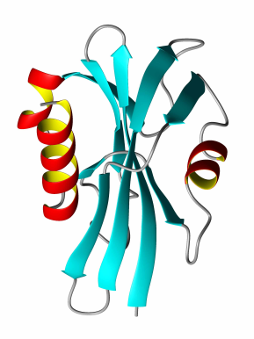

Biomolecules - Stuck in the middle…
GAP
Small Molecule Tools
Sequence-Based Tools
Small Molecules
Sequences
Biomolecules
4

Slide 5

HELM
HELM is the standard and corresponding toolkit that enables the representation and management of complex biomolecules
Small Molecules
Sequences
Biomolecules
5

Slide 6
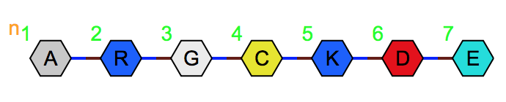
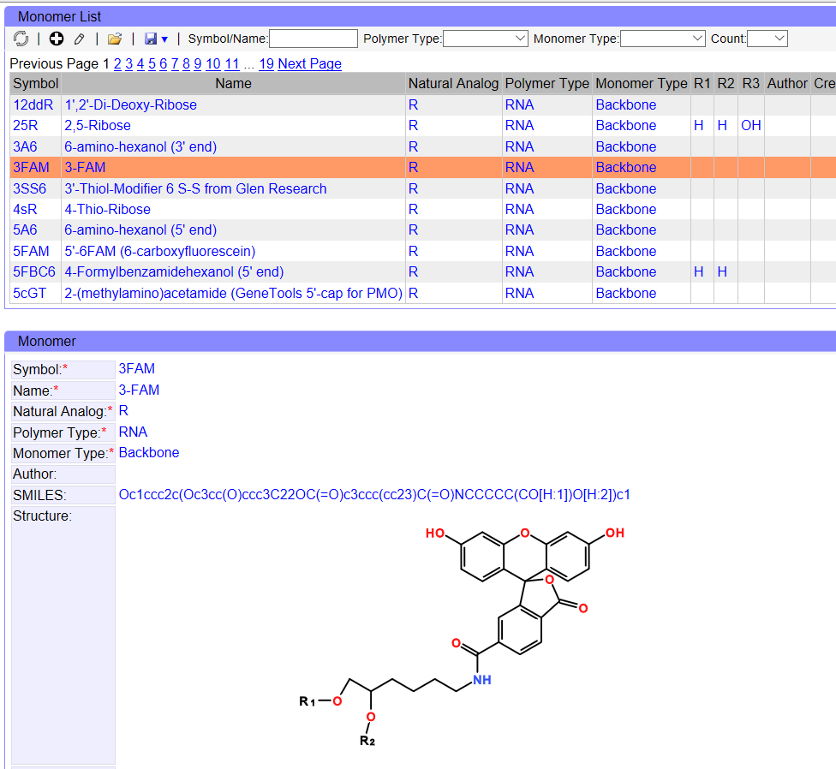
Monomer Manager
PEPTIDE1{A.R.G.C.K.D.E}$$$$V2.0
Creation / Import / Export
Filtering
Browsing
Structure Editing

Slide 7
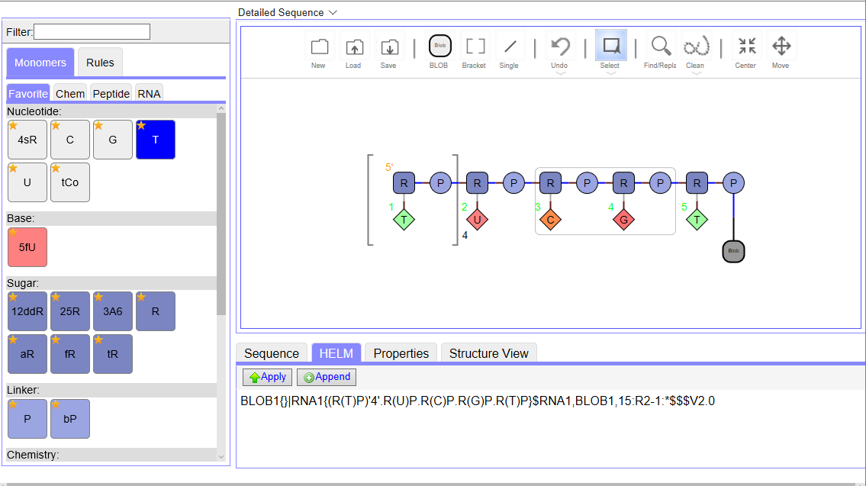
Web-Based HELM Editor
Repeating units
Ambiguous bonds
Groups
Unknown polymer
7

Slide 8
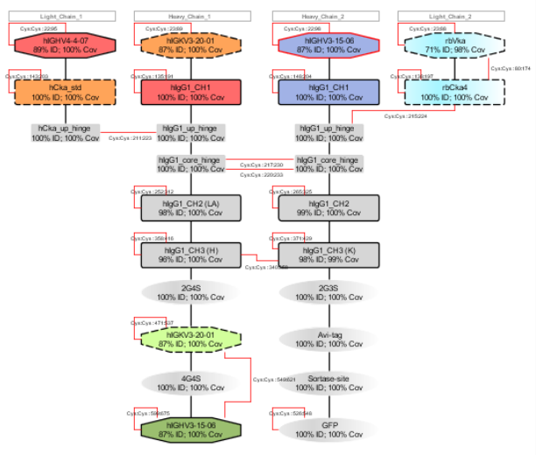
HELM Antibody Editor v2 (HAbE)
MonomerDesigner
Allows the user to add new chemical monomers to the local monomer store.
ADCDesigner
Allows the user to modify domains chemically by adding chemical monomers to them. The user can add or delete chemical monomers to the local monomer store.
Improvements in Layout
New Reactions
Sortase coupling
Biotinylation
Domain Protease Reaction

Slide 9
Industry Adoption

Slide 10
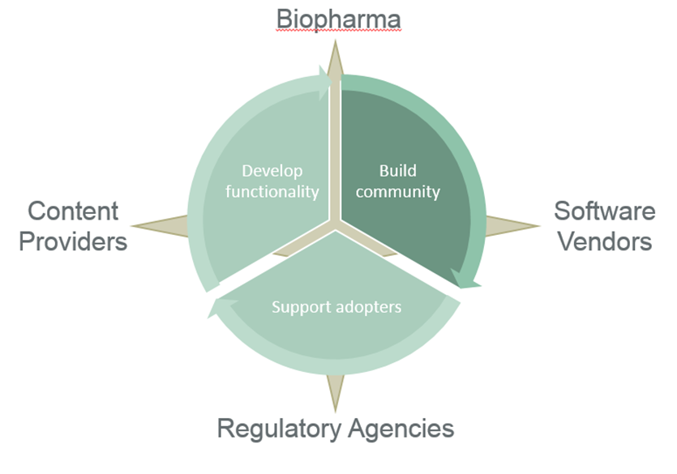
The HELM Ecosystem
Wave Life Science
Novartis
Roche
Merck
Rapafusyn
BMS
Pfizer
Ionis
GSK
NextMove
Perkin-Elmer
ChEMBL
Biovia
ChemAxon
PubChem
RDKit
IDBS
Monomer.org
Quattro reseach
Dotmatics
Sciligence
ISO/TS 19844

Slide 11
What’s Next

Slide 12
“BAU” HELM
Many areas of focus for the community of interest
Continuous refinement of the HELM standard and documentation
Continuous identification and removal of barriers to adoption
Investment of effort in the success of public resources
Monomer.org
Regulatory agencies
E.g. HELM adoption in GSRS
Community Engagement
Seminar Series
Talks
Posters
Evangelism
Software vendors
Content providers

Slide 13
Conclusion
In the ~5 years since launch, the Pistoia HELM project has created a standard that is:
Leveraged by many of the largest biopharma companies
Supported by key scientific software vendors
Included in a growing number of public data sources
Supported as a biomolecule representation standard by agencies that follow IDMP guidelines (e.g. FDA, EMA)

Slide 14
What does it take to build a new standard?

Slide 15
What does it take to build a new standard?
Andrey Yerin, ACDlabs
Hans de Bie, ACDlabs
Jan Holst Jensen , Biochemfusion
Dana Vanderwall, BMS
Mary Brawner , BMS
Matthias Nolte, BMS
Ramesh Durvasula, BMS
David Lowis, Certara
Akos Papp, ChemAxon
Alexander Drijver, ChemAxon
Roland Knispel, ChemAxon
Alex Allardyce, ChemAxon
Anna Gualton, EMBL-EBI
Andrew R Leach , EMBL-EBI
Dominic Clark, EMBL-EBI
John Overington, EMBL-EBI
Patricia Bento, EMBL-EBI
George Papadatos, EMBL-EBI
Leah O’Brien , GSK
Rama Bhamidipati , GSK
Michael Cui , GSK
John Smith, GSK
Simili Abhilash, Harvard University
Stephanie Dube, Harvard University
Thankam Girija, Harvard University
Sarah Leinicke, Harvard University
Chinedu Okongwu, Harvard University Justin Sanford, Harvard University
Stephen Heller, InChi Trust
Keith Taylor, Independent
Edward Currie, Infosys
Kirti Jindal, Infosys
Eric Swayze, Ionis
Jeff Milton, Ionis
Susan Turner , Merck
Thomas Gan, Merck
Chris Waller, Merck
Roger Sayle, Next Move Software
Noel O-Boyd, Next Move Software
John May, Next Move Software
Joann Prescott-Roy, Novartis
Yohann Potier, Novartis
Sven Neumeyer, Novartis
Quan Yang, Novartis
Pat Keller, Novartis
Boram Yi, Novartis
Pierre Morieux, Perkin Elmer
Andrew Smellie, Perkin Elmer
Philip Skinner, Perkin Elmer
Claire Bellamy, Pistoia Alliance
John Wise, Pistoia Alliance
Carmen Nitsche, Pistoia Alliance
Richard Holland, Pistoia Alliance
David Klatte, Pfizer
Hongli Li, Pfizer
Sergio Rotstein , Pfizer
Rob Stanton, Pfizer
Simon Xi, Pfizer
Tianhong Zhang , Pfizer
Bernhard Shirm, Quattro research
Markus Weisser, Quattro research
Anne Von Raven, Quattro research
Marco Lanig, Quattro research
Cathrin Mayer, Quattro research
Sabrina Hecht, Quattro research
Michael Braxenthaler, Roche
Margret Assfalg , Roche
Stefan Klostermann, Roche
Dennis Hansen, Roche
Jinbo Lee, Scilligence
Tony Yuan, Scilligence
Bret Daniel, Sial
Ian Stott, Unilever
Jerry Winter, Unilever
Andreas Bender, University of Cambridge
Andrea Chlebkova, University of Cambridge
Eva Bultel, University of Hamburg
Clémentine Campart, University of Lille
Maude Pupin, University of Lille
78 people across 25 organizations coming together for a common cause!!

Slide 16


www.OpenHelm.org info@openhelm.org

Slide 17
Thank you for attending
Claire.Bellamy@PistoiaAlliance.org
Sergio.Rotstein@PistoiaAlliance.org
@pistoiaalliance
www.pistoiaalliance.org
Notes:
Closing slide

