Slide 1
Why Large Molecule Standards are Important to Pharma
Expanding IUPAC Standards workshop at EBI
Domain Lead – Sergio Rotstein
Project manager – Claire Bellamy
20th March 2017
Notes:
Opening title slide

Slide 2
Contents
Why is this an issue now?
What is the problem?
What do we need?

Slide 3
Why Now? Best selling pharmaceuticals 2015
Rank | Drug | Trade name | Type | Main indications | Company | Sales (USD millions/year) | ∆ vs 2014
1 | Adalimumab | Humira | Biologic | Rheumatoid arthritis | AbbVie Inc. | 14,012 | 1,469
2 | Ledipasvir/sofosbuvir | Harvoni | Small molecule | Hepatitis C | Gilead Sciences | 13,864 | 11,737
3 | Etanercept | Enbrel | Biologic | Rheumatoid arthritis | Amgen Pfizer | 8,697 | 4,009
4 | Infliximab | Remicade | Biologic | Crohn's Disease Rheumatoid Arthritis | Johnson & Johnson | 8,355 | 1,487
5 | Rituximab | Mabthera Rituxan | Biologic | Lymphoma Leukemia Autoimmune disorders | Roche | 7,115 | 1,456
6 | Insulin glargine | Lantus | Biologic | Diabetes mellitus | Sanofi | 7,029 | 51
7 | Bevacizumab | Avastin | Biologic | Metastatic cancers | Roche | 6,751 | 270
8 | Trastuzumab | Herceptin | Biologic | Breast cancer | Roche | 6,603 | 265
9 | Lenalidomide | Revlimid | Small molecule | Multiple myeloma Myelodysplastic syndromes | Celgene | 5,801 | 821
10 | Sofosbuvir | Sovaldi | Small molecule | Hepatitis C | Gilead Sciences | 5,276 | (5,007
Source Wikipedia
Notes:
More than twice as much revenue from the biologics as the small molecules

Slide 4
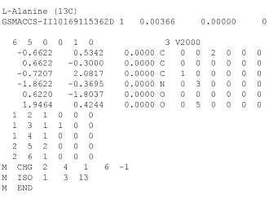
So what is the problem?
Small molecule representation is well understood and has been used for many years.
Although there are still areas to talk about the fundamentals are established.
Most compounds pharma can generally be handled
Biologics is a long way behind.
Many important substances cannot be represented fully with current tools
O=C(O)[C@@H](N)C
InChI=1S/C3H7NO2/c1-2(4)3(5)6/h2H,4H2,1H3,(H,5,6)/t2-/m1/s1
Key: QNAYBMKLOCPYGJ-UWTATZPHSA-N

Slide 5

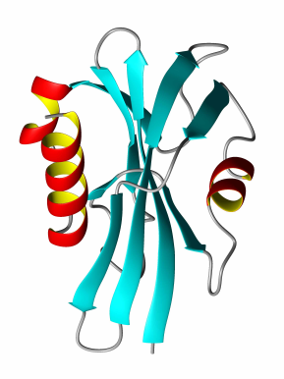

Biomolecules - Stuck in the middle…
GAP
Small Molecule Tools
Sequence-Based Tools
Small Molecules
Sequence
information
Biomolecules

Slide 6
Requirements
Compact and tractable
Atom/bond representation for macromolecules becomes unwieldy and slow to process in electronic systems.
Flexible
Able to describe different types of polymers; peptides, carbohydrates and nucleotides are the most common examples, but there are other large molecules.
Able to handle entity complexity
Modern techniques involve the use of non-natural elements. Simple sequence information does not allow for this.
Multiple levels of viewing and manipulation
Large molecule information is complex – we need a way of visualising it that makes sense for the scientist.

Slide 7
Requirements
Able to handle ambiguity
Unlike small molecules, we often don’t know everything about the biomolecule we just made. However there will be information worth capturing.
Understood by all

Slide 8
Requirements
Compact and tractable
Atom/bond representation for macromolecules becomes unwieldy and slow to process in electronic systems.
Able to handle entity complexity
Modern techniques involve the use of non-natural elements. Simple sequence information does not allow for this.
Flexible
Able to describe different types of polymers; peptides, carbohydrates and nucleotides are the most common examples, but there are other large molecules.
Multiple levels of viewing and manipulation
Large molecule information is complex – we need a way of visualising it that makes sense for the scientist.

Slide 9
Compact and tractable - Adalimumab
Human monoclonal antibody, anti-(human tumor necrosis factor)
1330 monomers, 144,190 Da
1: EVQLVESGGG LVQPGRSLRL SCAASGFTFD DYAMHWVRQA PGKGLEWVSA
51: ITWNSGHIDY ADSVEGRFTI SRDNAKNSLY LQMNSLRAED TAVYYCAKVS
101: YLSTASSLDY WGQGTLVTVS SASTKGPSVF PLAPSSKSTS GGTAALGCLV
151: KDYFPEPVTV SWNSGALTSG VHTFPAVLQS SGLYSLSSVV TVPSSSLGTQ
201: TYICNVNHKP SNTKVDKKVE PKSCDKTHTC PPCPAPELLG GPSVFLFPPK
251: PKDTLMISRT PEVTCVVVDV SHEDPEVKFN WYVDGVEVHN AKTKPREEQY
301: NSTYRVVSVL TVLHQDWLNG KEYKCKVSNK ALPAPIEKTI SKAKGQPREP
351: QVYTLPPSRD ELTKNQVSLT CLVKGFYPSD IAVEWESNGQ PENNYKTTPP
401: VLDSDGSFFL YSKLTVDKSR WQQGNVFSCS VMHEALHNHY TQKSLSLSPG
451: K
1: EVQLVESGGG LVQPGRSLRL SCAASGFTFD DYAMHWVRQA PGKGLEWVSA
51: ITWNSGHIDY ADSVEGRFTI SRDNAKNSLY LQMNSLRAED TAVYYCAKVS
101: YLSTASSLDY WGQGTLVTVS SASTKGPSVF PLAPSSKSTS GGTAALGCLV
151: KDYFPEPVTV SWNSGALTSG VHTFPAVLQS SGLYSLSSVV TVPSSSLGTQ
201: TYICNVNHKP SNTKVDKKVE PKSCDKTHTC PPCPAPELLG GPSVFLFPPK
251: PKDTLMISRT PEVTCVVVDV SHEDPEVKFN WYVDGVEVHN AKTKPREEQY
301: NSTYRVVSVL TVLHQDWLNG KEYKCKVSNK ALPAPIEKTI SKAKGQPREP
351: QVYTLPPSRD ELTKNQVSLT CLVKGFYPSD IAVEWESNGQ PENNYKTTPP
401: VLDSDGSFFL YSKLTVDKSR WQQGNVFSCS VMHEALHNHY TQKSLSLSPG
451: K
1: DIQMTQSPSS LSASVGDRVT ITCRASQGIR NYLAWYQQKP GKAPKLLIYA
51: ASTLQSGVPS RFSGSGSGTD FTLTISSLQP EDVATYYCQR YNRAPYTFGQ
101: GTKVEIKRTV AAPSVFIFPP SDEQLKSGTA SVVCLLNNFY PREAKVQWKV
151: DNALQSGNSQ ESVTEQDSKD STYSLSSTLT LSKADYEKHK VYACEVTHQG
201: LSSPVTKSFN RGEC
1: DIQMTQSPSS LSASVGDRVT ITCRASQGIR NYLAWYQQKP GKAPKLLIYA
51: ASTLQSGVPS RFSGSGSGTD FTLTISSLQP EDVATYYCQR YNRAPYTFGQ
101: GTKVEIKRTV AAPSVFIFPP SDEQLKSGTA SVVCLLNNFY PREAKVQWKV
151: DNALQSGNSQ ESVTEQDSKD STYSLSSTLT LSKADYEKHK VYACEVTHQG
201: LSSPVTKSFN RGEC
Source – CAS common chemistry

Slide 10
Compact and tractable - Adalimumab
Human monoclonal antibody, anti-(human tumor necrosis factor)
1330 monomers, 144,190 Da
1: EVQLVESGGG LVQPGRSLRL SCAASGFTFD DYAMHWVRQA PGKGLEWVSA
51: ITWNSGHIDY ADSVEGRFTI SRDNAKNSLY LQMNSLRAED TAVYYCAKVS
101: YLSTASSLDY WGQGTLVTVS SASTKGPSVF PLAPSSKSTS GGTAALGCLV
151: KDYFPEPVTV SWNSGALTSG VHTFPAVLQS SGLYSLSSVV TVPSSSLGTQ
201: TYICNVNHKP SNTKVDKKVE PKSCDKTHTC PPCPAPELLG GPSVFLFPPK
251: PKDTLMISRT PEVTCVVVDV SHEDPEVKFN WYVDGVEVHN AKTKPREEQY
301: NSTYRVVSVL TVLHQDWLNG KEYKCKVSNK ALPAPIEKTI SKAKGQPREP
351: QVYTLPPSRD ELTKNQVSLT CLVKGFYPSD IAVEWESNGQ PENNYKTTPP
401: VLDSDGSFFL YSKLTVDKSR WQQGNVFSCS VMHEALHNHY TQKSLSLSPG
451: K
1: EVQLVESGGG LVQPGRSLRL SCAASGFTFD DYAMHWVRQA PGKGLEWVSA
51: ITWNSGHIDY ADSVEGRFTI SRDNAKNSLY LQMNSLRAED TAVYYCAKVS
101: YLSTASSLDY WGQGTLVTVS SASTKGPSVF PLAPSSKSTS GGTAALGCLV
151: KDYFPEPVTV SWNSGALTSG VHTFPAVLQS SGLYSLSSVV TVPSSSLGTQ
201: TYICNVNHKP SNTKVDKKVE PKSCDKTHTC PPCPAPELLG GPSVFLFPPK
251: PKDTLMISRT PEVTCVVVDV SHEDPEVKFN WYVDGVEVHN AKTKPREEQY
301: NSTYRVVSVL TVLHQDWLNG KEYKCKVSNK ALPAPIEKTI SKAKGQPREP
351: QVYTLPPSRD ELTKNQVSLT CLVKGFYPSD IAVEWESNGQ PENNYKTTPP
401: VLDSDGSFFL YSKLTVDKSR WQQGNVFSCS VMHEALHNHY TQKSLSLSPG
451: K
1: DIQMTQSPSS LSASVGDRVT ITCRASQGIR NYLAWYQQKP GKAPKLLIYA
51: ASTLQSGVPS RFSGSGSGTD FTLTISSLQP EDVATYYCQR YNRAPYTFGQ
101: GTKVEIKRTV AAPSVFIFPP SDEQLKSGTA SVVCLLNNFY PREAKVQWKV
151: DNALQSGNSQ ESVTEQDSKD STYSLSSTLT LSKADYEKHK VYACEVTHQG
201: LSSPVTKSFN RGEC
1: DIQMTQSPSS LSASVGDRVT ITCRASQGIR NYLAWYQQKP GKAPKLLIYA
51: ASTLQSGVPS RFSGSGSGTD FTLTISSLQP EDVATYYCQR YNRAPYTFGQ
101: GTKVEIKRTV AAPSVFIFPP SDEQLKSGTA SVVCLLNNFY PREAKVQWKV
151: DNALQSGNSQ ESVTEQDSKD STYSLSSTLT LSKADYEKHK VYACEVTHQG
201: LSSPVTKSFN RGEC
Macromolecules are big,
very big
Source – CAS common chemistry

Slide 11
Requirements
Compact and tractable
Atom/bond representation for macromolecules becomes unwieldy and slow to process in electronic systems.
Flexible
Able to describe different types of polymers; peptides, carbohydrates and nucleotides are the most common examples, but there are other large molecules.
Able to handle entity complexity
Modern techniques involve the use of non-natural elements. Simple sequence information does not allow for this.
Multiple levels of viewing and manipulation
Large molecule information is complex – we need a way of visualising it that makes sense for the scientist.

Slide 12
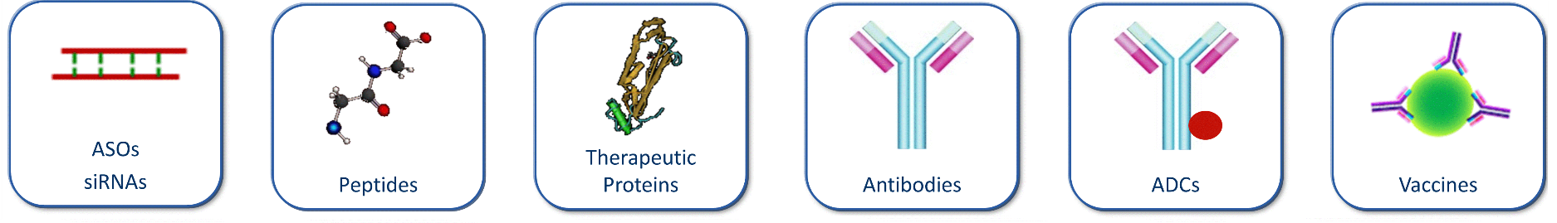
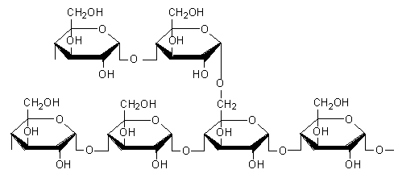
Flexible
Carbohydrates
We don’t want silo systems that can’t talk to each other.
One notation for all

Slide 13
Requirements
Compact and tractable
Atom/bond representation for macromolecules becomes unwieldy and slow to process in electronic systems.
Flexible
Able to describe different types of polymers; peptides, carbohydrates and nucleotides are the most common examples, but there are other large molecules.
Able to handle entity complexity
Modern techniques involve the use of non-natural elements. Simple sequence information does not allow for this.
Multiple levels of viewing and manipulation
Large molecule information is complex – we need a way of visualising it that makes sense for the scientist.

Slide 14
Entity complexity
Able to handle the unusual

Slide 15
Mipomersen
An Ionis product used to treat homozygous familial hypercholesterolemia.
The structure can be described as:
G*-C*-C*-U*-C*-dA-dG-dT-dC-dT-dG-dmC-dT-dT-dmC-G*-C*-A*-C*-C*
d = 2'-deoxy
* = 2'-O-(2-methoxyethyl)
with phosphorothioate linkages.
This is easy to read
But relies on a secondary explanation to capture all the information
A simple sequence is too limited

Slide 16
Requirements
Compact and tractable
Atom/bond representation for macromolecules becomes unwieldy and slow to process in electronic systems.
Flexible
Able to describe different types of polymers; peptides, carbohydrates and nucleotides are the most common examples, but there are other large molecules.
Able to handle entity complexity
Modern techniques involve the use of non-natural elements. Simple sequence information does not allow for this.
Multiple levels of viewing and manipulation
Large molecule information is complex – we need different ways of visualising it that makes sense for the scientist.

Slide 17
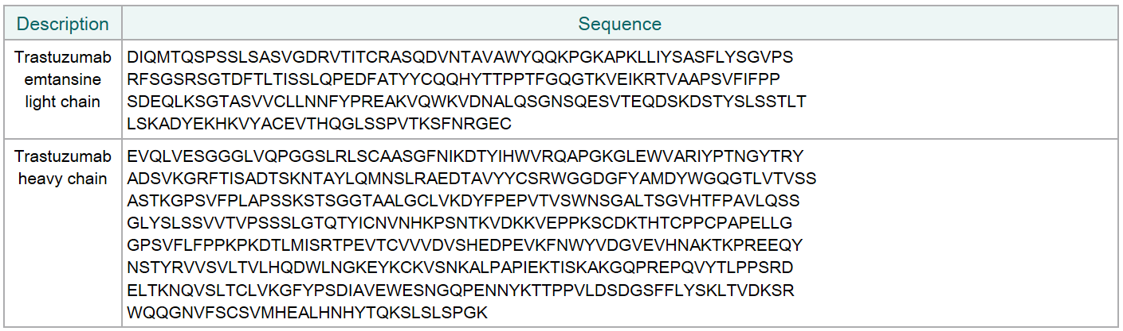
Trastuzumab emtansine (Kadcyla)
Her2 positive breast cancer drug. Antibody drug conjugate
Atoms and bond level give detail, but insights are not obvious
Mol formula C₆₄₄₈H₉₉₄₈N₁₇₂₀O₂₀₁₂S₄₄·(C₄₇H₆₂ClN₄O₁₃S)_{n}
Molar mass 148.5 kg/mol
Sequence conveys more information
Source - ChEMBL

Slide 18
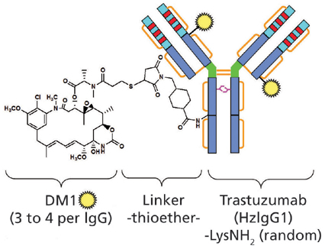
Schematics…
Very little detail about the structure – but there is relevant information

Slide 19
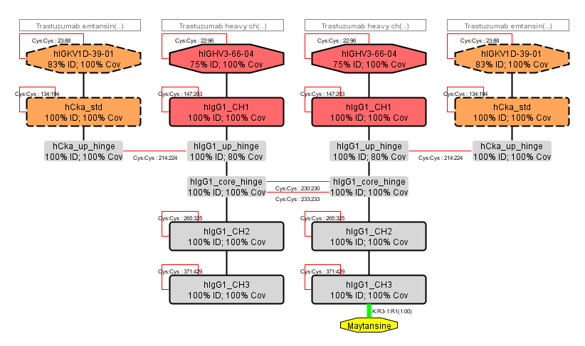
HELM Antibody Editor (HAbE)
Trastuzumab emtansine

Slide 20
Requirements
Able to handle ambiguity
Unlike small molecules, we often don’t know everything about the biomolecule we just made. However there will be information worth capturing.
Understood by all

Slide 21
Ambiguity - Kadcyla
The connection between the drug and antibody is not well understood (Marcoux et al. 2015). Lysine-linked, but where?
Each trastuzumab molecule may be linked to zero to eight DM1 molecules (3.5 on average)
Glycosylation is present and not well understood

Slide 22
Ambiguity abounds
There are many examples where our knowledge is incomplete.
There may be regions of the molecule where we don’t know which monomers are present.
We might know the sections of the molecule, but we don’t know where they are connected.
There may be a mixture but we don’t know exactly the proportions.
There may be two alternative compounds, but we don’t know which, but we do know (or can guess) the probability of each.
There may be Nanoparticle bonded entities:
Ambiguity is not something we handle well in either small or large molecule representation.

Slide 23
Requirements
Able to handle entity ambiguity
Unlike small molecules, we often don’t know everything about the biomolecule we just made. However there will be information worth capturing.
Understood by all

Slide 24
Requirements
Able to handle entity ambiguity
Unlike small molecules, we often don’t know everything about the biomolecule we just made. However there will be information worth capturing.
Understood by all
Standards are important in preventing the conversion challenges that this group is very aware of.

Slide 25
Summary
Industry needs a solution as biologics are an established and important part of the industries products.
Notations are becoming available – HELM for example - and we need to prevent multiplication.
The large molecule group meets tomorrow and will discuss opportunities and what can be done.
Please come along!

Slide 26
Thank you
Claire.Bellamy@pistoiaalliance.org

Slide 27
Backup slides

