Slide 1

Representation of ambiguous biomolecules using the Enhanced Standard HELM 2.0
Dr. Markus Weisser, Co-Founder and Managing Director quattro research GmbH

Slide 2
Agenda
HELM and ambiguity in biological molecules
HELM and very large molecules
HELM and structure representation

Slide 3
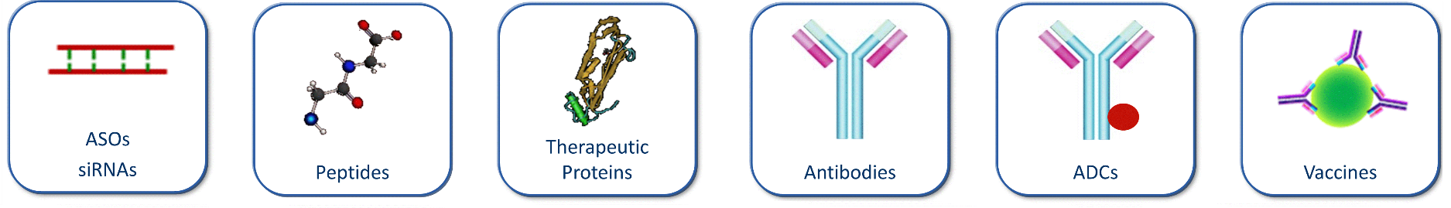
HELM and ambiguity in biological molecules
HELM is a line notation
that can encode the structure
of all biomolecules.

Slide 4
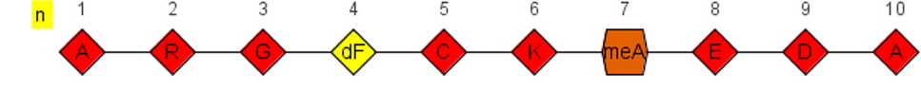
Syntax Elements
$ separate HELM sections ←polymers→$←connections→$←groupings→$←annotations→
. separate elements PEPTIDE1{A.R.G.G.C.A}
{}, [] and () are grouping characters
...
PEPTIDE1{A.R.G.[dF].C.K.[meA].E.D.A}$$$$

Slide 5
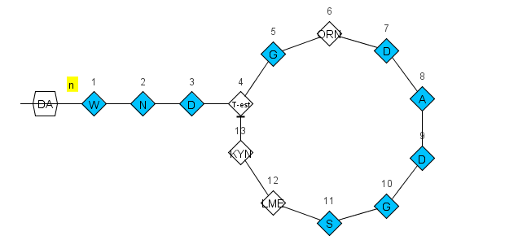
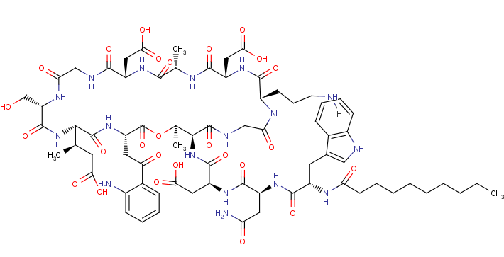
HELM Examples
Daptomycin
PEPTIDE1{W.N.D.[T-est].G.[OR].D.A.D.G.S.[LM].[KYN]}|CHEM1{DA}$
PEPTIDE1,PEPTIDE1,13:R2-4:R3|PEPTIDE1,CHEM1,1:R1-1:R1$$$

Slide 6
xHELM
Container format for HELM + monomer definitions
Use HELM across organizations
XHELM
HELM notation
Monomers

Slide 7
Mission completed?
?
?
?
?
?
?
Unknown numbers of repeating elements
Various connection points of ADCs
Unknown elements in sequences
Unknown connections between polymers
Undefined polymers
...

Slide 8
Ambiguity in HELM 2.0
Monomer ambiguity Unknown monomers in a polymer
Polymer ambiguity Sequence or polymer type is unknown
Connection ambiguity The details of the connections between polymers are unknown
Grouping ambiguity Unknown details of a grouping

Slide 9
Monomer Ambiguity
* | 0..n unknown monomers | PEPTIDE1{A.*.G.C}$$$$V2.0
X | Single unknown amino acid in a PEPTIDE | PEPTIDE1{A.X.G.C}$$$$V2.0
N | Single unknown base in a RNA | RNA1{R(A)P.R(N)P.R(C)P.R(C)P.R(C)}$$$$V2.0
( , ) | One of a list of monomer is possible | PEPTIDE1{A.(A:10,G:90).G.C}$$$$V2.0
( + ) | Mixture of monomers | PEPTIDE1{A.(A+G+C).G.C}$$$$V2.0
_ | Deleted or missing single monomer | PEPTIDE1{A.(A,_).G.C}$$$$V2.0
´ ´ | Repeating monomers | PEPTIDE1{A.G.A.C.A‘5-30‘}$$$$V2.0
?
A
G
C

Slide 10
Polymer Ambiguity
Sequence or polymer type is unknown
BLOB1{Bead}”Aminated Polystyrene”|PEPTIDE1{A.G.T}$$$$
A
G
T

Slide 11
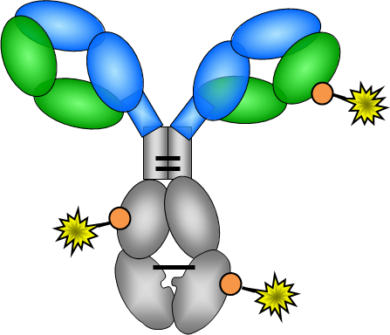
Connection Ambiguity
The details of the connections between polymers are unknown

Slide 12
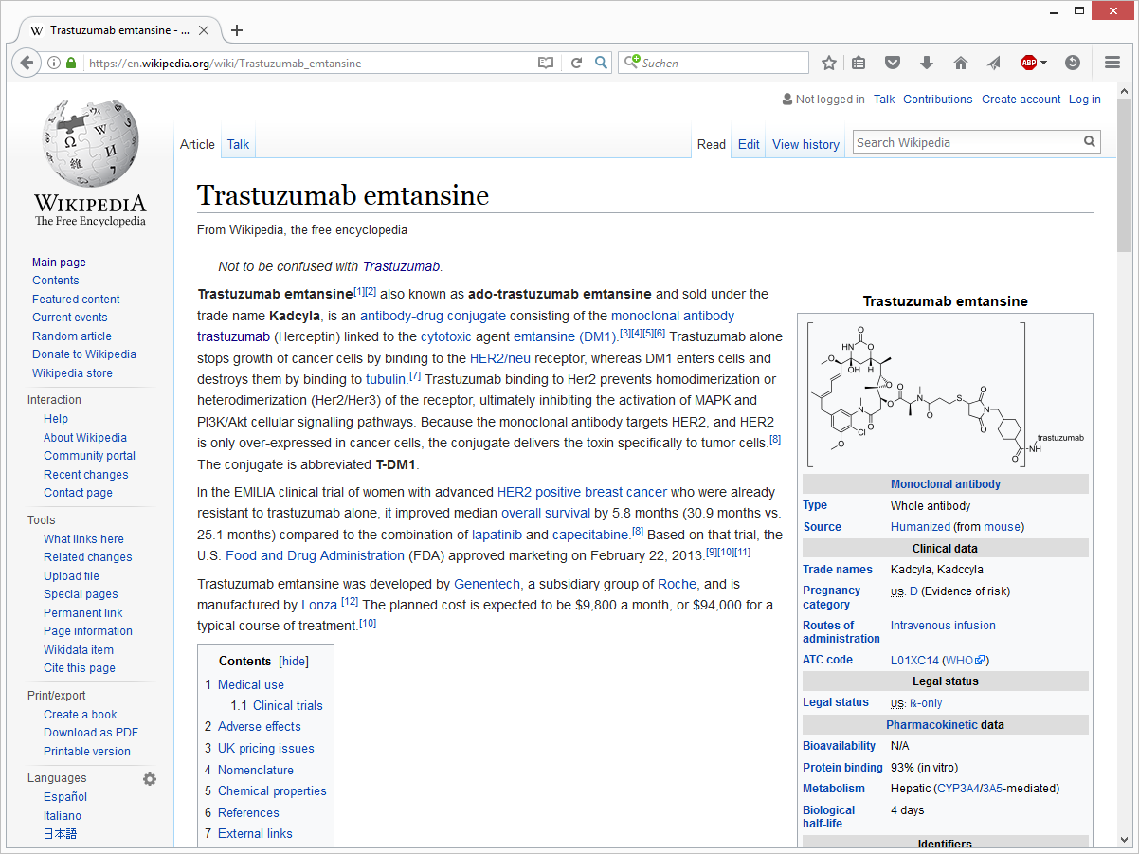
Example: Trastuzumab emtansine

Slide 13
Trastuzumab emtansine
Antibody drug concugate (ADC)
Trastuzumab (Herceptin): HER2 receptor positive
Emtansine (DM1): Cytotoxic agent
SMCC: Cross-linker between a Lysin and DM1
0 – 8 connections available
3.5 DM1/Trastuzumab on average

Slide 14
HELM notation of Trastuzumab emtansine
PEPTIDE1{D.I.Q.M.T.Q.S.P.S.S.L.S.A.S.V.G.D.R.V.T.I.T.C.R.A.S.Q.D.V.N.T.A.V.A.W.Y.Q.Q.K.P.G.K.A.P.K.L.L.I.Y.S.A.S.F.L.Y.S.G.V.P.S.R.F.S.G.S.R.S.G.T.D.F.T.L.T.I.S.S.L.Q.P.E.D.F.A.T.Y.Y.C.Q.Q.H.Y.T.T.P.P.T.F.G.Q.G.T.K.V.E.I.K.R.T.V.A.A.P.S.V.F.I.F.P.P.S.D.E.Q.L.K.S.G.T.A.S.V.V.C.L.L.N.N.F.Y.P.R.E.A.K.V.Q.W.K.V.D.N.A.L.Q.S.G.N.S.Q.E.S.V.T.E.Q.D.S.K.D.S.T.Y.S.L.S.S.T.L.T.L.S.K.A.D.Y.E.K.H.K.V.Y.A.C.E.V.T.H.Q.G.L.S.S.P.V.T.K.S.F.N.R.G.E.C}|PEPTIDE2{E.V.Q.L.V.E.S.G.G.G.L.V.Q.P.G.G.S.L.R.L.S.C.A.A.S.G.F.N.I.K.D.T.Y.I.H.W.V.R.Q.A.P.G.K.G.L.E.W.V.A.R.I.Y.P.T.N.G.Y.T.R.Y.A.D.S.V.K.G.R.F.T.I.S.A.D.T.S.K.N.T.A.Y.L.Q.M.N.S.L.R.A.E.D.T.A.V.Y.Y.C.S.R.W.G.G.D.G.F.Y.A.M.D.Y.W.G.Q.G.T.L.V.T.V.S.S.A.S.T.K.G.P.S.V.F.P.L.A.P.S.S.K.S.T.S.G.G.T.A.A.L.G.C.L.V.K.D.Y.F.P.E.P.V.T.V.S.W.N.S.G.A.L.T.S.G.V.H.T.F.P.A.V.L.Q.S.S.G.L.Y.S.L.S.S.V.V.T.V.P.S.S.S.L.G.T.Q.T.Y.I.C.N.V.N.H.K.P.S.N.T.K.V.D.K.K.V.E.P.P.K.S.C.D.K.T.H.T.C.P.P.C.P.A.P.E.L.L.G.G.P.S.V.F.L.F.P.P.K.P.K.D.T.L.M.I.S.R.T.P.E.V.T.C.V.V.V.D.V.S.H.E.D.P.E.V.K.F.N.W.Y.V.D.G.V.E.V.H.N.A.K.T.K.P.R.E.E.Q.Y.N.S.T.Y.R.V.V.S.V.L.T.V.L.H.Q.D.W.L.N.G.K.E.Y.K.C.K.V.S.N.K.A.L.P.A.P.I.E.K.T.I.S.K.A.K.G.Q.P.R.E.P.Q.V.Y.T.L.P.P.S.R.D.E.L.T.K.N.Q.V.S.L.T.C.L.V.K.G.F.Y.P.S.D.I.A.V.E.W.E.S.N.G.Q.P.E.N.N.Y.K.T.T.P.P.V.L.D.S.D.G.S.F.F.L.Y.S.K.L.T.V.D.K.S.R.W.Q.Q.G.N.V.F.S.C.S.V.M.H.E.A.L.H.N.H.Y.T.Q.K.S.L.S.L.S.P.G.K}|PEPTIDE3{E.V.Q.L.V.E.S.G.G.G.L.V.Q.P.G.G.S.L.R.L.S.C.A.A.S.G.F.N.I.K.D.T.Y.I.H.W.V.R.Q.A.P.G.K.G.L.E.W.V.A.R.I.Y.P.T.N.G.Y.T.R.Y.A.D.S.V.K.G.R.F.T.I.S.A.D.T.S.K.N.T.A.Y.L.Q.M.N.S.L.R.A.E.D.T.A.V.Y.Y.C.S.R.W.G.G.D.G.F.Y.A.M.D.Y.W.G.Q.G.T.L.V.T.V.S.S.A.S.T.K.G.P.S.V.F.P.L.A.P.S.S.K.S.T.S.G.G.T.A.A.L.G.C.L.V.K.D.Y.F.P.E.P.V.T.V.S.W.N.S.G.A.L.T.S.G.V.H.T.F.P.A.V.L.Q.S.S.G.L.Y.S.L.S.S.V.V.T.V.P.S.S.S.L.G.T.Q.T.Y.I.C.N.V.N.H.K.P.S.N.T.K.V.D.K.K.V.E.P.P.K.S.C.D.K.T.H.T.C.P.P.C.P.A.P.E.L.L.G.G.P.S.V.F.L.F.P.P.K.P.K.D.T.L.M.I.S.R.T.P.E.V.T.C.V.V.V.D.V.S.H.E.D.P.E.V.K.F.N.W.Y.V.D.G.V.E.V.H.N.A.K.T.K.P.R.E.E.Q.Y.N.S.T.Y.R.V.V.S.V.L.T.V.L.H.Q.D.W.L.N.G.K.E.Y.K.C.K.V.S.N.K.A.L.P.A.P.I.E.K.T.I.S.K.A.K.G.Q.P.R.E.P.Q.V.Y.T.L.P.P.S.R.D.E.L.T.K.N.Q.V.S.L.T.C.L.V.K.G.F.Y.P.S.D.I.A.V.E.W.E.S.N.G.Q.P.E.N.N.Y.K.T.T.P.P.V.L.D.S.D.G.S.F.F.L.Y.S.K.L.T.V.D.K.S.R.W.Q.Q.G.N.V.F.S.C.S.V.M.H.E.A.L.H.N.H.Y.T.Q.K.S.L.S.L.S.P.G.K}|PEPTIDE4{D.I.Q.M.T.Q.S.P.S.S.L.S.A.S.V.G.D.R.V.T.I.T.C.R.A.S.Q.D.V.N.T.A.V.A.W.Y.Q.Q.K.P.G.K.A.P.K.L.L.I.Y.S.A.S.F.L.Y.S.G.V.P.S.R.F.S.G.S.R.S.G.T.D.F.T.L.T.I.S.S.L.Q.P.E.D.F.A.T.Y.Y.C.Q.Q.H.Y.T.T.P.P.T.F.G.Q.G.T.K.V.E.I.K.R.T.V.A.A.P.S.V.F.I.F.P.P.S.D.E.Q.L.K.S.G.T.A.S.V.V.C.L.L.N.N.F.Y.P.R.E.A.K.V.Q.W.K.V.D.N.A.L.Q.S.G.N.S.Q.E.S.V.T.E.Q.D.S.K.D.S.T.Y.S.L.S.S.T.L.T.L.S.K.A.D.Y.E.K.H.K.V.Y.A.C.E.V.T.H.Q.G.L.S.S.P.V.T.K.S.F.N.R.G.E.C}|CHEM1{[SMCC]}|CHEM2{[DM1]}$CHEM1,CHEM2,1:R2-1:R1|PEPTIDE1,PEPTIDE1,23:R3-88:R3|PEPTIDE2,PEPTIDE2,371:R3-429:R3|PEPTIDE4,PEPTIDE4,134:R3-194:R3|PEPTIDE1,PEPTIDE1,134:R3-194:R3|PEPTIDE3,PEPTIDE3,265:R3-325:R3|PEPTIDE3,PEPTIDE4,224:R3-214:R3|PEPTIDE2,PEPTIDE3,233:R3-233:R3|PEPTIDE2,PEPTIDE2,265:R3-325:R3|PEPTIDE2,PEPTIDE2,147:R3-203:R3|PEPTIDE2,PEPTIDE3,230:R3-230:R3|PEPTIDE2,PEPTIDE1,224:R3-214:R3|PEPTIDE3,PEPTIDE3,147:R3-203:R3|PEPTIDE2,PEPTIDE2,22:R3-96:R3|PEPTIDE3,PEPTIDE3,22:R3-96:R3|PEPTIDE3,PEPTIDE3,371:R3-429:R3|PEPTIDE4,PEPTIDE4,23:R3-88:R3|G1,CHEM1,K:R3-1:R1$G1(PEPTIDE1+PEPTIDE2+PEPTIDE3+PEPTIDE4)|G2(CHEM1:3.5+G1:1)$$V2.0

Slide 15
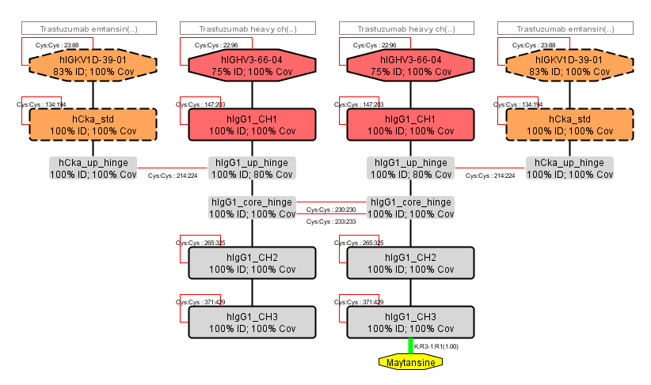
HELM Antibody Editor (HAbE)

Slide 16
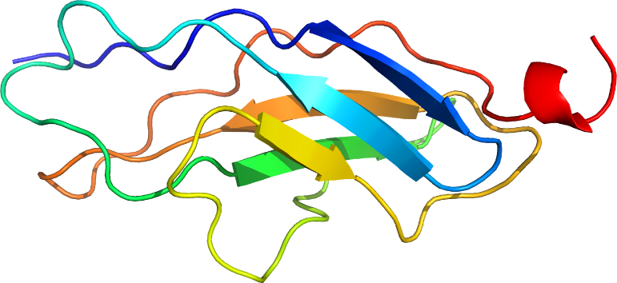
HELM and very large molecules
Example: Connectin (Titin)
Human muscle protein out of 34.350 amino acids
=> 540.000 atoms
Creation and validation of HELM notation from FASTA in < 1 s

Slide 17
HELM and structure representations
Monomer definitons in MOL format and SMILES (with atom maps)
HELM toolkit can create SMILES code from HELM
Limitations
No large molecules
No ambiguity
No SMILES/MOL/InChI to HELM conversion up to now
RDKit (peptide with standard amino acids)

Slide 18
HELM Challenges
Standardized key für large biological molecules
Unlimited number of atoms/elements
Canonicalized
Ambiguity support
Accepted by public databases and authorities

Slide 19
Thank you!

