Slide 1

HELM: A line notation and software infrastructure for managing biopolymers
Jeff Milton,
Assistant Director, Antisense Drug Discovery
Ionis Pharmaceuticals
HELM Steering Committee, Pistoia Alliance

Slide 2
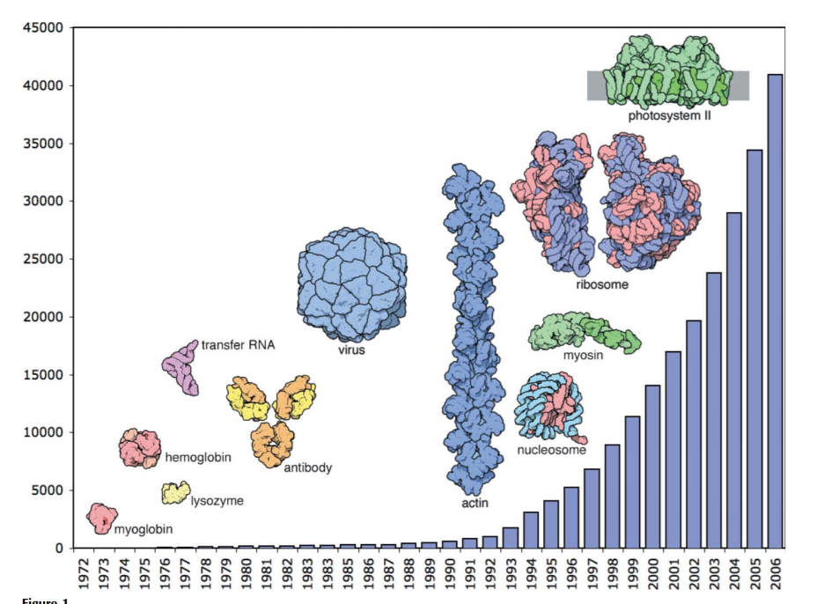
History → Protein Data Bank (pdb.org) has been dealing with this problem for a very long time

Slide 3
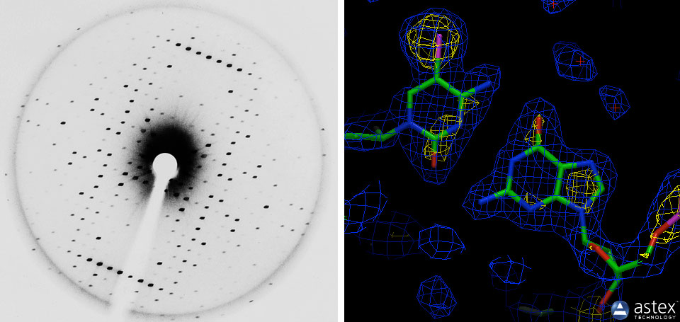
Electron density maps → structure
For biological molecules you often already have sequence information

Slide 4
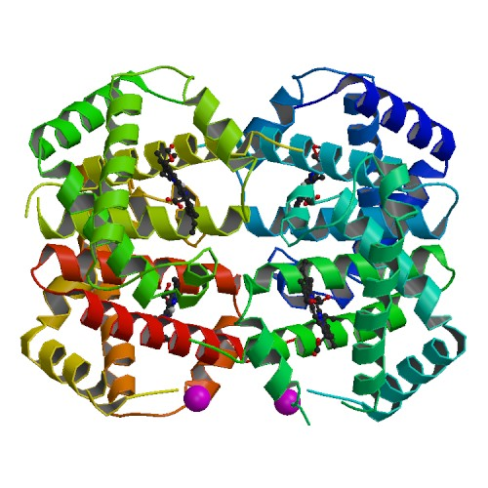

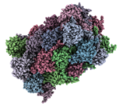
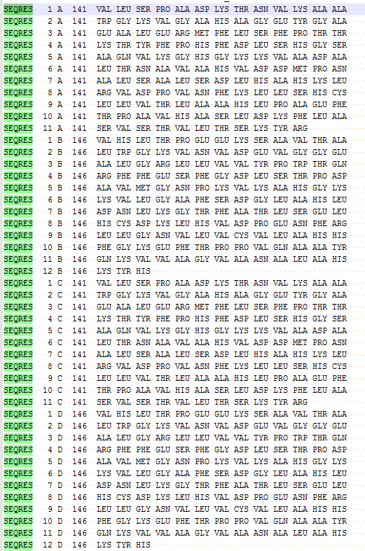
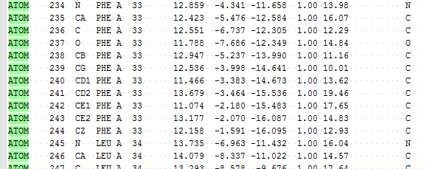
The tools we’ve used in the past:
PDB, (mm)CIF, PDBML…
Designed to capture both 3D atomic structure and sequence information

Slide 5
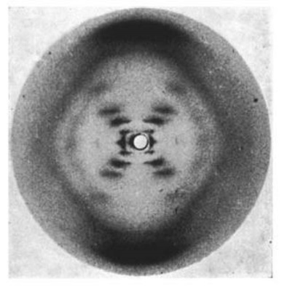
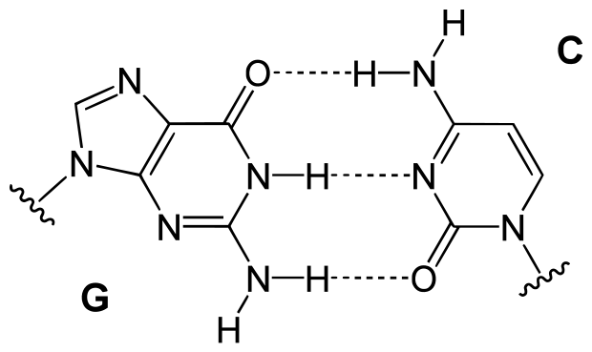
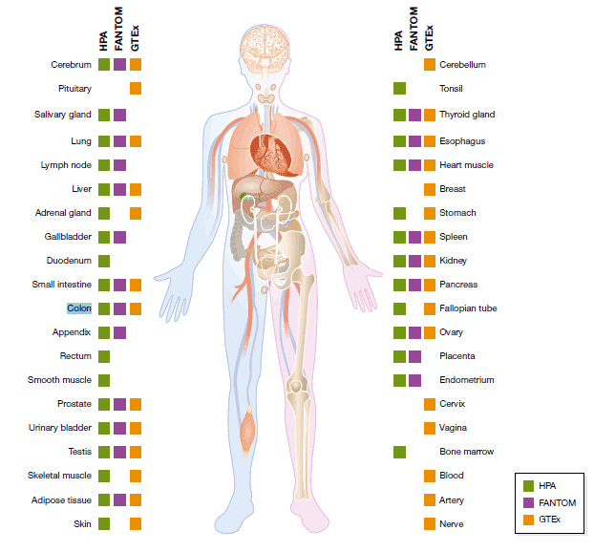
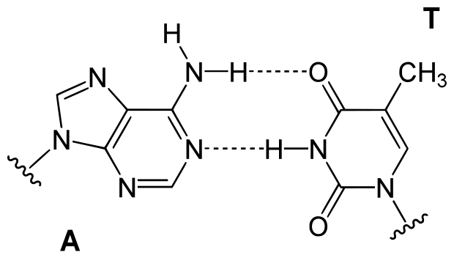
Chemistry → Function
Organs analyzed using RNA-seq by the Human Protein Atlas consortium

Slide 6
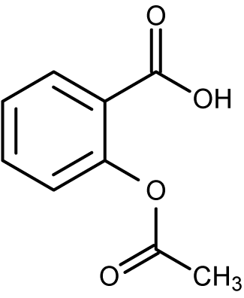
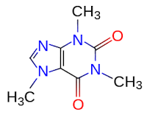
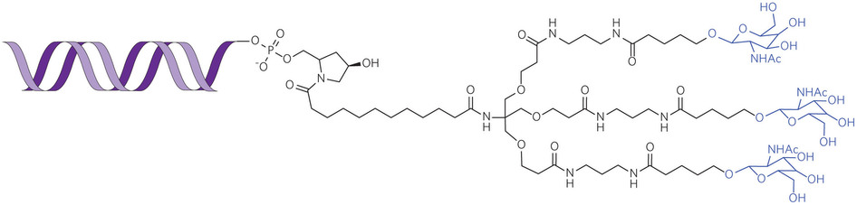
Chemistry → function
GalNAc–siRNA conjugates for better drug delivery
http://www.nature.com/nmat/journal/v12/n11/full/nmat3765.html

Slide 7
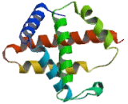
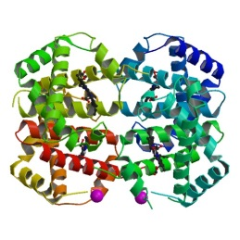

Primary
Secondary
Tertiary
Quaternary
VLSPADKTNVKAAWGKVGAHAGEYGAEALERMFLSFPTTKTYFPHFDLSHGSAQVKGHGKKVADALTNAVAHVDDMPNALSALSDLHAHKLRVDPVNFKLLSHCLLVTLAAHLPAEFTPAVHASLDKFLASVSTVLTSKYR…
Function

Slide 8
Primary
Secondary
Tertiary
Quaternary
VLSPADKTNVKAAWGKVGAHAGEYGAEALERMFLSFPTTKTYFPHFDLSHGSAQVKGHGKKVADALTNAVAHVDDMPNALSALSDLHAHKLRVDPVNFKLLSHCLLVTLAAHLPAEFTPAVHASLDKFLASVSTVLTSKYR…
Difficult to manage and often unnecessary
Function

Slide 9
Sequence → function
What about FASTA?
>4HHB:A|PDBID|CHAIN|SEQUENCE
VLSPADKTNVKAAWGKVGAHAGEYGAEALERMFLSFPTTKTYFPHFDLSHGSAQVKGHGKKVADALTNAVAHVDDMPNALSALSDLHAHKLRVDPVNFKLLSHCLLVTLAAHLPAEFTPAVHASLDKFLASVSTVLTSKYR

Slide 10
Sequence → function
Assumes sequence as ‘natural’ peptides or nucleotides
What about FASTA?
>4HHB:A|PDBID|CHAIN|SEQUENCE
VLSPADKTNVKAAWGKVGAHAGEYGAEALERMFLSFPTTKTYFPHFDLSHGSAQVKGHGKKVADALTNAVAHVDDMPNALSALSDLHAHKLRVDPVNFKLLSHCLLVTLAAHLPAEFTPAVHASLDKFLASVSTVLTSKYR

Slide 11
Engineering sequences changes everything:
Introducing the “Natural Analog”

Slide 12
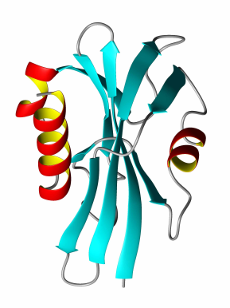

Biopolymers are stuck between small molecule tools and sequence-based tools
GAP
Small Molecule Tools
Sequence-Based Tools
Small Molecules
Sequences
Biomolecules

Slide 13

HELM: Hierarchical Editing Language for Macromolecules
2008 Pfizer created the Oligonucleotide Therapeutics Unit (“OTU”)
Sergio Rotstein, Director at Biotherapeutic and Bioinnovation Center Informatics recognized that the existing small-molecule database was inadequate
Tianhong led a team of chemists and computational scientists to develop the first iteration called PFRED
Pfizer decided to exit oligonucleotides
PFRED becomes Open-Source and the HELM project was started at the Pistoia Alliance
HELM: A Hierarchical Notation Language for Complex Biomolecule Structure Representation
Tianhong Zhang*, Hongli Li, Hualin Xi, Robert V. Stanton, and Sergio H. Rotstein
Pfizer Inc., 35 Cambridge Park Drive, Cambridge, Massachusetts 02140, United States
J. Chem. Inf. Model., 2012, 52 (10), pp 2796–2806
DOI: 10.1021/ci3001925

Slide 14
Pistoia Alliance
Claire Bellamy
Pfizer
Sergio Rotstein
Tianhong Zhang
Quattro Research
Bernhard Schirm
Markus Weisser
Sabrina Hecht
Roche & Genentech
Dennis Hansen
Stefan Klostermann
Novartis
Yohann Potier
Joann Roy
Sven Neumeyer
Bristol-Myers Squibb
Matthias Nolte
Scilligence
Tony (Yongwen) Yuan
ChemAxon
Roland Knispel
Merck
Thomas Gan
Biovia
Matt Hahn
Fred Bost
Ionis Pharmaceuticals
Jeff Milton
Eric Swayze
Many others..
HELM Steering Committee

Slide 15
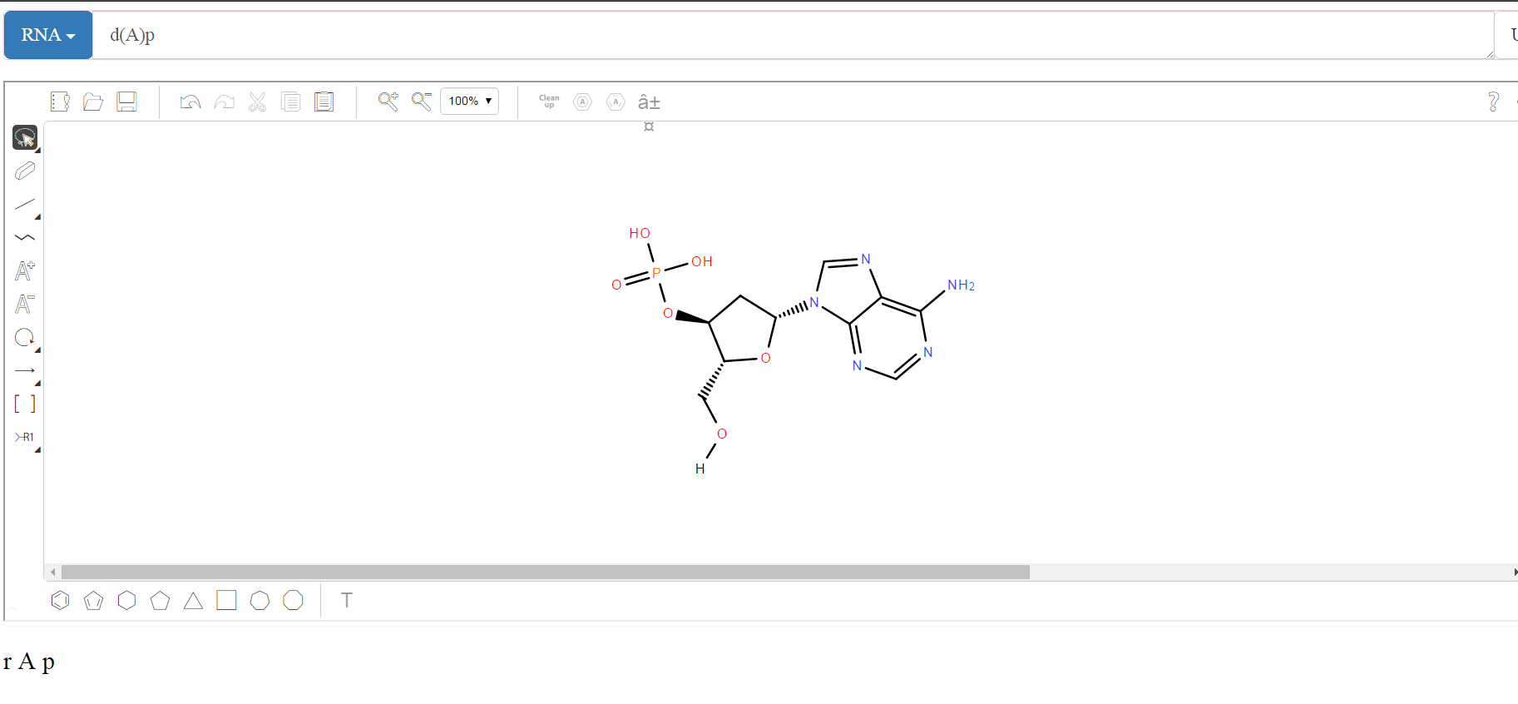
Demo: Building biopolymers one monomer at a time
HELM
Chemical Structure
Biological Sequence

Slide 16
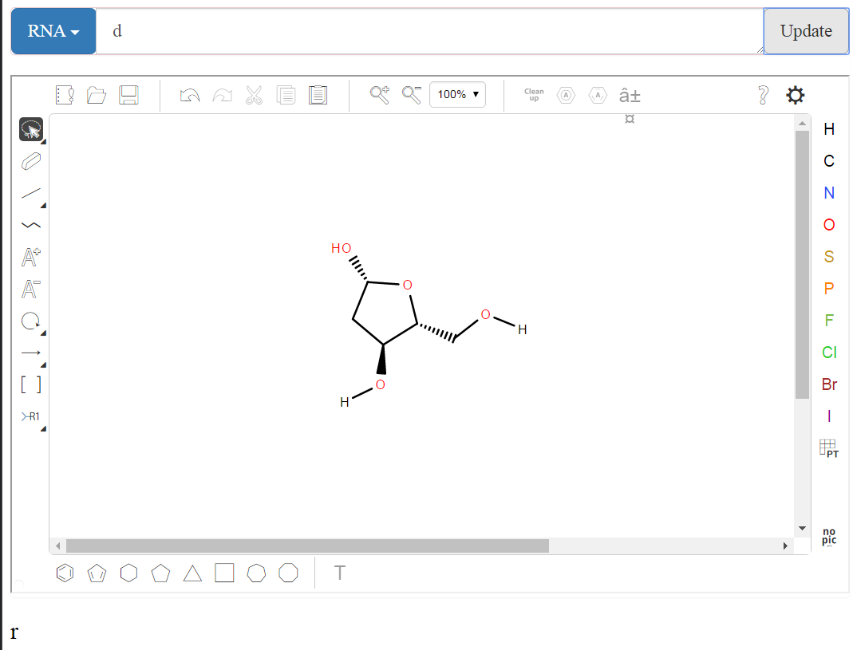

Slide 17
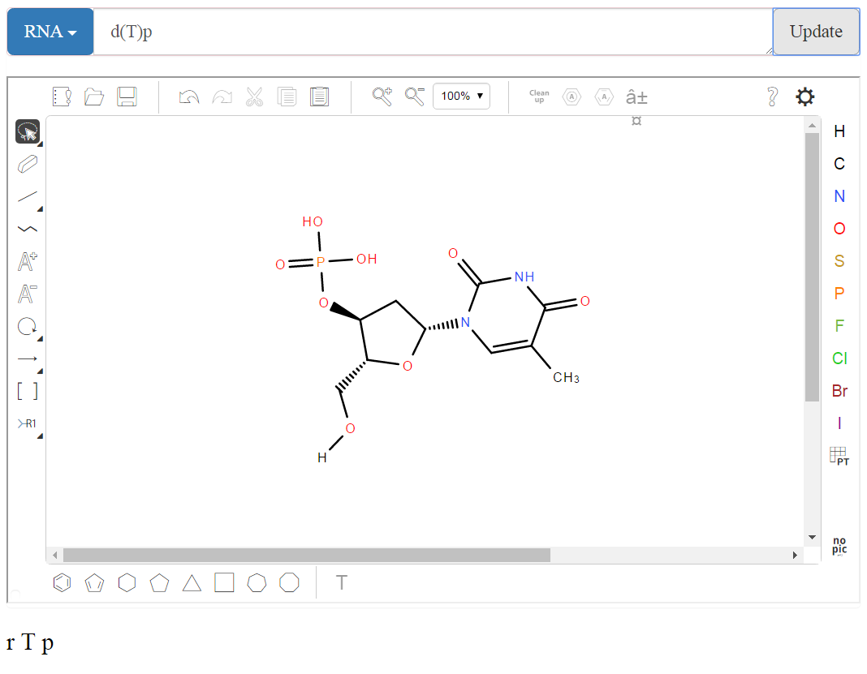

Slide 18
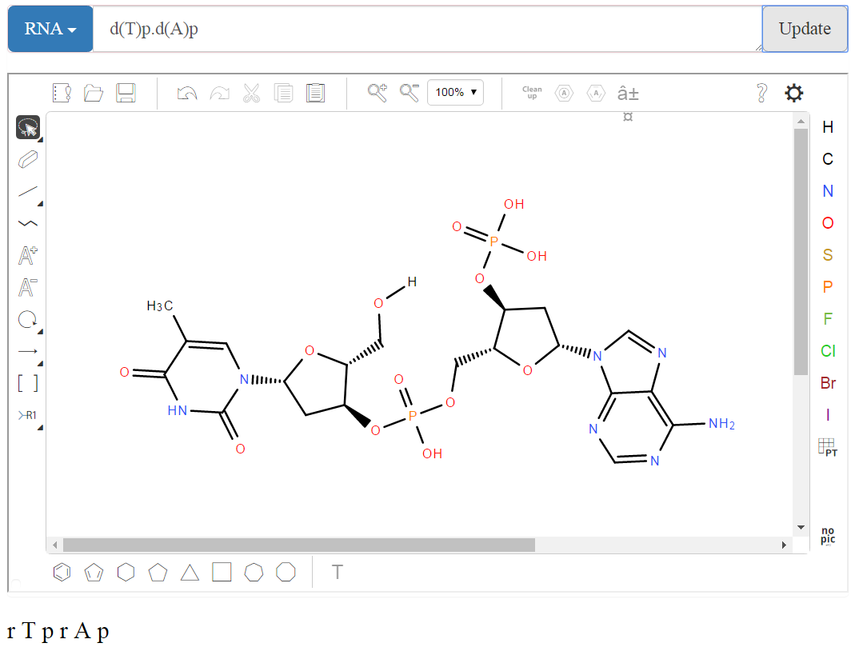

Slide 19
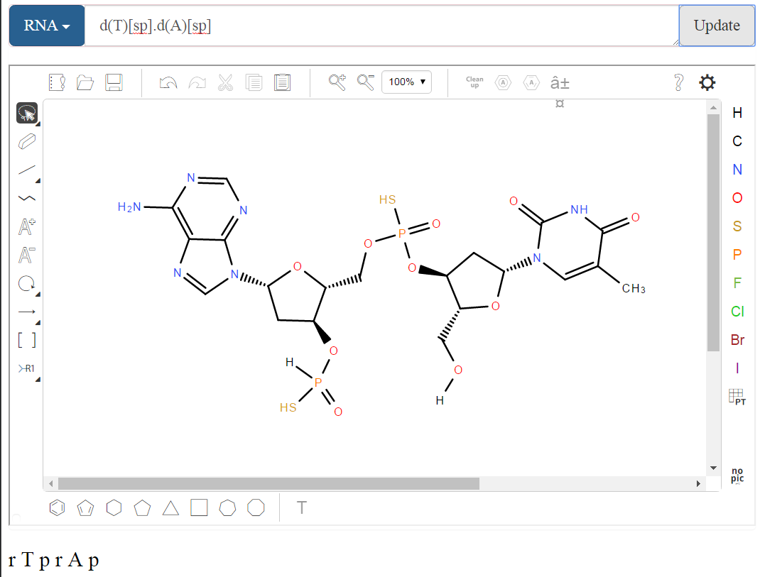

Slide 20
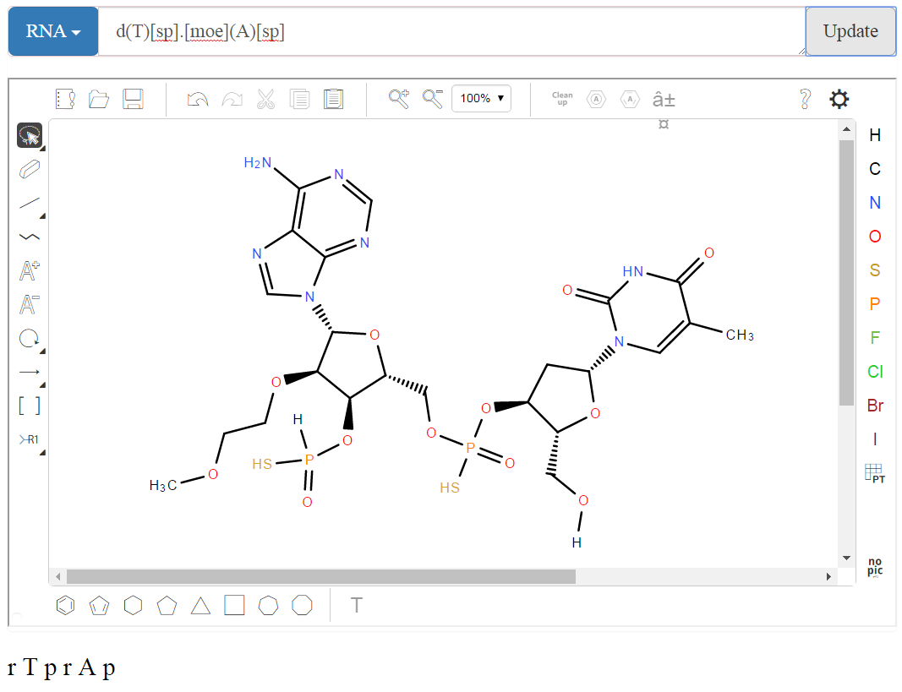

Slide 21
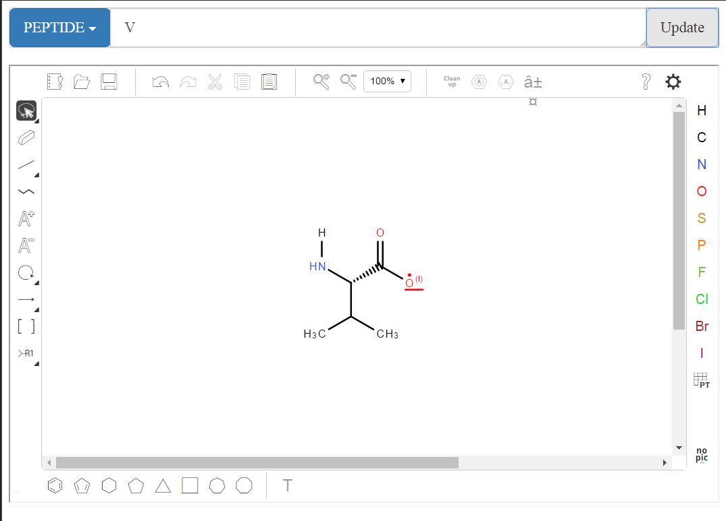

Slide 22
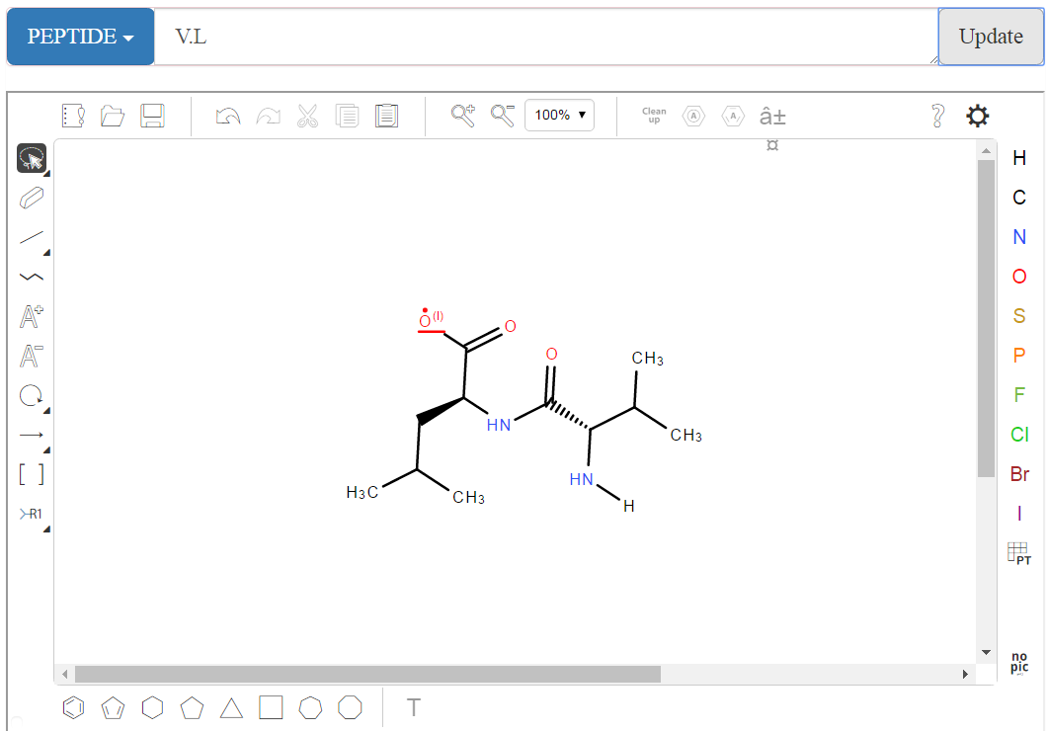

Slide 23
Hierarchical Editing Language for Macromolecules
Hierarchical
Biomolecules are “multi-level polymers”
Extensible
Allows addition of new polymer types
E.g. Polysaccharides
Able to handle entity complexity
Oligonucleotide hybridization
Chemically modified Biologics
Unnatural amino acids
Bioconjugates
Portable
Able to resolve cross-organization monomer library differences
Able to handle entity ambiguity
When not everything is known about molecular composition or arrangement

Slide 24
Hierarchical Editing Language for Macromolecules
Hierarchical
Biomolecules are “multi-level polymers”
Complex Polymer
Simple Polymer
Monomer
Atom

Slide 25
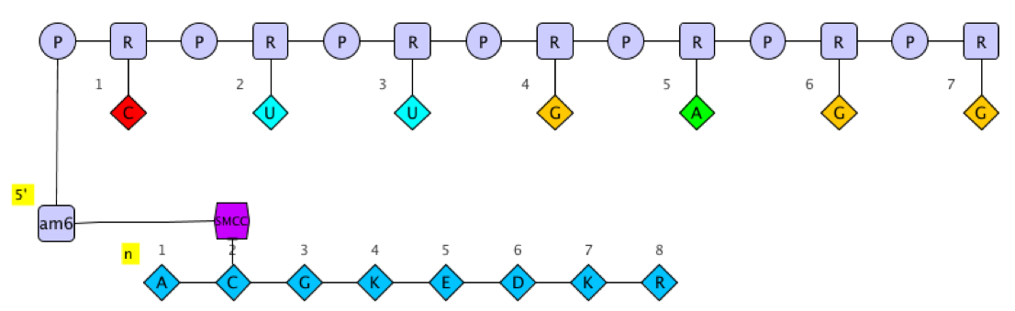
Hierarchical Editing Language for Macromolecules
Hierarchical
Biomolecules are “multi-level polymers”
Complex Polymer
Simple Polymer
Monomer
Atom

Slide 26
Hierarchical Editing Language for Macromolecules
Hierarchical
Biomolecules are “multi-level polymers”
Complex Polymer
Simple Polymer
Monomer
Atom

Slide 27
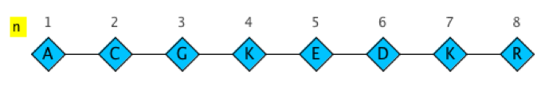
Hierarchical Editing Language for Macromolecules
Hierarchical
Biomolecules are “multi-level polymers”
Complex Polymer
Simple Polymer
Monomer
Atom

Slide 28
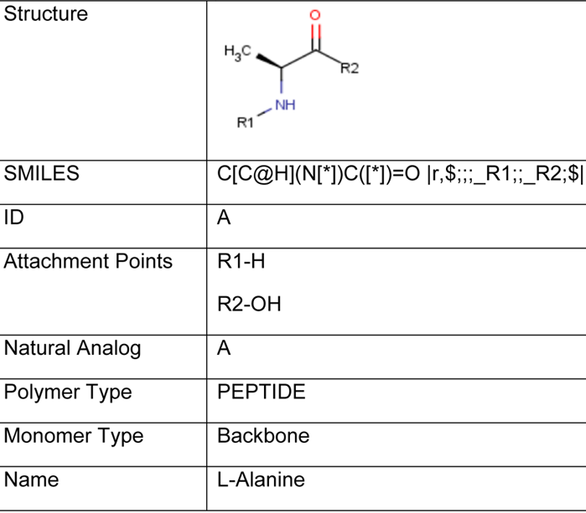

Hierarchical Editing Language for Macromolecules
Hierarchical
Biomolecules are “multi-level polymers”
Complex Polymer
Simple Polymer
Monomer
Atom

Slide 29
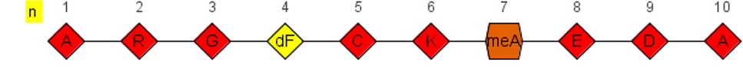
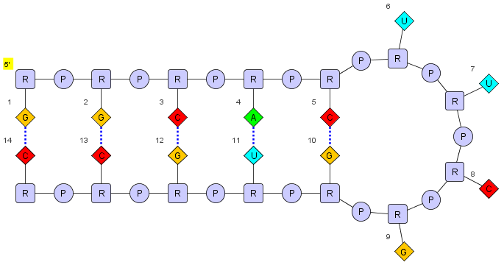
HELM notation
PEPTIDE1{A.R.G.[dF].C.K.[meA].E.D.A}$$$$
HELM notation
RNA1{R(G)P.R(G)P.R(C)P.R(A)P.R(C)P.R(U)P.R(U)P.R(C)P.R(G)P.R(G)P.R(U)P.R(G)P.R(C)P.R(C)}$$RNA1,RNA1,11:pair-32:pair|RNA1,RNA1,5:pair-38:pair|RNA1,RNA1,14:pair-29:pair|RNA1,RNA1,8:pair-35:pair|RNA1,RNA1,2:pair-41:pair$$

Slide 30
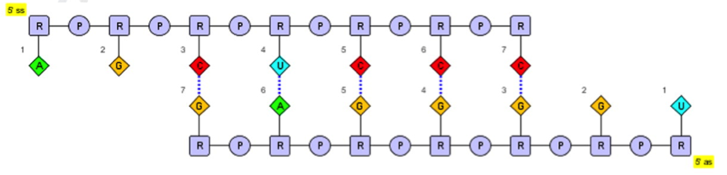
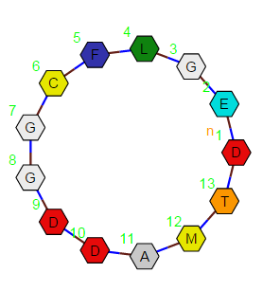
RNA1{r(A)p.r(G)p.r(C)p.r(U)p . . . }|RNA2{r(U)p.r(G)p.r(G)p.r(G)p . . . } $RNA1,RNA2,20:pair-8:pair|RNA1,RNA2,17:pair-11:pair|RNA1,RNA2,8:pair-20:pair|RNA1,RNA2,14:pair-14:pair|RNA1,RNA2,11:pair-17:pair$$$
PEPTIDE1{D.E.G.L.F.C.G.G.D.D.A.M.T}$PEPTIDE1,PEPTIDE1,1:R1-13:R2$$$

Slide 31
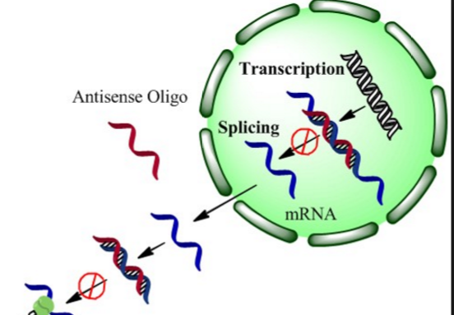
Oligonucleotide Drug Design
Intent is a rational approach to modulating a gene by leveraging Watson-Crick base pairing
Sequence is primary means of determining the mechanism of action
Protein

Slide 32
Some problems with ASO’s as a therapeutic
Sequence specificity
Oligonucleotide stability
Cell uptake
Binding affinity

Slide 33
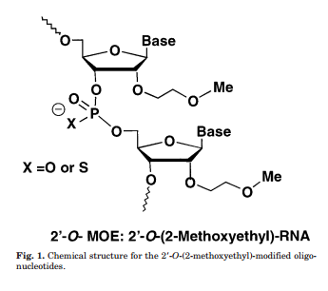
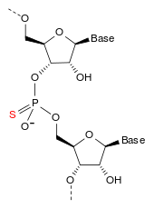
Solution
Modify the chemical units (Monomers) so they maintain specificity and affinity while enhancing stability and uptake.
Sequence is…
GCCTCAGTCTGCTTCGCACC
Bennett, C.F.; Swayze, E.E. (2010). "RNA targeting therapeutics: molecular mechanisms of antisense oligonucleotides as a therapeutic platform". Annu. Rev. Pharmacol. Toxicol. 50: 259–293. J Pharmacol Exp Ther. 2001 Mar;296(3):890-7.
Pharmacokinetic properties of 2'-O-(2-methoxyethyl)-modified oligonucleotide analogs in rats.
Geary RS1, Watanabe TA, Truong L, Freier S, Lesnik EA, Sioufi NB, Sasmor H, Manoharan M, Levin AA.

Slide 34
Mipomersen
(IUPAC) name
2'-O-(2-methoxyethyl)-P-thioguanylyl-(3'→5')-2'-O-(2-methoxyethyl)-5-methyl-P-thiocytidylyl-(3'→5')-2'-O-(2-methoxyethyl)-5-methyl-P-thiocytidylyl-(3'→5')-2'-O-(2-methoxyethyl)-5-methyl-P-thiouridylyl-(3'→5')-2'-O-(2-methoxyethyl)-5-methyl-P-thiocytidylyl-(3'→5')-2'-deoxy-P-thioadenylyl-(3'→5')-2'-deoxy-Pthioguanylyl-(3'→5')P-thiothymidylyl-(3'→5')-2'-deoxy-5-methyl-P-thiocytidylyl-(3'→5')-P-thiothymidylyl-(3'→5')-2'-deoxy-P-thioguanylyl-(3'→5')-2'-deoxy-5-methyl-P-thiocytidylyl-(3'→5')-P-thiothymidylyl-(3'→5')-P-thiothymidylyl-(3'→5')-2'-deoxy-5-methyl-P-thiocytidylyl-(3'→5')-2'-O-(2-methoxyethyl)-Pthioguanylyl-(3'→5')-2'-O-(2-methoxyethyl)-5-methyl-P-thiocytidylyl-(3'→5')-2'-O-(2-methoxyethyl)-P-thioadenylyl-(3'→5')-2'-O-(2-methoxyethyl)-5-methyl-P-thiocytidylyl-(3'→5')-2'-O-(2-methoxyethyl)-5-methylcytidine nonadecasodiumsalt

Slide 35
Mipomersen
HELM
RNA1{[moe](G)[sp].[moe]([m5C])[sp].[moe]([m5C])[sp].[moe](T)[sp].[moe]([m5C])[sp].d(A)[sp].d(G)[sp].d(T)[sp].d([m5C])[sp].d(T)[sp].d(G)[sp].d([m5C])[sp].d(T)[sp].d(T)[sp].d([m5C])[sp].[moe](G)[sp].[moe]([m5C])[sp].[moe](A)[sp].[moe]([m5C])[sp].[moe]([m5C])}$$$$V2.0

Slide 36
Nusinersen
RNA1{[moe](T)[sp].[moe]([m5C])[sp].[moe](A)[sp].[moe]([m5C])[sp].[moe](T)[sp].[moe](T)[sp].[moe](T)[sp].[moe]([m5C])[sp].[moe](A)[sp].[moe](T)[sp].[moe](A)[sp].[moe](A)[sp].[moe](T)[sp].[moe](G)[sp].[moe]([m5C])[sp].[moe](T)[sp].[moe](G)[sp].[moe](G)}$$$$
HELM can export to full atom-level representation

Slide 37
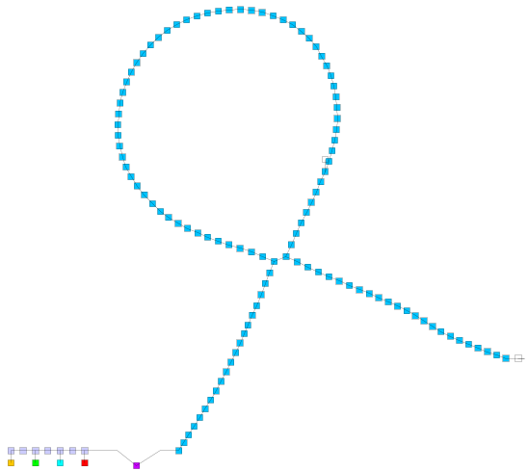
HELM 2.0 - Ambiguity
All known information can be captured alongside careful identification of what is not known.
Maybe
HELM 2.0 allows you to define what you do know and specify what you don’t
You don’t know exactly where the drug is connected to the antibody
Or which monomer has been attached at a particular position
Or your peptide is attached to a bead of unknown composition.

Slide 38



Slide 39
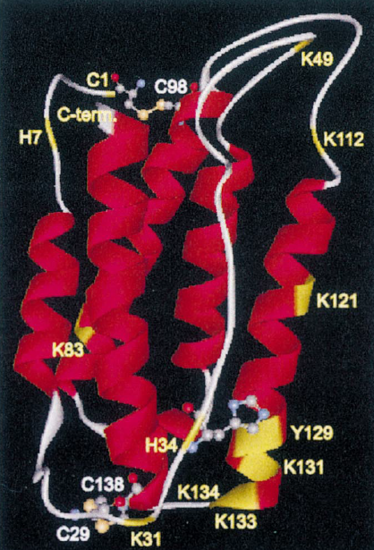
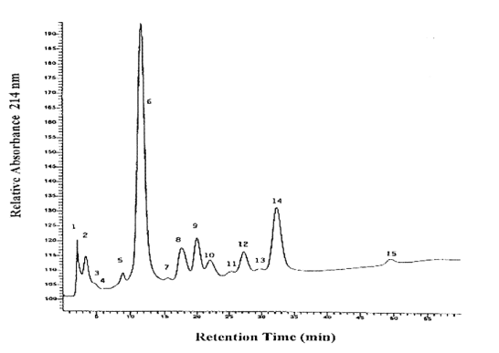
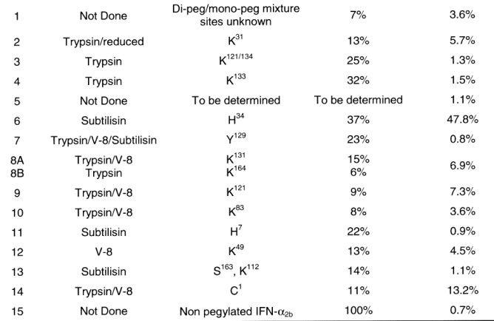
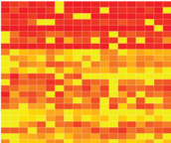
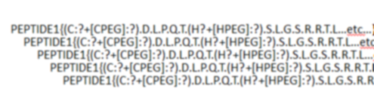
PEG isomers of IFN-a protein in PEG Intron
SAR for improved pharmacokinetic and pharmacodynamic properties
Synthesis yields a predominantly mono-pegylated product
Pegylation can occur at any of the numerous nucleophilic sites
Ion-exchange chromatography to determining positional isomers
PEPTIDE1{C.D.L.P.Q.T.H.S.L.G.S.R.R.T.L…etc…}$$$V2.0
PEPTIDE1{(C:?+[CPEG]:?).D.L.P.Q.T.(H?+[HPEG]:?).S.L.G.S.R.R.T.L…etc…}$$$V2.0
PEPTIDE1{(C+[CPEG]:11).D.L.P.Q.T.(H+[HPEG]:22).S.L.G.S.R.R.T.L…etc…}$$$V2.0
PEPTIDE1{(C:?+[CPEG]:?).D.L.P.Q.T.(H?+[HPEG
PEPTIDE1{(C:?+[CPEG]:?).D.L.P.Q.T.(H?+[HPEG
PEPTIDE1{(C:?+[CPEG]:?).D.L.P.Q.T.(H?+[HPEG
e.g. In Vivo SAR
PEPTIDE1{(C:?+[CPEG]:?).D.L.P.Q.T.(H?+[HPEG
PEPTIDE1{(C:?+[CPEG]:?).D.L.P.Q.T.(H?+[HPEG
PEPTIDE1{(C:?+[CPEG]:?).D.L.P.Q.T.(H?+[HPEG
PEPTIDE1{(C:?+[CPEG]:?).D.L.P.Q.T.(H?+[HPEG
PEPTIDE1{(C:?+[CPEG]:?).D.L.P.Q.T.(H?+[HPEG
PEPTIDE1{(C:?+[CPEG]:?).D.L.P.Q.T.(H?+[HPEG
Compact way to show polymer structure vs activity etc.

Slide 40
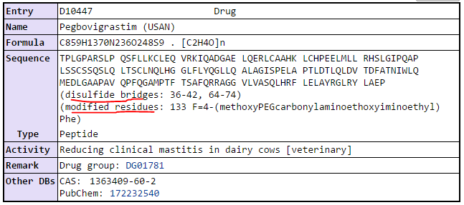

Neulasta® (pegfilgrastim)‎

Slide 41

Defibrotide
Defibrotide chemistry
Defibrotide is a mixture of 90% single-stranded phosphodiester oligonucleotides (length, 9-80mer; average, 50mer; average molecular mass, 16.5 ± 2.5 KDa) and 10% double stranded phosphodiester oligonucleotides derived from the controlled depolymerization of porcine intestinal mucosal DNA. That is, generally speaking, a heparin-like situation. Inside this mixture of oligonucleotides, aptamers (GGTTGGATTGGTTGG and GGTTGGATCGGTTGG) able to inhibit thrombin were discovered (Bracht and Schror, 1994). Later in a study carried out to discover inside defibrotide cathepsin G inhibiting aptamers the following consensus sequences were found: GGN_{1–7}GGN_{8–14}GGN_{1–6}GGN_{1–7}GGN_{1–6}GG,GGN_{10–13}GGN_{1–5}GGN_{1–5}GGN_{3–6}GGN_{2–7}GG and the sequenceGGGTTGAGGGTGGATTACGCCACGT-GGAGCTCGGATCCACACATCCAGG,wherein N represents nucleotides and the figures represent the number of possible nucleotides at that site. More recently a second study, aimed at finding effective inhibitors of Cathepsin G, showed a recurrence of alternating TG repeats in the selected Cat G binders, adopting an extended conformation that grants maximal interaction with the highly charged protein surface (Gatto et al., 2008). Synthetic TG oligonucleotides of different length were tested to assess the dependence of Cat G binding on oligonucleotide length. (dT-dG)₆₀ and (dT-dG)₅₀ appeared to be more potent binders than (dT-dG)₄₀. Cat G recognition is poorer with 20–30 mer oligonucleotides (Gatto et al., 2008). All of the above is, generally speaking a heparin-like situation. Heparin is a mixture of chains of different length in which there are binding sites for the thrombin–antithrombin complex.
mixture of 90% single-stranded phosphodiester oligonucleotides

Slide 42
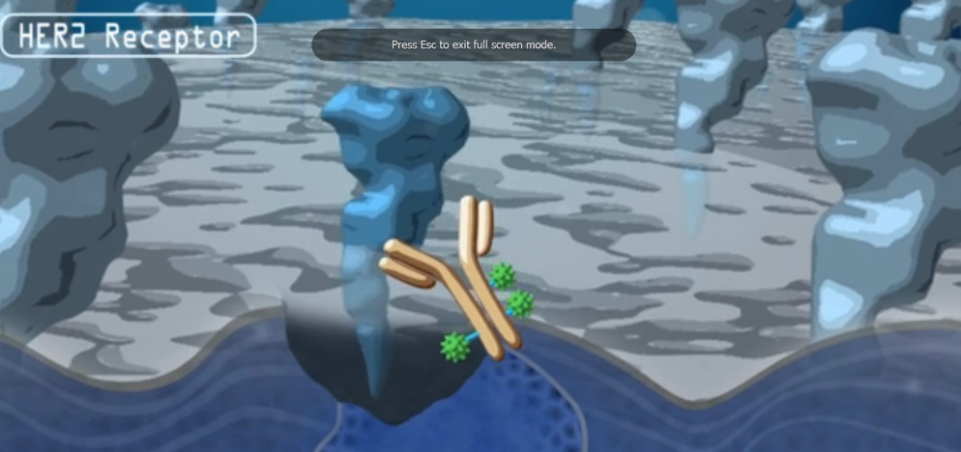
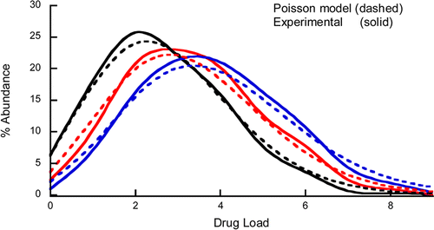
Trastuzumab with Emtansine
Target average drug to antibody ratio (DAR) of 3.5
Statistical Modeling of the Drug Load Distribution on Trastuzumab Emtansine (Kadcyla), a Lysine-Linked Antibody Drug Conjugate
Michael T. Kim*†, Yan Chen†, Joseph Marhoul‡, and Fred Jacobson†
†Departments of Protein Analytical Chemistry and ‡Biostatistics Genentech, Inc, South San Francisco, California 94080 United States
Bioconjugate Chem., 2014, 25 (7), pp 1223–1232

Slide 43
Ambiguity of the semi-specific conjugate locus
PEPTIDE1{...light_chain_sequence...}|PEPTIDE2{...heavy_chain_sequence..}|PEPTIDE3{...light_chain_sequence....}|PEPTIDE4{..heavy_chain_sequence...}|CHEM1{[MCC]}$PEPTIDE1,PEPTIDE1,134:R3-194:R3|PEPTIDE2,PEPTIDE3,229:R3-229:R3|PEPTIDE4,PEPTIDE4,134:R3-194:R3|PEPTIDE1,PEPTIDE1,23:R3-88:R3|PEPTIDE3,PEPTIDE4,223:R3-214:R3|PEPTIDE3,PEPTIDE3,370:R3-428:R3|PEPTIDE2,PEPTIDE2,264:R3-324:R3|PEPTIDE3,PEPTIDE3,147:R3-203:R3|PEPTIDE4,PEPTIDE4,23:R3-88:R3|PEPTIDE2,PEPTIDE1,223:R3-214:R3|PEPTIDE2,PEPTIDE2,22:R3-96:R3|PEPTIDE3,PEPTIDE3,22:R3-96:R3|PEPTIDE2,PEPTIDE2,147:R3-203:R3|PEPTIDE2,PEPTIDE2,370:R3-428:R3|PEPTIDE3,PEPTIDE3,264:R3-324:R3|PEPTIDE2,PEPTIDE3,232:R3-232:R3$G1(PEPTIDE1+PEPTIDE2+PEPTIDE3+PEPTIDE4)|G2(CHEM1+G1:3.4)$$V2.0
In this example two groups, G1 and G2, are defined at the end of the HELM string:
….G1(PEPTIDE1+PEPTIDE2+PEPTIDE3+PEPTIDE4)|G2(CHEM1+G1:3.4)$$V2.0

Slide 44
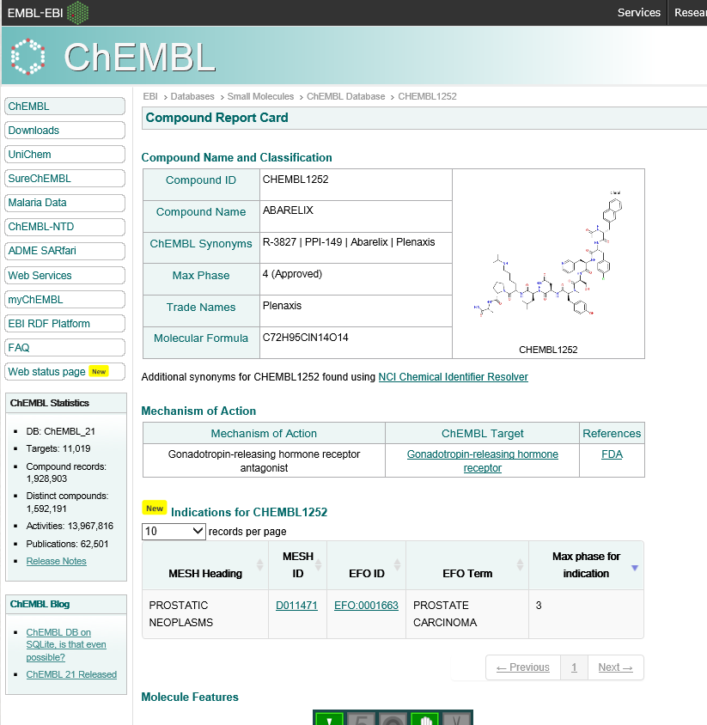
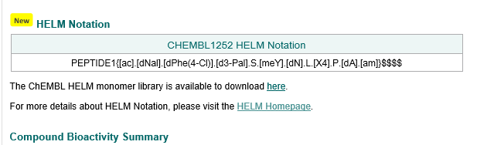
HELM at EBI: ChEMBL
ChEMBL20 onwards has HELM structures for 19K structures
As part of this work the EBI have created a monomer database of ~2800 structures

Slide 45
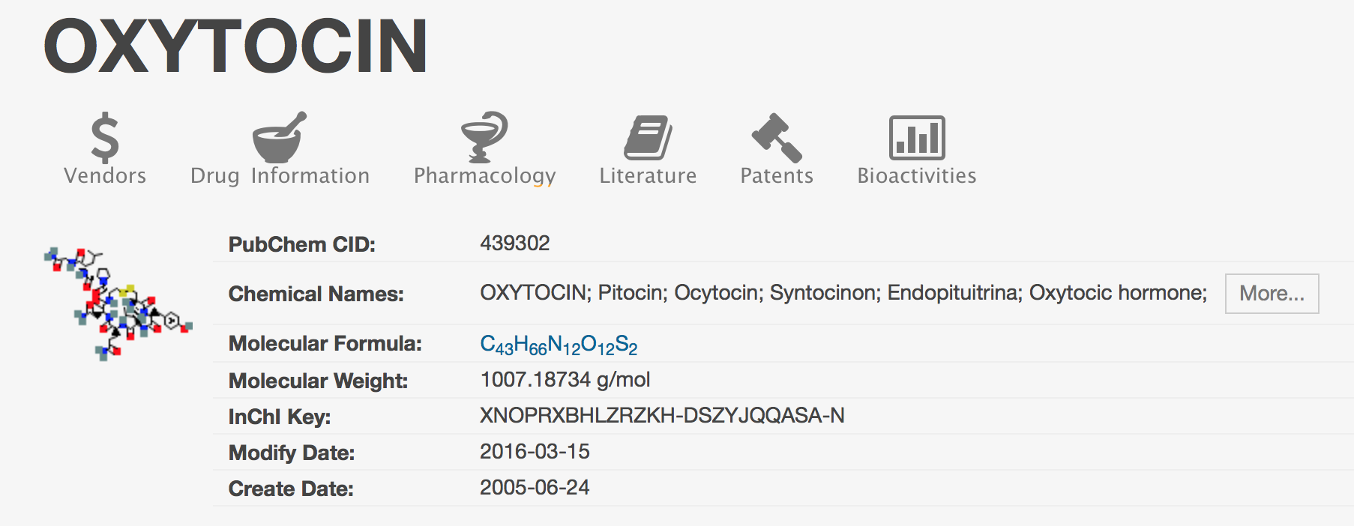
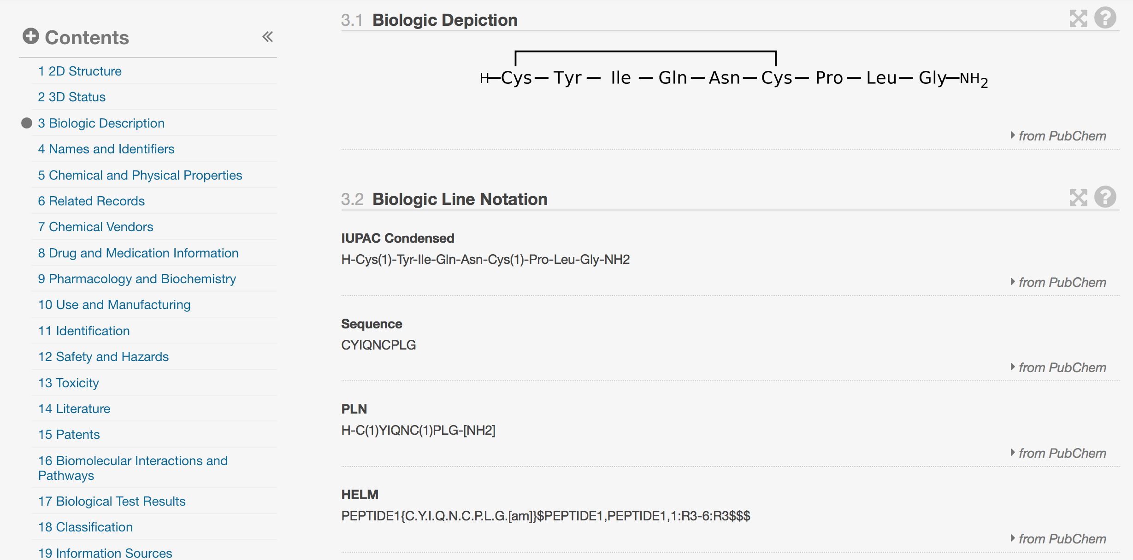
HELM at NCBI: PubChem
PubChem has recently added HELM notation

Slide 46
HELM will soon be the global format
FDA :
Recognition by the FDA that it is an acceptable submission format that is included in their guidance. ISO 11238: Health Informatics - Identification of medicinal products
ChEMBL 20 takes the HELM: European Bioinformatics Institute
EMBL-EBI has released version 20 of ChEMBL, the database of compound bioactivity data and drug targets. ChEMBL now incorporates the Hierarchical Editing Language for Macromolecules (HELM), the macromolecular representation standard recently released by the Pistoia Alliance….
ChemDraw v17: Perkin-Elmer currently developing a HELM implementation to be released later this year.

Slide 47
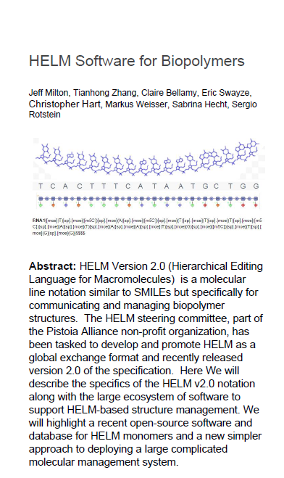

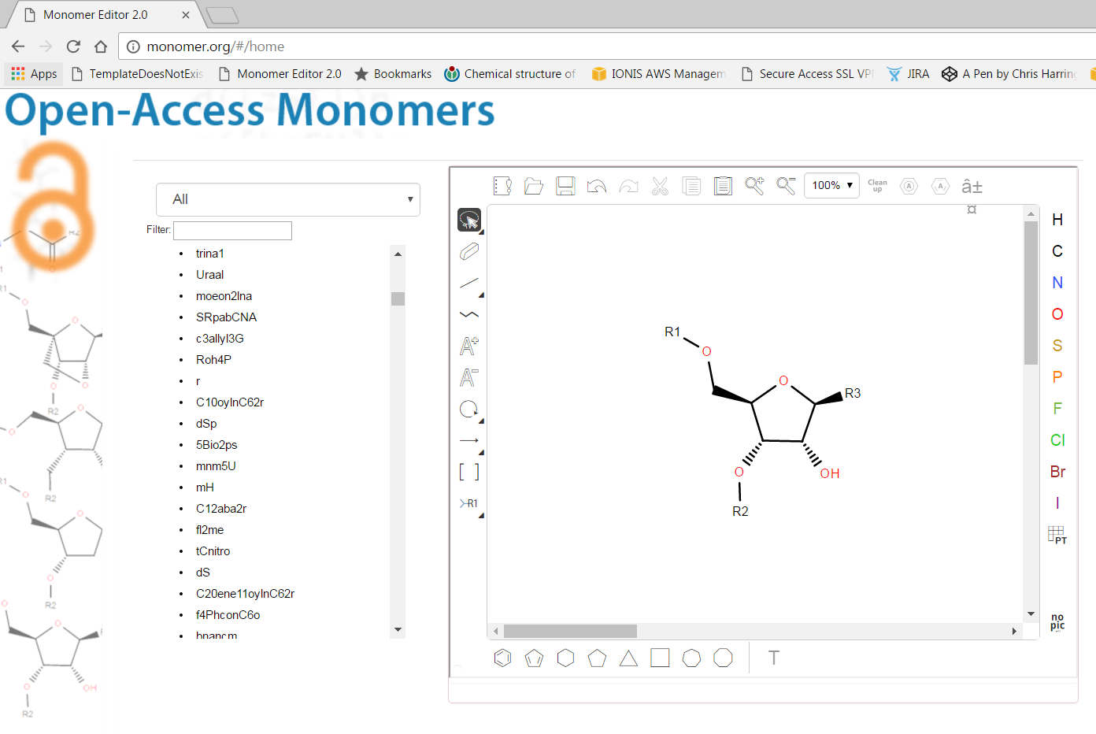
Open-Source software & Open-Access Monomers
monomer.org
Accepted, ACS CI

Slide 48
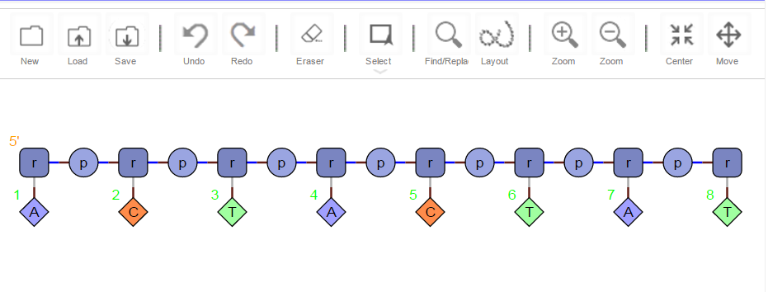
Example of how we might utilize monomer.org
Rosetta stone for communicating complex chemistries
monomer.org
IDT
ionis.monomer.org
pfizer.monomer.org
idt.monomer.org
ebi.monomer.org
pdb.monomer.org
thermofisher.monomer.org
ThermoFisher
etc..
Where to put monomer.org
Available for synthesis by IDT

Slide 49
HELM2Toolkit
Iterate over polymers and monomers within a complex structure
ListOfSimplePolymers$ListOfConnections$ListOfSimplePolymerGroups$ExtendedAnnotations$
List<PolymerNotation> polymerNodes = helm2notation.getListOfPolymers(); for (PolymerNotation polymerNode : polymerNodes) { String polymerType = polymerNode.getPolymerID().getType(); if (polymerType.equals(Monomer.NUCLIEC_ACID_POLYMER_TYPE)) { List<MonomerNotation> monomers = polymerNode.getListMonomers(); ..etc…. } }

Slide 50
Code
HELM2Notation kadcyla_helm2_notation = helm2.getHELM2Notation();
List<GroupingNotation> groupings = kadcyla_helm2_notation.getListOfGroupings();
for ( GroupingNotation gn : groupings )
{
GroupingAmbiguity ambiguity = gn.getAmbiguity();
System.out.println( " Ambiguity = "+ gn.getAmbiguity().toHELM2() );
List<GroupingElement> grouping_element_list = ambiguity.getListOfElements(); for ( GroupingElement ge : grouping_element_list ) { HELMEntity entity = ge.getID(); String type = entity.getType ();
String id = entity.getId(); List<Double> value_list = ge.getValue(); for ( Double value : value_list ) { System.out.println ("\t"+ id + " Type:" + type + " Value:" + value );
…etc……
Ambiguity = PEPTIDE1+PEPTIDE2+PEPTIDE3+PEPTIDE4
PEPTIDE1 Type:PEPTIDE Value:1.0
PEPTIDE2 Type:PEPTIDE Value:1.0
PEPTIDE3 Type:PEPTIDE Value:1.0
PEPTIDE4 Type:PEPTIDE Value:1.0
Ambiguity = CHEM1+G1:3.5
CHEM1 Type:CHEM Value:1.0
G1 Type:G Value:3.5

Slide 51
Using annotations
RNA1{[moe](G)[sp].[moe]([m5C])[sp].[moe]([m5C])[sp].[moe](T)[sp].[moe]([m5C])[sp].[dr](A)[sp].[dr](G)[sp].[dr](T)[sp].[dr]([m5C])[sp].[dr](T)[sp].[dr](G)[sp].[dr]([m5C])[sp].[dr](T)[sp].[dr](T)[sp].[dr]([m5C])[sp].[moe](G)[sp].[moe]([m5C])[sp].[moe](A)[sp].[moe]([m5C])[sp].[moe]([m5C])[sp]}$$${“Approved Indication”:”Homozygous Familial Hypercholesterolemia (HoFH)”}$V2.0
List<AnnotationNotation> annotations = mipmersen_helm2_notation.getListOfAnnotations(); for( AnnotationNotation annotation : annotations ) { String annotation_value = annotation.getAnnotation(); System.out.println( " Annotation value : " + annotation_value ); }

Slide 52

Accessing Chemistry
Chemical formats: SMILES (extended) and mol files.

Slide 53
Acknowledgements
Eric Swayze, Ionis
Chris Hart, Ionis
Sergio Rotstein, Prizer
Tianhong Zhang, Pfizer
Sven Neumeyer, Novartis
Claire Bellamy, Pistoia Alliance
Markus Weisser, Quattro research
Roland Knispel, Chemaxon

