Slide 1
Pistoia Alliance and HELM
An open information standard for the molecular representation of Biologics
Alex Drijver, ChemAxon
Domain Lead – Sergio Rotstein, Pfizer

Slide 2
The Pistoia Mission…
Lower the barriers to innovation
by improving inter-operability of R&D business processes
through pre competitive collaboration

Slide 3

















































Pistoia Alliance Membership
Q2 2013
Board

Slide 4
Unmet need
„At present most pharma companies have no way of storing complete structural machine-readable information about the macromolecules they prepare or use in their research projects.”
HELM project charter / Dec. 2012

Slide 5
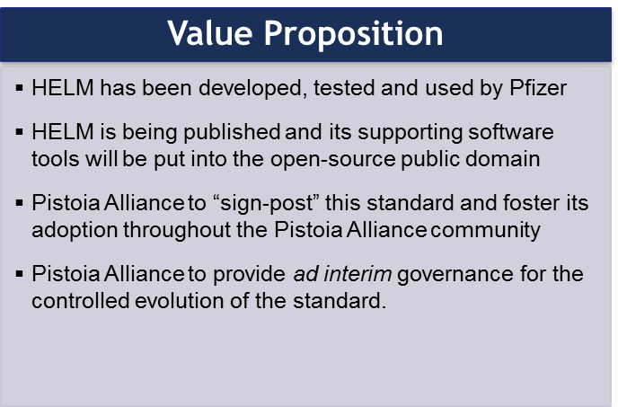
HELM
Business Case
Projected Shared Project Costs ~$125,000 [Project Coordinator, Governance, Promotion, Meeting]
Estimated value for the industry of implementing this project is ~$437m
Driven by productivity savings (e.g. fewer notation queries/resolutions from non-standard language)
Standard reference notation for macromolecules in pharma compound registration systems
The PA is the best-positioned, formally-established, x-company organization equipped to coordinate this kind of pre-competitive collaboration

Slide 6
Hierarchical Editing Language for Macromolecules
Macromolecules
Non-small molecules, Biologics
Editing Language
Notation system
Grammar and vocabulary
Hierarchy
Atom
Monomer
Simple Polymer
Complex Polymer

Slide 7
Structure hierarchy
Higher level components are a combination of lower level components
Complex polymer
Molecules described by a HELM notation consist of atoms and bonds
High
Simple polymer
Monomer
Low
Atom

Slide 8
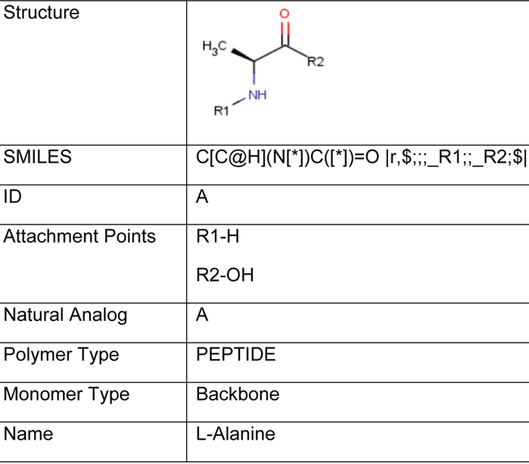
Structure hierarchy
Higher level components are a combination of lower level components
High
Complex polymer
Simple polymer
Monomer
Low
Atom

Slide 9
Structure hierarchy
Higher level components are a combination of lower level components
Complex polymer
Linear chains of Monomers or monomer units of a single biological molecule type (e.g. peptide chain, singular nucleic acid strand
High
Simple polymer
Type | Monomer (unit)
Peptide | A - Alanine
Nucleic acid | R(A)P R – Ribose A – Adenine P – Phosphate
Chem | [PEG3] – Pegylation
Monomer
Low
Atom

Slide 10
Structure hierarchy
Higher level components are a combination of lower level components
Complex polymer
Entire chemical structure information of the macromolecule
May include annotations per Simple polymer
High
Simple polymer
Monomer
Low
Atom

Slide 11
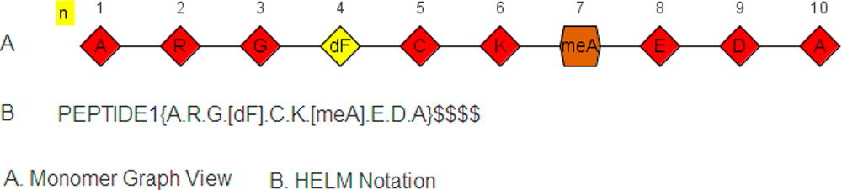
Example: Linear Peptide

Slide 12
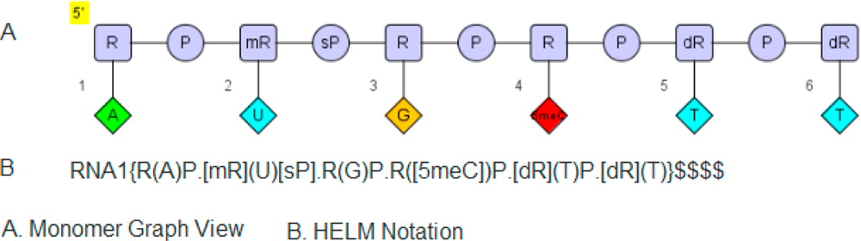
Example: Linear Oligonucleotide

Slide 13
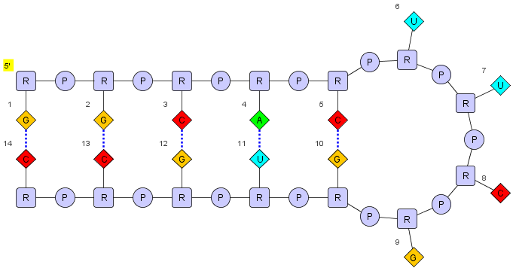
Example: Stem-loops (e.g. Tetraloops)
HELM notation:
RNA1{R(G)P.R(G)P.R(C)P.R(A)P.R(C)P.R(U)P.R(U)P.R(C)P.R(G)P.R(G)P.R(U)P.R(G)P.R(C)P.R(C)}$$RNA1,RNA1,11:pair-32:pair|RNA1,RNA1,5:pair-38:pair|RNA1,RNA1,14:pair-29:pair|RNA1,RNA1,8:pair-35:pair|RNA1,RNA1,2:pair-41:pair$$

Slide 14
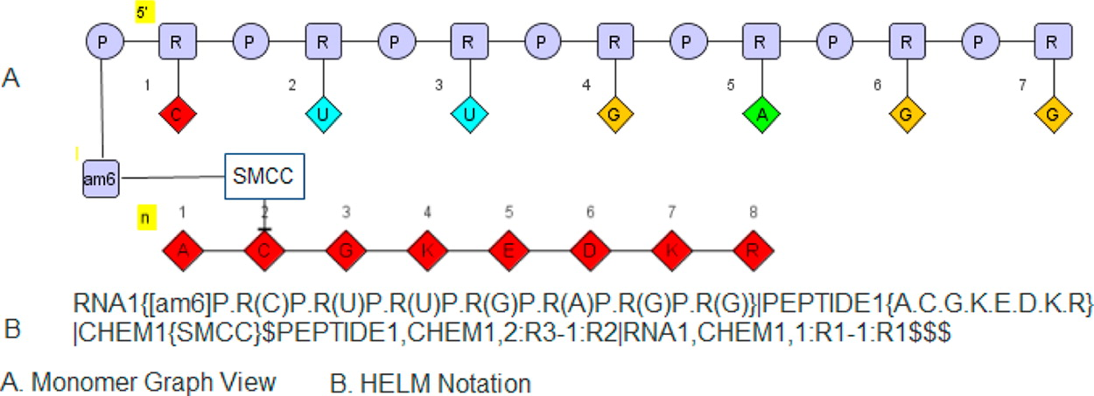
Example: Oligonucleotide Peptide Conjugate

Slide 15
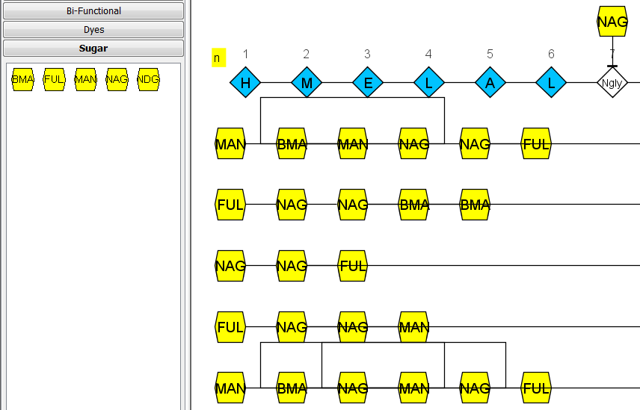
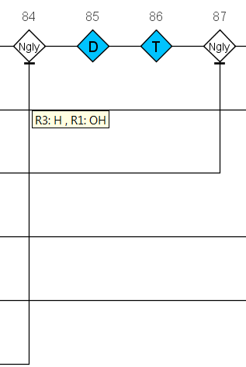
Example: Glycoprotein (PDB:3FUS)
H M E L
HELM notation:
CHEM1{BMA}|CHEM2{MAN}|CHEM3{MAN}|CHEM4{NAG}|CHEM5{FUL}|CHEM6{NAG}|CHEM7{NAG}|CHEM8{NAG}|CHEM9{FUL}|CHEM10{BMA}|CHEM11{BMA}|CHEM12{NAG}|CHEM13{NAG}|CHEM14{FUL}|CHEM15{NAG}|CHEM16{FUL}|CHEM17{NAG}|CHEM18{MAN}|CHEM19{BMA}|CHEM20{MAN}|CHEM21{MAN}|CHEM22{NAG}|CHEM23{NAG}|CHEM24{FUL}|CHEM25{MAN}|CHEM26{BMA}|CHEM27{NAG}|CHEM28{NAG}|PEPTIDE1{H.M.E.L.A.L.[Ngly].V.T.E.S.F.D.A.W.E.N.T.V.T.E.Q.A.I.E.D.V.W.Q.L.F.E.T.S.I.K.P.C.V.K.L.S.P.L.C.I.G.A.G.H.C.[Ngly].T.S.I.I.Q.E.S.C.D.K.H.Y.W.D.T.I.R.F.R.Y.C.A.P.P.G.Y.A.L.L.R.C.[Ngly].D.T.[Ngly].Y.S.G.F.M.P.K.C.S.K.V.V.V.S.S.C.T.R.M.M.E.T.Q.T.S.T.W.F.G.F.[Ngly].G.T.R.A.E.[Ngly].R.T.Y.I.Y.W.H.G.R.D.[Ngly].R.T.I.I.S.L.N.K.Y.Y.[Ngly].L.T.M.K.C.R.G.A.G.W.C.W.F.G.G.N.W.K.D.A.I.K.E.M.K.Q.T.I.V.K.H.P.R.Y.T.G.T.[Ngly].N.T.D.K.I.[Ngly].L.T.A.P.R.G.G.D.P.E.V.T.F.M.W.T.N.C.R.G.E.F.L.Y.C.K.M.N.W.F.L.N.W.V.E.D.R.D.V.T.N.Q.R.P.K.E.R.H.R.R.N.Y.V.P.C.H.I.R.Q.I.I.N.T.W.H.K.V.G.K.N.V.Y.L.P.P.R.E.G.D.L.T.C.[Ngly].S.T.V.T.S.L.I.A.N.I.D.W.T.D.G.[Ngly].Q.T.[Ngly].I.T.M.S.A.E.V.A.E.L.Y.R.L.E.L.G.D.Y.K.L.V.E.I.T}|CHEM29{NAG}|CHEM30{NAG}|CHEM31{BMA}|CHEM32{MAN}|CHEM33{MAN}|CHEM34{MAN}|CHEM35{NAG}|CHEM36{NAG}|CHEM37{BMA}|CHEM38{MAN}|CHEM39{BMA}|CHEM40{BMA}|CHEM41{MAN}|CHEM42{NAG}|CHEM43{NAG}|CHEM44{BMA}|CHEM45{NAG}|CHEM46{NAG}|CHEM47{FUL}|CHEM48{NDG}|CHEM49{NAG}|CHEM50{MAN}|CHEM51{BMA}|CHEM52{BMA}|CHEM53{NAG}|CHEM54{NDG}|CHEM55{FUL}$CHEM1,CHEM2,1:R2-1:R1|CHEM5,CHEM6,1:R1-1:R3|CHEM16,CHEM15,1:R1-1:R3|PEPTIDE1,CHEM30,52:R3-1:R1|PEPTIDE1,CHEM8,87:R3-1:R3|CHEM19,CHEM21,1:R3-1:R1|CHEM8,CHEM7,1:R1-1:R2|CHEM22,CHEM23,1:R1-1:R2|PEPTIDE1,CHEM28,292:R3-1:R1|PEPTIDE1,CHEM43,273:R3-1:R1|PEPTIDE1,CHEM46,146:R3-1:R1|PEPTIDE1,CHEM15,135:R3-1:R1|CHEM10,CHEM8,1:R1-1:R2|PEPTIDE1,CHEM36,289:R3-1:R1|CHEM51,CHEM50,1:R2-1:R1|CHEM39,CHEM41,1:R3-1:R1|PEPTIDE1,CHEM12,124:R3-1:R1|PEPTIDE1,CHEM29,7:R3-1:R1|CHEM39,CHEM38,1:R1-1:R2|CHEM20,CHEM19,1:R1-1:R2|CHEM17,CHEM15,1:R1-1:R2|CHEM12,CHEM13,1:R2-1:R1|CHEM46,CHEM47,1:R3-1:R1|CHEM32,CHEM31,1:R1-1:R3|CHEM52,CHEM51,1:R3-1:R1|PEPTIDE1,CHEM23,84:R3-1:R1|CHEM28,CHEM27,1:R2-1:R1|CHEM4,CHEM1,1:R2-1:R1|CHEM31,CHEM33,1:R2-1:R1|PEPTIDE1,CHEM54,190:R3-1:R1|CHEM34,CHEM33,1:R1-1:R2|CHEM18,CHEM17,1:R1-1:R2|CHEM31,CHEM35,1:R1-1:R2|CHEM9,CHEM7,1:R1-1:R3|CHEM26,CHEM27,1:R1-1:R2|CHEM54,CHEM53,1:R2-1:R1|CHEM6,CHEM4,1:R2-1:R1|CHEM1,CHEM3,1:R3-1:R1|CHEM25,CHEM26,1:R1-1:R2|CHEM54,CHEM55,1:R3-1:R1|CHEM43,CHEM42,1:R2-1:R1|CHEM40,CHEM37,1:R2-1:R1|CHEM46,CHEM45,1:R2-1:R1|CHEM12,CHEM14,1:R3-1:R1|CHEM42,CHEM40,1:R2-1:R1|PEPTIDE1,CHEM6,118:R3-1:R1|CHEM24,CHEM23,1:R1-1:R3|CHEM22,CHEM19,1:R2-1:R1|CHEM53,CHEM52,1:R2-1:R1|CHEM48,CHEM49,1:R2-1:R1|PEPTIDE1,CHEM48,184:R3-1:R1|CHEM45,CHEM44,1:R2-1:R1|CHEM37,CHEM38,1:R2-1:R1|CHEM11,CHEM10,1:R1-1:R2|CHEM36,CHEM35,1:R2-1:R1$$$

Slide 16
Example: Glycoprotein (PDB:3FUS)

H M E L
H E L M
HELM notation:
CHEM1{BMA}|CHEM2{MAN}|CHEM3{MAN}|CHEM4{NAG}|CHEM5{FUL}|CHEM6{NAG}|CHEM7{NAG}|CHEM8{NAG}|CHEM9{FUL}|CHEM10{BMA}|CHEM11{BMA}|CHEM12{NAG}|CHEM13{NAG}|CHEM14{FUL}|CHEM15{NAG}|CHEM16{FUL}|CHEM17{NAG}|CHEM18{MAN}|CHEM19{BMA}|CHEM20{MAN}|CHEM21{MAN}|CHEM22{NAG}|CHEM23{NAG}|CHEM24{FUL}|CHEM25{MAN}|CHEM26{BMA}|CHEM27{NAG}|CHEM28{NAG}|PEPTIDE1{H.M.E.L.A.L.[Ngly].V.T.E.S.F.D.A.W.E.N.T.V.T.E.Q.A.I.E.D.V.W.Q.L.F.E.T.S.I.K.P.C.V.K.L.S.P.L.C.I.G.A.G.H.C.[Ngly].T.S.I.I.Q.E.S.C.D.K.H.Y.W.D.T.I.R.F.R.Y.C.A.P.P.G.Y.A.L.L.R.C.[Ngly].D.T.[Ngly].Y.S.G.F.M.P.K.C.S.K.V.V.V.S.S.C.T.R.M.M.E.T.Q.T.S.T.W.F.G.F.[Ngly].G.T.R.A.E.[Ngly].R.T.Y.I.Y.W.H.G.R.D.[Ngly].R.T.I.I.S.L.N.K.Y.Y.[Ngly].L.T.M.K.C.R.G.A.G.W.C.W.F.G.G.N.W.K.D.A.I.K.E.M.K.Q.T.I.V.K.H.P.R.Y.T.G.T.[Ngly].N.T.D.K.I.[Ngly].L.T.A.P.R.G.G.D.P.E.V.T.F.M.W.T.N.C.R.G.E.F.L.Y.C.K.M.N.W.F.L.N.W.V.E.D.R.D.V.T.N.Q.R.P.K.E.R.H.R.R.N.Y.V.P.C.H.I.R.Q.I.I.N.T.W.H.K.V.G.K.N.V.Y.L.P.P.R.E.G.D.L.T.C.[Ngly].S.T.V.T.S.L.I.A.N.I.D.W.T.D.G.[Ngly].Q.T.[Ngly].I.T.M.S.A.E.V.A.E.L.Y.R.L.E.L.G.D.Y.K.L.V.E.I.T}|CHEM29{NAG}|CHEM30{NAG}|CHEM31{BMA}|CHEM32{MAN}|CHEM33{MAN}|CHEM34{MAN}|CHEM35{NAG}|CHEM36{NAG}|CHEM37{BMA}|CHEM38{MAN}|CHEM39{BMA}|CHEM40{BMA}|CHEM41{MAN}|CHEM42{NAG}|CHEM43{NAG}|CHEM44{BMA}|CHEM45{NAG}|CHEM46{NAG}|CHEM47{FUL}|CHEM48{NDG}|CHEM49{NAG}|CHEM50{MAN}|CHEM51{BMA}|CHEM52{BMA}|CHEM53{NAG}|CHEM54{NDG}|CHEM55{FUL}$CHEM1,CHEM2,1:R2-1:R1|CHEM5,CHEM6,1:R1-1:R3|CHEM16,CHEM15,1:R1-1:R3|PEPTIDE1,CHEM30,52:R3-1:R1|PEPTIDE1,CHEM8,87:R3-1:R3|CHEM19,CHEM21,1:R3-1:R1|CHEM8,CHEM7,1:R1-1:R2|CHEM22,CHEM23,1:R1-1:R2|PEPTIDE1,CHEM28,292:R3-1:R1|PEPTIDE1,CHEM43,273:R3-1:R1|PEPTIDE1,CHEM46,146:R3-1:R1|PEPTIDE1,CHEM15,135:R3-1:R1|CHEM10,CHEM8,1:R1-1:R2|PEPTIDE1,CHEM36,289:R3-1:R1|CHEM51,CHEM50,1:R2-1:R1|CHEM39,CHEM41,1:R3-1:R1|PEPTIDE1,CHEM12,124:R3-1:R1|PEPTIDE1,CHEM29,7:R3-1:R1|CHEM39,CHEM38,1:R1-1:R2|CHEM20,CHEM19,1:R1-1:R2|CHEM17,CHEM15,1:R1-1:R2|CHEM12,CHEM13,1:R2-1:R1|CHEM46,CHEM47,1:R3-1:R1|CHEM32,CHEM31,1:R1-1:R3|CHEM52,CHEM51,1:R3-1:R1|PEPTIDE1,CHEM23,84:R3-1:R1|CHEM28,CHEM27,1:R2-1:R1|CHEM4,CHEM1,1:R2-1:R1|CHEM31,CHEM33,1:R2-1:R1|PEPTIDE1,CHEM54,190:R3-1:R1|CHEM34,CHEM33,1:R1-1:R2|CHEM18,CHEM17,1:R1-1:R2|CHEM31,CHEM35,1:R1-1:R2|CHEM9,CHEM7,1:R1-1:R3|CHEM26,CHEM27,1:R1-1:R2|CHEM54,CHEM53,1:R2-1:R1|CHEM6,CHEM4,1:R2-1:R1|CHEM1,CHEM3,1:R3-1:R1|CHEM25,CHEM26,1:R1-1:R2|CHEM54,CHEM55,1:R3-1:R1|CHEM43,CHEM42,1:R2-1:R1|CHEM40,CHEM37,1:R2-1:R1|CHEM46,CHEM45,1:R2-1:R1|CHEM12,CHEM14,1:R3-1:R1|CHEM42,CHEM40,1:R2-1:R1|PEPTIDE1,CHEM6,118:R3-1:R1|CHEM24,CHEM23,1:R1-1:R3|CHEM22,CHEM19,1:R2-1:R1|CHEM53,CHEM52,1:R2-1:R1|CHEM48,CHEM49,1:R2-1:R1|PEPTIDE1,CHEM48,184:R3-1:R1|CHEM45,CHEM44,1:R2-1:R1|CHEM37,CHEM38,1:R2-1:R1|CHEM11,CHEM10,1:R1-1:R2|CHEM36,CHEM35,1:R2-1:R1$$$

Slide 17
Does HELM meet requirements?
“Standard reference notation for macromolecules in pharma compound registration systems”
Requirements:
Use case coverage
Specification and Documentation
Interoperability
Registrability
Long-term stability
Adoption

Slide 18
Use case coverage
Unmodified and modified biological molecules
Nucleic acids – dsDNA, siRNA, locked DNA/RNA...
Proteins – Antibodies, proteins with PTMs
Glycoproteins
Conjugated molecules
Covalently linked peptide-RNA hybrid molecules
Chemically crosslinked molecules – ADCs

Slide 19
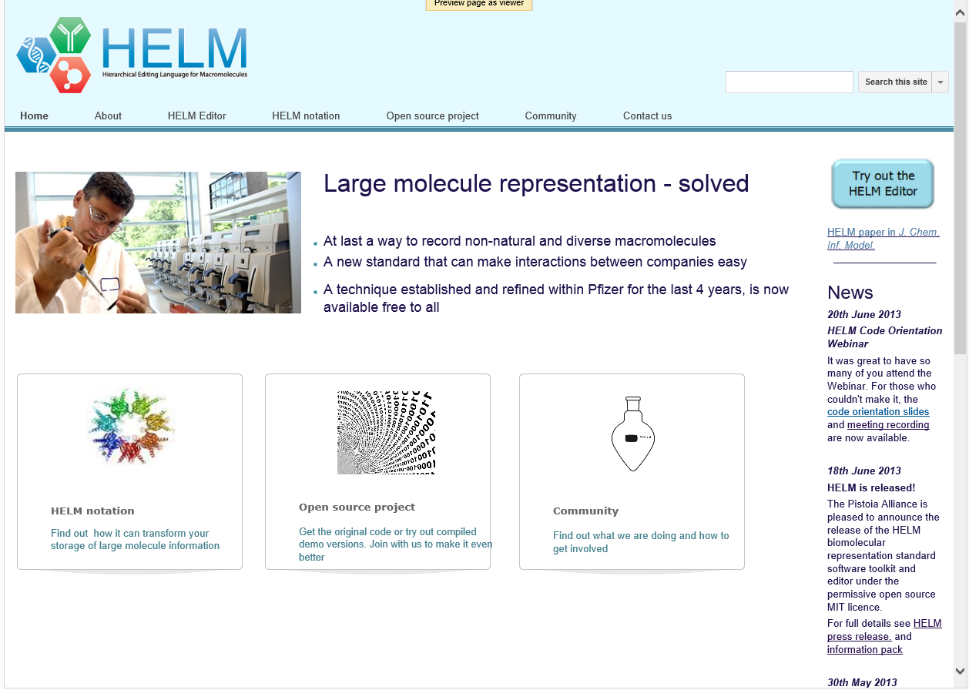
Specification and Documentation
www.openhelm.org

Slide 20
Interoperability
HELM
MDL Mol
Sequence
SMILES
Compound Registration
...?
HELM Notation Toolkit
Sequence Management
NA sequence
Central HELM monomer administration

Slide 21
Interoperability
Available tools currently export a HELM notation only
To regenerate the entire atomic structure the monomer information has to be passed on additionally (current PA project activity)
Harmonization of differing monomer dictionaries between partnering organizations
To avoid ambiguity of macromolecule representation for registration

Slide 22
Registrability
Integrated Registration
HELM
MDL Mol
Sequence
SMILES
Compound Registration
...?
Canonicalization
HELM DB
HELM Notation Toolkit
Sequence Management
NA sequence

Slide 23
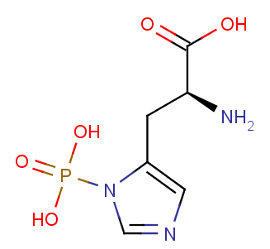
Registrability
Consistent automated registration of new HELM monomers is challenging
Histidine + Phosphate
or
1-Phospho-histidine
?
1-Phospho-histidine

Slide 24
Long-term stability
PA to „sign-post“ the HELM standard and foster adoption throughout PA community
PA to provide ad interim governance for controlled evolution of the standard
Release of HELM tools to the Open Source public domain facilitates public discourse
Widespread adoption

Slide 25
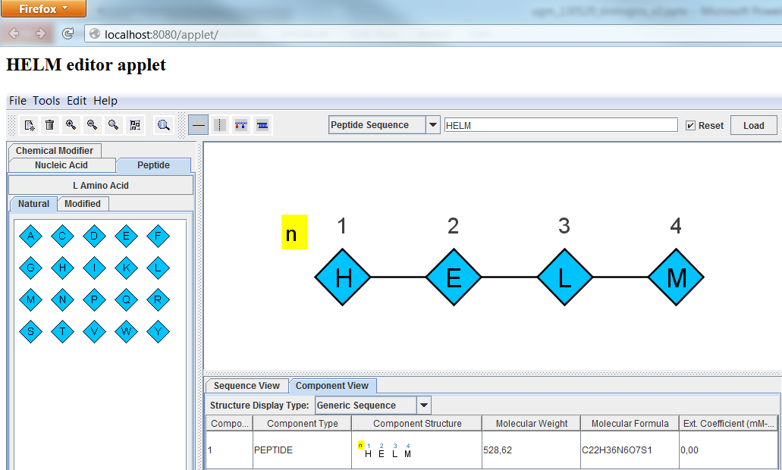
Which tools are available?
HELM Editor
API
HELM Notation Toolkit
https://github.com/PistoiaHELM

Slide 26
Adoption
Vendors
Pharma-/Polymer chemistry companies
Content providers
Academia
State agencies
Open HELM Standard is young, requires thorough assessment

Slide 27
HELM is already meeting most of the requirements for broad adoption
With your help we can make HELM the “language of the macromolecules”
Requirements:
Use case coverage
Specification and Documentation
Interoperability
Registrability
Long-term stability
Adoption – over to you!
()



()

Slide 28
HELM
For more information please visit
http://openhelm.org
or contact us at info@openhelm.org

