Slide 1
What About the Big Guys?
The emerging HELM standard for macromolecular representation and the Pistoia Alliance
Sergio H. Rotstein – Pfizer Incorporated
Sergio.H.Rotstein@Pfizer.com

Slide 2
Introduction
Pfizer Goal: “Top-tier biotherapeutics company by 2015”
But informatics infrastructure was inadequate
Biomolecules Team Goal: Remediate infrastructure to enable biomolecule
Registration
Visualization
Analysis and design
Workflows
Many companies facing a similar challenge
Pistoia HELM Goal: Facilitate the public release of HELM, providing a standard for data exchange and reducing need for other companies to develop their own equivalent systems

Slide 3

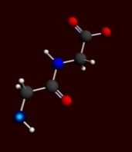

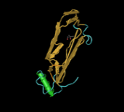

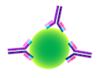
What is a “Biomolecule”?
ASOs
siRNAs
Peptides
For our purposes, anything that is not a small molecule is a biomolecule
Antibodies
Therapeutic Proteins
Goal
Eliminate biomolecule penalty
Make these entities first-class citizens of the Informatics tool portfolio
ADCs
Vaccines

Slide 4
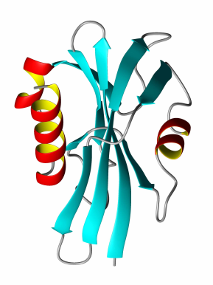

So what’s the problem?
GAP
Small Molecule Tools
Sequence-Based Tools
Small Molecules
Sequences
Biomolecules

Slide 5
“Fit-for-Purpose” Structure Representation
We need to enable the representation, manipulation and visualization of each molecule type in a way that is appropriate for its size and complexity

Slide 6
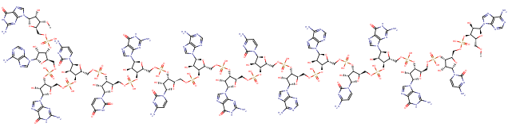
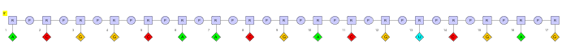
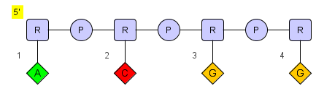
Fit for Purpose: “Monomer” Level
While you could draw out an oligonucleotide like this:
The representation is likely more intuitive / practical:

Slide 7
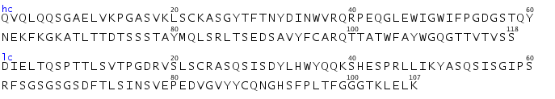
Fit for Purpose: Sequence Level
But even the monomer level representation would not scale well to proteins with hundreds of amino acids. Larger molecules require a more sequence-oriented representation:

Slide 8
Fit for Purpose: Component Level
For multi-component structures such as antibody drug conjugates, component level representations are required to enable each component to dealt with separately.
“Collapsed” Antibody
Ab
Expanded Drug

Slide 9
Hierarchical Editing Language for Macromolecules
Hierarchical – Amenable to the various “levels”
Complex Polymer ⇒ Simple Polymer ⇒ Monomer ⇒ Atom
Extensible
Allowing addition of new biopolymer types
(Reasonably) comprehensive
e.g. Allowing representation of oligonucleotide hybridization
Canonicalizable
Facilitating uniqueness checking
(Somewhat) human-readable

Slide 10
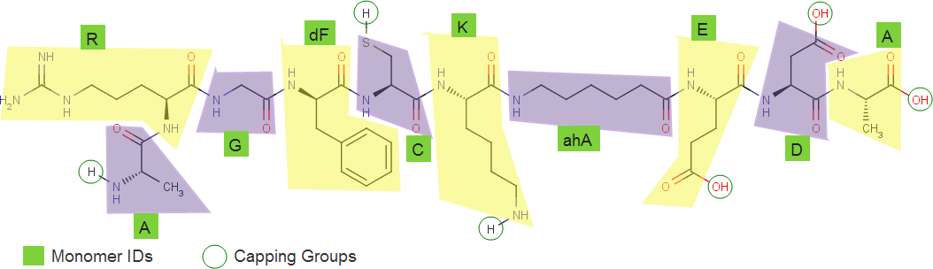
HELM Example: Simple polymer
HELM notation: A.R.G.[dF].C.K.[ahA].E.D.A
Non-natural amino acid codes are enclosed in square brackets
Natural equivalent: ARGFCKXEDA

Slide 11
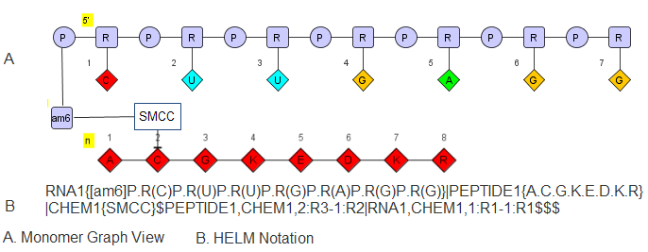
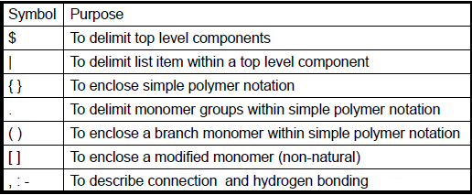
HELM Example: Complex Polymer

Slide 12
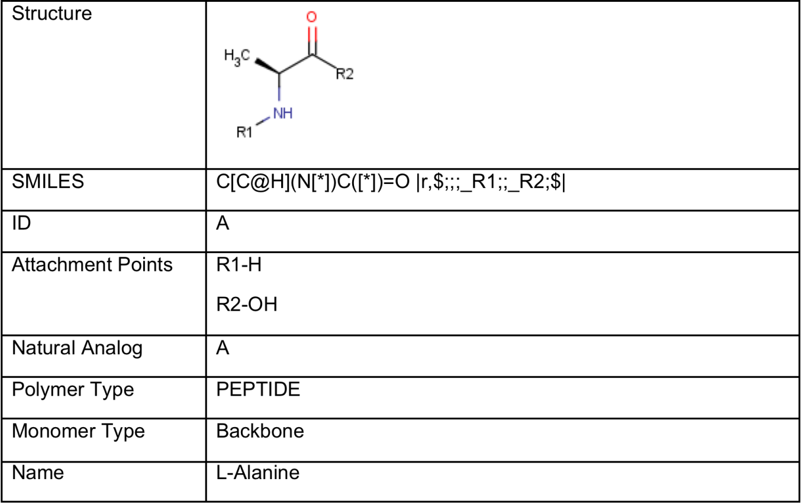
Monomer Database
Each monomer used in the notation needs to be predefined in a monomer database
The database includes the chemical structure of the monomer and a description of all acceptable attachment points

Slide 13
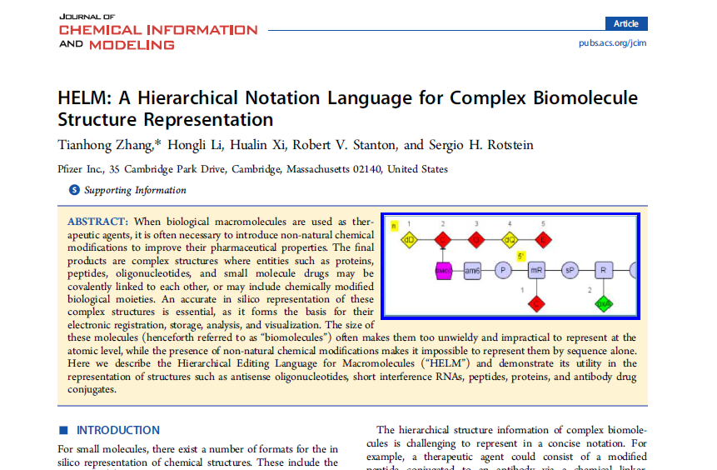
J. Chem. Inf. Model 2012, 52, 2796-2806
Notes:
Paper will soon be posted on the upcoming HELM web site.

Slide 14
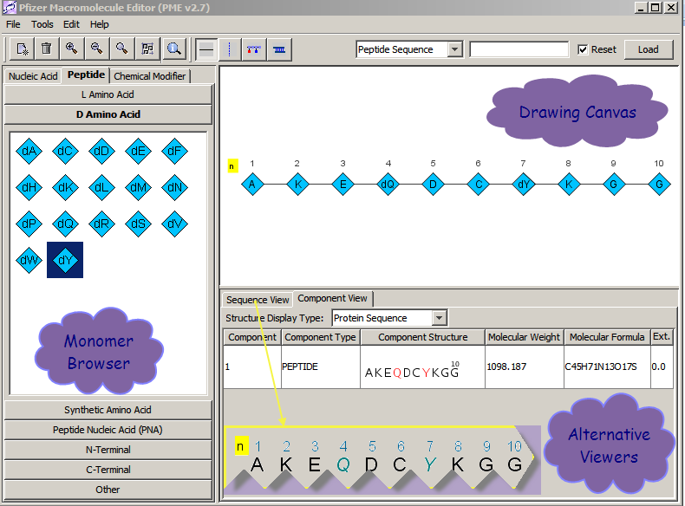
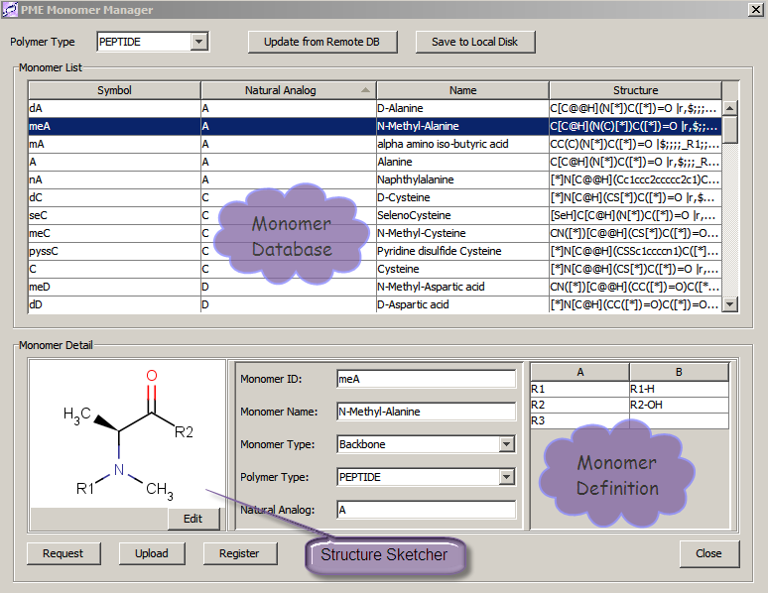
HELM at Pfizer: Drawing
PME

Slide 15
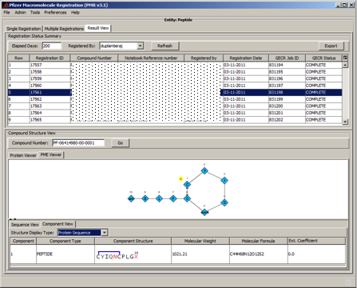
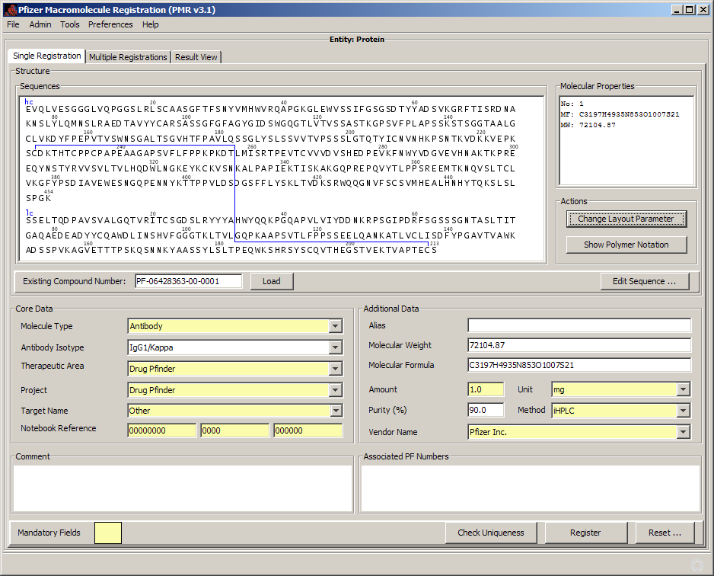
HELM at Pfizer: Registration
PMR

Slide 16
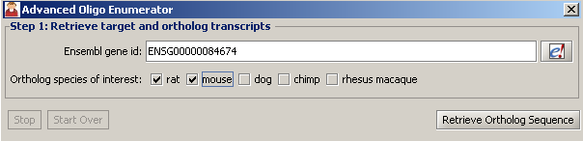
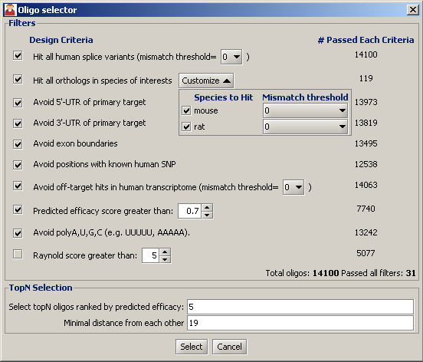
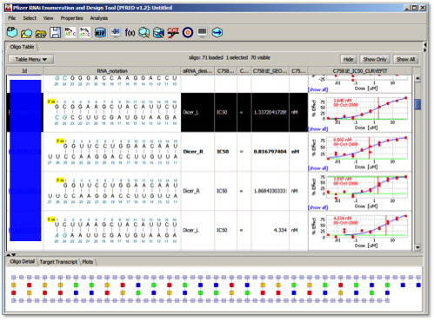
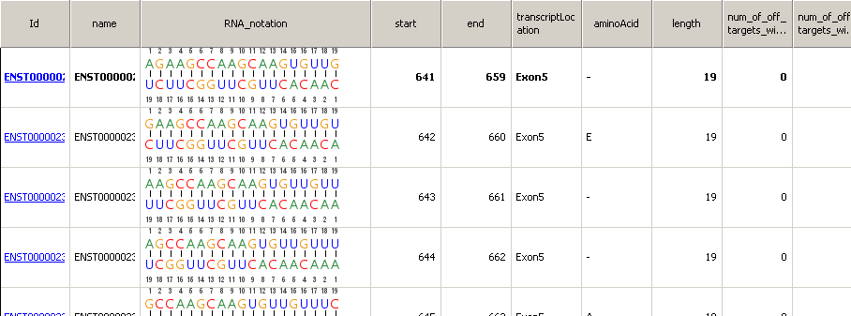
HELM at Pfizer: Analysis & Design
PFRED
PFRED: A computational tool for siRNA and antisense design. Simon Xi, Qing Cao, Christine Lawrence, Tianhong Zhang, Simone Sciabola, Sergio Rotstein, Jason Hughes, Daniel Caffrey, and Robert Stanton, PLOS ONE, Submitted

Slide 17
Pistoia Alliance HELM Project
Hierarchical Editing Language for Macromolecules
Domain Lead - Sergio Rotstein
Research Business Technology, Pfizer
Sergio@PistoiaAlliance.org

Slide 18
HELM Project Aims
Objective:
Establish and promote HELM as a biomolecule representation standard that can:
Provide a mechanism for data exchange between companies
Reduce software development costs by minimizing the need for companies to develop similar functionality

Slide 19
HELM Project Organization
Project Governance
Comprised of representatives from companies that make substantial contributions to the project in monetary or other resources, currently Pfizer, BMS, GSK, Roche and ChemAxon
Project Execution
Comprised of informatics professionals from Pharma, Biotech, Software Vendors
Steering Committee
HELM Project Team
Open Source Strategy Subgroup
Technical Subgroup
Communication Subgroup
De-Pfizerization Subgroup
Governance Subgroup

Slide 20
HELM Project Participation
Project team members
(Abbott) | InChi Trust | Pfizer
Accelrys | Lundbeck | Roche
ACDLabs | InfoSys | RSC
BMS | Merck | Sanofi
CDD | NextMove software | Scilligence
Certara | NIH | Thompson Reuters
ChemAxon | Novartis | UCB
GSK | Open BEL | Unilever
There are currently 24 organizations involved
Most of these companies have at least one person actively working in a subgroup

Slide 21
HELM Project Phase 1
Company systems
Commercial systems
Commercial systems
Pfizer
Independence
Open source
(hosted, licenced and managed)
HELM Toolkit
HELM editor
HELM notation
PME (Pfizer Macromolecule editor)
PMR (Pfizer Macromolecule registration tool)
Paper
Managed
HELM Definition
Well known and regarded

Slide 22
HELM Phase 1 Achievements
The Open Source repository infrastructure has been put in place
GitHub
The Open Source license terms have been defined and incorporated into the code
MIT License
The Contributor License terms have been defined and customized for the Pistoia Alliance
Apache
An initial governance structure has been defined to govern the evolution of the technology after the initial release
The source code has been “de-Pfizerized” and deposited into GitHub
ChemAxon has created an applet version of PME (now “HELM Editor”), enabling installation-free evaluation
A user guide developed, video tutorials underway
Accelrys has demoed prototype HELM reader and writer components in Pipeline Pilot
A website, OpenHelm.org, has been developed to enable interested parties to learn more about the project, get involved, make contributions, etc.
Numerous publicity opportunities have been planned and executed to raise awareness about the project and encourage additional involvement and adoption

Slide 23
What’s Next?
We are here
Phase 1
Make HELM publically available
Review
Agree high priority next steps
Phase 2
Accelerate adoption through an appropriate support infrastructure and targeted HELM improvement activities
The hard work has been done
Now we must ensure that:
HELM continues its growth and evolution in the open source domain
HELM creates value for our industry through its adoption by biopharmaceutical companies and support by software vendors and service providers
Great strides with ChemAxon and Accelrys

Slide 24
Acknowledgements
Our team Members (Subteam leads)
Akos Papp (ChemAxon)
Alex Allardyce (ChemAxon)
Alex Drijver (ChemAxon)
Andrey Yerin (ACD labs)
Dana Vanderwall (BMS)
Ed Currie (InfoSys)
Edvard Buki (ChemAxon)
Hans de Bie (ACDLabs)
Ian Stott (Unilever)
Jerry Winter (Unilever)
Jinbo Lee (Scilligence)
John Smith (GSK)
John Wise (Pistoia)
Keith Taylor (Accelrys)
Kirti Jindal (InfoSys)
Matthias Nolte (BMS)
Michael Cui (GSK)
Mike Travers (CDD)
Rama Bhamidpati (GSK)
Roland Knispel (ChemAxon)
Roland Molnar (ChemAxon)
Sergio Rotstein (Pfizer)
Stefan Klostermann (Roche)
Ted Slater (OpenBEL)
Tianhong Zhang (Pfizer)
Tony Yuan (Scilligence)
Our Steering Committee
John Wise (Pistoia Alliance)
Margret Assfalg (Roche)
Leah O'Brien (GSK)
Ramesh Dervasula (BMS)
Christoph Brockel (Pfizer)
Alex Drijver (ChemAxon)
Our Excellent Project Manager
Claire Bellamy
Special thanks to ChemAxon for their generous contribution of software development resources!!

Slide 25


