Slide 1
HELM: an open standard for representing large molecules
Roland W. Knispel, ChemAxon
Domain Lead – Sergio Rotstein, Pfizer

Slide 2
The Pistoia Mission…
Lower the barriers to innovation
by improving inter-operability of R&D business processes
through pre-competitive collaboration

Slide 3

















































Pistoia Alliance Membership
Q4 2013
Board

Slide 4
Pistoia Alliance Activities
1st Generation Projects
Current Projects
Emerging Portfolio
SESL
Sequence squeeze
Sequence services
ELN
App strategy
CSCS
HELM
TransMART
Analysome
BARD
DCCAV
SRPCPD
Notes:
DCCAV Discovery Compound Controlled Annotation Vocabulary
SRPCPD Shared Real Physico-Chemical Properties Data
SESL Semantically Enriched Scientific literature: amazon-like information brokerage for getting all available data to a single query e.g. a disease gene (pilot done with Diabetes 2 data -> largely fed into the OpenPhacts project
TransMART: originating from an internal project at J&J The tranSMART Foundation is a partnership between the Pistoia Alliance, the University of Michigan and the Imperial College London with the mission to enable effective sharing, integration, standardization, and analysis of heterogeneous data from collaborative translational research by mobilizing the tranSMART open-source and open-data community.
Analysome: collection of all analytes that can be measured, the technologies that can measure them, the limits of quantification of those technologies and the cost of obtaining those measurements. Such information – if curated, stored and accessed via an easy-to-use, globally-available, web-based catalogue – would be of value to the life science R&D community. It would support the search for biomarkers to enhance discovery hypotheses or to help establish diagnostics associated with a particular disease and indeed a particular cohort susceptible to that disease.

Slide 5
Unmet need
„At present most pharma companies have no way of storing complete structural machine-readable information about the macromolecules they prepare or use in their research projects.”
HELM project charter / Dec. 2012

Slide 6
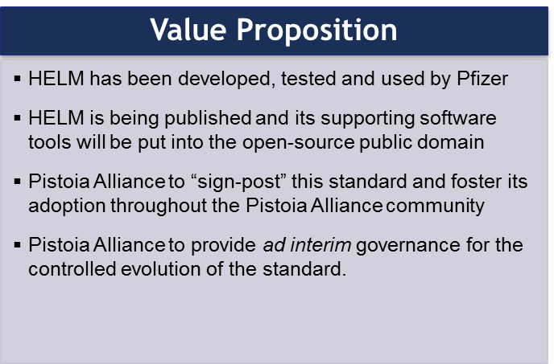
HELM
Business Case
Projected Shared Project Costs ~$125,000 [Project Coordinator, Governance, Promotion, Meeting]
Estimated value for the industry of implementing this project is ~$437m
Driven by productivity savings (e.g. fewer notation queries/resolutions from non-standard language)
Standard reference notation for macromolecules in pharma compound registration systems
The PA is the best-positioned, formally-established, x-company organization equipped to coordinate this kind of pre-competitive collaboration

Slide 7
Hierarchical Editing Language for Macromolecules
Macromolecules
Non-small molecules, Biologics
Editing Language
Notation system
Grammar and vocabulary
Hierarchy
Atom
Monomer
Simple Polymer
Complex Polymer
Zhang et al., J. Chem. Inf. Model 2012, 52, pp2796-2806

Slide 8
Structure hierarchy
Higher level components are a combination of lower level components
Complex polymer
Molecules described by a HELM notation consist of atoms and bonds
High
Simple polymer
Monomer
Low
Atom

Slide 9
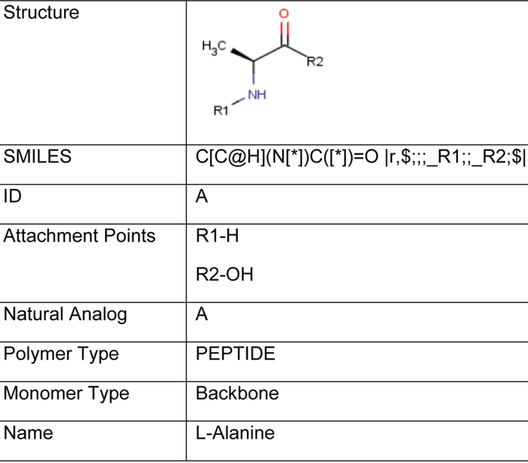
Structure hierarchy
Higher level components are a combination of lower level components
High
Complex polymer
Simple polymer
Monomer
Low
Atom

Slide 10
Structure hierarchy
Higher level components are a combination of lower level components
Complex polymer
Linear chains of Monomers or monomer units of a single biological molecule type (e.g. peptide chain, singular nucleic acid strand
High
Simple polymer
Type | Monomer (unit)
Peptide | A - Alanine
Nucleic acid | R(A)P R – Ribose A – Adenine P – Phosphate
Chem | [PEG3] – Pegylation
Monomer
Low
Atom

Slide 11
Structure hierarchy
Higher level components are a combination of lower level components
Complex polymer
Entire chemical structure information of the macromolecule
May include annotations per Simple polymer
High
Simple polymer
Monomer
Low
Atom

Slide 12
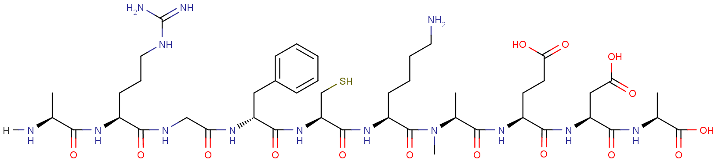
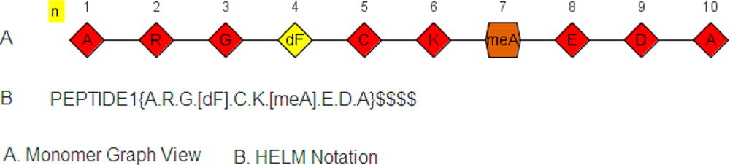
Example: Linear Peptide

Slide 13
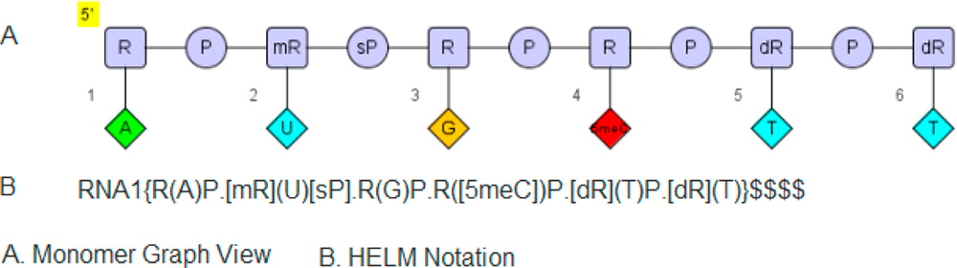
Example: Linear Oligonucleotide

Slide 14
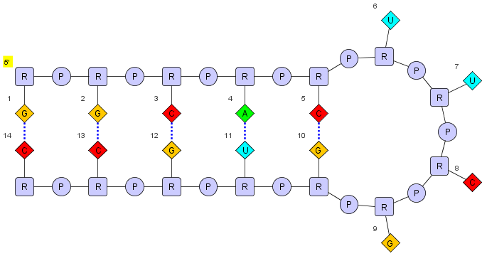
Example: Stem-loops (e.g. Tetraloops)
HELM notation:
RNA1{R(G)P.R(G)P.R(C)P.R(A)P.R(C)P.R(U)P.R(U)P.R(C)P.R(G)P.R(G)P.R(U)P.R(G)P.R(C)P.R(C)}$$RNA1,RNA1,11:pair-32:pair|RNA1,RNA1,5:pair-38:pair|RNA1,RNA1,14:pair-29:pair|RNA1,RNA1,8:pair-35:pair|RNA1,RNA1,2:pair-41:pair$$

Slide 15
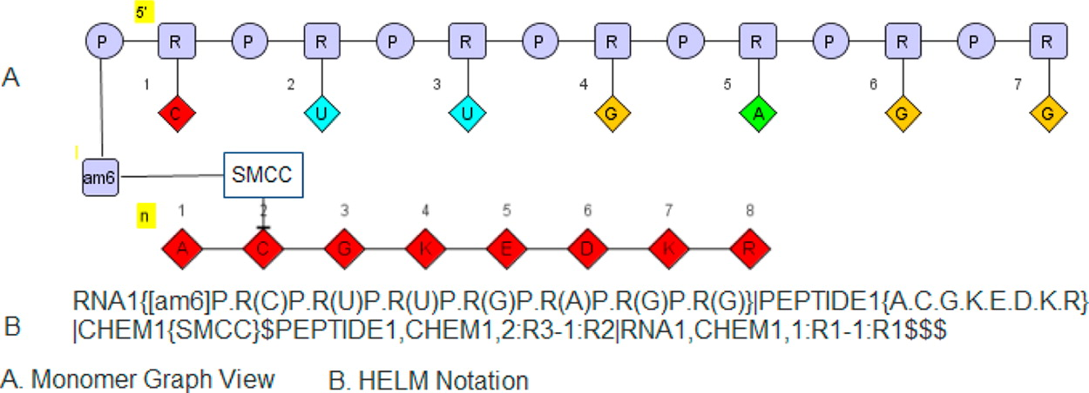
Example: Oligonucleotide Peptide Conjugate

Slide 16
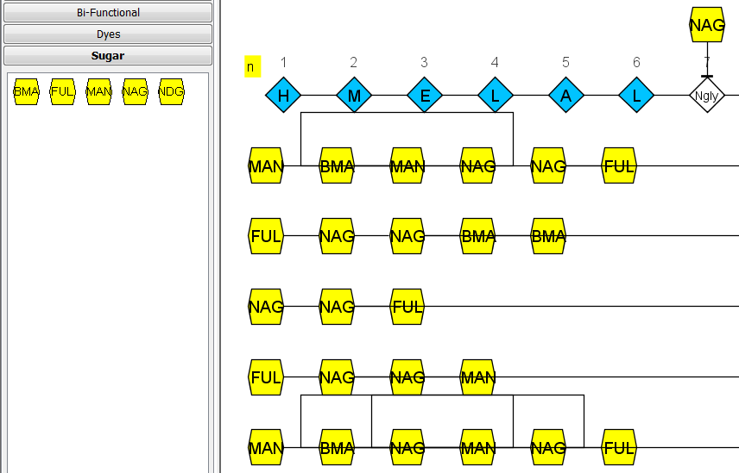
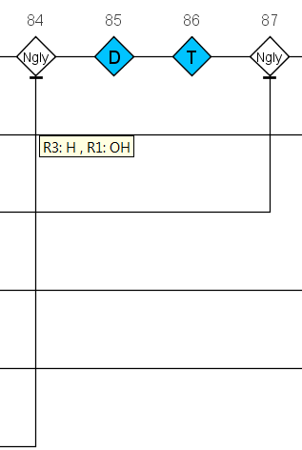
Example: Glycoprotein (PDB:3FUS)
H M E L
HELM notation:
CHEM1{BMA}|CHEM2{MAN}|CHEM3{MAN}|CHEM4{NAG}|CHEM5{FUL}|CHEM6{NAG}|CHEM7{NAG}|CHEM8{NAG}|CHEM9{FUL}|CHEM10{BMA}|CHEM11{BMA}|CHEM12{NAG}|CHEM13{NAG}|CHEM14{FUL}|CHEM15{NAG}|CHEM16{FUL}|CHEM17{NAG}|CHEM18{MAN}|CHEM19{BMA}|CHEM20{MAN}|CHEM21{MAN}|CHEM22{NAG}|CHEM23{NAG}|CHEM24{FUL}|CHEM25{MAN}|CHEM26{BMA}|CHEM27{NAG}|CHEM28{NAG}|PEPTIDE1{H.M.E.L.A.L.[Ngly].V.T.E.S.F.D.A.W.E.N.T.V.T.E.Q.A.I.E.D.V.W.Q.L.F.E.T.S.I.K.P.C.V.K.L.S.P.L.C.I.G.A.G.H.C.[Ngly].T.S.I.I.Q.E.S.C.D.K.H.Y.W.D.T.I.R.F.R.Y.C.A.P.P.G.Y.A.L.L.R.C.[Ngly].D.T.[Ngly].Y.S.G.F.M.P.K.C.S.K.V.V.V.S.S.C.T.R.M.M.E.T.Q.T.S.T.W.F.G.F.[Ngly].G.T.R.A.E.[Ngly].R.T.Y.I.Y.W.H.G.R.D.[Ngly].R.T.I.I.S.L.N.K.Y.Y.[Ngly].L.T.M.K.C.R.G.A.G.W.C.W.F.G.G.N.W.K.D.A.I.K.E.M.K.Q.T.I.V.K.H.P.R.Y.T.G.T.[Ngly].N.T.D.K.I.[Ngly].L.T.A.P.R.G.G.D.P.E.V.T.F.M.W.T.N.C.R.G.E.F.L.Y.C.K.M.N.W.F.L.N.W.V.E.D.R.D.V.T.N.Q.R.P.K.E.R.H.R.R.N.Y.V.P.C.H.I.R.Q.I.I.N.T.W.H.K.V.G.K.N.V.Y.L.P.P.R.E.G.D.L.T.C.[Ngly].S.T.V.T.S.L.I.A.N.I.D.W.T.D.G.[Ngly].Q.T.[Ngly].I.T.M.S.A.E.V.A.E.L.Y.R.L.E.L.G.D.Y.K.L.V.E.I.T}|CHEM29{NAG}|CHEM30{NAG}|CHEM31{BMA}|CHEM32{MAN}|CHEM33{MAN}|CHEM34{MAN}|CHEM35{NAG}|CHEM36{NAG}|CHEM37{BMA}|CHEM38{MAN}|CHEM39{BMA}|CHEM40{BMA}|CHEM41{MAN}|CHEM42{NAG}|CHEM43{NAG}|CHEM44{BMA}|CHEM45{NAG}|CHEM46{NAG}|CHEM47{FUL}|CHEM48{NDG}|CHEM49{NAG}|CHEM50{MAN}|CHEM51{BMA}|CHEM52{BMA}|CHEM53{NAG}|CHEM54{NDG}|CHEM55{FUL}$CHEM1,CHEM2,1:R2-1:R1|CHEM5,CHEM6,1:R1-1:R3|CHEM16,CHEM15,1:R1-1:R3|PEPTIDE1,CHEM30,52:R3-1:R1|PEPTIDE1,CHEM8,87:R3-1:R3|CHEM19,CHEM21,1:R3-1:R1|CHEM8,CHEM7,1:R1-1:R2|CHEM22,CHEM23,1:R1-1:R2|PEPTIDE1,CHEM28,292:R3-1:R1|PEPTIDE1,CHEM43,273:R3-1:R1|PEPTIDE1,CHEM46,146:R3-1:R1|PEPTIDE1,CHEM15,135:R3-1:R1|CHEM10,CHEM8,1:R1-1:R2|PEPTIDE1,CHEM36,289:R3-1:R1|CHEM51,CHEM50,1:R2-1:R1|CHEM39,CHEM41,1:R3-1:R1|PEPTIDE1,CHEM12,124:R3-1:R1|PEPTIDE1,CHEM29,7:R3-1:R1|CHEM39,CHEM38,1:R1-1:R2|CHEM20,CHEM19,1:R1-1:R2|CHEM17,CHEM15,1:R1-1:R2|CHEM12,CHEM13,1:R2-1:R1|CHEM46,CHEM47,1:R3-1:R1|CHEM32,CHEM31,1:R1-1:R3|CHEM52,CHEM51,1:R3-1:R1|PEPTIDE1,CHEM23,84:R3-1:R1|CHEM28,CHEM27,1:R2-1:R1|CHEM4,CHEM1,1:R2-1:R1|CHEM31,CHEM33,1:R2-1:R1|PEPTIDE1,CHEM54,190:R3-1:R1|CHEM34,CHEM33,1:R1-1:R2|CHEM18,CHEM17,1:R1-1:R2|CHEM31,CHEM35,1:R1-1:R2|CHEM9,CHEM7,1:R1-1:R3|CHEM26,CHEM27,1:R1-1:R2|CHEM54,CHEM53,1:R2-1:R1|CHEM6,CHEM4,1:R2-1:R1|CHEM1,CHEM3,1:R3-1:R1|CHEM25,CHEM26,1:R1-1:R2|CHEM54,CHEM55,1:R3-1:R1|CHEM43,CHEM42,1:R2-1:R1|CHEM40,CHEM37,1:R2-1:R1|CHEM46,CHEM45,1:R2-1:R1|CHEM12,CHEM14,1:R3-1:R1|CHEM42,CHEM40,1:R2-1:R1|PEPTIDE1,CHEM6,118:R3-1:R1|CHEM24,CHEM23,1:R1-1:R3|CHEM22,CHEM19,1:R2-1:R1|CHEM53,CHEM52,1:R2-1:R1|CHEM48,CHEM49,1:R2-1:R1|PEPTIDE1,CHEM48,184:R3-1:R1|CHEM45,CHEM44,1:R2-1:R1|CHEM37,CHEM38,1:R2-1:R1|CHEM11,CHEM10,1:R1-1:R2|CHEM36,CHEM35,1:R2-1:R1$$$

Slide 17
Example: Glycoprotein (PDB:3FUS)

H M E L
H E L M
HELM notation:
CHEM1{BMA}|CHEM2{MAN}|CHEM3{MAN}|CHEM4{NAG}|CHEM5{FUL}|CHEM6{NAG}|CHEM7{NAG}|CHEM8{NAG}|CHEM9{FUL}|CHEM10{BMA}|CHEM11{BMA}|CHEM12{NAG}|CHEM13{NAG}|CHEM14{FUL}|CHEM15{NAG}|CHEM16{FUL}|CHEM17{NAG}|CHEM18{MAN}|CHEM19{BMA}|CHEM20{MAN}|CHEM21{MAN}|CHEM22{NAG}|CHEM23{NAG}|CHEM24{FUL}|CHEM25{MAN}|CHEM26{BMA}|CHEM27{NAG}|CHEM28{NAG}|PEPTIDE1{H.M.E.L.A.L.[Ngly].V.T.E.S.F.D.A.W.E.N.T.V.T.E.Q.A.I.E.D.V.W.Q.L.F.E.T.S.I.K.P.C.V.K.L.S.P.L.C.I.G.A.G.H.C.[Ngly].T.S.I.I.Q.E.S.C.D.K.H.Y.W.D.T.I.R.F.R.Y.C.A.P.P.G.Y.A.L.L.R.C.[Ngly].D.T.[Ngly].Y.S.G.F.M.P.K.C.S.K.V.V.V.S.S.C.T.R.M.M.E.T.Q.T.S.T.W.F.G.F.[Ngly].G.T.R.A.E.[Ngly].R.T.Y.I.Y.W.H.G.R.D.[Ngly].R.T.I.I.S.L.N.K.Y.Y.[Ngly].L.T.M.K.C.R.G.A.G.W.C.W.F.G.G.N.W.K.D.A.I.K.E.M.K.Q.T.I.V.K.H.P.R.Y.T.G.T.[Ngly].N.T.D.K.I.[Ngly].L.T.A.P.R.G.G.D.P.E.V.T.F.M.W.T.N.C.R.G.E.F.L.Y.C.K.M.N.W.F.L.N.W.V.E.D.R.D.V.T.N.Q.R.P.K.E.R.H.R.R.N.Y.V.P.C.H.I.R.Q.I.I.N.T.W.H.K.V.G.K.N.V.Y.L.P.P.R.E.G.D.L.T.C.[Ngly].S.T.V.T.S.L.I.A.N.I.D.W.T.D.G.[Ngly].Q.T.[Ngly].I.T.M.S.A.E.V.A.E.L.Y.R.L.E.L.G.D.Y.K.L.V.E.I.T}|CHEM29{NAG}|CHEM30{NAG}|CHEM31{BMA}|CHEM32{MAN}|CHEM33{MAN}|CHEM34{MAN}|CHEM35{NAG}|CHEM36{NAG}|CHEM37{BMA}|CHEM38{MAN}|CHEM39{BMA}|CHEM40{BMA}|CHEM41{MAN}|CHEM42{NAG}|CHEM43{NAG}|CHEM44{BMA}|CHEM45{NAG}|CHEM46{NAG}|CHEM47{FUL}|CHEM48{NDG}|CHEM49{NAG}|CHEM50{MAN}|CHEM51{BMA}|CHEM52{BMA}|CHEM53{NAG}|CHEM54{NDG}|CHEM55{FUL}$CHEM1,CHEM2,1:R2-1:R1|CHEM5,CHEM6,1:R1-1:R3|CHEM16,CHEM15,1:R1-1:R3|PEPTIDE1,CHEM30,52:R3-1:R1|PEPTIDE1,CHEM8,87:R3-1:R3|CHEM19,CHEM21,1:R3-1:R1|CHEM8,CHEM7,1:R1-1:R2|CHEM22,CHEM23,1:R1-1:R2|PEPTIDE1,CHEM28,292:R3-1:R1|PEPTIDE1,CHEM43,273:R3-1:R1|PEPTIDE1,CHEM46,146:R3-1:R1|PEPTIDE1,CHEM15,135:R3-1:R1|CHEM10,CHEM8,1:R1-1:R2|PEPTIDE1,CHEM36,289:R3-1:R1|CHEM51,CHEM50,1:R2-1:R1|CHEM39,CHEM41,1:R3-1:R1|PEPTIDE1,CHEM12,124:R3-1:R1|PEPTIDE1,CHEM29,7:R3-1:R1|CHEM39,CHEM38,1:R1-1:R2|CHEM20,CHEM19,1:R1-1:R2|CHEM17,CHEM15,1:R1-1:R2|CHEM12,CHEM13,1:R2-1:R1|CHEM46,CHEM47,1:R3-1:R1|CHEM32,CHEM31,1:R1-1:R3|CHEM52,CHEM51,1:R3-1:R1|PEPTIDE1,CHEM23,84:R3-1:R1|CHEM28,CHEM27,1:R2-1:R1|CHEM4,CHEM1,1:R2-1:R1|CHEM31,CHEM33,1:R2-1:R1|PEPTIDE1,CHEM54,190:R3-1:R1|CHEM34,CHEM33,1:R1-1:R2|CHEM18,CHEM17,1:R1-1:R2|CHEM31,CHEM35,1:R1-1:R2|CHEM9,CHEM7,1:R1-1:R3|CHEM26,CHEM27,1:R1-1:R2|CHEM54,CHEM53,1:R2-1:R1|CHEM6,CHEM4,1:R2-1:R1|CHEM1,CHEM3,1:R3-1:R1|CHEM25,CHEM26,1:R1-1:R2|CHEM54,CHEM55,1:R3-1:R1|CHEM43,CHEM42,1:R2-1:R1|CHEM40,CHEM37,1:R2-1:R1|CHEM46,CHEM45,1:R2-1:R1|CHEM12,CHEM14,1:R3-1:R1|CHEM42,CHEM40,1:R2-1:R1|PEPTIDE1,CHEM6,118:R3-1:R1|CHEM24,CHEM23,1:R1-1:R3|CHEM22,CHEM19,1:R2-1:R1|CHEM53,CHEM52,1:R2-1:R1|CHEM48,CHEM49,1:R2-1:R1|PEPTIDE1,CHEM48,184:R3-1:R1|CHEM45,CHEM44,1:R2-1:R1|CHEM37,CHEM38,1:R2-1:R1|CHEM11,CHEM10,1:R1-1:R2|CHEM36,CHEM35,1:R2-1:R1$$$

Slide 18
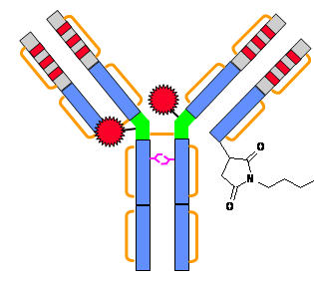
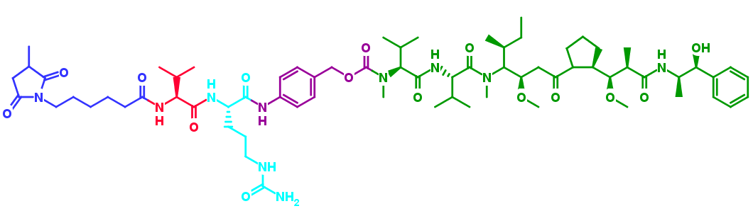
Example: Brentuximab vedotin
conjugation
linker
Cit
Val
spacer
anti-CD30 IgG
Linker
Auristatin E
PEPTIDE1,PEPTIDE2,
PEPTIDE3,PEPTIDE4
CHEM1
CHEM2

Slide 19
Example: Brentuximab vedotin (HELM v1.0)
PEPTIDE1{…}|PEPTIDE2{…}|PEPTIDE3{…}|PEPTIDE4{…}|CHEM1{[CathBLink]}|CHEM2{[AurE]}$
PEPTIDE4,PEPTIDE4,200:R3‑144:R3|…$
$
PEPTIDE1{lc}|PEPTIDE2{lc}|PEPTIDE3{hc}|PEPTIDE4{hc}|CHEM1{linker}|CHEM2{conjugate}$

Slide 20
Example: Brentuximab vedotin (HELM 1.x ?)
PEPTIDE1{…}|PEPTIDE2{…}|PEPTIDE3{…}|PEPTIDE4{…}|
CHEM1{SMILES/CID/HELMAbbreviation}|CHEM2{SMILES/CID/HELMAbbreviation}$
PEPTIDE4,PEPTIDE4,200:R3‑144:R3|…|
CHEM1,PEPTIDE1+PEPTIDE2+PEPTIDE3+PEPTIDE4,1:R1-generic:R3|
CHEM1,CHEM2,1:R2-1:R1$
$
PEPTIDE1{adcComponent: lc}|PEPTIDE2{adcComponent: lc}| PEPTIDE3{adcComponent: hc}|PEPTIDE4{adcComponent: hc}|
CHEM1{adcComponent:linker}|CHEM1{CID:CXN2‑714}|
CHEM2{adcComponent:conjugate}|CHEM2{CID:CXN17-286}|
CHEM1{adcConjTarget:E}|
CHEM1{adcRatio:4.2}|CHEM2{adcRatio:4.2}|
PEPTIDE1{adcConjSiteOccupancy:34,0.8}$

Slide 21
How to establish HELM as a standard?
Aim:
“Standard reference notation for macromolecules in pharma compound registration systems”
Prior to project start in Q4 2012:
HELM implemented at one pharmaceutical company in production environment
Journal article on HELM published in JCIM
No commercial software supporting HELM available

Slide 22

Achievements
Q1 2013
Externalization (‘De-Pfizerizing’) of source code
Creation of an applet version of the HELM Editor (former PME), enabling installation-free evaluation
Editor user guide written, video tutorials for end users and developers available
Q2 2013

Slide 23
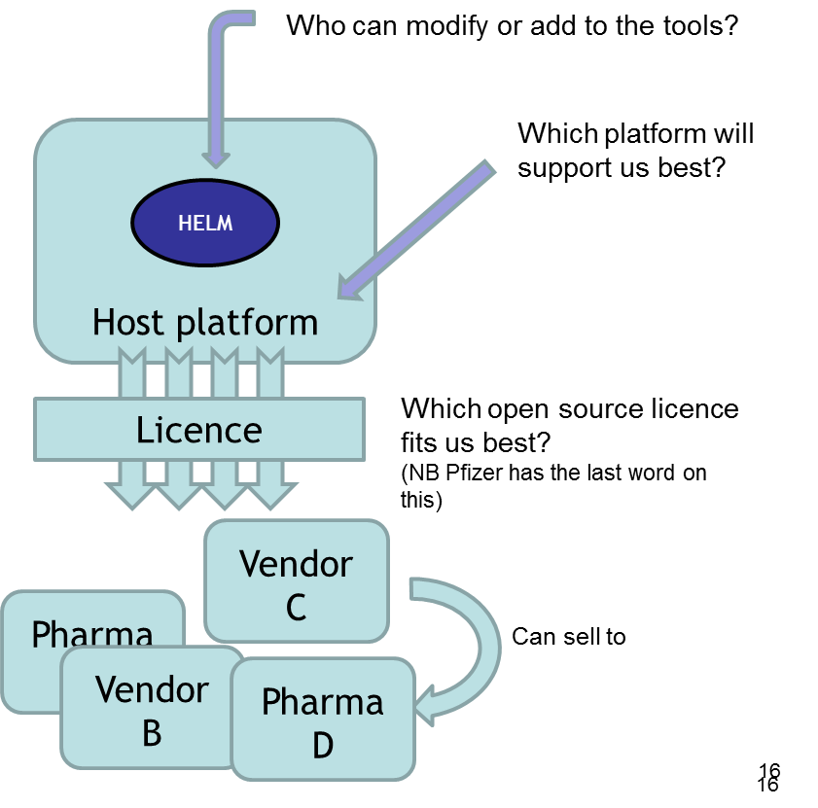
Achievements
GitHub chosen as Open Source repository and source code uploaded
Permissible MIT license selected and incorporation into the code
Selection of Apache Contributor License and customization of terms specific for the Pistoia Alliance
Definition of initial governance structure for evolution of HELM after release
Contributors under
Benevolent Dictator
GitHub
Q2 2013
MIT license

Slide 24

Achievements
HELM notation standard definition v1.0 released
Assessment of suggested HELM extensions
RfP release for Self-contained exchangeable HELM format
Pilot project with ChEMBL (EBI) exploring data migration to HELM format
Q3 2013
Q4 2013
now

Slide 25
Does HELM meet requirements?
“Standard reference notation for macromolecules in pharma compound registration systems”
Requirements:
Use case coverage
Specification and Documentation
Interoperability
Registrability
Long-term stability
Adoption

Slide 26
Use case coverage
Unmodified and modified biological molecules
Nucleic acids – dsDNA, siRNA, locked DNA/RNA...
Proteins – Antibodies, proteins with PTMs
Glycoproteins (dedicated sugar polymer type preferred)
Conjugated molecules
Well-defined conjugated molecules – RNA-tagged peptides, DNA-tagged reactants
Stochastically conjugated molecules – ADCs (controlled attribute vocabulary for textual annotations preferred)

Slide 27
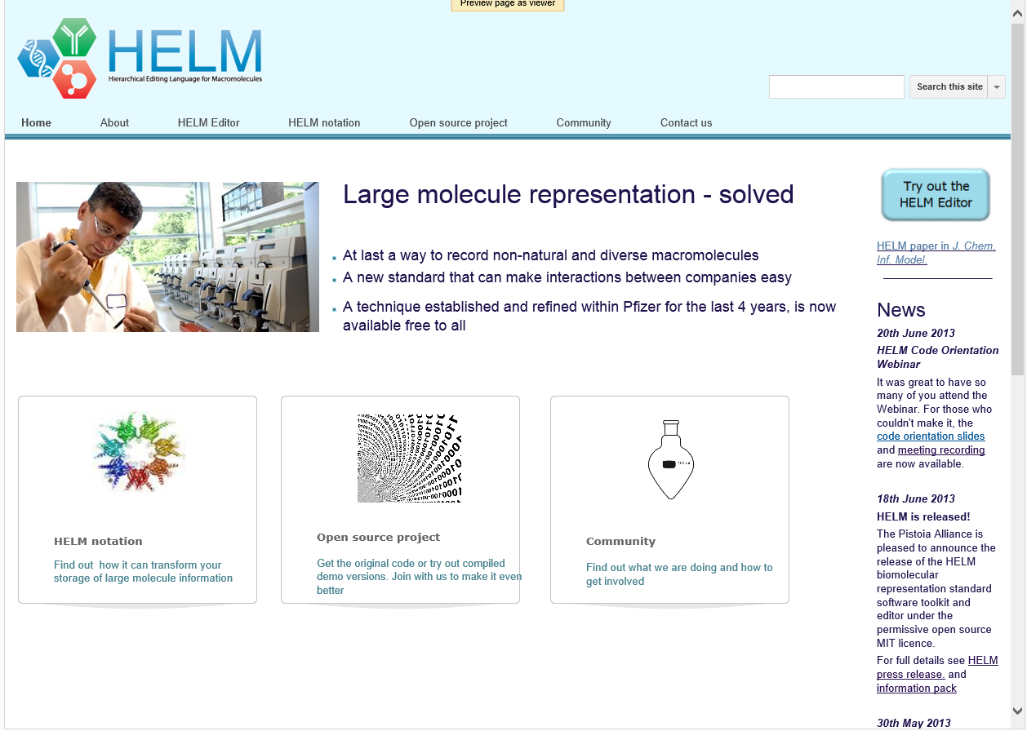
Specification and Documentation
www.openhelm.org

Slide 28
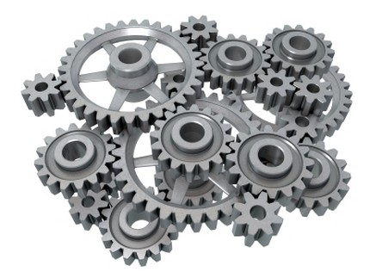

Interoperability
Internally:
Can I easily implement a HELM-based solution into my existing IT infrastructure?
Externally:
Will HELM allow me to exchange molecule data fully, unambiguously and efficiently with my partners?

Slide 29
Interoperability: internal systems
HELM
MDL Mol
Sequence
SMILES
Compound Registration
...?
HELM monomers
HELM Notation Toolkit
Sequence Management
NA sequence

Slide 30
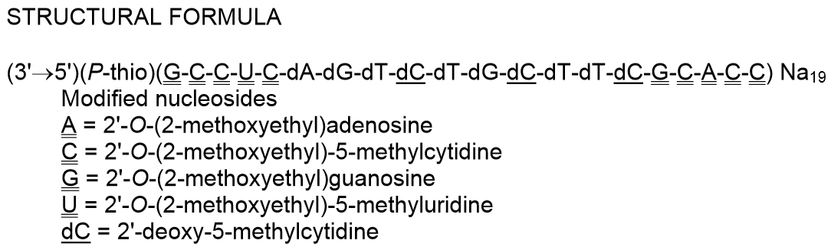
Interoperability: collaborators
Original PDF
Information mismatch
STRUCTURAL FORMULA
(3'→5')(P-thio)(G-C-C-U-C-dA-dG-dT-dC-dT-dG-dC-dT-dT-dC-G-C-A-C-C) Na19
Modified nucleosides
A= 2'-O-(2-methoxyethyl)adenosine
C= 2'-O-(2-methoxyethyl)-5-methylcytidine
G= 2'-O-(2-methoxyethyl)guanosine
U= 2'-O-(2-methoxyethyl)-5-methyluridine
dC= 2'-deoxy-5-methylcytidine
Copied text

Slide 31
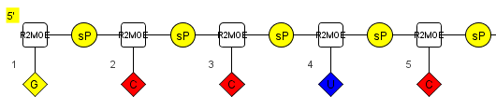
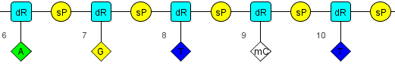
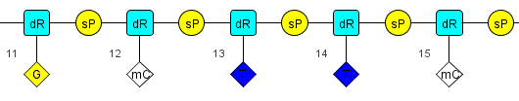
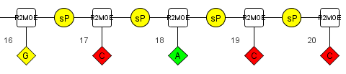
Interoperability: collaborators
Mipomersen
HELM notation:
RNA1{[R2MOE](G)[sP].[R2MOE](C)[sP].[R2MOE](C)[sP].[R2MOE](U)[sP].[R2MOE](C)[sP].[dR](A)[sP].[dR](G)[sP].[dR](T)[sP].[dR]([mC])[sP].[dR](T)[sP].[dR](G)[sP].[dR]([mC])[sP].[dR](T)[sP].[dR](T)[sP].[dR]([mC])[sP].[R2MOE](G)[sP].[R2MOE](C)[sP].[R2MOE](A)[sP].[R2MOE](C)[sP].[R2MOE](C)}$$$$

Slide 32
Interoperability: collaborators
Available tools currently export HELM notation without monomer information
Self-contained exchangeable HELM projected to be available in Q2 2014 (RfP started in Q4 2013)
Harmonization of differing monomer dictionaries between partner organizations
Simplified approach covered by self-contained exchangeable HELM RfP, but no full solution yet

Slide 33
Registrability
HELM
MDL Mol
Sequence
SMILES
Compound Registration
...?
HELM monomers
HELM Notation Toolkit
Sequence Management
NA sequence

Slide 34
Registrability
Integrated Registration
HELM
MDL Mol
Sequence
SMILES
Compound Registration
Mol/SMILES
HELM monomers
Canonicalization
HELM DB
HELM Notation Toolkit
Sequence Management
NA sequence

Slide 35
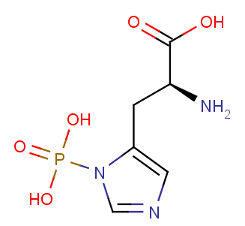
Registrability
Consistent automated registration of new HELM monomers is challenging
2 Monomers:
Histidine + Phosphate
or
1 Monomer:
1-Phospho-histidine
?
1-Phospho-histidine

Slide 36
Long-term stability
PA to „sign-post“ the HELM standard and foster adoption throughout PA community
PA to provide ad interim governance for controlled evolution of the standard
Release of HELM tools to the Open Source public domain facilitates public discourse
Widespread adoption

Slide 37
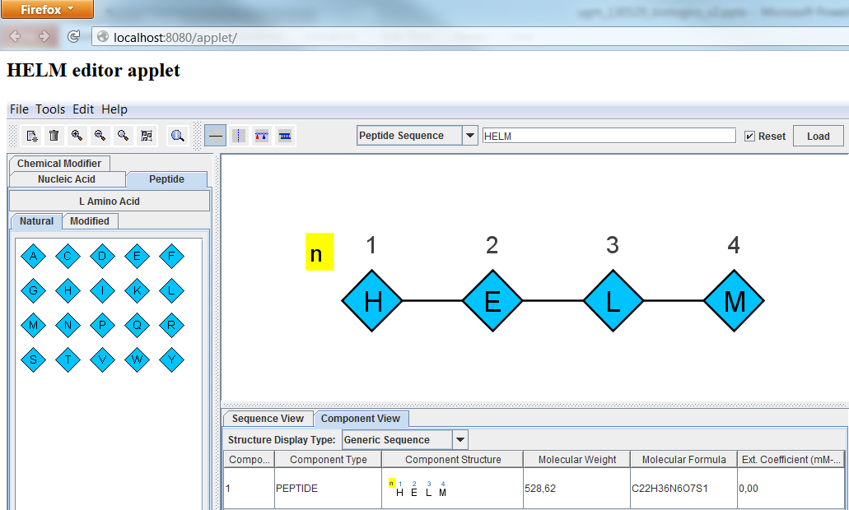
Which tools are available?
HELM Editor
API
HELM Notation Toolkit
https://github.com/PistoiaHELM

Slide 38
Adoption
Vendors
Pharma-/Polymer chemistry companies
Content providers
Academia
State agencies
Open HELM Standard is young, requires thorough assessment

Slide 39
HELM meets most requirements
With your help we can make HELM the “language of the macromolecules”
Requirements:
Use case coverage
Specification and Documentation
Interoperability
Registrability
Long-term stability
Adoption – over to you!
()



()

Slide 40

HELM
For more information please visit
http://openhelm.org
or contact us at info@openhelm.org

