Slide 1

The Pistoia Alliance HELM Project
An Open Standard for the Representation of Complex Biomolecules
Sergio Rotstein, Ph.D.
Director, Research Business Technology
Pfizer, Inc.

Slide 2
The Pistoia Alliance…
A global, not-for-profit, precompetitive alliance of life science companies, vendors, publishers, and academic groups that aims to lower barriers to innovation by improving the interoperability of R&D business processes

Slide 3












































Pistoia Alliance Membership
Q1 2014
Board

Slide 4
Background
Pfizer Goal
“Top-tier biotherapeutics company by 2015”
But informatics infrastructure was inadequate
Biomolecules Team Goal
Remediate infrastructure to enable biomolecule
Registration
Visualization
Analysis and design
Workflows
Make biomolecules “first-class citizens” of the informatics tool portfolio
HELM was the result of this initiative
Pistoia HELM Project Goal
Facilitate the public release of HELM, providing a set of tools for biomolecule data representation and exchange, that would reduce need for other companies to develop their own equivalent systems

Slide 5

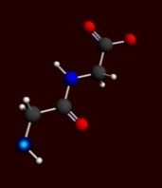
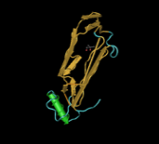


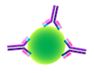
What is a “Biomolecule”
ASOs
siRNAs
Peptides
Therapeutic Proteins
Biomolecule: Anything that is not a small molecule
Antibodies
ADCs
Vaccines

Slide 6

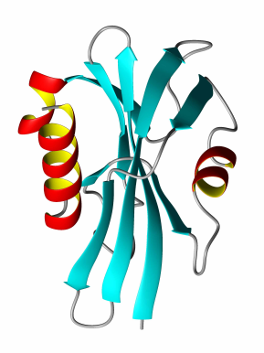

Biomolecules: Stuck in the middle…
GAP
Small Molecule Tools
Sequence-Based Tools
Small Molecules
Sequences
Biomolecules

Slide 7
“Fit-for-Purpose” Structure Representation
Enable the representation, manipulation and visualization of each macromolecule type in a way that is appropriate for its size and complexity

Slide 8
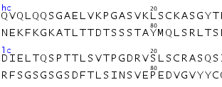
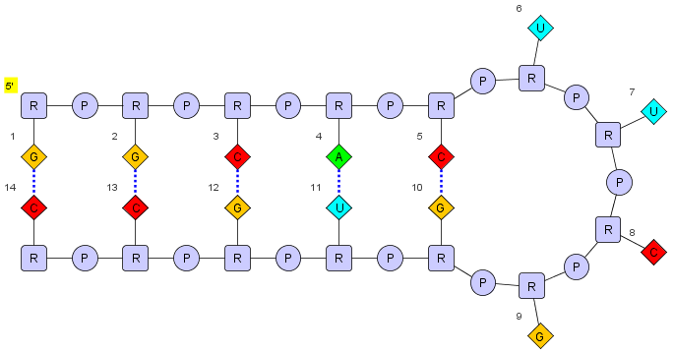
“Fit-for-Purpose” Structure Representation
Ab

Slide 9
Hierarchical Editing Language for Macromolecules
Hierarchical – Amenable to the various “levels”
Complex Polymer ⇒ Simple Polymer ⇒ Monomer ⇒ Atom
Extensible
Allowing addition of new biopolymer types
Versatile
e.g. Allowing representation of oligonucleotide hybridization
Canonicalizable
Facilitating uniqueness checking
(Somewhat) human-readable
“Smiles for macromolecules”

Slide 10
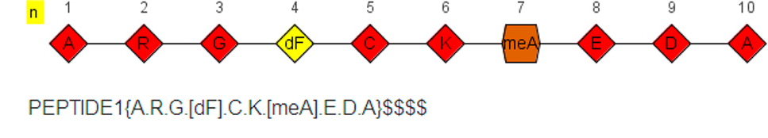
Example: Linear Peptide

Slide 11
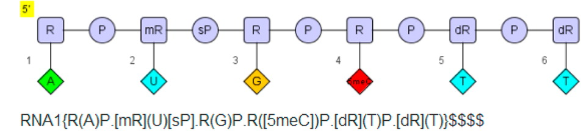
Example: Linear Oligonucleotide

Slide 12
Example: Stem-loops (e.g. Tetraloops)
HELM notation:
RNA1{R(G)P.R(G)P.R(C)P.R(A)P.R(C)P.R(U)P.R(U)P.R(C)P.R(G)P.R(G)P.R(U)P.R(G)P.R(C)P.R(C)}$$RNA1,RNA1,11:pair-32:pair|RNA1,RNA1,5:pair-38:pair|RNA1,RNA1,14:pair-29:pair|RNA1,RNA1,8:pair-35:pair|RNA1,RNA1,2:pair-41:pair$$

Slide 13
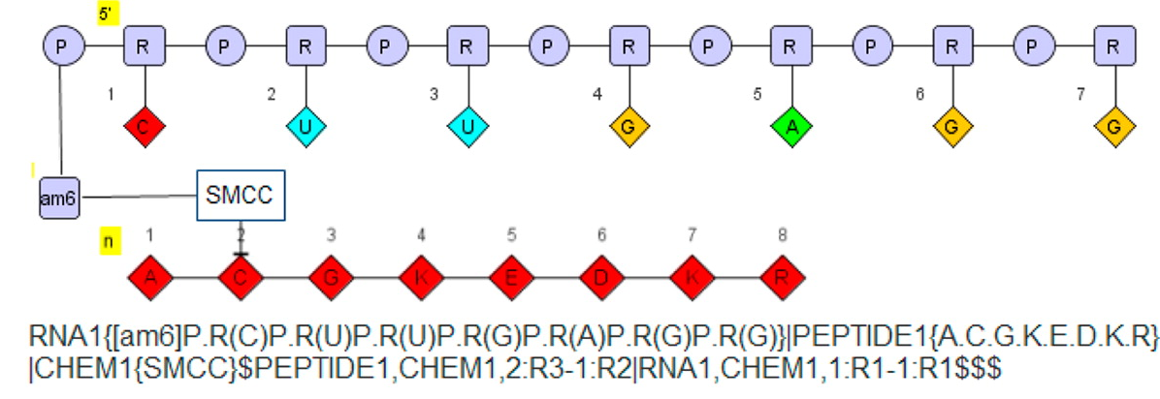
Example: Oligonucleotide Peptide Conjugate

Slide 14
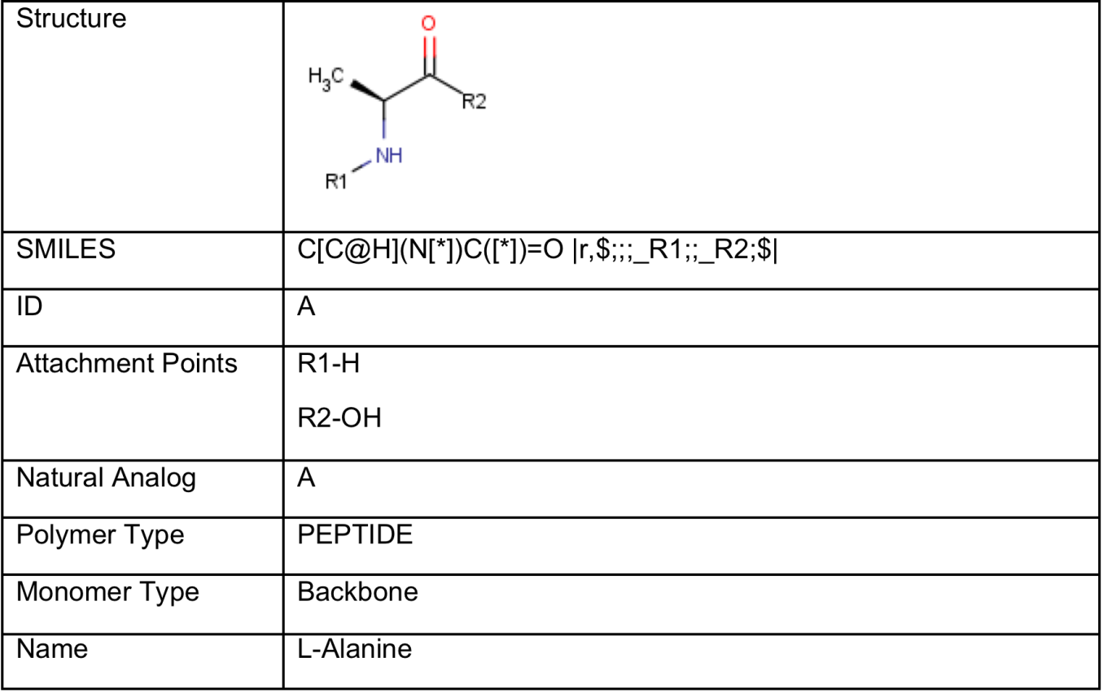
Monomer Database
Each monomer referenced in the notation is predefined in a monomer database
The database includes the chemical structure of the monomer and a description of all acceptable attachment points

Slide 15
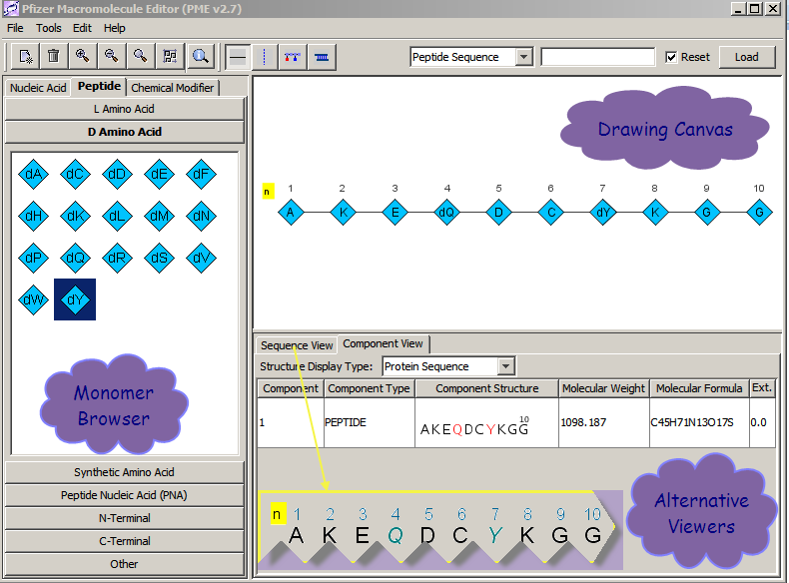
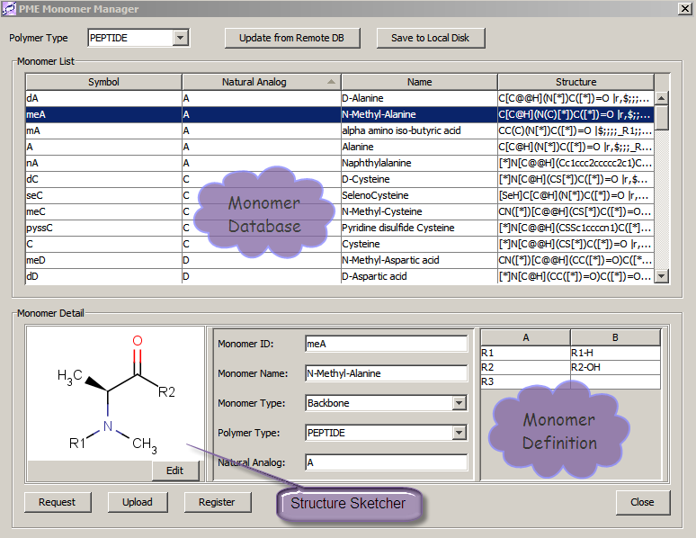
HELM at Pfizer: Drawing
PME

Slide 16
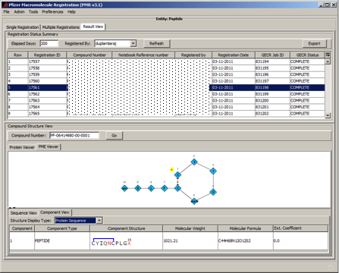

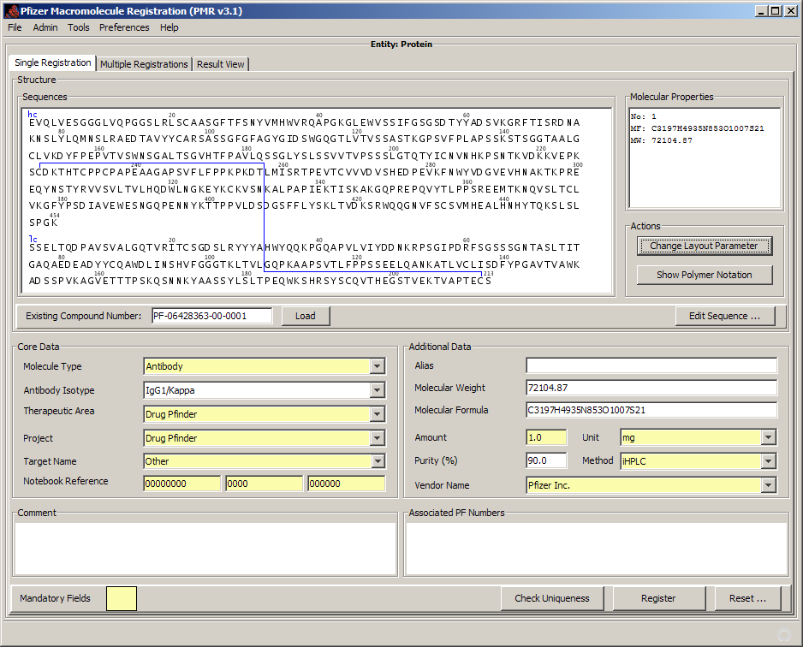
HELM at Pfizer: Registration
PMR

Slide 17
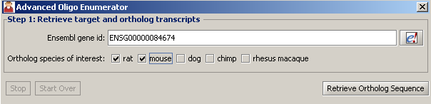
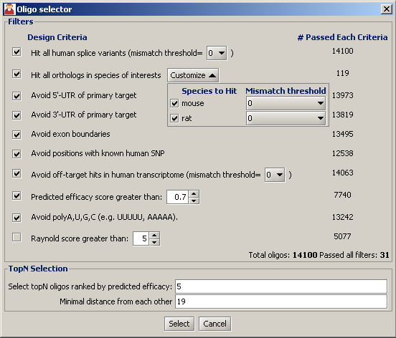
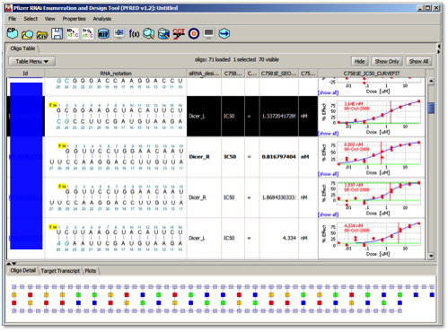
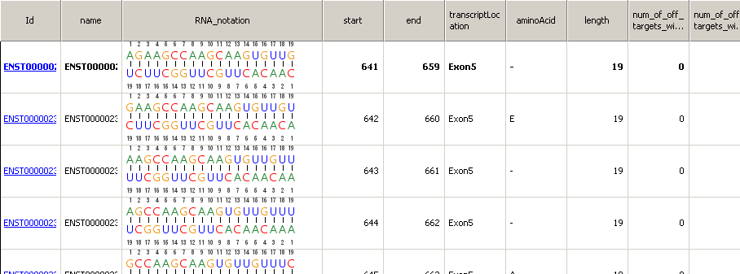
HELM at Pfizer: Analysis & Design
PFRED
PFRED: A computational tool for siRNA and antisense design. Simon Xi, Qing Cao, Christine Lawrence, Tianhong Zhang, Simone Sciabola, Sergio Rotstein, Jason Hughes, Daniel Caffrey, and Robert Stanton, PLOS ONE, Submitted

Slide 18
Pistoia HELM Project Objective
Establish and promote the HELM biomolecule representation standard and toolkit
Provide a mechanism for data exchange within and between organizations
Reduce software development costs by minimizing the need for companies to develop similar functionality

Slide 19
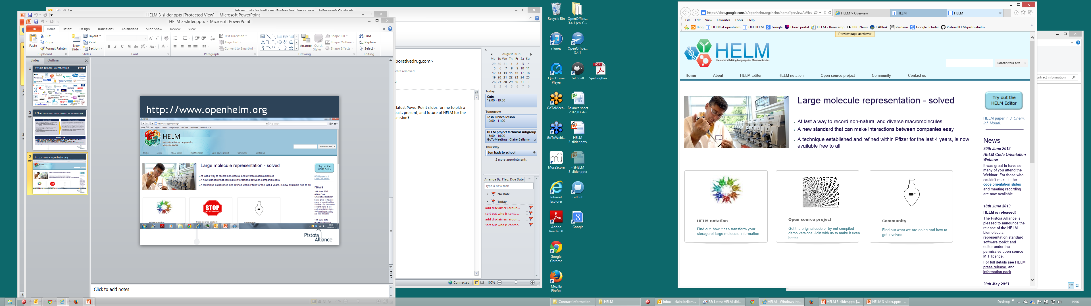
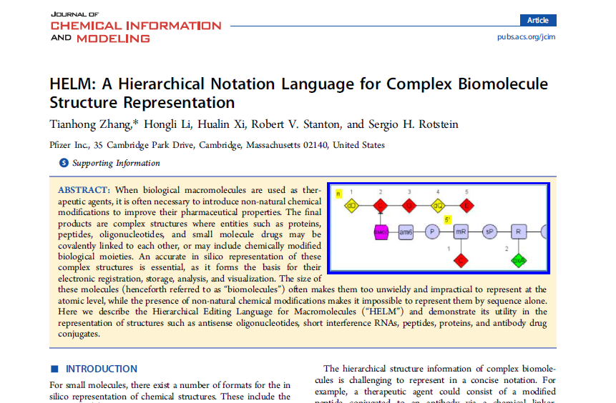
OpenHelm.Org
Specification
Documentation
Tutorials
Link to source code

Slide 20
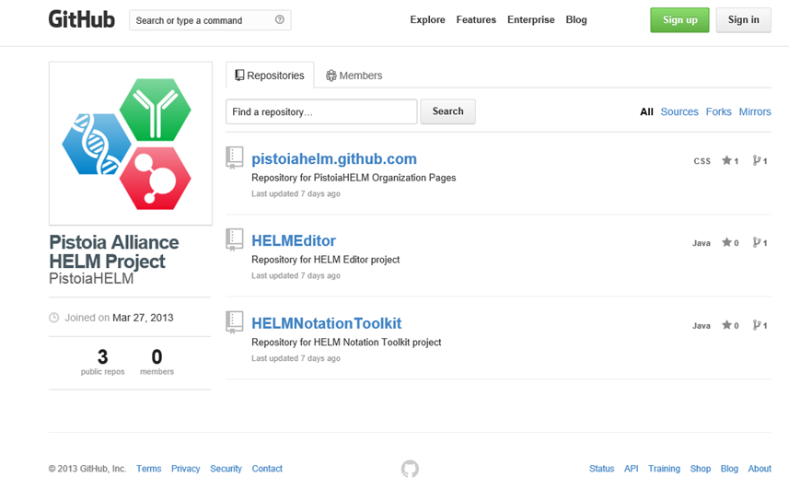
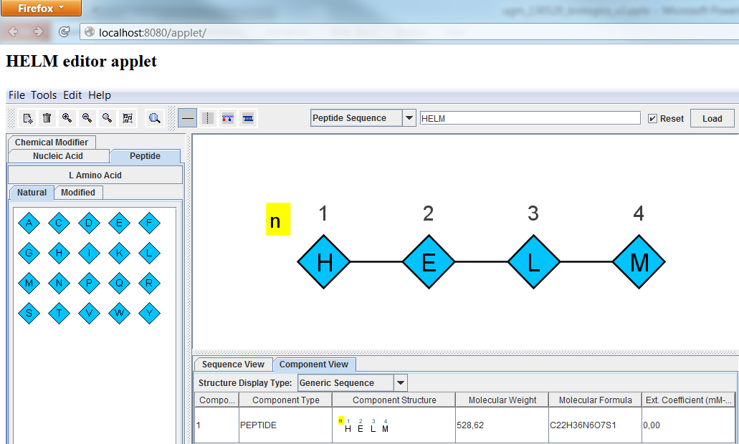
GitHub
HELM Editor
API
HELM Notation Toolkit
Source Code
HELM Applet
https://github.com/PistoiaHELM

Slide 21

Building the HELM Ecosystem
Software vendors
Accelrys, BioMax, ChemAxon, NextMove, Scilligence
Pharma / Biotech / Institutes
Pfizer, Roche, Lundbeck, etc.
Content Providers
EBI (ChEMBL)
Next: Regulatory Agencies
FDA, etc.
HELM improvements

Slide 22
HELM Team Members
Our team Members (Subteam leads)
Akos Papp (ChemAxon)
Alex Allardyce (ChemAxon)
Alex Drijver (ChemAxon)
Andrey Yerin (ACD labs)
Dana Vanderwall (BMS)
Ed Currie (InfoSys)
Edvard Buki (ChemAxon)
Hans de Bie (ACDLabs)
Ian Stott (Unilever)
Jerry Winter (Unilever)
Jinbo Lee (Scilligence)
John Smith (GSK)
John Wise (Pistoia)
Keith Taylor (Accelrys)
Kirti Jindal (InfoSys)
Matthias Nolte (BMS)
Michael Cui (GSK)
Mike Travers (CDD)
Rama Bhamidpati (GSK)
Roland Knispel (ChemAxon)
Roland Molnar (ChemAxon)
Sergio Rotstein (Pfizer)
Stefan Klostermann (Roche)
Ted Slater (OpenBEL)
Tianhong Zhang (Pfizer)
Tony Yuan (Scilligence)
Our Steering Committee
John Wise (Pistoia Alliance)
Margret Assfalg (Roche)
Leah O'Brien (GSK)
Ramesh Dervasula (BMS)
Sergio Rotstein (Pfizer)
Alex Drijver (ChemAxon)
Chris Waller (Merck)
Our Excellent Project Manager
Claire Bellamy
Special thanks to ChemAxon for their generous contribution of software development resources!!

Slide 23



www.OpenHelm.org info@openhelm.org

