Slide 1
Pistoia Alliance HELM Project
Bio-IT Reception, April 29, 2014
Domain Lead: Sergio H. Rotstein, Ph.D
Sergio@PistoiaAlliance.org

Slide 2
Agenda
Welcome!
Overview of Pistoia Alliance Projects
Overview of HELM
Partner Testimonials
ChemAxon
EBI
Accelrys
BMS
Roche
Closing Remarks

Slide 3
The Pistoia Alliance What’s New in the ‘Next Chapter’
Michael Braxenthaler
President
HELM Reception – Boston, April 29,2014

Slide 4
Agenda
What’s this ‘Next Chapter’ business?
Transparent portfolio – IP3
NYC meeting
EDO
Projects updates (other than HELM)
tranSMART
CSCS
Analysome

Slide 5
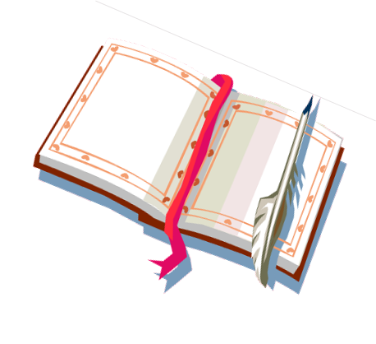


‘Next Chapter’ – What’s that?
2013
Extensive re-assessment of first five years
All options on the table
Decision:

Slide 6
NYC Meeting – June 17-19
Day 1: Public Meeting
Day 2: Core & Participating Members Meeting
Day 3: Board Meeting
NEW

Slide 7
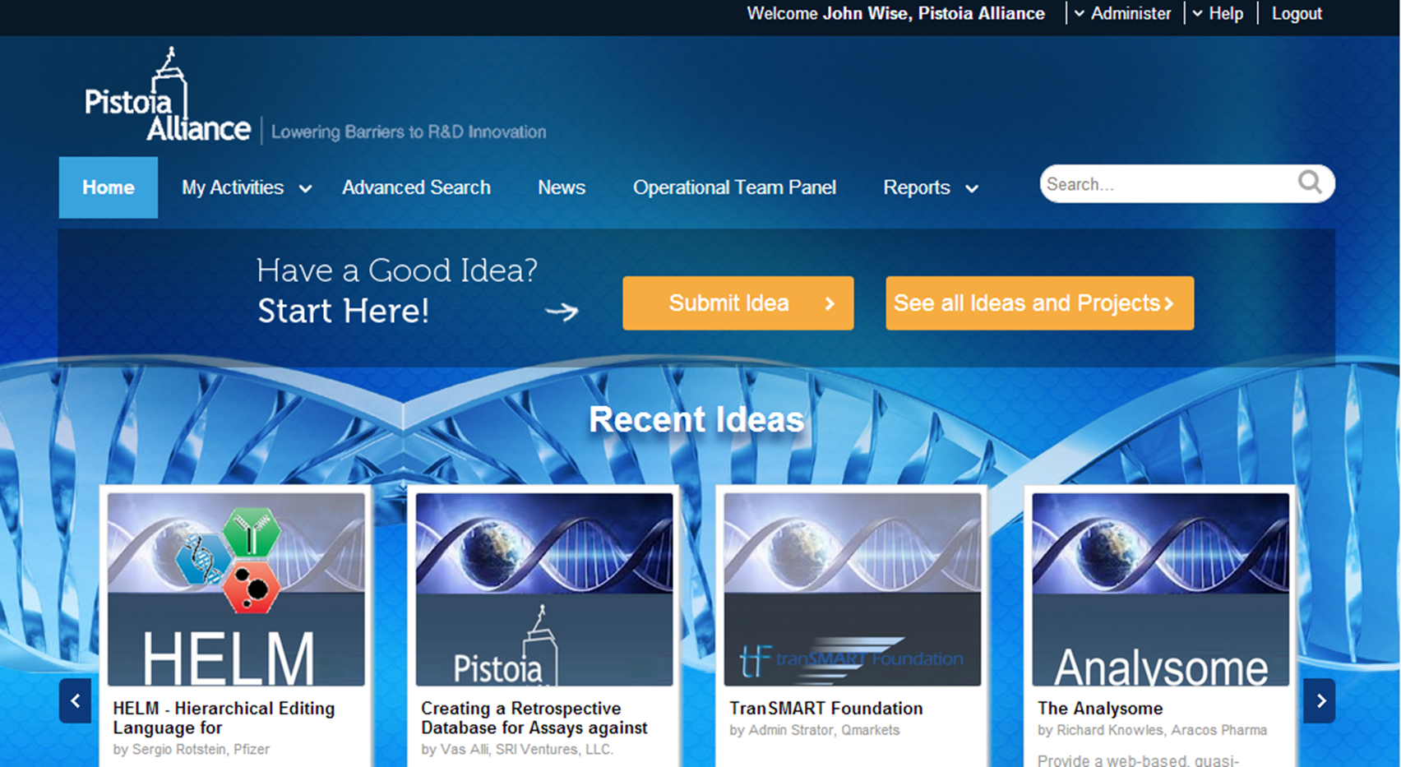

Transparent Portfolio – IP3
PA Portfolio
PA Portfolio

Slide 8
New Operational Team Functions
Executive Director Business Development
Executive Director Operations
Director Communications

Slide 9
HELM Overview
Tianhong Zhang
Pfizer Inc.
April 29, 2014

Slide 10
Outline
What is HELM?
The Genesis of HELM
HELM at Pfizer
Pistoia Alliance HELM Project
What does HELM mean to you?
Call to Action

Slide 11
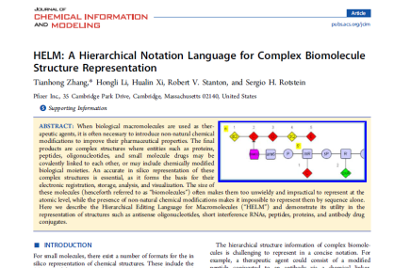
What is HELM?
Hierarchical Editing Language for Macromolecules
J. Chem. Inf. Model 2012, 52, 2796-2806
Notation Language for Polymer
Vocabulary - Monomers
Grammar - Rules to connect monomers
Hierarchical
Complex Polymer
Simple Polymer
Monomer
Atom
HELM to large molecules is
SMILES or InChi to small molecules

Slide 12
HELM Notation: Peptide
PEPTIDE1{A.C.G.[dK].E.D.F.C.K.A.A}$
PEPTIDE1, PEPTIDE1, 2:R3-8:R3$
$$
Single chain
Non-natural amino acid residue – dK
Cycle via disulfide bridge

Slide 13
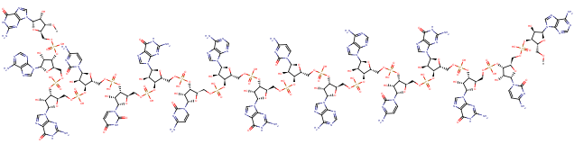
The Genesis of HELM: Oligonucleotide
In the spring of 2008,
Pfizer’s Oligonucleotide Therapeutic Unit (OTU) was created in its Research Technology Center (RTC) in Cambridge, MA to discover RNAi based therapeutics
Cheminformatics tools for small molecules fell short due to its size
Sequence based bioinformatics tools fell short with chemical modifications
Neither approach is ideal, is there a better way?
AGGGCCUCCAACCAA
- RNA
- 2’-O-Methyl modified

Slide 14






The Genesis of HELM: Biomolecules
ASOs
siRNAs
Peptides
While oligonucleotide was the focus at the Oligonucleotide Therapeutic Unit, other biomolecules were investigated at other research units
Similar informatics challenges existed for all biomolecules
We needed a notation system for all biomolecules, and we needed informatics tools to support:
Structure Drawing and Visualization
Compound Registration
Analysis and Design
Lab Workflow Management
Antibodies
Therapeutic Proteins
ADCs
Vaccines

Slide 15
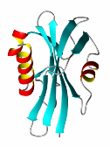

The Genesis of HELM: The Gap
Biomolecules
Small Molecules
Sequences
We would like to capture both chemical structure and sequence in the notation, but such a notation system did not exist either internally or externally
In the summer of 2008, HELM was born at Pfizer RTC

Slide 16
The Genesis of HELM: Software
Notation Toolkit
In the fall of 2008, the first version of the notation toolkit was developed, which enabled:
Parsing
Validation
Conversion
Calculation
PME (Pfizer Macromolecule Editor)
In the winter of 2008, the prototype version of the editor was released, which enabled the following for oligonucleotides:
Drawing and visualization
Property calculation
PMR (Pfizer Macromolecule Registration)
In the spring of 2009, the first version of the compound registration tool was released, which enabled the registration of oligonucleotides
Since 2009, we gradually added software functions to support other types of biomolecules, but HELM notation remains the same.

Slide 17
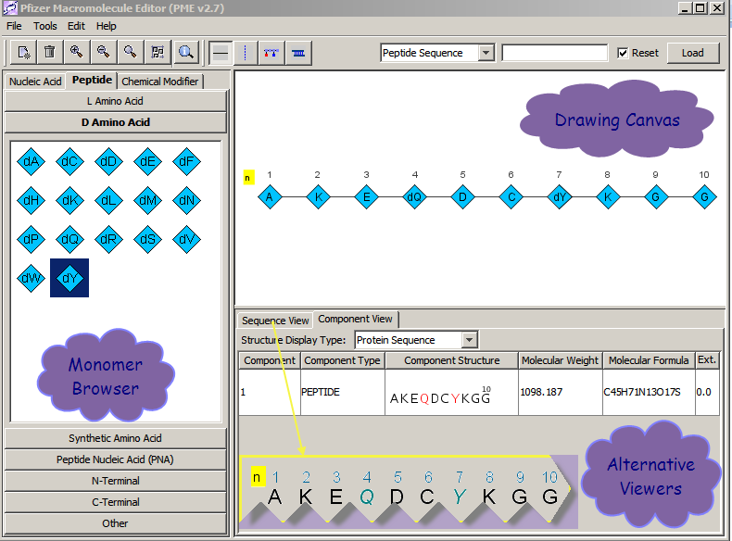
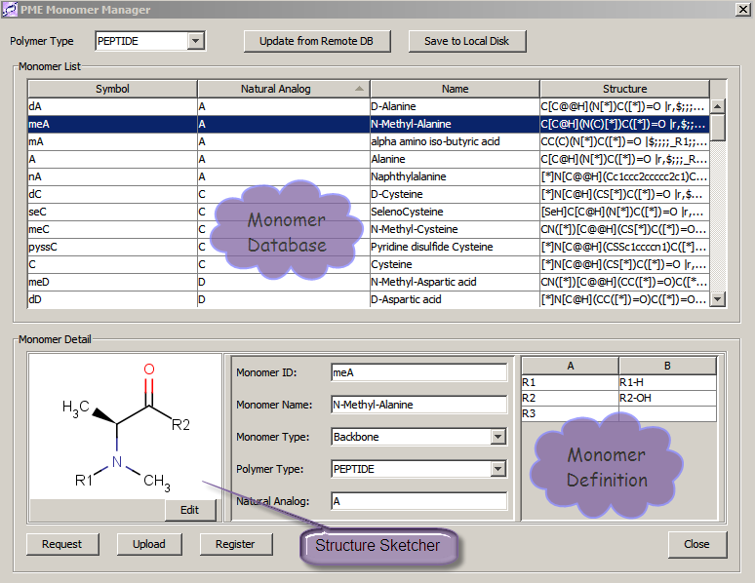
HELM at Pfizer: PME - Editor
Structure Drawing
Structure Visualization
Property Calculation
Compound Design

Slide 18
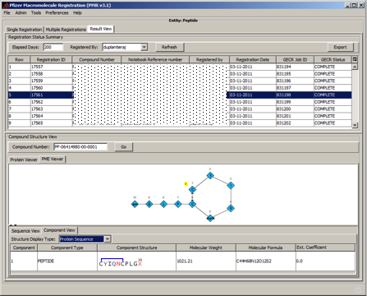
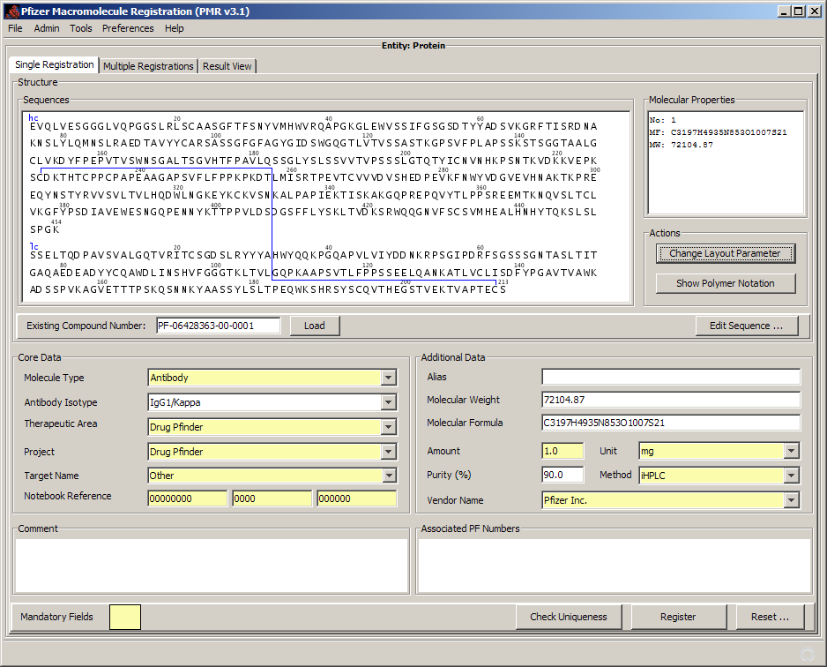
HELM at Pfizer: PMR - Registration
Oligonucleotide
Peptide
Protein/Antibody
Bio-conjugate (ADC..)
HELM Based
Modular

Slide 19
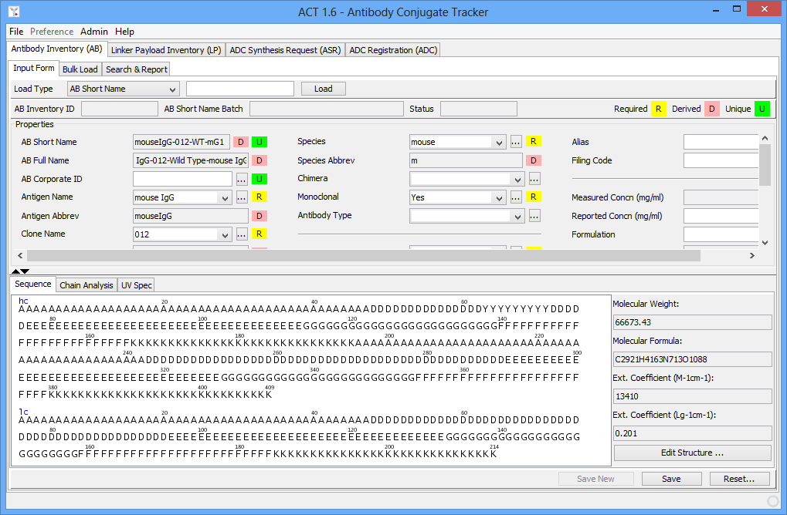
HELM at Pfizer: ADC Workflow
HELM Powered
Antibody | Linker Payload | ADC | Workflow

Slide 20
Pistoia Alliance HELM Project
2012-Present
To establish and promote HELM as a biomolecule representation standard that can:
Provide a mechanism for data exchange between companies
Reduce software development costs by minimizing the need for companies to develop similar functionality
Domain Lead - Sergio Rotstein
Research Business Technology, Pfizer
Sergio@PistoiaAlliance.org

Slide 21
Pistoia Alliance HELM Project: Highlights
Project Home
http://www.openhelm.org
HELM Standard Document 1.0
http://www.openhelm.org
Open Source Notation Toolkit 1.0.1
https://github.com/PistoiaHELM/HELMNotationToolkit
Open Source HELM Editor 1.1
https://github.com/PistoiaHELM/HELMEditor
F
R
E
E
F
R
E
E

Slide 22
Pistoia Alliance HELM Project: Next
Exchangeable HELM
Remove the dependency on shared monomer database
In-line HELM
Use monomer structure in lieu of monomer ID in HELM
Remove the dependency that all monomers have to be predefined
Annotation Extension
Enable annotation at complex polymer, simple polymer and monomer level

Slide 23
What does HELM mean to you?
Toolkit to power your biomolecule informatics infrastructure
HELM Notation
Drawing and Visualization
Registration System
Design and Analysis
Workflow Management
Biomolecule Data
Exchange Mechanism
Level of Adoption

Slide 24
Call to Action
Explore HELM project site
Learn what others are doing with HELM
Ask what HELM can do for your organization
Become an advocate for HELM
Adopt HELM where you see fit
Join the project
Influence the direction

Slide 25
Partner Testimonials

Slide 26
Roland Knispel - ChemAxon

Slide 27
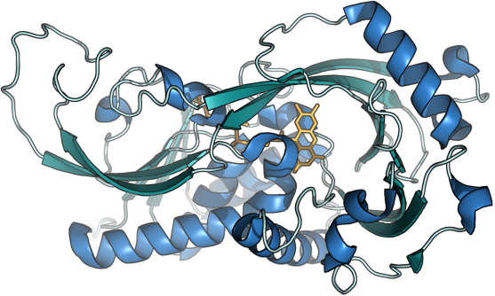

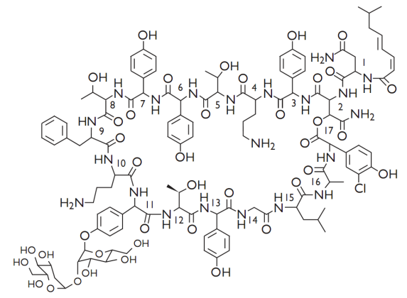
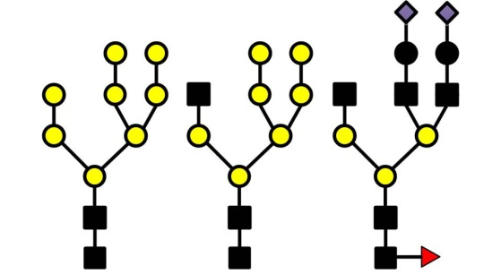
-ligands
-coordinates
Registration DB
MHSQKRVVVL GSGVIGLSSA LILARKGYSV HILARDLPED VSSQTFASPW AGANWTPFMT LTDGPRQAKW EESTFKKWVE LVPTGHAMWL KGTRRFAQNE DGLLGHWYKD ITPNYRPLPS SECPPGAIGV TYDTLSVHAP KYCQYLAREL QKLGATFERR TVTSLEQAFD GADLVVNATG LGAKSIAGID DQAAEPIRGQ TVLVKSPCKR CTMDSSDPAS PAYIIPRPGG EVICGGTYGV GDWDLSVNPE TVQRILKHCL RLDPTISSDG TIEGIEVLRH NVGLRPARRG GPRVEAERIV LPLDRTKSPL SLGRGSARAA KEKEVTLVHA YGFSSAGYQQ SWGAAEDVAQ LVDEAFQRYH GAARESKL
Representation is transparent to the user
-sequence
+unnatural
+residues
Search
Supporting multiple views
Consumers:
DataMarts, Data Analysis applications
Custom non-std
representation
Visit us at booth 333

Slide 28
Dominic Clark - EBI

Slide 29

Adopting HELM in ChEMBL
ChEMBL is a large-scale bioactivity database, containing >1.4 m bioactive molecules and >12 m activities:
https://www.ebi.ac.uk/chembl/
Primarily small molecules, but also growing number of biotherapeutics:
25K peptides from medicinal chemistry literature
800 biotherapeutic drugs/clinical candidates (~700 MAbs)
~500 additional biotherapeutic USAN applications
Current representation with molfiles (peptides) or natural amino acid sequences (antibodies) is suboptimal.
Plan to convert all peptide content to HELM notation and provide library of resulting amino acid monomers (estimated ~7K).
Possibility to also apply to new SureChEMBL patent database:
http://surechembl.org

Slide 30
Accelrys & HELM
Rob Brown

Slide 31
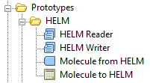
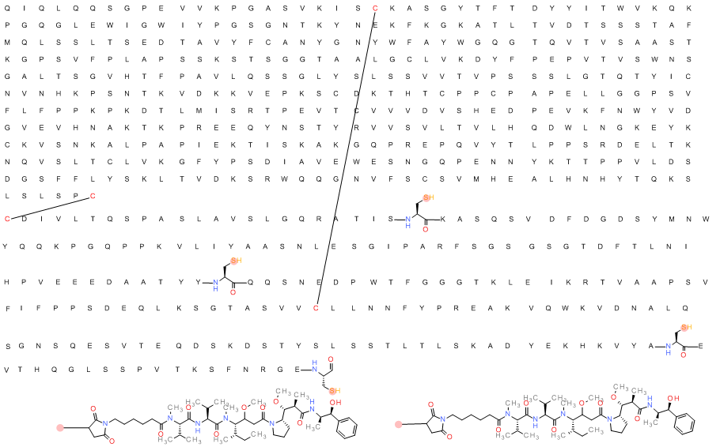
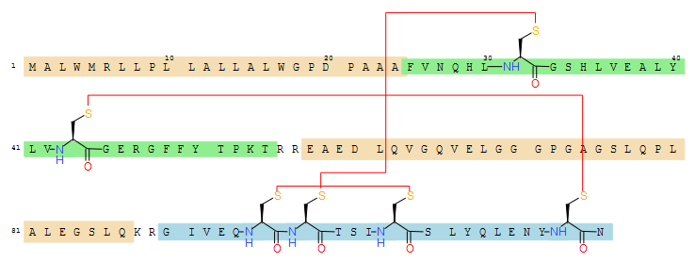
HELM Exchange in Pipeline Pilot, BioReg, Direct and Draw
Pipeline Pilot relies on common data exchange formats to facilitate integration and automation
Prototype HELM components available now Pipeline Pilot 9.1, full release in 9.2
Allows exchange of data with Accelrys apps that support biologics and chemically modified biologics

Slide 32
Dana Vanderwall - BMS

Slide 33
Stefan Klostermann - Roche

Slide 34
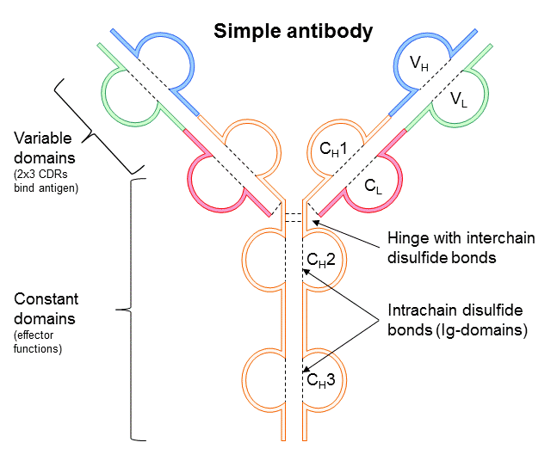
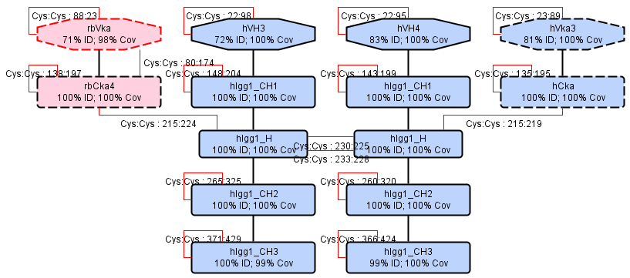
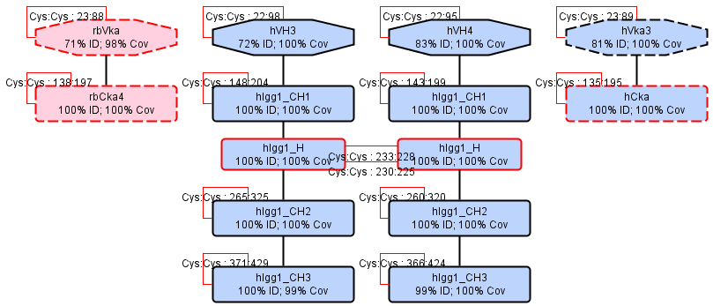


HELM Editor Extension for complex biologics Stefan Klostermann, Roche pREDi
To easily register biotherapeutics like even complex antibodies formats (multi-specifics, ADCs, ...)
Annotate raw input protein sequences by characterization of their building blocks (domain library) and closing almost all Cys-Cys bonds automatically
Further modify / add peptides, linkers, oligos, toxins etc. by bridging to the original Pfizer HELM Editor
Store all information incl. full HELM notation in database for further analyses

Slide 35


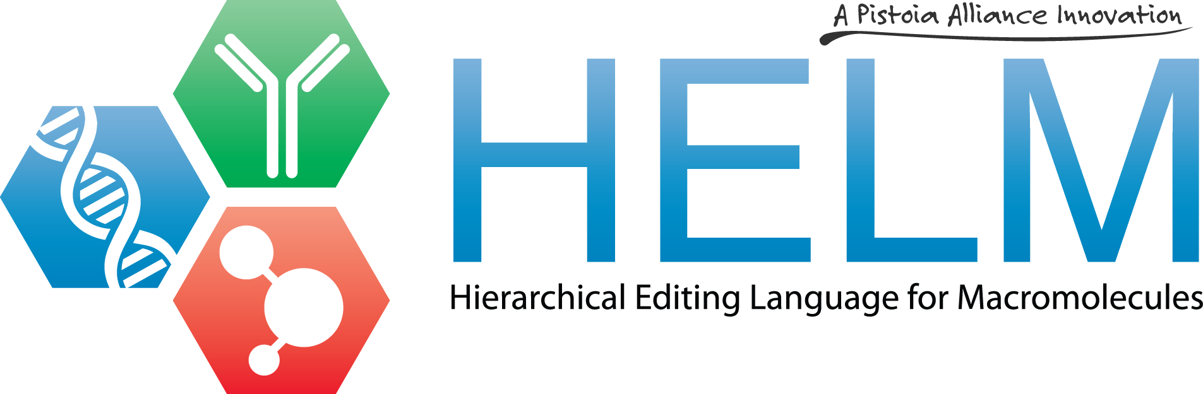
www.OpenHelm.org info@openhelm.org

