Slide 1
BIOVIA, Biologics and HELM
Neil Eccles PhD
Senior Product Manager

Slide 2
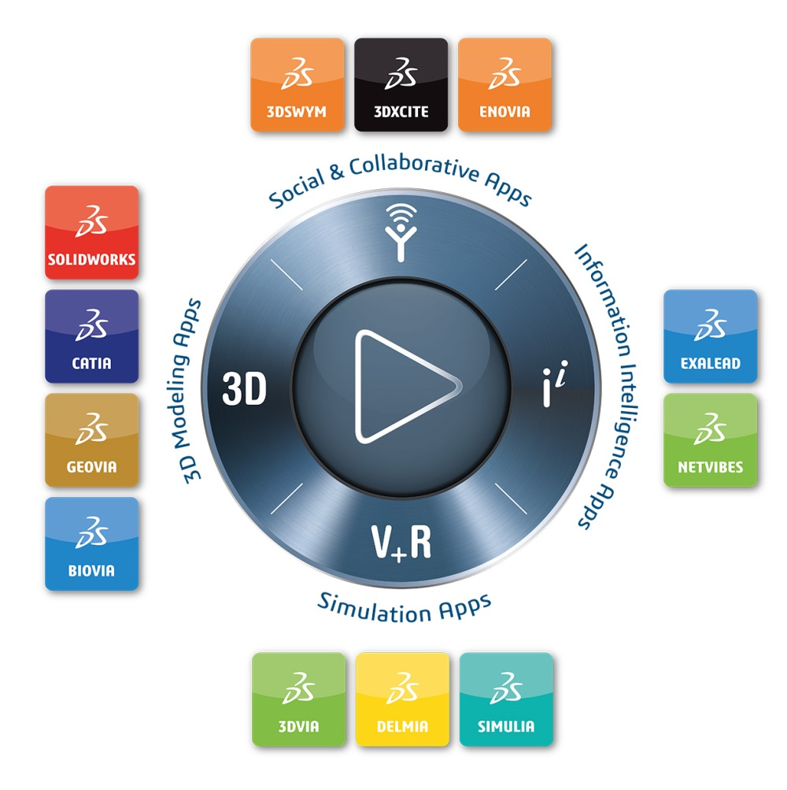

Slide 3
Solution Stack for Biologics Informatics and Design
Discovery Studio (for predicting manufacturability / developability)
Biotherapeutics Analysis Workbench (for sequence analysis and annotation)
Accelrys Notebook / Accelrys ELN (to record what you did and when)
AEP & Sequence Analysis Collection (for configuration & extension)
Biological Registration (for entity tracking and identification)
Accelrys EKB (for bioprocess management)

Slide 4
Representing Chemically Modified Biologics
Biovia now uses the “Direct” Data model across all our stack for:
Molecules
Polymers
Formulations
Reactions
Markush
NONS
Biologics / ADCs
Biologics use “Self Contained Sequence Representation (SCSR)”
A hybrid approach
Use pseudoatoms for standard residues
Embed explicit chemistry for non-standard residues and modifications
Embed the full structure of standard residues to enable full structure features to be calculated
Formula and formula weight
Very compact
Registration and searching much faster
No loss of structural information
Structure is portable
Visually resembles the abbreviated form
Self-Contained Sequence Representation: Bridging the Gap between Bioinformatics and Cheminformatics William L. Chen*†, Burton A. Leland†, Joseph L. Durant†, David L. Grier†, Bradley D. Christie†, James G. Nourse†, and Keith T. Taylor†
J. Chem. Inf. Model., 2011, 51 (9), pp 2186–2208. (DOI: 10.1021/ci2001988)

Slide 5
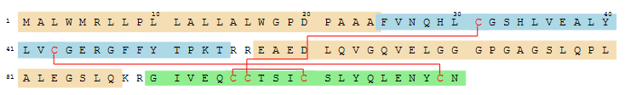
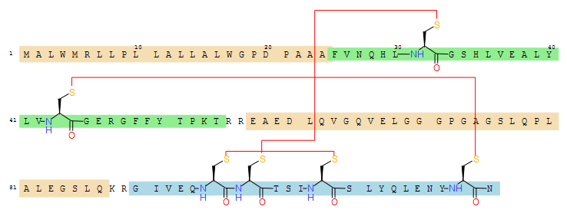
Chemically Aware Sequence Representation
Contracted
Expanded

Slide 6
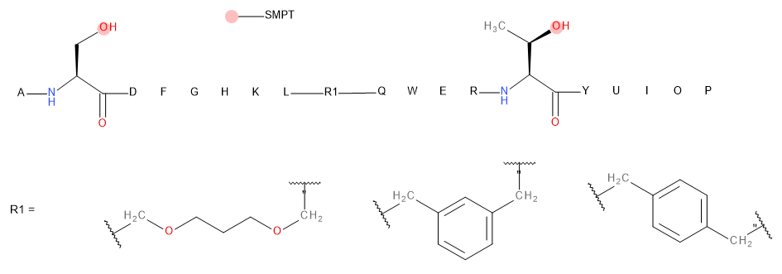
Markush Chemically Modified Biologic
Variable residue
Variable attachment

Slide 7
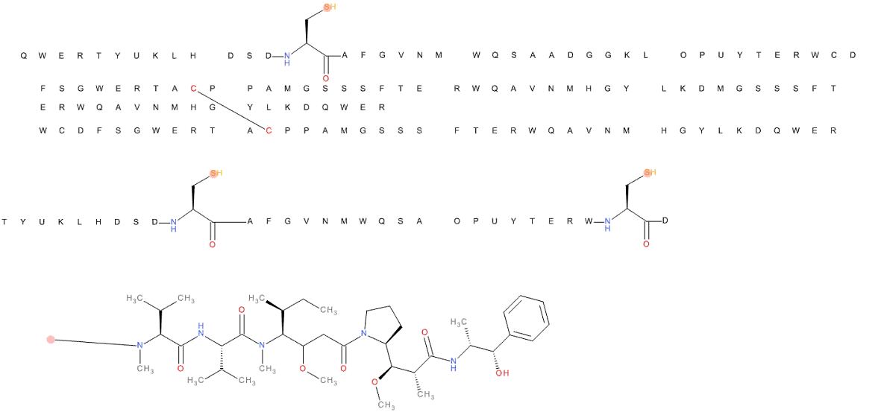
Antibody Drug Conjugate
Attachment Points
Payload (MMAE)
Linker

Slide 8
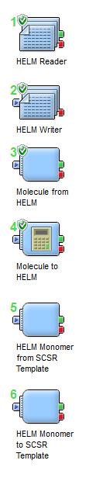
HELM Exchange in AEP I
Critical to have a means to exchange biologics between the BIOVIA stack and other applications / databases to facilitate integration and automation
HELM components now available in AEP 9.2
First released as prototypes in AEP 9.1 (2013)
Components enable:
Exchange of data with BIOVIA apps that support biologics and chemically modified biologics – BioReg, Direct, Draw etc.
Customer development of scientific services in Pipeline Pilot to integrate into their own HELM based apps

Slide 9
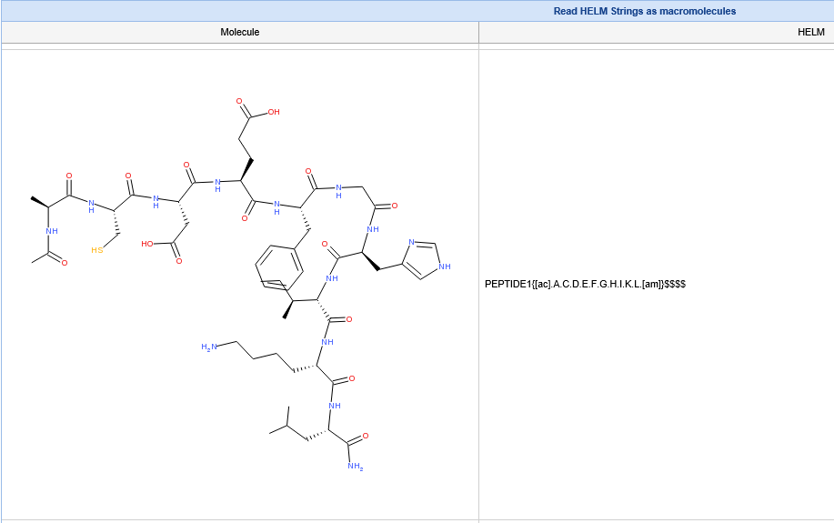
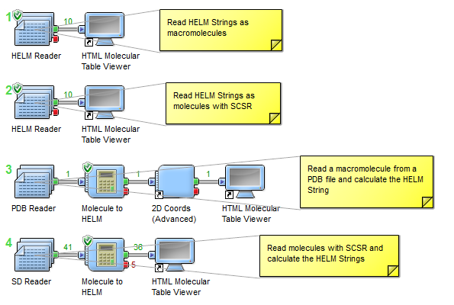
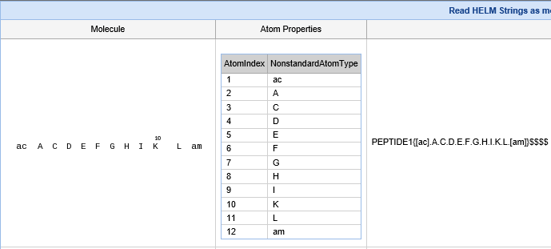
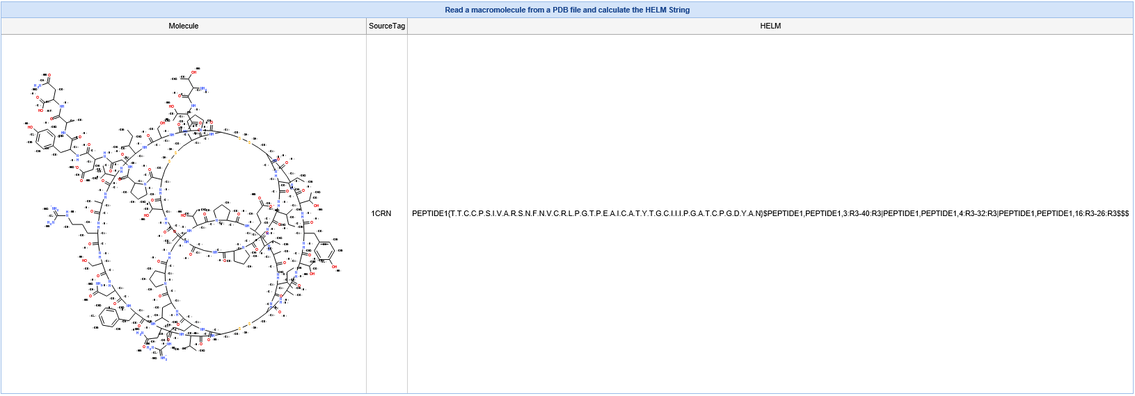
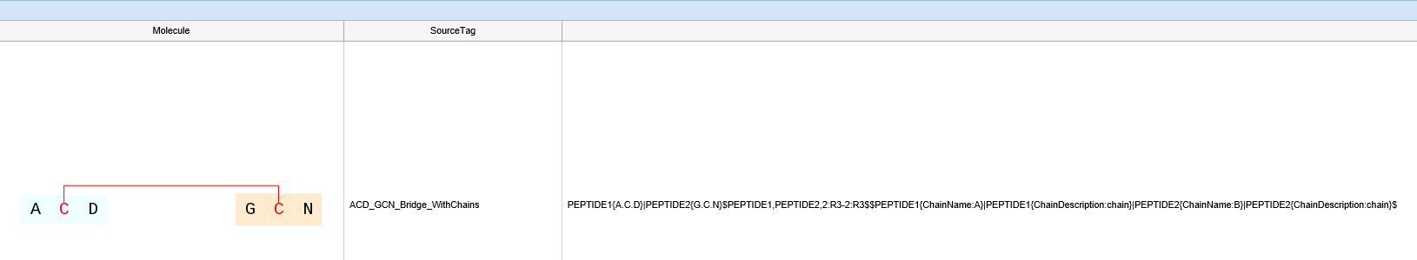
HELM Exchange in AEP II

Slide 10
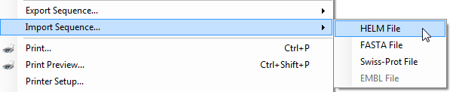
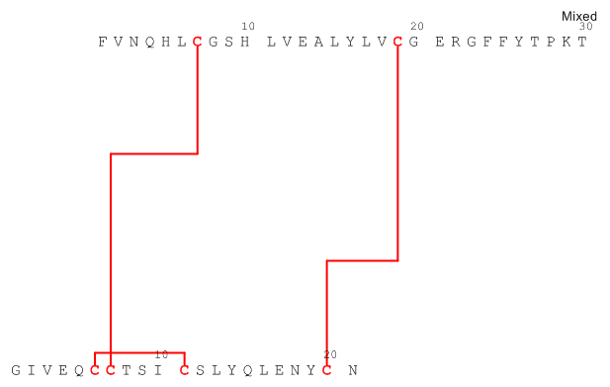
Support for HELM Strings in Draw I
Import HELM Strings
Cut and Paste of a HELM string into Draw window will follow in a future release
PEPTIDE1{F.V.N.Q.H.L.C.G.S.H.L.V.E.A.L.Y.L.V.C.G.E.R.G.F.F.Y.T.P.K.T}|PEPTIDE2{G.I.V.E.Q.C.C.T.S.I.C.S.L.Y.Q.L.E.N.Y.C.N}$PEPTIDE1,PEPTIDE2,7:R3-7:R3|PEPTIDE1,PEPTIDE2,19:R3-20:R3|PEPTIDE2,PEPTIDE2,6:R3-11:R3$$$
Sequence view in Draw
HELM String for Human Insulin

Slide 11


Support for HELM Strings in Draw II
Output HELM Strings
Cut and Paste of a HELM string from a Draw window will follow in a future release
RNA1{[dR](A)P.[dR](C)P.[dR](G)P.[dR](T)P.[dR](U)P.[dR](A)P.[dR](C)P.[dR](G)P.[dR](T)P.[dR](U)P}$$$$
DNA Sequence in Draw
HELM String for DNA Sequence

Slide 12
Summary
BIOVIA has significant capabilities in biologics informatics and design
We have developed a data model to allow our applications to represent and search chemically modified biologics
To allow the platform and applications to be open, it is critical to have a standard to allow Biologics to be exchanged
We have adopted HELM as a standard data exchange format
We have developed AEP components to support HELM
We have incorporated HELM exchanged into Draw and will extend support to other applications in the future

