Slide 1


Biomolecule registration toolkit
HELM Showcase webinar
Roland Knispel
July 2014

Slide 2
What it is...
Template-based bio-molecule registration toolkit with atom level representation
Fully compatible with the Open HELM standard for representing large molecules
WS toolkit with WS-API for integration into existing IT environments
Shippable preview version for exploration of relevant application areas

Slide 3
Architecture

Slide 4
Registration toolkit architecture
Browser-based client
Core registration
webservices
Auxiliary
webservices
HELM Editor
Converters
Marvin
Calculators
Registration DB
Search
Connectors
Monomer
push service
Monomer DB
JChemBase
Registration layer
Notes:
The monomer DB by itself can be seen as a small molecule registration DB.

Slide 5
Use case scenarios

Slide 6
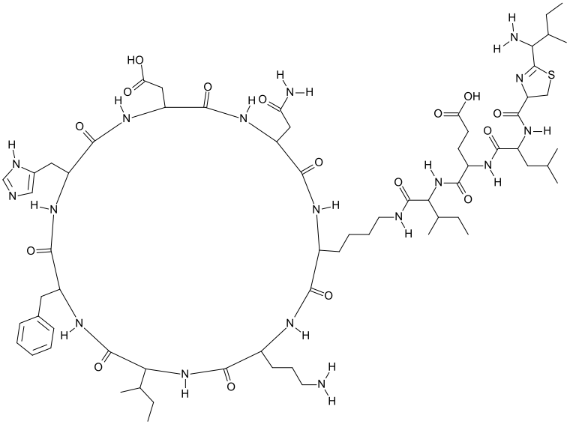
Use case 1 (Macrocyclic peptides)
Requirements:
Registration of sequence and chemical structure
Unambiguous representation of peptide sequence
Ability to quickly enumerate library with residue replacements chosen from a large set of peptide building blocks
POC implemented at major pharma company
with ChemAxon‘s Bio-molecule registration toolkit

Slide 7
Use case 2 (Agnostic molecule registration)
Integrated Registration
Biomolecule registration toolkit
Perception engine
Compound Registration
HELM
Sequence
Requirements:
Fast round-tripping between different representation formats
Searchable from any query format
Mol/SMILES
HELM DB
Sequence Management
POC in progress

Slide 8
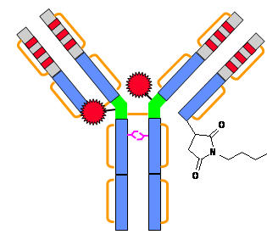
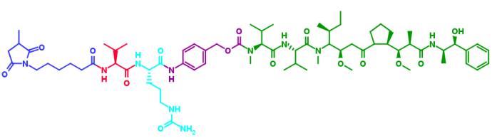
Use case 3 (ADCs)
Requirements:
Registration of sequence, chemical structure and conjugated molecules (i.e. PTMs)
Unambiguous representation of molecule structure and structurally relevant annotation (i.e. antibody drug ratio)
Ability to quickly search for given linker or payload by chemical structure
Ability to quickly search for Ab sequence or domain
Anti-CD30 IgG
Conjugation linker
Val
Cit
Spacer
Auristatin E
POC planned

Slide 9
Short-term plans
Deliver POCs for use cases (Q2/Q3 2014)
Public preview release (Q3/Q4 2014)
Get in touch with us, if you are looking to solve any of these, or other use cases!
email: rknispel@chemaxon.com

Slide 10
Example screenshots of client

Slide 11
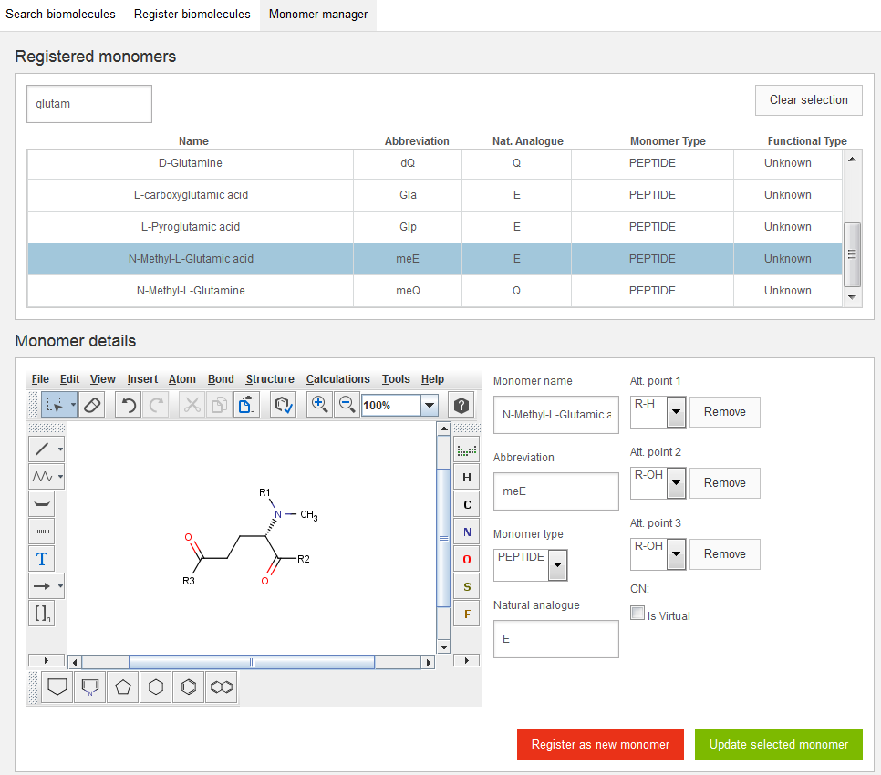
Monomer administration

Slide 12
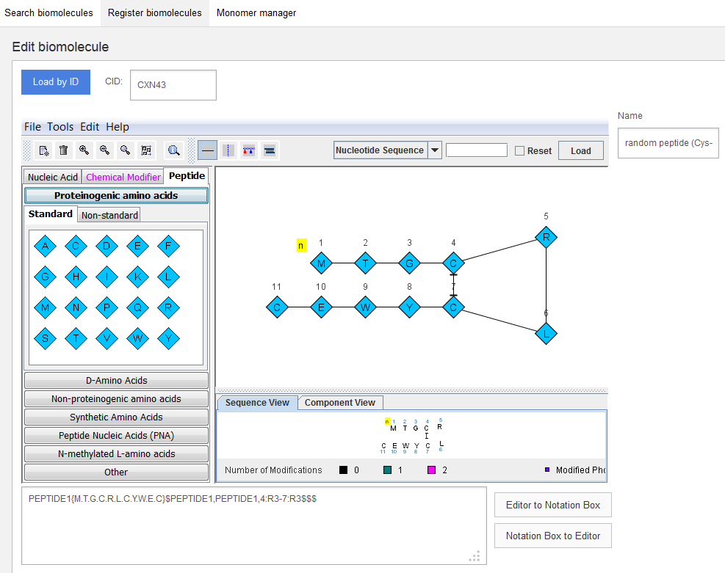
Register peptide with internal disulfide bridge

Slide 13
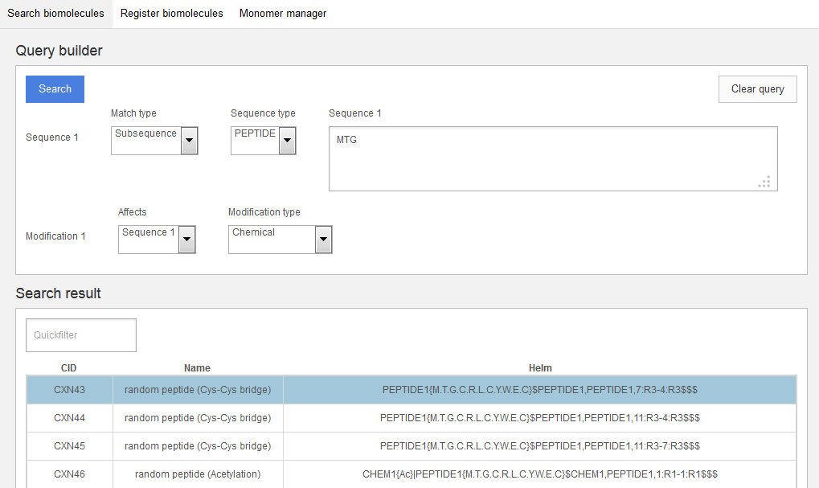
Search chemically modified peptides with an MTG subsequence

